Slide 1
Rating Decision Requirements
Compensation Service
April 2019
Notes:
Welcome to Rating Decision Requirements course. To advance each slide, click anywhere on the screen.

Slide 2
Lesson Objectives
With completion of this lesson and available references and resources, the RVSR should generate rating decisions with
required evidence,
appropriate terminology, and
all required text for both short and long form rating narratives.
Notes:
Lesson Objectives
With completion of this lesson and available references and resources you should, with 98% percent accuracy, generate rating decisions, with
required evidence,
appropriate terminology, and
all required text for both short and long form rating narratives.

Slide 3
References
M21-1 Part III, Subpart iv, 6.C.- Completing the Rating Decision Narrative
M21-1 Part III, Subpart iv, 6.D.- Codesheet Section
M21-1 Part III, Subpart iv, 6.E.- Coded Conclusion
Notes:
References
The references for this course are listed on the screen. You may click any hyperlinked references for further details.
M21 dash 1 Part Three, Subpart four, 6.C.- Completing the Rating Decision Narrative
M21 dash 1 Part Three, Subpart four, 6.D.- Codesheet Section
M21 dash 1 Part Three, Subpart four, 6.E.- Coded Section
M21 dash 1 Part Three, Subpart four, 6.F. - Automated Decision Letter (A D L) Rating Procedures

Slide 4
Overview of the Evidence Section
The Evidence section is a listing of each piece of evidence considered in arriving at the decision, which may include but is not limited to
service treatment records (STRs)
service personnel records
private and VA treatment records
VA or contract examination reports, to include Disability Benefits Questionnaires (DBQs)
lay statements, and/or
written or oral testimony, to include hearing transcripts.
Notes:
Overview of the Evidence Section
The Evidence section is a listing of each piece of evidence considered in arriving at the decision, which may include but is not limited to
service treatment records (STRs)
service personnel records
private and VA treatment records

Slide 5
Guidelines for the Evidence Section
If the Evidence section identifies ... | Then list the evidence type and ...
service records, such as STRs or personnel records | the date of receipt [MM-DD-YYYY], and the period of service associated with the records [MM-YYYY to MM-YYYY]. Example: STRs received on June 20, 2017, for the period October 2006 to November 2010.
VA treatment records | the name of the facility, and dates covered by the records [MM-DD-YYYY to MM-DD-YYYY].
private medical records | the name of the facility or physician date of receipt, and dates covered by the records [MM-YYYY to MM-YYYY]. Example: Medical records, Dr. Jones, received February 1, 2017, for the period May 2012 to Feb 2016.
Notes:
Guidelines for the Evidence Section
If the Evidence section identifies service records, such as STRs or personnel records
Then list the evidence type and the date of receipt [MM dash DD dash YYYY], and
the period of service associated with the records [MM dash YYYY to MM dash YYYY].
Example: STRs received on June 20, 2017, for the period October 2006 to November 2010.
If the Evidence section identifies VA treatment records
Then list the evidence type and the name of the facility, and
dates covered by the records [MM dash DD dash YYYY to MM dash DD dash YYYY].
If the Evidence section identifies private medical records
Then list the evidence type and the name of the facility or physician
date of receipt, and
dates covered by the records [MM dash YYYY to MM dash YYYY].
Example: Medical records, Dr. Jones, received February 1, 2017, for the period May 2012 to Feb 2016.

Slide 6
Guidelines for the Evidence Section
If the Evidence section identifies ... | Then list the evidence type and ...
VA or contract examination(s) | identify the examining facility/contractor, and date the exam was conducted.
other government, including Federal and State records | the name of the source (agency, facility, etc.), and date of receipt. Example: Social Security Administration records received on March 8, 2017.
lay statement(s) | the source of the statement, and date of receipt.
forms | the full name of the form, and date of receipt.
evidence requested, but not received | in the following format: Private medical records requested from [provider’s or facility’s name], but not received.
Notes:
Guidelines for the Evidence Section (continued)
If the Evidence section identifies VA or contract examination or examinations
Then list the evidence type and identify the
examining facility/contractor, and
date the exam was conducted.
If the Evidence section identifies other government, including Federal and State records
Then list the evidence type and the name of the source (agency, facility, etc.), and
date of receipt.
Example: Social Security Administration records received on March 8, 2017.
If the Evidence section identifies lay statement or statements
Then list the evidence type and the source of the statement, and
date of receipt.
If the Evidence section identifies forms
Then list the evidence type and the full name of the form, and
date of receipt.
If the Evidence section identifies evidence requested, but not received
Then list the evidence type and in the following format: Private medical records requested from [provider’s or facility’s name], but not received.

Slide 7
Guidelines for the Evidence Section
If the Evidence section identifies ... | Then list the evidence type and ...
evidence considered in a prior VA decision | by separately stating each piece of evidence considered, including the prior decision.
any medical evidence that is confidential under 38 U.S.C 7332 (certain medical records relating to human immunodeficiency virus (HIV) infection, substance abuse, or sickle cell anemia) | by specifying only the relevant date and name of the medical facility.
non-relevant records not requested | follow the documentation requirements specified in M21-1, Part I, 1.C.4.f.
Notes:
Guidelines for the Evidence Section (continued)
If the Evidence section identifies evidence considered in a prior VA decision
Then list the evidence type and by separately stating each piece of evidence considered, including the prior decision.
If the Evidence section identifies any medical evidence that is confidential under 38 U.S.C 73 32 (certain medical records relating to human immunodeficiency virus (H I V) infection, substance abuse, or sickle cell anemia)
Then list the evidence type and by specifying only the relevant date and name of the medical facility.
If the Evidence section identifies non-relevant records not requested
Then list the evidence type and follow the documentation requirements specified in M21 dash 1, Part One, 1.C.4.f.

Slide 8
Using Diagnostic Terminology
Use the diagnostic terminology provided by the medical examiner or other medical evidence in the rating decision.
Do not attempt to translate the examiner’s terms into schedular terminology unless citation is required by way of explanation, such as when rating by analogy.
Do not cite a lengthy diagnosis in full. Instead, retain its essential elements in the decision.
Do not cite residuals of diseases or therapeutic procedures without reference to the underlying disease.
Do not include unnecessary descriptive words in the diagnosis. For example, state the diagnosis as hypertension, and not severe hypertension.
Notes:
Using Diagnostic Terminology
Use the diagnostic terminology provided by the medical examiner in the rating decision.
Do not attempt to translate the examiner’s terms into schedular terminology unless citation is required by way of explanation, such as when rating by analogy.
Do not cite a lengthy diagnosis in full. Instead, retain its essential elements in the decision.

Slide 9
Using Diagnostic Terminology Cont.
If the diagnostic terminology used to describe the condition is different than the terminology used by the claimant on his/her application, the RVSR must include the terminology that the claimant used as a parenthetical note after the diagnostic terminology.
For example, Veteran claims ringing in the ears. The medical examiner diagnoses the Veteran’s condition as tinnitus. The rating decision should list the condition as tinnitus (claimed as ringing in the ears).
The parenthetical note should not appear on the Codesheet.
Notes:
Using Diagnostic Terminology (continued)
If the diagnostic terminology used to describe the condition is different than the terminology used by the claimant on his or her application, the RVSR must include the terminology that the claimant used as a parenthetical note after the diagnostic terminology.
For example, Veteran claims ringing in the ears. The medical examiner diagnoses the Veteran’s condition as tinnitus. The rating decision should list the condition as tinnitus (claimed as ringing in the ears).

Slide 10
Mandatory Use of VBMS-R Tools
Use of the VBMS-R embedded rules-based tools, such as the Evaluation Builder, and Hearing Loss Calculator, is mandatory.
These tools generate adequate explanation of an assigned evaluation and the requirements for the next higher evaluation.
RVSRs should always review VBMS-R tools output for accuracy prior to accepting the results.
Notes:
Mandatory Use of VBMS dash R Tools
Use of the VBMS dash R embedded rules-based tools, such as the Evaluation Builder and Hearing Loss Calculator, is mandatory.
These tools generate adequate explanation of an assigned evaluation and the requirements for the next higher evaluation.

Slide 11
Reasons for Decision- Grant
If ... | Then the Reasons for Decision must address ...
awarding the claim | benefit being awarded and legal basis for the award (for example, secondary SC) assigned evaluation, if applicable laws and regulations applicable to the claim fact that all elements required to decide the issue were met, and all findings are favorable to the claimant effective date basis for the current evaluation, if applicable requirements for the next higher evaluation, if applicable routine future examination notice, if applicable, and reason for the effective date.
Exception: An effective date explanation is not required when the assigned effective date is the date of the claim's receipt, or the day following discharge from active duty service.
Notes:
Reasons for Decision- Grant
If awarding the claim
Then the Reasons for Decision must address benefit being awarded and legal basis for the award (for example, secondary SC)
assigned evaluation, if applicable
effective date
basis for the current evaluation, if applicable
requirements for the next higher evaluation, if applicable
routine future examination notice, if applicable, and
reason for the effective date.

Slide 12
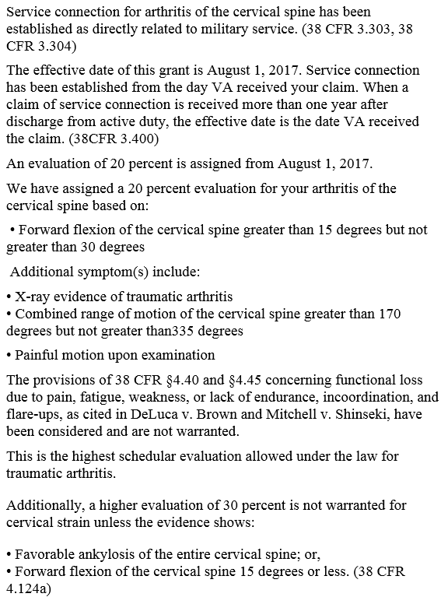
Example: Short Form Award
4.71a)
Notes:
Example: Short Form Award
Service connection for degenerative arthritis of the cervical spine has been established as directly related to military service.
An evaluation of 20 percent is assigned from April 12, 2014.
We have assigned a 20 percent evaluation for your cervical spine based on:
Forward flexion of the of the cervical spine greater than 15 degrees but not greater than 30 degrees

Slide 13
Reasons for Decision- C&C
If ... | Then the Reasons for Decision must address ...
confirming and continuing an existing evaluation | basis for the current evaluation laws and regulations applicable to the claim findings that are favorable to the claimant under 38 CFR 3.104(c), if any requirements for the next higher evaluation absence of evidence demonstrating sustained improvement, if applicable, and potential for routine future examination, if applicable.
Note: The VBMS-R glossary fragment CCEVAL may be selected to insert supplemental language into the Reasons for Decision.
Notes:
Reasons for Decision- C & C
If confirming and continuing an existing evaluation
Then the Reasons for Decisions must address basis for the current evaluation
requirements for the next higher evaluation
absence of evidence demonstrating sustained improvement, if applicable, and
potential for routine future examination, if applicable.
Note: The VBMS dash R glossary fragment C C E V A L may be selected to insert supplemental language into the Reasons for Decision and Automated Decision Letter (A D L).

Slide 14
Reasons for Decision- Denial
If ... | Then the Reasons for Decision must address ...
denying the claim | theory of SC being addressed in the decision (for example, direct SC), if applicable claimant’s contentions benefit denied, laws and regulations applicable to the claim, and reason for denial, including the criteria required to grant SC element(s) required to grant the claim that were not met, and findings favorable to the claimant under 38 CFR 3.104(c), if any.
Note: If there are multiple bases of SC being considered and/or multiple denial reasons, the relevant text must be added to the rating Narrative.
Notes:
Reasons for Decision- Denial
If denying the claim
Then the Reasons for Decision must address theory of SC being addressed in the decision (for example, direct SC), if applicable
all of the claimant’s contentions
benefit denied, and
reason for denial.
Note: If there are multiple bases of SC being considered and or multiple denial reasons, the relevant text must be added to the rating Narrative.
Example: A Veteran alleges hypertension due to exposure to Agent Orange. The denial must address SC on a direct basis, as well as the contention that the disability was due to herbicide exposure.

Slide 15
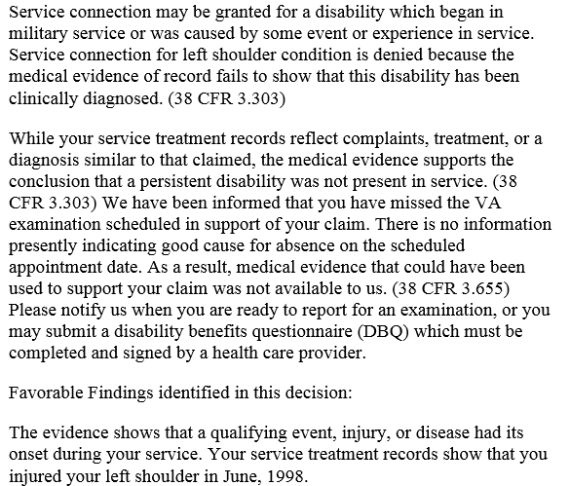
Example: Short Form Denial
Notes:
Example: Short Form Denial
Service connection may be granted for a disability which began in military service or was caused by some event or experience in service.
Service connection for left shoulder condition is denied because the medical evidence of record fails to show that this disability has been clinically diagnosed.
While your service treatment records reflect complaints, treatment, or a diagnosis similar to that claimed, the medical evidence supports the conclusion that a persistent disability was not present in service.
You did not attend the VA examination we scheduled in connection with your claim, and did not show good cause for your failure to do so. Therefore, medical evidence that could have been useful to support your claim was not available to us.

Slide 16
Addressing Favorable Findings
Rating decisions generated on or after February 19, 2019, must address, as a narrative element for each decided issue, any findings made by the adjudicator that are favorable to the claimant under 38 CFR 3.104(c)
If ... | Then address favorable findings in the Reasons for Decision by ...
awarding the claim | relying on system-generated grant language automated by VBMS-R’s DDI screen entries and selections.
denying the claim | adding and saving individual entries for each finding that was favorable to the claimant, if any, using the FAVORABLE FINDINGS screen under VBMS-R’s ISSUE MANAGEMENT tab.
increasing or continuing an existing evaluation | relying on system-generated language automated by evaluation builder entry and selections.

Slide 17
Short Form Rating Narrative
The short form rating narrative does not have to contain the entire explanation of the analysis or specifically cite each piece of the evidence; however, each element of the decision should be adequately explained.
Use of VBMS-R generated language, glossary fragments, calculators, the Evaluation Builder, Favorable Findings functionality, and limited free text will usually contain adequate explanation of the essential elements of the decision.
In the event, however, that all applicable laws or regulations are not cited via system automation, identify those outstanding laws or regulations by inserting free-text parenthetical annotations.
Notes:
Short Form Rating Narrative
The short form rating narrative does not have to contain the entire explanation of the analysis or specifically cite each piece of the evidence; however, each element of the decision should be adequately explained.
Use of VBMS dash R generated language, glossary fragments, calculators, the Evaluation Builder, and limited free text will usually contain adequate explanation of the essential elements of the decision.

Slide 18
Including Free Text in a Short Form Rating
In some cases, a limited amount of free text may be used to supplement the short form rating narrative.
Use free text in situations where it
is required by the selected glossary fragment to supplement the explanation of the denial reason, or
is needed because automated language does not exist.
Note: Any free text that you use must be clear, succinct, and written in lay terms.
Notes:
Including Free Text in a Short Form Rating
In some cases, a limited amount of free text may be used to supplement the short form rating narrative.
Use free text in situations where it
is required by the selected glossary fragment to supplement the explanation of the denial reason, or
is needed because automated language does not exist.
Note: Any free text that you use must be clear, succinct, and written in lay terms.

Slide 19
Generating Rating Language
avoid the use of abbreviations
use language that is appropriate to the audience
avoid complex medical or legal terminology, or explain the underlying concept in layman’s terms when such use is unavoidable
never include citations to case law unless required to do so by other, more specific procedural guidance
keep sentences direct, concise, and clear, and
draft the rating decision using
second person point of view, and
active voice.
Notes:
Generating Rating Language
Write directly to the claimant.
“You” is acceptable usage.
Use clear, concise, lay terms.
Refer simply to the condition or your condition.
DO NOT use:
abbreviations,
legal terminology, and or
legal citation.

Slide 20
Issues Requiring a Long Form Rating Narrative
A long form rating narrative must be used in decisions involving any of the following types of claims: (For complete list see M21-1 III.iv.6.C.)
clear and unmistakable error (CUE)
traumatic brain injuries
denials of SC for posttraumatic stress disorder (PTSD) based on
military sexual trauma, or
fear of hostile military or terrorist activity
adverse action proposals, including, but not limited to
severance of SC
discontinuance or reduction of benefits currently being paid
incompetency, and
those made under the Integrated Disability Evaluation System (IDES)
final effectuation of severance, discontinuance, or reduction of benefits being paid
final determinations of incompetency
Notes:
Issues Requiring a Long Form Rating Narrative
A long form rating narrative must be used in decisions involving any of the following types of claims: (For complete list see M21 dash 1 Three.four.6.C.)
clear and unmistakable error (C U E)
traumatic brain injuries
denials of SC for posttraumatic stress disorder (PTSD) based on
military sexual trauma, or
fear of hostile military or terrorist activity

Slide 21
Adequate Analysis in a Long Form Narrative
The long form rating narrative format must be used in certain types of claims to more thoroughly and adequately discuss the reason a decision was made. In general, the narrative should
address the decision elements noted in M21-1, Part III, Subpart iv, 6.C.5.a.
discuss evidence that is relevant and necessary to the determination, including specific treatment details both during service and after
clearly explain why that evidence is found to be persuasive or unpersuasive, and
address all pertinent evidence and all of the claimant's contentions.
Notes:
Adequate Analysis in a Long Form Narrative The long form rating narrative format must be used in certain types of claims to more thoroughly and adequately discuss the reason a decision was made. In general, the narrative should
address the decision elements noted in M21 dash 1, Part Three, Subpart four, 6.C.5.a.
discuss evidence that is relevant and necessary to the determination, including specific treatment details both during service and after
clearly explain why that evidence is found to be persuasive or unpersuasive, and
address all pertinent evidence and all of the claimant's contentions.

Slide 22
Adequate Analysis in a Long Form Narrative
The reason for denial should be based on a review of the available facts and how they relate to the statutory and regulatory requirements for the benefit sought. The key factors involve
the claimant’s stated belief or contentions
the pertinent facts, to include those that address the condition or circumstances claimed
what we may have asked for but did not receive, and
succinct reasoning explaining the elements not present which are needed to award the benefit.
Note: Cite both favorable and unfavorable evidence without partiality, especially when a decreased benefit is under consideration. Compare relevant findings at the time of the previous rating with present findings.
Notes:
Adequate Analysis in a Long Form Narrative (continued)
The reason for denial should be based on a review of the available facts and how they relate to the statutory and regulatory requirements for the benefit sought. The key factors involve:
the claimant’s stated belief or contentions
the pertinent facts, to include those that address the condition or circumstances claimed
what we may have asked for but did not receive, and
succinct reasoning explaining the elements not present which are needed to award the benefit.

Slide 23
Signatures on Rating Decisions
Rating decisions must contain the decision maker’s digital signature on the bottom of the last page of the Codesheet.
Exception: If a rating decision requires more than one signature, the rating decision Codesheet should display the required additional signature fields, but the digital signatures of the additional reviewers are documented on VA Form 21-0961, Electronic Signatures.
Important: The signature of the decision maker(s) certifies that the claims folder was reviewed and all phases of the claims process leading to the decision were correctly handled.
Notes:
Signatures on Rating Decisions
Rating decisions must contain the decision maker’s digital signature on the bottom of the last page of the Codesheet.
Exception: If a rating decision requires more than one signature, the rating decision Codesheet should display the required additional signature fields, but the digital signatures of the additional reviewers are documented on VA Form 21 dash 09 61, Electronic Signatures.
Important: The signature of the decision maker or makers certifies that the claims folder was reviewed and all phases of the claims process leading to the decision were correctly handled.

Slide 24
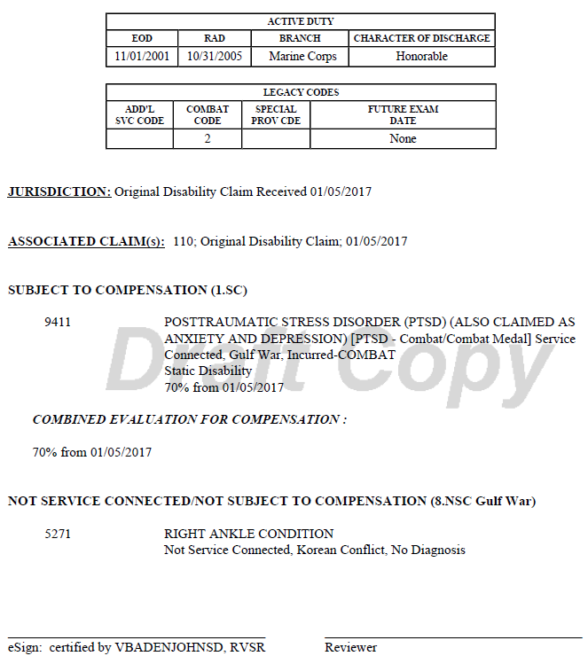
Sample Codesheet
Notes:
Sample Codesheet

Slide 25
Review
Questions
Notes:
Questions?

