Slide 1
Schedule of Operations
ECCT Training

Slide 2
Overview of Today’s Training
Schedule of Operations for Education Employees
The purpose of this lesson is to provide Education employees with the knowledge to understand, identify and answer questions regarding specific payment and special processing dates according to the Schedule of Operations (S of O).

Slide 3
Lesson Objectives
At the end of this lesson, you will be able to:
Identify features of the Schedule of Operations
Identify specific payment release dates associated with authorized transactions in BDN
Identify frequency/timeframe of special processing actions within the Schedule of Operations

Slide 4
Terminology

Slide 5
Schedule of Operations (Terms)
Hines - Most education processing is done through the Benefits Delivery Network (BDN). BDN is maintained at the BDC (Benefits Delivery Center) in Hines, Illinois. Hines is simply the location of the VA office that manages BDC.
Benefit Run - Is when the BDN system updates. This is generally scheduled at the end of the processing day as indicated on the schedule. It uses the daily transaction processing results to identify cases requiring letters, reports, certifications of attendance and payments.

Slide 6
Schedule of Operations (Terms)
Julian Day Number – An individual number assigned to each day of the year (1–365; or 1-366 during Leap Years). The Julian Date is the number for a specific day of the year that corresponds with the Benefit activity processing on that date.
FFP (Full File Pass) – A term used on the monthly Schedule of Operations to indicate when certain processing action occurs. Examples: automated certification, processing delinquent certifications, generation of collection letters, and report production.

Slide 7
Schedule of Operations (Terms)
NOES (Notice of Exception) – System-generated messages which indicate such things as new information from DoD, award input errors, returned checks or delinquent certifications.
DMDC (Defense Management Data Center) – This organization updates eligibility records for Chapter 30 and Chapter 1606 master records. This information is processed in batches.
CARS (Centralized Accounts Receivable System) – System used to collect type B accounts receivable.

Slide 8
Comprehension Check
When do Benefit Runs generally occur?
What is the term used on the Schedule of Operations to indicate when certain processing actions occur, such as letter and report production?
What does NOES stand for on the Schedule of Operations?
Where is Hines located?
Which system is used to collect type B accounts receivable?
Notes:
Answers to Comprehension Check:
Q: When do Benefit Runs generally occur?
A: Benefit Runs “generally” occur each business day. There are a few exceptions, such as Ch35 which has approximately 6 Benefit Runs per month and Ch1606 and 1607 which have Benefit Runs every other business day.
Q: What is the term used on the Schedule of operations to indicate when certain processing actions occur, such as letter and report production?
A: Benefit Run
Q: What does NOES stand for on the Schedule of Operations?
A: Notice of Exception Processing – these are system generated messages that indicate new information from DoD.
Q: Where is Hines located?
A: Hines, Illinois
Q: Which system is used to collect type B accounts receivable?
A: CARS – Centralized Accounts Receivable System

Slide 9
Background
The Schedule of Operations is a schedule of when certain actions will be processed within the BDN.
You can locate the Schedule of Operations from the following locations:
https://vaww.vba.esp.va.gov/sites/HIN-282Ops/ProdAnal/
OR, from the homepage of the ECC Index SharePoint site. It can be launched by clicking on the following icon:
Next, select the production schedule from the list of available months in order to view transactions for that particular month.

Slide 10
Reading the Schedule

Slide 11
Columns on Each Schedule
Columns information includes:
Locate appropriate benefit type on the S of O.
Column 1 = Processing Activities (what type of transaction)
Column 2 = Julian Day Number (the exact date of the transaction)
Column 3 = Daily Processing 2100 Military Time (dates BDN transactions are processed by HINES; transactions will be processed at 9:00pm Central Time on these dates)
Column 4 = Letters Reports (date when corresponding letters/reports are sent)
Column 5 = Transmit to Treasury (date information is sent to US Treasury)
Column 6 = Anticipated Date of Payment (Release date of payment)

Slide 12
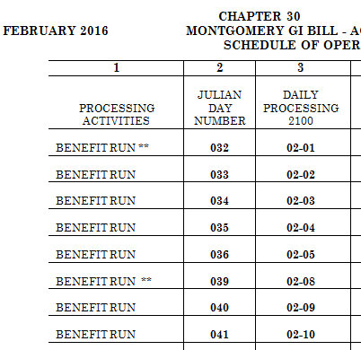
Benefit Run Example
Chapter 30 has eight benefit runs from February 1st until February 10th of 2016
The first benefit run of the month will occur on February 1st at 2100 (9:00pm Central Time)

Slide 13
Comprehension Check
Which column shows the date the payment should be released?
What does the Letter Reports column indicate on the Schedule of Operations?
What does the number 2100 mean in the Daily Processing Column?
Notes:
Answers to Comprehension Check:
Q: Which column shows the date the payment should be released?
A: Anticipated Date of Check/EFT Payments
Q: What does the Letter Reports column indicate on the Schedule of operations?
A: The date that letters and/or reports are sent.
Q: What does the number 2100 mean in the Daily Processing Column?
A: This is the time that the benefit run will occur for each date in the column (9:00pm Central Time)

Slide 14
Payment Release Dates

Slide 15
Determining Payment Date
In order to determine when an authorized payment in BDN will be released:
First locate the authorization date of the payment in question on the BDN M22 screen:

Slide 16
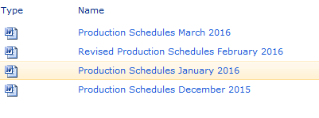
Determining Payment Date (Cont)
2. Locate the correct Production Schedule for the month in which the payment was authorized in BDN.
3. Scroll down to the correct Education Benefit table (in this example, Ch33).

Slide 17
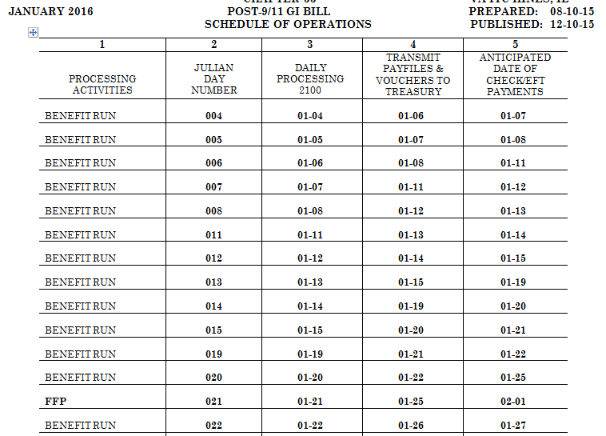
Determining Payment Date (Cont)
4. Locate the BDN authorization date in the “Daily Processing” column.

Slide 18
Determining Payment Date (Cont)
5. The payment release date is the “Anticipated Date of Check/EFT Payments” that corresponds with the “Daily Processing” date.

Slide 19
Pay Date in SHARE
Confirm in SHARE that the payment was released on the “Anticipated Date of Check/EFT Payments” date.

Slide 20
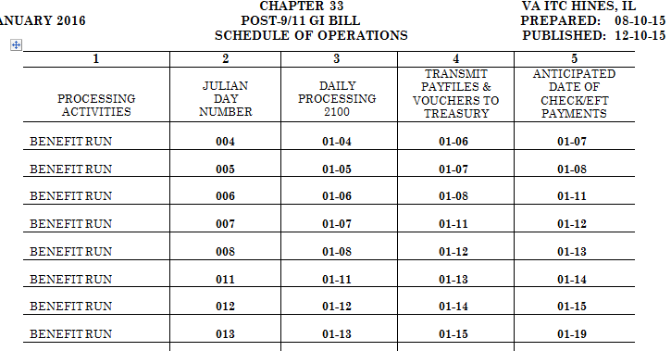
Comprehension Check
1. Where do you find the payment authorization date?
2. What is the anticipated payment date of the Ch33 Book Payment in the amount of $818.93?
Notes:
Answers to Comprehension Check:
Q: Where do you find the payment authorization date?
A: This date will be on the M22 screen in BDN and correspond to the “Daily Processing 2100” column on the Schedule of Operations.
Q: What is the anticipated payment date of the Ch33 Book Payment in the amount of $818.93?
A: January 15, 2016

Slide 21
Special Processing Dates

Slide 22
Special Payments – Advanced Pay
The Schedule of Operations uses asterisks(*) to indicate special processing dates such as: Advance Pay, Certificate of Delivery (COD) of Advance Pay, Full File Pass (FFP), and End of the Month (EOM) Accounting.
Advance Pay and COD of Advance Pay are indicated by two asterisks (**) on the Schedule of Operations
Advanced payments will cycle during the first Advance Pay cycle dated after the authorization date in BDN

Slide 23
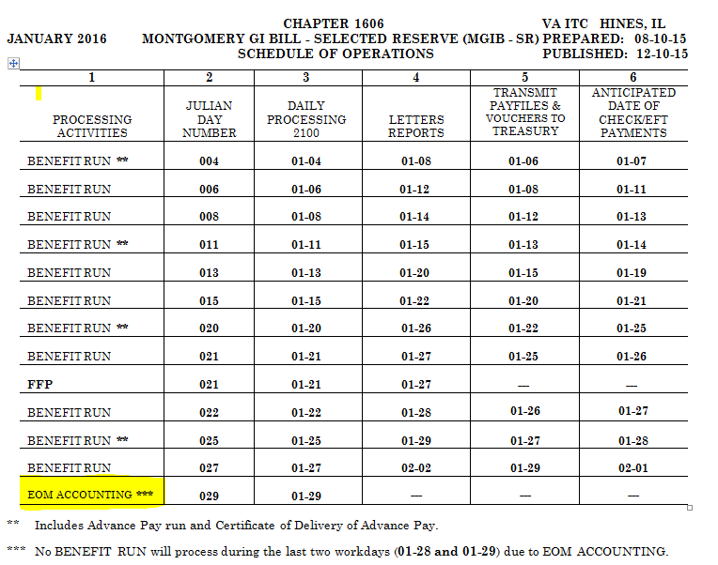
End of Month Accounting (EOM)
The No Benefit Run indicated by (***) on the Schedule of Operations will process during the last two workdays of the month due to End of the Month Accounting. BDN transactions authorized on this date will be held until the first “Daily Processing” date of the next month.

Slide 24
Full File Pass (FFP)
The Full File Pass occurs once each month for Chapters 30, 1606, 1607 and Chapter 33. This usually occurs around the 21st of each month.
Note: This is also the date that regular monthly housing stipends are authorized in BDN for Chapter 33. Any changes made to Direct Deposit accounts will need to be made by this date in order for the housing stipend to go to the correct account.

Slide 25
Other Special Processing
Notice of Exceptions (NOES) processing occurs each Thursday night for Chapter 30 and Chapter 1606, and each Friday night for Chapter 1607.
Centralized Accounts Receivable System (CARS) processing occurs every Tuesday and Thursday during the month, but not during the EOM Accounting (for Chapters 1606 and 1607).

Slide 26
Comprehension Check
How many asterisks indicate an Advance Pay was processed?
How many asterisks indicate the EOM Accounting occurred on the Schedule of Operations?
Which payment is released with a Chapter 33 FFP?
When does NOES processing occur according to the Schedule of Operations?
** Refer to Schedule of Operations on next slide.
Notes:
Answers to Comprehension Check:
Q: How many asterisks indicate an Advance Pay was processed?
A: Two
Q: How many asterisks indicate the EOM Accounting occurred on the Schedule of Operations?
A: Three
Q: Which payment is released with a Chapter 33 FFP?
A: The Chapter 33 housing payment
Q: When does NOES processing occur according to the Schedule of Operations?
A: processing occurs each Thursday night for Chapter 30 and Chapter 1606, and each Friday night for Chapter 1607.

Slide 28
Summary
You have completed the Schedule of Operations lesson. You should be able to:
List features of the Schedule of Operations
Identify specific payment release dates associated with authorized transactions in BDN
Identify frequency/timeframe of special processing actions within the Schedule of Operations

Slide 29
References
BDN Schedule of Operations located at the following website: https://vaww.vba.esp.va.gov/sites/HIN-282Ops/ProdAnal/
M22-4 Part II, Chapter 1, Subchapter 2 1.13
M22-4 Part IV, Chapter 10, 10.10

Slide 30
What questions do you have?

Slide 31
TMS Assessment and Survey
The assessment and survey have been assigned to you in TMS
The assessment is comprised of multiple choice questions
The questions are based on the information presented in this lesson
The assessment should take you approximately 30 minutes
Be sure to complete both the assessment and the survey in TMS to receive credit for this training

