Slide 1
Public Law 114-315, Section 405(h) Alternative Election by Secretary

Slide 2
Icebreaker Activity
Where is the red-bellied woodpecker predominately red?
Wings
Head
Belly
Feet
Notes:
Answer: B. Head
Point here is that what may appear obvious may not always be correct.

Slide 3
Lesson Objectives
At the conclusion of this lesson, you will be able to:
Recall the 5 specific scenarios when an alternative election is authorized
Distinguish when an alternative election would not be authorized
Restate the steps for processing claims involving an alternative election
Understand how to prepare and edit a letter with additional notification requirements for an alternate election

Slide 4
Background
On December 16, 2016, President Barack Obama signed H.R.6416, the Jeff Miller and Richard Blumenthal Veterans Health Care and Benefits Improvement Act of 2016, becoming Public Law 114-315.
Section 405 of PL 114-315 provides VA the authority to make an alternative election (forfeited benefit and effective date of forfeiture) on behalf of an individual that failed to make an election or submitted an election that was clearly not in their best interest on or after January 1, 2017.

Slide 5
Limited Authority
As a general rule, VA will not exercise this authority to override a valid election.
Applications received for Post-9/11 benefits with a valid election should be processed as requested with very few exceptions.
Limited to only the five (5) specific scenarios detailed on the next few slides,
This authority eliminates the need to develop for valid benefit forfeiture or
The need to gain prior authorization to alter the effective date of the forfeiture

Slide 6
When an Alternative Election would be Authorized (Scenarios 1-3)
An alternative election will be authorized in the following limited circumstances:
Veteran fails to relinquish a benefit but is only eligible for one benefit besides Chapter 33.
Veteran provides an invalid election (i.e. relinquishes a benefit for which he or she is not eligible) but is only eligible for one benefit besides Chapter 33.
Veteran provides a valid election but fails to provide an effective date to relinquish.

Slide 7
When an Alternative Election would be Authorized (Scenario 4)
Veteran provides a valid election with a valid effective date. But…
The provided effective date is simply the date the claimant signed the application (basically a default effective date choice). And…
The Veteran is currently in school but not receiving benefits under any VA educational benefit program

Slide 8
When an Alternative Election would be Authorized (Scenario 4 cont.)
Continued...
The choice of a default effective date prevents VA from paying benefits for the Veteran’s current term
Consequently, the Veteran is left without benefit coverage under any program for his or her current term
Had the Veteran chosen a retroactive effective date, the Veteran would receive Chapter 33 benefits for the current term

Slide 9
When an Alternative Election would be Authorized (Scenario 5)
5. Dependent applies for Chapter 33, Transfer of Entitlement (TOE) benefits,
The Veterans Information Solution (VIS) indicates a Transfer Request Date (TRD) of January 1, 2017, or later, and
The transferor has not provided VA with a valid election, and
The transferor is only eligible for one benefit besides Chapter 33

Slide 10
When an Alternative Election would Not be Authorized
An alternative election would not be authorized for any other scenario that does not fit within these 5 sets of circumstances.
In any other set of circumstances, develop with the appropriate individual for a valid relinquishment in writing, following existing procedures.

Slide 11
Comprehension Check
There are 5 specific scenarios when an alternative election is authorized.
How many of those scenarios can you recall?

Slide 12
Processing Steps

Slide 13
Step 1
Review the claim thoroughly for eligibility under the Post-9/11 GI Bill as normal. Determine processing required:
If not eligible, disallow the claim.
If eligible and the election fits into one of the 5 categories, adjust the election appropriately
Otherwise, continue to follow existing procedures for development when an election is still necessary, or process as normal when no development is required

Slide 14
Step 2
Update the Long Term Solution (LTS) and Benefits Delivery Network (BDN) appropriately:
Do not develop for a missing election or to correct a flawed [relinquishment] election when any of the 5 conditions identified are found. Instead, make an alternative election on behalf of the individual.

Slide 15
Step 3
Notify by letter of an alternative election: If an alternative election is made, edit the LTS generated letter or use PCGL as necessary (applies to one or the other):
a) Modify the initial system generated Certificate of Eligibility (COE) or Award letter with a clear explanation of what election changes were made and why VA made an alternative election.
(See Attachment A: “Alternative Election Letter Insert for Veteran”)
b) On TOE claims, send a locally produced letter to the transferor with a clear explanation of what election changes were made and why VA made an alternative election. Do not edit the dependent’s notifications.
(See Attachment B: “Alternative Election Letter for TOE Transferor”)

Slide 16
Step 4
Review and Electronic Notification: Review The Image Management System (TIMS) and LTS for an email address belonging to the individual.
When no email address is found, update TIMS with a Note indicating an email address was not on file.
When an email address is available, the authorizer should use the locally prescribed procedure for completing the email, approving and taking end product credit for the claim (see note below).
Requirement to Notify by Electronic Means Whenever Possible: The requirement for electronic responses should be delayed until a practical solution is found in cooperation with the Business Process Development team...

Slide 17
Attachment A Alternative Election Letter Insert for Veteran
In accordance with Section 3327(h) of Title 38, we have made an alternative election on your behalf to relinquish (enter benefit) effective (enter effective date) to establish Post-9/11 GI Bill benefits requested. We did this because (enter clear explanation of reason). This election we made on your behalf will be irrevocable after 30 days. If you disagree with our actions, send us written notice within 30 days from the date you receive this letter to the address at the top of this letter or, you may notify VA electronically by fax at: GI Bill website “Submit a Question.”

Slide 18
Attachment B Alternative Election Letter for TOE Transferor
Dear (insert name of transferor)
This letter is to notify you that in accordance with Section 3327(h) of Title 38, Section 405, we have made an alternative election on your behalf to relinquish (enter benefit) effective (enter effective date), the date you requested to Transfer Post-9/11 GI Bill benefits to dependents with your service department. We did this because (enter clear explanation of reason). This election we made on your behalf will be irrevocable after 30 days. If you disagree with our actions, send us written notice within 30 days from the date you receive this letter to the address at the top of this letter or, you may notify VA electronically by fax at: GI Bill website “Submit a Question.”
If You Have Questions or Need Assistance
If you have questions or need assistance, contact us. See the "If You Need Help" enclosure for contact information.
Sincerely,
Education Officer

Slide 19
Example Claims

Slide 20
Scenario 1a Example
Original Chapter 33 claim, VIS and other VA systems indicate:
Eligible for Chapter 30 and Chapter 33 only
Question: Can we make an alternative election with this claim? Why or why not?

Slide 21
Scenario 1b Example
Original Chapter 33 claim, VIS and other VA systems indicate:
Eligible for Chapter 1606, 30 and 33
Question: Can we make an alternative election with this claim? Why or why not?

Slide 22
Scenario 2a Example
Original Chapter 33 claim, VIS and other VA systems indicate:
Eligible for Chapter 30 and Chapter 33 only
Question: Can we make an alternative election with this claim? Why or why not?

Slide 23
Scenario 2b Example
Original Chapter 33 claim, VIS and other VA systems indicate:
Eligible for Chapter 1606, 1607 and Chapter 33
Question: Can we make an alternative election with this claim? Why or why not?

Slide 24
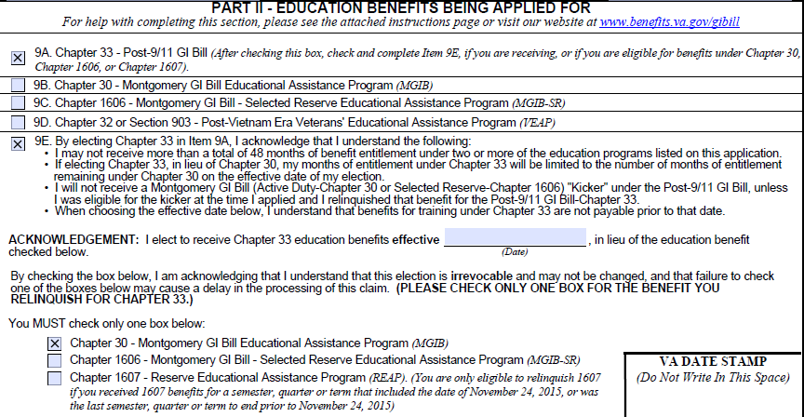
Scenario 3a Example
Original claim, VIS and other VA systems indicate:
Eligible for Chapter 30 and Chapter 33 only
Question: Can we make an alternative election with this claim? Why or why not?

Slide 25
Scenario 3b Example
Original claim, VIS and other VA systems indicate:
Eligible for Chapter 1606, 30 and 33
Question: Can we make an alternative election with this claim? Why or why not?

Slide 26
Scenario 4a Example
Original claim, VIS and other VA systems indicate:
Eligible for Chapter 30 and Chapter 33 only
Additional information reviewed on the application below:
Question: Can we make an alternative election with this claim? Why or why not?

Slide 27
Scenario 4b Example
Original Chapter 33 claim, VIS and other VA systems indicate:
Using Chapter 30 and eligible for Chapter 33
Additional information reviewed on the application below:
Question: Can we make an alternative election with this claim? Why or why not?

Slide 28
Scenario 5a Example
Original TOE claim, VIS and other VA systems indicate:
Sponsor has not applied for education benefits
Eligible for Chapter 1606 and Chapter 33 only
12 months of chapter 33 transferred to the dependent
Transfer Request Date (TRD) of February 1, 2017
Question: Can we make an alternative election with this claim?
Why or why not?

Slide 29
Scenario 5b Example
Original TOE claim, VIS and other VA systems indicate:
Sponsor has not applied for education benefits
Eligible for Chapter 1606, 30 and 33
12 months of chapter 33 transferred to the dependent
Transfer Request Date (TRD) of February 1, 2016
Question: Can we make an alternative election with this claim?
Why or why not?

Slide 30
Alternative Elections - FAQs
Review Handout:
Alternative Elections: Frequently Asked Questions – FAQs

Slide 31
Lesson References
Alternative Election by Secretary:
PL 114-315, Section 405(h)
38 USC 3327(h)
M22-4, Part III, Chapter 3 – Processing Applications for Benefits (3.09c)
Handout: Alternative Election - FAQs

Slide 32
Summary
Today you:
Recalled the 5 specific scenarios when an alternative election is authorized
Distinguished when an alternative election would not be authorized
Restated the steps for processing claims involving an alternative election
Provided guidance for understanding how to prepare and edit a letter with additional notification requirements for an alternate election

Slide 33
Questions?

Slide 34
TMS Assessment and Survey
The assessment and survey have been assigned to you in TMS
The questions are multiple choice or true and false, and are based on the information you learned today
You should be able to complete the assessment and survey within one half hour
Be sure to complete both the assessment and the survey in TMS to receive credit for this training

