Slide 1
Exams: Who, When, & How
Compensation Service
September 2020

Slide 2
Course Agenda
Topic discussions
Who is responsible
When it is most advantageous to order exams
How to draft a sufficient examination
Knowledge checks after each Topic to ensure understanding/clarity
Practical Exercise
Lesson Review/Wrap-up
End of course assessment
In TMS…must achieve 85% > to receive credit for course
Unlimited attempts to achieve passing score
Open book (all resources can be utilized)

Slide 3
Introduction to Exams: Who, When, and How

Slide 4
Purpose of Lesson
This lesson is intended to reinforce knowledge of the procedures surrounding examination requests. This lesson will contain discussions and exercises that will allow you to gain a better understanding of:
who is responsible for requesting examinations
when an examination is needed
how to properly request an examination

Slide 5
Lesson Objectives
Determine who is responsible for ordering examination(s) and/or medical opinion(s).
Identify when it is most advantageous to order a VA examination.
Demonstrate the ability to order a sufficient examination utilizing job aid resources.

Slide 6
Motivation
In an effort to expedite the processing of Veterans’ claims, reduce the high deferral rates, and minimize exam errors, we are reinforcing the fundamentals of examination procedures.
Explain: October 1, 2018, to August 1, 2019
29% (162,539) of avoidable deferrals (519,963) were due to exam issues (exams not ordered on all claims for increase, needed exam, insufficient exam, opinion needed).
Approximately 2% of the American population has served in the Armed Forces, of which .4% are currently active service members. We have a duty to assist this population, and it is our goal to increase efficiency and efficacy.

Slide 7
Motivation (Cont.)
Identifiable trend of avoidable deferrals nationwide
Deferrals have resulted in creating a backlog
Deferrals create unacceptable delay in providing Veterans benefits

Slide 8
References
38 CFR §3.159, Department of Veterans Affairs assistance in developing claims
38 CFR §3.303, Principles relating to service connection
38 CFR 3.304, Direct service connection; wartime and peacetime
38 CFR §3.309, Disease subject to presumptive service connection
38 CFR§3.317(a), Compensation for certain disabilities due to undiagnosed illness and medically unexplained chronic multisymptom illnesses
38 CFR 3.326, Examinations

Slide 9
References (Cont.)
M21-1 Part I, Chapter 1, Duty to Notify and Duty to Assist
M21-1 Part III, Subpart iv, 3.A. Examination Requests Overview
Disability Benefit Questionnaire (DBQ) Index
Exam Request Builder (ERB)
Examination Request Routing Assistant (ERRA) tool
National Work Queue Phase 1&2 Playbook
VBMS Job Aids
VBMS User Guide
Compensation Service Novel Coronavirus (COVID-19) Operational Information Page

Slide 10
Topic 1: Who Is Responsible

Slide 11
Exams Responsibilities: Development activity personnel
Examinations that development personnel are responsible for requesting are:
Posttraumatic Stress Disorder (combat and/or fear based)
Audio (Hearing loss & Tinnitus)
Presumptive issues
General medical examinations for Veterans within one year of discharge and pension examinations
Increase examinations
Important: The COVID-19 pandemic has impacted the exam process therefore; it is essential before requesting/rescheduling an examination that all claims adjudicators review the information posted on the Compensation Service Novel Coronavirus (COVID-19) Operational Information Page for any changes/updates to the examination process.

Slide 12
Exams Responsibilities...Continued
Development personnel who have completed CO specified training are authorized to prepare basic or straightforward medical opinion requests.
No rating activity review required
These basic requests include:
direct service-connection opinions
secondary service-connection opinions

Slide 13
Exams Responsibilities: Rating activity
Only rating activity personnel may prepare complex medical opinion requests. These requests involving issues such as:
compensation under 38 U.S.C. 1151
aggravation (including Allen aggravation)
diagnostic variation or conflicting medical evidence
questions of credibility of evidence presented to the examiner, or
any other matters specified by the VSCM or PMCM, such as
rare disorders/rare etiologies, or
sensitive or high priority claims

Slide 14
Knowledge Check

Slide 15
Topic 2: When It Is Most Advantageous to Order Exams

Slide 16
Identify When to Request a VA examination
The timing for examinations is determined on an issue-by-issue basis. For each disability claimed, request the examination at the earliest point during the development process
Assess whether an examination or opinion is necessary pursuant to the duty to assist, to the extent practicable, after the development of all other relevant evidence.
An examination or opinion is only necessary under 38 CFR 3.159(c)(4) when there is not sufficient medical evidence of record to make a decision on the claim.

Slide 17
Relevant Records
Relevant records for the purpose of VA’s statutory and regulatory duty to assist are those records that:
relate to the disability or injury for which the claimant is seeking benefits, and
have a reasonable possibility of helping to substantiate the claim.

Slide 18
Relevant Records...Continued
For the purpose of 38 U.S.C. 5103A, the Court of Appeals for Veterans Claims (CAVC), in Golz v. Shinseki, 590 F.3d 1317 (Fed. Cir. 2010) held that not all medical records have a reasonable possibility of helping substantiate a pending claim and that VA’s duty to assist applies only to relevant records.
Because each case presents unique circumstances, relevance of records shall be determined on a case-by-case basis.

Slide 19
Tracked Items & VBMS Notes
Tracked items are critical to proper claims management/create the specific corresponding DBQ tracked item for each exam requested
When routing claim for RVSR review (complex exam/medical opinion)
add the tracked item “Review Complex Exam”
append the special issue “RVSR examination” to at least one contention
add “Secondary Action Required” if an exam may be warranted but you are unable to enter the request at this time due to outstanding development.
add a permanent claim-level note to accurately reflect the status of any outstanding contentions requiring examination review.

Slide 20
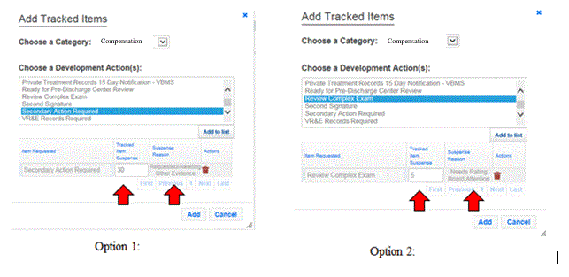
Tracked Item Selections in VBMS

Slide 21
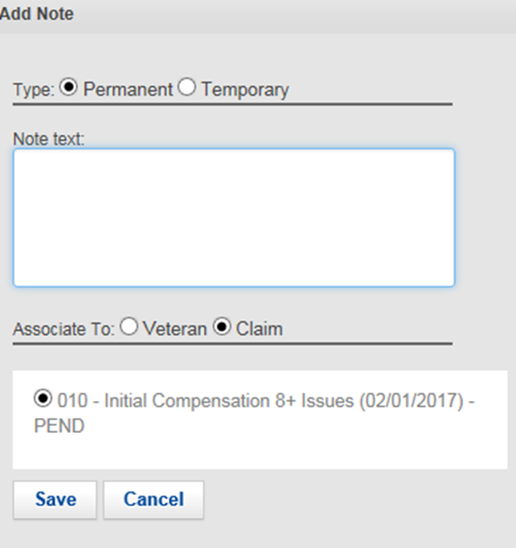
Tracked Item and Associated Note
When the tracked item “Secondary Action Required” is used in VBMS, a permanent claim-level note shall be placed regarding any outstanding contentions requiring development and/or examination review

Slide 22
Knowledge Check

Slide 23
Topic 3: How to Draft a Sufficient Examination

Slide 24
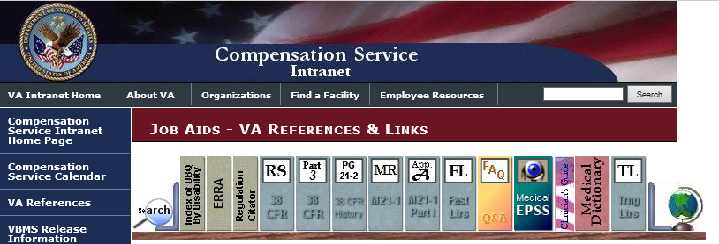
ERRA: Getting There

Slide 25
ERRA: Using the Tool
Information
Type the Veteran’s Zip Code into the box and click Submit

Slide 26
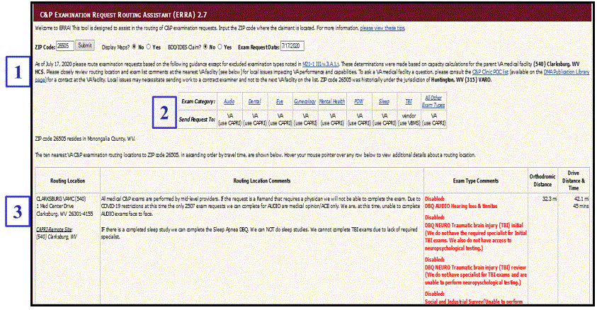
ERRA: The Product

Slide 27
Sufficient Exam Request-Index of DBQ
Selecting the correct Disability Benefit Questionnaire (DBQ)
The Index of DBQ/Exams by Disability tool allows users to search by a particular word, phrase, or diagnostic code (DC).

Slide 28
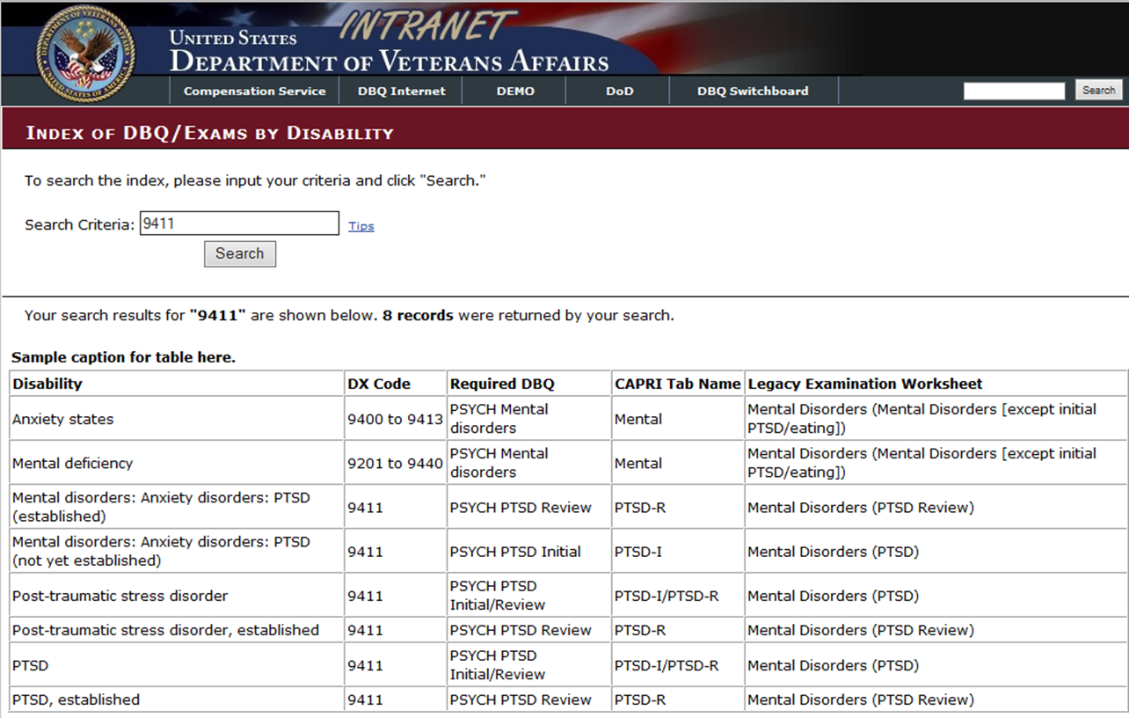
Index of DBQ – Product

Slide 29
Sufficient Exam Request-ERB
Exam Request Builder (ERB) tool is to standardize the format for exam requests
Use of the ERB tool is mandatory when requesting exams from VA Medical Center
As with all automated tools, users should ensure the suggested language and examinations are adequate before inputting the exam requests.

Slide 30
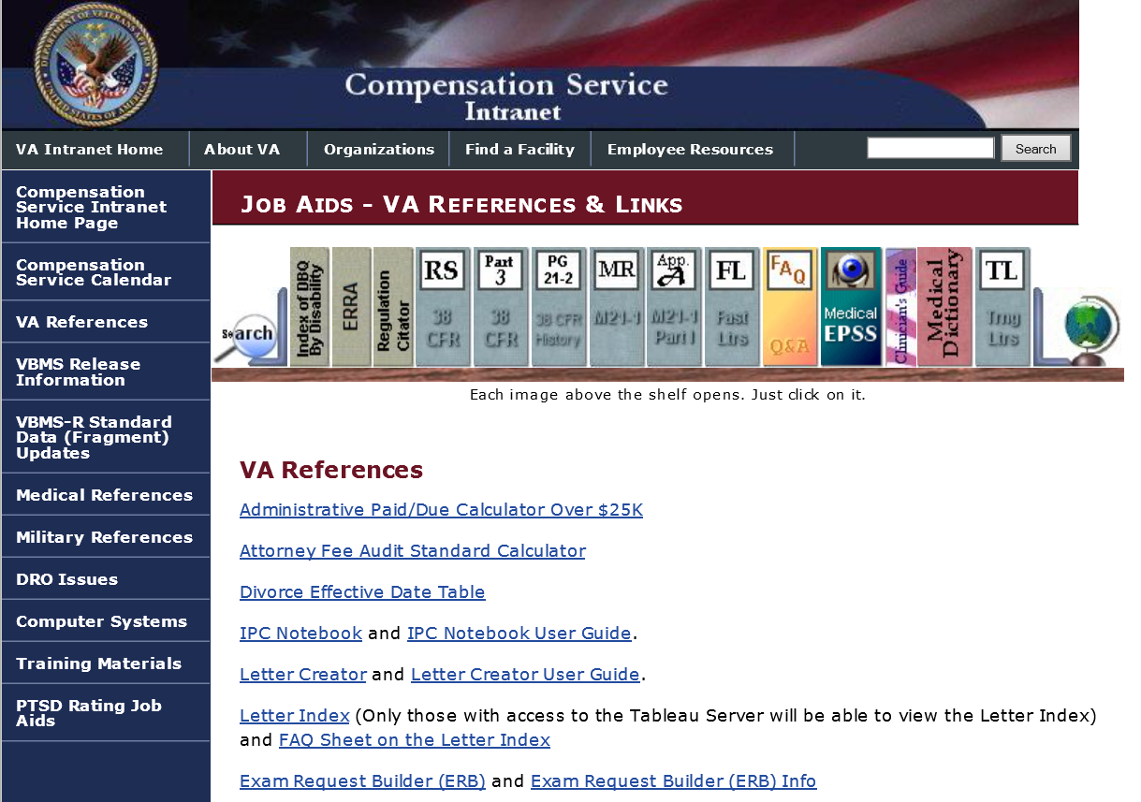
Sufficient Exam Request-ERB

Slide 31
Helpful Reminders When Ordering Exams
Make sure you list any pertinent evidence that the examiner needs to review
Tabs, annotations or bookmarks are required
Include the requestor’s contact information in every exam request
List all contentions to be examined in your request

Slide 32
PTSD Examinations
PTSD exams must be requested in these situations:
Receipt of combat decoration
Fear of hostile military or terrorist activities
Conceded stressor
In-service diagnosis
Note: The rationale for ordering the exam must be entered in exam request.

Slide 33
Hearing Loss and/or Tinnitus Examinations
Exams regarding claimed contention of hearing loss and/or tinnitus should be requested if any of the three situations are involved.
Confirmed noise exposure using the MOS occupational noise exposure listing
“moderate”, “high”, and “low” probability
Combat service indicated with receipt of a combat medal
Threshold shift shown in service
Important: Sensorineural hearing loss/tinnitus are organic diseases subject to presumptive SC (38 CFR 3.309(a))

Slide 34
Presumptive Examinations
Application of the three element standard still applies
although Elements 2 and 3 are satisfied differently
required service or triggering event = in-service injury, event, or disease (Element 2), and
manifestation during presumptive period = indication of association (Element 3)
Evidence must still include lay or medical evidence of a current disability or symptoms to warrant an examination.

Slide 35
General Medical Examinations
A general medical examination is the preferred type of examination in cases concerning original compensation claims
Contains a full report of complaints and functional impairments
Request a general medical examination if
an original claim is received within one year of discharge, or
an intent to file (ITF) is received within one year of discharge, and a substantially complete application is received within one year of the ITF.
It may be appropriate to request a general medical examination to obtain evidence in claims for
individual unemployability (IU)
service connection (SC) under 38 CFR 3.317 (GW General Medical), or
Veterans Pension.

Slide 36
General Medical Examinations Continued
When the medical examiner conducts the examination, he/she should confirm the existence of and evaluate
all disabilities listed in the examination request, and
any other disabilities the Veteran identifies during the examination.
The examination request for a general medical examination should clearly cite the conditions or particular diagnoses that require attention.
Note: Opinions addressing etiology and relationship to service are not typically provided by general medical examinations.

Slide 37
Increase Examinations
In a claim for increase in the evaluation of an SC condition, do not apply the 38 CFR 3.159(c)(4) standard.
no prescribed standard for evidence must be present before requesting exam
Claim for increase received request an examination
no requirement for statement of worsening
doesn’t matter if exam for claimed condition was completed within the last year
Note: please reference Live Manual for exceptions
when in doubt, seek informal guidance from the rating activity

Slide 38
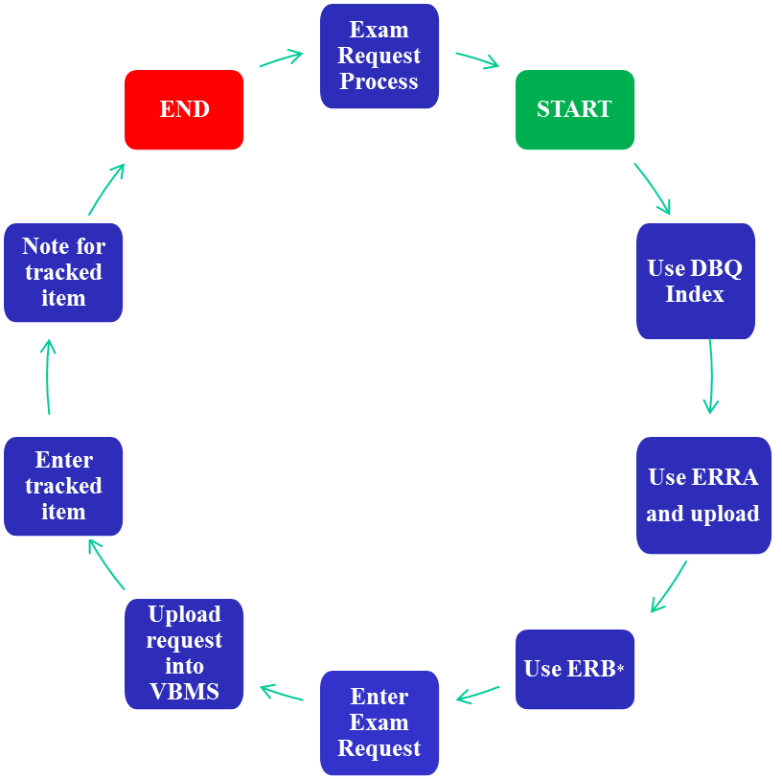
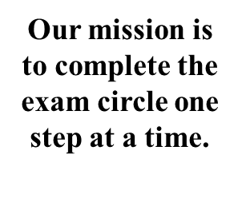
Exam Circle

Slide 39
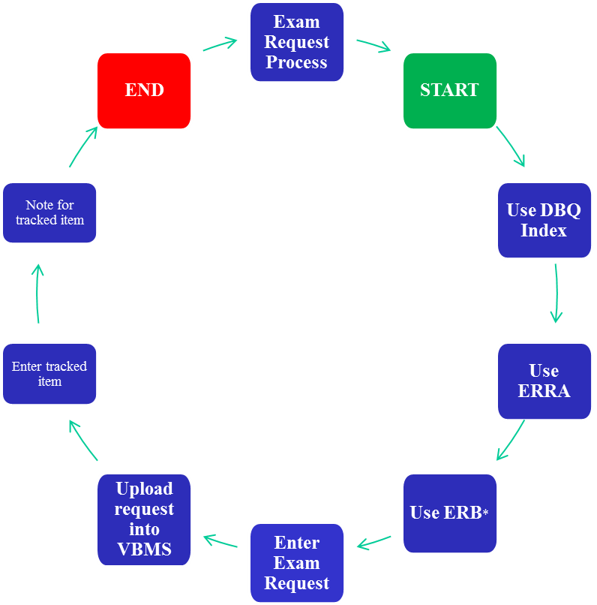
Dysfunctional Exam Circle

Slide 40
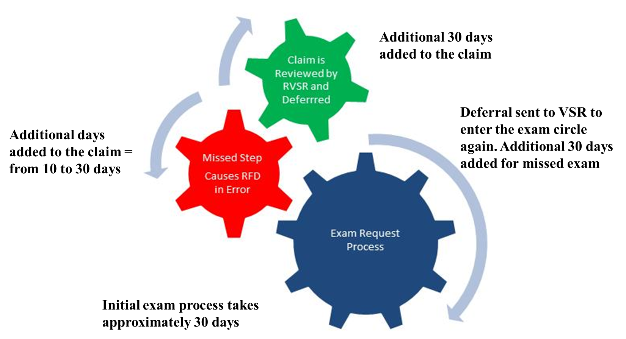
Example of an Incomplete Initial Exam Circle

Slide 41
Knowledge Check

Slide 42
Conclusion
Development and Rating activity personnel have the responsibility to order the appropriate examinations.
Understanding the exam process will reduce avoidable deferrals, backlog and provide timely benefits to Veterans.

Slide 43
Review
Questions

