Slide 1
New QA Error Report
Effective April 1, QA has transitioned to the new one-stop-shop, QA Error Report in SharePoint
First notification of error cases using the new list was done on April 11, containing cases with reviews finalized after April 1
The QA Error Report is located on the QRT SharePoint Site

Slide 2
New QA Error Report
National reviews with errors/deficiencies will be added to the new list weekly
Email notifications will continue, but only with a link
Training with all RO QRT coaches was conducted during the week of April 3, 2017

Slide 3
New QA Error Report
Reconsideration requests will be submitted via the QA Error Report
Formal memos with signatures are no longer required
It is up to the ROs’ discretion how to provide local approval for submitting a recon
Anyone at the RO who can access the QA Error Report SharePoint site has the ability to submit a recon

Slide 4
New QA Error Report
Rationale for removing the error(s) should be entered via the SharePoint site with supporting citations
Bulleted arguments are encouraged
Do not attach a Word document
QA will review the argument presented and provide the response via the QA Error Report

Slide 5
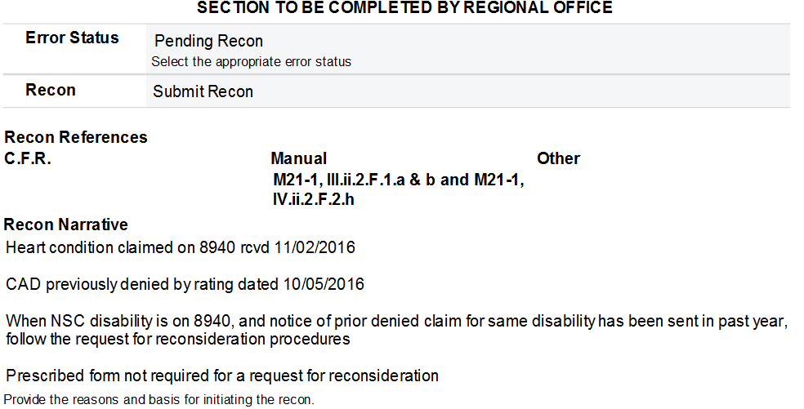
Example of RO Reconsideration Request

Slide 6
Example of QA Reconsideration Response

Slide 7
New QA Error Report
Reporting corrective actions taken is required
Taking corrective actions timely provides important customer service to Veterans, their families, and Survivors
GAO and OIG oversight offices routinely ask for verification that corrective actions are taken
Effective with national reviews finalized on and after April 1, 2017, corrections will be reported via the new QA Error Report
Actions taken to address ALL cited errors must be provided

Slide 8
New QA Error Report
Corrective actions must be initiated within 30 days of the Release Date and are expected to be timely worked to completion
When corrections are resolved for all cited errors, mark the status as “Completed”
Resolved means all actions to execute corrections are done, to include promulgation and authorization

Slide 9
New QA Error Report
QA will conduct annual Special Focused Reviews (SFR) to ensure compliance
SFRs will
Confirm that corrective actions were taken as reported, and
Assess accuracy of corrective actions taken

Slide 10
New QA Error Report
FY17Q2 Quarterly Error Report
Will contain errors cited between January 1 and March 31, 2017
Will be issued in the previous method in late April 2017
Will be the last QER in the old format
All errors on historical QERs – FY13Q2 thru FY17Q2 - must be closed out
At this time, over 2,400 outstanding errors exist that require action

