Slide 1
Kickers

Slide 2
Overview of Today’s Training
Kickers
The purpose of this lesson is to provide the Veterans Claims Examiner (VCE) with the knowledge to properly identify and process benefit payments involving kickers.

Slide 3
Objective
At the end of this lesson, you will be able to:
Utilize available references and systems to identify the different types of kickers
Utilize available references and systems to identify when kickers require verification
Utilize available references and systems to accurately calculate the amount of a kicker (including proration when necessary)
Utilize available references and systems to identify when a kicker is not payable

Slide 4
What Is a Kicker?
A Kicker is an additional monetary benefit payment, paid with education benefits offered as an incentive to certain individuals. A “kicker” is also known as a College Fund.
Benefits paid under Chapters 30, 32, 33, 1607 and 1606 are eligible to receive kicker payments with the benefit.
Service Departments determine amounts of kickers. A member must sign a “kicker contract,” agree to and perform the terms of the agreement in order to receive a kicker.

Slide 5
Types of Kickers
Active Duty Kickers (Chapter, 30, 32 and 33*) are used to
encourage enlistment in the Armed Forces. These kickers are only offered upon initial entry into service.
Active Duty Supplemental Kickers*, potentially available under Chapter 30 and 33 are used to encourage retention in the Armed Forces.
Chapter 1606 Kickers may be offered to encourage enlistment or retention in a selected job skill or in a critical unit.
*To date, these kickers have not been offered.

Slide 6
Active Duty Kickers Offered
Servicemembers eligible for Chapter 32 (Post-Vietnam Era Veterans' Educational Assistance Program, VEAP) or Chapter 30 under Category IVA or IVC with a kicker may receive kicker payments while using chapter 32 or chapter 30. VEAP kickers are not payable under chapter 33.
Currently Service Departments only offer a College Fund Kicker under the Montgomery GI Bill (MGIB, Chapter 30). MGIB Kickers are payable under Chapter 30 or Chapter 33 when Chapter 30 is relinquished.

Slide 7
Comprehension Check
What types of kickers are there?
Under what benefits are kickers paid?

Slide 8
MGIB Active Duty Kicker: Identify, Verify and Processing

Slide 9
Active Duty Kicker Rates
Kicker rates are found in BDN on the BDN 30D screen.
BDN 30D, indicates the monthly amount and the two-digit code.
When rates are not coded properly on the BDN 30D or need to be verified, locate kicker rates using the following:
M22-4, Part V, Chapter 1, Appendix E, Kicker Tables
RPO Letter 22-08-12, enclosures 2, 3, and 4
NOTE: Kickers are based on the claimant’s date of enlistment and the kicker code provided.
Remember: Although similar kicker data may appear in VIS, the BDN 30D screen is the authoritative source. If Chapter 30 kicker information appears in VIS and not on the BDN 30D screen, verify the conflict.

Slide 10
How to Locate a Kicker
Service departments notify VA of Chapter 30 Kicker information with codes on the BDN 30D screen.

Slide 11
Active Duty Kickers Offered
Air Force does not offer Active Duty Kickers.
The following active service departments do offer College
Funds (kickers) on initial enlistments.
Army Army College Fund (ACF)
Coast Guard Coast Guard College Fund (CGCF)
Marine Corps Marine College Fund (MCF)
Navy Navy College Fund (NCF)

Slide 12
Navy Active Duty Kicker Verification
The following Navy kickers must be initially verified:
All “BW", “BG", and "G4" kickers
When development is necessary, use DPRIS first and then develop to DoD and the claimant when a NCF contract is unavailable.
NOTE: The Navy no longer issues kickers with enlistments beginning February 2011. (No development required.)

Slide 13
Marine Corps Active Duty Kicker Verification
The following Marine Corps kickers must be initially verified:
All “BW", “G4” and "G5" kickers
When development is necessary, use DPRIS first and then develop to DoD and the claimant when a MCCF contract is unavailable.

Slide 14
Coast Guard Active Duty Kicker Verification
Only verify a Coast Guard kicker if the claimant states there is a discrepancy
When development is necessary, develop to Department of Homeland Security (DHS) and the claimant for a CGCF contract.
NOTE: DPRIS does not contain information for members of the Coast Guard.

Slide 15
Army Active Duty Kicker Verification
Army kicker development is necessary when the BDN 30D screen shows inadequate, erroneous, or incomplete data on an Army kicker or if the soldier claims he/she is authorized a kicker.
When development is necessary, use DPRIS first and then develop to DoD and the claimant when a ACF contract is unavailable.
NOTE: The Army no longer issues kickers with enlistments beginning March 16, 2012. (No development required.)

Slide 16
Kicker Information Not on the BDN 30D Screen
Always consider information in TIMS beginning with the application
If indicated on the application and not on the BDN 30D screen, develop for a contract using DPRIS first when appropriate and then with the service department and claimant when a contract cannot be obtained using DPRIS.
Yes

Slide 17
Analyzing a Kicker Contract
Pay the basic benefit rate until the contract arrives or is verified by the service department.
A kicker contract will often show total amount as “college fund”, the MGIB basic plus the kicker.
If the contact does not indicate the fulltime monthly rate then take the
following steps to determine the kicker monthly rate:
Locate the basic MGIB fulltime rate for enlistments of three or more years, effective when claimant first entered active duty using the rate tables,
Multiply this rate times 36 to calculate the basic MGIB total amount,
Subtract basic MGIB total amount from the total on the contract,
That will give you the kicker total amount,
Divide the kicker total amount by 36 to arrive at the fulltime monthly kicker rate.
MGIB Basic rate * 36 = Total MGIB;
Contact Total - Total MGIB = Kicker Total;
Kicker Total / 36 = Monthly Fulltime Kicker Rate

Slide 18
Determining a Kicker Amount
Never include additional buy up in the calculation.
If the contract states “up to”, the VCE should accept the “up to” amount as the total amount contracted.
If the individual does not complete his/her obligation period, then the kicker must be prorated. This will be covered later in the training.
An active duty kicker is granted only with a first enlistment. When an individual cannot establish eligibility to MGIB or must use a second period or later period of service to establish basic eligibility, the kicker authorized under an initial enlistment will not apply to the second period of service. (i.e. Member is not entitled to a kicker.)

Slide 19
MGIB Payments with Kicker
If a claimant is training at half-time or more and is not on active duty, the monthly rate is determined by adding the basic rate plus the proportionate amount of the Chapter 30 kicker.
Category IB eligible claimant
$400 Full-time monthly kicker
Training Time | Calculation (Using FY2016 Rates)
Full-time: | $1,789.00 + $400.00 = $2189.00
Three-quarter time: | $1,341.75 + $300.00 = $1,641.75
Half-time: | $894.50 + $200.00 = $1,094.50

Slide 20
MGIB Less Than Half Time Training
When a claimant is training at less than half-time, quarter time or
is on active duty, the claimant’s rate is based on tuition and fees,
up to the corresponding Veteran rate.
A kicker raises the ceiling or cap of the maximum monthly rate
payable.
Pay the lesser of monthly tuition and fees calculated or the cap
rate based on the following:
Less than half-time training = up to halftime rate plus half of kicker
Quarter time or less training = up to 1/4th of Basic MGIB rate plus 1/4th of kicker

Slide 21
Kicker and Enlistment Term
The enlistment term may have to be changed on the BDN 310 screen to match the kicker code. (e.g. a “BP” kicker requires a 4 year enlistment.) Inconsistencies not corrected may lead to kicker payment errors.
Notes:
Should the VCE develop for the kicker or enlistment term? Need guidance…

Slide 22
Things to Know and Remember about Kickers
Some kickers need to be verified
BDN processing of MGIB with a kicker may require overriding when the BDN 30D screen is not coded correctly for a kicker
Ensure the enlistment term and the kicker codes match
A kicker is not paid during any allowed extension of entitlement (i.e. Only 36 months of kicker entitlement)

Slide 23
Comprehension Check
What Navy kickers need to be verified?
What Army kickers need to be verified?
What Marine Corps kickers need to be verified?
What Coast Guard kickers need to be verified?
What Air Force kickers need to be verified?

Slide 24
Chapter 1606 Kickers: Identify, Verify, and Processing

Slide 25
1606 Kicker
An eligible reservist with a selected job skill, or in a critical unit may also receive an additional or increased amount of educational assistance, commonly called a “kicker.”
Kickers are payable at the service department's discretion
The service department will determine if a kicker is payable and will notify VA of the amount
Kickers are payable as an additional amount only for as long as the person remains in the position, or unit for which the kicker is awarded
A person can lose eligibility for a kicker but retain basic eligibility
A 1606 Kicker may be paid under Chapter 30, 33, or 1607
VA will compute the monthly kicker based on this information.
Notes:
1607 kicker payments ???

Slide 26
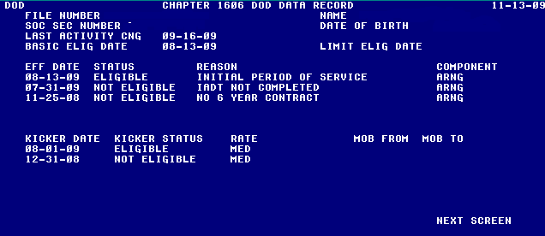
Review BDN DOD Screen
1606 Kicker information may be found on the BDN DOD screen.

Slide 27
Kicker Information Not on BDN DOD Screen
Always consider information in TIMS beginning with the application
If indicated on the application and not on the BDN DOD, develop with the appropriate service department.
A claimant may also submit a “Kicker” contract. Contact the appropriate service department for eligibility information before paying a kicker, when not updated on the BDN DOD screen or any time continued eligibility is questionable.

Slide 28
1606 Kicker Eligibility/Status
A 1606 Kicker status may change after the initial eligibility determination is made. It may be:
Terminated
Increased
Decreased
Suspended
Reinstated
Always verify BDN DOD screen and VIS for any changes to a kicker or service status with each supplemental claim involving 1606 Kickers. Develop with DoD if data is conflicting. (i.e. 1606 DoD Eligible status with VIS service status of Separated, Retired or Active Duty)

Slide 29
BDN Reason Codes
Under Chapter 1606 (only) the following codes should be used with kicker changes:
40 - Eligibility Suspended
41 - Eligibility Reinstated
45 - Kicker Increase
46 - Kicker Decrease.

Slide 30
BDN Kicker Override Codes & Rates
Under 1606 there are 4 override codes used on the 312 screen:
E = Eligible (Used to establish basic eligibility with 310 override)
L = Low Kicker ($100)
M = Medium Kicker ($200)
H = High Kicker ($350)
Since basic eligibility must exist, the current eligibility status must be Eligible or Eligibility Retained in order to use the kicker override codes. Valid Kicker rates are manually entered when both basic and kicker eligibility require overriding.

Slide 31
Rate is Based on Training Time
Chapter 1606 has only 4 rates of training, full, three-quarter, half, and quarter time.
Payment of a 1606 Kicker under Chapter 30 or 1607 may require overriding to ensure the 1606 Kicker is (always) added and paid at 1/4th of the rate for either less than halftime or quarter time or less training.
Rate: | High | Medium | Low
Full: | $350.00 | $200.00 | $100.00
¾: | $262.50 | $150.00 | $75.00
½: | $175.00 | $100.00 | $50.00
¼: | $87.50 | $50.00 | $25.00

Slide 32
Comprehension Check
What are the different 1606 kicker rates?
How can 1606 kicker eligibility change?

Slide 33
Paying Kickers Under Chapter 33

Slide 34
Kickers Payable Under Chapter 33
Claimants eligible for a Chapter 30 or Chapter 1606 kicker may receive kicker payments under chapter 33 provided that they relinquish the benefit associated with the kicker.
Chapter 30 and Chapter 1606 kicker verification rules still apply:
Chapter 30 rate may need to be prorated if member did not complete full initial enlistment period
A 1606 kicker may be suspended or terminated
BDN and VIS should be reviewed each time a supplemental claim is worked
1606 Kickers terminate upon separation

Slide 35
Prorated Chapter 30 Kickers

Slide 36
Prorated Kickers
A VCE will prorate an active duty Chapter 30 kicker whenever a Veteran does not serve the full initial obligated period of service.

Slide 37
Locate the Full Chapter 30 Kicker Rate
The Kicker Charts can be found in M22-4 Part V, Chapter 1, Appendix E, or
RPO Letter 22-08-12 Two Character Kicker Codes; enclosures 2, 3, and 4 contain kicker rate tables
Verify the correct rate kicker rate from the tables associated with the date the Veteran or servicemember initially enlisted

Slide 38
The Prorated Kicker Formula
‘K’ = Monthly Kicker Rate

Slide 39
The Prorated Kicker Formula – ‘A’
‘A’ = The contractual monthly kicker “accrual rate" determined by dividing the total kicker by the number of months in the enlistment term (e.g., $8000/24 months = $333.33).

Slide 40
The Prorated Kicker Formula – ‘X’
‘X’ = The number of months of active service with any remaining days rounded up to the next whole month (e.g., 17 months and 8 days is rounded up to 18 months).

Slide 41
The Prorated Kicker Formula – ‘Z’
‘Z’ = The number of months of original entitlement as determined by VA.
Note: Entitlement months may not exceed 36 months. When paying under Chapter 33 and member has not used Chapter 30, use 36 months for Z.

Slide 42
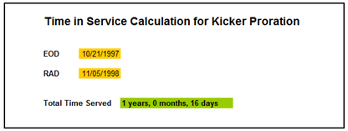
Net Active Service - DD214 Job Aid for Service Period Length
Use the “Net Active Service This Period” section from DD214:
Or a Job Aid for service period length:
This Job Aid will be made available through your station.

Slide 43
Prorated Kicker Example
A Veteran is eligible for a Kicker BE.
Entered into active duty on 1-8-98
Enlistment term is 3 years
The Veteran was discharged on 12-1-00 with an honorable discharge for a COG
NOTE: Single digit kicker codes have been recoded into two digit kicker codes. The letter B precedes the original single letter code. (e.g. An ‘E’ kicker is now a ‘BE’ kicker)

Slide 44
Kicker Table
Notes:
A policy advisory was sent in September 2002 which indicated that the monthly kicker rates and total kickers shown in the manual are incorrect for the S, T, V, and W kicker codes effective 03-07-97.
We recently received a manual update dated April 8, 2003 which has the correct monthly kicker rates and total kickers listed on the kicker chart.

Slide 45
A Prorated Kicker Example Step 1
Total dollar amount of Kicker ‘BE’ is $17,165.28 if Veteran served at least 36 months. Calculate how much of the $17,165.28 the Veteran earned for each month he was on active duty.
$17,165.28 / 36 month enlistment term
= the Veteran earns $476.81 of his total kicker
amount each month he/she serves on active duty
This is the “Monthly Accrual Rate” or A in the formula.

Slide 46
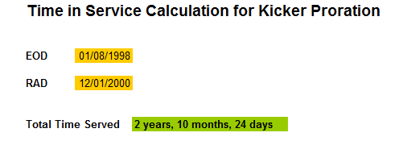
A Prorated Kicker Example Step 2
Determine how many months the claimant served on active
duty for DoD purposes (DoD always rounds up to the next
month)
The Veteran served a total of 2 years 10 months and 24
days on active duty or 35 months for DoD purposes
(rounded 24 days up to next month).
This is X in the equation.

Slide 47
A Prorated Kicker Example Step 3
Determine how much of the total kicker amount of
$17,165.28 the Veteran has earned.
Served 35 months on active duty x $476.81333 monthly
accrual rate = $16,688.466.
This is the numerator in the equation.

Slide 48
A Prorated Kicker Example Step 4
Determine how much entitlement the Veteran is eligible to receive.
For VA purposes you drop any fractional month. So the
Veteran served 34 months (2 years 10 months and 24
days) on active duty and received a honorable
discharge for COG.
VA entitlement is 36 months to the MGIB. This is Z in
the equation.

Slide 49
A Prorated Kicker Example Step 5
Putting it all together…
Prorated Kicker Payment = $16,688.466/36.
Prorated Kicker Payment = $463.57 per month of full time
training.
NOTE: Had the Veteran completed the full 3 year enlistment the monthly rate would have been $476.81.

Slide 50
Prorated Kicker in BDN
When the 310 screen is filled out correctly BDN calculates the correct rate provided the kicker is shown on the 310.
Double check the kicker rate and time served before you override a kicker to pay the full kicker rate.
Place a “STOP” message and the amount of the prorated kicker in the BDN message field, when BDN is not coded with the correct kicker code or is not prorating properly.

Slide 51
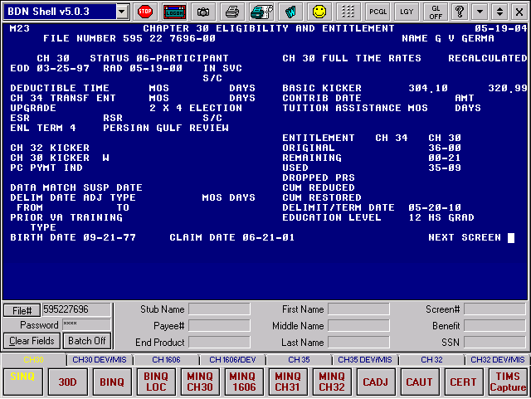
M23 Screen – Prorated Kicker Example
M23 screen shows prorated kicker under recalculated

Slide 52
Comprehension Check
Why would we prorate a kicker?

Slide 53
Questions
Questions?

Slide 54
References
Chapter 30 Kickers
M22-4, Pt. V, 1.22
M22-4. Pt. V, 3.08
RPO Letter 22-08-12 Two Character Kicker Codes and Kicker Rate Tables
Title 38, United States Code, §3015(d)
Kicker & Bad Discharge, Advisory date September 11, 2002
Kicker Calculation, Advisory dated September 10, 2002.
Kicker Table Error, Advisory dated September 6, 2002.
Multiple Kickers, Advisory dated March 6, 2003
R Kicker, Advisory dated July 31, 2003.
S Kicker and 3-year Rate Issue, Advisory dated July 8, 2004.

Slide 55
References Continued
Chapter 1606 Kickers
M22-4, Pt. VIII, 1.10b
RPO Letter 22-04-25
Army Data Problems, Advisory dated October 2, 2006. Chapter 1606 Kicker Eligibility Question , Advisory dated October 22, 2007. chapter 1606 Kicker Start Date, Advisory dated May 15, 2003.Policy Advisory of July 9, 2007 Chapter 1606 Kickers, Advisory dated July 9, 2007. Chapter 1606 Kicker Rates 1/2 time, Advisory dated July 25, 2007. Involuntary Separation and Retention of 1606 Benefits, Advisory dated March 18, 2005.
Multiple Kickers, Advisory dated March 6, 2003.
Chapter 33 Kickers
M22-4 Pt. VI, 1.01c(2)
M22-4 Pt. VI, 1.08(2), 1.11 and 1.14
Chapter 33 Kickers
M22-4 Pt. XII
21.9650 Increase in Educational Assistance
21.9655 Rates of Supplemental Educational Assistance
38 U.S.C. 3313
38 U.S.C. 3316

