Slide 1
Contaminants in Water Supply: Camp Lejeune Presumptive Regulation
Compensation Service
March 2017

Slide 2
Lesson Objectives
Demonstrate comprehension of the requirements for presumptive service connection (Diseases associated with exposure to contaminants in the water supply at Camp Lejeune)
Understand the Regional Office and Centralized claims processing requirements for CLCW claims
Identify rating considerations and criteria for the eight CLCW presumptive disabilities
Apply the liberalizing legislation effective date regulation to CLCW grants
Recognize and understand the rating decision and notification letter requirements for CLCW claims

Slide 3
References
38 CFR 3.307(a)(7): Diseases associated with exposure to contaminants in the water supply at Camp Lejeune
38 CFR 3.309(f): Diseases associated with contaminated water supply at Camp Lejeune
38 CFR 3.114: Change of law or Department of Veterans Affairs issue
38 CFR 3.383: Special consideration for paired organs
38 CFR Part 4: Schedule for Rating Disabilities

Slide 4
References
38 CFR 17.400 – Hospital care and medical services for Camp Lejeune Veterans
M21-1 Part III, Subpart iv, 4 – Rating specific disabilities
M21-1 Part IV, Subpart ii, 1.I.7 – Developing claims based on exposure to contaminants in the water supply at Camp Lejeune
M21-1 Part IV, Subpart ii, 2.C.6 - Disabilities resulting from exposure to contaminants in the water supply at Camp Lejeune

Slide 5
Presumptive Regulation

Slide 6
Background
In September 2016, VA published a rule proposing to create a presumption of service connection for eight diseases associated with contaminants present in the base water supply at U.S. Marine Corps Base Camp Lejeune, North Carolina.

Slide 7
38 CFR 3.307(a)(7)
Effective March 14, 2017, eight presumptive diseases were added to 38 CFR 3.309(f), for
service members, former reservists, National Guard members on official orders, who served
30 days (consecutive or nonconsecutive) at Camp Lejeune, between
August 1, 1953 to December 31, 1987

Slide 8
38 CFR 3.309(f)
If a Veteran was exposed to contaminated drinking water at Camp Lejeune, the following diseases shall be service-connected if the requirements of §3.307(a)(7) are met:
Kidney Cancer
Liver Cancer
Non-Hodgkin’s Lymphoma
Adult Leukemia
Multiple Myeloma
Parkinson’s Disease
Bladder Cancer
Aplastic Anemia and other Myelodysplastic Syndromes

Slide 9
Claim Processing

Slide 10
ROJ Processing
The ROJ will retain jurisdiction of a Camp Lejeune claim when:
the Veteran did not serve at Camp Lejeune between August 1, 1953, and December 31, 1987
the claim is for a disability recognized under 38 CFR 3.309(f) and
the Veteran had at least 30 days of service at Camp Lejeune during the contamination period, or
the evidence does not establish a diagnosis of the claimed condition
no disability is specifically claimed as a result of exposure, such as claims stating “Camp Lejeune” or “exposure at Camp Lejeune”
Veteran status needs to be established, such as a character of discharge determination, or
the only claim is for a disability of a dependent, including birth defects.

Slide 11
Centralized Processing
The ROJ will route the following Camp Lejeune claims for centralized processing at Louisville:
a diagnosed disability recognized under 38 CFR 3.309(f) with at least one, but less than 30 days of service at Camp Lejeune, OR
a condition recognized under 38 CFR 17.400, with at least one day of Camp Lejeune service, OR
any other disability specifically claimed as due to exposure at Camp Lejeune with at least one day of service during the contamination period.
Note: If a claimed condition is listed at either 38 CFR 3.309(f) or at 38 CFR 17.400, service at Camp Lejeune during the contamination period does not have to be expressly claimed and may otherwise be established by the evidence of record.

Slide 12
Centralized Processing
Stages of claims processing handled by the centralized RO:
Stage | Description
1 | Ensures Camp Lejeune service information and flash are accurate.
2 | Ensures any subsequent development letter as noted in M21-1 Part IV, Subpart ii, 1.I.7.j has been sent to the claimant.
3 | Requests Veterans Health Administration (VHA) subject matter expert (SME) review, when needed.
4 | Decides all claimed issues and sends notice of the decision to the claimant.
5 | Retains jurisdiction for any appeals received on Camp Lejeune claims and all other non-Camp Lejeune claims and/or appeals received during the one-year appeal period

Slide 13
VHA SME Review
Prior to finalizing the regulations allowing for presumptive SC, VBA referred CLCW claims to VHA for a subject matter expert (SME) review. These opinions must be weighed to determine if
SC can be established on a direct basis prior to the date the final presumptive regulation became effective, or
if the opinion sufficiently rebuts the presumption as discussed in 38 CFR 3.307(d).

Slide 14
VHA SME Review – Requirements
VHA SME review is required in the following claims:
38 CFR 3.309(f) disability with less than 30 days Camp Lejeune service
any disability claim with
at least one day of verified service at Camp Lejeune service during the contamination period, and
evidence sufficient to warrant an examination under 38 CFR 3.159, OR
chronic disability recognized for healthcare under 38 CFR 17.400 with at least one day of verified service at Camp Lejeune service during the contamination period.
Exception: If the only service at Camp Lejeune was with a National Guard or reserve unit while on active duty for training or inactive duty for training, do not request a SME review.

Slide 15
VHA SME Review – 3.307(d)
A negative VHA SME opinion may be sufficient to deny direct service connection, but it is not necessarily sufficient to rebut a presumption for an otherwise qualified claim under 38 CFR 3.307(a)(7).
To rebut the presumption of service connection, a burden of proof must be present and the opinion must meet a higher standard.

Slide 16
Presumptive Disabilities

Slide 17
Genitourinary: Kidney Cancer
Kidney cancer is evaluated under DC 7528
Single kidney cancer may be treated with radiation or nephrectomy:

Slide 18
Genitourinary: Kidney Cancer
If both kidneys are diseased, long-term dialysis may be required
Regular dialysis is evaluated under renal dysfunction and warrants a 100 percent evaluation

Slide 19
Genitourinary: Kidney Cancer
Rating considerations for rating under renal dysfunction:
Evaluating renal conditions using Blood Urea Nitrogen (BUN)
Evaluating renal conditions using creatinine
Limits on separate evaluation of nephritis and cardiovascular conditions with exceptions of kidney removal and regular dialysis
Annual review of evaluations based on hemodialysis

Slide 20
Genitourinary: Kidney Cancer
Paired organs: Loss of loss of use of one kidney as a result of SC disability and involvement of the other kidney as a result of NSC disability.
Kidney transplant may be required for treatment:

Slide 21
Genitourinary: Bladder Cancer
Bladder cancer is evaluated under DC 7528. Residuals will likely involve voiding dysfunction (urine leakage, frequency, obstructed voiding).
Suprapubic cystostomy (DC 7516):

Slide 22
Digestive: Liver Cancer
Liver cancer is evaluated under DC 7343:
Residuals of injury to the liver (DC 7311):

Slide 23
Digestive: Liver Cancer
Rating considerations for rating under the digestive system:
38 CFR 4.113 – Coexisting abdominal conditions
38 CFR 4.114 – Single evaluation under predominant disability

Slide 24
Digestive: Liver Cancer
Liver transplant may be required for treatment:
If not already at a total evaluation, lengthy hospitalization may be required while waiting for a liver transplant. 38 CFR 4.29

Slide 25
Hemic: Adult Leukemia
Leukemia is evaluated under DC 7703:
Chronic Lymphocytic Leukemia (CLL): Assign a P&T evaluation for CLL. CLL is considered an incurable malignancy.

Slide 26
Hemic: Aplastic Anemia
Aplastic anemia is evaluated under DC 7716:

Slide 27
Hemic: Myelodysplastic Syndrome
Myelodysplastic syndromes (MDS) are a group of closely related diseases in which the bone marrow produces too few functioning:
red blood cells
white blood cells
platelets, or
any combination of the three.
MDS will be rated as aplastic anemia under DC 7716, if the MDS progresses to leukemia, evaluate as leukemia under DC 7703.

Slide 28
Lymphatic: Non-Hodgkin’s
Non-Hodgkin’s lymphoma (NHL) is evaluated under DC 7715:
If the disease has actively persisted for several years, thoroughly examine the medical record to determine whether the disease is:
actually in remission
still active and being regularly treated over extended periods of time.

Slide 29
Lymphatic: Multiple Myeloma
Multiple myeloma is evaluated analogous to Hodgkin’s disease under DC 7799-7709:
Multiple myeloma is considered an incurable malignancy and generally requires a permanent and total evaluation.
There may be rare exceptions when the evidence clearly shows the multiple myeloma is no longer active.

Slide 30
Neurological: Parkinson’s Disease
Parkinson’s disease is evaluated under paralysis agitans - DC 8004:
The 30 percent evaluation will be assigned until complications can be separately evaluated and provide an evaluation of higher than 30 percent.

Slide 31
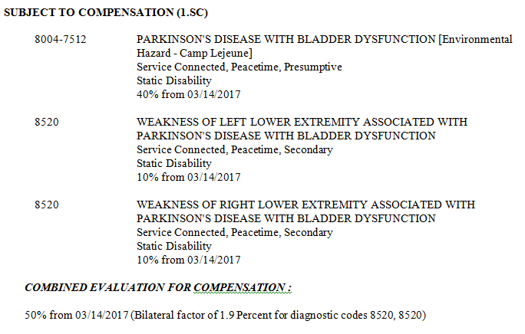
Neurological: Parkinson’s Disease
Evaluate residual disability similar to MS:
Evaluate each affected body system or body part separately
Show the DC for Parkinson’s only once by listing with the most severely affected function
Code involvement of other manifestations under their specific DC and show as secondary to PD.

Slide 32
Effective Date: March 14, 2017

Slide 33
38 CFR 3.114: Liberalizing Law
If criteria for eligibility for the liberalized benefit were met from the date of the law change, and
reviewed by VA or claimed by Veteran within one year of law change, effective date is date of law change.
reviewed by VA or claimed by Veteran more than one year after law change, effective date is one year prior to date of VA review/date of claim.

Slide 34
Scenario
The Veteran submits a claim for liver cancer on January 30, 2018. His DD-214 shows that he served honorably in the Marine Corps from 3/13/65 to 5/26/67. Personnel records show the Veteran was stationed at Camp Lejeune from April 1965 to September 1965.
In support of his claim he submits private treatment records that include laboratory tests confirming a diagnosis of liver cancer on August 9, 2014. Current treatment includes palliative chemotherapy. The Veteran is considered terminal.
What rating action should be taken?

Slide 35
Answer
Grant service connection for liver cancer with an evaluation of 100% effective March 14, 2017, the date of law change. The claim was received within one year of March 14, 2017 and the Veteran was diagnosed with liver cancer at the time of the change in law. DEA is warranted

Slide 36
Rating Requirements

Slide 37
Rating Requirements
When awarding or denying a claim due to exposure to contaminants in the Camp Lejeune water supply users must:
select the appropriate reason(s) for awarding or denying the claim in the DECISION BASIS
affix the Environmental Hazard-Camp Lejeune special issue in VBMS-R, and
insert the appropriate text as provided in M21-1 IV.ii.2.C.6.i or j.

Slide 38
Rating Requirements: Grants
If awarding a Camp Lejeune claim on a presumptive basis, the following text must be included in both the RATING NARRATIVE and NOTIFICATION LETTER user text fields:

Slide 39
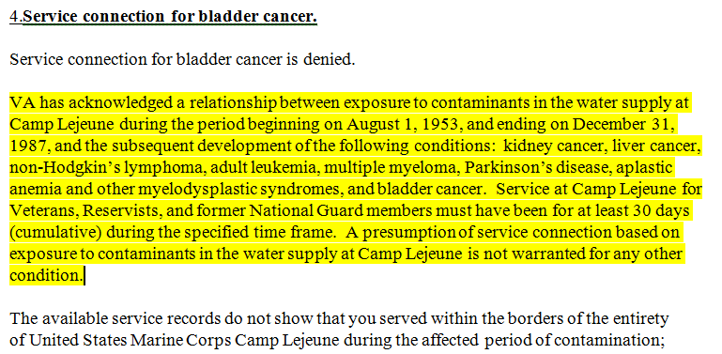
Rating Requirements: Denials
If denying a Camp Lejeune claim on a presumptive basis, the following text must be included in the RATING NARRATIVE field:

Slide 40
Rating Requirements: Denials
If denying a Camp Lejeune claim on a presumptive basis, all applicable denial reasons must be included in both the RATING NARRATIVE and NOTIFICATION LETTER user text fields:
The claimed disability is not a condition associated with exposure to contaminants at Camp Lejeune.
The Veteran did not serve at Camp Lejeune.
VA received a negative SME medical opinion.
The Veteran’s Camp Lejeune service was for less than 30 Days.
There is no diagnosis of the claimed condition.

Slide 41
Questions

