Slide 1

VSR IQR Checklist Training
Date: February 2017
Veterans Benefits Administration

Slide 2
Objectives
The AQRS will:
Understand the purpose for the task based checklist
Correctly perform a quality review using the task based checklist

Slide 3
Introduction
Task based reviews are intended to improve our local quality program by:
One checklist to review all VSR work
Checklist is more uniform with the work completed by a VSR
  VSRs assess claims as a whole, then decide what tasks are required
Enhanced error trend analysis
Allows us to focus VSR training on identified error trends

Slide 4
Highlighted changes
There are no non-critical errors
Overdevelopment is considered an error
Individual scope and actions will be considered while conducting reviews
Regardless of issues, EP, or team assigned; 11 “tasks” will be considered and counted
Each main task is an error; error descriptions are used to identify error trends

Slide 5
Checklist Instructions
All questions on the checklist must be answered for every review.
There are three possible answers for each of the eleven tasks:
  “Yes” indicates the activity associated with the question was completed accurately
  “No” indicates that the activity associated with the question was “in error”
  “NA” indicates:
    the question is not applicable to the case under review; or
    a “No” response would result in a cascade effect.

Slide 6
Checklist Instructions
A task is “in error” when an action taken, or lack of action, violates current regulations, policies, and procedures.
All errors or “No” response require an error narrative with supporting references.
When “No” is selected, multiple error descriptions can be selected.

Slide 7

Accuracy
A task is considered “accurate” if either “Yes” or “NA” is selected for that question.
A task is considered “in error” when “No” is selected for that question.
All 11 tasks are counted when determining accuracy.

Slide 8
Checklist Instructions
VSRs are reviewed for all actions taken or not taken up to that point.
  Overdevelopment completed previously by another VSR will not be cited on the current VSR under review.
Differences of opinions or best practices are not errors.

Slide 9
Cascading
The basis for one error is the same basis as a previously recorded error.
Errors are called based on the “root cause” error.
Errors are not called on subsequent errors that were caused by and were the direct result of that original error.
The “root error” is called as an error and the subsequent errors write as a remark.

Slide 10
Cascading Example 1
The VSR orders an unnecessary exam which in turn causes the tracked items to be incorrect. The QRS would call the error under Task 5 and would not call an error under Task 11 (unless an additional unrelated systems compliance error is identified). The QRS would input a remark regarding the tracked item.

Slide 11
Cascading Example 2
The effective date for a dependent is incorrect on the Veteran’s award which in turn effects the notification letter. The QRS would call the error under Task 8 and would not call an error under Task 10 (unless an additional unrelated notification error is identified). The QRS would input a remark regarding the notification letter.

Slide 12
Overdevelopment
Incorrect development that prevents the claim from progressing to the next stage (i.e., RFD or Auth).
Incorrect development that does not prevent the claim from progressing is a remark.
Not an error if the result of a written deferral or directed development by RVSR, DRO, or BVA.

Slide 13
Overdevelopment Example 1
A VSR is working a claim for PTSD. A previous claim had been filed and a PIES O50 request had been done. The Veteran also has a Distinguished Flying Cross. The only action the VSR takes is to order the personnel records via PIES O50 and write a letter to the Veteran requesting these records in addition to requesting stressor information. An overdevelopment error would be called in Task 3 (federal records other than STRs).

Slide 14
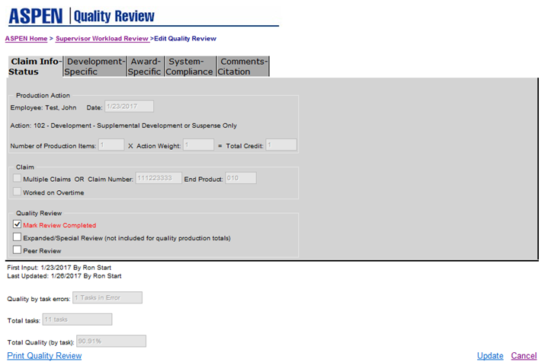
Checklist Tasks

Slide 15
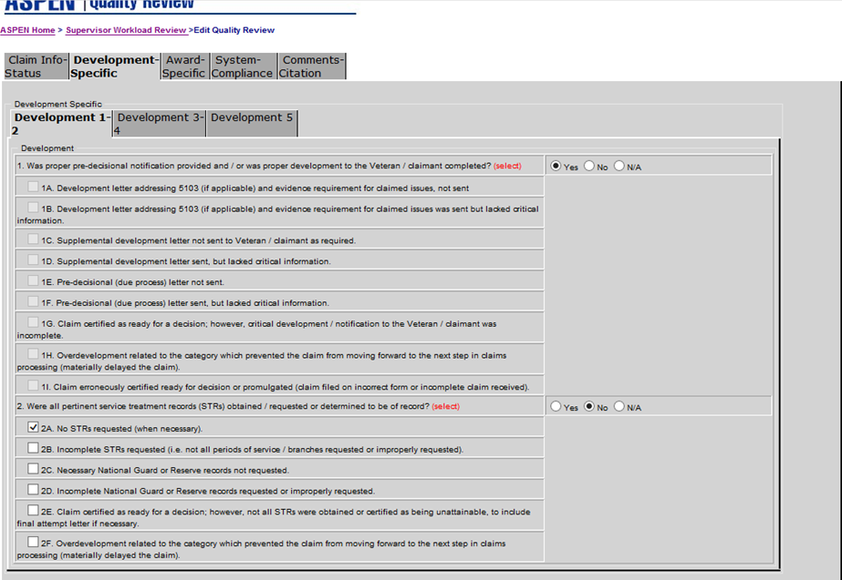
Checklist Tasks

Slide 16
1. Was proper pre-decisional notification provided and / or was proper development to the Veteran / claimant completed as required by regulations and/or the manual?
Includes 5103 notification
Required supplemental/follow-up letters
Appeal letters
Due Process
Dependency development/requests
RFA/ITF/Incomplete claims
Critical information- This is information (paragraphs) required by regulations and the manual to send to the veteran on how to support their claim
  i.e., PTSD stressor information, AO exposure and disability paragraphs, dependency requests
  Does not include the FDC exclusion paragraph

Slide 17
1. Was proper pre-decisional notification provided and / or was proper development to the Veteran / claimant completed as required by regulations and/or the manual?
Overdevelopment:
  Prevents a claim from moving forward to the next process (i.e., RFD and Auth)
  Overdevelopment would include sending additional 5103 or supplemental letter requesting information or evidence when not needed, therefor claim not able to be made RFD
  Another example of overdevelopment would be sending a letter requesting dependency information when all the required information was already of record

Slide 18
2. Were all pertinent service treatment records (STRs) obtained / requested or determined to be of record?
Includes when no STRs were requested or when only a portion of the STRs were requested
National Guard and Reserve records are included in this section
Final attempt letter (if necessary) must be of record
Overdevelopment could include submitting a PIES O50 request for STRs when they are already of record

Slide 19
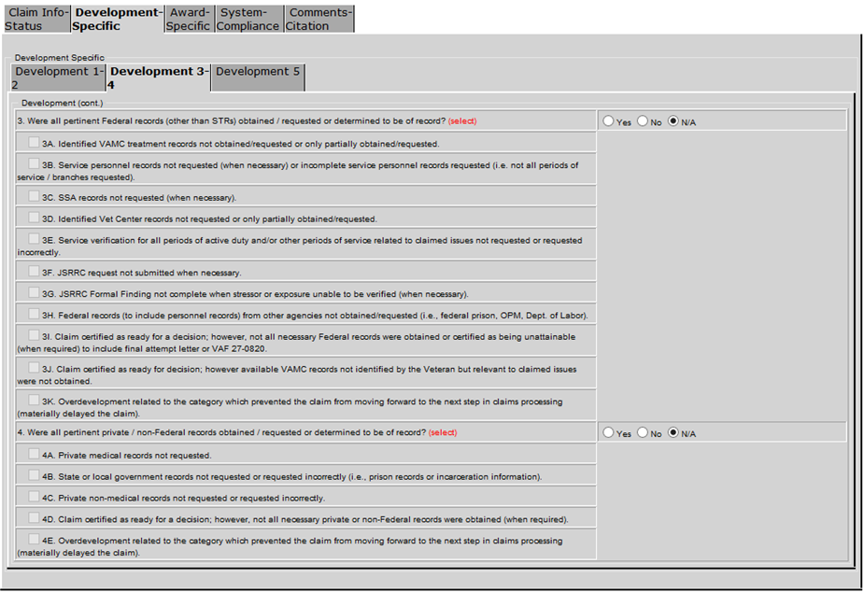
Checklist Tasks

Slide 20
3. Were all pertinent Federal records (other than STRs) obtained / requested or determined to be of record?
Service personnel records are included in this section.
Other federal records such as VAMC, SSA, Vet Center records etc.
JSRRC requests to include a JSRRC Formal Finding for stressor or exposure unable to be verified.
DPRIS screen shots will be necessary to show the completed requests.

Slide 21
3. Were all pertinent Federal records (other than STRs) obtained / requested or determined to be of record?
Final attempt letter and/or 27-0820 certifying that the federal records were unavailable
Verification of service
Overdevelopment could include requesting personnel records for RVN service when its is already of records (DD-214) or going out to JSRRC for AO verification when already of record

Slide 22
4. Were all pertinent private / non-Federal records obtained / requested or determined to be of record?
Private records not requested
  First and second attempt
Overdevelopment- requesting records that are already on file (even from previous claims)

Slide 23
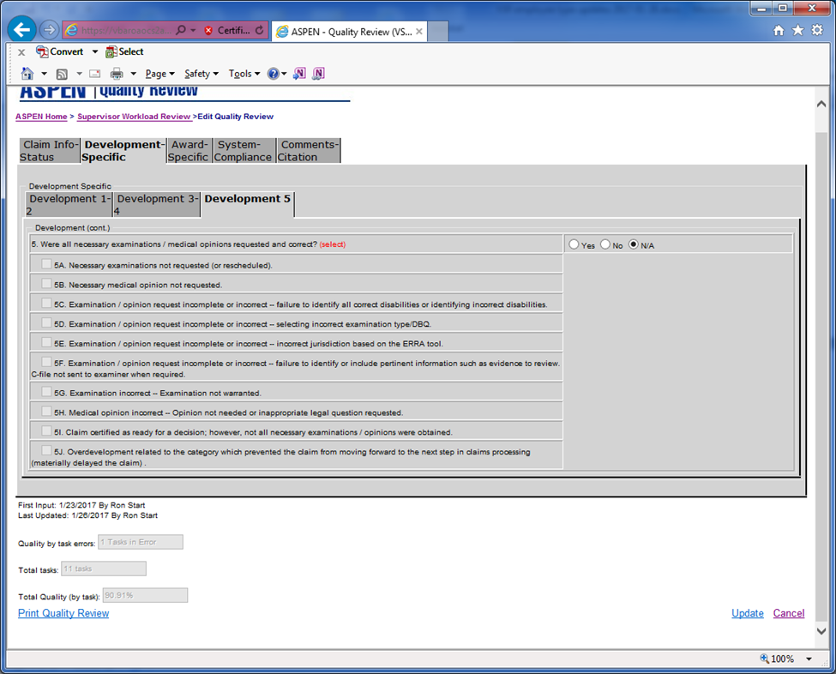
Checklist Tasks

Slide 24
5. Were all necessary examinations / medical opinions requested and correct?
Needed exams and opinions
Identifying all disabilities that need to be examined (more often in Gen Meds)
The correct DBQ needs to be selected
Jurisdiction (ERRA tool)
Failure to identify or include pertinent information (aka tabbing)
C-file review needed in specific situations (Mental TBI, opinions etc.)

Slide 25
5. Were all necessary examinations / medical opinions requested and correct?
Examination not warranted
  No basis for service connection
  Three prongs not met
  Evidence (private DBQ) of record
Opinion not warranted
Opinion written in legal verbiage
  Except when instructed by BVA or appeals

Slide 26
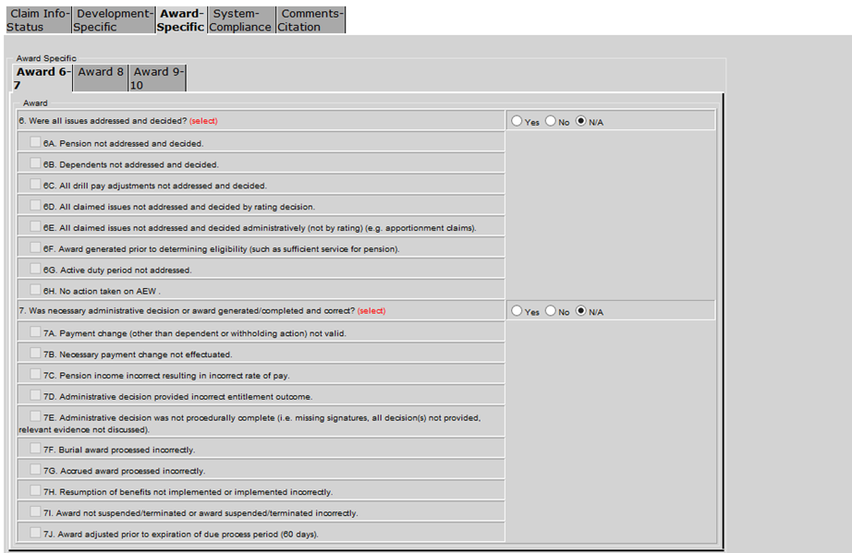
Checklist Tasks

Slide 27
6. Were all issues addressed and decided?
Covers claimed issues that were not addressed in any manner
Pension
Dependency (does not include adjustments)
Claimed disabilities not addressed by rating
Administrative claims addressed
Award generated prior to eligibility determination
AEW action

Slide 28
7. Was necessary administrative decision or award generated/completed and correct?
Payment change not valid or effectuated
Calculations of Pension income/expenses
Admin decision provides incorrect entitlement outcome or procedurally incorrect
Burial Awards & Accrued Awards
Resumption of benefits implementation
Award suspensions/terminations
Award adjustment prior to expiration of 60 day due process period

Slide 29
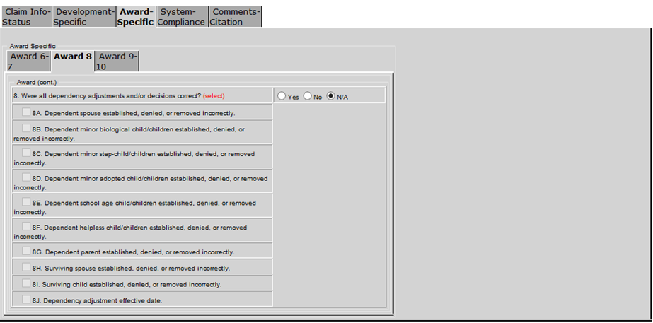
Checklist Tasks

Slide 30
8. Were all dependency adjustments and/or decisions correct?
Prematurely adding/removing dependent(s)
Adding ineligible dependent(s)
Removing or denying eligible dependents(s)
Incorrect dependency effective dates
  Unless effective date is due to incorrect effective date on rating code sheet
Erroneously changing dependent(s) status
Failing to change dependent(s) status
Incorrect future date for removal or change in dependent(s) status

Slide 31
8. Were all dependency adjustments and/or decisions correct?
Note: if multiple dependency issue are involved, only mark the error descriptions that are in error.
For example, a Veteran submits a claim to establish a spouse, a biological child, and a stepchild. The VSR correctly added the spouse to the award; however, the biological child was added from an incorrect effective date and the stepchild was added without the Veteran furnishing requested necessary evidence to establish entitlement. The reviewer would mark off error descriptions 8C and 8J.

Slide 32
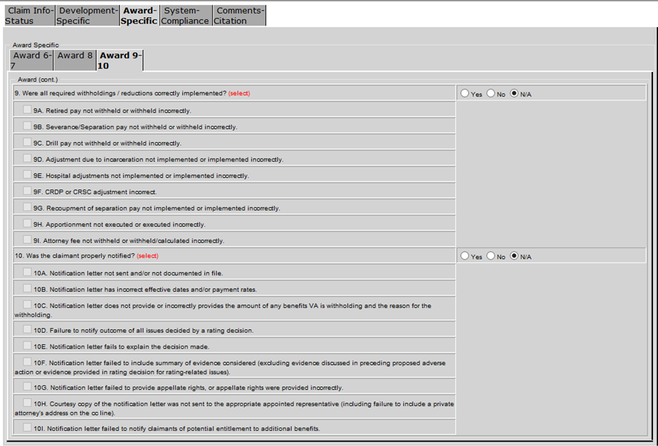
Checklist Tasks

Slide 33
9. Were all required withholdings / reductions correctly implemented?
Withholdings/Reductions
  Retired pay
  Severance pay
  Drill Pay
  Incarceration
  Hospital adjustments
  CRDP/CRSC
  Separation pay
  Apportionment
  Attorney fee

Slide 34
10. Was the claimant properly notified?
Notification errors sent an in the file
Correct effective dates and payment rates
Withholding reasons
Failure to notify veteran/claimant of the decisions that were made (rating or admin)
Evidence considered
Appeal rights when required or sent appeal rights when not warranted
POAs must be included in our notifications
Additional entitlement notifications

Slide 35
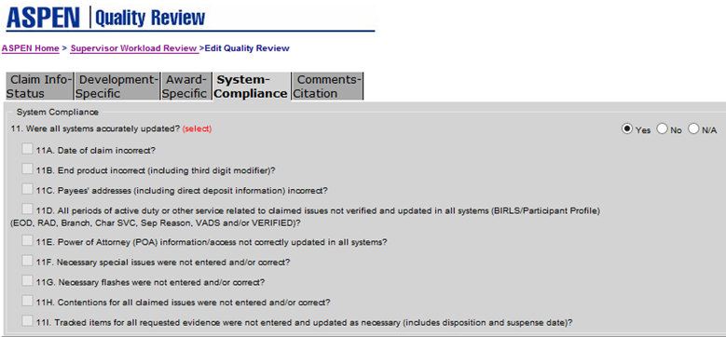
Checklist Tasks

Slide 36
11. Were all systems accurately updated?
9 systems compliance error descriptions
  Date of Claim
  End Product
  Payee Addresses
  Service (BIRLS and Participant Profile)
  Power of Attorney
  Special Issues
  Corporate Flashes
  Contentions
  Tracked Items

Slide 37
11. Were all systems accurately updated?
Only deficiencies that fall under the nine error descriptions are considered errors.
Any deficiencies that do not fall under the nine error descriptions are should be corrected, however no error will be called.
Only designated special issues and corporate flashes are errors. All others should be corrected, however no error will be called.

Slide 38
Corporate Flashes
38 USC 1151
Amyotrophic Lateral Sclerosis
Attorney Fee
BVA Decision
Blind
C-123
Camp Lejeune Veteran
Clear and Unmistakable Error
Committee on Waiver Case
Congressional
Death in Service
Denied – Fraud
Disappearance of Veteran
FBI Case
Foreign Claim
Forfeiture Case
Hardship
Homeless
IDES Participant
Incarceration
Locked File
Multiple Active POAs
OIG Case
Office of Investigation, Central Office
POW
Potential Attorney Fee
Potentially Dangerous
Priority Processing - Veteran 85 or older
Private Attorney - Fees Payable
Private Attorney - No Fees Payable
Restricted Access
Returned to Active Duty
Secret Service Case
Sensitive Level 6
Seriously Injured/Very Seriously Injured
TBI Equitable Relief Review
Terminally Ill
Terminated - Fraud
Traumatic Brain Injury
VA Employee

Slide 39
Special Issues
38 USC 1151
Administrative Decision Review - Level 1
Administrative Decision Review - Level 2
Agent Orange - Vietnam
Agent Orange - outside Vietnam or unknown
Amyotrophic Lateral Sclerosis (ALS)
Asbestos
Burn Pit Exposure
C-123
ChemBio
Compensation Service Review
Disability Benefits Questionnaire - Private
Disability Benefits Questionnaire - VA
Environmental Hazard - Camp Lejeune
Environmental Hazard in Gulf War
Fully Developed Claim
Hepatitis C
IDES Transfer to DRAS
JSRRC Request
Local Mentor Review
Local Quality Review
Military Sexual Trauma (MST)
POW
PTSD - Combat
PTSD - Non-Combat
PTSD - Personal Trauma
Pre-Discharge Consolidated Action
Quick Pay
RVSR Examination
Radiation
Rating Decision Review - Level 1
Rating Decision Review - Level 2
SHAD
Specialized Records Request
VACO Special issue 1
VACO Special issue 2
VACO Special Issue 3
VACO Special Issue 4

Slide 40
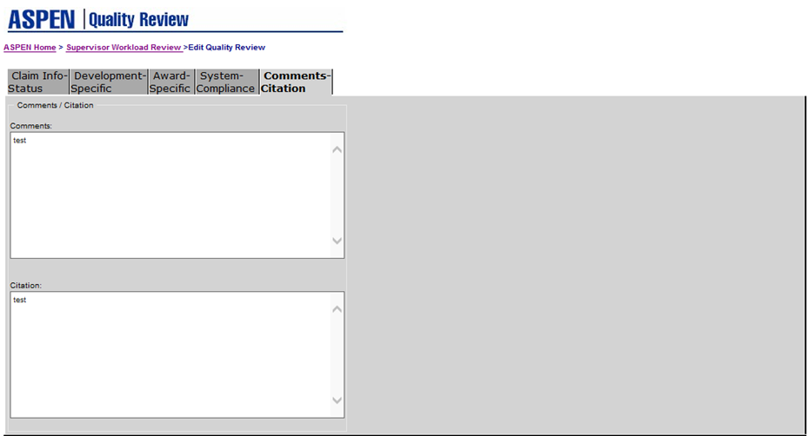
Checklist Tasks

Slide 41


Accuracy Example
A development action selected for a quality review required the VSR to request an exam, STRs, PMRs, and obtain VAMC records. The VSR took the correct development actions; however, they did not input the tracked items. Tasks 2, 3, 4, & 5 would be marked as “Yes.” Tasks 1, 6, 7, 8, 9, & 10 would be marked as “NA”. Task 11 would be marked as “No.”

Slide 42

Discussion and Questions
Email questions to:
VAVBAWAS/CO/QRT

