Slide 1
Sound Check
New Manager Training Skype Session Call will begin momentarily
A facilitator is currently talking. If you cannot hear, please place a ‘sad face’ emoticon in the chat box
Notes:
Narrator – Dale Sagotsky(15 / 7 mins)
Slide Instructions –
Open Lync/slide 15 minutes before call begins
Start Video when call begins (office start time of call)
Place all participants microphones in lecture mode (mute)
Slide Notes – Copy text “A facilitator is currently talking. If you cannot hear, please place a ‘sad face’ emoticon in the chat box.”
Slide Narration –
Hello, Welcome to the New Manager Training Lync Session Call. The call will begin in (15 /7 start time) minutes.
Please remember to mute your microphones when you are not speaking.
If you are calling in by phone, please ensure your microphone and speaker on your computer is muted. This will prevent feedback
Please do not use the Instant Message window for general discussion or commentary as it can be distracting to the audience and presenter.
Please post questions at the end of the call during the Q&A portion. Questions will be answered in the order they are received, within the remaining time of the Hotline call.
The video is currently active and you should see the presenter. If you do not see the presenter, select Video at the top of your window to activate the video. Be sure to pause your video.
(omit at start time) Please stand by until the call begins.

Slide 2

Welcome and Coaching Program Overview
VR&E New Manager Training
Briefed by:
NMT Subject Matter Expert Facilitators
THIS EVENT IS BEING RECORDED
Updated: January 07, 2020
Notes:
Dale –Today’s session will be an introduction to New Managers Training and an overview of the Coaching Program.

Slide 3
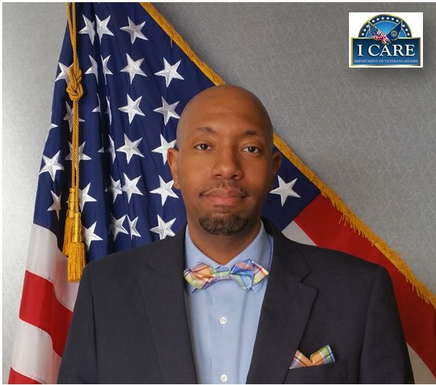
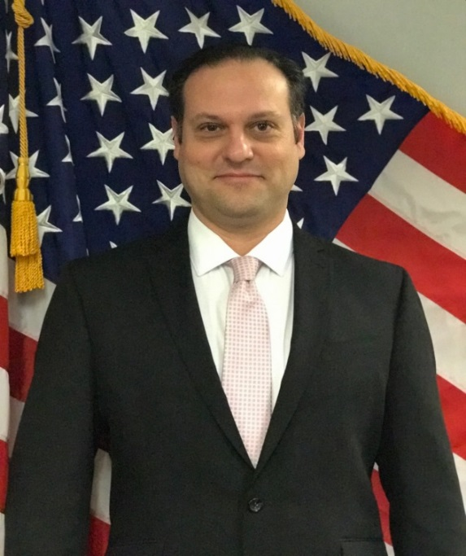

Presenters
Lamoyd Figures
VR&E Training Specialist
Orlando, FL
Dale Sagotsky
VR&E Training Specialist
Orlando, FL
Notes:
Welcome to NMT Session 1 for FY 2020. We are your facilitators with the VR&E Central Office Training Team.
Dale – intro – background info
Lamoyd – intro background info

Slide 4
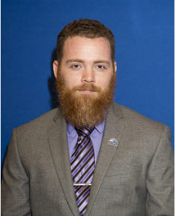
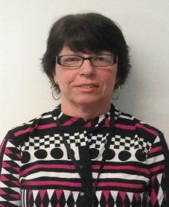
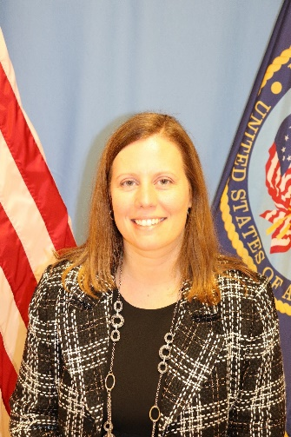
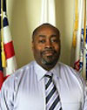
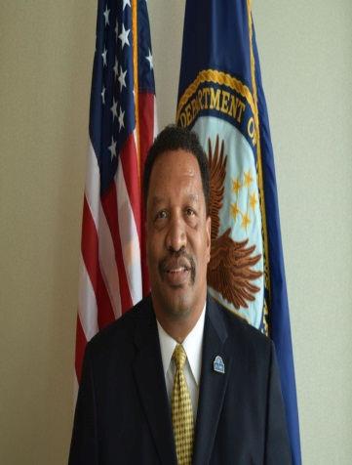
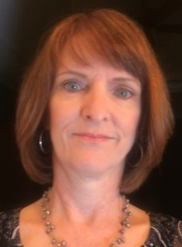
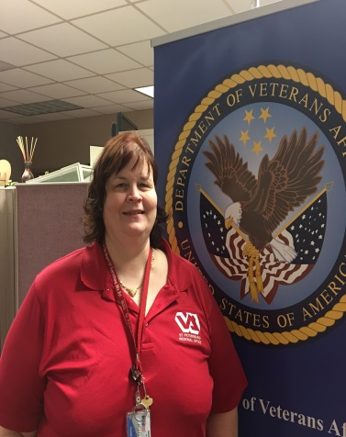
Subject Matter Experts
James Lester
Columbia VREO
Linda Steffensmeier
St. Paul VREO
Heather Becker
Buffalo AVREO
Rodney Hackney Oakland VREO
Kim Lloyd
St. Petersburg VREO
David Boyd
Seattle VREO
Tonna Mustian
Nashville VREO
Notes:
Dale
With that being said, I would like to inform you all of our subject matter experts for the NMT Program. (Name and introduce the SMES). These SMEs help to review, develop and facilitate virtual and in-person trainings to the newly hired division leaders. In addition to this, the SMEs also serve as coaches. We greatly applaud and appreciate all their efforts and assistance as we prepare to kick off this year of NMT training.

Slide 5

Introductions
What is your name?
What office are you from?
Name one thing interesting about the city where you work/live.
Please keep introduction to 15 seconds or less.
Notes:
Dale
I will be going through your names from the IM window and when I call on you, please provide your name, office and one interesting thing such as a hobby or something you would like to share about yourself to help others get to know you. Keep it pretty brief as we want to be able to get through everyone.

Slide 6
New Manager Training Participants
Station Number | Station | District | Employee Name | Position
NORTHEAST
301/373/405 | Boston/Manchester/WRJ | Northeast | Willett, Jenny | VREO
301/373/405 | Boston | Northeast | Schoenlein, Kate | AVREO
304 | Providence | Northeast | Williams, Danielle | SVRC
306 | New York | Northeast | Lopez, Ritchie | SVRC
308 | Hartford | Northeast | Bois, Donna | SVRC
308 | Hartford | Northeast | Fischer, Charleen | VREO
328 | Chicago | Northeast | Hubbard, Ersellia | AVREO
373 | Manchester/WRJ | Northeast | Nguyen, Teri | AVREO
SOUTHEAST
315 | Huntington | Southeast | Raphael, Megan | VREO
316 | Atlanta | Southeast | Wilson, Joetta | SVRC
318 | Winston Salem | Southeast | Allen, Veronica | SVRC
318 | Winston Salem | Southeast | Gorey, Vannalena | SVRC
318 | Winston Salem | Southeast | Penko, Christine | SVRC
318 | Winston Salem | Southeast | Piver, John | SVRC
CONTINENTAL
349 | Waco | Continental | Bynem, Shakesha | SVRC
349 | Waco | Continental | Ford, Shalonda | SVRC
349 | Waco | Continental | Muller-McIntyre, Lynne | SVRC
PACIFIC
343 | Oakland | Pacific | Gitten, Nicole | SVRC
343 | Oakland | Pacific | Thomas, Spencer | AVREO
344 | Los Angeles | Pacific | Castillo, Lauren | SVRC
345 | Phoenix | Pacific | Costello, Eric | AVREO
346 | Seattle | Pacific | Penna, Johnathan | SVRC
348 | Portland | Pacific | Athanas, Miya | AVREO
377 | San Diego | Pacific | Rogers, Michelle | SVRC
377 | San Diego | Pacific | Roundtree, Makita | SVRC
459 | Honolulu | Pacific | Hervieux, Andrew | SVRC
Notes:
Dale
Now that we have introduced ourselves, we would like to hear from you all (on the next slide). Please introduce yourself by giving us your name, station, job title and an fun fact or hobby.
The biographical data that you provided was reviewed and compared with the coaches biographical data. Later today, we will inform you of which coach you were paired with.
If anyone has not completed the bio or info sheet, just as a reminder, please submit your coaching information forms and biographies to Lamoyd and I.

Slide 7
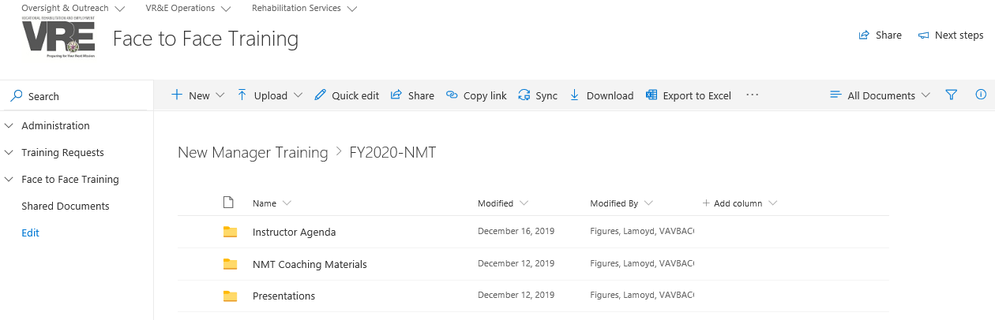
NMT SharePoint Site
https://dvagov.sharepoint.com/:f:/s/VBAVREService/SATI/train/F2F/Eu2vK1UZMBpEt7zkVK7KT1MBbB8dqN7yr-bg_S8fyW72Wg
Notes:
This is a screenshot of the NMT SharePoint Site.
FY2020-NMT folder houses all of the training materials and resources that will be used for all things related to NMT. The NMT Coaching Materials are also housed within this folder.

Slide 8
NMT TMS Courses
March 27th
VR&E New Manager Training Session 1 Courses | Learning Hours | TMS
Coaching Techniques that Inspire Coachees to Action | 0.40 | 4503931
Influence Others with Political Savvy | 0.40 | 4501159
Planning an Effective Performance Appraisal | 0.30 | 4501257
Developing a Plan to Further Your Career | 0.50 | 4501139
Managing Employee Development | 0.50 | 4501510
Effectively Directing and Delegating as a Manager | 0.50 | 4501254
Facing Virtual Team Challenges | 0.50 | 4502047
VR&E New Manager Training Session 2 Courses
The Reality of Being a First-time Manager | 0.40 | 4501252
Facing Challenges as a First-time Manager | 0.30 | 4501253
Leveraging Emotional Intelligence | 0.50 | 4501242
Establishing Team Goals and Responsibilities, and Using Feedback Effectively | 0.50 | 4501352
Take a Deep Breath and Manage Your Stress | 0.40 | 4501182
July 3rd
Notes:
Dale
The Independent Study must be completed by:
Session 1: Friday, March 27, 2020
Session 2: Friday, July 3, 2020
Independent Study includes:
NMT Talent Management System (TMS) Training – NMT TMS Courses will be assigned centrally from VR&E Service via TMS. If the courses are not automatically populated in your TMS To-Do List, please contact your VREO/AVREO and local Training Manager to verify that you have been added to the correct TMS Class.

Slide 9
Virtual Topics
Session 1 (April 2020) |  | Session 2 (Sept 2020)
VRE NMT: Preparing for Briefings | January 2020 | Welcome, Intro, Coaching Updates | May 2020
SAOs Part 1 | February 2020 | Program Oversight & Responsibilities | May 2020
SAOs Part 2 | February 2020 | Political Savvy | June 2020
Mid Year Performance Appraisals | March 2020 | Budget Management | June 2020
VR&E Modernization Initiatives: e-Authorization and e-Invoicing E-VA Updates Centralized Mail Active Folder Scanning Case Management Solution Updates | March 2020 | Human Resources Part 1 | July 2020
Global Perspective: VBA: Education Service Compensation Service Loan Guaranty Service Office of Field Operations | April 2020 | Human Resources Part 2 | July 2020
NMT TMS Capstone 1 | April 2020 | NMT TMS Capstone 2 | July 2020
NMT Director’s Briefing and Graduation | April 2020 | VR&E Service Overview Operations Overview Executive Front Office Overview Program and Policy Overview Employment and Collaboration Overview | August 2020
(All Sessions/Dates are pending approval) |  | NMT Director’s Briefing and Graduation | September 2020
Notes:
This is an overview of the Virtual Session schedule

Slide 10
Objectives
Upon completion of instruction, you will be able to:
  Understand an overview of Coaching
  Learn Coaching skills
  Determine roles for coaching
  Have knowledge of VR&E Coaching Requirements
Notes:
During this training, participants will be provided with the following information:
Coaching Overview
Coaching Skills
Determining Coaching Role
VR&E Coaching Requirements

Slide 11
Coaching Basics
What is “Coaching”?
What are the Benefits of Coaching?
How has Coaching benefited you?
Notes:
What is Coaching?
To be a good coach, you need a good understanding of what coaching is – for example, what roles you may need to adopt, what skills you need, and how to get an individual on board with coaching.
Coaching means different things to different people, but it's usually considered to be a dynamic collaborative relationship between a coach and a coachee. It also involves the coach and coachee communicating and interacting to help the coachee achieve growth, develop professionally, and improve performance.
The fact is, coaching can be perceived in many different ways. For instance, it might mean helping someone to set goals and achieve results.
Coaching can also involve sharing your wisdom and experience to help someone with less expertise.
And coaching can be as simple as offering feedback to help someone realize which steps are needed to improve performance.
Benefits of Coaching
And coaching has clear benefits – for your organization and you. When you improve your coaching skills, you'll be able to impart your knowledge onto your coachees.
As a result, your organization benefits from increased productivity, improvements in quality, and enhanced organizational strength. And you benefit as well. You'll learn new skills and improve your standard of work. Improving your coaching skills will help you gain confidence and probably lead to increased job satisfaction.
So coaching offers numerous benefits. But you should also recognize that the coaching role has its limits. Even though you want to help your coachees achieve their full potential, your goal isn't to be a trainer, counselor, or therapist.
Q: Based on the bios and coaching information that was collected, most of you all have participated as a coach and/or mentor before, please share how this type of relationship has benefited you?

Slide 12
Coaching Skills
Listening
Setting Goals
Questioning
Providing Support and Feedback
  Negative Feedback
Notes:
Listening:
If you want to be an effective coach, the first skill you need is the ability to listen. This is more than just passively taking in what the other person is saying. You should use active listening techniques to discern needs. For instance, listen for key words and repeat them back to ensure you've understood. And be aware of the other person's body language. If someone seems upset, don't make light of the situation. If the person is tense, try to create a less stressful atmosphere.
The most important part of listening is also the most challenging for many people. You should keep your own ideas to yourself until the other person has finished speaking.
This sends the powerful message that you're giving your full attention and that what the person has to say is valuable.
Another benefit of observing and listening with your full attention is that you'll naturally develop empathy for the person you're coaching. When you're able to put yourself in your coachee's shoes, you'll be more in tune with that person's feelings. This can help you identify which emotions might be behind a problem.
Without listening skills, there's a good chance the person you're coaching will feel like you don't care about her ideas or problems.
Setting Goals:
The second skill you need to be a good coach is the ability to help your coachee set goals. It's vital that you both agree on these goals.
For instance, the average (Number of Days to entitlement is 45 days). However, the Coachee RO is performing at 55 days to entitlement & the Coachee plans on reducing this number to an average of 37 days within one month. As a Coach, you may step in to help the coachee review the number of days to entitlement, to develop a more realistic goal that would get them closer to the actual performance standards with 3 months.
Coaching is, by nature, focused on goals. You need to be able to elicit clearly defined goals from your coachee. You can do this by asking questions from a goal-focused perspective. For example, you might ask your coachee how something he's doing helps him reach his goals. Or you might reframe problems as goals – if your coachee is having problems with a colleague, you could ask the coachee what's needed to improve that relationship.
You're probably familiar with the concept of SMART goals.
For your coachee to get anything meaningful out of the goal-setting process, goals must be specific, measurable, attainable, realistic, and time sensitive.
Questioning:
One of the best ways to find out how to approach a problem is to simply ask what the coachee thinks. That's why the third coaching skill, questioning, is so important. When you ask questions, you can elicit ideas from the coachee about how to approach a problem instead of imposing your own ideas. This is a key aspect of questioning – tapping into the coachee's creativity.
Asking questions can also focus the coachee's attention on a certain area. Maybe the person is having performance problems – if that's the case, you could ask questions to direct the coachee's attention to ways to improve performance. For instance, you could ask "What can you do to reduce the number of inactive Veterans on your caseload?"
Another benefit of asking questions is that it gives ownership of a problem to the coachee. Instead of telling the coachee how to solve a problem, you give the individual the tools to come up with ideas. This can foster a feeling of commitment in the coachee.
Providing Support and Feedback:
The final skill you need to be an effective coach is the ability to provide support and feedback. If your coachee is feeling discouraged or unable to complete a task, being an encouraging presence may be all that's required to get back on track. You can encourage a coachee by reassuring him of his ability to accomplish a goal, by showing you have confidence in him, and by not letting him give up. Even saying something as simple as "Don't give up" can be enough to restore confidence.
Providing feedback can be more challenging. The key is to deliver feedback that's specific and descriptive rather than vague and judgmental or subjective. You want to base your feedback on observed behavior and data.
For example, if you're giving feedback about a coachee's presentation, instead of just saying "Great job," which is vague, you should say something like "I really liked the way you answered those difficult questions during your presentation."
Negative Feedback:
Inevitably, you'll have to give negative feedback, and this can be difficult. Ensure you've already given positive feedback before moving on to the negatives. Then you won't seem like a coach who only criticizes and never praises. Commenting on the behavior and not the individual can also make negative feedback seem less harsh. Focus on what the coachee can do in the future rather than on past mistakes. And avoid blaming the coachee if something goes wrong – this only leads to defensiveness.
Positive feedback: "I really appreciate how you handled that difficult customer. It's not easy keeping your cool in a situation like that, but you were very professional. Well done!"
Negative feedback: "Organizing conferences is a big task. This was your first time. You got a great venue, but you miscalculated the number of people who would be attending. It's really important to double check those numbers in the future."

Slide 13
Your Role as a Coach
Career Development
Skills Acquisition
Performance Improvement
Change
Notes:
Your role will probably be different for each individual you coach. But you might ask yourself a few questions before you start coaching any individual:
What does this individual need and what do I hope to accomplish as a coach?
What are my unique strengths that make me a good coach?
What knowledge do I have that I'd like to share with others?
The answers to these questions can help you clarify your role.
You need to be able to quickly recognize what each individual needs from you as a coach. And when you're clear about your role, you'll be able to coach more effectively.
So how do you know which coaching role is best for dealing with an individual? Well, by observing employees in the workplace, you'll pick up on indicators that highlight opportunities for coaching.
Sometimes it can be tempting to assume that you should focus all your coaching energies on improving your coachee's performance. After all, this is often the area where your company wants to realize results.
But not everything you observe will be performance related. You need to watch carefully to get to the heart of the issues your coachee faces.
Whatever your mission is, it probably fits into one of four typical coaching roles:
1. coaching for career development,
2. coaching for skills acquisition,
3. coaching for performance improvement, and
4. coaching for change.
Career Development
Suppose an individual you're coaching completes tasks in minimum time and asks for more projects to work on. This person regularly takes on additional responsibilities and helps others, and often seems underutilized and bored. How would you coach such an individual? This is a great opportunity for you to support the employee by coaching for career development.
Take Margo, for instance. She's one of the VRCs on your SVRC’s outbased team, and your SVRC, Scott is coaching her.
Quite often, Margo finishes her work before noon and comes to Scott’s desk in search of extra projects.
Scott usually doesn't have anything else for her to work on, so he has Margo work on unimportant tasks.
Do you think Scott is satisfying Margo by giving her busy work? Probably not. If you find the person you're coaching is bored or asking for additional work, you have a chance to help develop this individual's career. You can do this by helping her find appropriate opportunities to take on more responsibility, suggesting she focus on a particular skill, or encouraging her to mentor others on the team.
After a coaching session with Scott, you assist him in understanding that Margo could be delegated more challenging task due to the fact that Margo is obviously being underutilized in her current position. Scott then begins to delegate some of his work such as preparing SAOs to Margo so she can gain additional skills to help her prepare for a move up in the organization.
In the meantime, Scott also arranges for Margo to work with all new VRCs, to coach and provide local training to them as needed.
Skills Acquisition
Another role is coaching for skills acquisition. An individual in need of this type of coaching might repeatedly make errors or have a backlog of work. This person usually doesn't achieve targets and standards and probably asks for assistance more than other employees. Someone fitting this description likely needs to acquire new skills, information, or experience.
If your coachee lacks the skills, experience, or information required to do the job, performance will likely falter. In this coaching role, you can guide the individual to learn how to perform tasks more quickly and figure out how to solve problems independently. You can also arrange for necessary training so the employee is better able to do the job well.
Performance Improvement
If your coachee is stuck in an ineffective routine, procrastinates, or lacks motivation, you have an opportunity to improve performance through coaching. Although skilled, employees like Frank might have poor attendance and unsatisfying relationships with peers.
You could help him find a new way of working that helps him complete tasks faster or more easily.
You might also help him identify skills or talents that he can maximize.
Change
Perhaps your coachee has had a major upheaval of a personal nature. Or maybe the coachee is having a hard time dealing with organizational restructuring. Whatever the source of the change, many people have a hard time letting go of the past and moving on. That's where you come in – major changes often present good opportunities for coaching.
Consider Eric, for instance. He's worked as a VRC only doing intakes and entitlement decisions.
A few months ago, the you as the new VREO completely restructured the alignment of cases and is transitioning to where all VRCs will provide intakes, entitlement decisions, case management and employment services. Because of this decision, Eric had to take a different position.
Even though he's been doing his new job for some time, he seems to be having a hard time dealing with the change. He's not comfortable in his new role, and he's on the verge of quitting.
When an employee like Eric is having trouble adapting to change, a coach can help the individual manage the change dynamics in a way that's comfortable for him.
You talk to Eric about how he can let go of the past and take charge of his future. Yes, he is no longer just doing a job he did for many years. But the new tasks offers different opportunities and areas for growth, and you show Eric how he can get ahead in a new capacity.
Even though he wishes the change didn't happen, Eric begins to realize how it can actually benefit him if he changes his mindset. He's no longer thinking about quitting but is working with other VRCs to learn his new tasks and responsibilities.
Pose these questions to participants and call on individuals to share their experiences with the rest of the group.
You might want to ask these additional questions to facilitate the discussion:
What change did you go through?
How did you handle it?
What mistakes did you make, if any?
How could you have handled it better?

Slide 14
Coaching-May Not Work
Resistant
Unwilling to Take Responsibility
Deeper Issues
Notes:
When it comes to coaching, you'll typically find yourself taking on one of the roles covered in this topic. Of course, how you use each will depend on the individual coachee. In some cases, you may find none of the roles will work. For instance, a potential coachee may be resistant to coaching. She might be unwilling to take responsibility or just wants a quick fix. And she might be facing other, deeper issues that can't be addressed with coaching. These can be difficult situations, and you'll need to use judgment about how to proceed.
Don’t forget, you are not on a VR&E island by yourself. Please feel free to reach out to your Coach or a Mentor to assist you. Trust me, utilize the connections that you make during this class to your sounding board to ask for assistance.

Slide 15

VR&E Coaching Requirements
Commitment
  Flexibility
  Minimum of one (1) hour per week
  Or independently scheduled arrangement
Forms
  Coaching Agreement
  Confidentiality Agreement
  Coaching Checklist
Notes:
Lamoyd Figures
In addition to the Coach/Coachee Roles, we would like to re-emphasize the main requirement to make sure that this partnership is a success.
The number one requirement is commitment. In order to be successful we request that the coachs/coachees spend at lease one (1) hour per week consulting with each other. Topics can range from a host of subjects but should be related to VRE Division management or professional development activities.
Forms
The coaching agreement form basically indicates when where and how you and your coach will be meeting.
The confidentiality agreement form details the confidential terms and clauses of the meetings with your and your coach
The coaching checklist is a guide to assist you and coach with covering recommended job related tasks and topics.
Please note: All of the above forms must be signed and completed by you and your coach. The coaching agreement form should be submitted to Terry or I by Session 1 Residential Training and the coaching checklist should be completed by the end of your 12 month official coaching relationship.
If at any time you feel as if this relationship is not beneficial, please do not hesitate to contact me or Lamoyd to discuss further options.
Please understand that the fostering of this relationship is pivotal to the success of the new manger, the division, VR&E Service and ultimately the Veteran/Servicemember.

Slide 16
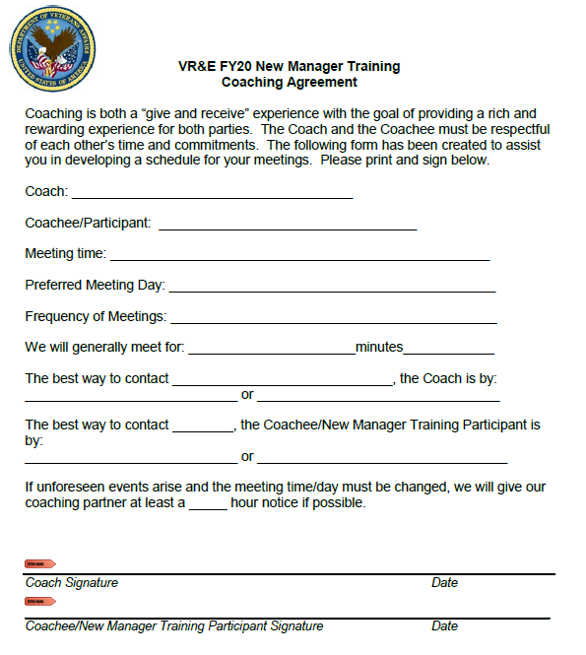
Coaching Agreement

Slide 17
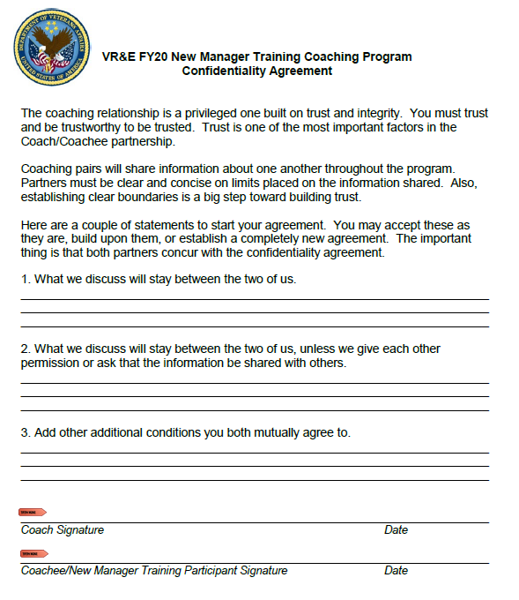
Confidentiality Agreement

Slide 18
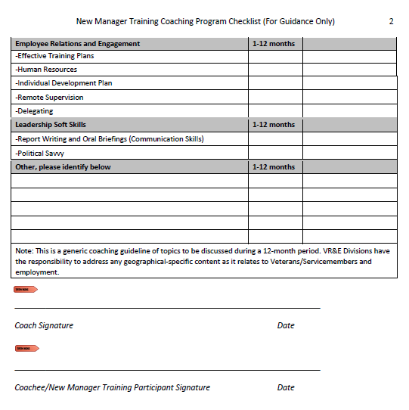
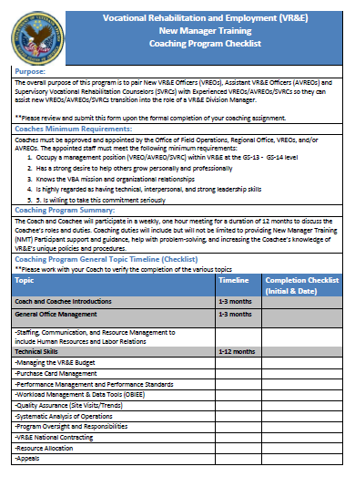
Coaching Checklist (Job Aid)

Slide 19
Coaching Pairing Updates

Slide 20

Questions/Discussion
Next NMT Skype Sessions:
NMT Preparing for Briefings
Tuesday, January 21, 2020 @ 11-12:30 PM ET
SAO Part I
Tuesday, February 4, 2020 @ 11-12:30 PM ET
SAO Part II
Tuesday, February 18, 2020 @ 11-12:30 PM ET
Mid Year Appraisals
Tuesday, March 3, 2020 @ 11-12:30 PM ET
VR&E Modernization Initiatives: e-Authorization and e-Invoicing and e-VA Update
Tuesday, March 17, 2020 @ 11-12:30 PM ET
TMS # 4209828
Coaching Overview
Notes:
Any questions.
TMS Info: Please complete the feedback survey.

