Slide 1
VA Examination Requests – IDES MSC
Compensation Service
October 2016

Slide 2
Lesson Objectives
Identify VA IDES examination request procedures.
Identify VA IDES post examination request procedures.

Slide 3
References
M21-1, Part III, Subpart i, Chapter 2, Section D.6, Requesting Examinations for IDES Participants
M21-1, Part III, Subpart I, Chapter 2, Section D.7, Handling IDES Examination Reports and Other Evidence
M21-1, Part III, Subpart iv, Chapter 3, Section A.13.c. General Medical Examinations and the SHA
M21-1, Part III, Subpart iv, Chapter 3, Section A.15.e, Bookmarking Documents for Examiner Review
M21-1, Part III, Subpart i, 2, F - Special Situations Related to the Integrated Disability Evaluation System (IDES)

Slide 4
Prerequisites
Prior to requesting a VA exam, the MSC ensures the following have been completed
proper referral from the PEBLO has been received
Service Treatment Records (STRs) are reviewed bookmarked, annotated, and tabbed
initial interview with Service Member has been completed
VA Form 21-0819 has been completed
All referred and claimed contentions have been entered into VBMS under EP 689

Slide 5
IDES VA Exam Requests
Request a VA exam for each potentially unfitting condition indicated in Section I of VA Form 21-0819.
At each IDES location, a local agreement specifies whether VHA to include VHA fee-basis examiners, VBA, or DoD is responsibility for conducting IDES examinations.
MSCs must submit examination requests to the specific providers noted in local agreements.

Slide 6
Determine appropriate IDES exam location
If VHA facility
  submit exam request through CAPRI
If Contract facility
  submit exam through Centralized Administrative Accounting Transaction System (CAATS)
If DoD facility
  notify PEBLO of required exams, and PEBLO will
  schedules the examination(s)
  notifies the MSC and participant of the date(s) and time(s) of the examination(s), and
  ensures the examination(s) is(are) completed.
Note: MSCs must submit examination requests to the specific providers noted in local agreements.

Slide 7
Mandatory use of Exam Request Builder (ERB)
The primary purpose of the Exam Request Builder (ERB) tool is to standardize the format for exam requests.
Mandatory use for VHA IDES Exams submitted in CAPRI
References: For additional information on exam requests in CAPRI, see M21-1, Part III, Subpart v, 6.G, and Compensation Service CAPRI Intranet Website

Slide 8
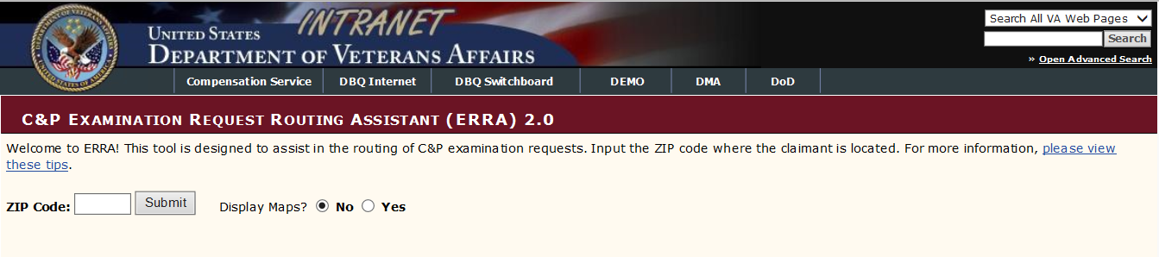
Examination Request Routing Assistant (ERRA)
MSCs must use ERRA tool to identify the exam provider nearest the participant with capability to complete the required exam when
the participant is not physically located at or near the referring MTF, and/or
the provider specified in the local agreement is unable to conduct the necessary examination(s).

Slide 9
IDES Exam categories
All IDES claimants receive a Separation Health Assessment (SHA) exam, and all appropriate Specialty exams
Audio
Eye
Mental disorders/ post traumatic stress disorder (PTSD) (Initial)
Dental (trauma only)
Traumatic Brain Injury (TBI)
Any other necessary specialty exam determined by the examining physician

Slide 10
VA exam request format
Exam request must include the following content
  Integrated Disability Evaluation System (IDES) – Please expedite.
  Referred disabilities: [list all referred disabilities]
  Claimed disabilities: [list all claimed disabilities]
  Required Specialty examinations for referred disabilities:
    Identify all specialty examinations that are required to evaluate disabilities the participant’s service department referred to VA

Slide 11
VA exam request format, cont.
  As soon as the examinations are scheduled, please notify the MSC and PEBLO of the dates and times.
  MSC: [provide name, title, complete mailing address, phone and fax number, and e-mail address of MSC], and
  PEBLO: [provide name, location, phone and fax number, and e-mail address of the participant’s PEBLO] This is not in the manual. Do we still want them to add to the exam remarks?

Slide 12
VA exam request format, cont.
If VA is processing a participant’s case electronically, MSCs must also indicate in the REMARKS section of the request that
the participant has an eFolder instead of a paper claims folder, and,
the eFolder is accessible through Virtual VA or VBMS (whichever applies).

Slide 13
Remarks to avoid
When requesting a VA exam, avoid using the following remarks:
“Condition and/or Pain” vs. diagnosis
DBQ worksheet specifics
Insensitivity within narrative
VBA acronyms and abbreviations

Slide 14
IDES Exam Special situations
Pregnant IDES Participants
If the PEBLO or Service member indicate the participant is or may be pregnant, the MSC must advise that
Some conditions may or may not be examined
VA may defer a condition if not examined
The deferral will not adversely effect the final outcome
Notify VA of any changes, and
Participant should contact VA if VA defers any decisions then fails to follow up with her within 90 days after her delivery date.

Slide 15
IDES Exam Special situations cont.
MSC must include the following remarks in the exam request for pregnant participants
“Please be advised that this individual has indicated that she is currently pregnant. If the examining physician determines that this examination (or any part of this examination) is medically contraindicated, please clearly indicate which parts of the examination were not completed due to the pregnancy.
Further, the examiner should indicate the earliest point (in days following delivery) that the examination may be safely completed.”

Slide 16
IDES Exam Special situations cont.
MSCs will make a second request for examination of an IDES participant after her pregnancy ends if
the participant’s PEBLO or MEB requests the examination, and
the time period has passed during which previous examiners indicated examination was contraindicated due to pregnancy.
Note: provide the examination reports to the participant’s PEBLO, and update the MEDICAL EVALUATION END DATE field on the MSC tab in VTA to reflect the date they provided the examination reports to the PEBLO.

Slide 17
IDES Exam Special situations cont.
IDES Gulf War (GW) issues
The SHA examination will assess GW related issues, eliminating the need to conduct a GW general medical exam.
When GW issues are indicated in a pending IDES case, the entire examination request must be directed to VHA and submitted through CAPRI.

Slide 18
IDES Exam Special situations cont.
When GW issues are raised, MSCs must
  include the “Notice to Examiners” shown in M21-1, Part IV, Subpart ii, 1.E.2.m in the remarks sections of the examination request,
  replace “Veteran” with “service member” (if applicable), and
  identify the conditions claimed or referred that have been indicated as GW issues.

Slide 19
IDES Exam Special situations cont.
Severely Disabled Service members
If the MSCs, PEBLOs, and/or physicians at the referring Military Treatment Facility (MTF) determine a participant is too disabled to travel to an examination the MSC must
Notify the DRAS of jurisdiction that the participant is too disabled to travel to an examination, and
sends to the DRAS the participant’s
  STRs, and
  current inpatient/outpatient treatment records that refer to any claimed or referred disability.

Slide 20
IDES Exam Special situations cont.
DRAS will determine whether the evidence is sufficient for rating purposes within five (5) days. If evidence is sufficient, the MSC
notifies the participant’s PEBLO that examination of the participant is unnecessary, and
enters the date of notification into the medical evaluation and exam fields on the MSC tab in VTA
If evidence is insufficient for rating purposes, the MSC
Emails the Office of Transition, Employment, and Economic Impact (OTEEI) of the RVSR’s findings, and awaits further guidance from OTEEI

Slide 21
Accuracy of Information
Prior to sending the request, the MSC should match all referred and claimed conditions to the exam requests, and ensure all special remarks are included.
REVIEW ALL REQUESTS PRIOR TO SENDING TO THE EXAMINER!

Slide 22
Sample formatted ERB request

Slide 23
Sample formatted ERB request

Slide 24
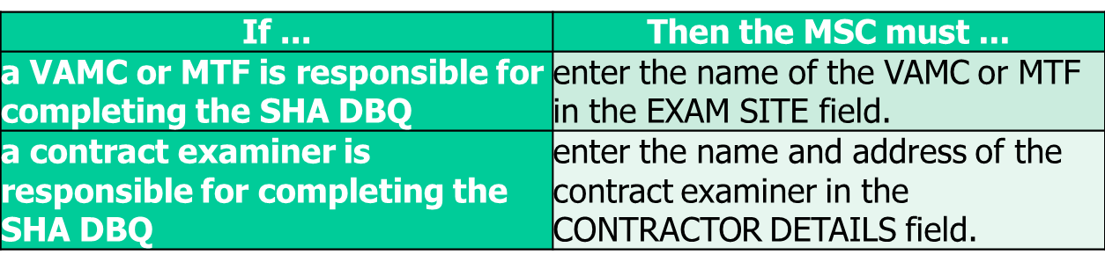
Exam tracking procedures
Track examination requests in VTA
entering the date the MSC submitted the request(s) for examination in the MEDICAL EVALUATION START DATE field, and
selecting the entity (VAMC, MTF, or QTC/Contract Provider) responsible for completing the SHA DBQ in the EXAM PROVIDER field.

Slide 25
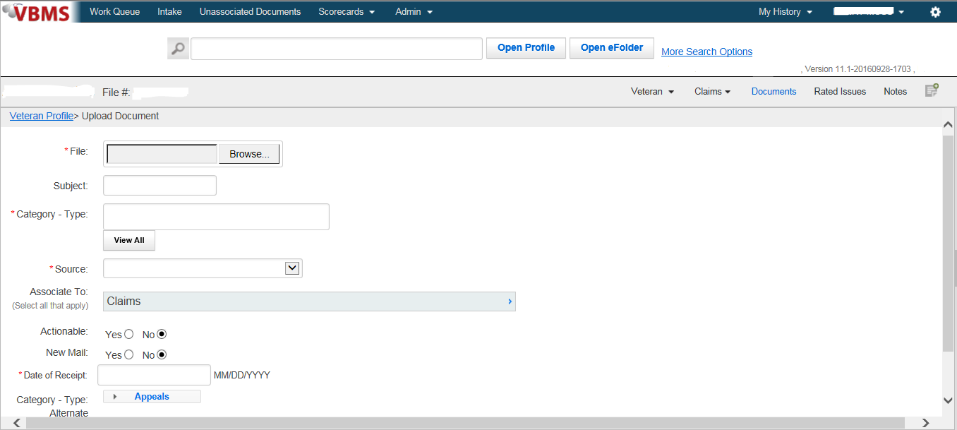
VBMS Tracking
Upload the examination request verbiage generated in CAPRI into VBMS.

Slide 26
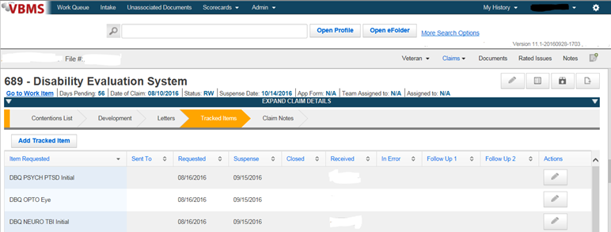
VBMS Tracking cont.
Add a tracked under the pending EP 689 for each examination requested.

Slide 27
Requirements for paper claim folder review
Both VHA and contract examiners must review the claims folder. As such, before shipping a paper claims folder to an examining facility, MSCs must
annotate IDES on a green sheet of paper and attach it to the front of the claims folder, and
update COVERS to reflect temporary transfer of the claims folder to the examining facility.

Slide 28
Medical Exam Requests Follow-Up
As the VA (VBA/VHA) is responsible for completing all examinations and providing results to the PEBLO within 45 days, at least once each week, MSCs must
run the Pending Exam Report in VTA, and
follow up on any examination requests that the report shows have been pending more than 35 days.

Slide 29
Actions once all examination reports are complete
MSCs must take the actions described in M21-1 Part III. Subpart i.2.D,7,e
Upload into eFolder
Ensure entire exam is available in VBMS and provide copies to PEBLO
Update VTA “med eval end date” field with date exams sent to PEBLO
Close tracked items
Ensure IDES Development Checklist is complete and uploaded into eFolder
Add the IDES Transfer to DRAS special issue indicator to one of the contentions in VBMS under EP 689. and Broker to DRAS

Slide 30
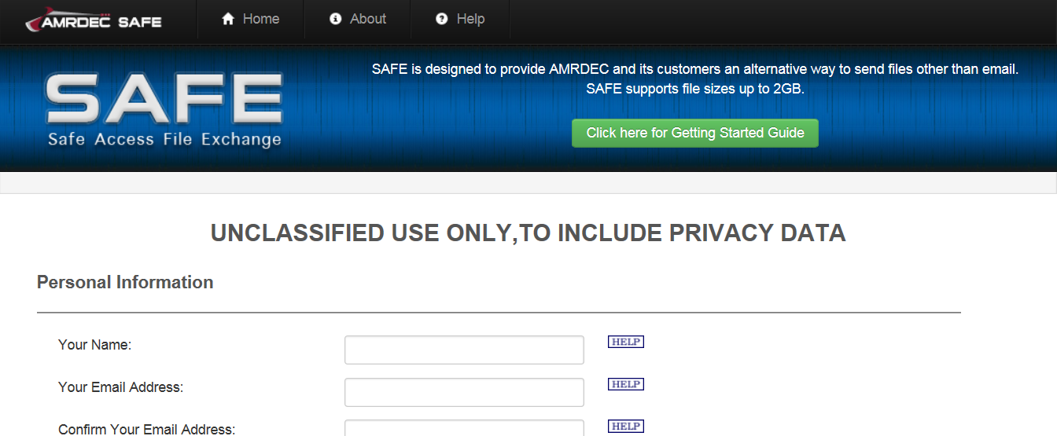
MSC Action Upon Return of Claims Folder From Exam Provider
Send all paper claims to be scanned into VBMS, and
Provide the examination reports to the PEBLO

Slide 31
DRAS Review of Examination Reports for Sufficiency
The DRAS will review the examinations and email the MSC that:
The examinations for IDES case have been reviewed and have been found to be sufficient for rating purposes, or
The examinations for IDES case] have been reviewed and have been found to be insufficient for rating purposes.

Slide 32
Examination Report Is Insufficient
If a DRAS reports that an IDES examination is insufficient for rating purposes, the MSC must
notify the participant’s PEBLO of the DRAS’s findings, and
provide the PEBLO with a copy of the new or revised VA examination report that replaces the insufficient report.
Note: The DRAS will complete follow-up actions to the examination facility for insufficient examination reports.

Slide 33
Review

Slide 34
Questions

