Slide 1
Compensation Service
January 2017
Introduction to Workload Management

Slide 2
Objectives
After this training, the VSR will be able to:
identify claims that require priority processing,
navigate ASPEN and input daily production and excluded time, and
sort and filter the VBMS Work Queue.

Slide 3
References
All M21-1 references are found in the CPKM Live Manual Website.
M21-1, Part III, Subpart ii, 1.D – Claims That Require Priority Processing
M21-4 Chapter 2 – Workflow Management
Subchapter I - Overview
Subchapter II – Claims and Appeals Workflow Management
M21-4 Chapter 4 – Claims and Appeals Processing Timelines

Slide 4
Claim/Claimant Types Requiring Priority
Any claims that meet one of the following criteria require priority processing:
Financial hardship
Homeless
Terminally ill
Former POW
Medal of Honor recipient
Older than 85 years of age
SI/VSI
The following claim types also require priority processing:
ALS
FDC

Slide 5
Priority Processing
Upon receipt of a claim requiring priority processing, the VSR must process this claim before any action is taken on a non-priority claim.
Priority claims should be aggressively managed by:
Frequently following up on all development,
Utilizing issue specific coordinators (e.g. homeless coordinator),
Utilizing telephone development whenever possible, and
Collaborating with any third parties (e.g. VAMC) to expedite development.

Slide 6
Adding Flashes
There are three different types of system flashes (M21-1 III.iii.1.D):
Claimant Flashes,
Claim Flashes (VBMS), and
Special Issue Flashes (VBMS)
Claimant flashes must be added using SHARE. VBMS currently only has functionality to view claims folder flashes.
Claimant flashes must be entered in the corporate record once the need is identified. Note: Most flashes are added by the end user, but some are generated by the system.
Notes:
Ensure that the instructor stresses that Claimant Flashes will exist on a claimant’s record until the flash is manually removed.

Slide 7
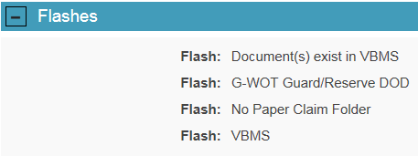
Viewing Flashes
Claimant flashes may be reviewed on the VBMS profile screen.

Slide 8
ASPEN – Entering Production
Production should be entered into ASPEN at the end of each day.
Each item completed should be listed separately.
You can add production retroactively (up to 7 days).
Notes:
Aspen has been known to glitch, so it is advised that each user keep a log of actions outside of Aspen.

Slide 9
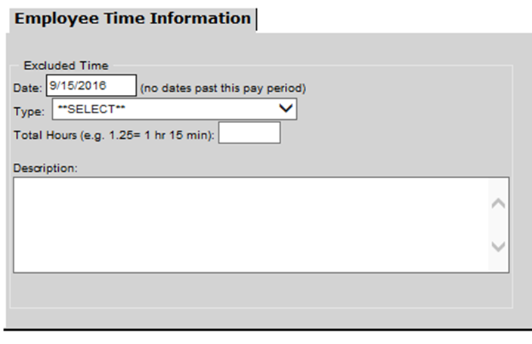
ASPEN – Entering Excluded Time
Excluded time is any time NOT
utilized for production.
Fill out all necessary fields
When finished, click Update

Slide 10
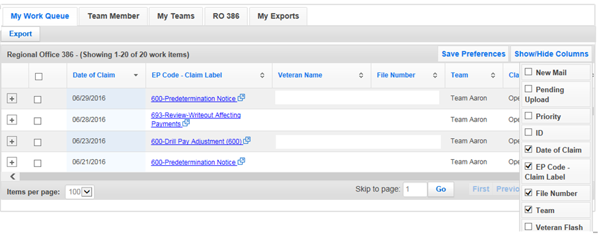
VBMS Work Queue - Columns
Click Show/Hide Columns
Choose which columns you want to show/hide
Click Save Preferences
3
1
2

Slide 11
VBMS Work Queue - Columns
While there are multiple sort column options on the VBMS Work Queue, the most helpful are:
Date of Claim (Default Sort)
EP Code – Claim Label
Suspense Reason
Claim Level Status
Days Assigned to User
VBMS allows user to sort multiple columns at once by holding shift while clicking the columns you wish to sort by.

Slide 12
VBMS Work Queue - Columns
Columns can be moved to fit the preference of the user by clicking the column to be moved and dragging it to the desired location in the work queue.

Slide 13
VBMS Work Queue - Filters
There are a large number of filters, but the following are particularly helpful:
Keyword
File Number
Claim Status
Lifecycle Phase
User defined filter

Slide 14
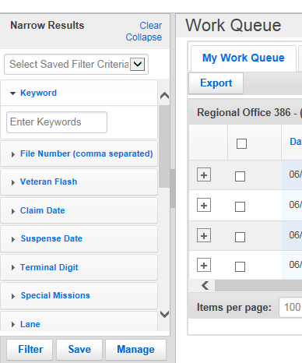
VBMS Work Queue - Filters
Once you have set up your filter(s):
To save filter criteria, click Save
To access your saved search, use the
drop down box
To edit/delete saved search criteria,
click Manage

Slide 15
VBMS Work Queue - Filters
Saved searches
Searches based on saved search criteria
Notes:
In this example the claims are sorted by a DOC more than 180 days from the current date. To select a saved search, select the appropriate saved search from the drop down list and VBMS will automatically sort based on the filter selections.

Slide 16
Questions?

