Slide 1
PMR Process: VSR Checklist
Compensation Service
October 2016

Slide 2
Objectives
Identify which private medical release (PMR) requests in VBMS did not go through Centralized Mail to the PMR contractor for processing.
Apply the steps in PMR Process: VSR Checklist.

Slide 3
References
M21-1, Part III. Subpart iii.1.C.7.a. Exhibit 2 PMR Process VSR Checklist
Private Medical Record (PMR) Retrieval Program Home Page

Slide 4
Medical Releases Not Sent to the PMR Contractor
PMR requests not received automatically through the Centralized Mail (CM) program:
VA Forms 21-4142 and 21-4142a received through Veterans On-Line Application (VONAPP) Direct Connect (VDC),
eBenefits uploads,
and non-standard medical release forms.
In these instances, the developing VSR will need to follow the steps in PMR Process: VSR Checklist. This ensures that the private medical release request forms will get processed by the contractor.

Slide 5
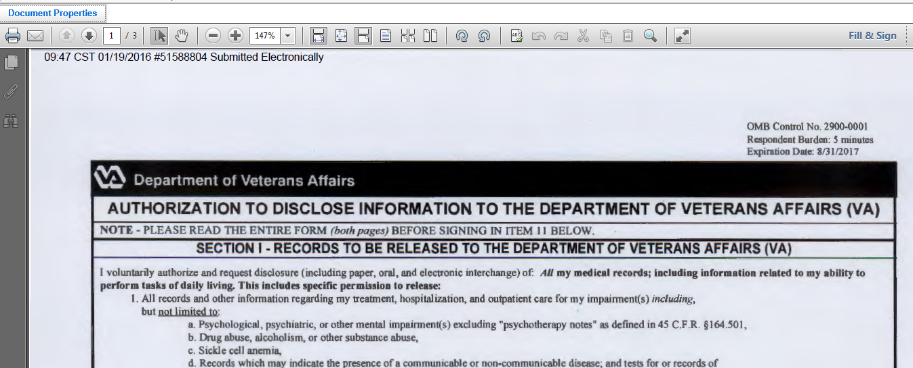
VDC 4142s
If the form did not get transmitted to DOMA, click Document Properties to review if the form is from VDC or eBenefits

Slide 6
VDC 4142s
Under Properties review if the form is from VDC

Slide 7
Non Standard Medical Release Requests
Some hospitals/private providers do not accept VA Form 21-4142 to release patient private medical records, they require their own release.
When a claimant submits a non-standard medical release request to support a VA claim, it does not go through Centralized Mail to the PMR contractor.
These releases will need to be identified in VBMS, and the steps on the PMR Process VSR Checklist need to be followed.

Slide 8
Non Standard Medical Release Requests: Example
Kaiser is an example of a private health care provider that sometimes requires their own release.

Slide 9
PMR Process: VSR Checklist
When the medical release request, which requires processing, has not been sent to the PMR contractor through Centralized Mail, the steps on the VSR Checklist should be followed.
This checklist is found at http://vbaw.vba.va.gov/bl/21/systems/pmr.htm

Slide 10
PMR Process: VSR Checklist Steps 1 - 3
The signature on the VA Form 21-4142 or other medical release form has to be the patient’s signature, unless the patient is a minor or has a legal representative to sign medical releases for them.

Slide 11
PMR Process: VSR Checklist Steps 4 - 6
Ensure that all mandatory fields as indicated are complete on the medical release.
Follow the naming convention guidelines to name the medical release to avoid delays in the PMR contractor processing. Save the document in a folder designated by the local management team. Only the PMR Super User will upload to PMR Vault.

Slide 12
Questions

