Slide 1
Compensation Service Training Staff
September 2016
Fully Developed Claims (Compensation) - Refresher

Slide 2
Objectives
After this training, the VSR will be able to:
process fully developed claims
exclude those claims that do not meet the criteria
determine the correct effective date for a grant of benefits
understand any new manual guidance
recognize common error trends

Slide 3
References
PL 112-154, Honoring America’s Veterans and Caring for Camp Lejeune Families
38 CFR 3.156 New and Material Evidence
M21-1, Part I, 1.B Duty to Notify Under 38 U.S.C. 5102 and 5103
M21-1, Part III, Subpart i, 3.A General Information About the Fully Developed Claim (FDC) Program
M21-1, Part III, Subpart i, 3.B Processing Fully Developed Claims (FDCs)

Slide 4
FDC Recap – Claim Forms
Claimants must complete and submit a VA Form 21-526EZ when filing for compensation
If the 526EZ does not contain contentions, it is considered an incomplete application
If the 526EZ is not signed, it is also considered an incomplete application
See M21-1, Part I. 1.B.1.e for instructions on processing incomplete applications

Slide 5
FDC Recap – Exclusions
The following are common FDC exclusion reasons:
the Veteran declines FDC processing
there is a claim or appeal already pending
the claim requires non-Federal development
the claim requires a character of discharge
the claim is a pre-discharge claim
the Veteran submits additional evidence, an additional claim, or an NOD after his claim
the Veteran fails to report for an exam and asks for it to be rescheduled
If the claim meets one of the exclusion criteria, we must update systems and send the Veteran notification of the exclusion

Slide 6
FDC Recap – Development
Generally, 5103 letters are not sent when a VA Form 21-526EZ has been received
However, development may still be needed to the Veteran or a third party
If a letter must be sent to the Veteran, the VSR should use the Supplemental Development Letter template

Slide 7
FDC Recap – Development
We will undertake the following development without exclusion from the FDC program:
all relevant Federal records
VA Form 21-4142&4142a for MTFs and Vet Centers
special issue claims
telephone contact
VA examinations
When developing, we must include the paragraph found in M21-1, Part III, Subpart I, 3.B.3.g

Slide 8
Revising FDC Exclusion Status
If we previously excluded the claim from the FDC program incorrectly or based on an outdated guidance, we should reinstate the claim into the FDC program
A claim that was included under the FDC program based on outdated guidance but does not meet inclusion criteria under current guidance should remain in the FDC program

Slide 9
FDC Recap – Effective Dates
Generally, the effective date for FDC grants is:
DOC
day after discharge
If the claim was filed between 08-06-13 and 08-05-15, a one year retro effective date can be established
If the original claim was included in the FDC program, we can still grant the one year retro effective date for:
a timely appeal of that claim
a timely request for reconsideration of that claim
a CUE found on that claim

Slide 10
New Manual Guidance
The Manual was recently updated with the following key changes:
An exclusion notification letter has been created in Letter Creator
Gulf War claims no longer require supplemental development. The 526EZ is sufficient
M21-1, Part III, Subpart i, 3.B.5.b applies to reconsiderations based on a previous FTR as long as the Veteran did not request the exam to be reordered during the original claim

Slide 11
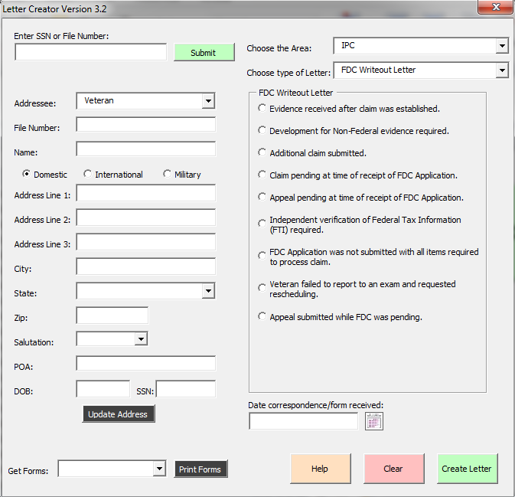
Letter Creator
The FDC Writeout Letter template
can be found under the IPC drop down
in Letter Creator
Enter in the Veteran’s information
Select the appropriate exclusion
reason

Slide 12
FTR Exam Reconsideration - Effective Date
Example: A Veteran files an original claim for a lower back condition on 7/13/2014. We order an exam but the Veteran does not show and an RVSR denies the claim. The Veteran comes in within a year and asks for reconsideration of his previous claim as he is now able to show for an exam. The Veteran shows for the second exam and an RVSR can grant the lower back condition. If medical evidence allows, the RVSR can grant the lower back condition effective 7/13/2013.

Slide 13
Error Trends – Error 1
Veteran filed an original claim for PTSD on 7/31/2015 on VA Form 21-526EZ
Veteran was discharged on 12/21/1969
There was no medical evidence showing that PTSD did not exist prior to the date of claim
There is no reason to exclude this claim from the FDC program
RVSR granted PTSD at 50% effective 7/31/2015

Slide 14
Error Trends – Error 1 (D1)
Effective date should have been 7/31/2014, one year retroactive from DOC
PL 112-154 Section 506

Slide 15
Error Trends – Error 2 (D1)
Veteran filed a new claim for bilateral hearing loss and tinnitus on 3/30/2015 on VA Form 21-526EZ
Veteran was discharged on 7/29/1982
There was no medical evidence showing that bilateral hearing loss or tinnitus did not exist prior to the date of claim
There is no reason to exclude this claim from the FDC program
RVSR granted tinnitus at 10% and bilateral hearing loss at 0% effective 3/30/2015

Slide 16
Error Trends – Error 2 (D1)
Effective date should have been 3/30/2015, date of claim
PL 112-154 Section 506 only applies to original claims

Slide 17
Error Trends – Error 3 (S1)
Veteran filed a original claim for service connection on 5/02/2016 on VA Form 21-526EZ
The Veteran checked box 25 on the VA Form 21-526EZ
The claim was not excluded from the FDC program

Slide 18
Error Trends – Error 3 (S1)
The claim should have been excluded from the FDC program
The Fully Developed Claim flash should have been removed and the FDC Excluded – Claimant declined FDC processing flash should have been added
M21-1 Part III, Subpart i, 3.B.2.a, d, & e

Slide 19
Error Trends – Error 4 (B2)
Veteran filed an original claim for PTSD based on MST on 4/15/2016 on VA Form 21-526EZ
Veteran also submitted a completed VA Form 21-0781a
There is no reason to exclude this claim from the FDC program
During 1st review, the VSR developed for the STRs and personnel file
During the 2nd review, the VSR developed for stressor details

Slide 20
Error Trends – Error 4 (B2)
Claim should have been routed to the Women’s Veteran Coordinator and MST development completed
M21-1, Part IV, Subpart ii, 1.D.5.e
M21-1, Part III, Subpart i, 3.B.3.e
Development for stressors should not have been done
M21-1, Part III, Subpart i, 3.B.3.d
When developing we must include the appropriate FDC development auto text
M21-1, Part III, Subpart i, 3.B.3.g

Slide 21
Questions?

