Slide 1
Benefits Delivery Network (BDN)

Slide 2
Overview of Today’s Training
The purpose of this lesson is to provide a better understanding of where to find BDN screen information and BDNSHELL functionality.

Slide 3
Lesson Objectives
At the end of this lesson, you will be able to:
Recall BDN location of claims processing information
Recall the function of various BDN commands
Identify the steps for modifying BDNSHELL

Slide 4
BDN Commands

Slide 5
BDN Commands Inquiry Commands
SINQ - Status inquiry, will default to any of the ones below
BINQ - BIRLS inquiry shows the location of a folder, and any military information at the NPRC
PINQ – Used to access the pending issues file inquiry (PIF)

Slide 6
BDN Commands Inquiry Commands
MINQ - Master record inquiry for education awards. Also accesses Department of Defense (DoD) records.
30D screen shows active duty information downloaded to our system by the DoD
DoD shows Guard/Reservist information downloaded to our system by Defense Manpower Data Center (DMDC)
M21 shows the education master record
M22 shows the education transaction history and payment history
M23 screen shows the entitlement used by the claimant
M01 is where you can change the collection code for debts

Slide 7
BDN Commands Adjudication Commands
CADJ – Claim adjudication, Sets up an end product to Adjudicate (work), or gives you access to one currently set up to be worked
GAD – Generate and display
GAP – Generate and print
UPD – Update
STOP - Stops/terminates an award. No further payments will be sent
CAUT – Claim authorization
CERT - Used to certify attendance (issue payment), without processing an award

Slide 8
BDN Commands Adjudication Commands
CADD - Changes address or add direct deposit information
CNAM - Changes name or stub name
BUPD – BIRLS update, updates the BIRLS screen information
CORR - Make corrections to an education Master Record
SUSP – Used to suspend a running master record
RESU – Used to resume a suspended master record (except for delinquent cert)

Slide 9
BDN Commands End Product Commands
PCAN – Pending EP cancel if there is no action necessary
PCHG - Pending EP change (e.g. 340 to 350, 200 to 210, etc...)
PCLR – Pending EP clear when you have to work a claim

Slide 10
Comprehension Check
What are some examples of BDN Commands we would use to adjudicate a claim?

Slide 11
BDN
Screens

Slide 12
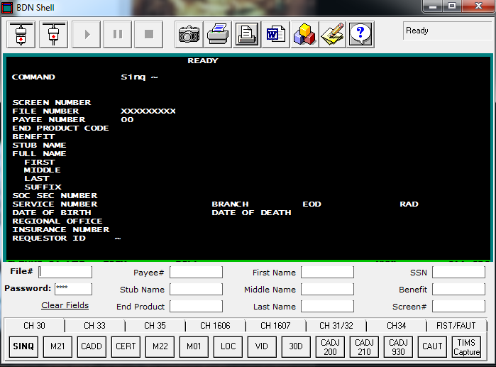
BDN Screens Ready Screen (F8)
The BDN fields circled (at top) are the commonly used editable fields and they correlate to the BDNSHELL fields circled across the bottom.

Slide 13
Status Inquiry
(SINQ)
Commands

Slide 14
Status Inquiry (SINQ) Commands
SINQ command uses:
Review claims for previous processing
Review master records (M/R) previously established
Review claims for pending end products (EP)

Slide 15
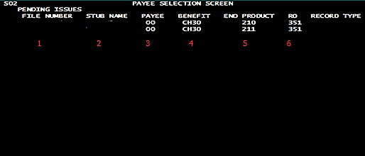
Status Inquiry (SINQ) Commands
What we see:
File Number
Stub Name
Payee Number
Benefit Type
Two Pending EPs Listed
Regional Office (RO) that Established the EP
SINQ command with multiple pending EPs on a single benefit.

Slide 16
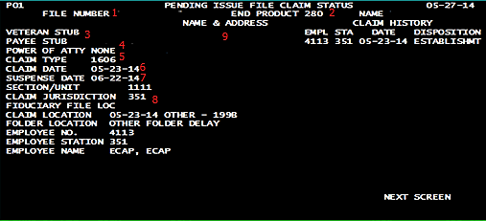
Status Inquiry (SINQ) Commands
What we see:
File Number
Pending EP
Stub Name
POA
Claim Type
Claim Date
Suspense Date
Claim Jurisdiction
Address
SINQ command with single EP.

Slide 17
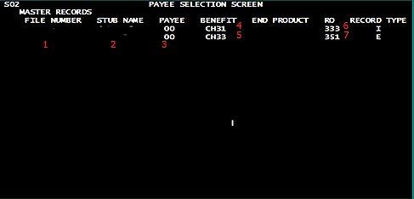
Status Inquiry (SINQ) Commands
What we see:
Benefits w/established M/Rs.
File Number
Stub Name
Payee Number
Benefit Type (Ch31)
Benefit Type (Ch33)
RO claim is under (333)
RO claim is under (351)
SINQ Command when no pending EP, but multiple benefits.

Slide 18
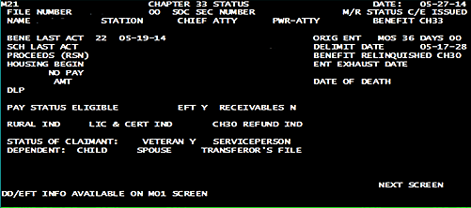
Status Inquiry (SINQ) Commands
What we See:
M/R for the single benefit that has been established (M21 screen), which will be covered in detail later.
SINQ Command with no pending EP and a single benefit.

Slide 19
BIRLS Inquiry
(BINQ)
Commands

Slide 20
BIRLS Inquiry (BINQ) Commands
Screens used for BINQ Command:
Location (LOC):
Types of claims that have established M/Rs
Locations of the claims
Prior location of claims
Veteran Identification Data (VID):
DoD Data
POA
Date of Birth (DOB)
Date of Death (DOD)

Slide 21
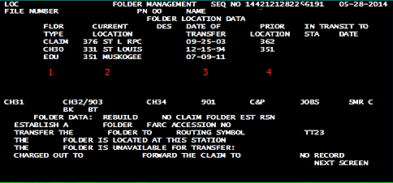
BIRLS Inquiry (BINQ) Commands
What we see:
VA File Type
Current Location
Date of Transfer
Previous Location
Command: BINQ
Screen Number: LOC

Slide 22
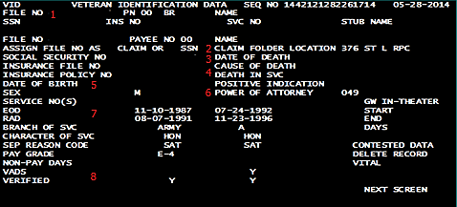
BIRLS Inquiry (BINQ) Commands
What we see:
DoD data.
File Number
Claim Folder Location
Date of Death
Death in Service
Date of Birth
POA
Service Information
Verification
Command: BINQ
Screen Number: VID

Slide 23
DoD
Master Record Inquiry
(MINQ)
Commands

Slide 24
DoD Master Record Inquiry (MINQ) Commands
Screens used for MINQ Commands:
Chapter 30 DoD data record (30D):
Ch30 eligibility
Service information
Ch30 KKR eligibility
Ch1606 DoD Data Record (DoD):
Ch1606 Eligibility
Ch1606 KKR Eligibility

Slide 25
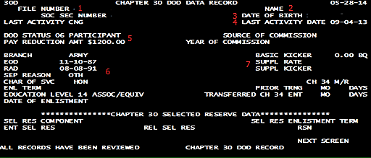
DoD Master Record Inquiry (MINQ) Commands
What we see:
DoD screen: Ch30 eligibility information.
File Number
Name
DOB
Last Activity Date
DoD Status and $1200
Service Information
KKR Information
Command: MINQ
Screen Number: 30D

Slide 26
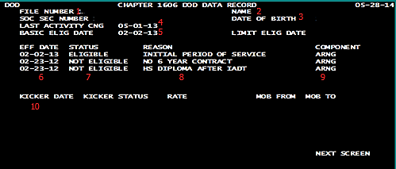
DoD Master Record Inquiry (MINQ) Commands
What we see:
DoD screen: Ch1606 eligibility information.
File Number
Name
DOB
Last Activity
Basic Eligibility
Effective Date
Eligibility Status
Reason
Component
KKR Eligibility
Command: MINQ
Screen Number: DOD

Slide 27
Comprehension Check
What is an example of a screen we would use the BINQ command to view in BDN?
What is an example of a DoD screen we would use the MINQ command to view in BDN?

Slide 28
Ch30/1606/1607 Master Record Inquiry
(MINQ) Commands

Slide 29
Ch30/1606/1607 Master Record Inquiry (MINQ) Commands
Screens used for CH30/1606/1607 MINQ Commands:
M21:
VA Master Record
Entitlement Information
School Attendance Information
Date Last Paid (DLP)
M22:
Transaction And Payment History
Payment Information
Transaction Information
M23:
Ch30 Eligibility And Entitlement
Information Pulled From 310
Entitlement Information
Dropped Priors
Cumulative Reduced/Restored

Slide 30
Ch30/1606/1607 Master Record Inquiry (MINQ) Commands
M01:
Deduction/Receivable/Balance/EFT Data
Debts
Collection Indicator
EFT Information
M20:
Dropped Priors
Terms no longer on M21 screen

Slide 31
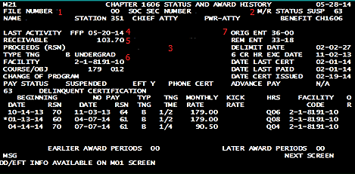
Ch30/1606/1607 Master Record Inquiry (MINQ) Commands
What we see:
File Number
M/R Status
Name and Address
Last Activity
Receivables/Proceeds
Type Training FAC/Course/OBJ
Original Entitlement Remaining Entitlement Delimiting Date
Command: MINQ
Screen Number: M21

Slide 32
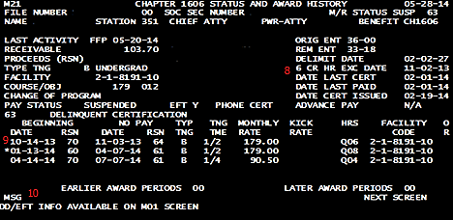
Ch30/1606/1607 Master Record Inquiry (MINQ) Commands
What we see continued:
6X Date/Date Last Cert/Date Last Paid
Enrollment Begin/End Dates/Reason Codes Training Time/Monthly Rate/Hours
Message Field
Command: MINQ
Screen Number: M21

Slide 33
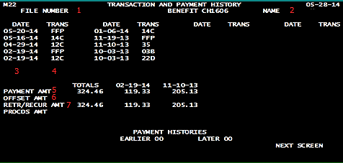
Ch30/1606/1607 Master Record Inquiry (MINQ) Commands
What we see:
File number
Name
Date of Transaction
Transaction Code
Payment Amount Due
Offset Amount
Actual Payment Issued
Command: MINQ
Screen Number: M22

Slide 34
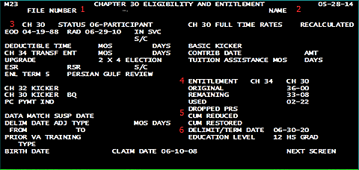
Ch30/1606/1607 Master Record Inquiry (MINQ) Commands
What we see:
File Number
Name
Ch30 Eligibility Status/Service Dates
Original Entitlement/ Remaining Entitlement Used Entitlement
Dropped Priors/ Cumulative Reduced and Restored Entitlement
Delimiting Date
Command: MINQ
Screen Number: M23
(Populated from the 310 screen)

Slide 35
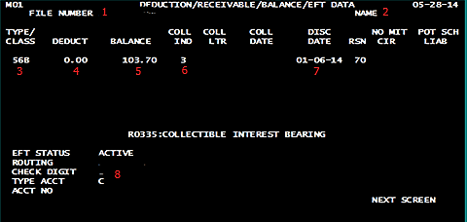
Ch30/1606/1607 Master Record Inquiry (MINQ) Commands
What we see:
File Number
Name
Type of Debt
Payment Plan Amounts
Debt Amount Remaining
Collection Indicator
Creation Date
EFT Information
Command: MINQ
Screen Number: M01

Slide 36
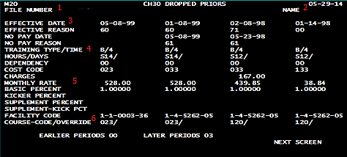
CH30/1606/1607 Master Record Inquiry (MINQ) Commands
What we see:
File Number
Name
Term Dates/Start and Stop Reason Codes
Type Training/Training Time/Hours
Monthly Rate/Rate of Pursuit
FAC/Course Code/Override
Command: MINQ
Screen Number: M20
(Accessible through F8 Ready Screen)

Slide 37
Comprehension Check
What information can be found on the M21 screen for Ch30/1606/1607 claims?
What information can be found on the M22 screen for Ch30/1606/1607 claims?

Slide 38
Ch33 Master Record Inquiry
(MINQ) Commands

Slide 39
Ch33 Master Record Inquiry (MINQ) Commands
Screens used for Ch33 MINQ Commands:
M21:
VA Master Record
Entitlement Information
Housing Award Information
Date Last Paid (DLP)
M22:
Transaction And Payment History
Payment Information
Transaction Information
M23:
Ch33 Claimant Transaction History
Transaction Dates
Transaction Codes

Slide 40
Ch33 Master Record Inquiry (MINQ) Commands
M24:
Ch33 School Transaction History
School Tuition and Fee Payments
Dates Payments Were Issued
M01:
Deduction/Receivable/Balance/EFT Data
Debts
Collection Indicator
EFT Information

Slide 41
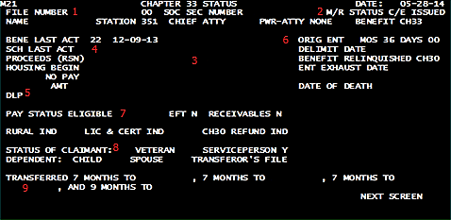
Ch33 Master Record Inquiry (MINQ) Commands
What we see:
File Number
Master Record Status
Name and Address
Last Activity Date/ Proceeds/ Housing
Date Last Paid
Original Entitlement/ Delimiting Date/ Benefit Relinquished
Pay Status
Claimant Status
Remarks
Command: MINQ
Screen Number: M21

Slide 42
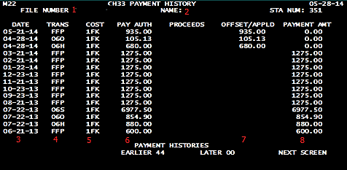
Ch33 Master Record Inquiry (MINQ) Commands
What we see:
File Number
Name
Payment Date
Transaction Type
Cost Code
Amount Due
Offsets Applied to Debts
Actual Payment Issued
Command: MINQ
Screen Number: M22

Slide 43
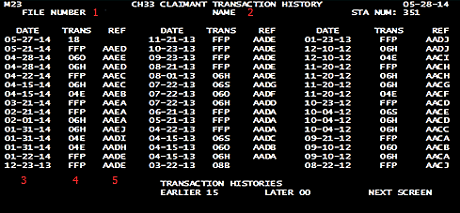
Ch33 Master Record Inquiry (MINQ) Commands
What we see:
File Number
Name
Date of Transaction
Transaction Type
Reference Code
Command: MINQ
Screen Number: M23

Slide 44
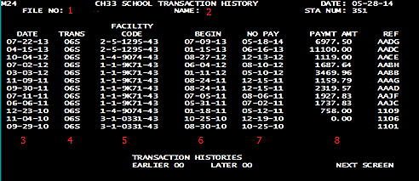
Ch33 Master Record Inquiry (MINQ) Commands
What we see:
File Number
Name
Date of Transaction
Transaction Code
Facility Code of School
Begin Date of Term
No Pay Date of Term
Payment Amount
Command: MINQ
Screen Number: M24

Slide 45
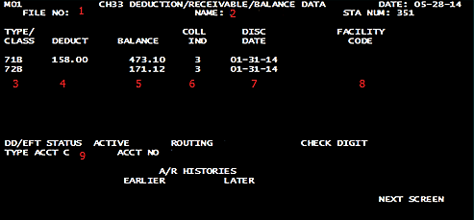
Ch33 Master Record Inquiry (MINQ) Commands
What we see:
File Number
Name
Type of Debt
Payment Plan Amounts
Debt Amount Remaining
Collection Indicator
Creation Date
Facility Code (T&F Debt Only)
EFT Information
Command: MINQ
Screen Number: M01

Slide 46
Comprehension Check
What information can be found on the M24 screen for Ch33 claims?
What information can be found on the M01 screen for Ch33 claims?

Slide 47
Ch35 Master Record Inquiry
(MINQ) Commands

Slide 48
Ch35 Master Record Inquiry (MINQ) Commands
Screens used for Ch35 MINQ Commands:
M21:
VA Master Record
Entitlement Information
School Attendance Information
Date Last Paid (DLP)
M22:
Edu M/R Award Status
Payment Information
Attendance dates and Monthly Rates

Slide 49
Ch35 Master Record Inquiry (MINQ) Commands
M23:
Education M/R Eligibility and Entitlement
Eligibility Information
Entitlement Information
M01:
Deduction/Receivable/ Balance/EFT Data
Debts
Collection Indicator
EFT Information

Slide 50
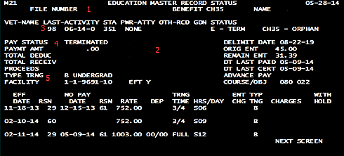
Ch35 Master Record Inquiry (MINQ) Commands
What we see:
File Number
Name and Address
Last Activity Date
Pay Status/Payment Amount/ Total Deduction/Total Receivables/ Proceeds
Type Training/ Facility Code
Command: MINQ
Screen Number: M21

Slide 51
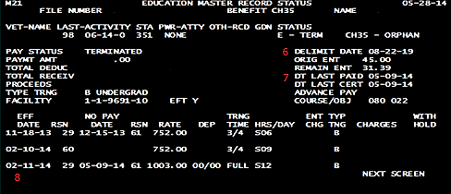
Ch35 Master Record Inquiry (MINQ) Commands
What we see:
Delimiting Date/ Original Entitlement/ Remaining Entitlement
Date Last Paid/Date Last Cert
School Attendance Information
Command: MINQ
Screen Number: M21

Slide 52
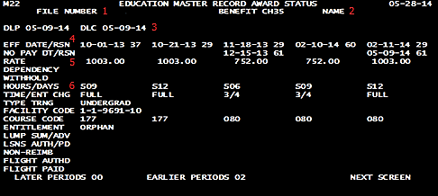
Ch35 Master Record Inquiry (MINQ) Commands
What we see:
File Number
Name
Date Last Paid/Date Last Cert
Start Date/No Pay Date for term
Monthly Rate
Hours/Time/Type Training/ FAC/Course Code
Command: MINQ
Screen Number: M22

Slide 53
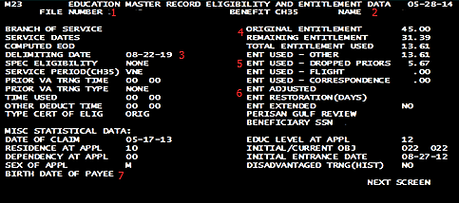
Ch35 Master Record Inquiry (MINQ) Commands
What we see:
File Number
Name
Delimiting Date
Original Entitlement/ Remaining Entitlement Used Entitlement
Dropped Priors
Entitlement Adjusted/ Entitlement Restored
Payee Birth Date
Command: MINQ
Screen Number: M23

Slide 54
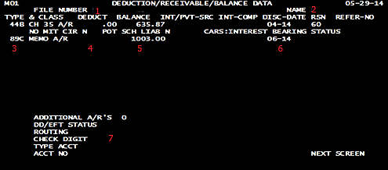
Ch35 Master Record Inquiry (MINQ) Commands
What we see:
File Number
Name
Type of Debt
Payment Plan Amounts
Debt Amount Remaining
Date Debt was Created
EFT Information
Command: MINQ
Screen Number: M01

Slide 55
Comprehension Check
What information can be found on the M22 screen for Ch35 claims?

Slide 56
Ch32 Master Record Inquiry
(MINQ) Commands

Slide 57
Ch32 Master Record Inquiry (MINQ) Commands
Screens used for Ch32 MINQ Commands:
M21:
VA Master Record
Entitlement Information
School Attendance Information
Date Last Paid (DLP)
M26:
Ch32 Participant Account Summary
Service Dates
Eligibility Information
M27:
Ch32 Participant Contribution History
Refund Date
Contribution Amounts

Slide 58
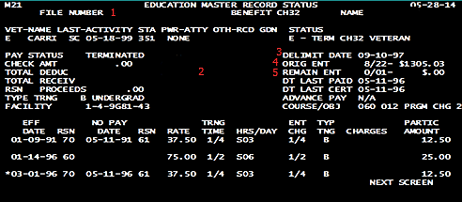
Ch32 Master Record Inquiry (MINQ) Commands
What we see:
File Number
Name and Address
Delimiting Date
Original Entitlement
Remaining Entitlement
Command: MINQ
Screen Number: M21

Slide 59
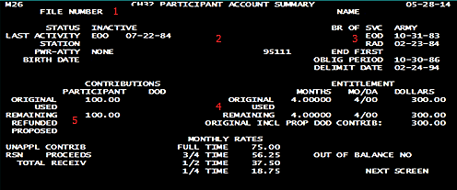
Ch32 Master Record Inquiry (MINQ) Commands
What we see:
File Number
Name and Address
Service Dates Used for Eligibility
Entitlement
Refund
Command: MINQ
Screen Number: M26

Slide 60
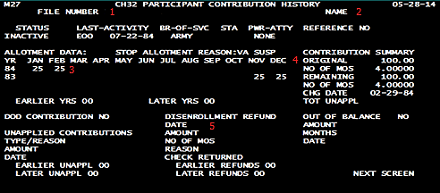
Ch32 Master Record Inquiry (MINQ) Commands
What we see:
File Number
Name
Contribution Amounts and Months
Original Entitlement/ Remaining Entitlement
Refund Date and Amount
Command: MINQ
Screen Number: M27

Slide 61
Comprehension Check
What information can be found on the M27 screen for Ch32 claims?

Slide 62
Commonly Used Adjudicative Commands

Slide 63
Commonly Used Adjudicative Commands
F8 (Ready) Screen:
Used as a starting point for all commands
Claim Adjudication (CADJ) Command:
Used to set up or access an End Product
Correction (CORR) Command:
Used to make corrections to education Master Records

Slide 64
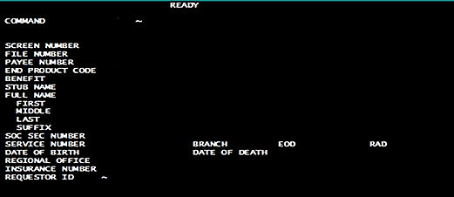
Commonly Used Adjudicative Commands F8 (Ready) screen
What we see:
Ready Screen Waiting for input.
Commonly used editable fields include:
Screen Number
File Number
Payee Number
End Product Code
Benefit
Stub Name
F8 key on keyboard
(Editable fields can be determined by pressing the (TAB) key)

Slide 65
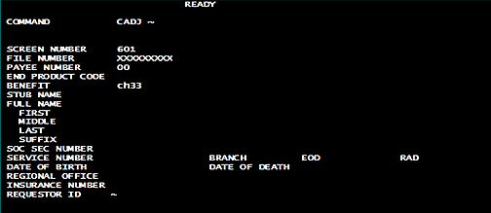
Commonly Used Adjudicative Commands Claim Adjudication (CADJ) Command
What we see:
Ready Screen with required CADJ Screen Information entered.
Required fields:
Screen Number
File Number
Payee Number
Benefit
Command: CADJ
Screen Number: 601

Slide 66
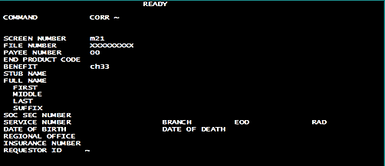
Commonly Used Adjudicative Commands Correction (CORR) Command
What we see:
Ready Screen with required CORR Screen Information entered.
Required fields:
Screen Number
File Number
Payee Number
Benefit
Command: CORR
Screen Number: M21

Slide 67
Creating and Adjusting
BDNSHELL Buttons

Slide 68
Creating and Adjusting BDNSHELL Buttons
BDNSHELL commands (buttons) are arranged by:
8 tabs (titles) across the top.
14 commands per tab.
112 commands can be created.
Each button may be modified independently by first clicking on the tab you want, and then “right clicking” on the command you want to edit.

Slide 69
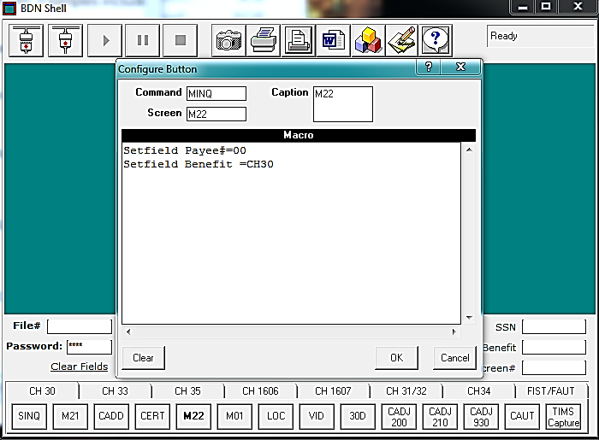
Creating and Adjusting BDNSHELL Buttons
When this screen comes up you have the option to type in commands, screens, and captions at the top, as well as, the macro field underneath.

Slide 70
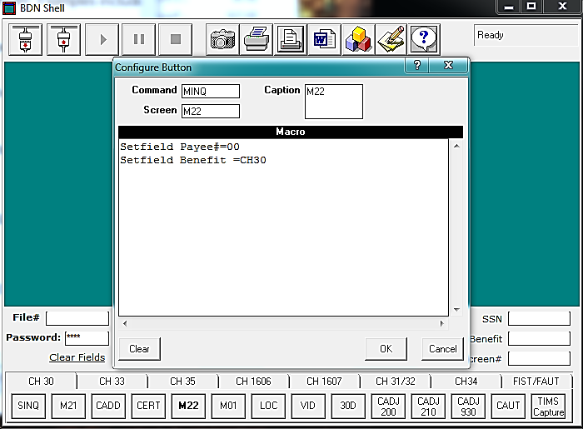
Creating and Adjusting BDNSHELL Buttons
The Command box is for the command you want the button to perform. Examples include: SINQ,MINQ,CADJ, etc…

Slide 71
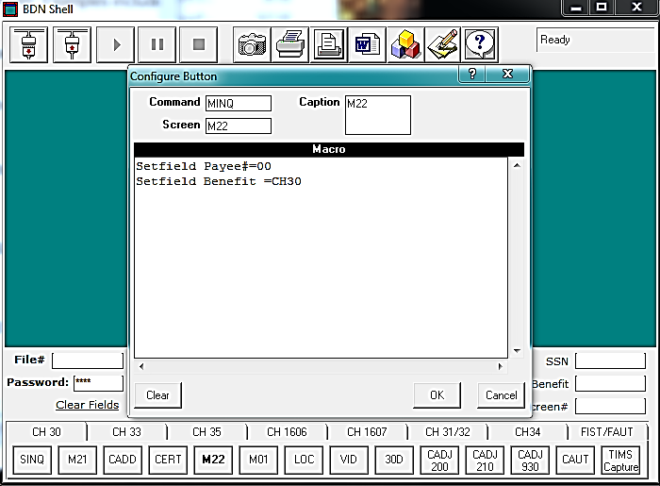
Creating and Adjusting BDNSHELL Buttons
The Screen box is for the specific screen you want the button to take you to when the command is performed. Examples include: LOC, 30D, M21, etc…

Slide 72
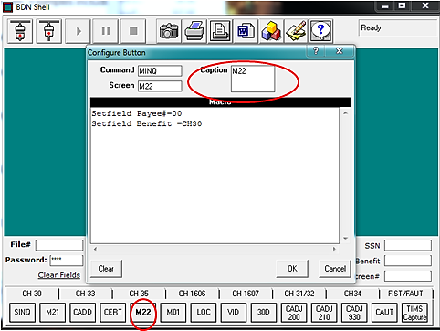
Creating and Adjusting BDNSHELL Buttons
The Caption box is for the label or name you want this button to display.

Slide 73
Creating and Adjusting BDNSHELL Buttons
The Macro box is for the other fields you may need this button to fill. Examples: Benefit, End Product, Payee, etc…

Slide 74
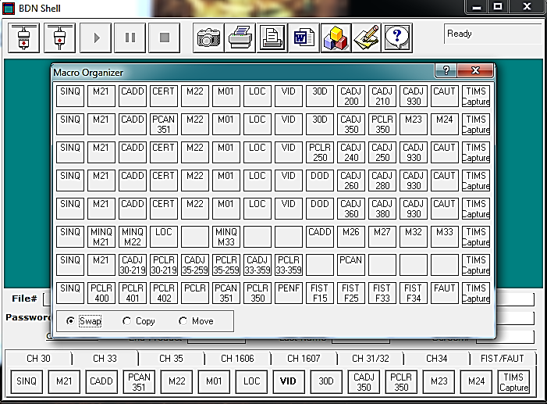
Creating and Adjusting BDNSHELL Buttons Moving and Deleting Buttons
Click on the Organize Macros button at the top of BDNSHELL. The Macro Organizer screen will appear.

Slide 75
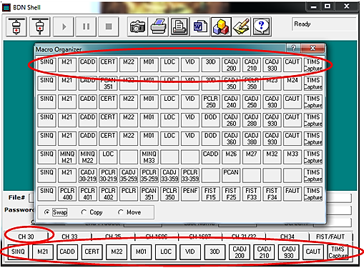
Creating and Adjusting BDNSHELL Buttons Moving and Deleting Buttons
Each row correlates with the tabs across the bottom of BDNSHELL. Row 1 is the first tab, row 2 is the second tab, and row 3 is the third tab, etc…

Slide 76
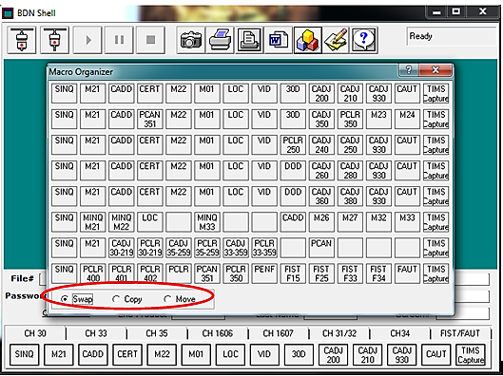
Creating and Adjusting BDNSHELL Buttons Moving and Deleting Buttons
There are three options when rearranging these commands, swap, copy, and move.

Slide 77
Creating and Adjusting BDNSHELL Buttons Moving and Deleting Buttons
Swap is used when you want to switch or trade the location of two tiles
Copy is used when you want to copy the same command from one place to another
Move is used when you want to move a command from one place to another, replacing whatever is in the desired location

Slide 78
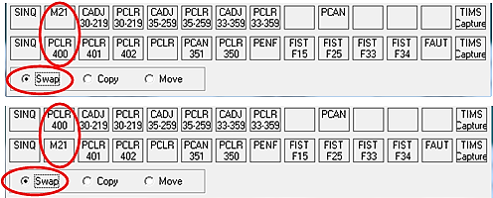
Creating and Adjusting BDNSHELL Buttons Moving and Deleting Buttons
Swap:
Make sure the Swap option (Circled at the bottom) is Marked.
Click and drag the desired button from the original location to the new location.
Notice: The two buttons have swapped positions.
Before
After

Slide 79
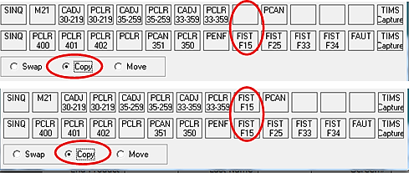
Creating and Adjusting BDNSHELL Buttons Moving and Deleting Buttons
Copy:
Make sure the Copy option (Circled at the bottom) is Marked
Click and drag the desired button from the original location to the new location
Notice: The FIST F15 button from the bottom row is now copied to the top row from the bottom row.
Before
After
Caution: The button being copied to, will be completely replaced and old information will be lost.

Slide 80
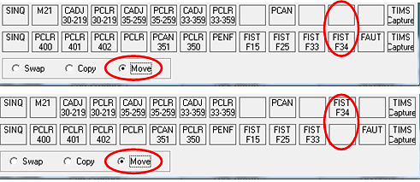
Creating and Adjusting BDNSHELL Buttons Moving and Deleting Buttons
Move:
Make sure the Move option (Circled at the bottom) is Marked
Click and drag the desired button from the original location to the new location
Notice: The FIST F34 button has Moved from the bottom row to the top, leaving the bottom row empty.
Before
After
Caution: The button being Moved to, will be completely replaced and old information will be lost.

Slide 81
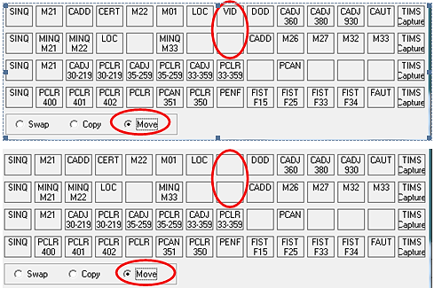
Creating and Adjusting BDNSHELL Buttons Moving and Deleting Buttons
Delete:
The quickest way to delete a command completely, is to Move a blank command over the command you want to be deleted.
You can also delete a command manually by “right clicking” on the command and deleting the information in all of the field boxes.
Before
After

Slide 82
Comprehension Check
What are the steps to create a BDNSHELL button?

Slide 83
Lesson References
M22-4 Part 2: Chapter 1, 1.01 to 1.12
M22-4 Part 2: Chapter 3
M22-4 Part 2: Chapter 4
M22-4 Part 2: Chapter 6

Slide 84
Summary
You have completed the Benefits Delivery Network (BDN) lesson. You should be able to:
Recall BDN location of claims processing information
Recall the function of various BDN commands
Identify the steps for modifying BDNSHELL

Slide 85
Questions??

Slide 86
TMS Assessment and Survey
The assessment and survey have been assigned to you in TMS
The assessment is comprised of multiple choice questions
The questions are based on the information presented in this lesson
The assessment should take you approximately 30 minutes
Be sure to complete both the assessment and the survey in TMS to receive credit for this training

