Slide 1
Musculoskeletal Disabilities
Compensation Service
September 2016

Slide 2

Objectives
Identify musculoskeletal disabilities and the evidence needed to evaluate them.
Determine if criteria has been met after an examination report is received to send for decision.

Slide 3
References
38 CFR 3.159 -Department of Veterans Affairs assistance in developing claims
38 CFR 3.303(b) – Principles relating to service connection/ Chronicity and continuity
38 CFR 4.40 – Functional Loss
38 CFR 4.45 – The Joints
38 CFR 4.63 – Loss of use of hand or foot
38 CFR 4.71 – Measurement of ankyloses and joint motion
M21-1 Part III. Subpart iv.4.a – Musculoskeletal Conditions
M21-1 Part III. Subpart iv.3.D.4.g – Musculoskeltal Report Review for Functional Loss, ROM, and X-Rays
M21-1 Part III. Subpart iv.3.D.3.a – Insufficient Examination Reports
Medical Electronic Performance Support System (Medical EPSS)

Slide 4
Evaluating Joint Conditions
The musculoskeletal system is the largest system in the body and is closely related to the neurologic and vascular systems. The musculoskeletal system includes:
Bones
Joints
Muscles
Tendons
Ligaments
Bursae

Slide 5
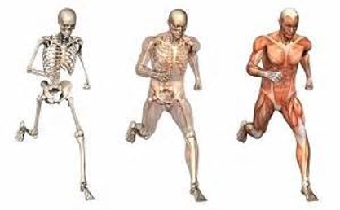
Functions
Functions of the musculoskeletal system include:
Protection
Support
Locomotion
Mineral Storage
Production and development of blood vessels
Heat Production

Slide 6
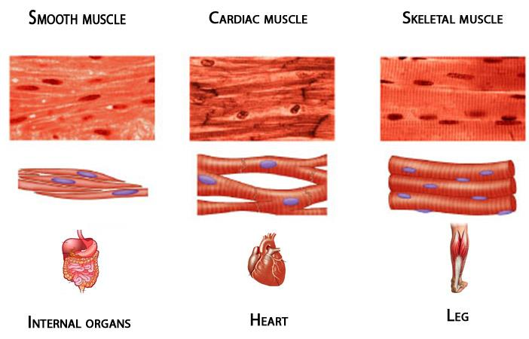
Types of Muscles
The three types of muscles include:
Skeletal
Cardiac
Involuntary (smooth)

Slide 7
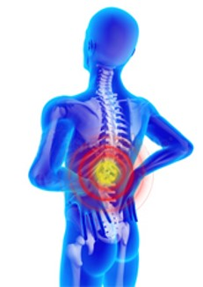
Skeletal Disabilities
Musculoskeletal disabilities involve:
Disabilities of the upper extremities
Disabilities of the spine and lower extremities
Congenital Conditions
Arthritis

Slide 8
Skeletal Disabilities Cont.
Upper Extremities
Separate evaluations may be given if the manifestations represent separate and distinct symptoms.
Spine and Lower Extremities
Evaluations are based on orthopedic manifestations and associated neurologic manifestations.
Congenital Disabilities
Evaluations are given careful consideration based on absence of parts, subluxation, deformity, etc.
Arthritis
There are different types of arthritis and each one is evaluated differently based on the diagnosis. A diagnosis must be confirmed through X-rays or other radiographic testing.

Slide 9
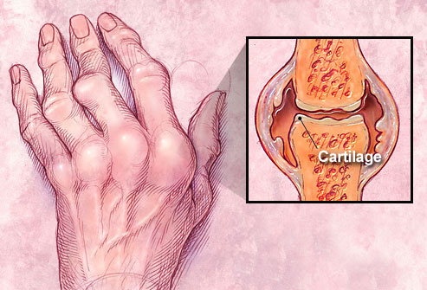

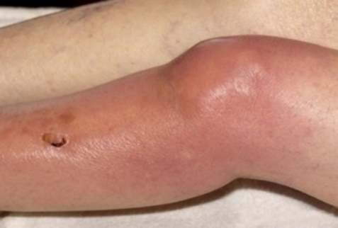
Arthritis
Types of arthritis include:
  Inflammatory (Rheumatoid)
  Osteoarthritis
    Primary (Degenerative)
    Secondary (Traumatic)
  Septic (Bacterial)

Slide 10
Arthritis
Rheumatoid arthritis is a chronic systemic disease of joints and related structures marked by inflammatory changes that causes stiffness, swelling, weakness, loss of mobility, and leads to damage and eventual destruction of the joints and crippling deformities.
Characteristics of Rheumatoid Arthritis include:
  onset before middle age
  may be acute
Symptoms of Rheumatoid arthritis include:
  first affecting PIP and MCP joints
  next causing atrophy of muscles, deformities, contractures, subluxations, and
  finally causing fibrous or bony ankylosis (abnormal adhesion of the bones of the joint).

Slide 11
Arthritis
Rheumatoid arthritis (cont’d)
There are periods of remission and periods of flare with Rheumatoid Arthritis. When body tissues are inflamed, the disease is active. When tissue inflammation subsides, the disease is in remission.

Slide 12
Arthritis
Degenerative arthritis is primarily a disorder of cartilage and the bone underlying the cartilage. All tissues in and around involved joints are enlarged. The condition is noted by marked deterioration in synovial joints and vertebrae. The condition is non-inflammatory.
Characteristics of degenerative arthritis includes:
  The onset generally occurs after the age of 45.
  It has no relation to infection.
  It is asymmetrical (more pronounced on one side of the body than the other).
  There is limitation of movement in the late stages only.
Some symptoms of degenerative arthritis include:
  Ankylosis, in rare cases
  Destruction of cartilage
  Bone eburnation

Slide 13
Arthritis
Traumatic arthritis is a form of arthritis that is caused by blunt, penetrating, or repeated trauma or from forced inappropriate motion of a joint or ligament. This type of arthritis does not spread to other joints.
Symptoms of traumatic arthritis include:
  Pain
  Tenderness
  Limitation of motion
Note: Arthritis is also considered a presumptive condition, chronic disease, if it manifested to a degree of 10% or more within a year from the date of separation.

Slide 14
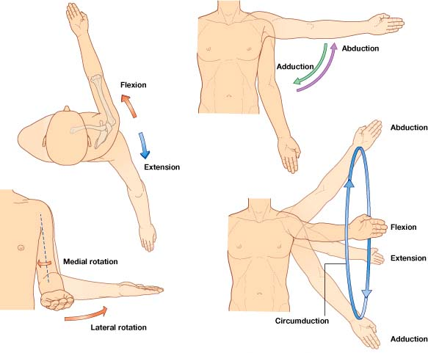
Range of Motion
The common movements that are performed by muscles and joints are:
Flexion/Extension
Abduction/Adduction
Lateral/Medial Rotation
Circumduction

Slide 15
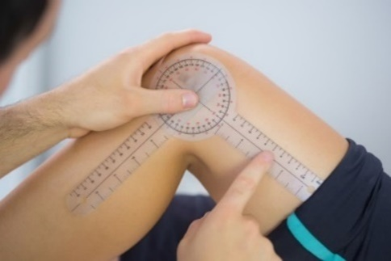
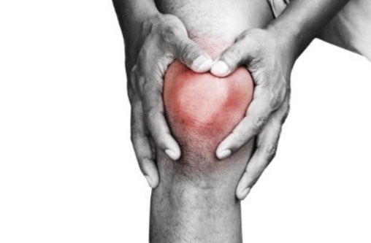
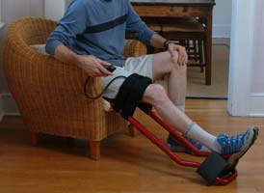
Factors to consider when evaluating joints
The first factor is loss of motion.
  flexion (bending), and
  extension (straightening)
The second factor is painful motion.
The third factor is functional loss.

Slide 16
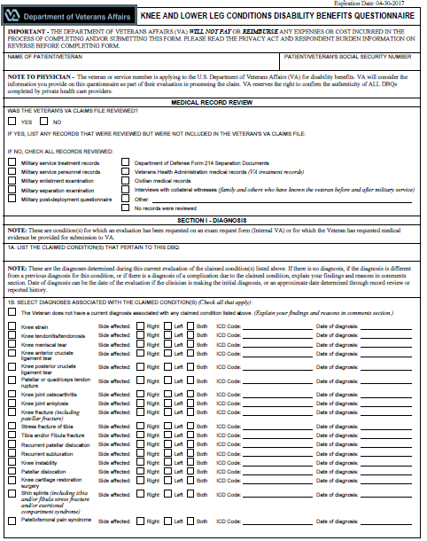
Examinations
These examinations require:
  Specific evidence regarding active and passive range of motion
  Detailed description of the symptoms and flare-ups

Slide 17
Examination Requirements
Musculoskeletal joint examinations must address:
  range of motion (ROM) criteria
  the medical evidence used to evaluate functional impairment due to pain must account for painful motion, pain on use, and pain during flare-ups or with repeated use over a period of time
Note: In most cases, these disabilities require a VA examination to obtain all the necessary evidence to evaluate. Treating physicians rarely have a need to document actual range of motion and may not provide any details regarding additional limitation. These requirements are unique to VA disability evaluations.

Slide 18
Examination Requirements
The examiner must address:
  additional functional limitation or limitation of motion (LOM) during flares-ups or repeated use over time, based on the Veteran’s history and the examiner’s clinical judgment.
The examination report must address:
whether functional ability of a joint is significantly limited during flare-ups (DeLuca) or when the joint is used repeatedly over a period of time (Mitchell) .
Check to ensure that x-rays were obtained when necessary.

Slide 19
Review of Examination Reports
When reviewing examination reports in all situations the report must show:
  The examination report is signed.
  The examination report addressed all disabilities for which an examination was requested.
  The required question(s) on the DBQ were completed.
  The required review of the claims folder was accomplished.
  There is no missing information on the report pertinent to the disability under review, such as failure to discuss the impact of musculoskeletal pain on the functional loss of an affected joint.
  A medical opinion is properly supported by a valid rationale and/or by the evidence of record.
  A requested medical opinion was furnished.

Slide 20
Musculoskeletal Insufficient Exams
The following shown in a musculoskeletal report may lead to an insufficient exam:
  unaffected gait but walks with a cane
  surgery to joint but scar not addressed
  no arthritis but x-ray states degenerative joint disease (DJD)
  limited ROM but no diagnosis provided.
  pain of joint with exam or movement but diagnosis is “normal joint”
  stress fractures: resolved, and
  stress fractures with residual limited ROM, pain.

Slide 21
Complete Assessment and Evaluation

Slide 22
Questions

