Slide 1
Cardiovascular (Arteries and Veins)
Compensation Service
September 2020
Notes:
Welcome to Cardiovascular (Arteries and Veins) course. To advance each slide, click anywhere on the screen.

Slide 2
Objectives
At the end of the lesson the RVSR trainees will be able to:
Provide precise application of the rating schedule 38 CFR 4.104 for arteries and veins.
Correctly identify special considerations for conditions under 38 CFR 4.104.
Evaluate an e-case of the arteries and veins, with focus on hypertension, varicose veins, peripheral vascular disease and/or cold injuries.
Notes:
Objectives
At the end of the lesson the RVSR trainees will be able to:
Provide precise application of the rating schedule 38 CFR 4.104 for arteries and veins
Correctly identify special considerations for conditions under 38 CFR 4.104
Evaluate an e-case of the arteries and veins, with focus on hypertension, varicose veins, peripheral vascular disease and or cold injuries.

Slide 3
References
38 CFR 3.309 Disease subject to presumptive service connection
38 CFR 3.350 Special monthly compensation ratings
38 CFR §4.104 Schedule of Ratings—Cardiovascular system
M21-1, Part III, Subpart iv, Chapter 4, Section G - Cardiovascular System Conditions (to include cold injuries)
M21-1, Part III, Subpart iv, Chapter 6, Section B.5 - Other Issues to Consider When Evaluating Evidence
Notes:
References
The references for this course are listed on the screen. You may click any hyperlinked references for further details.
38 CFR 3.309 Presumptive for Service Connection
38 CFR 3.350 Special Monthly Compensation
38 CFR §4.104 Schedule of Ratings—Cardiovascular system
M21 dash 1, Part Three, Subpart four, Chapter 4, Section E Cardiovascular System Conditions (to include Cold Injuries)
M21 dash 1.Three.four.6.B.5 Other Issues to Consider When Evaluating Evidence

Slide 4
Hypertension (38 CFR 4.104, DC 7101)
A condition in which a patient has a higher than normal blood pressure.
Notes:
Hypertension (38 CFR 4.104, DC 7101)
A condition in which a patient has a higher than normal blood pressure.

Slide 5
Hypertension (38 CFR 4.104, DC 7101)
7101 Hypertensive vascular disease (hypertension and isolated systolic hypertension):
Diastolic pressure predominantly 130 or more | 60
Diastolic pressure predominantly 120 or more | 40
Diastolic pressure predominantly 110 or more, or; systolic pressure predominantly 200 or more | 20
Diastolic pressure predominantly 100 or more, or; systolic pressure predominantly 160 or more, or; minimum evaluation for an individual with a history of diastolic pressure predominantly 100 or more who requires continuous medication for control | 10
Note (1): Hypertension or isolated systolic hypertension must be confirmed by readings taken two or more times on at least three different days. For purposes of this section, the term hypertension means that the diastolic blood pressure is predominantly 90mm. or greater, and isolated systolic hypertension means that the systolic blood pressure is predominantly 160mm. or greater with a diastolic blood pressure of less than 90mm.
Note (2): Evaluate hypertension due to aortic insufficiency or hyperthyroidism, which is usually the isolated systolic type, as part of the condition causing it rather than by a separate evaluation.
Note (3): Evaluate hypertension separately from hypertensive heart disease and other types of heart disease.
Special considerations:
May be subject to a presumption of service connection (38 CFR 3.309(a)) if manifest to a compensable degree within one year of discharge.
Notes:
Hypertension (38 CFR 4.104, DC 71 01) (continued)
71 01 Hypertensive vascular disease (hypertension and isolated systolic hypertension):
Diastolic pressure predominantly 130 or more 60
Diastolic pressure predominantly 120 or more 40
Diastolic pressure predominantly 110 or more, or; systolic pressure predominantly 200 or more 20
Diastolic pressure predominantly 100 or more, or; systolic pressure predominantly 160 or more, or; minimum evaluation for an individual with a history of diastolic pressure predominantly 100 or more who requires continuous medication for control 10
Note (1): Hypertension or isolated systolic hypertension must be confirmed by readings taken two or more times on at least three different days. For purposes of this section, the term hypertension means that the diastolic blood pressure is predominantly 90mm. or greater,
and isolated systolic hypertension means that the systolic blood pressure is predominantly 160mm. or greater with a diastolic blood pressure of less than 90mm.
Note (2): Evaluate hypertension due to aortic insufficiency or hyperthyroidism, which is usually the isolated systolic type, as part of the condition causing it rather than by a separate evaluation.
NOTE (3): Evaluate hypertension separately from hypertensive heart disease and other types of heart disease.

Slide 6
Disability Benefits Questionnaire - Hypertension
Notes:
Disability Benefits Questionnaire - Hypertension

Slide 7
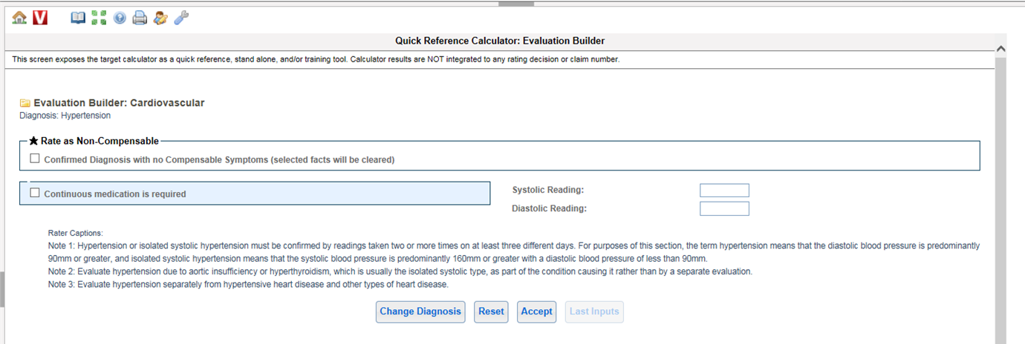
Evaluation Builder
Notes:
Evaluation Builder

Slide 8
Discussion
Veteran served in the US Army from May 6, 1962 through May 31, 1965. 21-526EZ for hypertension is received January 10, 2016. STRs reflect no evidence of complaint, treatment, or diagnosis of hypertension during military service. Post-service treatment records reflect a substantiated diagnosis of hypertension in February 1966. Three-day blood pressure readings reflected the following: day #1 145/94, 140/92, 140/90; day#2: 140/95, 145/100, 140/97; and day#3: 160/90, 145/95, 145/95. Veteran has been prescribed hypertension medication since that time.
Notes:
Discussion
Veteran served in the US Army from May 6, 1962 through May 31, 1965. 21 dash 5 26 E Z for hypertension is received January 10, 2016. STRs reflect no evidence of complaint, treatment, or diagnosis of hypertension during military service.
Post-service treatment records reflect a substantiated diagnosis of hypertension in February 1966. Three day blood pressure readings reflected the following: day #1 145 over 94, 140 over 92, 140 over 90- day#2: 140 over 95, 145 over100, 140 over 97- day#3: 160 over 90, 145 over 95, 145 over 95. Veteran has been prescribed hypertension medication since that time.

Slide 9
Discussion
Answer:
Deny – even though diagnosis substantiated within one year of discharge, disability not at a compensable level within presumptive time period.
Notes:
Discussion
Answer: Deny – even though diagnosis substantiated within one year of discharge, disability not at a compensable level within presumptive time period.

Slide 10
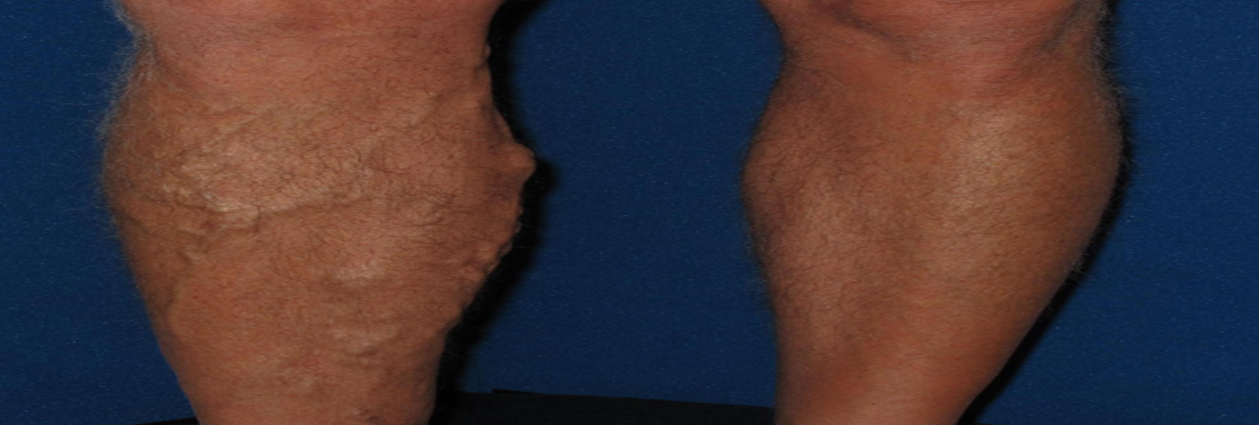
Varicose Veins (38 CFR 4.104, DC 7120)
In varicose veins, the veins are twisted and abnormally enlarged, with valves that leak and are incompetent.
Notes:
Varicose Veins (38 CFR 4.104, DC 71 20)
In varicose veins, the veins are twisted and abnormally enlarged, with valves that leak and are incompetent.

Slide 11
Varicose Veins (38 CFR 4.104, DC 7120)
7120 Varicose veins:
With the following findings attributed to the effects of varicose veins: Massive board-like edema with constant pain at rest |  | 100
Persistent edema or subcutaneous induration, stasis pigmentation or eczema, and persistent ulceration |  | 60
Persistent edema and stasis pigmentation or eczema, with or without intermittent ulceration |  | 40
Persistent edema, incompletely relieved by elevation of extremity, with or without beginning stasis pigmentation or eczema |  | 20
Intermittent edema of extremity or aching and fatigue in leg after prolonged standing or walking, with symptoms relieved by elevation of extremity or compression hosiery |  | 10
Asymptomatic palpable or visible varicose veins |  | 0
Note: These evaluations are for involvement of a single extremity. If more than one extremity is involved, evaluate each extremity separately and combine (under §4.25), using the bilateral factor (§4.26), if applicable.
Notes:
Varicose Veins (38 CFR 4.104, DC 71 20)
71 20 Varicose veins:
With the following findings attributed to the effects of varicose veins: Massive board-like edema with constant pain at rest 100
Persistent edema or subcutaneous induration, stasis pigmentation or eczema, and persistent ulceration 60
Persistent edema and stasis pigmentation or eczema, with or without intermittent ulceration 40
Persistent edema, incompletely relieved by elevation of extremity, with or without beginning stasis pigmentation or eczema 20
Intermittent edema of extremity or aching and fatigue in leg after prolonged standing or walking, with symptoms relieved by elevation of extremity or compression hosiery 10
Asymptomatic palpable or visible varicose veins 0
Note: These evaluations are for involvement of a single extremity. If more than one extremity is involved, evaluate each extremity separately and combine (under §4.25), using the bilateral factor (§4.26), if applicable.

Slide 12
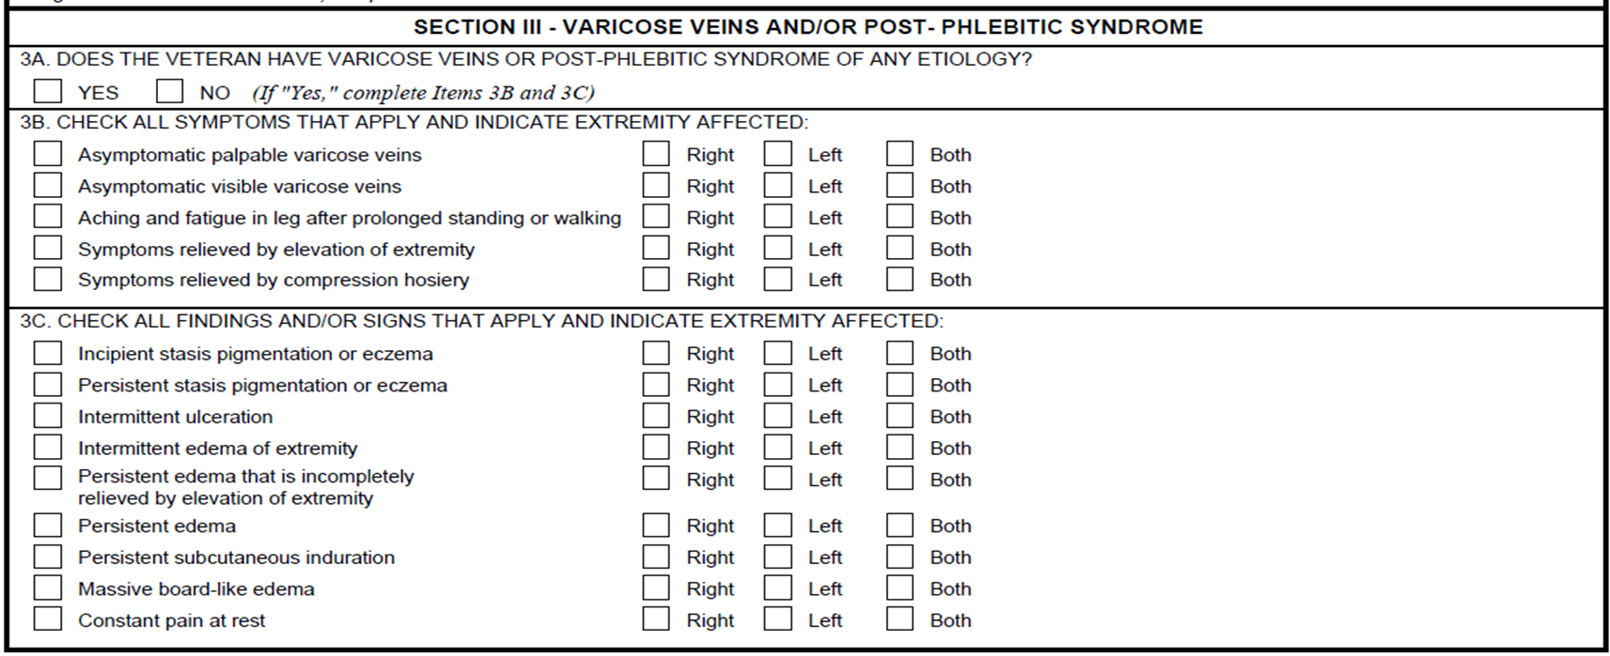
Disability Benefits Questionnaire – Varicose Veins
Notes:
Disability Benefits Questionnaire – Varicose Veins

Slide 13
Evaluation Builder
Notes:
Evaluation Builder

Slide 14
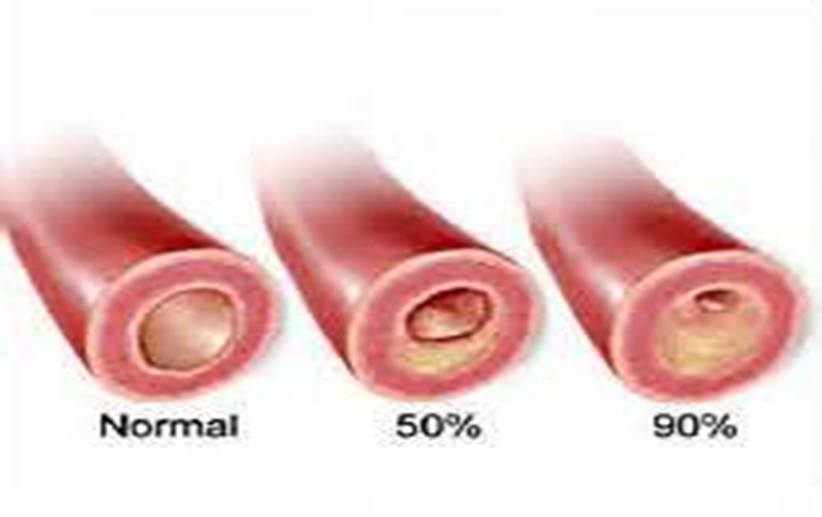
Peripheral Vascular Disease (38 CFR 4.104, DC 7114)
A term indicating diseases of the arteries and veins of the extremities, especially conditions that interfere with adequate blood flow to or from the extremities. Also known as Peripheral Artery Disease (PAD).
Notes:
Peripheral Vascular Disease (38 CFR 4.104, DC 71 14)
A term indicating diseases of the arteries and veins of the extremities, especially conditions that interfere with adequate blood flow to or from the extremities. Also known as Peripheral Artery Disease (P A D).

Slide 15
Peripheral Vascular Disease (38 CFR 4.104, DC 7114)
7114 Arteriosclerosis obliterans:
Ischemic limb pain at rest, and; either deep ischemic ulcers or ankle/brachial index of 0.4 or less | 100
Claudication on walking less than 25 yards on a level grade at 2 miles per hour, and; either persistent coldness of the extremity or ankle/brachial index of 0.5 or less | 60
Claudication on walking between 25 and 100 yards on a level grade at 2 miles per hour, and; trophic changes (thin skin, absence of hair, dystrophic nails) or ankle/brachial index of 0.7 or less | 40
Claudication on walking more than 100 yards, and; diminished peripheral pulses or ankle/brachial index of 0.9 or less | 20
Note (1): The ankle/brachial index is the ratio of the systolic blood pressure at the ankle (determined by Doppler study) divided by the simultaneous brachial artery systolic blood pressure. The normal index is 1.0 or greater.
Note (2): Evaluate residuals of aortic and large arterial bypass surgery or arterial graft as arteriosclerosis obliterans.
Note (3): These evaluations are for involvement of a single extremity. If more than one extremity is affected, evaluate each extremity separately and combine (under §4.25), using the bilateral factor (§4.26), if applicable.
Special considerations:
May be subject to a presumption of service connection (38 CFR 3.309(a)) if manifested to a compensable degree within one year of discharge.
Notes:
Peripheral Vascular Disease (38 CFR 4.104, DC 71 14)
71 14 Arteriosclerosis obliterans:
Ischemic limb pain at rest, and; either deep ischemic ulcers or ankle/brachial index of 0.4 or less 100
Claudication on walking less than 25 yards on a level grade at 2 miles per hour, and; either persistent coldness of the extremity or ankle/brachial index of 0.5 or less 60
Claudication on walking between 25 and 100 yards on a level grade at 2 miles per hour, and; trophic changes (thin skin, absence of hair, dystrophic nails) or ankle/brachial index of 0.7 or less 40
Claudication on walking more than 100 yards, and; diminished peripheral pulses or ankle/brachial index of 0.9 or less 20
Note (1): The ankle/brachial index is the ratio of the systolic blood pressure at the ankle (determined by Doppler study) divided by the simultaneous brachial artery systolic blood pressure. The normal index is 1.0 or greater.
Note (2): Evaluate residuals of aortic and large arterial bypass surgery or arterial graft as arteriosclerosis obliterans.
Note (3): These evaluations are for involvement of a single extremity. If more than one extremity is affected, evaluate each extremity separately and combine (under §4.25), using the bilateral factor (§4.26), if applicable.

Slide 16
Disability Benefits Questionnaire - PVD
Notes:
Disability Benefits Questionnaire - PVD

Slide 17
Evaluation Builder
Notes:
Evaluation Builder

Slide 18
Discussion
How would you evaluate a claim for a Veteran that has claudication on walking on more than 100 yards with an ankle/brachial index of 0.5 on each leg?
20%
40%
60%
Notes:
Discussion
How would you evaluate a claim for a Veteran that has claudication on walking on more than 100 yards with an ankle/brachial index of 0.5 on each leg?
20%
40%
60%

Slide 19
Discussion
Answer:
DC 7114, 20% for each lower extremity
Claudication on walking more than 100 yards
Ankle/brachial index of 0.9 or less.
Extra kudos if you calculated the combined of 40% with a bilateral factor of 3.6!
Notes:
Discussion
Answer: DC 7114, 20% for each lower extremity
Claudication on walking more than 100 yards
Ankle/brachial index of 0.9 or less.
Extra kudos if you calculated the combined of 40% with a bilateral factor of 3.6!

Slide 20
Cold Injuries (38 CFR 4.104, DC 7122)
Injury by cold causes structural and functional disturbances of small blood vessels, cells, nerves, skin, and bone. Exposure to damp cold causes frostnip and immersion (trench) foot. Exposure to dry cold causes frostbite.
Notes:
Cold Injuries (38 CFR 4.104, DC 71 22)
Injury by cold causes structural and functional disturbances of small blood vessels, cells, nerves, skin, and bone. Exposure to damp cold causes frostnip and immersion (trench) foot. Exposure to dry cold causes frostbite.

Slide 21
Cold Injuries (DC 7122)
7122 Cold injury residuals:
With the following in affected parts:
Arthralgia or other pain, numbness, or cold sensitivity plus two or more of the following: tissue loss, nail abnormalities, color changes, locally impaired sensation, hyperhidrosis, X-ray abnormalities (osteoporosis, subarticular punched out lesions, or osteoarthritis) | 30
Arthralgia or other pain, numbness, or cold sensitivity plus tissue loss, nail abnormalities, color changes, locally impaired sensation, hyperhidrosis, or X-ray abnormalities (osteoporosis, subarticular punched out lesions, or osteoarthritis) | 20
Arthralgia or other pain, numbness, or cold sensitivity | 10
Note (1): Separately evaluate amputations of fingers or toes, and complications such as squamous cell carcinoma at the site of a cold injury scar or peripheral neuropathy, under other diagnostic codes. Separately evaluate other disabilities that have been diagnosed as the residual effects of cold injury, such as Raynaud's phenomenon, muscle atrophy, etc., unless they are used to support an evaluation under diagnostic code 7122.
Note (2): Evaluate each affected part (e.g., hand, foot, ear, nose) separately and combine the ratings in accordance with §§4.25 and 4.26.
Special considerations:
May be subject to a presumption of service connection (38 CFR 3.309(c).
If there is amputation or loss of use of an extremity, consider entitlement to special monthly compensation under 38 CFR 3.350
Notes:
Cold Injuries (DC 71 22)
71 22 Cold injury residuals:
With the following in affected parts:
Arthralgia or other pain, numbness, or cold sensitivity plus two or more of the following: tissue loss, nail abnormalities, color changes, locally impaired sensation, hyperhidrosis, X-ray abnormalities (osteoporosis, subarticular punched out lesions, or osteoarthritis) 30
Arthralgia or other pain, numbness, or cold sensitivity plus tissue loss, nail abnormalities, color changes, locally impaired sensation, hyperhidrosis, or X-ray abnormalities (osteoporosis, subarticular punched out lesions, or osteoarthritis) 20
Arthralgia or other pain, numbness, or cold sensitivity 10
Note (1): Separately evaluate amputations of fingers or toes, and complications such as squamous cell carcinoma at the site of a cold injury scar or peripheral neuropathy, under other diagnostic codes.
Separately evaluate other disabilities that have been diagnosed as the residual effects of cold injury, such as Raynaud's phenomenon, muscle atrophy, etc., unless they are used to support an evaluation under diagnostic code 71 22.
Note (2): Evaluate each affected part (e.g., hand, foot, ear, nose) separately and combine the ratings in accordance with §§4.25 and 4.26.
Special considerations: May be subject to a presumption of service connection (38 CFR 3.309(c).
If there is amputation or loss of use of an extremity, consider entitlement to special monthly compensation under 38 CFR 3.350

Slide 22
Disability Benefits Questionnaire – Cold Injuries
For Signs and Symptoms this will continue for all of the extremities.
If amputations, other complications, or scars, then additional DBQs are required.
Notes:
Disability Benefits Questionnaire – Cold Injuries
For Signs and Symptoms this will continue for all of the extremities.
If amputations, other complications, or scars, then additional DBQs are required.

Slide 23
Evaluation Builder
Notes:
Evaluation Builder

Slide 24
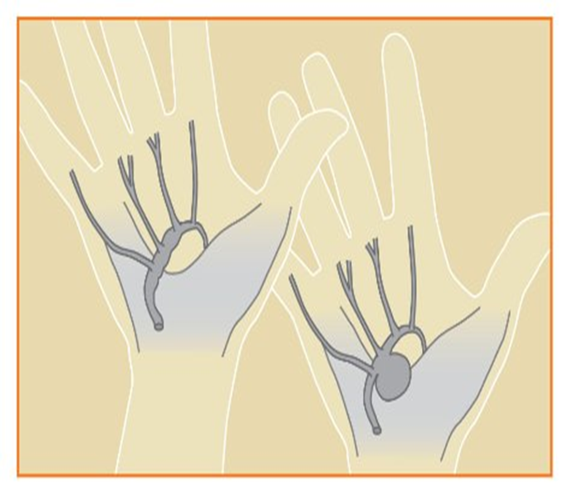
Aneurysms (38 CFR 4.104, DC 7111/7112)
Bulging or sac of a blood vessel formed by the dilation of the wall of an artery, a vein, or the heart.
Notes:
Aneurysms (38 CFR 4.104, DC 71 11/71 12)
Bulging or sac of a blood vessel formed by the dilation of the wall of an artery, a vein, or the heart.

Slide 25
Aneurysm, Large Artery (38 CFR 4.104, DC 7111)
7111 Aneurysm, any large artery:
If symptomatic, or; for indefinite period from date of hospital admission for surgical correction | 100
Following surgery:
Ischemic limb pain at rest, and; either deep ischemic ulcers or ankle/brachial index of 0.4 or less | 100
Claudication on walking less than 25 yards on a level grade at 2 miles per hour, and; persistent coldness of the extremity, one or more deep ischemic ulcers, or ankle/brachial index of 0.5 or less | 60
Claudication on walking between 25 and 100 yards on a level grade at 2 miles per hour, and; trophic changes (thin skin, absence of hair, dystrophic nails) or ankle/brachial index of 0.7 or less | 40
Claudication on walking more than 100 yards, and; diminished peripheral pulses or ankle/brachial index of 0.9 or less | 20
Note (1): The ankle/brachial index is the ratio of the systolic blood pressure at the ankle (determined by Doppler study) divided by the simultaneous brachial artery systolic blood pressure. The normal index is 1.0 or greater.
Note (2): These evaluations are for involvement of a single extremity. If more than one extremity is affected, evaluate each extremity separately and combine (under §4.25), using the bilateral factor, if applicable.
Note (3): A rating of 100 percent shall be assigned as of the date of hospital admission for surgical correction. Six months following discharge, the appropriate disability rating shall be determined by mandatory VA examination. Any change in evaluation based upon that or any subsequent examination shall be subject to the provisions of §3.105(e) of this chapter.
Notes:
Aneurysm, Large Artery (38 CFR 4.104, DC 71 11)
71 11 Aneurysm, any large artery:
If symptomatic, or; for indefinite period from date of hospital admission for surgical correction 100
Following surgery: Ischemic limb pain at rest, and; either deep ischemic ulcers or ankle/brachial index of 0.4 or less 100
Claudication on walking less than 25 yards on a level grade at 2 miles per hour, and; persistent coldness of the extremity, one or more deep ischemic ulcers, or ankle/brachial index of 0.5 or less 60
Claudication on walking between 25 and 100 yards on a level grade at 2 miles per hour, and; trophic changes (thin skin, absence of hair, dystrophic nails) or ankle/brachial index of 0.7 or less 40
Claudication on walking more than 100 yards, and; diminished peripheral pulses or ankle/brachial index of 0.9 or less 20
Note (1): The ankle/brachial index is the ratio of the systolic blood pressure at the ankle (determined by Doppler study) divided by the simultaneous brachial artery systolic blood pressure. The normal index is 1.0 or greater.
Note (2): These evaluations are for involvement of a single extremity. If more than one extremity is affected, evaluate each extremity separately and combine (under §4.25), using the bilateral factor, if applicable.
Note (3): A rating of 100 percent shall be assigned as of the date of hospital admission for surgical correction. Six months following discharge, the appropriate disability rating shall be determined by mandatory VA examination.
Any change in evaluation based upon that or any subsequent examination shall be subject to the provisions of §3.105(e) of this chapter.

Slide 26
Aneurysm, Aneurysm, Small Artery (38 CFR 4.104, DC 7112)
7112 Aneurysm, any small artery:
Asymptomatic | 0
Note: If symptomatic, evaluate according to body system affected. Following surgery, evaluate residuals under the body system affected.
Notes:
Aneurysm, Aneurysm, Small Artery (38 CFR 4.104, DC 71 12)
71 12 Aneurysm, any small artery:
Asymptomatic 0
Note: If symptomatic, evaluate according to body system affected. Following surgery, evaluate residuals under the body system affected.

Slide 27
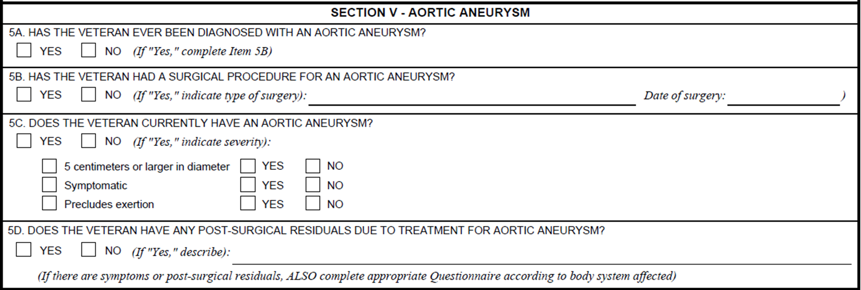
Disability Benefits Questionnaire – Artery and Vein DBQ
Notes:
Disability Benefits Questionnaire – Artery and Vein

Slide 28
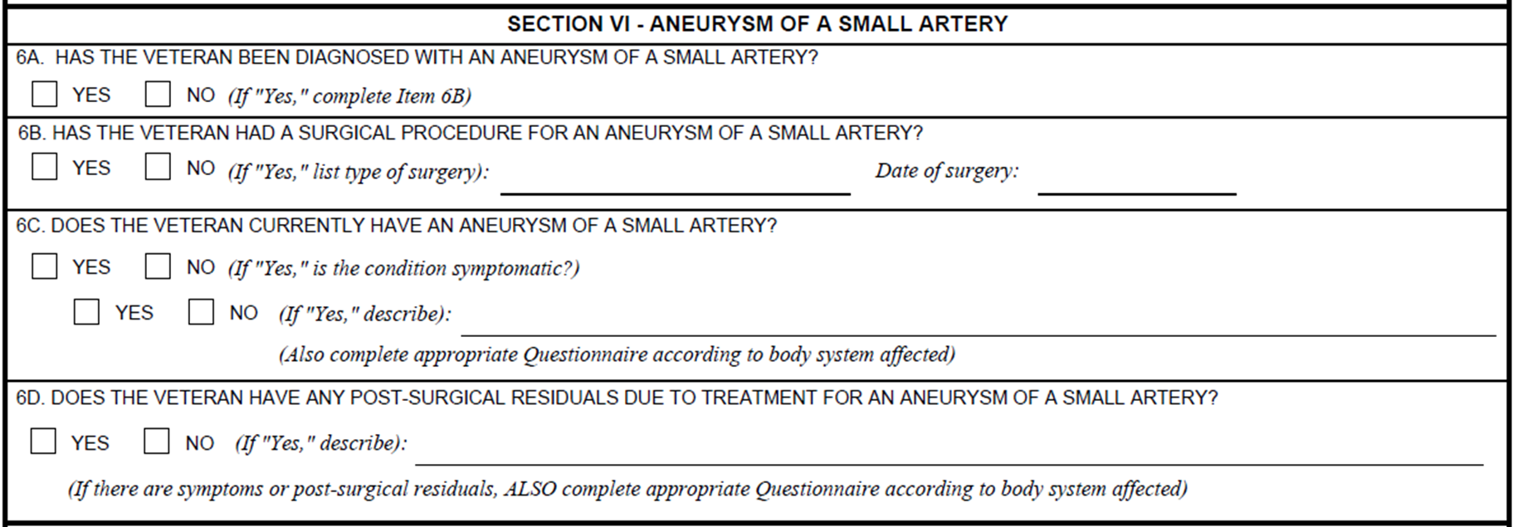
(DBQ continued)
Notes:
DBQ

Slide 29
Evaluation Builder
Notes:
Evaluation Builder

Slide 30
Evaluation Builder
Notes:
Evaluation Builder

Slide 31
Discussion
While on active duty a Veteran was diagnosed with a uterine aneurysm. The treatment resulted in a hysterectomy.
If service connection is granted, are there any other benefits we need to consider?
Notes:
Discussion
While on active duty a Veteran was diagnosed with a uterine aneurysm. The treatment resulted in a hysterectomy.
If a benefit is granted are there any other benefits we need to consider?

Slide 32
Discussion
ANSWER:
Per note associated with DC 7112 “Following surgery, evaluate residuals under the body system affected.”
Therefore grant service connection under DC 7112-7618.
Veteran also entitled to SMC K per 38 CFR §3.350.
Notes:
Discussion
ANSWER: Per note associated with DC 71 12 “Following surgery, evaluate residuals under the body system affected.”
Therefore DC 71 12 dash 76 18
Veteran also entitled to SMC K per 38 CFR §3.350.

Slide 33
Questions
Notes:
Questions?

