Slide 1
Amputation Rule, Pyramiding, and Muscle Injury
Compensation Service
September 2016

Slide 2
Objectives
Define the amputation rule and understand exceptions to the rule.
Identify the elective level for amputations and demonstrate application of the amputation rule.
Recognize how the amputation rule applies to osteomyelitis.
Obtain a working knowledge of how to apply the amputation rule in VBMS-R.
Define pyramiding and understand the prohibition against pyramiding.

Slide 3
Objectives
Recognize specific pyramiding principles applicable to each of the body systems.
Understand types of muscles, muscle groups, and muscle injuries.
Demonstrate knowledge of combining ratings for muscle injuries. (38 CFR 4.55)
Demonstrate knowledge of the evaluation of muscle disabilities. (38 CFR 4.56)

Slide 4
References
38 CFR 4.68, Amputation Rule
38 CFR 4.14, Avoidance of Pyramiding
38 CFR 4.59, Painful Motion
38 CFR 4.71a, Schedule of Ratings-Musculoskeletal System, DC 5120-5126, Amputations: Upper Extremity; and, 5160-5173, Amputations: Lower Extremity
38 CFR 4.55, Principles of Combined Ratings for Muscle Injuries
38 CFR 4.56, Evaluation of Muscle Disabilities
Notes:
Give titles

Slide 5
References
38 CFR 4.73, Schedule of Ratings-Muscle Injuries
38 CFR 4.96, Special Provisions Regarding Evaluation of Respiratory Conditions
38 CFR 4.115, Nephritis
38 CFR 4.114, Schedule of Ratings – Digestive System
38 CFR 3.310(d), Traumatic Brain Injury
38 CFR 4.126, Evaluation of Disability from Mental Disorders
38 CFR 4.150, Dental and Oral Conditions
Notes:
Give titles

Slide 6
References
M21-1 Part III, Subpart iv, 4.A, Musculoskeletal Conditions
M21-1 Part III, Subpart iv, 4.B.2.b, Considering Impairments of Both Visual Acuity and Visual Field
M21-1 Part III, Subpart iv, 4.G, Neurological Conditions and Convulsive Disorders
M21-1 Part III, Subpart iv, 4.J, Skin Conditions
M21-1 Part III, Subpart iv, 6.D.10.a, Sample Draft Code-sheet, Amputation Rule
VBMS Job Aid, Amputation Rule and VBMS-R
Compensation and Pension Medical EPSS
Note: All M21-1 references are found in the Live Manual Website

Slide 7
Amputation Rule

Slide 8
38 CFR 4.68: Amputation Rule
The combined evaluation for disabilities of an extremity shall not exceed the evaluation for the amputation at the elective level, were amputation to be performed.
The amputation rule is included in the musculoskeletal section of the rating schedule and, consequently, applies only to musculoskeletal disabilities and not to disabilities affecting other body systems.

Slide 9
Exceptions
Any peripheral nerve injury, associated with the musculoskeletal injury, applies to and counts towards the amputation rule.
Actual amputation with associated neuroma will be evaluated at the next higher site of elective re-amputation.

Slide 10
Exceptions
The amputation rule does not apply to bilateral evaluations under DCs 5276-5279.
The amputation rule does not apply when temporary evaluations are assigned to an extremity, such as Paragraph 29 and 30.

Slide 11
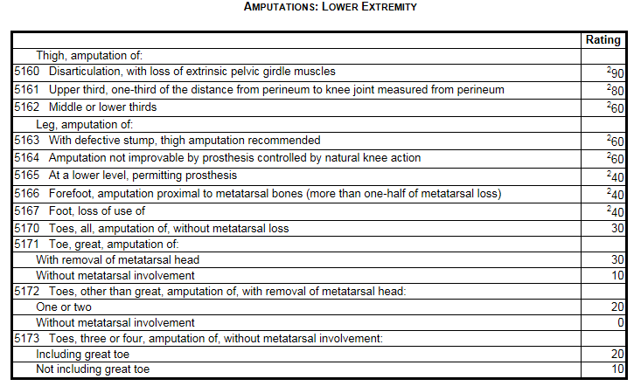
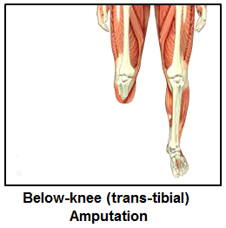
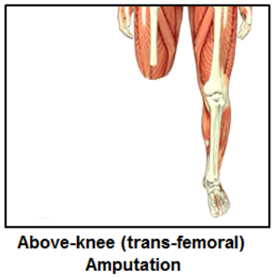
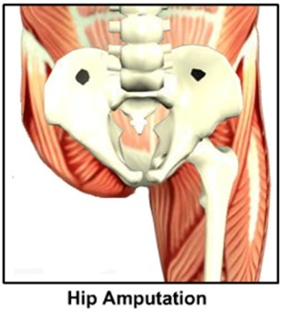
Identifying the Elective Level of Amputations: Lower Extremity

Slide 12
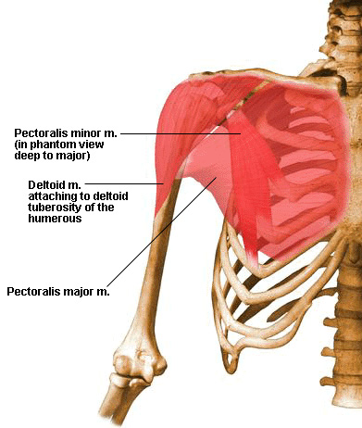
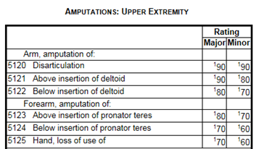
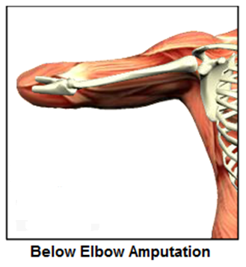
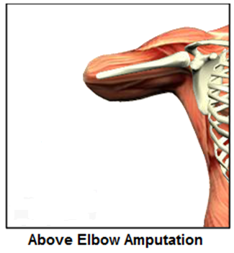
Identifying the Elective Level of Amputations: Upper Extremity

Slide 13
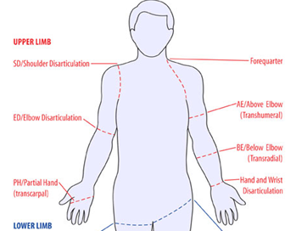
Applying the Amputation Rule
If there is limitation of flexion of the left (minor) elbow evaluated at 40%, limitation of extension of the left elbow evaluated at 20%, prosthetic replacement of the left wrist evaluated as 30%, and three digits ankylosed in the left hand at 30%, the combined evaluation of the left extremity would be 80% disabling.
Because amputation of the forearm above insertion of the pronator teres is evaluated as 70% disabling in the minor extremity, the amputation rule would be applied and a 70% combined evaluation would be assigned.
If the disabilities were present in the major extremity, there would be no violation of the amputation rule, as amputation of the forearm above insertion of the pronator teres in the major extremity is evaluated as 80% disabling.
Major
Minor
90%
90%
70%
80%
60%
60%
60%

Slide 14
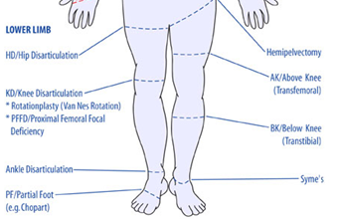
Applying the Amputation Rule
If there is malunion of the right tibia and fibula with marked ankle disability rated 30% and right flat foot rated at 30%, the combined evaluation of the right leg below the knee would equal 50% disabling.
Because the loss of use or amputation below the knee is evaluated as 40% disabling, the amputation rule would be applied and a 40% combined evaluation would be assigned.
If the flat foot condition was rated as bilateral at 30%, then all the conditions could be combined. The amputation rule does not apply to bilateral evaluations under DCs 5276-5279. The combined overall rating of 60% would not be a violation of the amputation rule as only the 30% evaluation for the right tibia and fibula would be considered for the right lower extremity.
90%
90%
60%
60%
40%
40%
40%
40%

Slide 15
Amputation Rule and Osteomyelitis (DC 5000)
The amputation rule DOES NOT apply if:
the osteomyelitis evaluation is 10% based on active osteomyelitis of a body part where the evaluation would normally be 0 percent, or
the osteomyelitis evaluation is 60% based on constitutional symptoms of osteomyelitis.
The amputation rule DOES apply if:
the osteomyelitis evaluation is 10% based on active osteomyelitis of a body part where the evaluation would normally be 0 percent, or
30% or less under DC 5000, AND
combined with evaluations for ankylosis, limited motion, nonunion or malunion, shortening, or other musculoskeletal impairment.

Slide 16
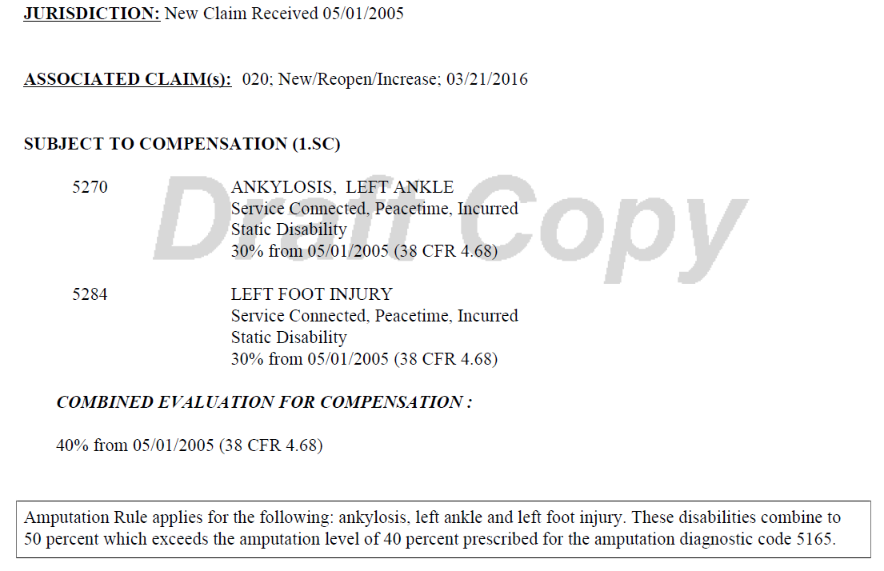
Amputation Rule within VBMS-R
In order to apply the amputation rule to applicable disabilities, an “Amputation Umbrella” must be created within VBMS-R. Please see the following VBMS Job Aid referencing how a rating specialist utilizes VMBS-R to apply the amputation rule.

Slide 17
Pyramiding

Slide 18
38 CFR 4.14: Avoidance of Pyramiding
Pyramiding is rating the same manifestations of a disability under two separate DCs.
Disability from injuries to the muscles, nerves, and joints of an extremity may overlap to a great extent, so that special rules are included in the appropriate bodily system for their evaluation.
Notes:
III.iv.6.c.5.d

Slide 19
Pyramiding: Joints and Pain
38 CFR 4.59 does not permit separate compensable evaluations for each painful joint motion.
When each qualifying joint motion is painful but motion is not actually limited to a compensable degree under its applicable 52XX-series DC, only one compensable evaluation can be assigned.
When more than one qualifying joint motion is actually limited to a compensable degree and there is painful but otherwise non-compensable limitation of the complementary movement(s), only one compensable evaluation can be assigned.

Slide 20
Pyramiding: Musculoskeletal Conditions
Degenerative Arthritis: Separate evaluations under diagnostic code 5003 with any other joint evaluation based on limitation of motion or painful motion, due to degenerative arthritis, is prohibited.
Forearm: Do not assign a compensable evaluation for both limitation of pronation and limitation of supination of the forearm in the same extremity.
Fibromyalgia: The criteria for the evaluation of fibromyalgia does not exclude assignment of separate evaluations when secondary disabilities are diagnosed. The same signs and symptoms; however, cannot be used to assign separate evaluations under different DCs.

Slide 21
Pyramiding: Musculoskeletal Conditions
IVDS: If the evaluation of IVDS is based on incapacitating episodes, a separate evaluation may not be assigned for limitation of motion, radiculopathy, or any other associated objective neurological abnormality.
Arthroplasty: Once joint replacement occurs, separate evaluations for range of motion and/or instability in the joint is prohibited.
Meniscus (semilunar cartilage): Do not assign separate evaluations for a meniscus disability (DC 5258/DC 5259) with limitation of motion in the same knee OR with subluxation/lateral instability.

Slide 22
Pyramiding: Musculoskeletal Conditions
Shin Splints: If the evaluation of shin splints is based on impairment of the knee and/or ankle joint, do not assign separate evaluations for shin splints and the applicable joint(s).
Ankle Instability: Separate evaluations for limitation of motion and instability of the ankle are prohibited.
Pes Planus/Plantar Fasciitis: When SC is established for both pes planus and plantar fasciitis, the symptoms of both symptoms are evaluated together under DC 5276 and cannot be separately evaluated.

Slide 23
Pyramiding: Musculoskeletal Conditions
Muscles: A separate evaluation cannot be assigned for each muscle within a single muscle group.
Muscles/Joints: 38 CFR 4.55, Principles of Combined Ratings for Muscle Injuries
Muscles/Peripheral Nerves: A muscle injury and a peripheral nerve paralysis of the same body part, whether associated with the muscle injury OR originating from other etiologies, may not be rated separately unless entirely different functions are affected.

Slide 24
Pyramiding: Organs of Special Sense
Vision: Separate evaluations cannot be assigned for impairments of both visual acuity and visual field defect. The evaluations must evaluated together as a single disability.
Meniere’s Syndrome: Do not provide separate evaluations for hearing impairment, tinnitus, or vertigo with an evaluation of Meniere’s disease under DC 6205.

Slide 25
Pyramiding: Respiratory Conditions
Co-existing Respiratory Conditions: 38 CFR 4.96(a)
Ratings under DCs 6600-6817 and 6822-6847 cannot be separately evaluated.
Where there is lung or pleural involvement, ratings under DCs 6819 and 6820 cannot be separately evaluated from each other or the DCs noted above.
Single ratings are assigned under the diagnostic code which reflects the predominant disability with elevation to the next higher evaluation when the severity of the overall disability warrant such elevation.
GSW and Respiratory: Separate evaluations for restrictive lung disease due to gunshot wound and muscle group XXI cannot be assigned.

Slide 26
Pyramiding: Cardiovascular
Hypertension: Evaluate hypertension due to aortic insufficiency or hyperthyroidism, as part of the condition causing it rather than by a separate evaluation.
Cardiovascular and Nephritis: 38 CFR 4.115 Separate ratings are not to be assigned for disability from disease of the heart (which includes hypertension) and any form of nephritis unless there is absence of a kidney or regular dialysis is required.
Cold Injury: Separately diagnosed residuals of cold injuries, such as Raynaud’s phenomenon, muscle atrophy, etc., cannot be assigned as separate evaluations if they are used to support an evaluation under DC 7122.

Slide 27
Pyramiding: Digestive
38 CFR 4.114: Evaluations of digestive conditions under certain DCs will not be combined with each other or assigned separate evaluations. Instead, a single evaluation should be assigned under the DC which reflects the predominant disability, with elevation to the next higher evaluation when the severity of the overall disability warrants such elevation.
Separate evaluations are prohibited for digestive conditions under the following 38 CFR 4.114 DCs:
7301 to 7329, inclusive (meaning all the DCs from 7301 to 7329)
7331
7342, and
7345 to 7348, inclusive (meaning all the DCs from 7345 to 7348).

Slide 28
Pyramiding: Endocrine
Diabetic Complications:
Evaluate compensable complications of diabetes mellitus separately unless they are a part of the criteria used to support a 100-percent evaluation under DC 7913.
Non-compensable complications of diabetes mellitus are considered part of the diabetic process under DC 7913.
Hyperthyroidism: Symptoms of hyperthyroidism used to support the evaluation of other DCs; or, granted as separate disabilities, cannot be used to support an evaluation under DC 7900.

Slide 29
Pyramiding: Traumatic Brain Injury
Multiple Evaluations: In addition to the evaluation for TBI manifestations under DC 8045, separate evaluations of comorbid mental, neurologic, or other physical disorder can be assigned unless the manifestation was used to assign an evaluation under DC 8045.
TBI and Vertigo: A separate evaluation of vertigo cannot be assigned. Vertigo is a subjective symptom that is already considered in the facets of TBI criteria.

Slide 30
Pyramiding: Traumatic Brain Injury
TBI and Mental Disorder: Sufficiently clear and unequivocal medical opinion evidence must be present to determine whether TBI and a mental disorder are distinct and can be separately evaluated.
38 CFR 3.310(d) established five conditions held to be secondary to TBI dependent on the initial severity of the TBI and the period of time between the injury and onset of the secondary illness. Avoid pyramiding when considering the initial TBI evaluation and symptoms that are now associated with the five secondary conditions.

Slide 31
Pyramiding: Peripheral Nerves
Upper Extremities: Separate evaluations may not be assigned for disability affecting multiple nerve branches of the same upper extremity.
Lower Extremities: Separate evaluations for disability affecting lower extremity nerves are warranted when symptoms arise from any of the five individual nerve branches.
If symptoms arise from within the same nerve branch of any of the five individual nerve branches in the lower extremity, assigning separate evaluation for those symptoms would constitute pyramiding.

Slide 32
Pyramiding: ALS/MS
Amyotrophic Lateral Sclerosis (ALS): If a single 100 percent evaluation is warranted for a complication of ALS, assign a 100 percent for that complication and separately evaluate additional complications. Do not assign a separate evaluation under DC 8017; however, as this would constitute pyramiding.
Multiple Sclerosis (MS): Residuals of MS are evaluated separately when the combined evaluation for the residuals are 30 percent or greater. When residuals are separately evaluated, the minimum evaluation under DC 8018 may not be concurrently assigned.

Slide 33
Pyramiding: Mental
Physical/Mental Disorders: When a single disability has been diagnosed both as a physical condition and as a mental disorder, the rating agency shall evaluate it using a DC which represents the dominant (more disabling) aspect of the condition.
To warrant separate evaluations, the symptoms considered must be distinct and not overlap.

Slide 34
Pyramiding: Skin and Scars
Disfigurement: Multiple scars may not be added together to meet the width of scarring requirement under characteristics of disfigurement.
Painful Scar(s): A separate evaluation for a painful scar under DC 7804 may be assigned when the functional impairment is:
distinct and separate from the functional impairment addressed by another DC, and is not,
duplicative or overlapping with symptomatology addressed under another DC.

Slide 35
Pyramiding: Skin and Scars
Scars associated with Muscle Injury: If there is scarring that results in functional loss under DC 7805 that is compensable, do not assign a separate evaluation if the body part affected and the functional impairment resulting from the scar are the same as the part and function affected by the muscle injury.
Alternative Rating Criteria: When evaluating skin conditions where the DC offers variable methods to evaluate the disability, assign only a single evaluation using the criteria that results in the higher rating. Do not assign separate evaluations.

Slide 36
Pyramiding: Multiple Skin Conditions
Percentage of Exposed Skin/Entire Body Affected: Multiple skin conditions may receive separate evaluations based on the percentage of exposed areas affected by each skin condition. If an examiner cannot provide separate percentages solely due to each skin condition, separate evaluations cannot be assigned using that criteria alone.
Medication Criteria: If the same medication is used to treat each skin condition, separate evaluations may not be assigned unless the separately evaluated condition uses alternative criteria to establish a disability evaluation.

Slide 37
Pyramiding: Dental and Oral Conditions
Inter-Incisal Motion: In assigning an evaluation for TMJ or any other dental disability on the basis of limited motion of temporomandibular articulation under DC 9905, do not assign separate evaluations for limited inter-incisal motion involving each side of the jaw.
If both sides of the jaw are affected, use the limitation of motion on the side that affords the highest evaluation.

Slide 38
Muscles and Gunshot Wounds

Slide 39
Types of Muscles
Three types of muscle structures:
Striated (skeletal) – Muscles that are attached to bones by tendons, producing movement under conscious control. Movement occurs when stimulated muscle fibers contract to change the position of the bones at a joint.
Cardiac – An involuntary muscle not under conscious control, forms the heart wall, and creates the pulsing beat of the heart.
Smooth – Involuntary muscles found in the walls of hollow body organs, blood vessels, and respiratory passageways.

Slide 40
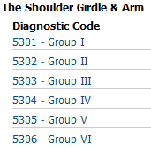
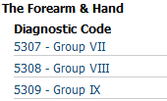
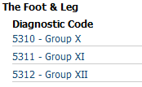
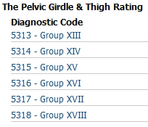
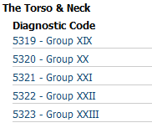
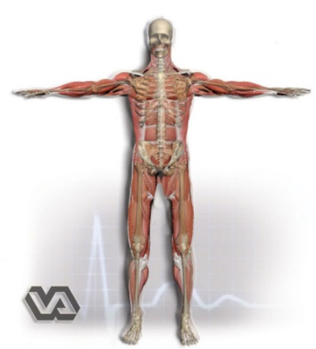
Muscle Groups
For rating purposes, the skeletal muscles of the body are divided into 23 muscle groups in 5 anatomical regions:

Slide 41
Types of Muscle Injuries
Type of Injury | Initial Effects | Signs and Symptoms
Gunshot wounds | Entrance and exit wounds result. The amount of damage and relative size of entrance and exit wounds depends on may factors such as: Caliber of bullet Distance from victim Organs, bone, blood vessels, and other structures hit. | Exit wounds are generally larger than entrance wounds, and Bullets are essentially sterile when they reach the body but carry particles into wound which could be sources of infection
Shell fragment wounds | Most result in decreased tissue penetration compared to denser bullets. | Multiple fragments in a localized area result in tissue disruption affecting a wide area.

Slide 42
Types of Muscle Injuries
Type of Injury | Initial Effects | Signs and Symptoms
Tears and lacerations | Muscles that become isolated from nerve supply by lacerations will be non-functional. | Torn muscle fibers heal with very dense scar tissue, but the nerve stimulation will not cross this barrier. Parts of muscle isolated from the nerve will most likely remain non-contractile resulting in a strength deficit proportional to amount of muscle tissue disrupted. Treatment for small tears is symptomatic. Large tears/lacerations may require reconstruction.
Through and through wound | Inuring instrument enters and exits body. | Entrance and Exit wound results.

Slide 43
Combined Ratings for Muscle Injuries: PN Paralysis
38 CFR 4.55(a): A muscle injury rating will not be combined with a peripheral nerve paralysis rating of the same body part, unless the injuries affect entirely different functions.
Etiology of the disability is irrelevant in rendering a determination regarding combining evaluations for muscle injuries and peripheral nerve paralysis.

Slide 44
Combined Ratings for Muscle Injuries: Ankylosed Joints
38 CFR 4.55(c): There will be no rating assigned for muscle groups which act upon an ankylosed joint, with the following exceptions:
In the case of an ankylosed knee, if muscle group XIII is disabled, it will be rated, but at the next lower level than that which would otherwise be assigned.
In the case of an ankylosed shoulder, if muscle groups I and II are severely disabled, the evaluation of the shoulder joint under diagnostic code 5200 will be elevated to the level for unfavorable ankylosis, if not already assigned, but the muscle groups themselves will not be rated.

Slide 45
Combined Rating For Muscle Injuries: Unankylosed Joint
38 CFR 4.55(d): The combined evaluation of muscle groups acting upon a single unankylosed joint must be lower than the evaluation for unfavorable ankylosis of that joint, except in the case of muscle groups I and II acting upon the shoulder.
If muscle groups I and II are affected and acting on the shoulder, assign separate evaluations for the muscle injuries. The combined evaluation does not have to be lower, but cannot exceed the evaluation for unfavorable ankylosis of the shoulder.

Slide 46
Combined Rating for Muscle Injuries: Anatomical Regions
38 CFR 4.55(e): For compensable muscle group injuries which are in the same anatomical region but do not act on the same joint, the evaluation for the most severely injured muscle group will be increased by one level and used as the combined evaluation for the affected muscle groups.
38 CFR 4.55(f): For muscle group injuries in different anatomical regions which do not act upon ankylosed joints, each muscle group injury shall be separately rated and the ratings combined under the provisions of §4.25.

Slide 47
Evaluation of Muscle Disabilities
Muscle injuries are evaluated based on the following:
History and Complaint: Review for in-service treatment, hospitalization, and cardinal signs and symptoms.
Objective Findings: Review for types of scarring, metallic fragments, loss of muscle, and impairment of function.
Type of Injury: Classified as slight, moderate, moderately severe, and severe.

Slide 48
Evaluation of Muscle Disabilities: Specific Guidelines
38 CFR 4.56(a): An open comminuted fracture with muscle or tendon damage will be rated as a severe injury of the muscle group involved unless, for locations such as in the wrist or over the tibia, evidence establishes that the muscle damage is minimal.
38 CFR 4.56(b): A through-and-through injury with muscle damage shall be evaluated as no less than a moderate injury for each group of muscles damaged.

Slide 49
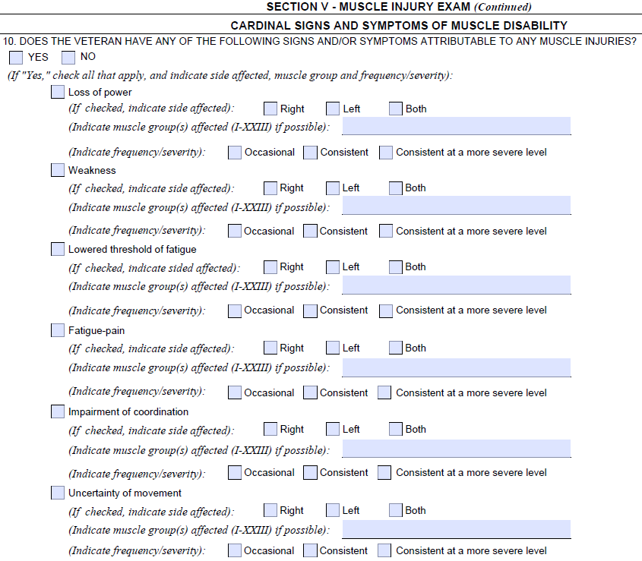
Evaluation of Muscle Disabilities: Cardinal Signs and Symptoms
38 CFR 4.56(c): For VA rating purposes, the cardinal signs and symptoms of muscle disability are loss of power, weakness, lowered threshold of fatigue, fatigue-pain, impairment of coordination and uncertainty of movement.

Slide 50
Slight Muscle Injury
Type of Injury | History and Complaint | Objective Findings
Simple wound of muscle without debridement or infection. | Service record of superficial wound with brief treatment and return to duty. Healing with good functional results. No cardinal signs or symptoms of muscle disability. | Minimal scar. No evidence of fascial defect, atrophy, or impaired tonus. No impairment of function No metallic fragments retained in muscle tissue.

Slide 51
Moderate Muscle Injury
Type of Injury | History and Complaint | Objective Findings
Through and through or deep penetrating wound of short track from a single bullet, small shell or shrapnel fragment, without explosive effect of high velocity missile, residuals of debridement, or prolonged infection. | Service record or other evidence of in-service treatment for the wound. Record of consistent complaint of one or more of the cardinal signs and symptoms, particularly lowered threshold of fatigue after average use, affecting the particular functions controlled by the injured muscles. | Entrance and (if present) exit scars, small or linear, indicating short track of missile through muscle tissue. Some loss of deep fascia or muscle substance or impairment of muscle tonus and loss of power or lowered threshold of fatigue when compared to the sound side.

Slide 52
Moderately Severe Muscle Injury
Type of Injury | History and Complaint | Objective Findings
Through and through or deep penetrating wound by small high velocity missile or large low-velocity missile, with debridement, prolonged infection, or sloughing of soft parts, and intermuscular scarring. | Service record or other evidence showing hospitalization for a prolonged period for treatment of wound. Record of consistent complaint of cardinal signs and symptoms of muscle disability and, If present, evidence of inability to keep up with work requirements. | Entrance and (if present) exit scars indicating track of missile through one or more muscle groups. Indications on palpation of loss of deep fascia, muscle substance, or normal firm resistance of muscles compared with sound side. Tests of strength and endurance compared with sound side demonstrate positive evidence of impairment.

Slide 53
Severe Muscle Injury
Type of Injury | History and Complaint | Objective Findings
Through and through or deep penetrating wound due to high-velocity missile, or large or multiple low velocity missiles, or With shattering bone fracture or open comminuted fracture with extensive debridement, prolonged infection, or sloughing of soft parts, intermuscular binding and scarring. | Service record or other evidence showing hospitalization for a prolonged period for treatment of wound. Record of consistent complaint of cardinal signs and symptoms of muscle disability, worse than those shown for moderately severe muscle injuries, and, If present, evidence of inability to keep up with work requirements. | Ragged, depressed and adherent scars indicating wide damage to muscle groups in missile track. Palpation shows loss of deep fascia or muscle substance, or soft flabby muscles in wound area. Muscles swell and harden abnormally in contraction. Tests of strength, endurance, or coordinated movements compared with the corresponding muscles of the uninjured side indicate severe impairment of function.

Slide 54
Severe Muscle Injury
If present, the following are also signs of severe muscle disability:
X-ray evidence of minute multiple scattered foreign bodies indicating intermuscular trauma and explosive effect of the missile.
Adhesion of scar to one of the long bones, scapula, pelvic bones, sacrum or vertebrae, with epithelial sealing over the bone rather than true skin covering in an area where bone is normally protected by muscle.
Diminished muscle excitability to pulsed electrical current in electrodiagnostic tests.

Slide 55
Severe Muscle Injury
Visible or measurable atrophy.
Adaptive contraction of an opposing group of muscles.
Atrophy of muscle groups not in the track of the missile, particularly of the trapezius and serratus in wounds of the shoulder girdle.
Induration or atrophy of an entire muscle following simple piercing by a projectile.

Slide 56
Important Reminders for Muscle Injuries
Rate all Disabilities
All manifestations of a muscle injury affecting different bodily functions are separately ratable.
Amputation Rule
The combined rating for residuals of a muscle injury to an upper or lower extremity, with certain exceptions related to osteomyelitis, cannot exceed the rating for amputation at the elective level, were amputation to be performed. 38 CFR 4.68

Slide 57
Important Reminders for Muscle Injuries
Pleural Cavity Injury and MG XXI
Separate ratings for a pleural cavity injury (diagnostic code 6800) and injury to Muscle Group XXI are prohibited. 38 CFR 4.97, Diagnostic Codes 6840 to 6845, note 3.
Pleural Cavity Injury and MG I & IV
Disabling injuries of shoulder girdle muscles (Groups I and IV) shall be separately rated and combined with respiratory involvement. 38 CFR 4.97, Diagnostic Codes 6840 to 6845, note 3.

Slide 58
Important Reminders for Muscle Injuries
Open Comminuted Fracture = Severe Muscle Rating
Open comminuted fracture with muscle or tendon damage will be rated as a severe injury of the muscle group involved unless, for locations such as in the wrist or over the tibia, evidence establishes that the muscle damage is minimal. 38 CFR 4.56(a)
GSW/SFW Fractures Considered Open
All GSW/SFW fractures should be considered open because all of them involve an opening to the outside. Most GSW/FSW fractures are also comminuted due to the shattering nature of the injury.

Slide 59
Important Reminders for Muscle Injuries
Through and Through Muscle Injury = No less than Moderate
Through and through injury with muscle damage shall be evaluated no less than a moderate injury for each muscle group affected. 38 CFR 4.56(b)
Special Monthly Compensation for Loss of Use
Consider special monthly compensation for loss of use of any extremity or loss of use of both buttocks.

Slide 60
Important Reminders for Muscle Injuries
Muscles Disability Benefits Questionnaire (DBQ)
The examination report must include information to adequately identify the MG affected by either:
specifically noting which MG is affected, or
noting which muscles are involved so that the name of the muscles may be used to identify the MG affected.

Slide 61
Questions

