Slide 1
Musculoskeletal System Lower Body
Compensation Service
September 2016

Slide 2
Objectives
Demonstrate an understanding of the basic principles for applying the Rating Schedule while evaluating lower body musculoskeletal disabilities
Recognize the rules and regulations surrounding the musculoskeletal disabilities
Identify the circumstances in which separate evaluations are permissible for the same joint
Determine appropriate evaluation levels based on the evidence surrounding the disabilities of the lower extremities

Slide 3
References
38 CFR 4.14 – Avoidance of pyramiding
38 CFR 4.25 – Combined ratings table
38 CFR 4.30 – Convalescent ratings
38 CFR 4.40 – Functional Loss
38 CFR 4.43 - Osteomyelitis
38 CFR 4.45 – The Joints
38 CFR 4.46 – Accurate Measurement
38 CFR 4.55 – Principles of combined raings for muscle injuries
38 CFR 4.56 – Evaluation of muscle disabilities
38 CFR 4.57 – Static foot deformities
38 CFR 4.58 – Arthritis due to strain
38 CFR 4.62 – Circulatory disturbances
38 CFR 4.63 – Loss of use of hand or foot
38 CFR 4.64 – Loss of use of both buttocks

Slide 4
References cont.
38 CFR 4.68 – Amputation Rule
38 CFR 4.59 – Painful Motion
38 CFR 4.71 – Measurement of Ankylosis and Joint Motion
38 CFR 4.71a – Rating Schedule of Musculoskeletal Disabilities
M21-1, Part III, Subpart iv, 4.A – Musculoskeletal Conditions
M21-1, Part III, Subpart iv, 3.D – Examination Reports
VSCM Conference Calls – July 2011 & April 2014
MEPSS – Medical EPSS
VBN Broadcast – September 2004
Deluca v. Brown and Mitchell v. Shinseki
VAOPGCPREC 9-2004 – Rating Limitation of Flexion and Extension of the Leg
VAOPGCPREC 23-97 – Multiple Ratings for Knee Disabilities
Musculoskeletal DBQs

Slide 5
Functional Loss
38 CFR 4.40
Inability to perform the normal working movements of the body with normal excursion, strength, speed, coordination and endurance
Note: A part which has become painful on use must be regarded as seriously disabled

Slide 6
Functional Loss
DeLuca v. Brown, 1995
Requires that when evaluating musculoskeletal conditions we consider not only limitation of motion, but also:
Weakened movement,
Excess fatigability,
Incoordination, and
Pain

Slide 7
Functional Loss
Mitchell v. Shinseki, 2011
Requires that the examiner:
provide an opinion on whether pain, weakness, fatigability or incoordination could significantly limit functional ability during flare-ups or when the joint is used repeatedly over a period of time.
Should be expressed in terms of the degrees of additional ROM loss due to “pain on use or during flare-ups”.

Slide 8
What are the Major & Minor Lower Body Joints?
Major Joints
Hip
Knee
Ankle
Minor Joints
Interphalangeal, metatarsal and tarsal joints of the lower extremities
(rated on disturbance of lumbar spine functions)

Slide 9
Painful Motion
38 CFR 4.59
With any form of arthritis, painful motion is an important factor of disability.
The joints involved should be tested for:
Pain with active motion
Pain with passive motion
Pain with weight-bearing
Pain with nonweight-bearing
Note: Facial expressions, wincing, etc. on pressure or manipulation should be carefully noted when addressing affected joints.

Slide 10
Painful Motion
Reminder: Findings of painful, unstable, or misaligned joints
due to healed injury should be entitled to at least the
minimum compensable evaluation. (10%)

Slide 11
Circulatory Disturbances
38 CFR 4.62
The circulatory disturbances, especially of the lower extremity following injury in the popliteal space, must not be overlooked
Require rating generally as phlebitis.

Slide 12
Acute, Subacute, or Chronic Diseases
Osteomyelitis (DC 5000) Inflammation of bone matter
Active = infection and antibiotic treatment (20% evaluation)
Inactive = no recurrence for 5 years (10% evaluation)
Note: An initial episode of active osteomyelitis is not a basis for either of the evaluations.
See 38 CFR 4.43 and M21-1, III.iv.4.A.7 for additional guidance

Slide 13
Acute, Subacute, or Chronic Diseases
Rheumatoid arthritis (Also called rheumatoid spondylitis, ankylosing spondylitis, or Marie-Strumpell diseases)
In addition to, or in advance of, x-ray evidence pay attention to:
Muscle spasms
Soft tissue changes
Constitutional changes
Rate as an active process, or inactive process based on chronic residuals such as LOM or ankylosis under the appropriate diagnostic codes for the specific joints involved

Slide 14
Acute, Subacute, or Chronic Diseases
Degenerative Arthritis (Also known as osteoarthritis or hypertrophic arthritis)
Degeneration of joint cartilage or hypertrophy of bone
If there is limitation of motion (LOM):
Rate on LOM under the appropriate DC unless this would result in a non-compensable evaluation, then rate at 10% for each major joint or group of minor joints
**Note: Need x-ray evidence to diagnose**

Slide 15
Acute, Subacute, or Chronic Diseases
Degenerative Arthritis continued
If there is no LOM:
With X-ray evidence of involvement of 2 or more major joints or 2 or more minor joint groups = 10%
With X-ray evidence of involvement of 2 or more major joints or 2 or more minor joint groups, with occasional incapacitating exacerbations = 20%
** Note: The 10% and 20% ratings based on X-ray findings, above, will not be combined with ratings based on LOM. **

Slide 16
Acute, Subacute, or Chronic Diseases
Other types of arthritis (DC 5004-5009)
Traumatic arthritis (DC 5010)
Need X-ray evidence
** Same criteria as DC 5003
Caisson Disease of the Bones (DC 5011)
Malignant New Growths of Bones (DC 5012)

Slide 17
Arthritis Due to Strain
38 CFR 4.58
When there is a lower extremity shortening or amputation, an associated arthritis that subsequently develops (in lower extremities, lumbosacral joints, or lumbosacral spine) will be service connected.

Slide 18
Arthritis Cases Previously Rated as a Single Disability
Re-rate as follows:
If separate evaluation results in no change in combined evaluation, use the new procedure
If there is an increase in the combined evaluation, use 38 CFR 3.105(a) to retroactively increase the evaluation
If re-rating causes decrease in combined evaluation, apply 38 CFR 3.105(a) & (e) unless there is protection under 3.951

Slide 19
Examinations
38 CFR 4.45
Examiners should provide history and objective findings, as well as findings of:
Less movement than normal
More movement than normal
Weakened movement
Excess fatigability
Incoordination
Pain on movement

Slide 20
Medical Examination Criteria
Examiner must report based on requirements of 38 CFR 4.45
Additional x-rays, lab work, MRI or CT scans may be ordered
Complete range of motion studies are required
Accurate measurement of the length of any amputation stump is required
Scars and any additional disability due to them should be noted. They are to be rated separately if appropriate.

Slide 21
The Amputation Rule
38 CFR 4.68
The combined evaluation for disabilities on an extremity shall not exceed the rating for the amputation at the elective level, were the amputation to be performed.
i.e. The combined evaluation for disabilities below the knee shall not exceed the 40 percent evaluation. This 40 percent rating may be further combined with an evaluation for disabilities above the knee, but not to exceed the above the knee amputation elective level.

Slide 22
Prosthetic Implants
38 CFR 4.30 - Temporary total evaluation for one year following replacement of:
hip, knee, or ankle joint
After year, rate on residual disability
SMC may be assigned during the period of total evaluation if the permanent use of crutches are required

Slide 23
Anatomical Loss and Loss of Use
X-ray studies may be needed to determine level of amputation
A painful neuroma shall be assigned to the evaluation for the elective site of re-amputation

Slide 24
Loss of Use of Hand or Foot
38 CFR 4.63
For purposes of SMC, loss of use is conceded when the Veteran would be equally well served by an amputation with suitable prosthesis
Note: When ordering exams, do not ask about loss of use; rather, ask about remaining function

Slide 25
Loss of Use of Both Buttocks
38 CFR 4.64
For purposes of SMC, it exists when there is severe damage to muscle group XVII, and when the person cannot, without assistance:
Rise from a seated position, or
Rise from a stooped position
And maintain postural stability

Slide 26
Combinations of Anatomical Loss and Loss of Use Disabilities
Provide for 100% evaluation based on combinations of disabilities related to anatomical loss or loss of use
Diagnostic codes for upper extremities: DC 5120 – 5156
Diagnostic codes for lower extremities: DC 5160 – 5173
**Note: May result in higher SMC levels

Slide 27
Evaluating Non-Amputation Disabilities of the Lower Extremities
DCs 5250 – 5274
Used to evaluate disabilities of the hip, thigh, knee and leg
Evaluations based on ankylosis, limitation of motion, or weight bearing impairment
Possible SMC with extremely unfavorable ankylosis of the hip

Slide 28
Shortening of the Lower Extremity
When there is a shortening of the bones of the lower extremity, a separate evaluation may be assigned.
DO NOT combine with other evaluations for fracture / faulty union of the same extremity.

Slide 29
Other Disabilities of Bones and Joints
Fibromyalgia – Syndrome characterized by chronic widespread musculoskeletal pain associated with multiple tender or “trigger” points
Added to Rating Schedule on May 7, 1996
Often with multiple somatic complaints, such as sleep disorders, anxiety, fatigue, headache, and irritable bowel symptoms

Slide 30
Other Disabilities of Bones and Joints
Osteoporosis (DC 5013)
Osteomalacia (DC 5014)
Benign New Growths of Bones (5015)
Osteitis Deformans (DC 5016)
Gout (DC 5017 – rated under DC 5002, rheumatoid arthritis)
Hydrarthrosis (DC 5018)
Bursitis (DC 5019)
Synovitis (DC 5020)
Myositis (DC 5021)
Periostitis (DC 5022)
Myositis Ossificans (DC 5023)
Tenosynovitis (DC 5024)

Slide 31
Combined Ratings for Muscle Injuries
38 CFR 4.55
(a) A muscle injury will not be combined with a peripheral nerve paralysis rating of the same body part unless the injuries affect different functions.
(b) The skeletal muscles are divided into 23 muscle groups in 5 anatomical regions; the lower body muscles consist of the following:
Pelvic girdle and thigh
(c) No ratings for muscles acting on ankylosed joints except:
Muscle group XIII with ankylosed knee, or
Muscle groups I and II with ankylosed shoulder
Foot and leg

Slide 32
Combined Ratings for Muscle Injuries
38 CFR 4.55
(d) The combined evaluation of muscle groups acting on a single unankylosed joint must be lower than the evaluation for unfavorable ankylosis for that joint.
Exception: Muscle groups I and II acting on the shoulder
(e) For compensable muscle group injuries in the same anatomical region, but not the same joint:
The evaluation for the most severely injured muscle group will be elevated by one level and used as the combined evaluation for the groups
(f) For muscle injuries in different anatomical regions that do not act on ankylosed joints:
Rate separately and combine under 38 CFR 4.25

Slide 33
Evaluation of Muscle Disabilities
38 CFR 4.56
Rate an open comminuted fracture with muscle or tendon damage as a severe injury of the muscle group involved unless evidence establishes that the muscle damage is minimal
Disabilities resulting from muscle injuries shall be classified as slight, moderate, moderately severe or severe
A through-and-through injury with muscle damage shall be evaluated as no less than a moderate injury for each group of muscles damaged

Slide 34
Evaluation of Muscle Disabilities
38 CFR 4.56
Cardinal signs of muscle disability are:
Loss of power
Weakness
Lowered threshold of fatigue
Fatigue-pain
Impairment of coordination
Uncertainty of movement

Slide 35
Muscle Injury Considerations
Reminder: Injuries that cause damage to muscles can also damage bones and nerves… DO NOT pyramid these conditions.

Slide 36
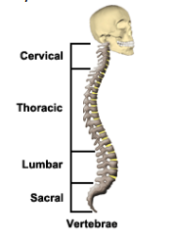
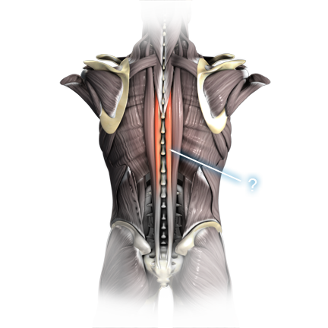
Spine conditions

Slide 37
The Spine
Low Back Pain (LBP), Lumbosacral Strain (LS) and subsequently developing Herniation of a Nucleus Pulposus (HNP)
Commonly a veteran will establish SC for LBP/LS and will later develop HNP. The HNP can be service connected if a progressive condition can be established.
HOWEVER, denial may be appropriate if the LS-LBP has been long asymptomatic, and no causal relationship can be established to the HNP.

Slide 38
Ankylosis and Limitation of Motion of the Spine
DC’s 5235 – 5243 are used for ankylosis or limitation of motion of the spine
Normal Ranges of Motion of Spine
Forward Flexion
Extension
Left Lateral Flexion
Right Lateral Flexion
Left Lateral Rotation
Right Lateral Rotation
0 to 90 degrees
0 to 30 degrees
0 to 30 degrees
0 to 30 degrees
0 to 30 degrees
0 to 30 degrees

Slide 39
Intervertebral Disc Syndrome (IVDS)
May also be called:
Slipped
Ruptured
Bulging
Degenerative disc disease (DDD)
Discogenic pain syndrome
Herniated
Prolapsed
Protruded disc
Sciatica
Herniated nucleus pulposus
Results from displacement of intervertebral disc or disc fragments
Evaluated based on:
Periods of acute symptoms, or
Chronic orthopedic manifestations
**If both are present, use the method that is most advantageous to the Veteran

Slide 40
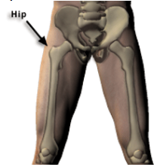
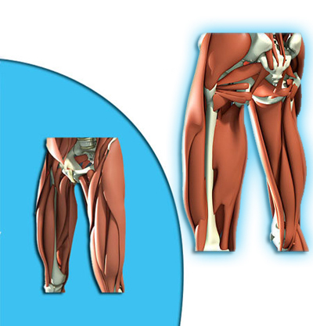
Hip Conditions

Slide 41
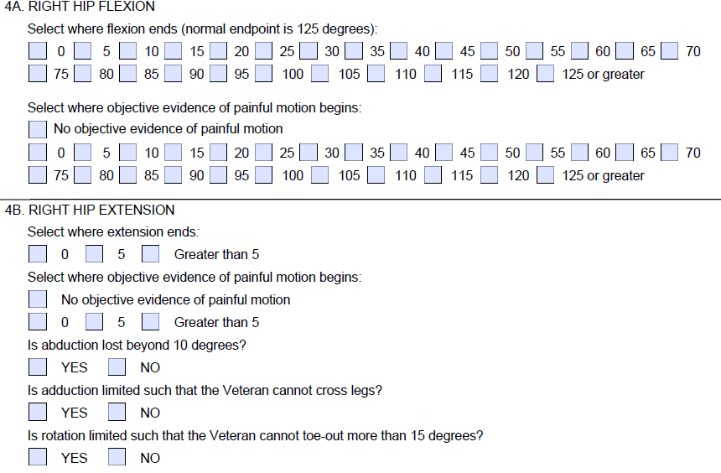
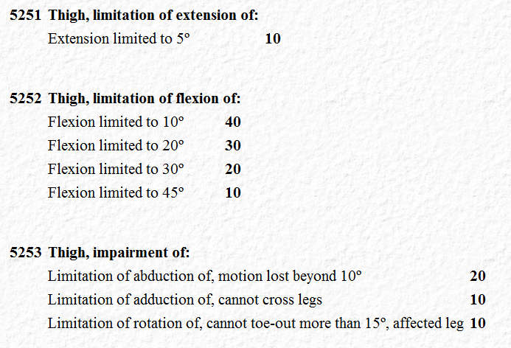
Limitation of Hip Motion
Diagnostic Codes 5251 - 5253

Slide 42
Overview of Hips
Common hip-related diagnoses include, but are in no way limited to:
Ankylosis (DC 5250)
Thigh impairment (DC 5253)
Degenerative joint disease / traumatic arthritis (DC 5010)
Regardless of diagnosis, functional impairments routinely involve:
Limitation of flexion
Limitation of extension
Instability

Slide 43
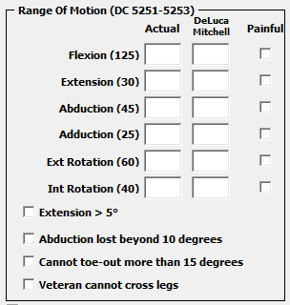
Movement of the Hip
Flexion:
Occurs when the back is strait, and the knee is raised to the chest to an angle of 125 degrees
Extension:
Involves positioning the knee and the hip in a straight line at 0 degrees
Abduction:
The movement of a straitened leg away from the midline of the body to a 45 degree angle
Adduction:
The movement of a straightened leg toward and slightly past the midline of the body to a 20-30 degree angle
External Rotation:
Involves bending the knee and turning the leg outward to an angle of 60 degrees
Internal Rotation:
Involves bending the knee and turning the leg inward to a 40 degree angle

Slide 44
Separate Evaluations for the Hip
VAOPGCPREC 9-2004
General Counsel Opinion held that a Veteran may receive separate ratings for:
DC 5251 (limitation of extension) and
DC 5252 (limitation of flexion)
For the same hip
Extension and flexion MUST meet non-compensable scheduler criteria to warrant separate ratings.
Exception: Like the knee joint, where motion is not limited, but there is objective evidence of pain on motion, one compensable evaluation can be assigned under either DC 5251 or DC 5252 (38 CFR 4.14)

Slide 45
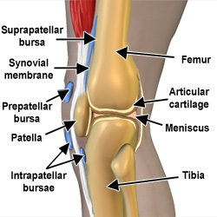
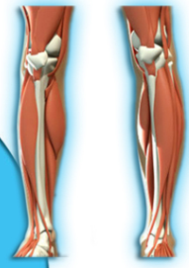
Knee conditions

Slide 46
Overview of Knees
Common knee-related diagnoses include, but are in no way limited to:
Bursitis (DC 5019)
Synovitis (DC 5020)
Degenerative joint disease / traumatic arthritis (DC 5010)
Regardless of diagnosis, functional impairments routinely involve:
Limitation of flexion
Limitation of extension
Instability

Slide 47
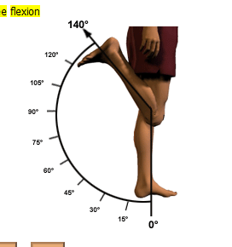
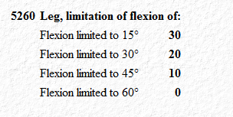
Limitation of Knee (Leg) Flexion
Diagnostic Code 5260
NOTE:
This field serves SOLELY to confirm painful motion and facilitate consideration of a compensable evaluation under 38 CFR 4.59.

Slide 48
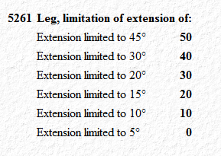
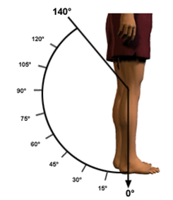
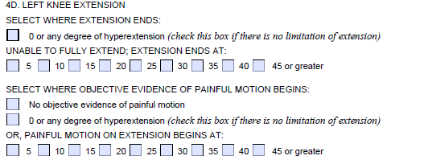
Limitation of Knee (Leg) Extension
Diagnostic Code 5261
NOTE:
This field serves SOLELY to confirm painful motion and facilitate consideration of a compensable evaluation under 38 CFR 4.59.

Slide 49
Separate Evaluations for the Knee
VAOPGCPREC 9-2004
General Counsel Opinion held that a Veteran may receive separate ratings for:
DC 5260 (limitation of flexion) and
DC 5261 (limitation of extension)
For the same knee
Extension and flexion MUST meet non-compensable scheduler criteria to warrant separate ratings.
Exception: Where joint motion is not limited, but there is objective evidence of pain on motion, one compensable evaluation can be assigned under either DC 5260 or DC 5261 (38 CFR 4.14)

Slide 50
Separate Evaluations for Arthritis of the Knee
VAOPGCPREC 23-97
General Counsel Opinion held that a Veteran who has arthritis and instability of the knee may be rated separately under:
DC 5003 (degenerative arthritis) and
DC 5257 (knee instability)

Slide 51
Separate Evaluations for Arthritis of the Knee
38 CFR 4.14
ONLY prohibits separate evaluations of disorders having the same disabling manifestations
A separate rating can be assigned if there is additional disability.
i.e. Loss of motion during flexion and extension

Slide 52
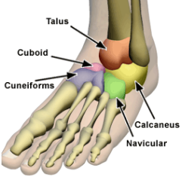
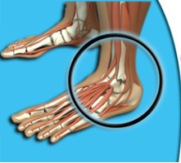
Ankle conditions

Slide 53
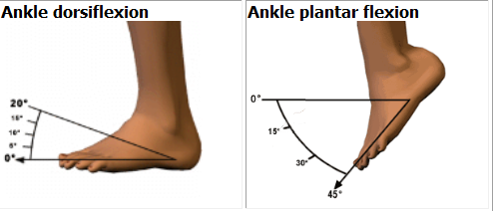
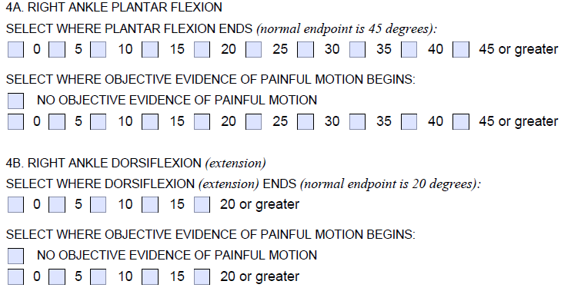
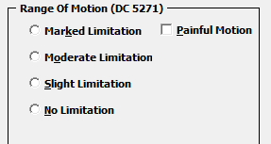
Limitation of Ankle Motion

Slide 54
Moderate vs. Marked
Moderate limitation of ankle motion will be present when there is:
Less than 15 degrees dorsiflexion, or
Less than 30 degrees plantar flexion
Marked limitation of ankle motion is demonstrated when there is:
Less than 5 degrees dorsiflexion
Less than 10 degrees plantar flexion

Slide 55
The Ankle
Reminders:
You must look at:
Special monthly compensation for loss of use of a foot / lower extremity, or for statutory housebound
Ancillary benefits, to include automobile allowance

Slide 56
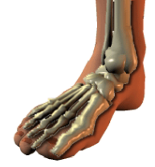
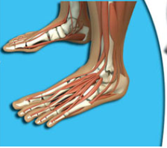
Foot Conditions

Slide 57
Flat Foot (Pes Planus)
38 CFR 4.57 - It is essential to make an initial distinction between bilateral flatfoot as a congenital or as an acquired condition.
Congenital abnormalities are not compensable
Acquired conditions are compensable, under DC 5276
Must show anatomical changes and other evidence of pain / limitation of motion
The symptoms should be apparent without regard to exercise.

Slide 58
Flat Foot (Pes Planus)
Mild symptoms relieved by built-up shoe or arch support – 0%
Moderate; weight-bearing line over or medial to great toe, inward bowing of the tendo achillis, pain on manipulation and use of the feet, bilateral or unilateral – 10%
Severe, objective evidence of marked deformity (pronation, abduction, etc.), pain on manipulation and use accentuated, indication of swelling on use, characteristic callosities:
Bilateral – 30%
Unilateral – 20%
Pronounced; marked pronation, extreme tenderness of plantar surfaces of the feet, marked inward displacement and severe spasm of the tendo achillis on manipulation, not improved by orthopedic shoes or appliances:
Bilateral – 50%
Unilateral – 30%

Slide 59
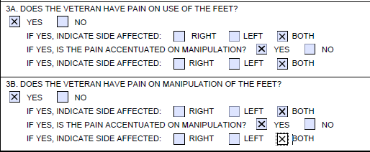
Flat Foot (Pes Planus)
The following selections on the DBQ qualify for a 50% evaluation. This is the maximum entitlement allowed.

Slide 60
Other Foot Conditions in the Rating Schedule
Weak Foot – DC 5277
Claw Foot – DC 5278
Metatarsalgia (Morton’s disease) – DC 5279
Hallux Valgus – 5280
Hallux Rigidus – 5281
Hammer Toes – 5282
Other foot injuries – DC 5284

Slide 61
Questions

