Slide 1
Hospital Adjustments
Compensation Service
August 2020

Slide 2
Lesson Objectives
The scope of this lesson is how benefits are affected when a beneficiary is receiving Special Monthly Compensation (SMC) Aid and Attendance (A&A) and hospitalized at VA expense.
At the end of this lesson, you will be able to:
Describe hospital adjustment provisions
Determine the dates of reduction and reinstatement of benefits
Identify 38 CFR §3.552 exceptions
Explain the requirements to process a hospital adjustment
Demonstrate the ability to process hospital adjustments

Slide 3
References
38 CFR §3.552, Adjustment of allowance for aid and attendance
38 CFR §3.556, Adjustment on discharge or release
M21-1 I.2.A, General Information on Due Process
M21-1 I.2.B.3.c, Special Procedures for Hospitalized Veterans
M21-1 III.v.6.C, Adjusting Awards Involving an Aid and Attendance (A&A) Allowance
M21-4, Appendix B.2, End Products – Compensation, Pension, and Fiduciary Operations
*Additional references are provided in the trainee handout.

Slide 4
Aid and Attendance (A&A)
Aid and Attendance is:
An additional allowance available to Veterans, spouses of Veterans, surviving spouses, and parents
Usually awarded to Veterans with mental or physical disabilities requiring the regular aid and attendance of another person to perform functions of daily living

Slide 5
Aid and Attendance (A&A) (cont.)
The following are some reasons a claimant may qualify for A&A:
Inability to dress/undress
Inability to keep clean and presentable
Frequent need for adjustment of any special prosthetic or orthopedic appliances
Inability to feed self through loss of coordination of upper extremities or extreme weakness
Inability to attend to the wants of nature
Incapacity which requires care on a regular basis to protect the Veteran from hazards within the daily environment

Slide 6
Hospital Adjustment Requirement
Veteran hospitalized at VA expense:
Reduction of benefits may be required
Two provisions governing reduction of benefits due to hospitalization:
38 CFR §3.551 – Pension, Veteran with no dependents
Reduction of pension to $90
38 CFR §3.552 – Compensation
Reduction of SMC A&A to the Housebound (most common) or other appropriate hospitalized rate
This lesson focuses mainly on Compensation, as Pension is handled by Pension Management Centers (PMCs)

Slide 7
Notification of Hospitalization
The hospital adjustment process begins when the VA Medical Center (VAMC) notifies a Regional Office (RO) of a change in a Veteran’s hospitalization status using:
VA Form 10-7131, Exchange of Beneficiary Information and Request for Administrative and Adjudicative Action (trainee handout, Attachment A)
VA Form 10-7132, Status Change (trainee handout, Attachment B)
CAPRI – Clinical Documents tab (slide 9)
If information is unavailable, request it under the 7131 tab
Centralized, automated reporting informed by Veterans Health Administration (VHA) clinical data
Notes:
III.v.6.A.1.b

Slide 8
Notification of Hospitalization (cont.)
The Veterans Benefits Administration (VBA) currently audits VHA clinical data to centrally automate timely creation and National Work Queue distribution of reports disclosing
• admissions and discharges of service-connected (SC) Veterans hospitalized in excess of 21 days, and
• hospital admissions, discharges, and re-admissions of beneficiaries in receipt of aid and attendance (A&A) or pension.
However, ROs must still use CAPRI to manually generate, on or around the first day of each month, the
• Contract Nursing Home (CNH) Report of Admissions/Discharges to ensure benefits do not require adjustment in accordance with procedures found in M21-1, Part V, Subpart iii, 2.B, and
• Discharge Report to ensure that convalescent ratings under 38 CFR §4.30 are properly applied, if/as warranted, in accordance with procedures found in M21-1, Part IV, Subpart ii, 2.J.4.
Notes:
III.v.6.A.1.e

Slide 9
Notification of Hospitalization – CAPRI Information for Individual Veteran

Slide 10
Benefits Adjustments
38 CFR §3.552 – A&A must be reduced to the Housebound or other appropriate hospitalized rate when a Veteran is provided hospital, domiciliary, or nursing home care at VA expense.
A&A not required because VA authorized facilities can provide similar services
Notes:
III.v.6.C.1.a, III.v.6.C.1.f,

Slide 11
Reduction of Benefits
According to 38 CFR §3.552, the following must be met to reduce SMC A&A to the Housebound or other appropriate hospitalized rate:
Veteran must be in receipt of SMC A&A
Veteran must be hospitalized at VA expense
Veteran’s disability may not be:
Paraplegia involving paralysis of both lower extremities together with loss of anal and bladder control, or
Hansen’s disease
Important: If A&A entitlement is established under 38 U.S.C. 1114(r)(1) or 38 U.S.C. 1114(r)(2), then A&A must be discontinued during hospitalization regardless of the disability involved.
Notes:
III.v.6.C.1.a

Slide 12
Reduction of Benefits (cont.)
Reduction to the Housebound or other appropriate hospitalized rate is effective the first day of the second calendar month following admission to the facility.
Example: If the Veteran was admitted into a VA hospital on March 14, 2016, the reduction would be effective on May 1, 2016.
See chart on Attachment C of the trainee handout
Notes:
III.v.6.C.1.a

Slide 13
Reinstating Benefits
After receiving a notice of discharge from the hospital, resume the payment of benefits at the A&A rate effective the date of discharge without waiting for receipt of a hospital report.
Example: If a Veteran was discharged from the VA hospital on February 2, 2020, then February 2, 2020, is also the date that A&A would resume.
Notes:
III.v.6.C.3.a

Slide 14
Hospital Absences of 30 Days or More
Adjust benefits for authorized absences of 30 days or more:
Report received, showing authorized absence of 30 days or more
Resume payments at the full A&A rate effective the date the Veteran left the hospital, domiciliary, or nursing home
Report received showing resumption of hospitalization
Reduce A&A to the Housebound or other appropriate hospitalized rate effective the date of readmission at VA expense
Notes:
III.v.6.C.3.b-f

Slide 15
Readmission Following an Irregular Discharge
If notice is received of readmission for hospitalization:
Within 6 months of the date of irregular discharge
Discontinue allowance for A&A effective the date of readmission
6 months or more after date of irregular discharge
Discontinue allowance for A&A effective the 1st day of the 2nd calendar month following the month of readmission
Example: Veteran was discharged on April 3, 2019, then readmitted on December 19, 2019. Discontinue the A&A rate on February 1, 2020.
Note: Notice of proposed adverse action procedures must be followed.
Notes:
III.v.6.C.3.g

Slide 16
Topic 1 Knowledge Check
Turn to Attachment D in the trainee handout and complete the exercise.

Slide 17
Hospital Adjustment Process
The hospital adjustment process requires the VSR to:
Assess the Veteran's hospital status and claim information
Make adjustment decisions based on the 38 CFR §3.552 criteria
Perform the necessary steps in VBMS-A to complete the adjustment

Slide 18
Determine the Source of A&A
Once the hospitalization notice is received, the VSR should determine the source of the A&A, either SMC or Special Monthly Pension (SMP):
A&A based on SMC – Screen the EP 330 to ensure it has the correct claim label.
A&A based on SMP – Screen the EP 330 to ensure it has the correct claim label. NWQ will forward to the appropriate PMC.
Notes:
III.v.6.C.1.c.Step 1

Slide 19
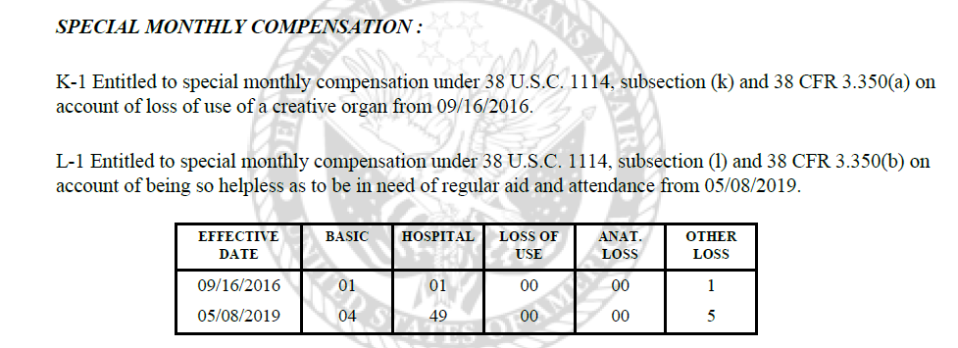
Determine if a Reduction is Necessary
Determine if a reduction is necessary based on 38 CFR §3.552 as previously discussed.
Review the Veteran’s latest Rating Codesheet for indication of A&A and other service-connected disabilities
Notes:
III.v.6.C.1.c.Step 3

Slide 20
Determine if a Reduction is Necessary (cont.)
Reminder: a Veteran receiving A&A at the R-1 or R-2 level must be reduced to the Housebound or other appropriate hospitalized rate regardless of the disabilities involved.
Notes:
III.v.6.C.1.a, 38 CFR 3.552(b)(2),

Slide 21
If a Reduction is Not Necessary
If a reduction is not necessary:
Clear the EP 330
Enter a VBMS note explaining why no adjustment was necessary
Take no further action
Notes:
III.v.6.C.1.c.Step 3

Slide 22
If a Reduction is Necessary – Notice of Proposed Adverse Action
Take the following steps if a hospital adjustment is necessary:
Change the EP 330 to an EP 320 – Review Due to Hospitalization and clear the EP 320.
Establish an EP 600 – Hospital Adjustment
Prepare a notice of proposed adverse action (due process)
Send one copy to the Veteran at the institution of hospitalization
Send another copy to the Veteran’s address of record
Set suspense for 65 days
When due process expires, reduce the SMC to the Housebound or other appropriate hospitalized rate.
Act immediately upon:
Expiration of due process period, or
Request for action by Veteran
Notes:
III.v.6.C.1.c.Step 5-e

Slide 23
Notice of Proposed Adverse Action (cont.)
Include in the notice of proposed adverse action the following statement, either at the bottom of the letter or on an attached VA Form 21-4138, Statement in Support of Claim:
I was admitted to the [hospital’s name] on [admission date]. Please take action without awaiting expiration of the due process period to reduce my payments to the proper rate authorized by law.
Request the Veteran sign and return the notice or form.
Note: See Attachment E in the trainee handout for an example letter.
Notes:
I.2.B.3.c

Slide 24
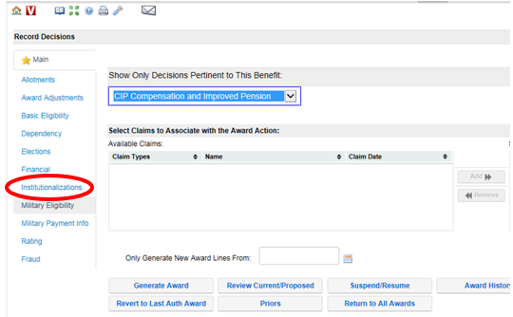
VBMS-A Steps for Reduction
VBMS-A Record Decisions screen:
Click on the Institutionalizations tab

Slide 25
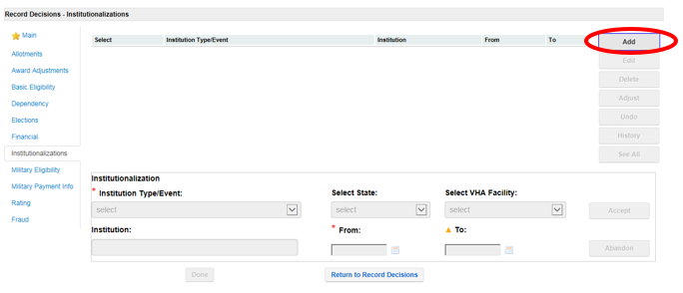
VBMS-A Steps for Reduction (cont.)
Institutionalizations screen:
Click Add

Slide 26
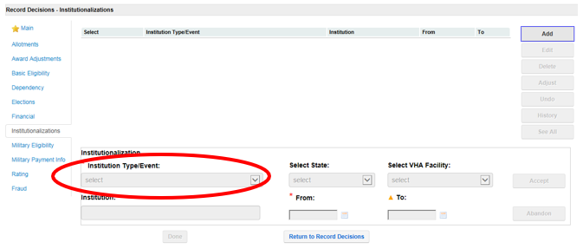
VBMS-A Steps for Reduction (cont.)
Institutionalizations screen:
Select the Institution Type/Event

Slide 27
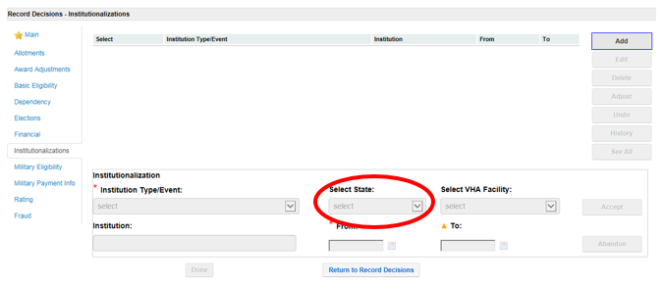
VBMS-A Steps for Reduction (cont.)
Institutionalizations screen:
For VA hospitalizations, select the State in which the Veteran is hospitalized

Slide 28
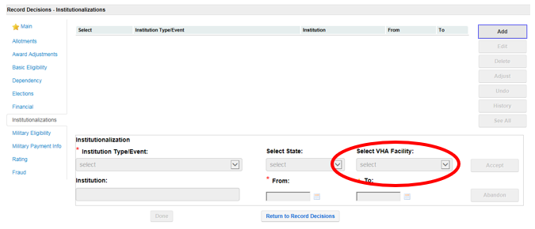
VBMS-A Steps for Reduction (cont.)
Institutionalizations screen:
Select the VHA Facility

Slide 29
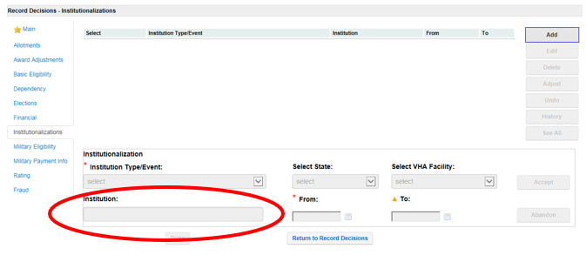
VBMS-A Steps for Reduction (cont.)
Institutionalizations screen:
The Institution name will be system populated for VHA admission

Slide 30
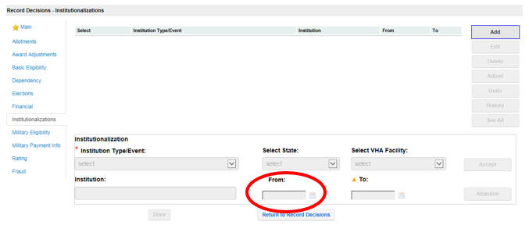
VBMS-A Steps for Reduction (cont.)
Institutionalizations screen:
Enter the From and To dates as necessary

Slide 31
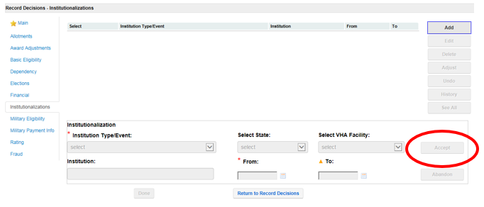
VBMS-A Steps for Reduction (cont.)
Institutionalizations screen:
Click Accept to update the screen

Slide 32
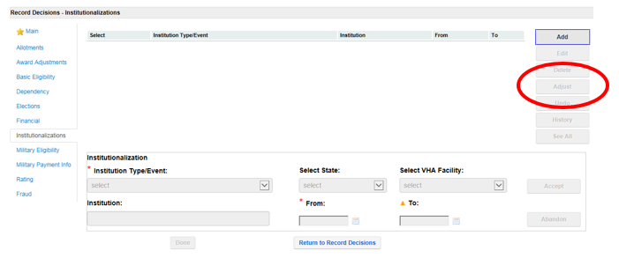
VBMS-A Steps for Reduction (cont.)
Institutionalizations screen:
Click Adjust to open the 2nd screen where the details regarding the decision to adjust benefits are recorded

Slide 33
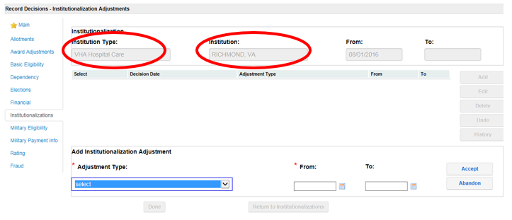
VBMS-A Steps for Reduction (cont.)
Institutionalization Adjustments screen:
Note that the details of the institutionalization are shown in the upper part of the screen

Slide 34
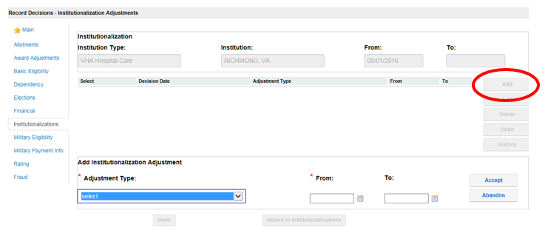
VBMS-A Steps for Reduction (cont.)
Institutionalization Adjustments screen:
Click Add

Slide 35
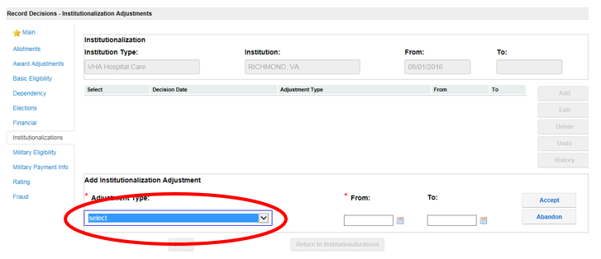
VBMS-A Steps for Reduction (cont.)
Institutionalization Adjustments screen:
Select the Adjustment Type

Slide 36
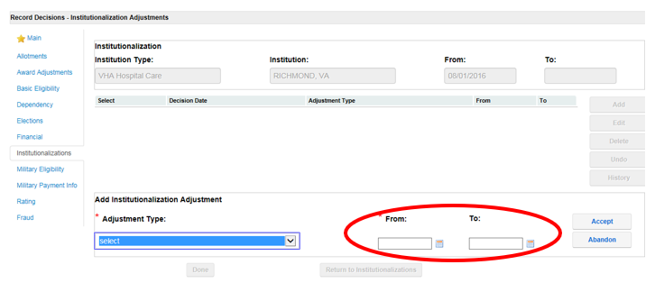
VBMS-A Steps for Reduction (cont.)
Institutionalization Adjustments screen:
The From and To dates will be system populated based on the dates entered on the previous screen

Slide 37
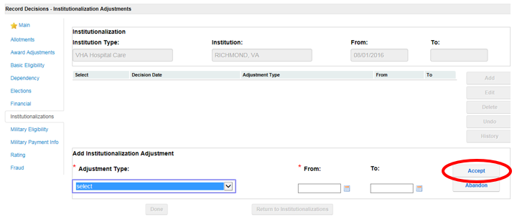
VBMS-A Steps for Reduction (cont.)
Institutionalization Adjustments screen:
Click Accept to update the screen

Slide 38
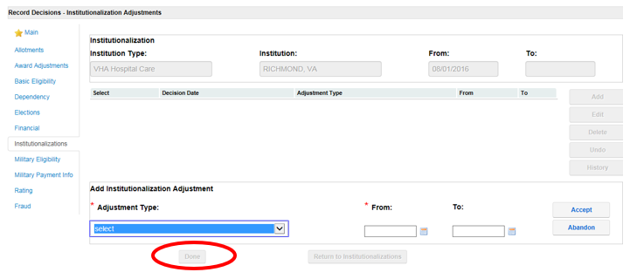
VBMS-A Steps for Reduction (cont.)
Institutionalization Adjustments screen:
Click Done to save the decision and close the Institutionalization Adjustments screen

Slide 39
Send Final Notice
Complete final notice to inform the Veteran of the reduction from A&A to the Housebound or other appropriate hospitalized rate, and:
Include new rates and effective dates in the letter
Check CAPRI to see if the Veteran remains hospitalized
If not yet discharged, ask the Veteran to notify VA upon discharge to reinstate A&A benefits
Include applicable laws and regulations in the letter:
e.g. 38 CFRs §3.105(e), §3.350, §3.552, §3.556
Note: See Attachment F in the trainee handout for an example letter.

Slide 40
VSR Assistant – Electronic Performance Support System (EPSS)
VSR Assistant is a tool available to aid in reinforcement and just-in-time training of complex processes. Some advantages include:
Reduces the level of complexity of multi-step claims
Provides performance support information as a VSR performs a task
Provides decision support that enables a VSR to identify the appropriate action
Includes calendars and calculators to assist in certain determinations

Slide 41
Topic 2 Knowledge Check
Turn to Attachment G in the trainee handout and complete the exercise.

Slide 42
Review
Questions?
Notes:
Questions?

