Slide 1
Neurological RVSR IWT
Compensation Service
August 2016
Notes:
Welcome to Neurological RVSR IWT course. To advance each slide, click anywhere on the screen.

Slide 2
Lesson Objectives
Given the review exercise and available references, the RVSR will be required to accomplish the following:
Identify types of neurological disorders and which nerves are effected
Identify the different types of DBQ’s and what sections are necessary for the examiner to complete for each identified disability
Identify special considerations when evaluating neurological disabilities
Complete a neurological rating.
Notes:
Lesson Objective
Given the review exercise and available references, the RVSR will be required to accomplish the following:
Identify types of neurological disorders and which nerves are effected
Identify the different types of DBQ’s and what sections are necessary for the examiner to complete for each identified disability
Identify special considerations when evaluating neurological disabilities
Complete a neurological rating.

Slide 3
References
38 CFR §3.307, §3.309, and §3.318 – Presumptive Service Connection
38 CFR §4.120 to §4.124a – Neurological Conditions and Convulsive Disorders
M21-1 Part, III, Subpart iv, Chapter 4, Section A, Evaluating Musculoskeletal Disabilities of the Spine and Lower Extremities
M21-1 Part III, Subpart iv, Chapter 4, Section E, Granting SC for Arteriosclerotic Manifestations Due to Hypertension
M21-1 Part III, Subpart iv, Chapter 4, Section G, Neurological and Convulsive Disorders
M21-1 Part IV, Subpart ii, Chapter 2, Section B, Overview of Presumptive SC & Definition: Other Organic Diseases of the Nervous System
M21-1 Part IV, Subpart ii, Chapter 2, Section C, Processing Claims Based on Early-Onset PN
Medical EPSS
Notes:
References
The references for this course are listed on the screen. You may click any hyperlinked references for further details.
38 CFR §3.307, §3.309, and §3.318 – Presumptive Service Connection
38 CFR §4.120 to §4.124a – Neurological Conditions and Convulsive Disorders
M21 dash 1 Part Three, Subpart four, Chapter 4, Section A, Evaluating Musculoskeletal Disabilities of the Spine and Lower Extremities
M21 dash 1 Part Three, Subpart four, Chapter 4, Section E, Granting SC for Arteriosclerotic Manifestations Due to Hypertension
M21 dash 1 Part Three, Subpart four, Chapter 4, Section G, Neurological and Convulsive Disorders
M21 dash 1 Part Four, Subpart two, Chapter 2, Section B, Overview of Presumptive SC & Definition: Other Organic Diseases of the Nervous System
M21 dash 1 Part Four, Subpart two, Chapter 2, Section C, Processing Claims Based on Early-Onset PN
Medical E P S S

Slide 4
Neurological System Described
Connects all functions of the body, enabling individuals to receive and adapt to input from internal and external environments.
Information received from the environments is analyzed by the brain, and then is transmitted to appropriate body areas or parts.
Notes:
Neurological System Described
Connects all functions of the body, enabling individuals to receive and adapt to input from internal and external environments.
Information received from the environments is analyzed by the brain, and then is transmitted to appropriate body areas or parts.

Slide 5
Types of Neurological Disorders
Organic diseases and traumatic injury to the central nervous system (brain and spinal cord)
Miscellaneous neurological
Cranial nerve
Peripheral nerve
Epilepsies
Notes:
Types of Neurological Disorders
Organic diseases and traumatic injury to the central nervous system (brain and spinal cord)
Miscellaneous neurological
Cranial nerve
Peripheral nerve
Epilepsies

Slide 6
Neurological Highlights
Migraines
Stroke
Amyotrophic Lateral Sclerosis (ALS)
Multiple Sclerosis
Parkinson’s Disease
Peripheral Neuropathy
Notes:
Neurological Highlights
Migraines
Stroke
Amyotrophic Lateral Sclerosis (A L S)
Multiple Sclerosis
Parkinson’s Disease
Peripheral Neuropathy

Slide 7
Migraines (DC 8100)
A throbbing headache that occurs on one side and is episodic.
May be subject to a presumption of service connection (38 CFR 3.309(a))if manifested compensably within one year of discharge
Rating Schedule:
Evaluation Builder:
Notes:
Migraines (DC 8 100)
A throbbing headache that occurs on one side and is episodic.
May be subject to a presumption of service connection (38 CFR 3.309(a))if manifested compensably within one year of discharge

Slide 8
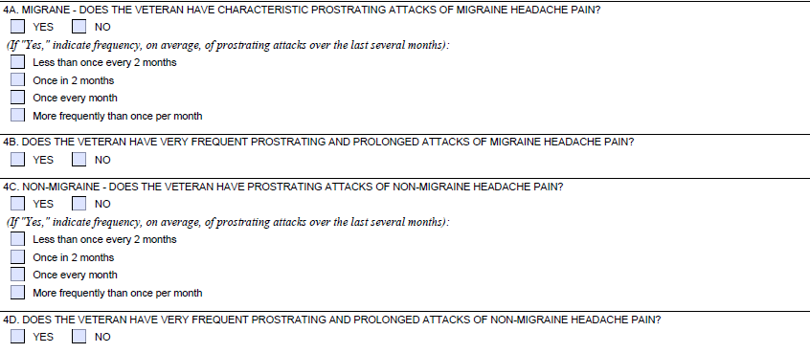
Headaches (Including Migraine Headache) DBQ
Notes:
Headaches (Including Migraine Headache) DBQ

Slide 9
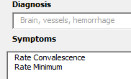
Stroke (DC 8007/8008/8009)
Cerebral infarction residuals may include blindness, weakness, paralysis, and aphasia
Rate based on residuals OR assign the minimum 10 percent, whichever is the greater benefit.
Evaluation Builder:
Also subject to a presumption of service connection (38 CFR 3.309(a)) if manifested within one year of discharge.
Notes:
Stroke (DC 80 07 / 80 08 / 80 09)
Cerebral infarction residuals may include blindness, weakness, paralysis, and aphasia
Rate based on residuals OR assign the minimum 10 percent, whichever is the greater benefit.

Slide 10
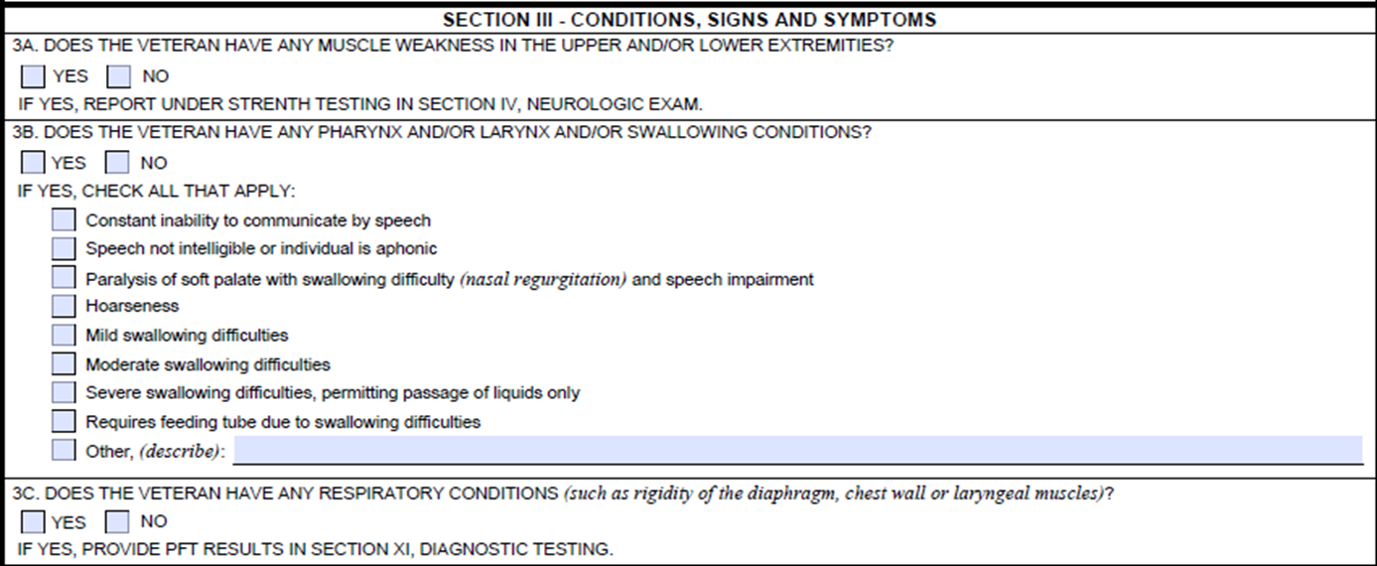
DBQ
Notes:
DBQ

Slide 11
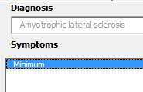
Amyotrophic Lateral Sclerosis (DC 8017)
Progressive deterioration of brain and spinal cord nerve cells that control voluntary muscles. The condition is a combination of upper and lower motor neuron deficit. The condition is also referred to as ALS or Lou Gehrig's disease.
Prior to January 19, 2012 the minimum was 30 percent.
Evaluation Builder:
Subject to a presumption of service connection under 3.318 if manifested at any time after discharge from active duty, with at least 90 days of continuous service.
Notes:
Amyotrophic Lateral Sclerosis (DC 80 17)
Progressive deterioration of brain and spinal cord nerve cells that control voluntary muscles. The condition is a combination of upper and lower motor neuron deficit. The condition is also referred to as A L S or Lou Gehrig's disease.
Prior to January 19, 2012 the minimum was 30 percent.

Slide 12
Evaluation Guidelines for ALS
Notes:
Evaluation Guidelines for ALS
If there is no complication warranting a single 100 percent evaluation then assign a 100 percent evaluation under 38 CFR 4.124a, DC 8017, and
Include all compensable complications in the description of the diagnosis.
Example: ALS with loss of use of the left food and partial ninth cranial nerve paralysis.
If a single 100 percent evaluation is warranted for a complication of ALS, the assign a 100 percent evaluation for that complication. Use a hyphenated DC.
Example: 80 17 dash 51 10, loss of use of both feet.
Or, separately evaluate additional complications. Do no assign a separate evaluation under 38 CFR 4.124a, DC 80 17 alone; this would be pyramiding under 38 CFR 4.14.
Note: A 100 percent evaluation for a complication of ALS satisfies the policy that all ALS awards will be assigned at least a 100 percent evaluation.

Slide 13
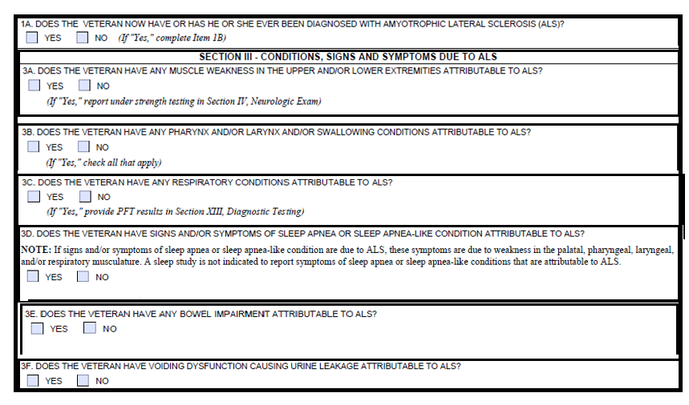
ALS (Lou Gehrig’s Disease) DBQ
Notes:
ALS (Lou Gehrig’s Disease) DBQ

Slide 14
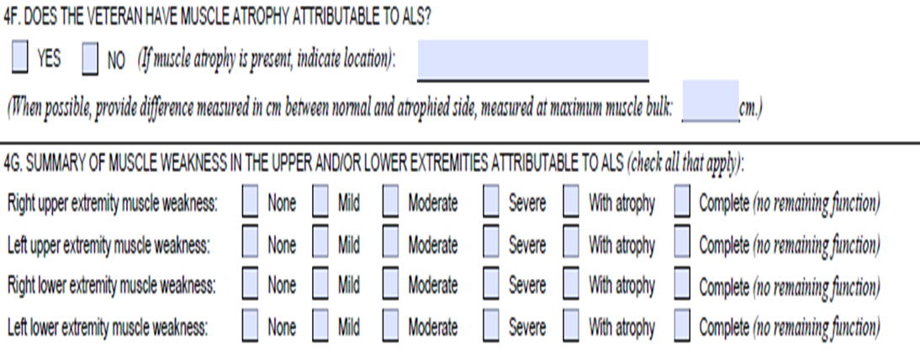
Amyotrophic Lateral Sclerosis DBQ (cont.)
Notes:
Amyotrophic Lateral Sclerosis DBQ (continued)

Slide 15
Amyotrophic Lateral Sclerosis DBQ (cont.)
Be sure to separately evaluate each extremity affected!
Notes:
Amyotrophic Lateral Sclerosis DBQ (continued)
Be sure to separately evaluate each extremity affected!

Slide 16
Amyotrophic Lateral Sclerosis DBQ (cont.)
When strength/DTR are significantly decreased-Consider loss of use!
Notes:
Amyotrophic Lateral Sclerosis DBQ (continued)
When strength/DTR are significantly decreased – Consider loss of use!

Slide 17
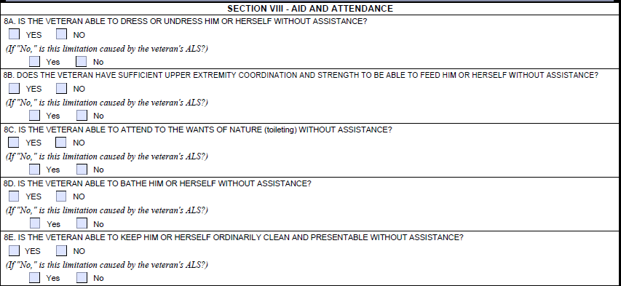
ALS DBQ (cont)
Notes:
ALS DBQ (continued)

Slide 18
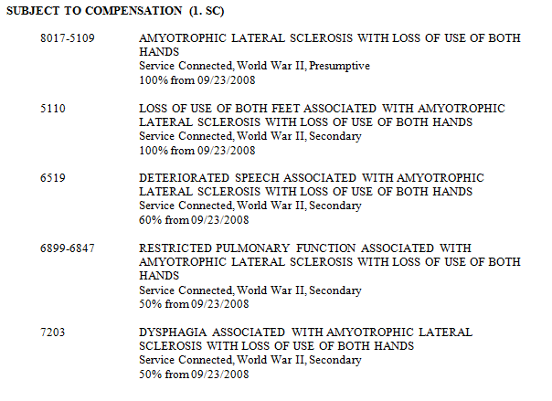
ALS Sample Codesheet
Show the DC of the disease entity only once as the lead DC. Follow the lead code with a code for the body system of the most severely affected disorder.
Code the involvement of the other body systems under the diagnostic code for the disability on which the evaluation is determined.
Don’t forget: Chapter 35, SAH and any other applicable SMC/Ancillary benefits!!!
Notes:
ALS Sample Codesheet
Show the DC of the disease entity only once as the lead DC. Follow the lead code with a code for the body system of the most severely affected disorder.

Slide 19
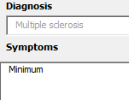
Multiple Sclerosis (DC 8018)
Chronic, slowly progressive, worsening central nervous system (CNS) disorder, characterized by weakness, numbness, tingling or unsteadiness in a limb, spastic paraparesis, and disequilibrium.
7 year presumptive period!!! (under 3.309(a))
Evaluation Builder:
Rate based on residuals OR assign the minimum 30 percent, whichever is the greater benefit.
**MS DBQ is almost identical to ALS.
Notes:
Multiple Sclerosis (DC 80 18)
Chronic, slowly progressive, worsening central nervous system (CNS) disorder, characterized by weakness, numbness, tingling or unsteadiness in a limb, spastic paraparesis. and disequilibrium.
7 year presumptive period!!! (under 3.309(a))

Slide 20
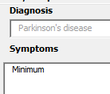
Parkinson’s Disease (DC 8004)
Chronic, slowly progressive, worsening central nervous system (CNS) disorder, characterized by muscular rigidity, a tremor of resting muscles, slow and decreased voluntary movements, and position instability.
Rate based on residuals OR assign the minimum 30 percent, whichever is the greater benefit.
Also subject to a presumption of service connection under 3.309(a) if manifested within one year of discharge, and under 3.309(e) if the Veteran was exposed to herbicides and Parkinson’s Disease manifests at any time after discharge.
Evaluation Builder:
If granting due to AO exposure and diagnosed prior to August 31, 2010, 3.114 applies!
Notes:
Parkinson’s Disease (DC 80 04)
Chronic, slowly progressive, worsening central nervous system (CNS) disorder, characterized by muscular rigidity, a tremor of resting muscles, slow and decreased voluntary movements, and position instability.
Rate based on residuals OR assign the minimum 30 percent, whichever is the greater benefit.
Also subject to a presumption of service connection under 3.309(a) if manifested within one year of discharge, and under 3.309(e) if the Veteran was exposed to herbicides and Parkinson’s Disease manifests at any time after discharge.
If granting due to A O exposure and diagnosed prior to August 31, 2010, 3.114 applies!

Slide 21
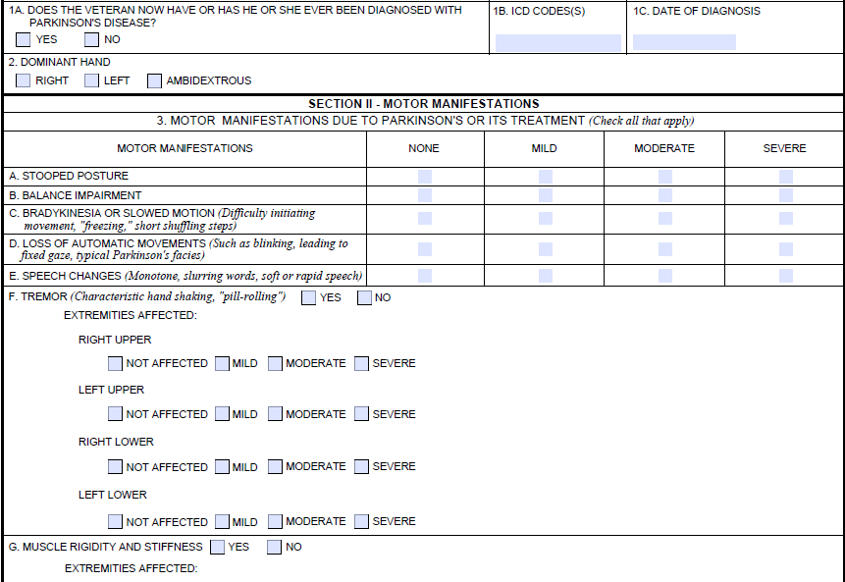
Parkinson’s DBQ
Notes:
Parkinson’s DBQ

Slide 22
Peripheral Neuropathy (DC 8510- 8730)
Nerve dysfunction, typically resulting in tingling, burning, loss of sensation, or paralysis.
(more than sensory findings are demonstrated, such as atrophy, weakness, diminished reflexes, etc)
(absence of sensation confirmed by objective findings)
(subjective symptoms or diminished sensation)
When the involvement is wholly sensory, the rating should be for the mild,
or at most, the moderate degree.
Also subject to a presumption of service connection under 3.309(a) if manifested compensably within one year of discharge, under 3.309(c) if the Veteran is a POW for not less than 30 days and peripheral neuropathy manifests compensably at any time after discharge, and under 3.309(e) if diagnosis/symptoms within 1 year of after last in-service herbicide exposure (early-onset), manifests compensably within 1 year period and current disability, which has persisted continuously
Notes:
Peripheral Neuropathy (DC 85 10 dash 87 30)
Nerve dysfunction, typically resulting in tingling, burning, loss of sensation, or paralysis.

Slide 23
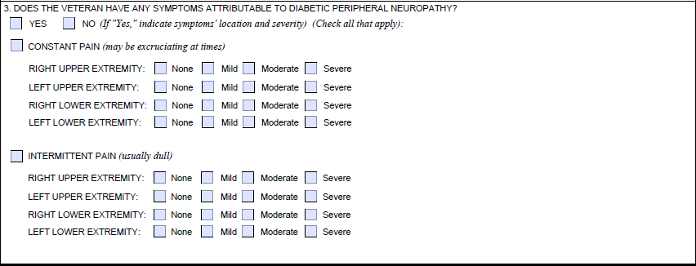
Diabetic Sensory Motor Peripheral Nerve DBQ
Subjective
Symptoms!
2 DBQs for peripheral neuropathy:
Diabetic Peripheral Neuropathy
Peripheral Nerves
Notes:
Diabetic Sensory Motor Peripheral Nerve DBQ
Subjective Symptoms!

Slide 24
Diabetic Sensory Motor Peripheral Nerve DBQ
Objective
Symptoms!
Notes:
Diabetic Sensory Motor Peripheral Nerve DBQ (continued)
Objective Symptoms!

Slide 25
Diabetic Sensory Motor Peripheral Nerve DBQ
Absent is enough for Moderate!
Notes:
Diabetic Sensory Motor Peripheral Nerve DBQ (continued)
Absent is enough for Moderate!

Slide 26
Diabetic Sensory Motor Peripheral Nerve DBQ
Where the doctor identifies the nerve(s) involved as well as severity of incomplete paralysis.
Notes:
Diabetic Sensory Motor Peripheral Nerve DBQ (continued)
Where the doctor identifies the nerve nerves involved as well as severity of incomplete paralysis.

Slide 27
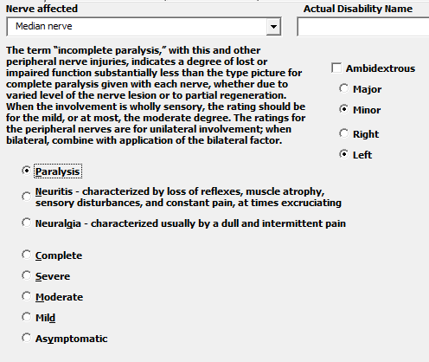
Peripheral Neuropathy Evaluation Builder:
Separate evaluations may be assigned for peripheral nerve disabilities of the lower extremities.
4.123 & 4.124
Only select when no specific nerve(s) identified!
Notes:
Peripheral Neuropathy Evaluation Builder:
Separate evaluations may be assigned for peripheral nerve disabilities of the lower extremities.

Slide 28
Peripheral Neuropathy Evaluation Builder:
Notes:
Peripheral Neuropathy Evaluation Builder:

Slide 29
Peripheral Neuropathy Evaluation Builder:
Notes:
Peripheral Neuropathy Evaluation Builder: (continued)

Slide 30
Peripheral Neuropathy Evaluation Builder:
Notes:
Peripheral Neuropathy Evaluation Builder: (continued)

Slide 31
Special Considerations
Presumptive Disabilities
Special Monthly Compensation
Ancillary Considerations
Special Development
Manual Changes
Rating Schedule Changes
Notes:
Special Considerations
Presumptive Disabilities
Special Monthly Compensation
Ancillary Considerations
Special Development
Manual Changes
Rating Schedule Changes

Slide 32
Questions
Notes:
Questions?

