Slide 1
Rating Traumatic Brain Injury (TBI)
Compensation Service
August 2016
Notes:
Welcome to Rating Traumatic Brain Injury (TBI) course. To advance each slide, click anywhere on the screen.

Slide 2
Objectives
Upon completion of this lesson and given available references, the trainee will be able to prepare a rating decision targeting TBI.
Notes:
Objectives
Upon completion of this lesson and given available references, the trainee will be able to prepare a rating decision targeting TBI.

Slide 3
References
38 CFR 3.114 - Change of law or Department of Veterans Affairs issue.
38 CFR 3.304 - Direct service connection; wartime and peacetime
38 CFR 3.350 - Special monthly compensation ratings
38 CFR 4.7 - Higher of two evaluations
38 CFR 4.87 - Schedule of ratings - ear
38 CFR 4.124a - Schedule of ratings – neurological conditions and convulsive disorders
38 CFR 4.130 - Schedule of ratings – mental disorder
Notes:
References
The references for this course are listed on the screen. You may click any hyperlinked references for further details.
38 CFR 3.114 - Change of law or Department of Veterans Affairs issue.
38 CFR 3.304 - Direct service connection; wartime and peacetime
38 CFR 3.350 - Special monthly compensation ratings
38 CFR 4.7 - Higher of two evaluations

Slide 4
References
M21-1, Part III, Subpart iv, Chapter 3, Section D - Examination Reports
M21-1, Part III, Subpart iv, Chapter 4, Section G - Neurological Conditions and Convulsive Disorders
M21-1, Part III, Subpart iv, Chapter 4, Section H - Mental Disorders
M21-1, Part III, Subpart iv, Chapter 6, Section C - Completing the Rating Decision Narrative
M21-1, Part III, Subpart iv, Chapter 6, Section D - Codesheet Section
M21-1, Part IV, Subpart ii, Chapter 2, Section H - Special Monthly Compensation (SMC)
M21-1, Part IV, Subpart ii, Chapter 2, Section I - History of SMC
Notes:
References
The references for this course are listed on the screen. You may click any hyperlinked references for further details.
M21 dash 1, Part Three, Subpart four, Chapter 3, Section D - Examination Reports
M21 dash 1, Part Three, Subpart four, Chapter 4, Section G - Neurological Conditions and Convulsive Disorders
M21 dash 1, Part Three, Subpart four, Chapter 4, Section H - Mental Disorders
M21 dash 1, Part Three, Subpart four, Chapter 6, Section C - Completing the Rating Decision Narrative

Slide 5
Traumatic Brain Injury (TBI)
Has been called the “signature wound” of the conflicts in Iraq and Afghanistan
Often occurs as the result of an Improvised Explosive Device (IED)
High public profile of this issue
Complex issue that leads to errors
Notes:
Traumatic Brain Injury (TBI)
Has been called the “signature wound” of the conflicts in Iraq and Afghanistan
Often occurs as the result of an Improvised Explosive Device (I E D)
High public profile of this issue
Complex issue that leads to errors

Slide 6
Topics for Discussion
Define TBI
Evaluate TBI
Recognize common complications of TBI
Avoid pyramiding residuals of TBI
Secondary conditions associated with TBI
Consider special monthly compensation
Long Form Rating Narrative
TBI second signature requirements
Notes:
Topics for Discussion (continued)
Define TBI
Evaluate TBI
Recognize common complications of TBI
Avoid pyramiding residuals of TBI

Slide 7
Definition of TBI
The term traumatic brain injury (TBI) means the physical, cognitive and/or behavioral/emotional residual disability resulting from an event of external force causing an injury to the brain.
Notes:
Definition of TBI
The term traumatic brain injury (TBI) means the physical, cognitive and or behavioral/emotional residual disability resulting from an event of external force causing an injury to the brain.

Slide 8
TBI Residuals
Three categories of dysfunction that may result from TBI
Cognitive
Emotional and behavioral
Physical
Notes:
TBI Residuals
Three categories of dysfunction that may result from TBI
Cognitive
Emotional and behavioral
Physical

Slide 9
Cognitive Residuals
Defined as decreased memory, concentration, attention and executive functions of the brain
Executive functions: goal setting, processing information, organizing, problem solving and flexibility
Examples of TBI cognitive residuals:
Dementias (pre-senile Alzheimer’s type, dementia pugilistica, post traumatic dementia)
Attention & concentration deficits
Memory, processing and learning impairment
Language deficiencies
Planning difficulties
Judgement and control difficulties
Reasoning and abstract thinking limitations
Self-awareness limitations
Notes:
Cognitive Residuals
Defined as decreased memory, concentration, attention and executive functions of the brain
Executive functions: goal setting, processing information, organizing, problem solving and flexibility
Examples of TBI cognitive residuals:
Dementias (pre-senile Alzheimer’s type, dementia pugilistica, post traumatic dementia)
Attention & concentration deficits
Memory, processing and learning impairment
Language deficiencies
Planning difficulties
Judgement and control difficulties
Reasoning and abstract thinking limitations
Self-awareness limitations

Slide 10
Emotional and Behavioral Residuals
Diagnosed mental disorder due to TBI or separate from TBI (PTSD): rate under 4.130 for the specific mental disorder
No diagnosis of mental condition with only symptoms due to TBI (anxiety, depression) rate under 8045
TBI behavioral/emotional residuals:
Depression
Agitation and irritability
Impulsivity
Aggression
Anxiety
Posttraumatic stress disorder
Notes:
Emotional and Behavioral Residuals
Diagnosed mental disorder due to TBI or separate from TBI (PTSD): rate under 4.130 for the specific mental disorder
No diagnosis of mental condition with only symptoms due to TBI (anxiety, depression) rate under 80 45
TBI behavioral/emotional residuals:
Depression
Agitation and irritability
Impulsivity
Aggression
Anxiety
Posttraumatic stress disorder

Slide 11
Physical Residuals
Motor and Sensory Impairment
Visual-Spatial Orientation: rated on ability to follow directions and recognize self and surroundings
TBI physical residuals:
Apraxia (inability to execute purposeful, previously learned motor tasks, despite physical ability and willingness)
Aphasia (difficulty communicating orally and/or in writing)
Paresis (muscle weakness or incomplete paralysis)
Plegia (paralysis or stroke)
Dysphagia (difficulty swallowing)
Disorders of balance and coordination
Diseases of hormone deficiency
Parkinsonism
Nausea/vomiting
Headaches
Dizziness
Blurred vision
Seizure disorder
Sensory loss
Weakness
Sleep disturbance
Notes:
Physical Residuals
Motor and Sensory Impairment
Visual-Spatial Orientation: rated on ability to follow directions and recognize self and surroundings

Slide 12
Residuals of TBI
Residual with distinct diagnosis: rate separately (i.e. migraines)
If symptoms overlap, rating is based on the condition that provides the highest evaluation
A 10% maximum evaluation for subjective symptoms only no longer applies for 38 CFR 4.124a, DC 8045
Notes:
Residuals of TBI
Residual with distinct diagnosis: rate separately (i.e. migraines)
If symptoms overlap, rating is based on the condition that provides the highest evaluation
A 10% maximum evaluation for subjective symptoms only no longer applies for 38 CFR 4.124a, DC 80 45

Slide 13
Multiple Evaluations and Pyramiding in TBI Cases
In addition to the evaluation for TBI manifestations under the table “Evaluation of Cognitive Impairment and Other Residuals of Residuals of TBI Not Otherwise Classified” in DC 8045 (and also incorporated into VBMS-R), manifestations of a comorbid mental, neurologic or other physical disorder can be separately evaluated under another DC if there is a distinct diagnosis – even if based on subjective symptoms – and no more than one evaluation is based on the same manifestation(s).
Consider assigning separate evaluations for migraines, tinnitus, mental disorders, etc. as long as the manifestations do not overlap with those used to assign the evaluation of TBI under DC 8045
Evaluate occasional, subjective headaches and subjective feelings of anxiety as part of the TBI evaluation.
Do not evaluate vertigo separately when evaluating TBI. Vertigo is a subjective symptom that is already considered in the facets of the TBI criteria. However, if vertigo has already been awarded a separate compensable evaluation, do not change or correct the evaluation.
Remember that TBI is an issue that requires a long form rating narrative.
Notes:
Multiple Evaluations and Pyramiding in TBI Cases
In addition to the evaluation for TBI manifestations under the table “Evaluation of Cognitive Impairment and Other Residuals of Residuals of TBI Not Otherwise Classified” in DC 80 45 (and also incorporated into VBMS dash R),
manifestations of a comorbid mental, neurologic or other physical disorder can be separately evaluated under another DC if there is a distinct diagnosis – even if based on subjective symptoms – and no more than one evaluation is based on the same manifestation manifestations.
Consider assigning separate evaluations for migraines, tinnitus, mental disorders, etc. as long as the manifestations do not overlap with those used to assign the evaluation of TBI under DC 80 45

Slide 14
TBI Evaluation Facets
Executive Functions; memory, attention, and concentration
Judgment
Social Interaction
Orientation
Motor Activity
Visual-Spatial Orientation
Subjective Symptoms
Neurobehavioral Effects
Communication
Consciousness
Evaluation is based on the most disabling facet
Notes:
TBI Evaluation Facets
Executive Functions; memory, attention, and concentration
Judgment
Social Interaction
Orientation
Motor Activity
Visual-Spatial Orientation
Subjective Symptoms
Neurobehavioral Effects
Communication
Consciousness
Evaluation is based on the most disabling facet

Slide 15
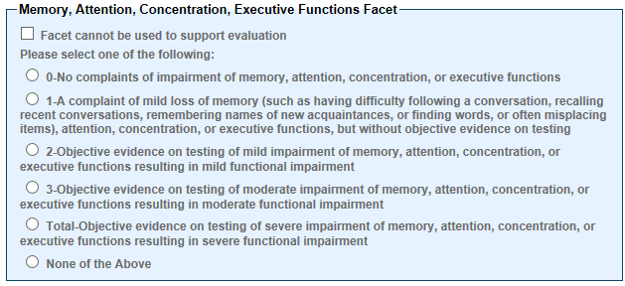
TBI DBQ and Evaluation Builder Memory, Attention, Concentration, Executive Functions Facet
1. Memory, attention, concentration, executive functions
No complaints of impairment of memory, attention, co centration, or executive functions
A complaint of mild memory loss (such as having difficulty following a conversation, recalling recent conversations, remembering names of new acquaintances, or finding words, or often misplacing items), attention, concentration, or executive functions, but without objective evidence on testing
Objective evidence on testing of mild impairment of memory, attention, concentration, or executive functions resulting in mild functional impairment
Objective evidence on testing of moderate impairment of memory, attention, concentration, or executive functions resulting in moderate functional impairment
Objective evidence on testing of severe impairment of memory, attention, concentration, or executive functions resulting in severe functional impairment
Notes:
TBI DBQ and Evaluation Builder Memory, Attention, Concentration, Executive Functions Facet
1. Memory, attention, concentration, executive functions
No complaints of impairment of memory, attention, co centration, or executive functions
A complaint of mild memory loss (such as having difficulty following a conversation, recalling recent conversations, remembering names of new acquaintances, or finding words, or often misplacing items), attention, concentration, or executive functions, but without objective evidence on testing

Slide 16
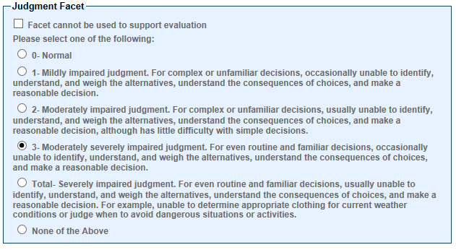
Judgment Facet
2. Judgment
Normal
Mildly impaired judgment: For complex or unfamiliar decisions, occasionally unable to identify, understand, and weigh the alternatives, understand the consequences of choices, and make a reasonable decision
Moderately impaired judgment: For complex or unfamiliar decisions, usually unable to identify, understand, and weigh the alternatives, understand the consequences of choices, and make a reasonable decision, although has little difficulty with simple decisions
Moderately severely impaired judgment: For even routine and familiar decisions, occasionally unable to identify, understand, and weigh the alternatives, understand the consequences of choices, and make a reasonable decision
Severely impaired judgment: For even routine and familiar decisions, usually unable to identify, understand, and weigh the alternatives, understand the consequences of choices, and make a reasonable decision. For example, unable to determine appropriate clothing for current weather conditions or judge when to avoid dangerous situations or activities.
Notes:
Judgment Facet
2. Judgment
Normal
Mildly impaired judgment: For complex or unfamiliar decisions, occasionally unable to identify, understand, and weigh the alternatives, understand the consequences of choices, and make a reasonable decision
Moderately impaired judgment: For complex or unfamiliar decisions, usually unable to identify, understand, and weigh the alternatives, understand the consequences of choices, and make a reasonable decision, although has little difficulty with simple decisions

Slide 17
Social Interaction Facet
3. Social interaction
Social interaction is routinely appropriate
Social interaction is occasionally inappropriate
Social interaction is frequently inappropriate
Social interaction is inappropriate most or all of the time
Notes:
Social Interaction Facet
3. Social interaction
Social interaction is routinely appropriate
Social interaction is occasionally inappropriate
Social interaction is frequently inappropriate
Social interaction is inappropriate most or all of the time

Slide 18
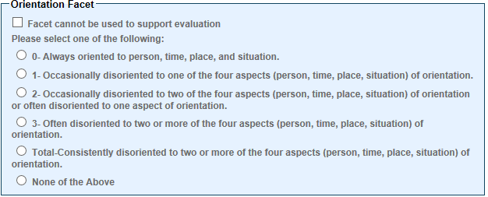
Orientation Facet
4. Orientation
Always oriented to person, time, place, and situation
Occasionally disoriented to one of the four aspects (person, time, place, situation) of orientation
Occasionally disoriented to two of the four aspects (person, time, place, situation) of orientation or often disoriented to one aspect of orientation
Often disoriented to two or more of the four aspects (person, time, place, situation) of orientation
Consistently disoriented to two or more of the four aspects (person, time, place, situation) of orientation
Notes:
Orientation Facet
4. Orientation
Always oriented to person, time, place, and situation
Occasionally disoriented to one of the four aspects (person, time, place, situation) of orientation
Occasionally disoriented to two of the four aspects (person, time, place, situation) of orientation or often disoriented to one aspect of orientation

Slide 19
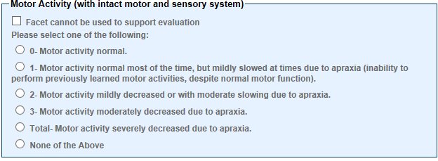
Motor Activity Facet
5. Motor activity (with intact motor and sensory system)
Motor activity normal
Motor activity is normal most of the time, but mildly slowed at times due to apraxia (inability to perform previously learned motor activities, despite normal motor function)
Motor activity is mildly decreased or with moderate slowing due to apraxia
Motor activity moderately decreased due to apraxia
Motor activity severely decreased due to apraxia
Notes:
Motor Activity Facet
5. Motor activity (with intact motor and sensory system)
Motor activity normal
Motor activity is normal most of the time, but mildly slowed at times due to apraxia (inability to perform previously learned motor activities, despite normal motor function)
Motor activity is mildly decreased or with moderate slowing due to apraxia

Slide 20
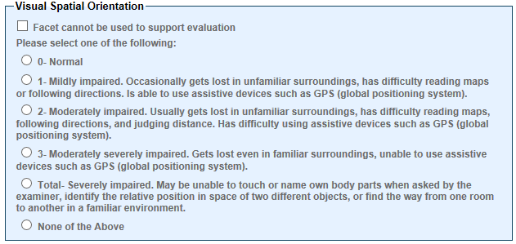
Visual Spatial Orientation Facet
6. Visual spatial orientation
Normal
Mildly impaired: Occasionally gets lost in unfamiliar surroundings, has difficulty reading maps or following directions. Is able to use assistive devices such as GPS (global positioning system)
Moderately impaired: Usually gets lost in unfamiliar surroundings, has difficulty reading maps, following directions, and judging distance. Has difficulty using assistive devices such as GPS (global positioning system)
Moderately severely impaired: Gets lost even in familiar surroundings, unable to use assistive devices such as GPS (global positioning system)
Severely impaired: May be unable to touch or name own body parts when asked by the examiner, identify the relative position in space of two different objects, or find the way from one room to another in a familiar environment
Notes:
Visual Spatial Orientation Facet
6. Visual spatial orientation
Normal
Mildly impaired: Occasionally gets lost in unfamiliar surroundings, has difficulty reading maps or following directions. Is able to use assistive devices such as GPS (global positioning system)
Moderately impaired: Usually gets lost in unfamiliar surroundings, has difficulty reading maps, following directions, and judging distance. Has difficulty using assistive devices such as GPS (global positioning system)

Slide 21
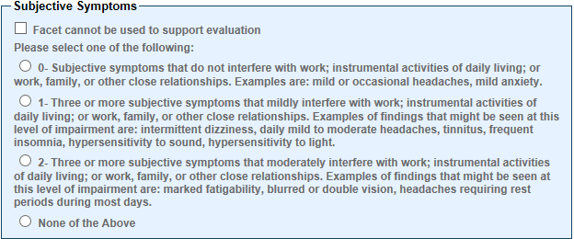
Subjective Symptoms Facet
7. Subjective symptoms
No subjective symptoms
Subjective symptoms that do not interfere with work; instrumental activities of daily living; or work, family or other close relationships. Examples are: mild or occasional headaches, mild anxiety
Three or more subjective symptoms that mildly interfere with work; instrumental activities of daily living; or work, family or other close relationships. Examples of findings that might be seen at this level of impairment are: intermittent dizziness, daily mild to moderate headaches, tinnitus, frequent insomnia, hypersensitivity to sound, hypersensitivity to light
Three or more subjective symptoms that moderately interfere with work; instrumental activities of daily living; or work, family or other close relationships. Examples of findings that might be seen at this level of impairment are: marked fatigability, blurred or double vision, headaches requiring rest periods during most days
Notes:
Subjective Symptoms Facet
7. Subjective symptoms
No subjective symptoms
Subjective symptoms that do not interfere with work; instrumental activities of daily living; or work, family or other close relationships. Examples are: mild or occasional headaches, mild anxiety

Slide 22
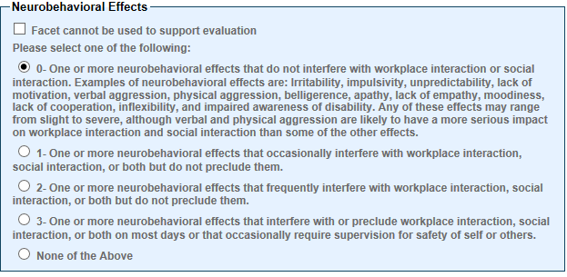
Neurobehavioral Effects Facet
8. Neurobehavioral effects
NOTE: Examples of neurobehavioral effects of TBI include: irritability, impulsivity, unpredictability, lack of motivation, verbal aggression, physical aggression, belligerence, apathy, lack of empathy, moodiness, lack of cooperation, inflexibility, and impaired awareness of disability. Any of these effects may range from slight to severe, although verbal and physical aggression are likely to have a serious impact on workplace interaction and social interaction than some of the other effects.
No neurobehavioral effects
One or more neurobehavioral effects that do not interfere with workplace interaction or social interaction.
One or more neurobehavioral effects that occasionally interfere with workplace interaction, social interaction, or both but do not preclude them
One or more neurobehavioral effects that frequently interfere with workplace interaction, social interaction, or both but do not preclude them
One or more neurobehavioral effects that interfere with or preclude workplace interaction, social interaction, or both on most days or that occasionally require supervision for safety of self or others
Notes:
Neurobehavioral Effects Facet
8. Neurobehavioral effects
No neurobehavioral effects
One or more neurobehavioral effects that do not interfere with workplace interaction or social interaction.
One or more neurobehavioral effects that occasionally interfere with workplace interaction, social interaction, or both but do not preclude them

Slide 23
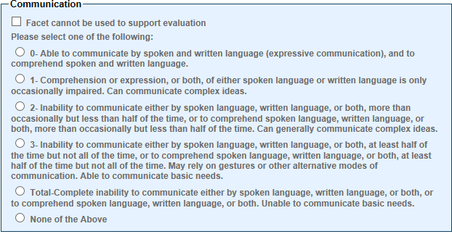
Communication Facet
9. Communication
Able to communicate by spoken and written language (expressive communication) and to comprehend spoken and written language
Comprehension or expression, or both, of either spoken language or written language is only occasionally impaired. Can communicate complex ideas
Inability to communicate either by spoken language, written language, or both, more than occasionally but less than half of the time, or to comprehend spoken language, written language, or both, more than occasionally but less than half of the time. Can generally communicate complex ideas
Inability to communicate either by spoken language, written language, or both, at least half of the time but not all of the time, or to comprehend spoken language, written language, or both, at least half of the time but not all of the time. May rely on gestures or other alternative modes of communication. Able to communicate basic needs
Complete inability to communicate either by spoken language, written language, or both, or comprehend spoken language, written language, or both. Unable to communicate basic needs
Notes:
Communication Facet
9. Communication
Able to communicate by spoken and written language (expressive communication) and to comprehend spoken and written language
Comprehension or expression, or both, of either spoken language or written language is only occasionally impaired. Can communicate complex ideas
Inability to communicate either by spoken language, written language, or both, more than occasionally but less than half of the time, or to comprehend spoken language, written language, or both, more than occasionally but less than half of the time. Can generally communicate complex ideas

Slide 24
Consciousness Facet
10. Consciousness
Normal
Persistent altered state of consciousness, such as vegetative state, minimally responsive state, coma
Notes:
Consciousness Facet
10. Consciousness
Normal
Persistent altered state of consciousness, such as vegetative state, minimally responsive state, coma

Slide 25
Effective Dates
Regulation effective: 10/23/2008
3.114 does apply
Notes:
Effective Dates
Regulation effective: 10/23/2008
3.114 does apply

Slide 26
Scenario (1)
A Veteran suffers a TBI while serving with the Army in Afghanistan, and submits an original claim for service connection. The Veteran has a TBI DBQ that indicates a diagnosis of TBI, with the highest facet indicated as a 2 for neurobehavioral effects. The Veteran also has subjective complaints of anxiety, but no diagnosis. The Veteran has separate diagnoses of tinnitus and migraine headaches (with characteristic prostrating attacks averaging one in 2 months over the last several months).
How would you combine (or separate) these conditions?
Notes:
Scenario (1)
A Veteran suffers a TBI while serving with the Army in Afghanistan, and submits an original claim for service connection. The Veteran has a TBI DBQ that indicates a diagnosis of TBI, with the highest facet indicated as a 2 for neurobehavioral effects.
The Veteran also has subjective complaints of anxiety, but no diagnosis. The Veteran has separate diagnoses of tinnitus and migraine headaches (with characteristic prostrating attacks averaging one in 2 months over the last several months).
How would you combine (or separate) these conditions?

Slide 27
Scenario (1) Answer
Rate the TBI under DC 8045 with an evaluation of 40%. The TBI evaluation includes the subjective complaints of anxiety.
Rate the tinnitus separate under DC 6260 with an evaluation of 10%.
Rate the migraine headaches separate under DC 8100 with an evaluation of 10%.
Notes:
Scenario (1) Answer
Rate the TBI under DC 80 45 with an evaluation of 40%. The TBI evaluation includes the subjective complaints of anxiety.
Rate the tinnitus separate under DC 62 60 with an evaluation of 10%.
Rate the migraine headaches separate under DC 8 100 with an evaluation of 10%.

Slide 28
Service Treatment Records
May document the TBI as mild, moderate, or severe (see 38 CFR 3.310(d)(3)(i))
These levels of TBI are an initial assessment of the injury and do not coincide with the current rating evaluation under DC 8045, but are a consideration for secondary conditions associated with TBI.
Notes:
Service Treatment Records
May document the TBI as mild, moderate, or severe (see 38 CFR 3.310(d)(3)(i))
These levels of TBI are an initial assessment of the injury and do not coincide with the current rating evaluation under DC 80 45, but are a consideration for secondary conditions associated with TBI.

Slide 29
Secondary SC under 38 CFR 3.310
38 CFR 3.310 was amended on December 17, 2013, to establish an association between TBI and certain illnesses.
In absence of clear evidence to the contrary, the following five diagnosable illnesses are held to be a secondary result of TBI:
Parkinsonism, including Parkinson’s disease, following moderate or severe TBI
unprovoked seizures, following moderate or severe TBI
dementias (pre-senile dementia of the Alzheimer’s type, frontotemporal dementia, and dementia with Lewy bodies), if the condition manifests within 15 years following moderate or severe TBI
depression, if the condition manifests within three years of moderate or severe TBI or within 12 months of mild TBI, or
diseases of hormone deficiency that result from hypothalamo-pituitary changes, if the condition manifests within 12 months of moderate or severe TBI.
Entitlement to secondary SC for these TBI-related conditions in 38 CFR 3.310 depends upon the initial severity of the TBI and the period of time between the injury and onset of the secondary illness.
Important: There is no need to obtain a medical opinion to determine whether the above conditions are associated with TBI when there is a TBI of a qualifying degree of severity.
Notes:
Secondary SC under 38 CFR 3.310
38 CFR 3.310 was amended on December 17, 2013, to establish an association between TBI and certain illnesses.

Slide 30
Scenario (2)
A Veteran suffers a moderate TBI while serving with the Marines in Iraq. The Veteran submits an original claim for service connection for a TBI. The Veteran has a TBI DBQ that indicates a diagnosis of TBI, with the highest facets indicated as a 2 for judgement and a 2 for subjective symptoms. The Veteran has subjective headaches without a diagnosis. The Veteran also has a separate diagnosis of unprovoked seizure disorder with 2 minor seizures in the last six months, and a separate diagnosis of tinnitus.
How would you rate this?
Notes:
Scenario (2)
A Veteran suffers a moderate TBI while serving with the Marines in Iraq. The Veteran submits an original claim for service connection for a TBI.
The Veteran has a TBI DBQ that indicates a diagnosis of TBI, with the highest facets indicated as a 2 for judgement and a 2 for subjective symptoms. The Veteran has subjective headaches without a diagnosis.
The Veteran also has a separate diagnosis of unprovoked seizure disorder with 2 minor seizures in the last six months, and a separate diagnosis of tinnitus.
How would you rate this?

Slide 31
Scenario (2) Answer
Rate the TBI under DC 8045 with an evaluation of 40%. The TBI evaluation includes the subjective complaints of headaches.
Rate the seizure disorder under DC 8910 with an evaluation of 20%.
Rate the tinnitus under DC 6260 with an evaluation of 10%.
Notes:
Scenario (2) Answer
Rate the TBI under DC 80 45 with an evaluation of 40%. The TBI evaluation includes the subjective complaints of headaches.
Rate the seizure disorder under DC 89 10 with an evaluation of 20%.
Rate the tinnitus under DC 62 60 with an evaluation of 10%.

Slide 32
Special Monthly Compensation for TBI
PL 111-275 amended 38 U.S.C. 1114 to authorize payment of SMC at the new (t) rate, which is equal to SMC at the (r)(2) rate for Veterans who:
need regular A&A for residuals of TBI, but
are not eligible for higher level of A&A under (r)(2), and
would require hospitalization, nursing home care, or other residential institutional care in the absence of regular A&A.
Note: The SMC(t) rate authorized by PL 111-275 is not the same historical SMC(t) rate that was discontinued in 1986. The current benefit cannot be awarded or rated using that historical code.
Notes:
Special Monthly Compensation for TBI
PL 111 dash 275 amended 38 U.S.C. 11 14 to authorize payment of SMC at the new (t) rate, which is equal to SMC at the (r)(2) rate for Veterans who:
need regular A & A for residuals of TBI, but
are not eligible for higher level of A & A under (r)(2), and
would require hospitalization, nursing home care, or other residential institutional care in the absence of regular A & A.
Note: The SMC(t) rate authorized by PL 111 dash 275 is not the same historical SMC(t) rate that was discontinued in 1986. The current benefit cannot be awarded or rated using that historical code.

Slide 33
Rating Decision Format and Signatures
For TBI ratings, the following are required:
A long form rating decision
Two signatures until a decision maker has demonstrated an accuracy rate of 90 percent or greater based on a review of at least 10 TBI cases.
Notes:
Rating Decision Format and Signatures
For TBI ratings, the following are required:
A long form rating decision
Two signatures until a decision maker has demonstrated an accuracy rate of 90 percent or greater based on a review of at least 10 TBI cases.

Slide 34
Questions
Notes:
Questions?

