Slide 1
Lesson 14: Determine Dependency Eligibility: Helpless Child
PMC VSR Advanced Core Course Phase 5: Stages of a Claim Part 1: Determine Eligibility

Slide 2
You Are Here

Slide 3
Why It Matters!
Overview of Administrative Decisions
Establish Veteran Status
Determine if Veteran Meets Presumptive Criteria for Permanent and Total Disability
Determine Dependency Eligibility: Spouse
Determine Dependency Eligibility: Child
Determine Dependency Eligibility: Helpless Child
Establish Parental Relationship for DIC

Slide 4
Ice Breaker Activity
What is the age of the child/children?
What is the relationship to the Veteran?
Does the form indicate that the child is helpless?
What other important information can you derive from this form?

Slide 5
Technical Competencies
Program Benefits and Eligibility (PMC VSR)
Processing Claims (PMC VSR)
VBA Applications (PMC VSR)

Slide 6
Lesson Objectives
Determine dependency eligibility for a helpless child of a Veteran.
Define helpless child for VA purposes.
Determine dependency eligibility requirements for a helpless child of a Veteran.
Determine whether claim is ready to rate for helpless child.
Determine what to develop for a helpless child of a Veteran.

Slide 7
Knowledge Check

Slide 8
Relationship and Dependency

Slide 9
What Is a Helpless Child for VA Purposes? (1 of 2)
A helpless child is a Veteran’s child who is permanently incapable of self-support through his/her own efforts due to physical or mental disabilities.

Slide 10
What Is a Helpless Child for VA Purposes? (2 of 2)
A helpless child has to be rated by the rating team and requires evidence to support the permanent incapacity for self-support.
A helpless child must be shown to be permanently incapable of self-support by reason of mental or physical defect at the date of attaining the age of 18 years.

Slide 11
Age Requirement for a Helpless Child
What is the age requirement for a helpless child?

Slide 12
Age Requirement for a Helpless Child Answers
What is the age requirement for a helpless child?
The helpless child is only relevant for a child who is over the age of 18.

Slide 13
Dependency Eligibility—Helpless Child
What are the dependency eligibility requirements for a child that also apply to a helpless child?

Slide 14
Dependency Eligibility—Helpless Child Answers
What are the dependency eligibility requirements for a child that also apply to a helpless child?
Cannot be married
Relationship established: biological, adopted, or stepchild

Slide 15
Dependency Eligibility—Helpless Child Example
Example: Cindy Chapps is 20 years old and her mother is applying for DIC benefits. Cindy submitted VA Form 21-534EZ to show she was the Veteran’s stepchild at the time of the Veteran’s death. On section IV of VA Form 21-534EZ, a check indicates that Cindy seriously disabled. Evidence of record shows Cindy was already established as a dependent on the Veteran’s award at the time of his death.
What dependency eligibility requirements for a child may apply to this helpless child example?
Where on the VA Form 21-534EZ would indicate the child is married?

Slide 16
Dependency Eligibility—Helpless Child Example Answers
What dependency eligibility requirements for a child may apply to this helpless child example?
The child is not married.
The child is over 18.
The relationship to the Veteran has been established—she is the Veteran’s stepchild.
What item on the VA Form 21-534EZ would indicate the child is married?
Section IV, item 28H

Slide 17
Dependency Eligibility—Helpless Child Demonstration
VA Form 21-534EZ (Application for DIC, Death Pension, and/or Accrued Benefits) section IV, item 28H, Seriously Disabled
VA Form 21-686c (Declaration of Status of Dependents) section III, item 14H, Seriously Disabled
VA Form 21p-0519C-1 (Improved Pension Eligibility Verification Report) item 1E, block 3, Disabled Child

Slide 18
Dependency Check
It is important to make sure that all the evidence regarding dependency information is included with the claim
If evidence is missing then go to develop for dependency related claim information

Slide 19
Proof of Permanent Incapacity for Self-support
What are some documents that may provide proof of permanent incapacity for self-support?

Slide 20
Proof of Permanent Incapacity for Self-Support Answers
What are some example documents that may provide proof of permanent incapacity for self-support?
Medical or psychiatric examination reports showing:
Dates of onset
Extent of child’s disability
Diagnosis
Prognosis to include a description of the present condition
Vocational or educational assessment reports

Slide 21
Facts Based on Personal Observation (1 of 2)
Statements from individuals who have:
Knowledge of the facts
Observed the child’s condition as of 18
Statements must conclude with:
Name and signature of person making the statement
Certification: "I hereby certify that the information I have given above is true and correct to the best of my knowledge and belief.”

Slide 22
Facts Based on Personal Observation (2 of 2)
Describe witnesses who could have knowledge of facts and could have observed the helpless child’s condition.
Teachers
Specialists
Social workers
Physicians
Institutions where the child may have been maintained

Slide 23
Evidence Examples

Slide 24
Is Helpless Child Information Complete?
Example: VA received a pension application on VA Form 21-534EZ from a 40-year-old surviving child who claims he is incapable of self-support. The surviving child meets all the requirements to receive pension benefits. He submitted his birth certificate, which establishes him as the Veteran's child. The surviving child lists that he is living in an institution and submits medical evidence from his doctor, who indicates he has been incapable of self-support since he was under 18. The doctor also submits supporting medical evidence.
Is the helpless child information complete for the type of claim requested?

Slide 25
Is Helpless Child Information Complete? Answers
Is the helpless child information complete for the type of claim requested?
Yes, the helpless child can be established as a dependent on his own right and the application would be submitted with the medical evidence to the RVSR to prepare a rating decision.

Slide 26
Group Activity—Practice Exercise
Instructions:
Divide into groups of three.
Review Claim 2, 3, and 4.
Use the Dependency Eligibility Requirements job aid to determine if the helpless child meets the dependency eligibility requirements.
Mark your answers based on the questions asked on the checklist.
Provide the rationale for your decision.
Time allowed: 10–15 minutes

Slide 27
Group Activity—Practice Exercise Answers
Dependency Eligibility: Helpless Child Checklist | Yes | No
Is the child identified on the VA Form as disabled?
Is the child married?
Is the child the Veteran’s biological, step, or adopted child? If yes, list _____________________________
Has supporting evidence been provided?
Is the child information complete?

Slide 28
Ready to Rate for Helpless Child
Is there evidence of prior designation of helpless child under Veteran or Survivors award?
Is the medical evidence of record sufficient for the child to be rated?
Is the claim for Veterans Pension, Survivors Pension, or DIC?

Slide 29
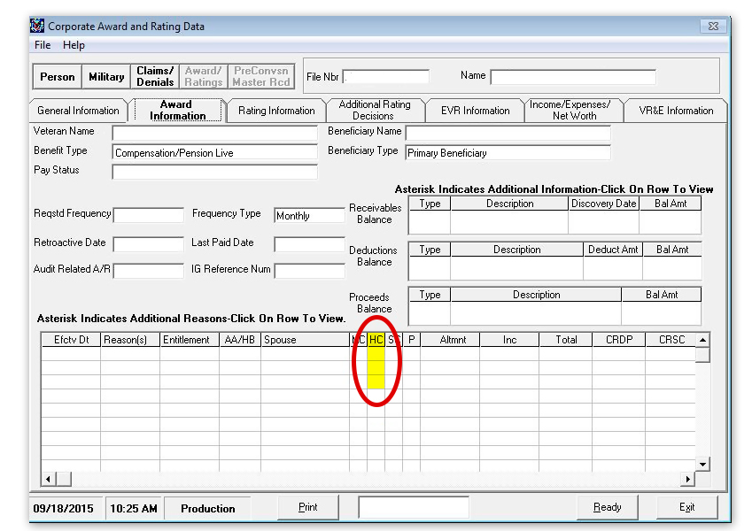
Helpless Child Prior Designation

Slide 30
Sufficient Medical Evidence
What are some examples of sufficient evidence? (Hint: discussed early in lesson)
What are some examples of insufficient evidence?

Slide 31
Sufficient Medical Evidence Answers
What are some examples of sufficient evidence? (Hint: discussed early in lesson)
Medical or psychiatric examination reports
Vocational or educational assessment reports
Employment records
Statements for persons having knowledge of facts and who have observed the child’s current condition
What are some examples of insufficient evidence?
2680—no diagnosis code
Physician failed to sign the exam
No medical evidence

Slide 32
Sufficient Medical Evidence Missing
If the medical evidence is missing then go to develop for missing or additional evidence.

Slide 33
Helpless Child Veterans Pension
A helpless child is a dependent for the purpose of determining monthly payments for the Veteran’s Pension award.
Determine Dependency Eligibility: Helpless Child

Slide 34
Helpless Child Survivors Pension
Additional allowance is payable for a helpless if the surviving spouse is receiving Survivors Pension.

Slide 35
Helpless Child DIC
A helpless child will be on a separate award in his or her own right even if the surviving spouse has custody of the child and is receiving DIC benefits.

Slide 36
Is Claim Ready to Rate?
Is the Veterans or Survivors Pension claim ready to rate?
Is the DIC claim ready to rate?

Slide 37
Is Claim Ready to Rate? Answers
Is the Veterans or Survivors Pension claim ready to rate?
If there is evidence of prior designation of helpless child under Veteran or Surviving Pension award, then it does not need to get rated.
If the medical evidence is sufficient then Veteran or Survivors Pension is ready to rate
Is the DIC claim ready to rate?
If the claim is DIC and there is evidence of prior designation then it must go to the RVSR to be rated.
If the medical evidence is sufficient then Veteran or Survivors Pension is ready to rate.

Slide 38
Ready to Rate Demonstration

Slide 39
Questions?

Slide 40
Lesson Summary
How is helpless child dependency determined?
What are the eligibility requirements for a helpless child?
How do you determine if the helpless child claim is ready to rate?

Slide 41
What’s Next
Phase 5, Part 1, Lesson 15: Establish Parental Relationship for DIC

