Slide 1
Lesson 3: References
PMC VSR Core Course
Phase 3: PMC VSR Resources

Slide 2
Why Are References Important?
  References, when used properly, can:
      Improve quality of work
      Increase timeliness
      Provide job satisfaction
      Reduce stress
      Provide promotion potential
      Help Veterans and other claimants
      Substantiate administrative decisions and determinations that affect a Veteran’s case

Slide 3
Technical Competencies
Program benefits and eligibility (PMC VSR)
VBA applications (PMC VSR)

Slide 4
Lesson Objectives
Identify the most commonly used references by PMC VSRs.
Describe the purpose and applicability of the different types of references.
Describe the elements of each reference.
Locate the appropriate reference.
Navigate to the CPKM portal
Know how to subscribe to the manual updates email

Slide 5
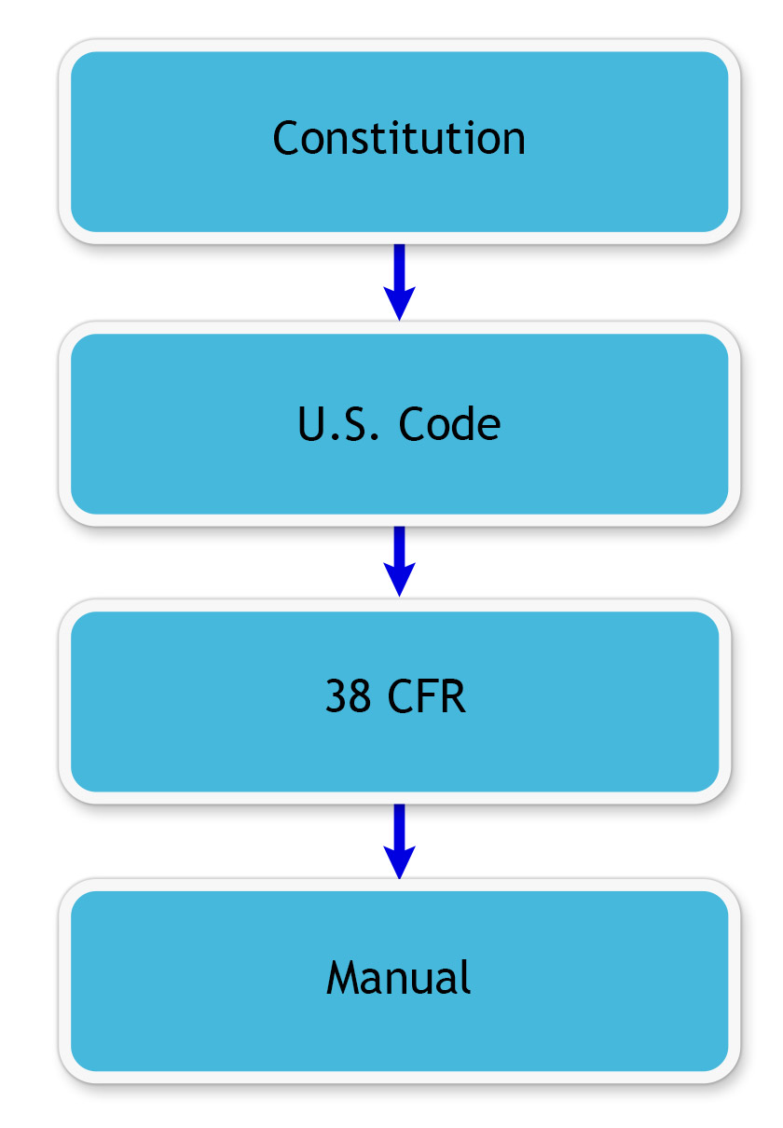
Precedence of VBA Laws, Regulations, and Procedures

Slide 6
Most Commonly Used References for PMC
VSRs
38 CFR, Title 38 USC
M21-1 Compensation and Pension Materials, Adjudication Procedures Manual
M21-4 Manpower Control and Utilization in Adjudication Divisions
M27-1 Benefits Assistance Materials
VBA Letters
Job aids, located in the VSR Assistant from the PMC VSR button

Slide 7
How to Access References
Compensation and Pension Knowledge Management (CPKM)
Pension and Fiduciary homepage

Slide 8
VA and Title 38 USC
Chapter 1 of Title 38 of the United States Code (USC) of Federal Regulations (CFR) governs the administration of Veterans benefits.
This reference is used by federal agencies of the United States regarding pensions, bonuses, and Veterans’ relief.
VSRs work primarily in Part 3 of 38 CFR.
Available online through the Code of Federal Regulations (e-CFR) website and through the publications website.
Organized in numerical order from the first regulation (3.1) to the two thousand six hundredth regulation (3.2600).

Slide 9
M21-1 Adjudication Procedures Manual
The M21-1 is an interpretation of CFRs
Also known as “The Manual”
Consists of the following parts:
  Prologue, Table of Contents and Technical Glossary
  Part 1. Claimants’ Rights and Responsibilities
  Part 3. General Claims Process
  Part 4. Compensation, DIC, and Death Compensation Benefits
  Part 5. Pension and Parents’ Dependency and Indemnity Compensation (DIC)
  Part 6. Chapter 18 Benefits
  Part 7. Burial Benefits
  Part 8. Accrued Benefits
  Part 9. Ancillary and Special Benefits
  Part 10. Matching Programs

Slide 10
M21-4 Manual
Provides a logistical overview of how the stations function
Consists of the following parts:
  Chapter 1. Overview
  Chapter 2. Workload Management Plans
  Chapter 3. National Quality Reviews
  Chapter 4. Claims and Appeals Processing Timeliness
  Chapter 5. Systematic Analyses of Operations (SAO)
  Chapter 6. Quality Review Team
  Chapter 7. PMC National Quality and QRT
  Chapter 8. Fiduciary Hub (Hub) National Quality Reviews and Quality Review Teams (QRT)
  Appendix A. Regional Office Station Numbers and Payee Codes
  Appendix B. End Product Codes and Work-Rate Standards for Quantitative Measurements
  Appendix C. Index of Claim Attributes
  Appendix D. Index of Claim Stage Indicators

Slide 11
Manual Changes
Directions to subscribe to the weekly manual update email.
Go to https://www.knowva.ebenefits.va.gov/system/templates/selfservice/va_ssnew/help/customer/locale/en-US/portal/554400000001018/topic/554400000001924/Compensation
Click on “subscribe here”
Follow the steps for subscribing to updates on the subsequent page. Updates are generally sent weekly.
Notes:
Demo

Slide 12
M27-1 Benefits Assistance Service
Procedures
Used primarily for providing timely and accurate benefit information and services to Servicemembers, Veterans, dependents, and survivors
Consists of the following parts:
  Part I. VBA Public Contact and Direct Services
  Part II. VBA Outreach
  Part III. VBA Web Communications
  Part IV. Quality and Training
  Part V. Access and Business Applications

Slide 13
VBA Letters
Can be found under the “VBA Letters” section of the Publications Index
Written from the office of the Undersecretary for Benefits
Cover a range of topics from benefit processing instructions to information about leadership programs
Communicated via upper management

Slide 14
Other PMC VSR References
AMA FAQs
P&F Service Inquiries
Job aids
  Can be provided by management or peers, or created by you
VSR Assistant EPSS from the PMC VSR button

Slide 15
VBA References Review Exercise
Instructions:
  Complete the Appendix A: References worksheet
  Access the Common VA References job aid, located in the VSR Assistant from the PMC VSR button
  Navigate to CPKM to access the references in the job aid
  Answer the questions in the worksheet using the references
  Submit answers to another trainee
Time allowed: 15 min.

Slide 16
VBA References Review Exercise Answers
(1 of 3)
What is the topic of 38 CFR 3.110?
  Computation of time limit
According to M21-1 III.v.1.B.5.k, what are the types of uncharacterized separations?
  Entry level separation
  Void enlistment or induction
  Dropped from the rolls

Slide 17
VBA References Review Exercise Answers
(2 of 3)
Where is the reference for development for accrued benefits in the Manual?
  M21-1 VIII.3
According to the M21-1, V.i.2.1.a, what elements must be shown to establish entitlement to Veterans Pension?
  Qualifying service
  Permanent and total disability or 65 years old
  Countable income below the MAPR, and
  Net worth limitations met
What is the topic of 38 CFR 3.701?
  Elections of pension or compensation

Slide 18
VBA References Review Exercise Answers
(3 of 3)
What reference provides information regarding the effect of income and net worth on pension and parents DIC? Provide the citation.
  M21-1, Part V, Subpart iii, Chapter 1, Section A
What is the topic of 38 CFR 3.53?
  Continuous cohabitation
What is the reference for End Product Classification codes?
  M21-4, Appendix B

Slide 19
Lesson Summary
  Knowing what references are available and how to use them are essential in performing tasks and duties on the job.
  Remember, references are important because they:
    Improve quality of work
    Increase timeliness
    Provide job satisfaction
    Reduce stress
    Provide promotion potential
    Help Veterans
    Substantiate administrative decisions and determinations that affect a Veteran’s case

Slide 20

Questions?

Slide 21
What’s Next
TMS Evaluation:
TMS #4189331 References

