Slide 1
Pyramiding (Residency)
Compensation Service
May 2016
Notes:
Welcome to Pyramiding (Residency) course. To advance each slide, click anywhere on the screen.

Slide 2
Objectives
Given the available references, the trainee will be able to identify the regulations and manual references associated with pyramiding to properly evaluate a rating with 98% accuracy.
Notes:
Objectives
Given the available references, the trainee will be able to identify the regulations and manual references associated with pyramiding to properly evaluate a rating with 98% accuracy.

Slide 3
References
38 CFR§4.14 - Avoidance of Pyramiding
38 CFR§4.55 - Principles of Combined Ratings for Muscle Injuries
38 CFR§4.96 - Special Provisions Regarding Evaluation of Respiratory Conditions
38 CFR 4.97 - Respiratory System
38 CFR§4.113 - Coexisting Abdominal Conditions
Notes:
References
The references for this course are listed on the screen. You may click any hyperlinked references for further details.
38 CFR§4.14 - Avoidance of Pyramiding
38 CFR§4.55 - Principles of Combined Ratings for Muscle Injuries
38 CFR§4.96 - Special Provisions Regarding Evaluation of Respiratory Conditions
38 CFR 4.97 - Respiratory System
38 CFR§4.113 - Coexisting Abdominal Conditions

Slide 4
References
M21-1, Part III, Subpart iv, 4.A - Musculoskeletal Conditions
M21-1, Part III, Subpart iv, 4.D.1 - Respiratory Conditions
M21-1, Part III, Subpart iv 6.C - Completing the Rating Decision Narrative
Decision Assessment Document (DAD), Esteban v. Brown, No. 92-693 - Pyramiding
Notes:
References
The references for this course are listed on the screen. You may click any hyperlinked references for further details.
M21 dash 1, Part III, Subpart iv, 4.A - Musculoskeletal Conditions
M21 dash 1, Part III, Subpart iv, 4.D.1 - Respiratory Conditions
M21 dash 1, Part III, Subpart iv 6.C - Completing the Rating Decision Narrative
Decision Assessment Document (D A D), Esteban v. Brown, No. 92 dash 693 - Pyramiding

Slide 5
38 CFR 4.14
Don’t use the same disability under various diagnoses
Disabilities may overlap to a great extent
    Special rules included in the specific bodily system for their evaluation
Don’t use manifestations not resulting from service-connected disease or injury in establishing the service-connected evaluation, and
The evaluation of the same manifestation under different diagnoses
Notes:
38 CFR 4.14
Don’t use the same disability under various diagnoses
Disabilities may overlap to a great extent
Special rules included in the specific bodily system for their evaluation
Don’t use manifestations not resulting from service-connected disease or injury in establishing the service-connected evaluation, and
The evaluation of the same manifestation under different diagnoses

Slide 6
Esteban v. Brown
Esteban claimed separate evaluations for painful scars, disfiguring scars and facial muscle damage with mastication difficulties
Initially denied multiple evaluations
The Court determined separate disability ratings are appropriate when a single injury results in distinct functional impairments.
Separate ratings for a single disability, when allowed by the rating schedule, are authorized unless there is overlapping symptomology.
Notes:
Esteban verses Brown
Esteban claimed separate evaluations for painful scars, disfiguring scars and facial muscle damage with mastication difficulties
Initially denied multiple evaluations
The Court determined separate disability ratings are appropriate when a single injury results in distinct functional impairments.
Separate ratings for a single disability, when allowed by the rating schedule, are authorized unless there is overlapping symptomology.

Slide 7
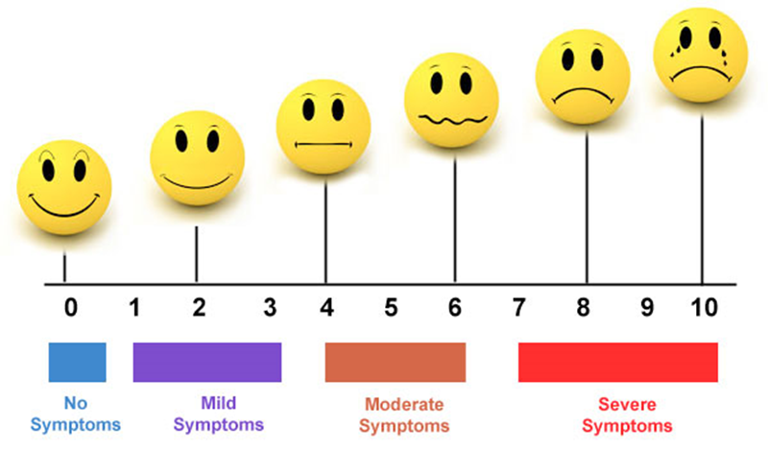
Points to Consider
What are the objective manifestations shown by medical evidence?
Notes:
Points to Consider
What are the objective manifestations shown by medical evidence?

Slide 8
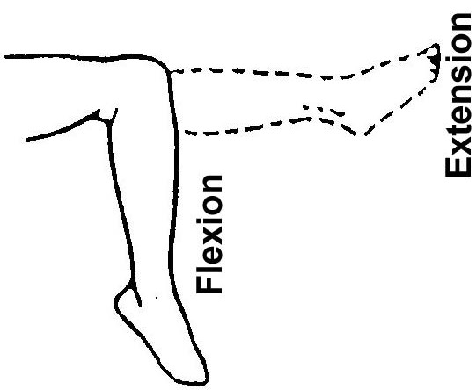
Points to Consider
Do those manifestations result in distinct functional impairments?
Notes:
Points to Consider
Do those manifestations result in distinct functional impairments?

Slide 9
Points to Consider
What diagnostic codes in the rating schedule most accurately reflect the objective manifestations?
5260?
5257?
5261?
7331?
7342?
5243?
5242?
Notes:
Points to Consider
What diagnostic codes in the rating schedule most accurately reflect the objective manifestations?

Slide 10

Points to Consider
Are the manifestations of the disability covered under one diagnostic code that is duplicative or overlapping of manifestations covered under another diagnostic code?
Notes:
Points to Consider
Are the manifestations of the disability covered under one diagnostic code that is duplicative or overlapping of manifestations covered under another diagnostic code?

Slide 11
Examples
Painful Scars vs. Scar Measurements
Limited motion of the Spine vs. Radiculopathy
Residuals of TBI vs. Headaches, PTSD, Tinnitus
Notes:
Examples
Painful Scars verses Scar Measurements
Limited motion of the Spine verses Radiculopathy
Residuals of TBI verses Headaches, PTSD, Tinnitus

Slide 12
Remember
Some sections of the code are specifically written to address potential pyramiding
Notes:
Remember
Some sections of the code are specifically written to address potential pyramiding

Slide 13
Rating Schedule
Notes:
Rating Schedule
4.96 Special provisions regarding evaluation of respiratory conditions.
Rating coexisting respiratory conditions. Ratings under diagnostic codes 6600 through 68 17 and 68 22 through 68 47 will not be combined with each other.
Where there is lung or pleural involvement, ratings under diagnostic codes 68 19 and 68 20 will not be combined with each other or with diagnostic codes 6600 through 68 17 or 68 22 through 68 47.
A single rating will be assigned under the diagnostic code which reflects the predominant disability with elevation to the next higher evaluation where the severity of the overall disability warrants such evaluation.
However, in cases protected by the provisions of Pub. L 90 through 493, the graduated ratings of 50 and 30 percent for inactive tuberculosis will not be elevated.
4.114 Schedule of ratings – digestive system.
Ratings under diagnostic codes 73 01 to 73 29, inclusive, 73 31, 73 42, and 73 45 to 73 48 inclusive will not be combined with each other.
A single evaluation will be assigned under the diagnostic code which reflects the predominant disability picture, with elevation to the next higher evaluation where the severity of the overall disability warrants such elevation.

Slide 14
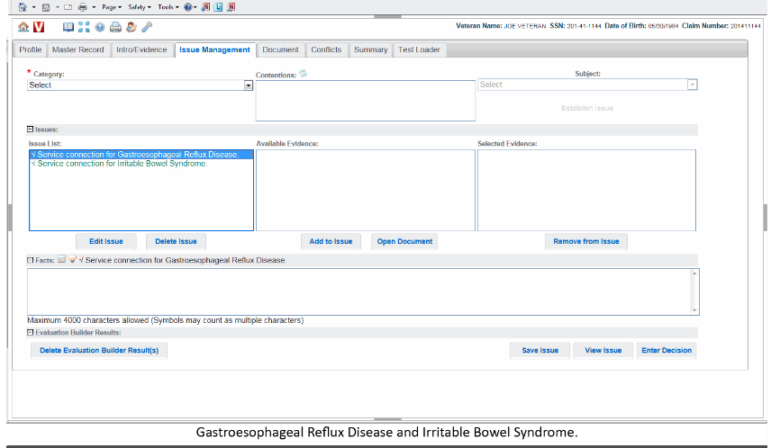
VBMS-R Conflicts Tab
Notes:
VBMS dash R Conflicts Tab

Slide 15
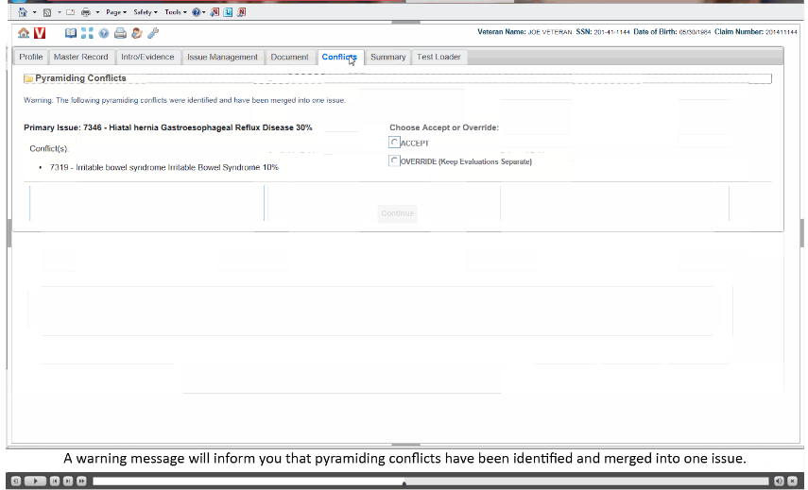
VBMS-R Conflicts Tab
Notes:
VBMS dash R Conflicts Tab

Slide 16
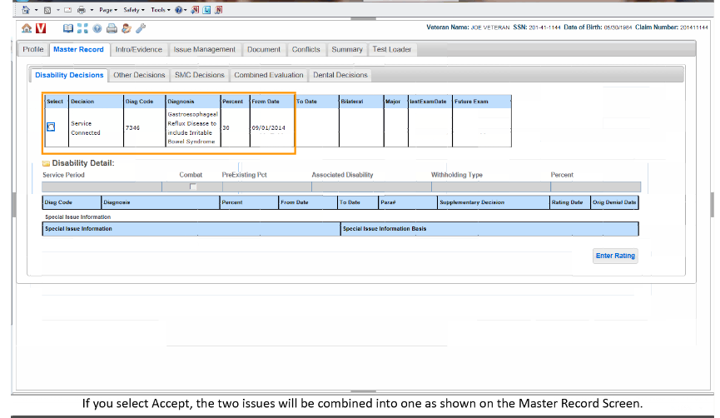
VBMS-R Conflicts Tab
Notes:
VBMS dash R Conflicts Tab

Slide 17
Questions
Notes:
Questions?

