Slide 1
Respiratory System (RVSR IWT)
Compensation Service
May 2016
Notes:
Welcome to Respiratory System (RVSR IWT) course. To advance each slide, click anywhere on the screen.

Slide 2
Objectives
Upon completion of this lesson and given available references, the trainee will prepare a rating decision targeting respiratory conditions with 98% accuracy. The trainee will be able to:
Properly evaluate respiratory conditions.
Apply pulmonary functions test (PFT) results to the rating schedule.
Identify other considerations.
Notes:
Objectives
Upon completion of this lesson and given available references, the trainee will prepare a rating decision targeting respiratory conditions with 98 percent accuracy. The trainee will be able to:
Properly evaluate respiratory conditions.
Apply pulmonary functions test (PFT) results to the rating schedule.
Identify other considerations.

Slide 3
References
38 CFR 3.309, Disease subject to presumptive service connection
38 CFR 3.317(b), Signs or symptoms of undiagnosed illness and medically unexplained chronic multisymptom illnesses
38 CFR 3.350, Special monthly compensation ratings
38 CFR 3.380, Diseases of allergic etiology
38 CFR 3.809(a), Special home adaptation grants under 38 U.S.C. 2101(b)
38 CFR 4.88(c), Ratings for inactive nonpulmonary tuberculosis initially entitled after August 19, 1968
38 CFR 4.89, Ratings for inactive nonpulmonary tuberculosis in effect on August 19, 1968
38 CFR 4.96, Special provisions regarding evaluation of respiratory conditions
38 CFR 4.97, Schedule of ratings—respiratory system
Notes:
References
The references for this course are listed on the screen. You may click any hyperlinked references for further details.
38 CFR 3.309, Disease subject to presumptive service connection
38 CFR 3.317(b), Signs or symptoms of undiagnosed illness and medically unexplained chronic multisymptom illnesses
38 CFR 3.350, Special monthly compensation ratings
38 CFR 3.380, Diseases of allergic etiology
38 CFR 3.809(a), Special home adaptation grants under 38 U.S.C. 2101(b)
38 CFR 4.88(c), Ratings for inactive nonpulmonary tuberculosis initially entitled after August 19, 1968
38 CFR 4.89, Ratings for inactive nonpulmonary tuberculosis in effect on August 19, 1968

Slide 4
References
M21-1, Part III, Subpart iv, Chapter 4, Section D Respiratory Conditions
M21-1, Part III, Subpart v, Chapter 7, Section A Eligibility for Hospital, Nursing Home, Domiciliary, and Medical Care
M21-1, Part IV, Subpart ii, Chapter 1, Section I, Developing Claims for Service Connection (SC) Based on Other Exposure Types
M21-1, Part IV, Subpart ii, Chapter 2, Section C, Service Connection (SC) for Disabilities Resulting From Exposure to Environmental Hazards or Service in the Republic of Vietnam (RVN)
Notes:
References
The references for this course are listed on the screen. You may click any hyperlinked references for further details.
38 CFR 4.96, Special provisions regarding evaluation of respiratory conditions
38 CFR 4.97, Schedule of ratings—respiratory system
M21 dash 1, Part III, Subpart iv, Chapter 4, Section D Respiratory Conditions
M21 dash 1, Part III, Subpart v, Chapter 7, Section A Eligibility for Hospital, Nursing Home, Domiciliary, and Medical Care
M21 dash 1, Part IV, Subpart ii, Chapter 1, Section I, Developing Claims for Service Connection (SC) Based on Other Exposure Types
M21 dash 1, Part IV, Subpart ii, Chapter 2, Section C, Service Connection (SC) for Disabilities Resulting From Exposure to Environmental Hazards or Service in the Republic of Vietnam (RVN)

Slide 5
Overview of the Respiratory System
The respiratory system has as a primary purpose, the exchange of
oxygen and carbon dioxide in the lungs and tissues.
The respiratory tract consists of upper and lower airways.
Structures of the upper airway include: the nose, pharynx, adenoids, tonsils, epiglottis, and larynx
Structures of the lower airway include: the trachea, bronchi, bronchioles, and lungs
Notes:
Overview of the Respiratory System
The respiratory system has as a primary purpose, the exchange of
oxygen and carbon dioxide in the lungs and tissues.
The respiratory tract consists of upper and lower airways.
Structures of the upper airway include: the nose, pharynx, adenoids, tonsils, epiglottis, and larynx
Structures of the lower airway include: the trachea, bronchi, bronchioles, and lungs

Slide 6
Conditions for Discussion
Tuberculosis
Respiratory Cancer
Sleep Apnea
Sinusitis
Asbestosis
Rhinitis
Asthma
COPD
Notes:
Conditions for Discussion
Tuberculosis, Respiratory Cancer
Sleep Apnea, Sinusitis
Asbestosis, Rhinitis
Asthma, COPD

Slide 7
Tuberculosis (DC 6701 – 6732)
An infectious disease of the lung in which the lesion or lesions become fibrosed, calcify, and heal through treatment. Following this course, the disease becomes inactive.
Important: A positive tuberculin reaction without any other evidence of a tuberculosis infection is not a disease or disability.
Notes:
Tuberculosis (DC 67 01 dash 67 32)
An infectious disease of the lung in which the lesion or lesions become fibrosed, calcify, and heal through treatment. Following this course, the disease becomes inactive.
67 30 Tuberculosis, pulmonary, chronic, active
Note: Active pulmonary tuberculosis will be considered permanently and totally disabling for non-service-connected pension purposes in the following circumstances:
Associated with active tuberculosis involving other than the respiratory system.
With severe associated symptoms or with extensive cavity formation.
Reactivated cases, generally.
With advancement of lesions on successive examinations or while under treatment. (e) Without retrogression of lesions or other evidence of material improvement at the end of six months hospitalization or without change of diagnosis from “active” at the end of 12 months hospitalization.
Material improvement means lessening or absence of clinical symptoms, and X-ray findings of a stationary or retrogressive lesion.
67 31 Tuberculosis, pulmonary, chronic, inactive:
Depending on the specific findings, rate residuals as interstitial lung disease, restrictive lung disease, or, when obstructive lung disease is the major residual, as chronic bronchitis (DC 6600).
Rate thoracoplasty as removal of ribs under DC 52 97.
Note: A mandatory examination will be requested immediately following notification that active tuberculosis evaluated under DC 67 30 has become inactive. Any change in evaluation will be carried out under the provisions of 3.105(e)
67 32 Pleurisy, tuberculous, active or inactive
Rate under 4.88c or 4.89, whichever is appropriate.
Important: A positive tuberculin reaction without any other evidence of a tuberculosis infection is not a disease or disability.

Slide 8
Protected Tuberculosis under 38 CFR 4.96(b)
United States Code which had provided graduated ratings for inactive tuberculosis was repealed, however, it still applies to the case of any Veteran who on August 19, 1968, was receiving or entitled to receive compensation for tuberculosis.
The use of the protective provisions should be mentioned in the discussion portion of all ratings in which these provisions are applied.
Notes:
Protected Tuberculosis under 38 CFR 4.96(b)
United States Code which had provided graduated ratings for inactive tuberculosis was repealed, however, it still applies to the case of any Veteran who on August 19, 1968, was receiving or entitled to receive compensation for tuberculosis.
The use of the protective provisions should be mentioned in the discussion portion of all ratings in which these provisions are applied.

Slide 9
Respiratory Cancer (DC 6819)
A new and abnormal formation of tissue that forms as a tumor or new growth. It infiltrates, metastasizes, and often recurs after attempts at removal.
Respiratory cancers (cancer of the lung, bronchus, larynx, or trachea) are Agent Orange Presumptive.
Lung Cancer is presumptive for radiation exposure and potentially contaminated water at Camp Lejeune (examination with medical opinion is required).
Where there is lung or pleural involvement, ratings under diagnostic codes 6819 and 6820 will not be combined with each other or with diagnostic codes 6600 through 6817 or 6822 through 6847.
Notes:
Respiratory Cancer (DC 68 19)
A new and abnormal formation of tissue that forms as a tumor or new growth. It infiltrates, metastasizes, and often recurs after attempts at removal.
68 19 Neoplasms, malignant, any specified part of respiratory system exclusive of skin growths
Note: A rating of 100 percent shall continue beyond the cessation of any surgical, X-ray, antineoplastic chemotherapy or other therapeutic procedure. Six months after discontinuance of such treatment, the appropriate disability rating shall be determined by mandatory VA examination.
Any change evaluation based upon that or any subsequent examination shall be subject to the provisions of 3.105(e) of this chapter. If there has been no local recurrence or metastasis, rate on residuals.
Respiratory cancers (cancer of the lung, bronchus, larynx, or trachea) are Agent Orange Presumptive.
Lung Cancer is presumptive for radiation exposure and potentially contaminated water at Camp Lejeune (examination with medical opinion is required).
Where there is lung or pleural involvement, ratings under diagnostic codes 68 19 and 68 20 will not be combined with each other or with diagnostic codes 66 00 through 68 17 or 68 22 through 68 47.

Slide 10
Sleep Apnea (DC 6847)
Sleep apnea (AP-ne-ah) is a common disorder in which you have one or more pauses in breathing or shallow breaths while you sleep.
Breathing pauses can last from a few seconds to minutes, and may occur 30 times or more an hour. Typically, normal breathing then starts again, sometimes with a loud snort or choking sound. As a result, the quality of your sleep is poor, which makes you tired during the day. Sleep apnea is a leading cause of excessive daytime sleepiness.
A diagnosis of sleep apnea, for rating purposes, cannot be accepted unless the diagnosis is confirmed by a sleep study. Without sleep study confirmation, service connection for sleep apnea cannot be granted.
Notes:
Sleep Apnea (DC 68 47)
Sleep apnea (AP-ne-ah) is a common disorder in which you have one or more pauses in breathing or shallow breaths while you sleep.
Breathing pauses can last from a few seconds to minutes, and may occur 30 times or more an hour. Typically, normal breathing then starts again, sometimes with a loud snort or choking sound.
As a result, the quality of your sleep is poor, which makes you tired during the day. Sleep apnea is a leading cause of excessive daytime sleepiness.
A diagnosis of sleep apnea, for rating purposes, cannot be accepted unless the diagnosis is confirmed by a sleep study.
Without sleep study confirmation, service connection for sleep apnea cannot be granted.
68 47 Sleep Apnea Syndromes (Obstructive, Central, Mixed):
Chronic respiratory failure with carbon dioxide retention or cor pulmonale, or; requires tracheostomy. Rating 100.
Requires use of breathing assistance device such as continuous airway pressure (CPAP) machine. Rating 50.
Persistent day-time hypersomnolence. Rating 30.
Asymptomatic but with documented sleep disorder breathing. Rating 0.

Slide 11
Sinusitis (DC 6510 – 6514)
Inflammation of one or more paranasal sinuses, due to bacterial or viral infection, or an allergy.
Notes:
Sinusitis (DC 65 10 dash 65 14)
Inflammation of one or more paranasal sinuses, due to bacterial or viral infection, or an allergy.
General Rating Formula for Sinusitis (DC’s 65 10 through 65 14):
Following radical surgery with chronic osteomyelitis, or; near constant sinusitis characterized by headaches, pain and tenderness of affected sinus, and purulent discharge or crusting after repeated surgeries. Rating 50.
Three or more incapacitating episodes per year of sinusitis requiring prolonged (lasting four to six weeks) antibiotic treatment, or;
more than six non-incapacitating episodes per year of sinusitis characterized by headaches, pain, and purulent discharge or crusting. Rating 30.
One or two incapacitating episodes per year of sinusitis requiring prolonged (lasting four to six weeks) antibiotic treatment, or;
three to six non incapacitating episodes per year of sinusitis characterized by headaches, pain, and purulent discharge or crusting. Rating 10.
Detected by X-ray only. Rating 0.
Note: An incapacitating episode of sinusitis means one that requires bed rest and treatment by a physician.

Slide 12
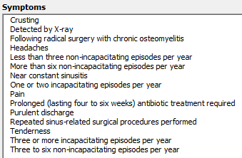
Sinusitis – DBQ and Evaluation Builder
Notes:
Sinusitis DBQ and Evaluation Builder

Slide 13
Rhinitis (DC 6522 – 6523)
Inflammation of nasal mucous membranes due to bacterial infection, or allergies
Notes:
Rhinitis (DC 65 22 dash 65 23)
Inflammation of nasal mucous membranes due to bacterial infection, or allergies
65 22 Allergic or vasomotor rhinitis:
With polyps. Rating 30
Without polyps, but with greater than 50 percent obstruction of nasal passage on both sides or complete obstruction on one side. Rating 10.
65 23 Bacterial rhinitis:
Rhinoscleroma. Rating 50.
With permanent hypertrophy of turbinates and with greater than 50 percent obstruction of nasal passage on both sides or complete obstruction on one side. Rating 10.
65 24 Granulomatous rhinitis:
Wegener’s granulomatosis, lethal midline granuloma. Rating 100.
Other types of granulomatous infection. Rating 20.

Slide 14
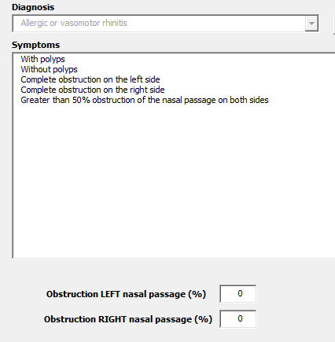
Rhinitis – DBQ and Evaluation Builder
Notes:
Rhinitis dash DBQ and Evaluation Builder

Slide 15
Coexisting Respiratory Conditions under 38 CFR 4.96(a)
Ratings under diagnostic codes 6600 through 6817 and 6822 through 6847 will not be combined with each other.
A single rating will be assigned under the diagnostic code which reflects the predominant disability with elevation to the next higher evaluation where the severity of the overall disability warrants such elevation.
Notes:
Coexisting Respiratory Conditions under 38 CFR 4.96(a)
Ratings under diagnostic codes 6600 through 68 17 and 68 22 through 68 47 will not be combined with each other.
A single rating will be assigned under the diagnostic code which reflects the predominant disability with elevation to the next higher evaluation where the severity of the overall disability warrants such elevation.

Slide 16
Special Provisions DC 6600, 6603, 6604, 6825–6833, and 6840–6845
Pulmonary Function Test (PFT) results are required to evaluate, EXCEPT:
When the results of a maximum exercise capacity test are of record and are 20 ml/kg/min or less. If a maximum exercise capacity test is not of record, evaluate based on alternative criteria.
When pulmonary hypertension (documented by an echocardiogram or cardiac catheterization), cor pulmonale, or right ventricular hypertrophy has been diagnosed.
When there have been one or more episodes of acute respiratory failure.
When outpatient oxygen therapy is required.
Notes:
Special Provisions DC 6600, 66 03, 66 04, 68 25 through 68 33, and 68 40 through 6845
Pulmonary Function Test (PFT) results are required to evaluate, EXCEPT:
When the results of a maximum exercise capacity test are of record and are 20 ml per kg per minute or less. If a maximum exercise capacity test is not of record, evaluate based on alternative criteria.
When pulmonary hypertension (documented by an echocardiogram or cardiac catheterization), cor pulmonale, or right ventricular hypertrophy has been diagnosed.
When there have been one or more episodes of acute respiratory failure.
When outpatient oxygen therapy is required.

Slide 17
Special Provisions DC 6600, 6603, 6604, 6825–6833, and 6840–6845
If the DLCO test is not of record, evaluate based on alternative criteria as long as the examiner states why the test would not be useful or valid in a particular case.
When the PFT's are not consistent with clinical findings, evaluate based on the PFT's unless the examiner states why they are not a valid indication of respiratory functional impairment in a particular case.
Post-bronchodilator studies are required when PFT's are done for disability evaluation purposes except when the results of pre-bronchodilator pulmonary function tests are normal; or when the examiner determines that post-bronchodilator studies should not be done and states why; or using the DLCO score values.
Notes:
Special Provisions DC 6600, 66 03, 66 04, 68 25 through 68 33, and 68 40 through 68 45
If the DLCO test is not of record, evaluate based on alternative criteria as long as the examiner states why the test would not be useful or valid in a particular case.
When the PFT's are not consistent with clinical findings, evaluate based on the PFT's unless the examiner states why they are not a valid indication of respiratory functional impairment in a particular case.
Post bronchodilator studies are required when PFT's are done for disability evaluation purposes except when the results of pre bronchodilator pulmonary function tests are normal;
or when the examiner determines that post-bronchodilator studies should not be done and states why; or using the DLCO score values.

Slide 18
Special Provisions DC 6600, 6603, 6604, 6825–6833, and 6840–6845
When evaluating based on PFT's, use post-bronchodilator results in applying the evaluation criteria in the rating schedule unless the post-bronchodilator results were poorer than the pre-bronchodilator results. In those cases, use the pre-bronchodilator values for rating purposes.
When there is a disparity between the results of different PFT's (FEV-1, FVC, etc.), so that the level of evaluation would differ depending on which test result is used, use the test result that the examiner states most accurately reflects the level of disability.
If the FEV-1 and the FVC are both greater than 100 percent, do not assign a compensable evaluation based on a decreased FEV-1/FVC ratio.
Notes:
Special Provisions DC 6600, 66 03, 66 04, 68 25 through 68 33, and 68 40 through 68 45
When evaluating based on PFT's, use post-bronchodilator results in applying the evaluation criteria in the rating schedule unless the post-bronchodilator results were poorer than the pre-bronchodilator results. In those cases, use the pre-bronchodilator values for rating purposes.
When there is a disparity between the results of different PFT's (FEV dash 1, FVC, etc.), so that the level of evaluation would differ depending on which test result is used, use the test result that the examiner states most accurately reflects the level of disability.
If the FEV dash 1 and the FVC are both greater than 100 percent, do not assign a compensable evaluation based on a decreased FEV dash 1 slash FVC ratio.

Slide 19
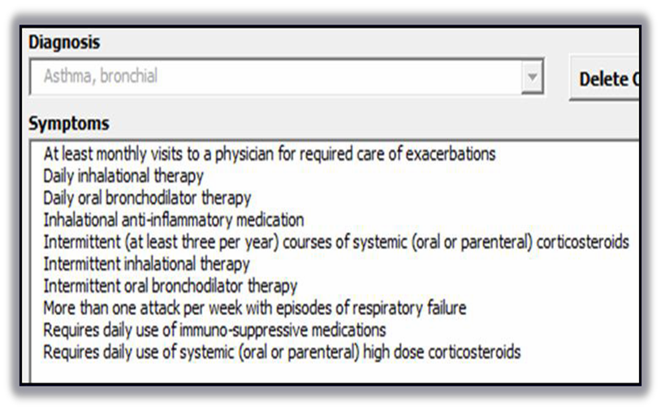
Asthma (DC 6602)
Spasm, constriction, and/or swelling of the bronchial tubes caused by increased responsiveness of the tracheobronchial tree to assorted stimuli.
Important: The evaluation can be based on the PFT OR frequency and type of medication! (Whichever is higher!)
Notes:
Asthma (DC 66 02)
Spasm, constriction, and or swelling of the bronchial tubes caused by increased responsiveness of the tracheobronchial tree to assorted stimuli.
Important: The evaluation can be based on the PFT OR frequency and type of medication! (Whichever is higher!)
66 02 Asthma, bronchial:
FEV dash 1 less than 40 percent predicted, or; FEV dash 1 slash FVC less than 40 percent, or; more than one attack per week with episodes of respiratory failure, or;
requires daily use of systemic (oral or parenteral) high dose corticosteroids or immuno-suppressive medications. Rating 100.
FEV dash 1 of 40 to 55 percent predicted, or; FEV dash 1 slash FVC of 40 to 55 percent, or; at least monthly visits to physician for required care of exacerbations, or;
intermittent (at least three per year) courses of systemic (oral or parenteral) corticosteroids. Rating 60.
FEV dash 1 of 56 to 70 percent predicated, or; FEV dash 1 slash FVC of 56 to 70 percent, or; daily inhalational or oral bronchodilator therapy, or; inhalational anti-inflammatory medication. Rating 30.
FEV dash 1 of 71 to 80 percent predicted, or; FEV dash 1 slash FVC of 71 to 80 percent, or intermittent inhalational or oral bronchodilator therapy. Rating 10.
Note: In the absence of clinical findings of asthma at time of examination, a verified history of asthmatic attacks must be of record.

Slide 20
Asthma – DBQ
Notes:
Asthma dash DBQ

Slide 21
Asthma – DBQ
Notes:
Asthma dash DBQ

Slide 22
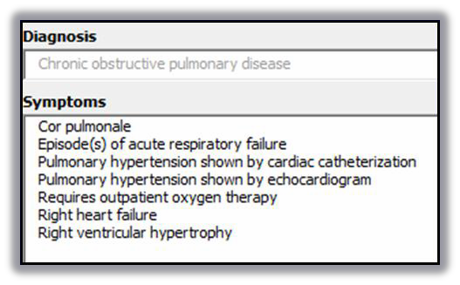
Chronic Obstructive Pulmonary Disease (COPD) (DC 6604)
Decreased ability of the lungs to perform their function of ventilation due to airway obstruction.
Notes:
Chronic Obstructive Pulmonary Disease (C O P D) (DC 66 04)
Decreased ability of the lungs to perform their function of ventilation due to airway obstruction.
66 04 Chronic obstructive pulmonary disease:
FEV dash 1 less than 40 percent of predicted value, or; the ratio of Forced Expiratory Volume in one second to Forced Vital Capacity (FEV dash 1 slash FVC) less than 40 percent, or;
Diffusion Capacity of the Lung for Carbon Monoxide by the Single Breath Method (DLCO (SB)) less than 40 percent predicted, or; maximum exercise capacity less than 15 ml per kg per minute oxygen consumption (with cardiac or respiratory limitation), or;
cor pulmonale (right heart failure), or; right ventricular hypertrophy, or; pulmonary hypertension (shown by Echo or cardiac catheterization), or;
episode episodes of acute respiratory failure, or; requires outpatient oxygen therapy. Rating 100.
FEV dash 1 of 40 to 55 percent predicted, or; FEV dash 1 slash FVC of 56 to 70 percent, or; DLCO (SB) of 40 to 55 percent predicted, or; maximum oxygen consumption of 15 to 20 ml per kg per minute (with cardiorespiratory limit). Rating 60.
FEV dash 1 of 56 to 70 percent predicted, or; FEV dash 1 slash FVC of 56 to 70 percent, or; DLCO (SB) 56 to 65 percent predicted. Rating 30.
FEV dash 1 of 71 to 80 percent predicted, or; FEV dash 1 slash FVC of 71 to 80 percent, or; DLCO (SB) 66 to 80 percent predicted. Rating 10.

Slide 23
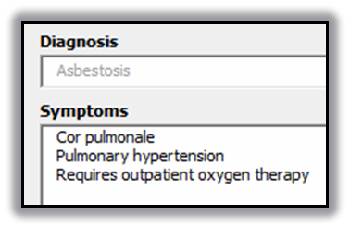
Asbestosis (DC 6833)
A form of pneumoconiosis that results from prolonged inhalation of asbestos particles.
Notes:
Asbestosis (DC 68 33)
A form of pneumoconiosis that results from prolonged inhalation of asbestos particles.
68 33 Asbestosis
General Rating Formula for Interstitial Lung Disease (diagnostic codes 68 25 through 68 33):
Forced Vital Capacity (FVC) less than 50 percent predicted, or; Diffusion Capacity of the Lung for Carbon Monoxide by the Single Breath Method (DLCO (SB)) less than 40 percent predicted, or;
maximum exercise capacity less than 15 ml per kg per minute oxygen consumption with cardiorespiratory limitation, or; cor pulmonale or pulmonary hypertension, or; requires outpatient oxygen therapy. Rating 100.
FVC of 50 to 64 percent predicted, or; DLCO (SB) of 40 to 55 percent predicted, or maximum exercise capacity of 15 to 20 ml per kg per minute oxygen consumption with cardiorespiratory limitation. Rating 60.
FVC of 65 to 74 percent predicted, or; DLCO (SB) of 56 to 65 percent predicted. Rating 30.
FVC of 75 to 80 percent predicted, or; DLCO (SB) of 66 to 80 percent predicted. Rating 10.

Slide 24
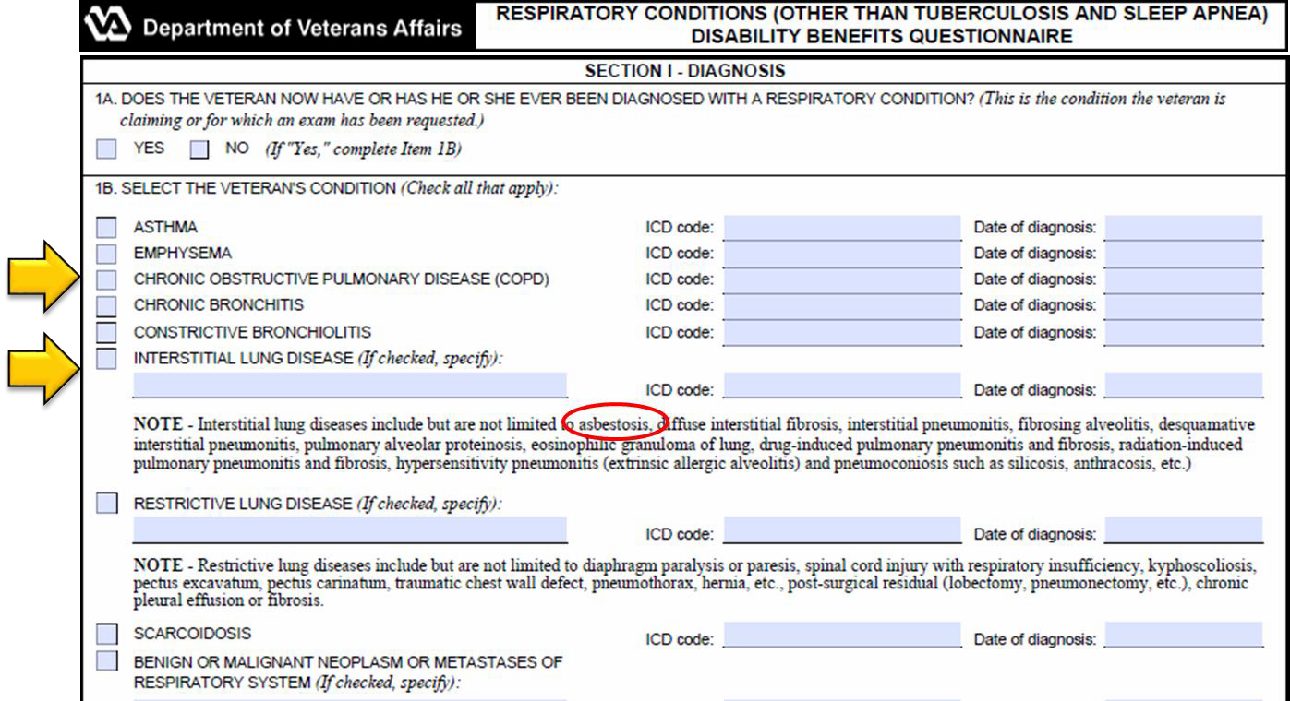
Respiratory Conditions (other than TB and Sleep Apnea) – DBQ
Exposure to Asbestos is not a condition – the Veteran MUST have a disease or disability that resulted from such exposure to warrant service connection.
Notes:
Respiratory Conditions (other than TB and Sleep Apnea) dash DBQ
Exposure to Asbestos is not a condition the Veteran MUST have a disease or disability that resulted from such exposure to warrant service connection.

Slide 25
Presumptive Considerations
3.309(a) – Chronic diseases (within one year of discharge): Sarcoidosis, Active Tuberculosis, Malignant tumors
3.309(d) – Radiation exposure: Cancer of the Lung
3.309(e) – Herbicide exposure: Respiratory Cancers (of the lung, bronchus, larynx, or trachea), Soft-tissue sarcoma (of the cells lining lungs)
3.317(b) – Gulf War: Undiagnosed illness – signs or symptoms involving respiratory system (upper or lower)
3.317(c) – Gulf War: Infectious diseases
Notes:
Presumptive Considerations
3.309(a) Chronic diseases (within one year of discharge): Sarcoidosis, Active Tuberculosis, Malignant tumors
3.309(d) Radiation exposure: Cancer of the Lung
3.309(e) Herbicide exposure: Respiratory Cancers (of the lung, bronchus, larynx, or trachea), Soft-tissue sarcoma (of the cells lining lungs)
3.317(b) Gulf War: Undiagnosed illness - signs or symptoms involving respiratory system (upper or lower)
3.317(c) Gulf War: Infectious diseases

Slide 26
Special Monthly Compensation (SMC)
Notes:
Special Monthly Compensation (SMC)

Slide 27
Ancillary Considerations
38 CFR 3.809(a) Special Home Adaptation – Residuals of an inhalation injury- including, but not limited to:
pulmonary fibrosis
asthma, and
chronic obstructive pulmonary disease
Note: An inhalational injury due to breathing steam or toxic inhalants such as fumes, gases, and mists present in a fire environment.
Notes:
Ancillary Considerations
38 CFR 3.809(a) Special Home Adaptation dash Residuals of an inhalation injury including, but not limited to:
pulmonary fibrosis
asthma, and
chronic obstructive pulmonary disease
Note: An inhalational injury due to breathing steam or toxic inhalants such as fumes, gases, and mists present in a fire environment.

Slide 28
Questions

