Slide 1
eBenefits
(for Education)

Slide 2
Overview of Today’s Training
The eBenefits portal is a joint VA and DoD effort that allows users to update personal information, apply for benefits, view benefit payment history, check the status of a pending claim, and access official military personnel records.
As a VCE, you may receive general or education-specific inquiries about the system; therefore you should have a basic understanding of its features and how users may interact with it.

Slide 3
Overview of Today’s Training, Cont.
Today’s training will discuss the purpose of eBenefits, the services it provides, how to register for access, and what to do if technical issues arise.
This PowerPoint also serves as a visual guide that VA employees may use to assist claimants in navigating through various portions of the portal.

Slide 4
Icebreaker
Has anyone heard of eBenefits?
What do you know about eBenefits, or what have you heard about it?

Slide 5
Lesson Objectives
At the conclusion of this lesson, you will be able to:
Recall characteristics and features of the eBenefits portal
Differentiate between methods of obtaining Basic vs. Premium level eBenefits account access
Recognize location of content within the eBenefits portal
Recall education-specific features of eBenefits
Identify actions when users report fraud and/or technical issues pertaining to eBenefits

Slide 6
History and Features of eBenefits

Slide 7
History
Benefits is a joint VA/DoD Web portal that provides self-service capabilities to Veterans, Servicemembers, and their dependents and caregivers.
Development of eBenefits began in March of 2007 at the recommendation of the President’s Commission on Care for America’s Returning Wounded Warriors (Dole/Shalala).
Veterans Online Application (VONAPP) is a website linked to eBenefits that allows Veterans to apply for benefits online by completing and sending an application electronically.

Slide 8
Features of eBenefits
Secure, personalized online access to numerous VA and DoD applications and services
Links to other sites containing information about military and Veteran benefits and services
24/7 access to information, records, and services from VA and DoD
Faster way for Servicemembers, Veterans, and their eligible dependents (age 18 and over) to access and submit information
Complete career lifecycle access to personnel and other records

Slide 9
Features of eBenefits, Cont.
Access and download VA and DoD documents (to include DD214)
Edit personal information (to include address and Electronic Funds Transfer (EFT) changes)
Apply for benefits
Review benefit claims and appeal status
Check Post-9/11 GI Bill status
Transfer Post-9/11 GI Bill benefits
Verify enrollment for Ch30, 1606, or 1607
Search for employment
Order medical equipment

Slide 10
Enrolling in eBenefits

Slide 11
eBenefits Account Options
Two types or levels of access exist for the eBenefits portal:
Basic eBenefits (DS Logon Level 1) account
  Does not allow access to Personally-Identifiable Information (PII)
  Allows limited access to self-service features
Premium eBenefits (DS Logon Level 2) account
  Includes access to individual’s PII
  Allows full access to all self-service features

Slide 12
Basic vs Premium Account
eBenefits Feature | Basic Account | Premium Account
Apply for VA benefits | X | X
Check eligibility for health benefits | X | X
Request state benefit information | X | X
Get a VA home loan Certificate of Eligibility | X | X
Check status of a Compensation or Pension claim |  | X
Check VA payment history |  | X
View TRICARE health information |  | X
Check claim appeal status |  | X
Transfer Post-9/11 GI Bill education benefits |  | X
Obtain a copy of DD214 or other military records |  | X

Slide 13
Obtaining a Basic Account
In order to obtain a Basic account, the user must be registered in Defense Enrollment Eligibility Reporting System (DEERS)
Once registered in DEERS, the user may obtain a Basic eBenefits account by either:
  Online self-registration
  In-person registration at a VA Regional Office or TRICARE center

Slide 14
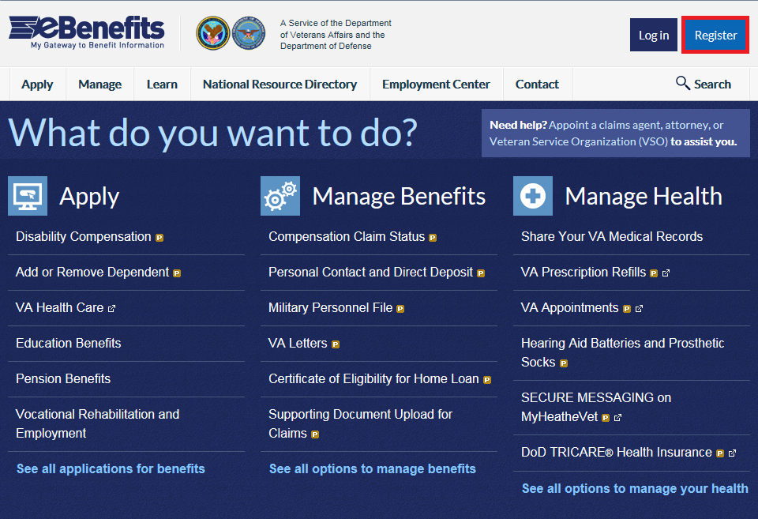
Basic Account Online Registration
To register for a Basic eBenefits account online, select “Register” from the homepage.

Slide 15
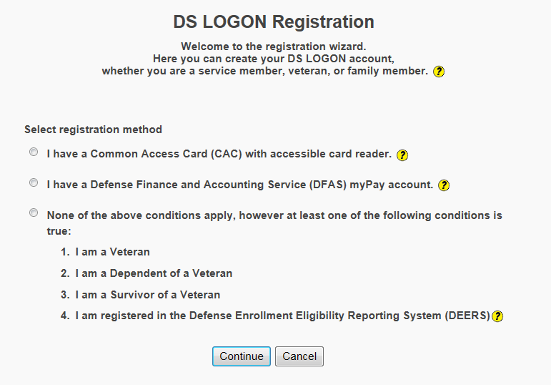
Basic Account Registration Page
Select the appropriate registration method and then select “Continue”.

Slide 16
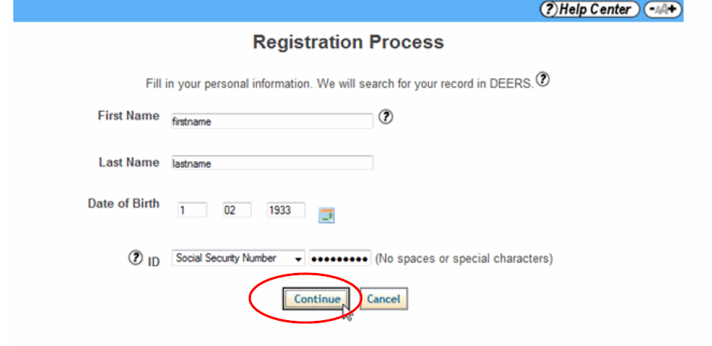
Basic Account Personal Information
User should enter their personal information and select “Continue”. If they are not registered in DEERS, they will receive an error message.

Slide 17
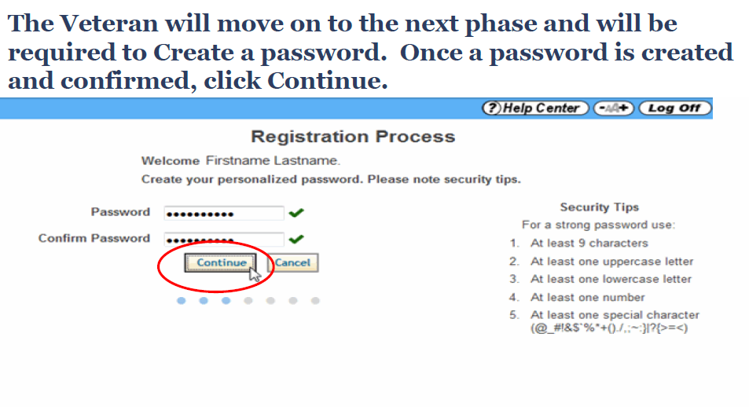
Basic Account Password
User should create and confirm a password; then, select “Continue”.

Slide 18
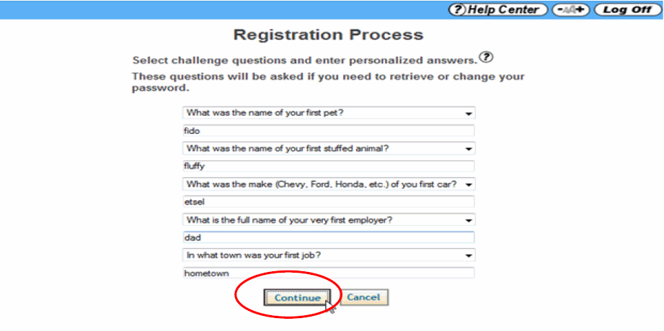
Basic Account Challenge Questions
User should select and respond to five challenge questions. Then, select “Continue”.

Slide 19
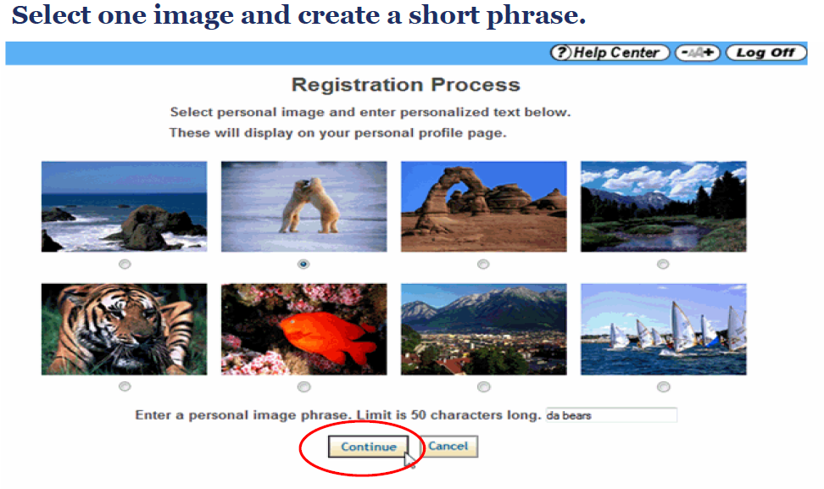
Basic Account Personal Image
User should select a personal image and enter a personal image phrase. Select “Continue”.

Slide 20
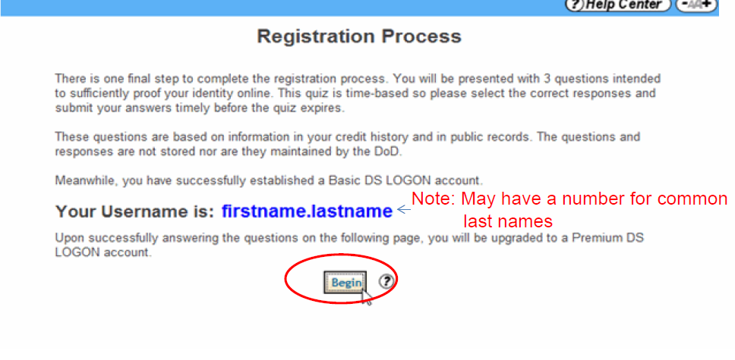
Basic Account Username Assigned
A username will be provided. If needed, user should keep a copy for future reference. User should select “Begin” to continue with the Premium Account registration process.

Slide 21
Obtaining a Premium Account
Before obtaining a Premium account, user must have a Basic eBenefits account
Once they have a Basic level account, there are three ways they can obtain a Premium eBenefits account:
  Online, self-service proofing
  Phone proofing
  In-person proofing at a VA Regional Office

Slide 22
Premium Account Online Proofing
In order to upgrade to a Premium account online:
User should login to eBenefits (www.ebenefits.va.gov) with their Basic account login
And select “Upgrade to a Premium Account”

Slide 23
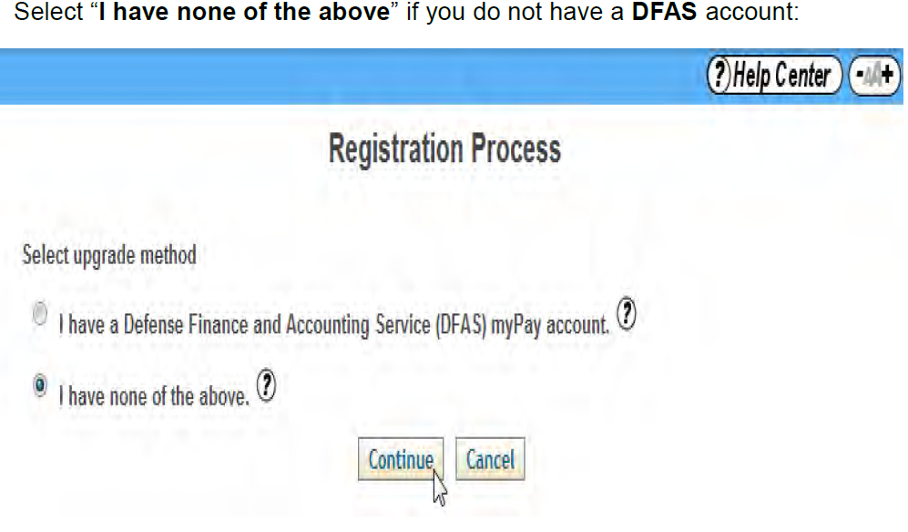
Upgrade Method
User should select the appropriate upgrade method option. Then select “Continue”.

Slide 24
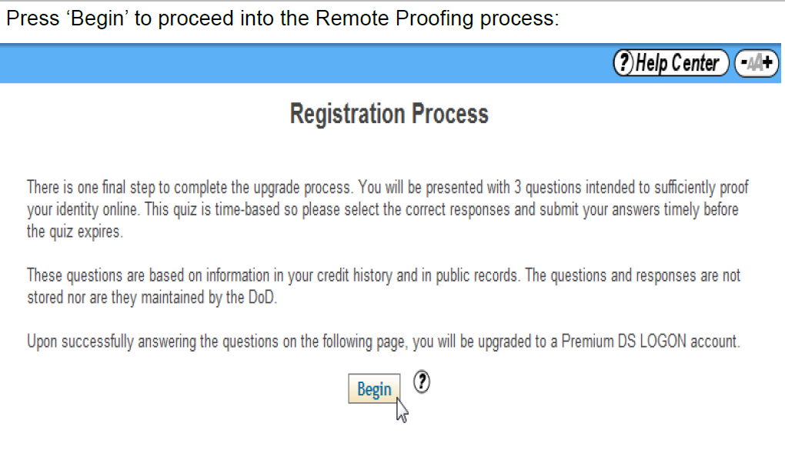
Premium Account Proofing Instructions
User should select “Begin” to proceed with the remote proofing process.

Slide 25
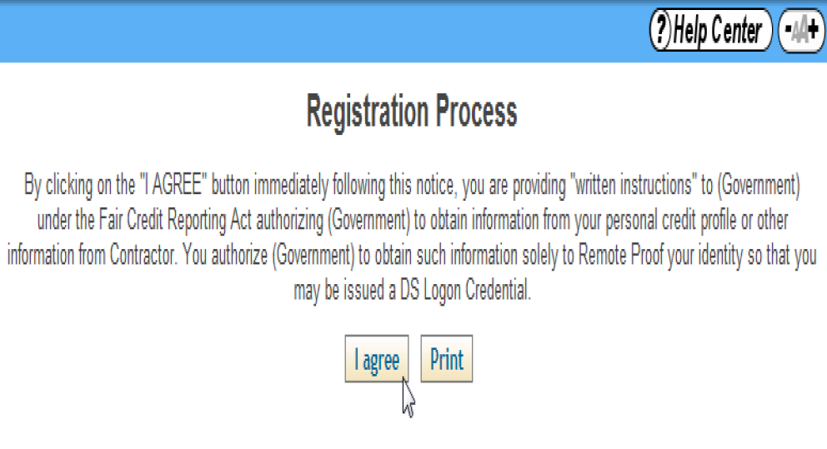
Premium Account Consent Page
User should select “I agree” to provide consent to use the remote proofing service.

Slide 26
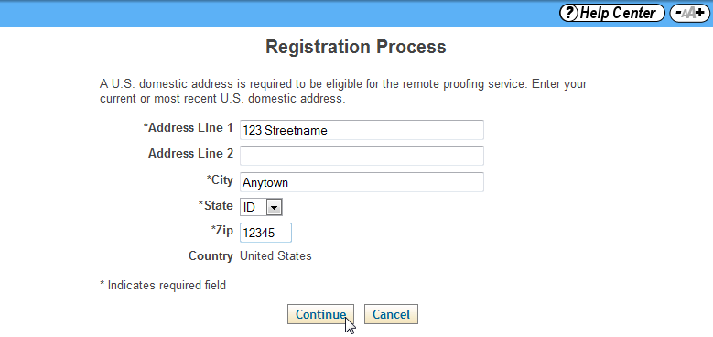
Premium Account Personal Information
User should enter their address and select “Continue”.

Slide 27
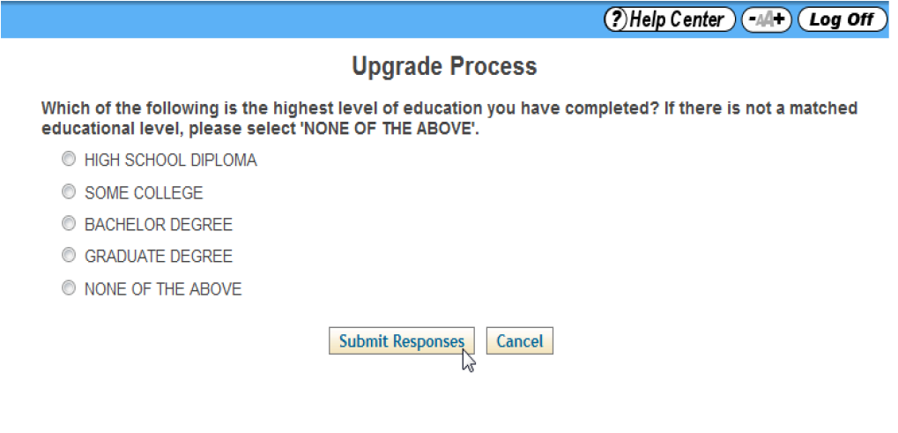
Premium Account Proofing Questions
A quiz appears consisting of three applicant-specific questions. The user’s answers must be submitted within a few minutes for the remote proofing process to be successful.

Slide 28
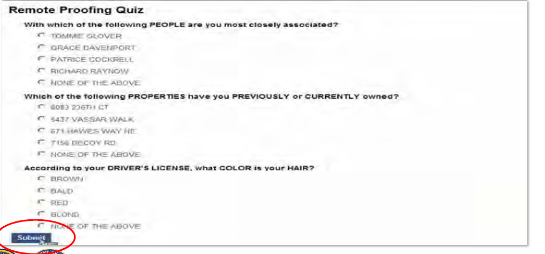
Premium Account Proofing Questions, Cont.
The user will have four minutes to select the correct answers to the quiz. Once the questions have been answered, they should select “Submit”. If the user answers one question incorrectly, an extra question will be asked.

Slide 29
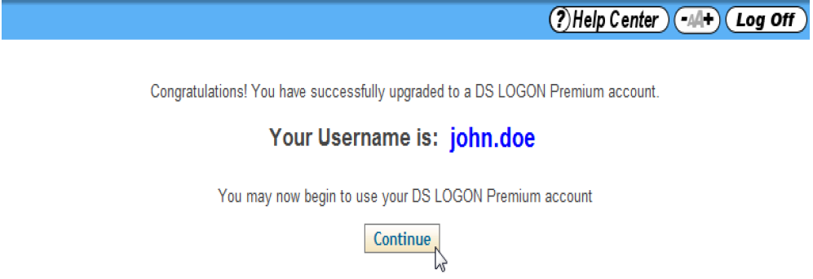
Premium Account Confirmation
If the answers are successful, the user will receive confirmation of a Premium account. If they are unable to use remote proofing, they may need to pursue a different upgrade path.
Users should log back into the eBenefits portal instead of logging in from this page.

Slide 30
Premium Account Phone Proofing
Users must be receiving VBA payments by direct deposit
This service is not available for dependents
Dial 1-800-827-1000, options 1, 7, and 0
  ECC Phone Agents may transfer the call by dialing *6, then 150
Users must have available:
  Date of birth
  Primary ID (driver’s license, Military ID, or passport)
  Secondary ID (birth certificate or social security card)
  Bank account number
  The exact dollar amount of their most recent VA payment

Slide 31
Premium Account In-Person Proofing
Users may go to the nearest VA Regional Office or TRICARE Service Center
Provide a Federal or State-issued picture ID (such as Driver’s License, Military ID, or Passport)
Provide a Federal or State-issued non-picture ID (such as Social Security Card, Voter Registration, or Birth Certificate)
Note: Creating a Premium account by visiting a RO without having a Basic account first will require the Veteran to receive an activation code from DoD within 6-12 days at their mailing address on record.

Slide 32
Comprehension Check
What methods are available to apply for a Basic level eBenefits account?
What methods are available to upgrade to a Premium level eBenefits account?
Which account level is needed to apply for VA benefits?
Notes:
Answers:
Online or in-person at VARO or TRICARE
Online, phone, VA office
Either Basic or Premium level accounts may apply for benefits.

Slide 33
Navigating the eBenefits Portal

Slide 34

eBenefits Home Page

Slide 35
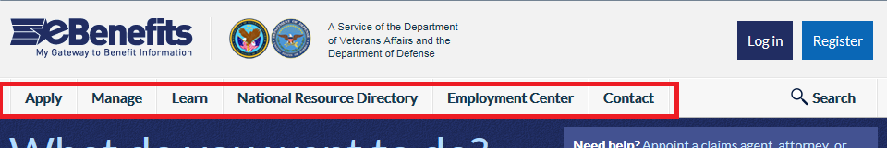
eBenefits Homepage Tabs
Apply
Manage
Learn
National Resource Directory
Employment Center
Contact

Slide 36
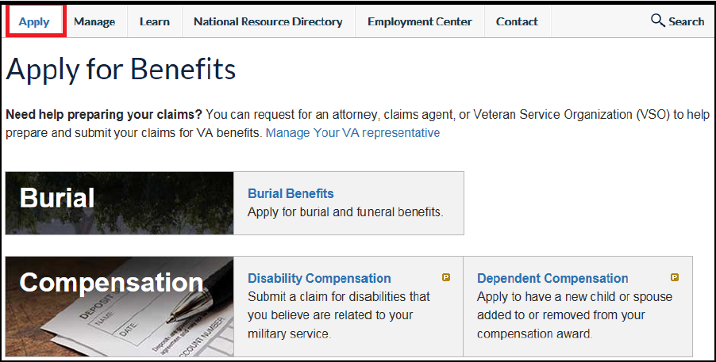
Apply for Benefits
To apply for benefits, user should select the “Apply” tab. Then, select the hyperlink that corresponds to the type of benefit they wish to apply for.

Slide 37
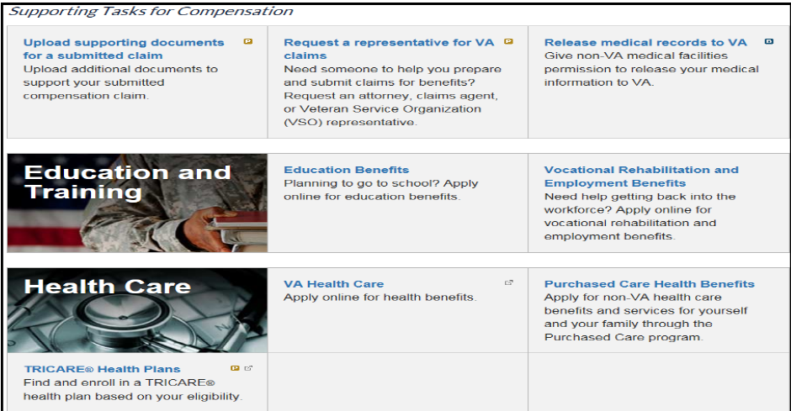
Apply for Benefits, Cont.
User may apply for burial, compensation, education and training, health care, housing, insurance, or pension benefits through eBenefits.

Slide 38
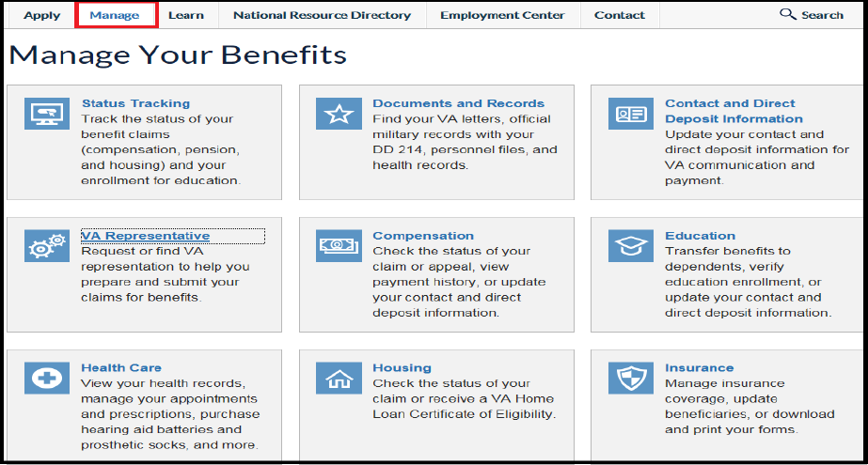
Manage Your Benefits
From the “Manage Your Benefits” tab users may track the status of their compensation and pension claim, order certain medical supplies, request copies of military documents, transfer education benefits, and update insurance beneficiaries.

Slide 39
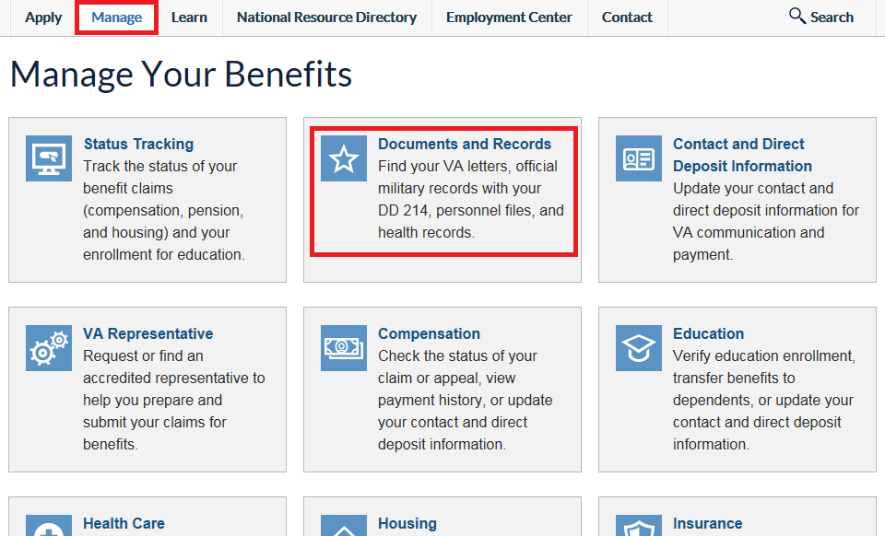
Obtaining VA Letters
To request copies of official military documents, the user must first select the “Manage” tab, then select “Documents and Records”.

Slide 40
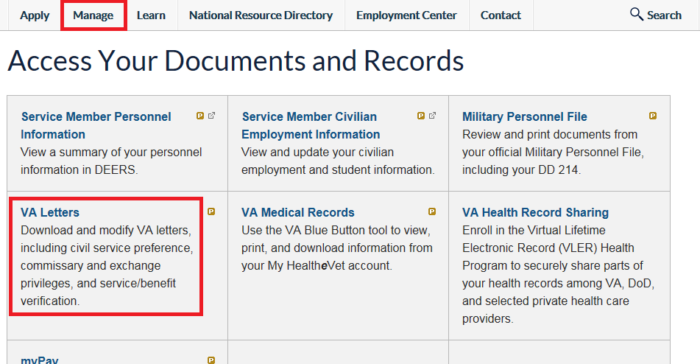
Obtaining VA Letters, Cont.
The “Access Your Documents and Records” page shows several types of documents that may be requested. The user should select “VA Letters”.

Slide 41
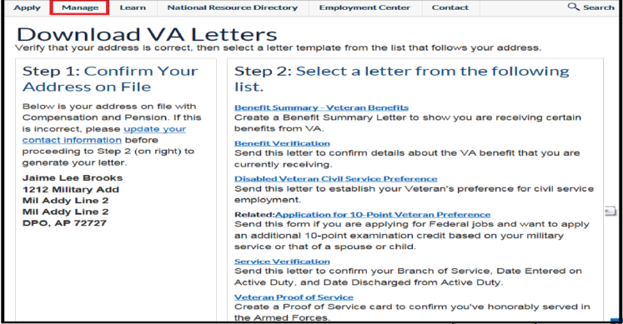
Obtaining VA Letters, Cont.
From the “Download VA Letters” page, the user will need to further specify the type of letter needed by selecting the appropriate hyperlink.

Slide 42
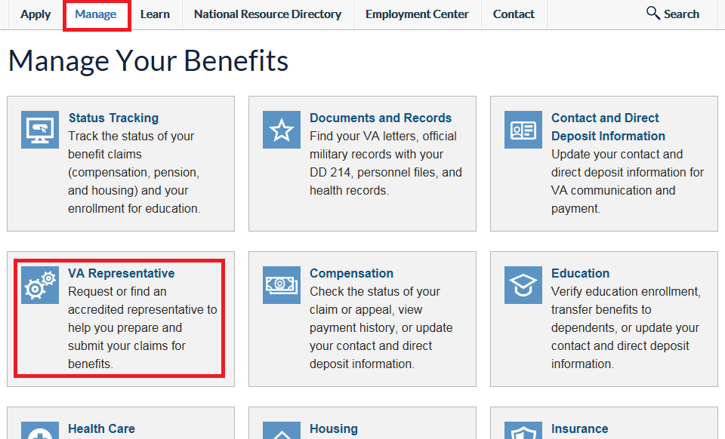
Finding a VA Representative
Users may also request or find VA representation by selecting the “VA Representative” link from the “Manage” tab.

Slide 43
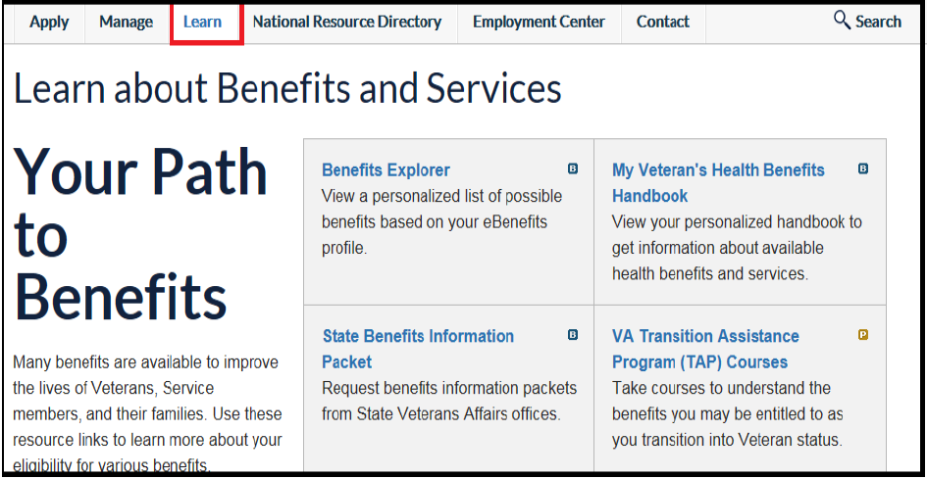
Learn Page
From the “Learn” tab, users may select and explore the various links to find resources that are available to them.

Slide 44
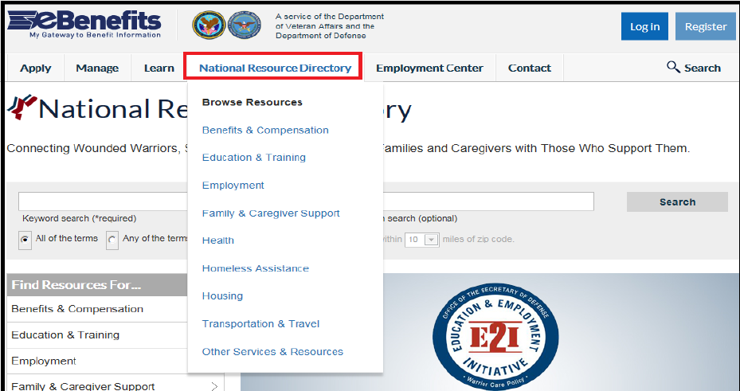
National Resource Directory
From the “National Resource Directory” tab drop-down menu, users may find resources in their specific geographic area. They should select the hyperlink for the type of resources they are searching for to find additional information.

Slide 45
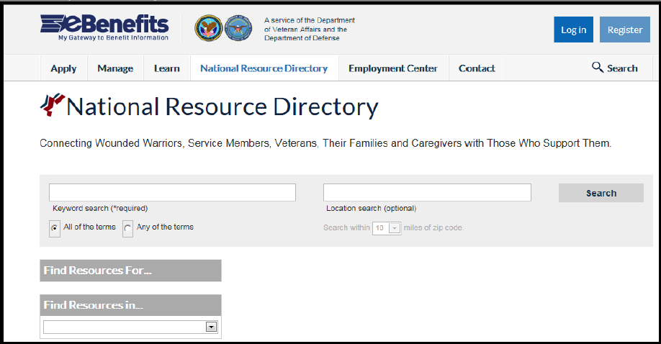
National Resource Directory, Cont.
Users may also enter a keyword for the type of assistance they need from the “National Resource Directory” page. Then, enter their location and select “Search”. A list of topic-specific local resources will be displayed.

Slide 46
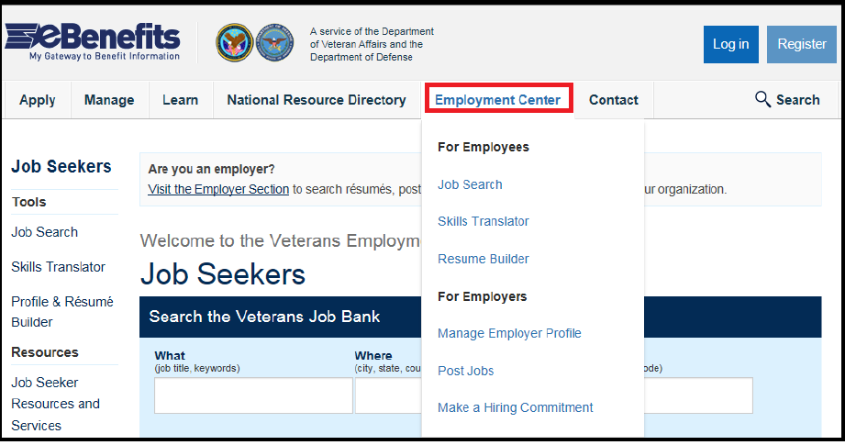
Employment Center Page
The “Employment Center” tab provides options such as searching for jobs, translating military skills into similar civilian occupations, and building resumes.

Slide 47
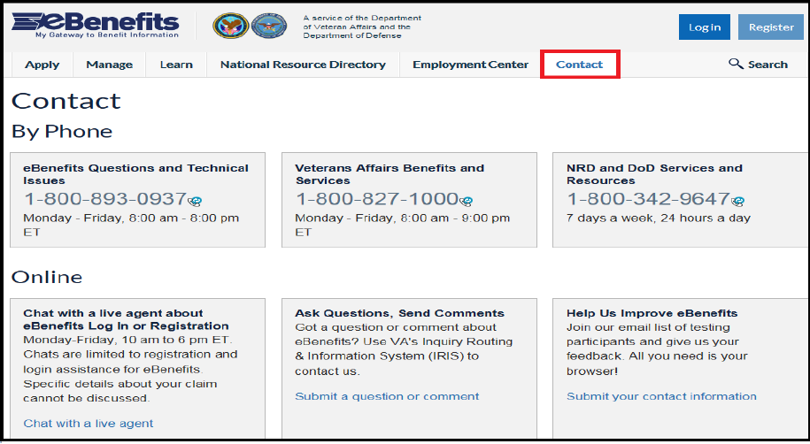
Contact Page
The “Contact” tab provides various means of interacting with VA. Users may contact the VA by phone, email, or chat.

Slide 48
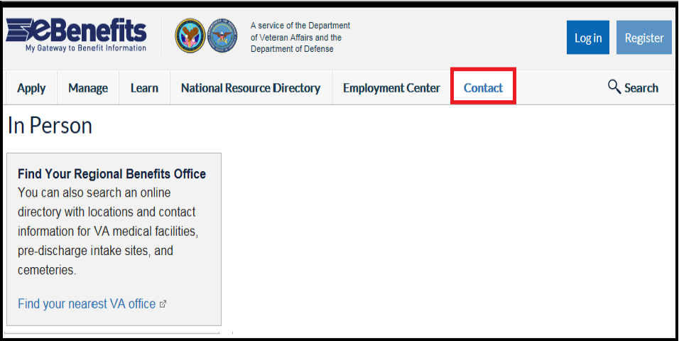
Contact Page, Cont.
The “Contact” tab also provides a list of nearest VA facilities.

Slide 49
Comprehension Check
What types of benefits may be applied for on the eBenefits site?
What are the main tabs available on the eBenefits site?
Notes:
Answers:
Burial; Compensation; Education/Training, Health Care, Housing, Insurance, and Pension
Apply; Manage; Learn; National Resource Directory; Employment Center; Contact

Slide 50
Education-Related eBenefits Features

Slide 51
Education Related Features
Apply for benefits
Enroll in direct deposit
Change address
Review Post 9/11 GI Bill enrollment status
Check remaining benefits and delimiting date
Transfer Post-9/11 GI Bill entitlement
Web Automated and Verification of Enrollment (WAVE) for Ch30, 1606, and 1607

Slide 52
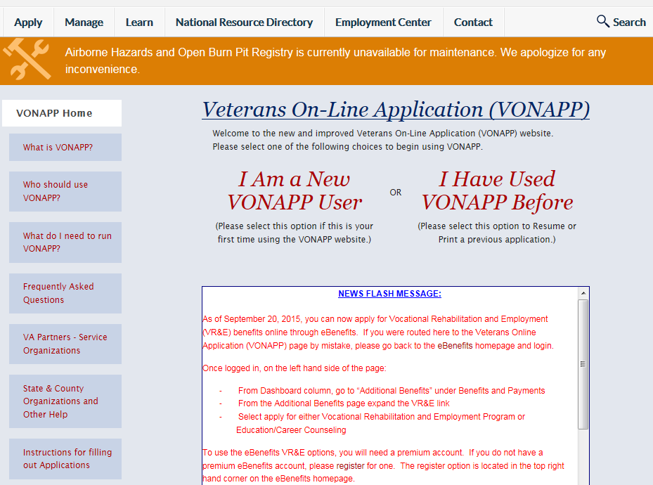
Applying for Benefits
From the “Apply” tab, the user may select “Education”, to be directed to the VONAPP portal where they can apply for a variety of VA Education benefits. If they are a new VONAPP user, they will first have to set up a VONAPP account.

Slide 53
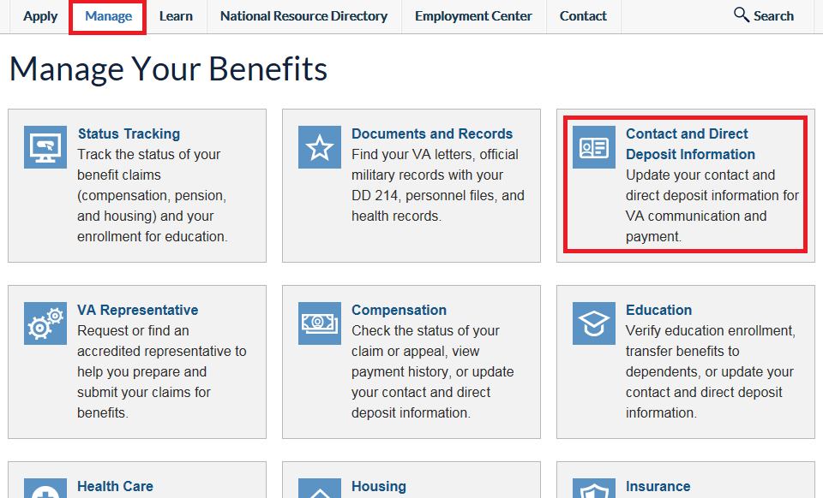
Address or Direct Deposit Changes
In order for a user to change their address or EFT information, the user should select the “Contact and Direct Deposit Information” link from the “Manage” tab.

Slide 54
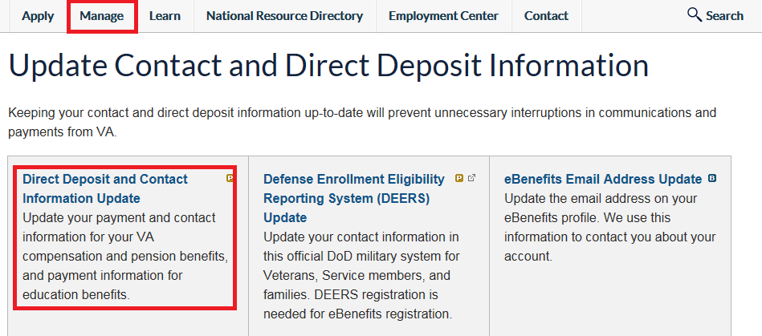
Address or Direct Deposit Changes, Cont.
Select “Direct Deposit and Contact Information Update”.

Slide 55
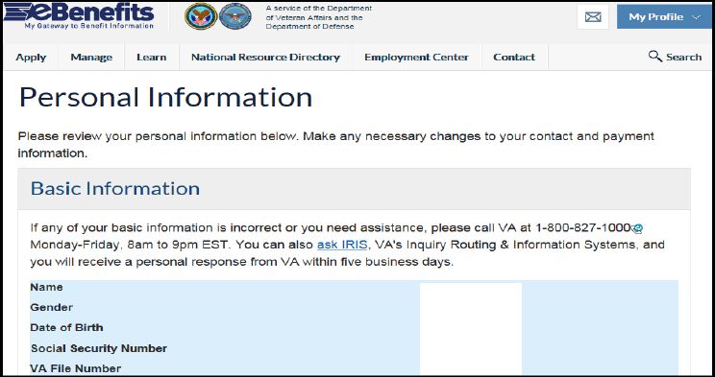
Address or Direct Deposit Changes, Cont.
The “Personal Information” page will display and show their personal information that is already on file. From there the user may edit their direct deposit and/or address.

Slide 56
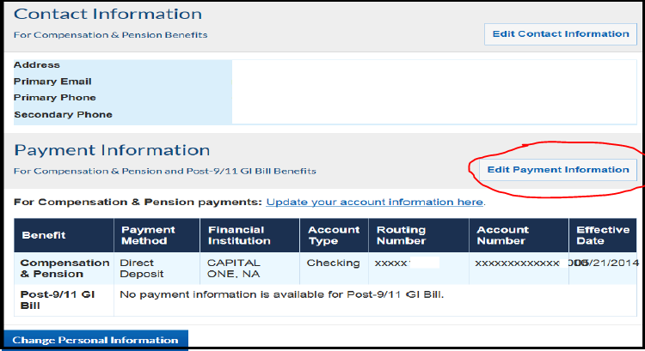
Direct Deposit Changes
To edit direct deposit information, the user should select “Edit Payment Information” and submit the updated information.

Slide 57
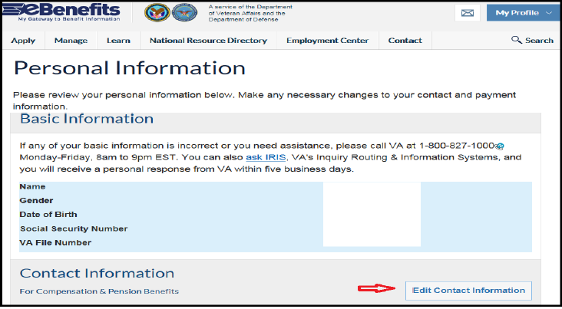
Address Changes
To edit an address, the user should select “Edit Contact Information”.

Slide 58
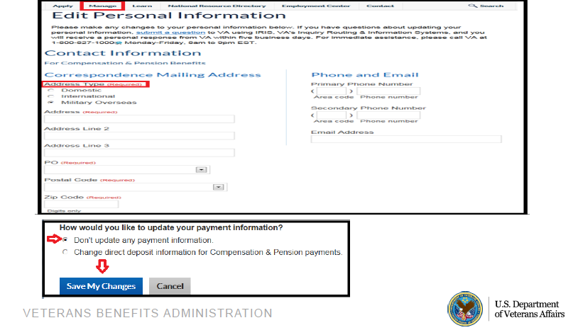
Address Changes, Cont.
  The user will then update address information as necessary, then select “Save My Changes”.
  NOTE: Address changes completed in eBenefits will have a 22 transaction code in BDN, but no NOTE in the TIMS file.

Slide 59
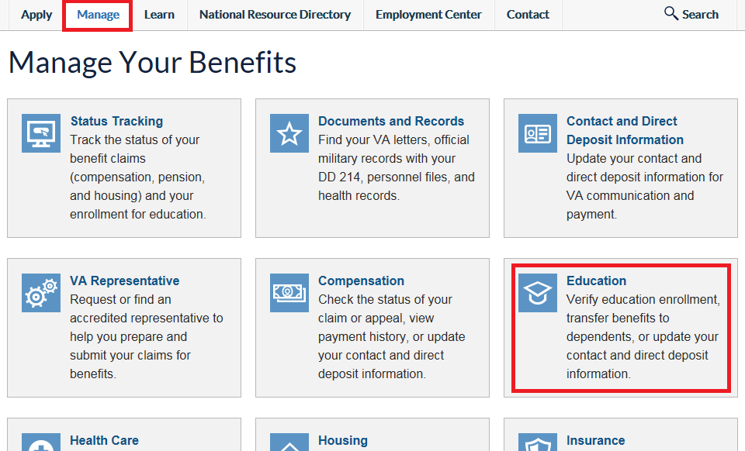
Managing Education Benefits
  The “Manage Your Education Benefits” page, accessible from the “Manage” tab, provides access to a variety of education benefit specific features and information.

Slide 60
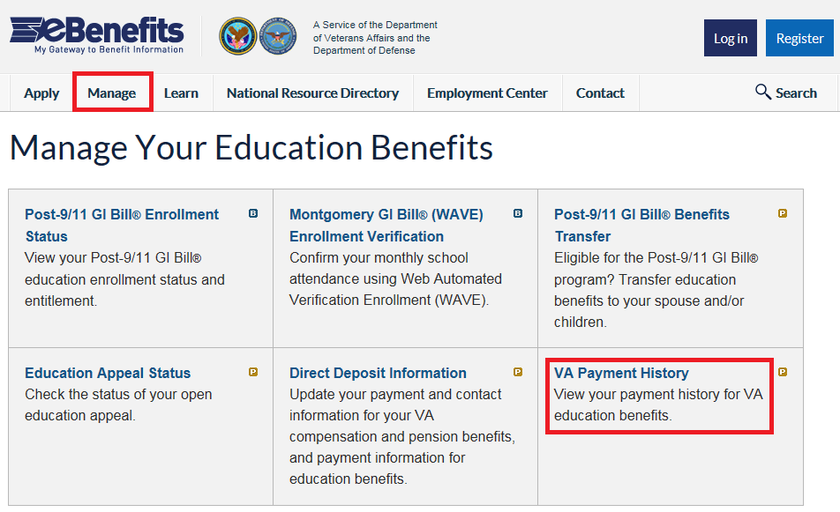
Checking VA Education Payments
User should select the “VA Payment History” link to review their education benefit payment history.

Slide 61
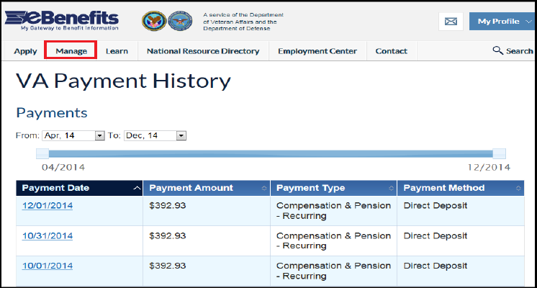
Checking VA Education Payments, Cont.
User should select the time period for which they would like to view past payments.

Slide 62
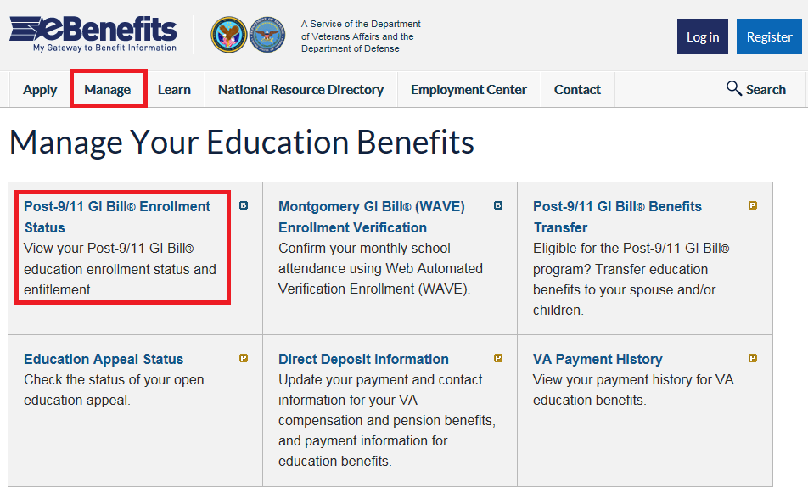
Post 9/11 GI Bill Enrollment Status
User should select the “Post-9/11 GI Bill Enrollment Status” link to review benefit status.
Note: Enrollment status for other education benefits is currently not available.

Slide 63
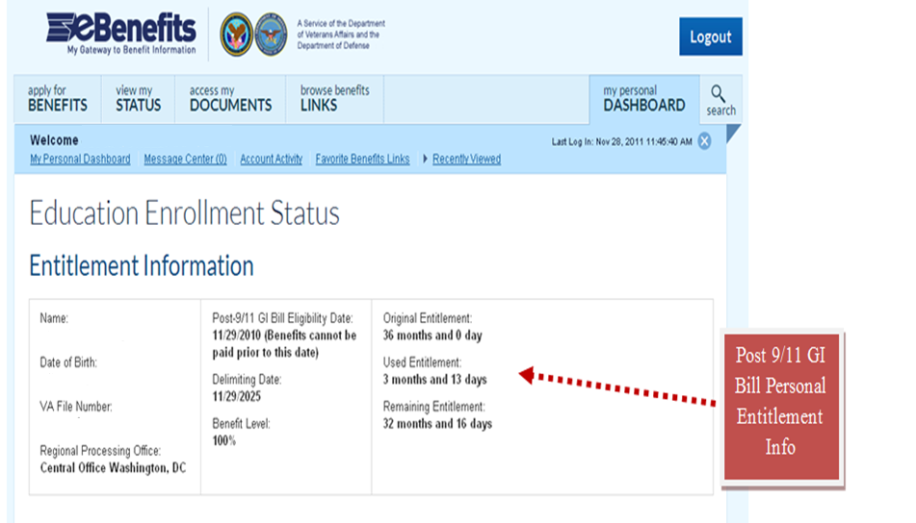
Remaining Benefits and Delimiting Date
Under “Entitlement Information” the user may view their school enrollment information, delimiting date, and the amount of entitlement used and remaining.

Slide 64
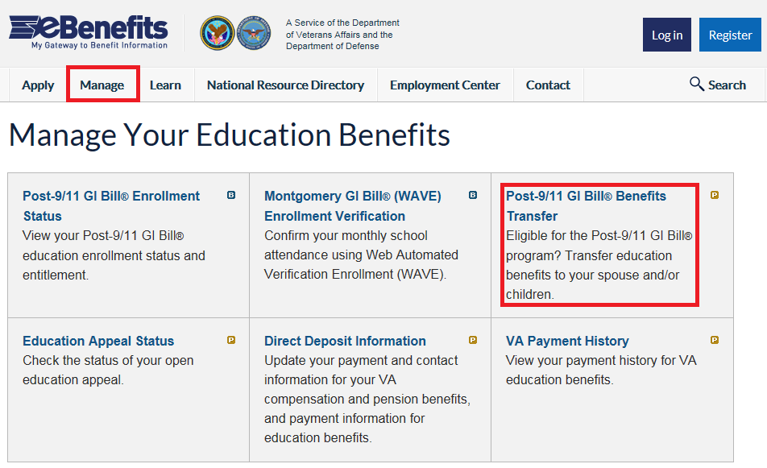
Transferring Post-9/11 GI Bill Benefits
User may select the “Post-9/11 GI Bill Benefits Transfer” link to transfer education benefit(s) to their dependent(s).

Slide 65
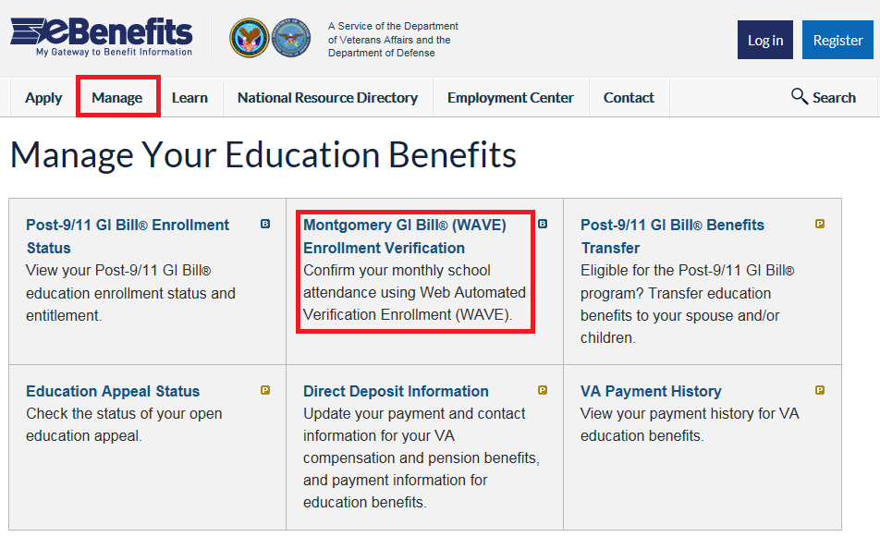
WAVE
Students using Ch30, Ch1606, Ch1607 may access WAVE to certify their attendance electronically, rather than calling the Education Call Center.

Slide 66
Comprehension Check
What are some education-related features available within eBenefits?
Which education benefit displays enrollment status on eBenefits?
Notes:
Answers:
Review Post-9/11 GI Bill enrollment; Transfer Post-9/11 GI Bill benefits; Review education benefit payment history; Certify attendance for Ch30, Ch1606, and Ch1607; Add/update direct deposit information
Post-9/11 GI Bill (Chapter 33)

Slide 67
Fraud and Technical Issues

Slide 68
Fraud Issues
eBenefits users have occasionally reported that their personal information (address, EFT) has been changed in the eBenefits system without their consent
In these instances, VA Education employees must:
  Advise the user to contact their local police department and file a report
  Correct any address or EFT information as needed
  Complete a payment tracer for any missing payment
  Complete a VA Form 119, Report of Contact, and email (via encrypted email) to their supervisor
  **Please refer to the Fraud/Privacy Violation Guidelines – Reportable Incidents, Procedural Guidance, FAQs, and Suggested Scripts for specific reporting instructions

Slide 69
Technical Issues
Transfer callers who are experiencing technical issues with the eBenefits portal to 1-800-983-0937.
Do not transfer for:
Navigational help
Help with applying for Education Benefits
Problems with the VONAPP website
Problems with the GI Bill website
Phone proofing

Slide 70
Comprehension Check
Which actions should you complete if a customer suspects fraud on their eBenefits account?
True or False: You should transfer individuals who are having difficulty with the VONAPP site to the technical helpdesk.
Notes:
Answers:
Offer to correct the change; Advise caller to contact local authorities; Notify supervisor via encrypted email with VA Form 119, Report of Contact; Complete a payment tracer, if necessary.
False

Slide 71
Summary
eBenefits is a self-service portal that offers services and access to VA and DoD programs and information
Veterans and dependents may obtain a Basic or Premium account
The site contains six tabs which categorize services by function: Apply, Manage, Learn, National Resource Directory, Employment Center, and Contact
Education specific functions include the ability to apply for education benefits, manage EFT and address information, check Post-9/11 GI Bill enrollment/benefit status, transfer benefits, and certify enrollment
A dedicated phone line is available for technical help with the site

Slide 72
Summary, Cont.
You have completed the eBenefits lesson. You should now be able to:
Recall characteristics and features of the eBenefits portal
Differentiate between methods of obtaining Basic vs. Premium level eBenefits account access
Recognize location of content within the eBenefits portal
Recall education-specific features of eBenefits
Identify actions when users report fraud and/or technical issues pertaining to eBenefits

Slide 73
Questions
What questions do you have about today’s training?

Slide 74
References
eBenefits portal
eBenefits Help Desk Reference Guide, Release 3.3 – December 2011
eBenefits for the Call Center Representative and Public Contact, TMS VA #3864696, 11/6/13
Fraud/Privacy Violation Guidelines – Reportable Incidents, Procedural Guidance, FAQs, and Suggested Scripts

Slide 75
TMS Assessment and Survey
The assessment and survey have been assigned to you in TMS
The assessment is comprised of multiple choice questions
The questions are based on the information presented throughout the lesson
The assessment should take approximately 30 minutes
Be sure to complete both the assessment and the survey in TMS to receive credit for this training

