Slide 1
Private Medical Records (PMR) Responses
Compensation Service
July 2016

Slide 2
Objectives
Categorize the four potential outcomes of a PMR request
Identify a PMR Return response and subsequent action
Identify Medical Records Request Reject Notice and subsequent action
Identify Reports of Contact and subsequent action
Identify the PMR Fax Sheet response from providers

Slide 3
References
38 CFR 3.159(c), VA's duty to assist claimants in obtaining evidence
M21-1, Part III, Subpart iii, 1.C, Requesting Evidence From Sources Other Than the ClaimantSubpart
PMR Retrieval Program Home Page

Slide 4
4142s Transmitted to DOMA
All VA forms 4142s are identified and electronically submitted from Centralized Mail (CM) to DOMA, the PMR contractor, and concurrently submitted for ingest to the VBMS electronic eFolder. *
The 4142 may be stamped by CM in any of the following ways:
* Note: Any 4142s which did not go through the CM automated process should be handled under the guidance of the PMR Process: VSR Checklist.

Slide 5
PMR Request: Potential Outcomes
DOMA could have one of four outcomes in processing a VA Form 21-4142:
PMR Returns – Medical release requests that cannot be developed by DOMA
Medical Records Request Reject Notice – Request is not for a Private Health Provider (PHP) or other categories
PMRs – DOMA receives the private medical records from the physician
Report of Contact – DOMA attempts to retrieve PMRs but is not successful

Slide 6
PMR Returns
DOMA will receive some incomplete medical release forms that prevent them from requesting PMRs. Examples of these:
VA Form 21-4142 that is missing a page
VA Form 21-4142 without a VA Form 21-4142a or vice versa (new form)
entirely blank forms
entirely blank forms with the Veteran/claimant signature (no other data outside of the signature)
a form that only has the claim number or SSN listed and no other data

Slide 7
PMR Return: Example of Subsequent Development
Veteran submits VA Form 21-4142 without the VA Form 21-4142a.
DOMA receives the form through CM and processes as a PMR Return.
Upon review of the pending claim, the developing VSR should:
Develop to the claimant by telephone and record any PHP/Vet Center source information provided by the claimant on VA Form 21-4142a, or
if unable to reach the claimant via telephone, generate a development letter to the claimant through VBMS requesting the return of a completed VA Form 21-4142a, and
create a custom development action titled 21-4142a in VBMS.

Slide 8
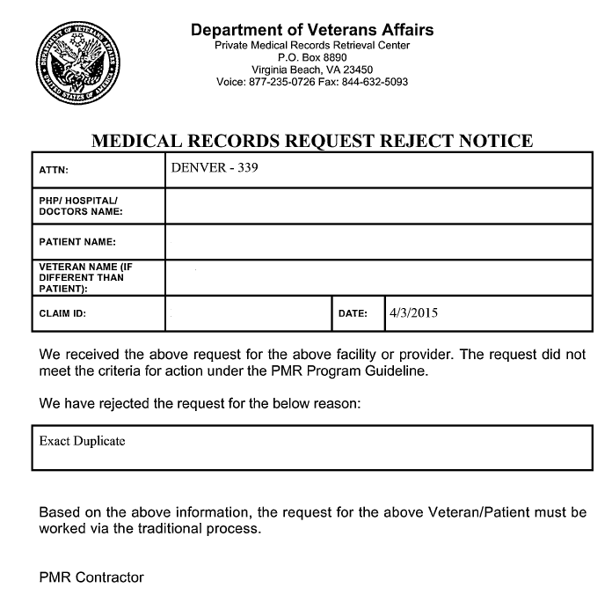
Medical Records Request Reject Notice
There are several circumstances when DOMA will not process the private medical release. In these instances, they will create this document.
This example is for an exact duplicate.

Slide 9
Types of Medical Records Request Reject Notices
an exact duplicate
provider listed is non private
improperly signed
incomplete Private Health Care Provider (PHP) information that cannot be obtained by DOMA
complete form but missing a signature and/or signature date
identifying a foreign provider/claimant with foreign address
expired

Slide 10
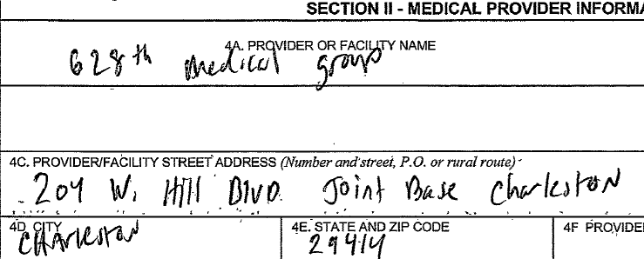
Provider Listed is Non-Private
If the provider listed is non-private, the developing VSR should review to determine subsequent development actions.

Slide 11
Invalid Signature
If the VA Form 21-4142 is signed by someone other than the patient or legal guardian of the patient, then DOMA will not be able to process the release.
For example: a VA fiduciary signature in block 11 is not valid on the VA Form 21-4142 unless they are the legal guardian of the claimant.

Slide 12
Incomplete PHP Information
If there is incomplete information on the private health care provider that DOMA cannot process, then subsequent development to the claimant will need to be done by the VA.

Slide 13
Missing a Signature or Signature Date
If box 11 on VA Form 21-4142 is blank then DOMA will reject the form
If box 12 on VA Form 21-4142 is blank or does not represent a date then DOMA will reject the form

Slide 14
Claimant has foreign address or foreign provider
If the Veteran or private health care provider are listed at a foreign address, DOMA cannot process the VA form 21-4142
In these instances, the developing VSR will need to develop the medical release or direct it to the RO responsible for developing foreign claims.

Slide 15
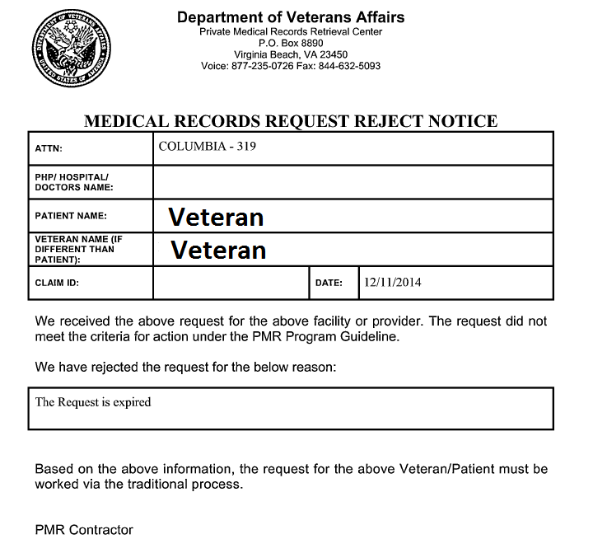
Request is expired
Important: If VA Form 21-4142 expires before VA can obtain the Private Health Care (PHP) records, request the Veteran/claimant provide VA with an updated VA Form 21-4142. Do not request the Veteran/claimant complete an additional VA Form 21-4142a.

Slide 16
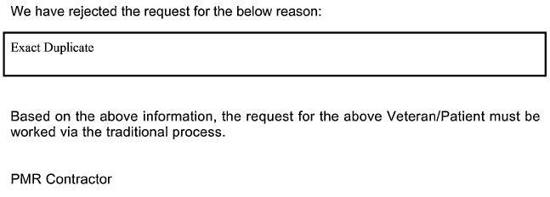
Knowledge Check
Is VA development likely needed with the following PMR Medical Records Request Reject Notices?
#1
#2
#3

Slide 17
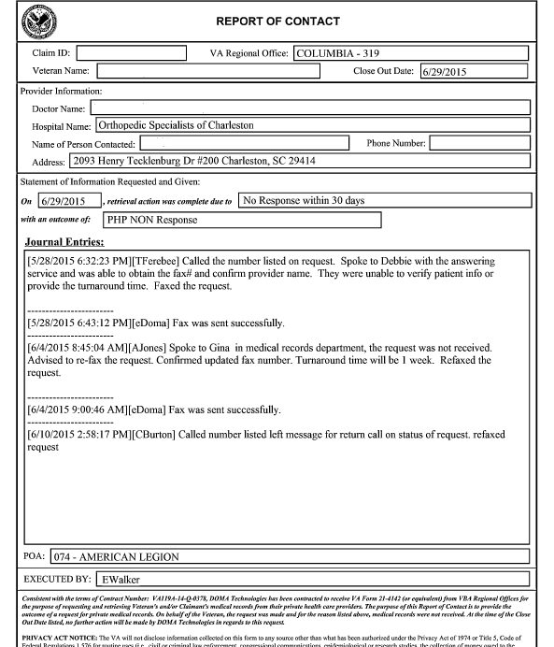
PMR Report of Contact
There are several circumstances when DOMA will not receive the private medical records they are requesting. In these instances, they will create this document.
This example is for no response from the provider within 30 days of the request being made.

Slide 18
Types of PMR Reports of Contact
PHP non response
Fee required
Already supplied to the VA or Veteran
Dates of treatment/condition discrepancy
No records found
Records destroyed
PHP invalid
PHP unwilling to comply
Redaction
Request is expired
Additional form required
DOT/conditions required
Deceased Veteran
Veteran Information discrepancy

Slide 19
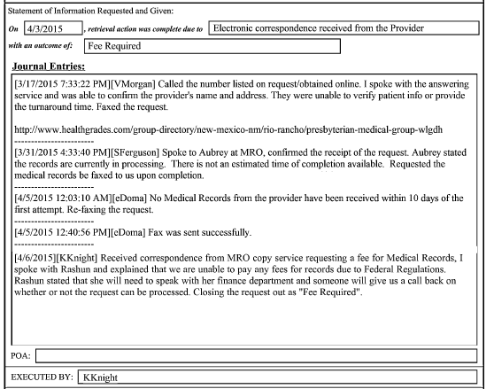
Fee Required
The provider required a fee for the records.
DOMA documents all attempts made to get the records including the last conversation in which they were advised a fee was required.

Slide 20
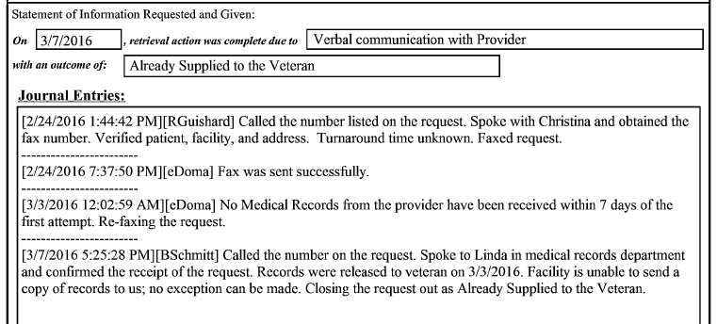
Already Supplied to the VA Already Supplied to the Veteran
The private medical records were reported by the provider as already being supplied to the VA.
The private medical records were reported by the provider as already being supplied to the Veteran.

Slide 21
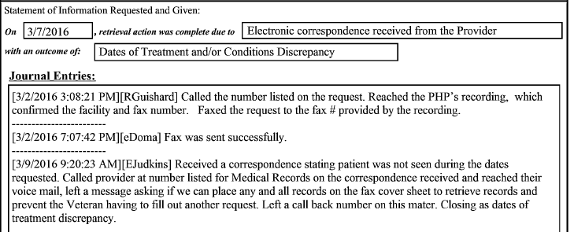
Dates of Treatment/Condition Discrepancy
On the 4142, the Veteran indicated only the year 2010 for treatment dates, which resulted in the response below from the provider.
The provider indicated that the patient was “not seen” during the dates listed on the 4142, so they would not provide the records.

Slide 22
No Records Found Records Destroyed
The provider indicated no records were found for the patient.
The provider indicated that the records were destroyed for the patient.

Slide 23
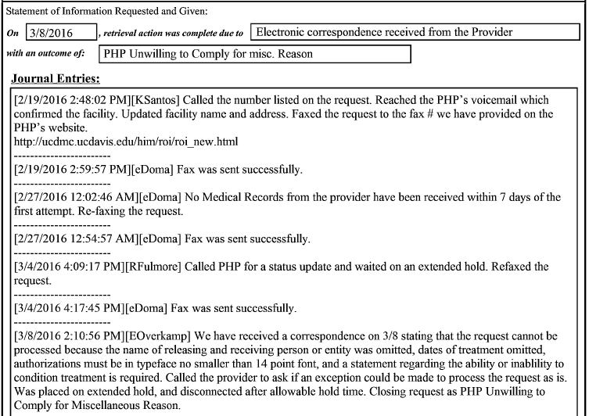
PHP Unwilling to Comply
The provider was unwilling to comply for miscellaneous reasons.
DOMA documents all attempts made to get the records including the last conversation in which they were advised of multiple reasons why the provider would not comply.

Slide 24
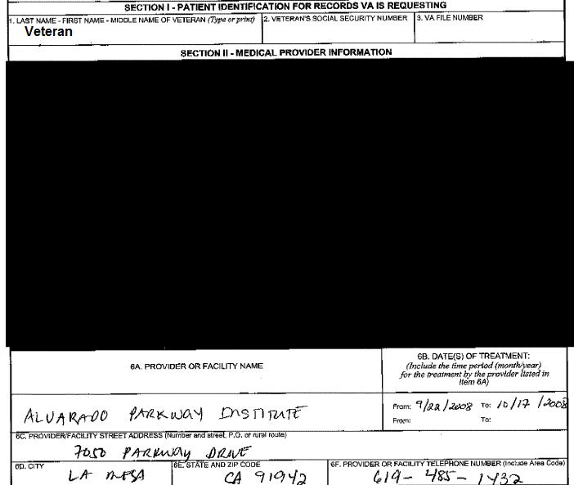
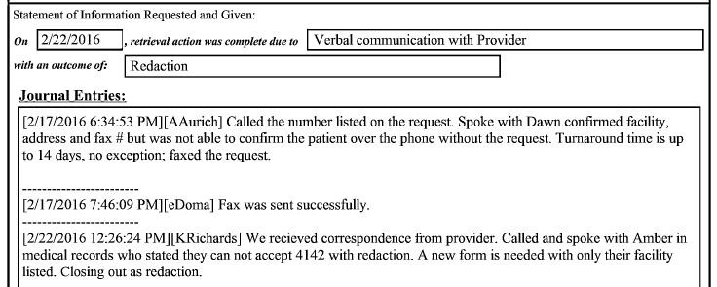
Redaction
DOMA will redact the provider information that should not be displayed and send out the 4142 to the provider that is displayed.
However, some providers will not accept the redacted form.

Slide 25
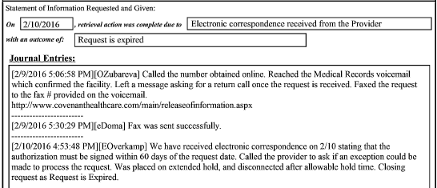
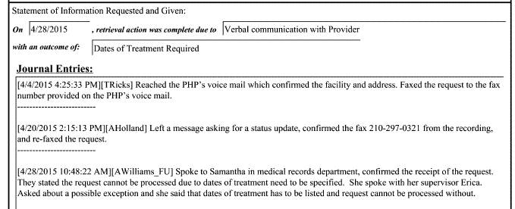
Request is Expired Dates of Treatment Required
The provider indicated that the request is expired.
Provider indicated that the dates of treatment were required on the form and they would not process without the dates being defined.

Slide 26
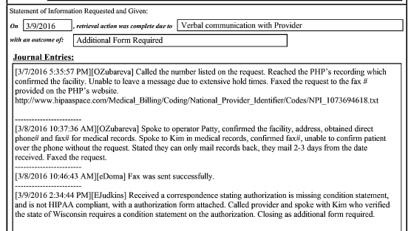
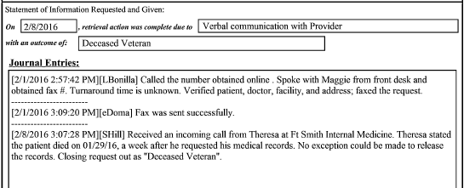
Additional Form is Required Veteran Deceased
The provider would not accept the medical release provided and indicated another HIPAA compliant form in the state of Wisconsin was needed.
Provider indicated that the Veteran died during the medical release request processing period, therefore they could not release the records.

Slide 27
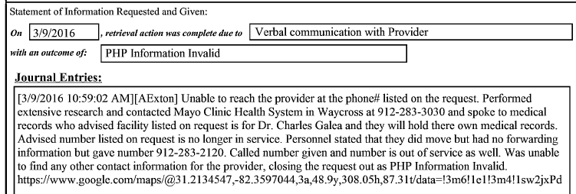
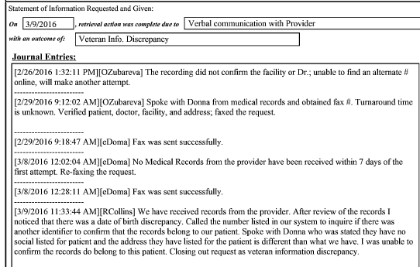
PHP Information Invalid Veteran Information Discrepancy
DOMA cannot determine valid information to locate the provider listed by the Veteran.
DOMA determines that there is discrepant information on the Veteran for the records requested and those received. If they cannot confirm accuracy of records, they will close out.

Slide 28
Knowledge Check
Other than VBMS updates, is subsequent VA development needed with the following PMR Report of Contacts?
#1
#2
#3

Slide 29
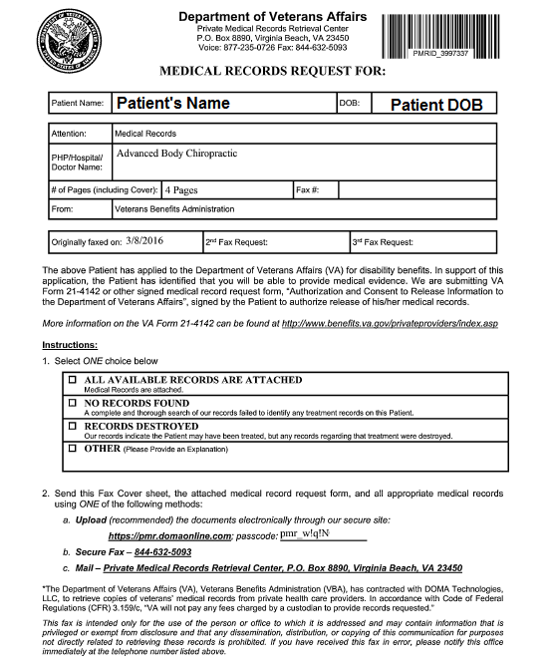
PMR Fax Cover Sheet
DOMA provides the PMR Fax Cover Sheet for every 4142 they fax to a provider, after they confirm the fax number with the provider.
The provider is requested to return the fax cover sheet with one of the boxes selected.
The provider is given a unique passcode to securely upload medical records online. The passcode contains no PII data.

Slide 30
Review

Slide 31
Questions

