Slide 1
Review of DC 5003 / DC 5010
Compensation Service
May 2016
Notes:
Welcome to Review of DC 50 03 DC 50 10 course. To advance each slide, click anywhere on the screen.

Slide 2
Objectives
Objectives – With 98 percent accuracy, the trainee will apply the given regulations, references and tools to evaluations of disabilities associated with DC 5003 and DC 5010.
Notes:
Objectives
Objectives With 98 percent accuracy, the trainee will apply the given regulations, references and tools to evaluations of disabilities associated with DC 50 03 and DC 50 10.

Slide 3
References
38 CFR 4.41 History of injury
38 CFR 4.71(a) Schedule of ratings – musculoskeletal system
M21-1, Part III, Subpart iv,4.A, Musculoskeletal conditions
VBMS-R Evaluation Builder
VBN Broadcast – Arthritis
Notes:
References
The references for this course are listed on the screen. You may click any hyperlinked references for further details.
38 CFR 4.41 History of injury
38 CFR 4.71(a) Schedule of ratings – musculoskeletal system
M21 dash 1, Part III, Subpart iv,4.A, Musculoskeletal conditions
VBMS-R Evaluation Builder
VBN Broadcast - Arthritis

Slide 4
Degenerative Arthritis
The cause is unknown
May be from a singular event or combination of events or causes
Risk factors associated with the condition are numerous
Osteoarthritis is the most common form of joint disease
Notes:
Degenerative Arthritis
The cause is unknown
May be from a singular event or combination of events or causes
Risk factors associated with the condition are numerous
Osteoarthritis is the most common form of joint disease

Slide 5
Arthritis and DC 5003
Degenerative arthritis is a systemic process that can involve many joints
Diagnostic code 5003 uses limitation of motion by way of the 5200 series as its main evaluation criterion
Diagnostic code 5003 also provides compensable evaluations for early cases of degenerative arthritis shown by x-ray only with no LOM
Notes:
Arthritis and DC 50 03
Degenerative arthritis is a systemic process that can involve many joints
Diagnostic code 50 03 uses limitation of motion by way of the 5200 series as its main evaluation criterion
Diagnostic code 50 03 also provides compensable evaluations for early cases of degenerative arthritis shown by X ray only with no L O M

Slide 6
Musculoskeletal System: Arthritis of the Spine
Where the degenerative process has been established as service connected, is not dependent on the choice of diagnostic codes
If degenerative arthritis has been properly established as service connected, the subsequent development of degenerative arthritis in other joints is to also be service connected
Notes:
Musculoskeletal System: Arthritis of the Spine
Where the degenerative process has been established as service connected, is not dependent on the choice of diagnostic codes
If degenerative arthritis has been properly established as service connected, the subsequent development of degenerative arthritis in other joints is to also be service connected

Slide 7
Arthritis Degenerative DC 5003
Notes:
Arthritis Degenerative DC 50 03
50 03 Arthritis, degenerative (hypertrophic or osteoarthritis)
Degenerative arthritis established by X ray findings will be rated on the basis of limitation of motion under the appropriate diagnostic codes for the specific joint or joints involved (DC 5200 etc.).
When however, the limitation of motion of the specific joint or joints involved is noncompensable under the appropriate diagnostic codes,
a rating of 10 percent is for application for each such major joint or group of minor joints affected by limitation of motion, to be combined, not added under diagnostic code 50 03.
Limitation of motion must be objectively confirmed by finding such as swelling, muscle spasm, or satisfactory evidence of painful motion. In the absence of limitation of motion, rate as below:
With X ray evidence of involvement of 2 or more major joints or 2 or more minor joint groups, with occasional incapacitating exacerbations 20
With X ray evidence of involvement of 2 or more major joints or 2 or more minor joint groups 10
NOTE (1): The 20 percent and 10 percent ratings based on X ray findings, above, will not be combined with ratings based on limitation of motion.
NOTE (2): The 20 percent and 10 percent ratings based on X ray findings, above, will not be utilized in rating conditions listed under diagnostic codes 50 13 to 50 24, inclusive.

Slide 8
Traumatic Arthritis
Traumatic arthritis is a form of arthritis that is caused by blunt, penetrating, or repeated trauma or from forced inappropriate motion of a specific joint or ligament.
Notes:
Traumatic Arthritis
Traumatic arthritis is a form of arthritis that is caused by blunt, penetrating, or repeated trauma or from forced inappropriate motion of a specific joint or ligament.

Slide 9
Traumatic Arthritis
For rating purposes, it is considered distinct and separate from degenerative arthritis, which is systemic.
TRAUMA = DC 5010
Notes:
Traumatic Arthritis
For rating purposes, it is considered distinct and separate from degenerative arthritis, which is systemic.

Slide 10
Traumatic Arthritis 5010
Degenerative arthritis under DC 5003 is considered a systemic process that may effect multiple joints. Only warranted when no other compensable arthritic joint.
DC 5010 applies to arthritis due to a trauma which should include the vast majority of arthritis claims due to the nature of military service.
Consider 4.41 - History of Injury - when determining degenerative vs. traumatic. The examiners not always use the term traumatic arthritis so you may need to determine by a review of the evidence.
VBN Broadcast - Arthritis
Notes:
Traumatic Arthritis 50 10
50 10 Arthritis, due to trauma, substantiated by X ray findings: Rate as arthritis, degenerative.
Degenerative arthritis under DC 50 03 is considered a systemic process that may effect multiple joints. Only warranted when no other compensable arthritic joint.
DC 50 10 applies to arthritis due to a trauma which should include the vast majority of arthritis claims due to the nature of military service.
Consider 4.41 dash History of Injury when determining degenerative verses traumatic. The examiners not always use the term traumatic arthritis so you may need to determine by a review of the evidence.
VBN Broadcast dash Arthritis

Slide 11
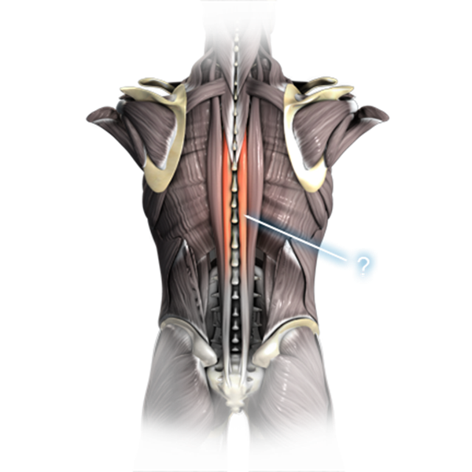
Arthritis of the Spine
Arthritis of the spine is sometimes associated with repetitive trauma, or minor trauma to a joint that is weakened by normal wear and tear. Where the arthritis is clearly of traumatic origin, use of the hyphenated diagnostic code, 5010-5242, would be appropriate.
Notes:
Arthritis of the Spine
Arthritis of the spine is sometimes associated with repetitive trauma, or minor trauma to a joint that is weakened by normal wear and tear.
Where the arthritis is clearly of traumatic origin, use of the hyphenated diagnostic code, 50 10 dash 52 42, would be appropriate.

Slide 12
Evaluation Builder
Notes:
Evaluation Builder

Slide 13
Evaluation Builder
Notes:
Evaluation Builder

Slide 14
Evaluation Builder
Notes:
Evaluation Builder

Slide 15
Evaluation Builder
Notes:
Evaluation Builder
How We Decided the Percentage of Disability
DC: 50 03 dash 52 60: Limitation of Flexion of the Leg (Knee)
We have assigned a 10 percent evaluation for your knee condition based on:
Painful motion of the knee (38 CFR 4.59 allows consideration of functional loss due to painful motion to be rated to at least the minimum compensable rating for a particular joint.
Since you demonstrate painful motion of the leg at the knee, the minimum compensable evaluation of 10 percent is assigned.)
X ray evidence of degenerative arthritis along with any limitation of motion of the joint
The provisions of 38 CFR 4.40 and 4.45 concerning functional loss due to pain, fatigue, weakness, or lack of endurance, incoordination, and flare ups,
as cited in DeLuca verses Brown and Mitchell verses Shinseki have been considered and applied under 38 CFR 4.59.
A higher evaluation of 20 percent is not warranted for limitation of flexion of the knee unless there is flexion limited to 16 to 30 degrees.
A higher evaluation of 20 percent is not warranted for degenerative arthritis unless there is X ray evidence of involvement of two or more major joints or two or more minor joint groups, with occasional incapacitating exacerbations.

Slide 16
Questions
Notes:
Questions?

