Slide 1
Return to Active Duty
Compensation Service
July 2020
Notes:
Welcome to Return to Active Duty course. To advance each slide, click anywhere on the screen.

Slide 2
Objectives
Identify Systems to Verify Active Duty Service
Describe the Process for Active Duty Adjustments
Differentiate Between Static and Non-Static Disabilities
Identify the Procedures for Restoring Benefits
Process Awards for Return to Active Duty
Notes:
Objectives
Upon completion of this lesson, you will be able to:
Identify Systems to Verify Active Duty Service
Describe the Process for Active Duty Adjustments
Differentiate Between Static and Non-Static Disabilities
Identify the Procedures for Restoring Benefits
Process Awards for Return to Active Duty

Slide 3
References
38 U.S.C. 5304(c), Prohibition against duplication of benefits
38 CFR 3.654(c), Active Service Pay and Training Pay
M21-1, Part I, 2 - Due Process
M21-1, Part III, Subpart iv, 3. C - Control of Examinations
M21-1, Part III, Subpart iv, 8. D - Reductions in Awards
M21-1, Part III, Subpart v, 4. E - Award Adjustments Necessitated by a Veteran’s Return to and Discharge From Active Duty
VBMS Awards User Guide/VETSNET Awards User Guide
PCGL User Guide
Notes:
References
The references for this course are listed on the screen. You may click any hyperlinked references for further details.

Slide 4
Identifying Active Duty Service
Certified copy of DD Form 214, Certificate of Release or Discharge from Active Duty
Share BIRLS VID/VADS Screen
Return to Active Duty Report (DOD Matching Program)
Veterans Information Solutions (VIS)
Contact from Veteran
Notes:
Identifying Active Duty Service
Certified copy of D D Form 2 14, Certificate of Release or Discharge from Active Duty
SHARE B I R L S V I D V A D S Screen
Return to Active Duty Report (D O D Matching Program)
Veterans Information Solutions (V I S)
Contact from Veteran

Slide 5
Reviewing Share Awards Screen
Review for current or previous active duty adjustments
To ensure VA benefits have not already been previously terminated
If the payment screen shows adjustment, verify the dates of adjustment are consistent with the active duty service period
Verify active duty by viewing DD Form 214, SHARE VADS screen, Veteran’s Statement, copy of military orders and/or VIS
Notes:
Reviewing Share Awards Screen
Review for current or previous active duty adjustments.
To ensure V A benefits have not already been previously terminated.
If the payment screen shows adjustment, verify the dates of adjustment are consistent with the active duty service period.
Verify active duty by viewing D D Form 2 14, SHARE V A D S screen, Veteran’s Statement, copy of military orders and or V I S.

Slide 6
Processing Active Duty Adjustment
Once active duty service is verified to be processed:
Establish an EP 290 Return to Active Duty with the appropriate date (if not already pending)
Add “Potential Under/Overpayment” special issue (required)
Important: Active duty processing must be initiated simultaneously when processing any award action.
Notes:
Processing Active Duty Adjustment
Once active duty service is verified to be processed:
Establish an E P 2 90 Return to Active Duty with the appropriate date (if not already pending)
Establish an E P 6 90 Review – Potential Overpayment is required if a potential overpayment exists (if not already pending)
Important: Active duty processing must be initiated simultaneously when processing any award action.

Slide 7
Active Duty Due Process
Due Process is required when:
The information is not received directly from the beneficiary or their fiduciary, this is 3rd Party information. Due process must be given if the information is received from a 3rd Party.
VADS, VIS, and DD Form 214 from Defense Personal Retrieval System (DPRIS) are considered 3rd Party
Clear EP 290 Return to Active Duty and establish an EP 600 Return to Active Duty (with Potential Under/Overpayment Special Issue) when initiating the action
Make sure to include the VA Form 21-0789, Your Rights to Representation and a Hearing (Possible Overpayment)
Notes:
Active Duty Due Process
Due Process is required when:
The information is not received directly from the beneficiary or their fiduciary, this is 3rd Party information. Due process must be given if the information is received from a 3rd Party.
V A D S, V I S, and D D Form 2 14 from Defense Personal Retrieval System (D P R I S) are considered 3rd Party
Clear E P 2 90 Return to Active Duty and establish an E P 600 Review-Potential Overpayment when initiating the action
Important: E P 6 90 Review – Potential Overpayment remains open until all final actions are completed

Slide 8
Active Duty Due Process (cont.)
Due Process is not required when:
The Veteran reports that they are currently on or returning to active duty
Prescribed form is not required for this information
If we have any indication that the Veteran submitted a certified DD Form 214
Ex., DD 214 uploaded in eBenefits
Notes:
Active Duty Due Process (continued)
Due Process is not required when:
The Veteran reports that they are currently on or returning to active duty.
Prescribed form is not required for this information.
If we have any indication that the Veteran submitted a certified D D Form 2 14:
Ex., D D 2 14 uploaded in eBenefits.

Slide 9
Active Duty Notifications
PCGL may be used for Contemporaneous and Final Award letters.
GD3 (Activated Reserve or Guard)
Used when a Veteran informs VA they have, or are, returning to active duty
GP 9 (Pre: Gen Red/Term Award)
Used when VA receives notice that a Veteran returned to active duty from a source other than the Veteran and due process is needed
GP 14 (Post: Drill Pay) for (Final award notice)
Used as a contemporaneous notice for any final award action
* PCGL letters can be found under C and P
Notes:
Active Duty Notifications
P C G L is used for Contemporaneous and Final Award letters.
G D 3 (Activated Reserve or Guard)
Used when a Veteran informs V A they have or are returning to active duty.
G P 9 (Pre: Gen Red Term Award)
Used when V A receives notice that a Veteran returned to active duty from a source other than the Veteran and due process is needed.
G P 14 (Post: Drill Pay) for (Final award notice)
Used as a contemporaneous notice for any final award action.

Slide 10
Active Duty Notifications (cont.)
PCGL can be used for both Post Adverse Action and Final Award Notices
GP 13 (Pre: Drill Pay)
When VA receives notice or identifies an active duty service period that needs to have a proposed adverse action (due process) letter issued prior to an award adjustment
GP 14 (Post: Drill Pay) for (final award action)
Used for any final award action following the due process period
Important: The GP13 and GP14 letters will require modifications to address the active duty service periods and include any applicable regulations. See example letters listed in the Return to Active Duty handout.
Notes:
Active Duty Notifications (continued)
P C G L is used for both Post Adverse Action and Final Award Notices
G P 13 (Pre: Drill Pay)
When V A receives notice or identifies an active duty service period that needs to have a proposed adverse action (due process) letter issued prior to an award adjustment
G P 14 (Post: Drill Pay) for (final award action)
Used for any final award action following the due process period
Important: The G P 13 and G P 14 letters will require adjustments to address the active duty service periods. See example letters listed in the Return to Active Duty handout.

Slide 11
Effective Dates
The last day the Veteran is entitled to benefits is the day preceding the date he/she returns to active duty, and
The date the Veteran returned to active duty represents the first day of non-payment of VA benefits.
The requirement in 38 CFR 3.31 to award benefits effective the first of the month following the month of entitlement is not applicable.
Notes:
Effective Dates
The last day the Veteran is entitled to benefits is the day preceding the date he she returns to active duty, and
The date the Veteran returned to active duty represents the first day of non-payment of V A benefits.
The requirement in 38 C F R 3.31 to award benefits effective the first of the month following the month of entitlement is not applicable.

Slide 12
Restoring Benefits
Ensure VA properly discontinued benefits effective the date the Veteran entered active duty and notify the Veteran that VA will reinstate his or her benefits effective the day following release from active duty.
DD Form 214 alone is not sufficient to reinstate benefits
Establish an EP 290 Return to Active Duty in order to resume the Veteran’s benefits
Payments, if otherwise in order, will be resumed effective the day following release from active duty if claim for recommencement of payments is received within 1 year from the date of such release; otherwise payments will be resumed effective 1 year prior to the date of receipt of a new claim.
Notes:
Restoring Benefits
Ensure V A properly discontinued benefits effective the date the Veteran entered active duty and notify the Veteran that V A will reinstate his or her benefits effective the day following release from active duty.
D D Form 2 14 alone is not sufficient to reinstate benefits
Establish an E P 2 90 Return to Active Duty in order to resume the Veteran’s benefits
An E P 6 90 Review – Potential Overpayment should be established as well if there will be a potential overpayment

Slide 13
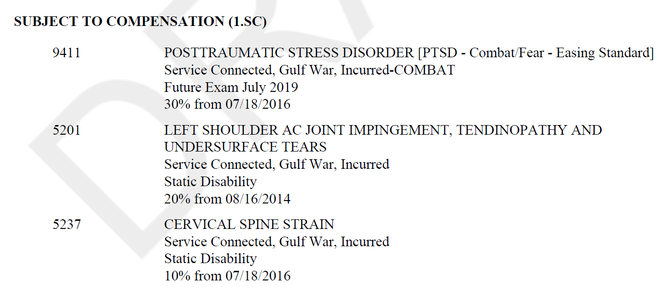
Static and Non-Static Disabilities
VA will resume the entire award (all disabilities, static and non-static), and request an immediate examination for the non-static conditions that would have been subject to a future examination during the Veteran’s active duty service period through the date that the action to resume benefits is taken.
Notes:
Static and Non-Static Disabilities
V A will resume the entire award (all disabilities, static and non-static), and request an immediate examination for the non-static conditions that would have been subject to a future examination during the Veteran’s active duty service period through the date that the action to resume benefits is taken.
See Return to Active Duty Handout for examples

Slide 14
Static and Non-Static Disabilities
If the Veteran has static disabilities only and is not pursuing an initial or supplemental claim:
Establish an EP 290
Resume benefits with appropriate effective date
If the Veteran has non-static disabilities, and/or is pursuing an initial or supplemental claim:
Establish an EP 290 for resumption of benefits
Establish an EP 020/040/310 as detailed in the chart in M21-1.III.v.4.E.1.g
Notes:
Non-Static Disabilities
If active duty service period overlaps a future examination for a non-static disability:
Establish an E P 020
Undertake any necessary development
If the Veteran has non-static, S C disabilities, schedule him/her for an examination unless the evidence of record is sufficient to assign a disability rating without an examination report.

Slide 15
Processing Return to Active Duty Awards
VBMS-A/Vetsnet Awards is used to stop and reinstate VA benefits
The Basic Eligibility Tab:
The “Return to Active Duty” drop down is used to stop the award
The “Eligible Beneficiary” drop down is used to reinstate the award
Most active duty adjustments will create an overpayment (Ensure the Potential Under/Overpayment Special Issue to the pending EP)
Notes:
Processing Return to Active Duty Awards
V B M S-A/Vetsnet Awards is used to stop and reinstate V A benefits.
The Basic Eligibility Tab:
The “Return to Active Duty” drop down is used to stop the award
The “Eligible Beneficiary” drop down is used to reinstate the award
Most active duty adjustments will create an overpayment (Ensure to establish an E P 6 90 Review – Potential Overpayment if needed).

Slide 16
Summary
Identified criteria used to verify Active Duty service
Reviewed Due Process for Active Duty adjustments
Discussed Static and Non-Static Disabilities pertaining to Active Duty service
Outlined procedures for restoring benefits
Steps taken to process an award involving Active Duty service
Notes:
Summary
Identified criteria used to verify Active Duty service
Reviewed Due Process for Active Duty adjustments
Discussed Static and Non-Static Disabilities pertaining to Active Duty service
Outlined procedures for restoring benefits
Steps taken to process an award involving Active Duty service

Slide 17
Questions

