Slide 1
Auditory Disorders
Compensation Service
May 2016
Notes:
Welcome to Auditory Disorders course. To advance each slide, click anywhere on the screen.

Slide 2
Lesson Objectives
Provided all available references, trainees will be able to prepare a rating decision targeting auditory disabilities with 98% accuracy.
Notes:
Lesson Objectives
Provided all available references, trainees will be able to prepare a rating decision targeting auditory disabilities with 98 percent accuracy.

Slide 3
References
M21-1 Part III, Subpart iv, 4.B Conditions of the Organs of Special Sense, Hearing Impairment
M21-1 Part III, Subpart iv, 4.G Definition: Other Organic Diseases of the Nervous System
38 CFR 3.159 Department of Veterans Affairs Assistance in Developing Claims
38 CFR 3.309 Disease Subject to Presumptive Service Connection
38 CFR 3.350 Special Monthly Compensation Ratings
38 CFR 3.383(a)(3) Paired Organs and Extremities
38 CFR 3.385 Disability Due to Impaired Hearing
38 CFR 4.85 Evaluation of Hearing Impairment
38 CFR 4.86 Exceptional Patterns of Hearing Impairment
38 CFR 4.87 Schedule of Ratings - Ear
38 CFR 4.87a Schedule of Ratings - Other Sense Organs
Notes:
References
The references for this course are listed on the screen. You may click any hyperlinked references for further details.
M21 dash 1 Part III, Subpart iv, 4.B Conditions of the Organs of Special Sense, Hearing Impairment
M21 dash 1 Part III, Subpart iv, 4.G Definition: Other Organic Diseases of the Nervous System
38 CFR 3.159 Department of Veterans Affairs Assistance in Developing Claims
38 CFR 3.309 Disease Subject to Presumptive Service Connection
38 CFR 3.350 Special Monthly Compensation Ratings
38 CFR 3.383(a)(3) Paired Organs and Extremities
38 CFR 3.385 Disability Due to Impaired Hearing
38 CFR 4.85 Evaluation of Hearing Impairment
38 CFR 4.86 Exceptional Patterns of Hearing Impairment
38 CFR 4.87 Schedule of Ratings dash Ear
38 CFR 4.87a Schedule of Ratings dash Other Sense Organs

Slide 4
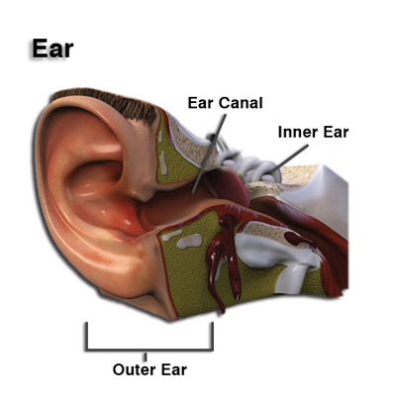
Overview of the Ear
The ear serves dual functions, regulating both hearing and equilibrium.
The external and middle portions of the ear act as conduits that amplify and transport sound inward.
The inner ear receives acoustic impulses and transmits them to the cranial nerves and brain.
Notes:
Overview of the Ear
The ear serves dual functions, regulating both hearing and equilibrium.
The external and middle portions of the ear act as conduits that amplify and transport sound inward.
The inner ear receives acoustic impulses and transmits them to the cranial nerves and brain.

Slide 5
Auditory System Highlights
Peripheral Vestibular Disorders
Meniere’s syndrome
Hearing loss
Tinnitus
Notes:
Auditory System Highlights
Peripheral Vestibular Disorders
Meniere’s syndrome
Hearing loss
Tinnitus

Slide 6
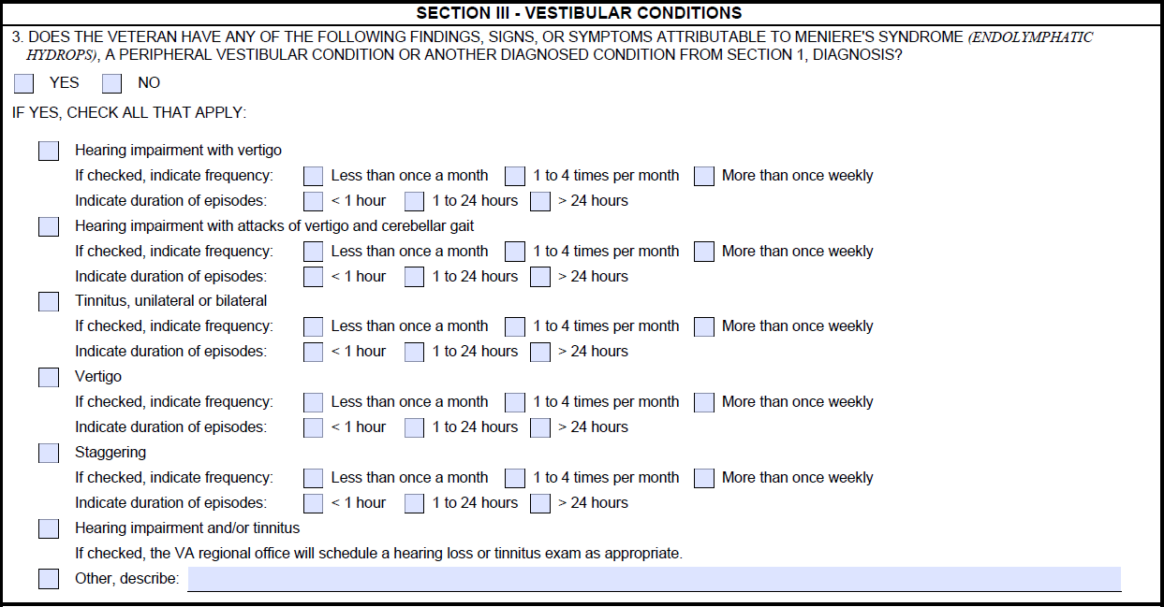
Peripheral Vestibular Disorder (DC 6204)
Common diagnoses include vertigo and labyrinthitis. Characteristic symptoms entail dizziness, lightheadedness, and imbalance.
Notes:
Peripheral Vestibular Disorder (DC 62 04)
Common diagnoses include vertigo and labyrinthitis. Characteristic symptoms entail dizziness, lightheadedness, and imbalance.
62 04 Peripheral vestibular disorders:
Dizziness and occasional staggering Rating 30
Occasional dizziness Rating 10
Note: Objective findings supporting the diagnosis of the vestibular disequilibrium are required before a compensable evaluation can be assigned under this code.
Hearing impairment or suppuration shall be separately rated and combined.

Slide 7
Meniere’s Syndrome (DC 6205)
A progressive condition characterized by violent, paroxysmal attacks of vertigo, as well as component hearing loss and tinnitus.
Notes:
Meniere’s Syndrome (DC 62 05)
A progressive condition characterized by violent, paroxysmal attacks of vertigo, as well as component hearing loss and tinnitus.
62 05 Meniere’s syndrome (endolymphatic hydrops):
Hearing impairment with attacks of vertigo and cerebellar gait occurring more than once weekly, with or without tinnitus Rating 100
Hearing impairment with attacks of vertigo and cerebellar gait occurring from one to four times a month, with or without tinnitus Rating 60
Hearing impairment with vertigo less than once a month, with or without tinnitus Rating 30
Note: Evaluate Meniere’s syndrome either under these criteria or by separately evaluating vertigo (as a peripheral vestibular disorder, hearing impairment, and tinnitus, whichever method results in a higher overall evaluation.
But do not combine an evaluation for hearing impairment, tinnitus, or vertigo with an evaluation under diagnostic code 62 05.

Slide 8
Auditory Disorders
Our discussion will include:
How we determine what hearing loss is (38 CFR 3.385);
Rating hearing loss (38 CFR 4.85);
Exceptional Patterns of hearing (38 CFR 4.86);
A review of the Hearing Loss & Tinnitus DBQ;
Special considerations specific to hearing loss;
Data entry in the Hearing Loss Evaluation Builder (Calculator).
Notes:
Auditory Disorders
Our discussion will include:
How we determine what hearing loss is (38 CFR 3.385);
Rating hearing loss (38 CFR 4.85);
Exceptional Patterns of hearing (38 CFR 4.86);
A review of the Hearing Loss and Tinnitus DBQ;
Special considerations specific to hearing loss;
Data entry in the Hearing Loss Evaluation Builder (Calculator).

Slide 9
Proper Hearing Loss Development and Our Duty to Examine
When adjudicating claims for service connection for hearing loss and tinnitus, request a VA audiology examination if:
the record contains a current diagnosis of hearing loss or tinnitus or persistent or recurrent symptoms of the disability (which may be satisfied by the Veteran’s lay statement), AND
establishes that the Veteran suffered an injury, disease, or event (to include moderately or highly probable noise exposure sustained by reason of military occupational specialty) in service, AND
indicates the current diagnosis of, or recurrent/persistent symptoms of, hearing loss or tinnitus may be associated with the in-service injury, disease or event. (See 38 CFR § 3.159(c)(4)).
The Duty MOS Noise Exposure Listing should be consulted in considering the likelihood of in-service noise exposure.
Notes:
Proper Hearing Loss Development and Our Duty to Examine
When adjudicating claims for service connection for hearing loss and tinnitus, request a VA audiology examination if:
the record contains a current diagnosis of hearing loss or tinnitus or persistent or recurrent symptoms of the disability (which may be satisfied by the Veteran’s lay statement), AND
establishes that the Veteran suffered an injury, disease, or event (to include moderately or highly probable noise exposure sustained by reason of military occupational specialty) in service, AND
indicates the current diagnosis of, or recurrent persistent symptoms of, hearing loss or tinnitus may be associated with the in service injury, disease or event. (See 38 CFR § 3.159(c)(4)).

Slide 10
38 CFR 3.385 – Disability Due to Impaired Hearing
“For the purposes of applying the laws administered by VA, impaired hearing will be considered to be a disability when the auditory threshold in any of the frequencies 500, 1000, 2000, 3000, 4000 Hertz is 40 decibels or greater; or when the auditory thresholds for at least three of the frequencies 500, 1000, 2000, 3000, or 4000 Hertz are 26 decibels or greater; or when speech recognition scores using the Maryland CNC Test are less than 94 percent.”
Notes:
38 CFR 3.385 dash Disability Due to Impaired Hearing
“For the purposes of applying the laws administered by VA, impaired hearing will be considered to be a disability when the auditory threshold in any of the frequencies 500, 1000, 2000, 3000, 4000 Hertz is 40 decibels or greater;
or when the auditory thresholds for at least three of the frequencies 500, 1000, 2000, 3000, or 4000 Hertz are 26 decibels or greater; or when speech recognition scores using the Maryland CNC Test are less than 94 percent.”

Slide 11
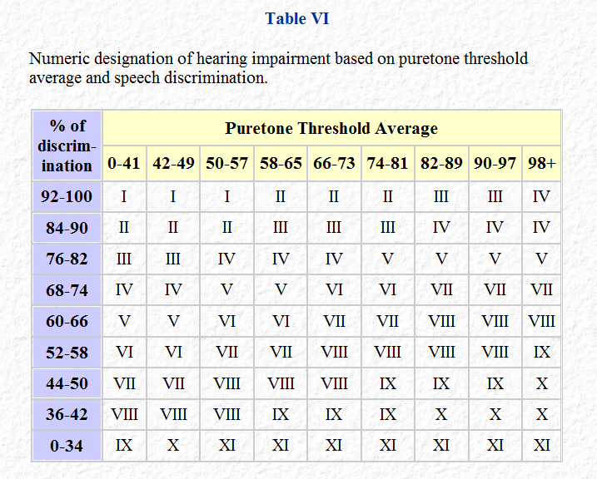
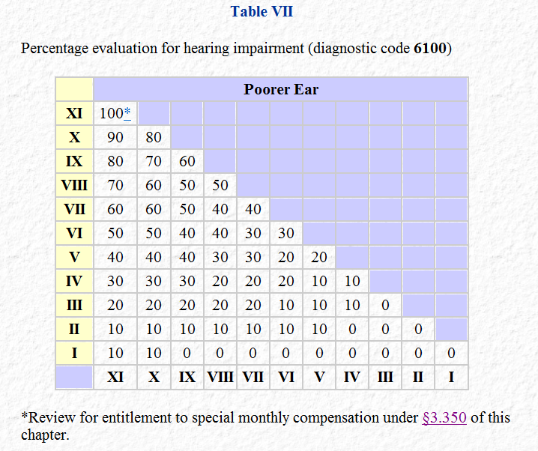
Hearing Loss (DC 6100)
In most instances, evaluations are predicated on a combination of objective factors – specifically puretone threshold average and speech discrimination score.
The average of decibel loss recorded at frequencies of 1000, 2000, 3000, and 4000 Hz for each ear.
Notes:
Hearing Loss (DC 61 00)
In most instances, evaluations are predicated on a combination of objective factors specifically puretone threshold average and speech discrimination score.
The average of decibel loss recorded at frequencies of 1000, 2000, 3000, and 4000 Hz for each ear.

Slide 12
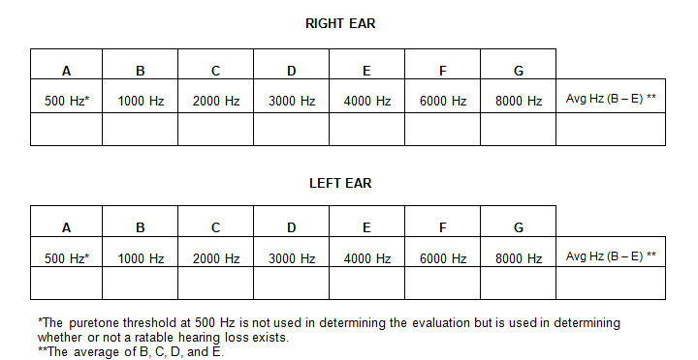
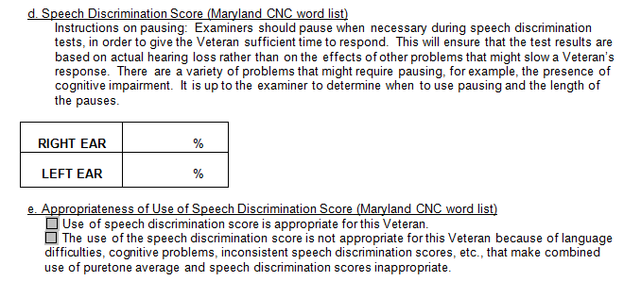
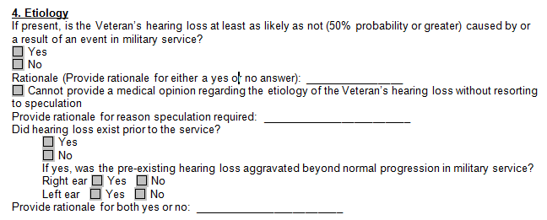
Hearing Loss: The DBQ***
Puretone thresholds and averages
Speech Discrimination
Etiology Opinion
***NOTE: the examination must (i) be conducted by a state-licensed audiologist; (ii) include a Maryland CNC speech discrimination test; and (iii) be carried out without the use of hearing aids.
Notes:
Hearing Loss: The DBQ
Puretone thresholds and averages
Speech Discrimination
Etiology Opinion
NOTE: the examination must (i) be conducted by a state licensed audiologist; (ii) include a Maryland CNC speech discrimination test; and (iii) be carried out without the use of hearing aids.

Slide 13
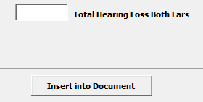
Special Considerations for Hearing Loss
Hearing loss is considered an “organic disease of the nervous system” and is subject to a one-year presumption of service connection as a chronic disease under 38 CFR 3.309(a).
A 100-percent evaluation for bilateral hearing loss (tantamount to a finding of bilateral “deafness”) entitles a Veteran to SMC at the (K) level/rate (38 CFR 3.350(a)(5).
SMC Calculator
Notes:
Special Considerations for Hearing Loss
Hearing loss is considered an “organic disease of the nervous system” and is subject to a one year presumption of service connection as a chronic disease under 38 CFR 3.309(a).
A 100 percent evaluation for bilateral hearing loss (tantamount to a finding of bilateral “deafness”) entitles a Veteran to SMC at the (K) level rate (38 CFR 3.350(a)(5).

Slide 14
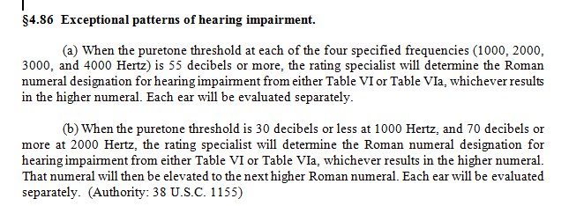
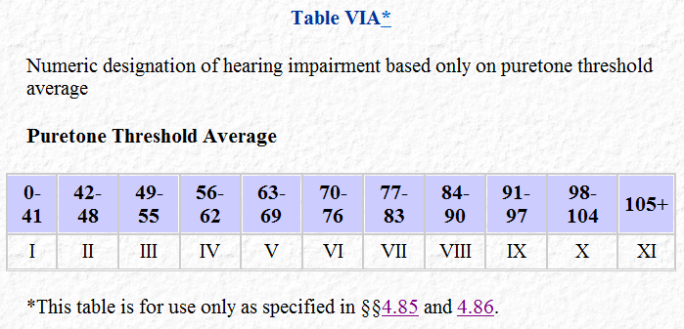
Special Considerations for Exceptional Patterns
NOTE: Table VIA will also be used if an examiner indicates that use of speech discrimination testing is inappropriate or medically contraindicated.
Notes:
Special Considerations for Exceptional Patterns
4.86 Exceptional patterns of hearing impairment.
When the puretone threshold at each of the four specified frequencies (1000, 2000, 3000, and 4000 Hertz) is 55 decibels or more, the rating specialist will determine the Roman numeral designation for hearing impairment from either Table VI or Table VI a, whichever results in the higher numeral.
Each ear will be evaluated separately.
When the puretone threshold is 30 decibels or less at 1000 Hertz, and 70 decibels or more at 2000 Hertz, the rating specialist will determine the Roman numeral designation for hearing impairment from either Table VI or Table VI a, whichever results in the higher numeral.
That numeral will then be elevated to the next higher Roman numeral. Each ear will be evaluated separately. (Authority: 38 U.S.C 11 55)
NOTE: Table VIA will also be used if an examiner indicates that use of speech discrimination testing is inappropriate or medically contraindicated.

Slide 15
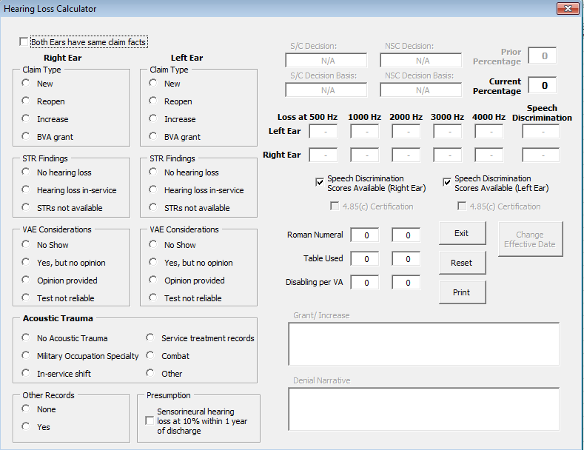
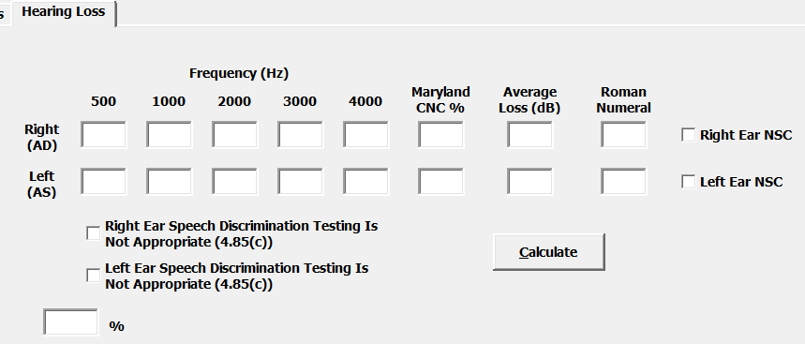
The Hearing Loss Calculator/Evaluation Builder
Service
Connection
Evaluation
Notes:
The Hearing Loss Calculator Evaluation Builder

Slide 16
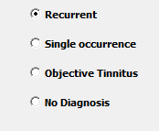
Tinnitus (DC 6260)
Subjective or objective perception of a ringing or tingling sound in one or both ears without external stimulus.
DBQ excerpts
Notes:
Tinnitus (DC 62 60)
Subjective or objective perception of a ringing or tingling sound in one
62 60 Tinnitus, recurrent
Note (1): A separate evaluation for tinnitus may be combined with an evaluation under diagnostic codes 6100, 6200, 62 04, or other diagnostic code, except when tinnitus supports an evaluation under one of those diagnostic codes.
Note (2): Assign only a single evaluation for recurrent tinnitus, whether the sound is perceived in one ear, both ears, or in the head.
Note (3): Do not evaluate objective tinnitus (in which the sound is audible to other people and has a definable cause that may or may not be pathologic) under this diagnostic code, but evaluate it as part of any underlying condition causing it. (Authority: 38 U.S.C. 11 55)

Slide 17
Special Considerations for Tinnitus
Tinnitus is a chronic disability subject to a one-year presumption of service connection under 38 CFR 3.309(a). (See M21-1 Part IV, Subpart ii, 2.B.2.b; Fountain v McDonald
A claim for hearing loss that ultimately yields a diagnosis of (unclaimed) tinnitus should be “sympathetically read” as inclusive of both contentions, provided favorable medical opinions exist for both (M21-1 Part III, Subpart iv, 4.B).
Tinnitus that is opined to be secondary or related to service-connected hearing loss should still be granted and coded service connection on a direct/incurred (vs. secondary) basis (M21-1 Part III, Subpart iv, 4.B).
If service treatment records mention a complaint of tinnitus and the veteran claims tinnitus and has current complaints of tinnitus, a medical opinion regarding possible causation is not required. Service connection can be established without an opinion about the specific cause of the tinnitus because it began in service (M21-1 Part III, Subpart iv, 4.B.3.g).
Notes:
Special Considerations for Tinnitus
Tinnitus is a chronic disability subject to a one year presumption of service connection under 38 CFR 3.309(a). (See M21 dash 1 Part IV, Subpart ii, 2.B.2.b; Fountain verses McDonald
A claim for hearing loss that ultimately yields a diagnosis of (unclaimed) tinnitus should be “sympathetically read” as inclusive of both contentions, provided favorable medical opinions exist for both (M21 dash 1 Part III, Subpart iv, 4.B).

Slide 18
Questions
Notes:
Auditory Disorders
Questions?

