Slide 1
VA Office of Business Oversight (OBO)
Internal Controls Testing Findings
Remediation Training
Notes:
Hello VR&E Staff. Thank you for attending today’s training. The purpose of today’s training is to update you on the VA Office of Business Oversight (OBO)/Internal Controls Service (ICS) Site Visit Findings and provide targeted refresher training on the deficiencies identified during the Site Visits.

Slide 2
Training Agenda
Welcome | Instructor
Overview of Findings New Processes for FY 2017 | VR&E Officer
Application Processing (CADJ and CAUT on GED Tear Sheet) CER Folder Maintenance (Filing of VA Forms and VA Letters)
Entitlement Determination (Narrative for SEH)
Development of Rehabilitation Plans (signature, levels of approval, modifications)
Fiscal Accuracy (use of VA Form 28-1905, invoice processing)
Next Steps (completion reports, training material)
Q&A
Notes:
Today’s agenda consists of the findings from the OMB site visit and new processes for FY17 as they relate to the findings report. Training will include the following:
Application Process - CADJ and CAUT on GED Tear Sheet
CER Folder Maintenance - Filing of VA Forms and VA Letters
Entitlement Determination - Narrative for SEH
Development of Rehabilitation Plans - signature, levels of approval, modifications
Fiscal Accuracy - use of VA Form 28-1905, invoice processing
Next Steps - completion reports, training material

Slide 3
Purpose of OMB Site Visit
Grant Thornton was contracted by VA’s Office of Business Oversight (OBO)/ Internal Controls Service (ICS) to conduct the internal controls testing based on the OMB -123, Appendix A circular as mandated by the Federal Government across all agencies.
During the review, internal controls over financial reporting were identified, evaluated, tested, and reported.
Focus is on internal controls for accounts that support the effectiveness and efficiency of operations, compliance with applicable laws and regulations, the integrity of VA, and/or are material to the financial statements.
Allows the Secretary to provide assurance to the Public, Congress and the President.
Assurance Statement is signed by the VA Secretary and published with VA’s annual Performance and Accountability Report.
Notes:
Grant Thornton was contracted by VA’s VA Office of Business Oversight (OBO)/Internal Controls Service (ICS) to assist the internal control testing based on the OMB A-123, Appendix A circular mandated by the Federal Government across all agencies. The internal control testing occurred department-wide between April and July of 2015. Four VR&E Divisions were part of the testing in 2015. During the review, internal controls over financial reporting were identified, evaluated, tested, and reported. The focus is on internal controls for accounts that support the effectiveness and efficiency of operations, compliance with applicable laws and regulations, the integrity of VA, and/or are material to the financial statements. It allows the Secretary to provide assurance to the Public, Congress and the President. The Assurance Statement is signed by the VA Secretary and published with VA’s annual Performance and Accountability Report.

Slide 4
Process Areas Covered
Under $25,000
Missing documentation
Rehabilitation Plan not signed by proper individual
Tuition payment did not reconcile to the invoice
The same individual performed both the generate and authorize functions.
Over $25,000
Cost Memo or Serious Employment Handicap Determination were missing from the file
No approved Cost Memo but the Veteran was in a program that was over the $25,000 threshold
Total tuition for the transaction exceeded the amount on the Cost Memo but the Regional Office Director did not approve or sign the Cost Memo after the VA approved the tuition invoice
Rehabilitation Plan was not signed by the counselor and Veteran or was not updated to cover the period of tuition
Notes:
ICS reviewed a random sample of payments under $25,000 and a sample of payments over $25,000. The objective of the reviews was to ensure that reimbursement of tuition expenses were valid, accurate, and supported by an authorized Rehabilitation Plan. ICS identified several deficiencies involving improper maintenance of Counseling/Evaluation/Rehabilitation (CER) folders and lack of documentation to support tuition reimbursement.
The Summary Finding Descriptions for the Under $25,000 category include:
Missing documentation
Rehabilitation Plan not signed by proper individual
Tuition payment did not reconcile to the invoice
The same individual performed both the generate and authorize functions
The Summary Finding Descriptions for the Over $25,000 category include:
Cost Memo or Serious Employment Handicap Determination were missing from the file
No approved Cost Memo but the Veteran was in a program that was over the $25,000 threshold
Total tuition for the transaction exceeded the amount on the Cost Memo but the Regional Office Director did not approve or sign the Cost Memo after the VA approved the tuition invoice
Rehabilitation Plan was not signed by the counselor and Veteran or was not updated to cover the period of tuition

Slide 5
New Processes for FY 2017
Update the Quality Assurance (QA) Standard Operating Procedures (SOP) in the M28R. This guarantees consistency with the Internal Controls Testing characterization of fiscal error deficiencies during Systematic Technical Accuracy Review (STAR) and the local QA reviews.
Update the M28R to reflect there is no longer a requirement to print and file the Generated Eligibility Determination (GED) tear sheet in the CER folder since the information found in the GED tear sheet is available in CWINRS.
Notes:
A review of the findings resulted in the following New Processes for FY 2017:
Update the Quality Assurance (QA) Standard Operating Procedures (SOP) in the M28R. This entails citing the same errors found in the OMB review as fiscal errors during the Systematic Technical Accuracy Review (STAR) and the local QA review.
This is effective October 1, 2016.
Update the M28R to reflect that there is no longer a requirement to print and file the Generated Eligibility Determination (GED) tear sheet in the CER folder since the information found in the GED tear sheet is available in CWINRS.

Slide 6
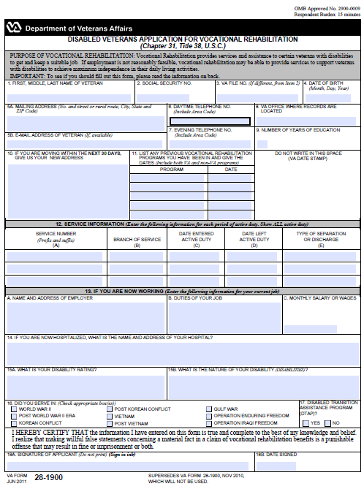
Application Processing
Corporate WINRS
Notes:
The testing identified issues related to the processing of claims and applications for Veterans seeking Chapter 31 services. Stations were primarily using BDN when the claims for processing applications were reviewed by Grant Thorton/ICS. BDN is no longer used for processing applications, and therefore it is important to focus our attention on current procedures. VR&E is transitioning from BDN to Corporate WINRS exclusively. VR&E Officers were notified that they are no longer authorized to use BDN for processing claims.
On August 11, 2015, VR&E Service released Circular 28-15-05, which addresses the procedures for processing applications. VR&E offices can reference this Circular for step-by-step procedures, which are current and active, and address claim processes.

Slide 7
CER Folder Maintenance
The following documents shall be included in the CER:
Rating Decision
Entitlement Determination
High Cost Memo
Rating Narrative
Rehabilitation Plan
Notes:
Next, I will be talking about CER folder maintenance. It is important to remember that all documentation regarding the Veteran and case management activities should be placed in the CER folder or documented in CWINRS. This includes Vocational Rehabilitation Letters, Forms, and evidence, and supporting documentation. During the site visit, the following deficiencies in CER folder maintenance were identified:
No Rating decision placed in the file
No Rating narrative in the file
No Cost Memo for high cost cases in the file
Rehabilitation plan not in the file
No Entitlement determination in the file

Slide 8
CER Folder Maintenance
CER Folder
Eligibility and Fiscal Documentation
Case Management Documentation
Entitlement Determination Documentation
Notes:
VR&E Divisions use three-flap folders to maintain all pertinent documentation related to a Veteran’s request for, and receipt of, VA Vocational Rehabilitation and Employment benefits and services. M28R.II.A.2 provides detailed instructions on placing documentation in the CER folder.
The left side of the CER folder must include all supporting information related to eligibility, fiscal authorizations, and payments, such as VA Form 28-1905, Authorization and Certification of Entrance or Reentrance into Rehabilitation and Certification of Status as well as Subsistence allowance awards and related documents.
The center portion of the CER folder must include all forms, form letters, and other documentation regarding case management activities related to monitoring the progress of the Veteran; such as all written and printed communication with the Veteran, to include letters and emails, concerning the Veteran’s rehabilitation program.
The right side of the CER folder must include all documentation that supports determinations for the Veteran’s entitlement to benefits and services, such as copies of rating decisions, counseling and evaluation forms, rehabilitation plans and all forms in the 1902 series.
There are some exceptions to placing records in the CER folder. These exceptions include:
VA medical records available in CAPRI are not to be printed and placed within CER folders.
CWINRS notes, email messages, and school certifications received electronically through VA-Once do not need to be printed and placed in the Veteran’s CER folder.

Slide 9
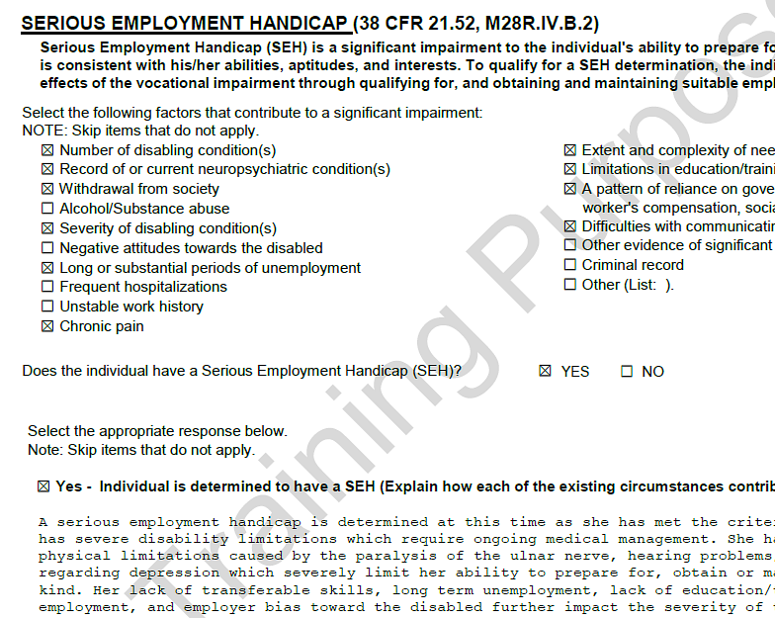
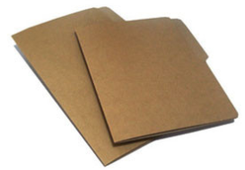
Entitlement Determination
Notes:
Before a Veteran can receive Chapter 31 services, a Vocational Rehabilitation Counselor makes a determination as to whether or not the Veteran is entitled to services based on a comprehensive initial evaluation. The internal controls test found that not all Veterans with a ten percent service-connected disability (SCD) had an approved Serious Employment Handicap (SEH) determination within the CER folder. An SEH is required for entitlement to VR&E services, if the Veteran has a combined rating of ten percent. However, a Veteran with a ten percent disability rating who is found to have an SEH, is not entitled to a program solely of independent living services. Once the VRC determines the Veteran is entitled to services, the VRC is required to determine whether or not it is currently reasonably feasible for the Veteran or Servicemember to achieve a vocational goal.
The VA Form 28-1902b, Counseling Record – Narrative Report, is used to document the synthesis of data collected during the initial evaluation and logically support the legal determinations and development of planned services. VA Form 28-1902b, Counseling Record – Narrative Report, is made up of two parts, Part one - Certification of Entitlement/Current Feasibility and Part two - Counseling Narrative. Both of these parts, and all applicable sections are required to be completed when making entitlement determinations. In part one, box nine asks whether the Veteran has an SEH. For a Veteran with an SEH, this item must be checked. In part two, there is a section titled Serious Employment Handicap. This section must be completed.
When completing the entitlement determination for a Veteran with a ten percent SCD, review the individual’s file, and consider input from the Veteran to select the appropriate boxes and develop a description for why an SEH exists or does not exist. Be as detailed as possible, and reference information from the CER folder, other VA records, feedback from the individual and any other information considered in making the decision. Upon completion of the narrative, select the appropriate box for determining whether an SEH exists.
For more information on the procedures for completing the entitlement determination and use of VA Form 28-1902b, Counseling Record – Narrative Report, refer to M28R.IV.B.2.

Slide 10
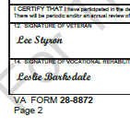
Rehabilitation Plan Development
Notes:
Next, let’s look at the development of rehabilitation plans and fiscal accuracy. During the internal controls test, deficiencies were found which included the rehabilitation plan in the CER folder not being signed by the case manager and/or Veteran, the rehabilitation plan was missing from the CER folder, and the change in the period of tuition and enrollment was not updated in the rehabilitation plan. Also, the CER folder did not include the required program cost approval memo that is beyond the VRC’s level of authority.
M28R.IV.C.1.04.a states that the Veteran is the most important stakeholder in the development of the rehabilitation plan. For the plan to be a success, the Veteran must be an active participant in the development of the rehabilitation plan. The Veteran must agree to the plan before services are provided per 38 CFR 21.92. M28R.III.A.1.06.d.1(b) specifies that once the plan is completed, the VRC and the Veteran must sign the plan. Additionally, M28R.II.A.2.04.b.3(c) requires that the plan must be placed on the right side of the CER folder.
The rehabilitation plan is considered a fluid document, which means that unexpected events may occur in the Veteran’s life that could cause changes to the agreed upon plan. These unanticipated events may be related to financial, medical, family, or other circumstances that may cause a change in the plan goal and objectives and the completion and effective dates of the plan. Case managers are required to meet regularly with the Veterans assigned to their case load to address these situations as they arise to make the necessary adjustments to the plan.
M28R.III.A.1.09 and M28R.IV.C.1.06 provide the guidelines for amending rehabilitation plans. Minor or intermediate modifications include changes in the rate of pursuit, frequency of case management appointments, and schedule of plan review. Major modifications entail changing the vocational goal and redeveloping the rehabilitation plan. Any major or minor changes in the rehabilitation plan must be agreed upon by the Veteran. All actions and changes must be documented in the rehabilitation plan, CWINRS and/or filed in the CER folder. For example, if a Veteran’s training is extended by six months, the VRC will need to document the changes and justification for the changes, in either a CWINRS case note or VA Form 28-1905d, Special Report of Training. Therefore, the VRC must make the adjustment on the plan in CWINRS and document the change in the CER folder. The rehabilitation plan in the CER folder can be adjusted, for minor changes, by striking through the original date and writing the new date.

Slide 11
Rehabilitation Plan Development
VR&E Officer
*IWRP: $25k-$75k
**IILP (no construction):
up to $75k
Construction: up to
$2k
***Self-Employment:
up to $25k (Category I)
Regional Office Director
*IWRP: $75k – $100k
VR&E Service Director
*IWRP: exceeds $100k
**IILP (no construction): $75k - $100k
Construction: $2k - $15k
**IILP (no construction):
exceeds $100k
Construction: exceeds
$15k
***Self-Employment (SE):
exceeds $25k (All costs)
*Calendar Year **Annual Year ***Total
Notes:
The chart provides an illustration of the required levels of cost approval. 38 CFR 21.430 states that training costs specified in an IWRP for the calendar year, that exceeds $25,000 must be approved by the VR&E Officer. The Regional Office (RO) Director approves training costs exceeding $75,000 up to $100,000, while the VR&E Service Director approves training costs exceeding $100,000.
For an IWRP, if the facility cost exceeds the VRC’s approval level, the VRC must complete the High Cost Memo in CWINRS and submit to the VR&E Officer for approval prior to plan development. The VRC can complete the High Cost Memo by accessing the Rehabilitation Tab in CWINRS; then clicking “View Plan”, and choosing the “High Cost Memo” button. The memo must be submitted with the CER folder to the VR&E Officer (VREO) for concurrence. If the cost level exceeds the VREO’s authority or approval level, the VREO will route the memo with the required checklist to the appropriate level of approval per M28R.IV.C.1.04.
The signed High Cost memo and other associated documentation must be filed in the CER folder. Payment for the training costs must be supported with the signed memo and appropriate justification for the specified program costs.
Annual program costs specified in an Independent Living (IL) plan that does not include construction costs up to $75,000 must be approved by the VR&E Officer. The RO Director approves the program costs exceeding $75,000 up to $100,000, while the VR&E Service Director approves program costs exceeding $100,000. On the other hand, IL plans with construction costs up to $2,000 must be approved by the VR&E Officer. The RO Director approves IL plans with construction costs exceeding $2,000 up to $15,000, while the VR&E Service Director approves IL plans with construction costs exceeding $15,000. These levels of approval require the use of checklists to assist in obtaining the required approval, as outlined in M28R.IV.C.9.07.e. All IL plans require review and concurrence by the VR&E Officer.
38 CFR 21.258 states that self-employment program costs, estimated and/or actual total cost, up to $25,000 must be approved by the VR&E Officer, while the VR&E Service Director approves self-employment program costs exceeding $25,000 and Category I assignment. The VRC must submit the self-employment plan and VA Form 28-0794, Self-Employment Plan Approval Request, to the VR&E Officer for approval before obtaining the Veteran’s signature or authorizing any services. Additional information on program approval for self-employment plans are outlined in M28R.IV.C.8.07.e.

Slide 12
Fiscal Accuracy
Prepare VAF
28-1905
File VAF
28-1905
Sign VAF
28-1905
Notes:
During the testing, additional errors were found on using and filing VA Form 28-1905, Authorization and Certification of Entrance or Reentrance into Rehabilitation and Certification of Status, in the CER folder and ensuring the invoice amounts in CWINRS match the dollar amounts on the approved invoice.
M28R.V.A.1.09 provides the procedures for authorizing training services. VA Form 28-1905 is used to notify the facility that the Veteran is authorized to attend training at VA expense and also provides the program of study approved for the Veteran. This form must be completed in CWINRS. However, required data that are not automatically entered using CWINRS must be entered manually and accurately. The original document signed by the VRC must be provided to the training facility with a copy of the form provided to the Veteran and another copy filed in the CER folder.

Slide 13
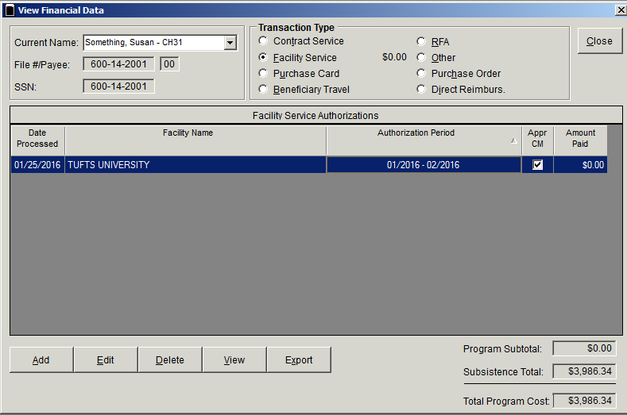
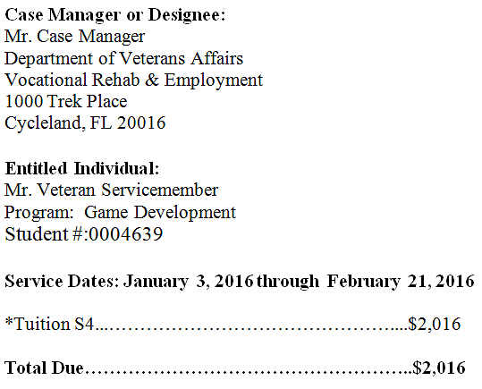
Fiscal Accuracy
$2,016
Notes:
The invoice amount entered in CWINRS must match with the amount on the approved invoice sent by the school. M28R.V.B.7.05 outlines the case manager’s responsibilities for reviewing and determining approval for invoices submitted by a training facility. Specifically, M28R.V.B.7.05.a.3(b) provides the necessary steps that the case manager must take when he or she receives an invoice from a training facility. These include putting the date stamp on the invoice immediately upon receipt; determining whether documentation in CWINRS and the Veteran’s CER folder indicates that tuition and fees were authorized for payment by VR&E; determining if the invoice is proper or valid and that VR&E has been billed appropriately; notifying the facility of any discrepancies or items that cannot be approved under VA guidelines; approving payment by completing necessary actions in CWINRS and coordinating with the Finance activity at the local regional office that is in compliance with the Prompt Payment Rule. Detailed information for approving an invoice is provided in M28R.B.7.04.d.
When authorizing payment for tuition fees, the voucher auditor reviews the Veteran’s CWINRS View Financial Data screen that will verify the authorized period of enrollment and will support payment of invoices. If the electronic VA Form 28-1905, Authorization and Certification of Entrance or Reentrance into Rehabilitation and Certification of Status, is not found in the CWINRS View Financial Data screen, the voucher auditor contacts the VR&E Officer to review the CER folder to determine if a signed paper copy of VA Form 28-1905 is included in the file. If a signed copy of the VAF 28-1905 cannot be found, the unpaid invoice is to be returned to the VR&E Division to research the invoice and determine the appropriate next steps. No payments can be made without the required VA Form 28-1905.
A discrepancy in the amount entered in CWINRS and the approved invoice is not acceptable. When reviewing invoices for approval, the case manager must ensure that the invoiced amount can be approved. If the case manager determines that the invoice amount is incorrect or not approvable, the case manager must contact the facility to discuss the unapproved cost(s). The case manager must ensure that the correct invoice is received to authorize payment.

Slide 14
Completion of Training
Title | VRE Office of Management and Budget (OMB) Site Visit Remediation Training
TMS ID | VA 4185261
Notes:
This completes the instruction portion of today’s training. Training participants will need to self-certify the completion of this training through their individualized Talent Management System (TMS) account, under VRE Office of Management and Budget (OMB) Site Visit Remediation Training, ID – VA 4185261.

Slide 15
Questions?
Notes:
Thank you for attending today’s training.

