Slide 1
Introduction to Special Monthly Compensation (VSR)
Compensation Service
December 2016

Slide 2
Objectives
  Demonstrate understanding of the concept of special monthly compensation (SMC) and two levels of SMC: (K) and (S1)
  Recognize a claim for SMC
  Develop a claim for SMC
  Verify the Rating Codesheet for accuracy

Slide 3
References
38 U.S.C. 1114, Rates of Wartime Disability Compensation
38 U.S.C. 5103, Notice to claimants of required information and evidence
38 CFR 3.159, Department of Veterans Affairs assistance in developing claims
38 CFR 3.350, Special monthly compensation ratings
38 CFR 3.951, Preservation of disability ratings
38 CFR 4.16, Total disability ratings for compensation based on unemployability of the individual
M21-1, Part I, 1.B, Duty to Notify Under 38 U.S.C. 5102 and 5103
M21-1, Part I, 1.C, Requesting Records
M21-1, Part III, Subpart ii, 2.B, Claims for Disability Compensation and/or Pension
M21-1, Part III, Subpart v, 2.A, Decision Authorization
M21-1, Part IV, Subpart ii, 2.H, Special Monthly Compensation (SMC)
Bradley v. Peake, No. 06-1854, November 26, 2008
Guerra v Shinseki, No. 2010-7080, April 29, 2011

Slide 4
Concept of SMC
SMC came about to recognize the severity of certain disabilities by adding additional compensation to the schedular evaluation
SMC levels are evaluations not disabilities
They are referred to in VA vernacular or acronym by the letter of the subparagraph of 38 USC

Slide 5
Types of SMC
SMC (K) – loss of use of specific organs, sensory functions, or an extremity
SMC (L) – disabilities that render the Veteran permanently bedridden or in need of aid and attendance
Higher levels of SMC (L, M, N, O) – combinations of severe disabilities that significantly affect locomotion
P-steps – existence of multiple, independent disabilities each rated at 50% or 100%, 3rd affected extremity, deafness and blindness together, and blindness and LOU of extremity
SMC (R1) – level of severity includes one or more higher level SMCs (L, M, N, O) and there is a need for A&A based on a high degree of impairment
SMC (R2) – existence of multiple disabilities which render the Veteran in need of special skilled assistance referred to as a “Higher Level of Care”
SMC (S1) – existence of a single disability rated at 100% and additional S/C disability(ies) independently ratable at 60% or more
SMC (S2) – disabilities that confine the Veteran to his residence

Slide 6
SMC (K)
SMC (K) requires anatomical loss or loss of use (LOU) of a hand or foot, both buttocks, one or more creative organs, blindness of one eye, deafness of both ears, complete organic aphonia, or radiation or loss of 25% of breast tissue (women only).
A Veteran can be entitled to multiple K awards as long as the disabilities involve separate and unrelated body functions.

Slide 7
SMC (S)
There are two types of SMC S:
  (S-1): a single 100% disability and additional S/C disability(ies) independently ratable at 60% (referred to as statutory housebound)
  (S-2): a single 100% disability and factually housebound due to that disability
Unlike most other SMC levels, only SMC (S1) can be granted temporarily

Slide 8
Bradley v. Peake
When determining entitlement to (S1):
  multiple like disabilities (i.e., DMII, BUPN, BLPN) cannot be combined to substitute for one 100% disability
  if IU is based on a single disability, then it can be substituted for one 100% disability
Guerra v. Shinseki confirmed this decision

Slide 9
Check for Comprehension
Use the Rating Combinator if needed

Slide 10
Scenario 1
The Veteran is service connected for coronary artery disease (60%), diabetes mellitus (40%), peripheral neuropathy left lower extremity (20%), peripheral neuropathy right lower extremity (20%), peripheral neuropathy left upper extremity (20%), and peripheral neuropathy right upper extremity (20%). The RVSR increases the evaluation of coronary artery disease to 100% effective 02/14/2015. Is the Veteran entitled to SMC (K) and/or SMC (S1), statutory housebound, and if so, what is the effective date of the grant?

Slide 11
Scenario 1 - Answer
The Veteran is only entitled to SMC (S1), effective 02/14/2015, as he has a 100% evaluation for coronary heart disease and the rest of his service connected disabilities combine to 80% disabling.

Slide 12
Scenario 2
The Veteran is service connected for tinnitus (10%) and bilateral hearing loss (0%). The RVSR grants service connection for prostate cancer with erectile dysfunction at 100% effective 03/12/2016. Is the Veteran entitled to SMC (K) and/or SMC (S1), statutory housebound, and if so what is the effective date of the grant?

Slide 13
Scenario 2 - Answer
The Veteran is entitled to SMC (K), effective 03/12/2016, as he has loss of use of a creative organ. The Veteran is not entitled to SMC (S1) as his other service connected disabilities do not combine to at least 60%.

Slide 14
Scenario 3
The Veteran is service connected for posttraumatic stress disorder (70%), degenerative disc disease of lumbosacral spine (20%), degenerative disc disease of the cervical spine (20%), patellofemoral pain syndrome right knee (20%), and patellofemoral pain syndrome left knee (20%). The RVSR grants entitlement to the individual unemployability (IU) based on the Veteran’s posttraumatic stress disorder effective 04/08/2014. Is the Veteran entitled to SMC (K) and/or SMC (S1), statutory housebound, and if so what is the effective date of the grant?

Slide 15
Scenario 3 - Answer
The Veteran is only entitled to SMC (S1), effective 04/08/2014, as she was granted IU based on one condition and the rest of her service connected conditions combine to 60% disabling.

Slide 16
Reviewing the Codesheet
The VSR promulgating or authorizing an award should review the Rating Codesheet for any obvious errors:
  correct effective date of grant
  duplicate grant of the same issue
  incorrect SMC information
The VSR is not expected to argue grants/denials or evaluations levels

Slide 17
Review the Codesheet
When reviewing the Codesheet for SMC information, ask the following:
  Were all SMC issues addressed?
  If there was an SMC (K) grant prior to another SMC grant (i.e., S or L), did it continue after the grant?
  Did we grant SMC (S1), statutory housebound, if applicable?
  If the SMC (S1) grant was based on a temporary 100%, is the SMC (S1) stopped and is it stopped on the appropriate date?
  Are the SMC codes in the SMC Code Box correct?

Slide 18
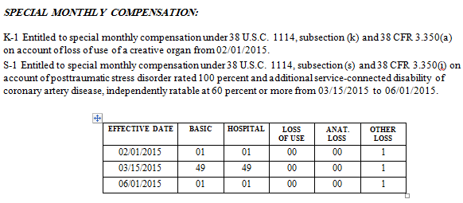
Rating Codesheet – Attachment A (Correct)

Slide 19
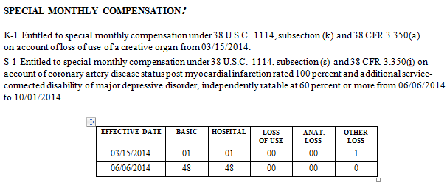
Rating Codesheet – Attachment B (Incorrect)

Slide 20
Topic 2 Exercise A: SMC Codes Exercise
Complete SMC Codes Exercise

Slide 21
Topic 2 Exercise B: SMC (S1) Exercise
Complete SMC (S1) Exercise

Slide 22
Substantially Complete Application
The Veteran may submit a stand-alone claim for SMC or special monthly pension (SMP) on a VA Form 21-2680
For the application to be considered complete, the form must contain:
  Claimant’s name
  Sufficient service information to verify the Veteran’s service
  The benefit claimed
  Disabilities on which the claim is based
  Statement of income (for pension claim)

Slide 23
VA Form 21-2680
The main problem with the VA Form 21-2680 is that is does not contain a section that allows the Veteran to clearly identify if he is claiming SMC or SMP
Use the table found in M21-1 Part III, Subpart ii, 2.B.1.f when faced with an unclear VA Form 21-2680

Slide 24
Clarification Development
The VA Form 21-2680 cannot be used as a claim for service-connection or pension
If clarification can be accomplished over the phone, call the Veteran
Depending on the scenario, a standard or modified RFA letter may be needed

Slide 25
Clarification Development
If the Veteran’s claim falls into scenarios 4 and 5 found in the chart in the manual reference, a standard RFA letter is needed.
If the Veteran’s claim falls into scenarios 1 and 2 found in the chart in the manual reference, a modified RFA letter is needed. Send the Veteran the RFA – Solicit for a Claim for SMP template under the VSC drop down in Letter Creator.

Slide 26
Topic 3 Exercise: VA Form 21-2680 Exercise
Complete VA Form 21-2680 Exercise

Slide 27
SMC Development
If the Veteran provides a VA Form 21-526EZ with her claim for SMC, no 5103 development is required.
If the Veteran does not provide a VA Form 21-526EZ, then SMC WTEMS will need to be sent with the standard or custom 5103.
Other development may be needed, depending on the situation (i.e., private treatment records or VA treatment records).

Slide 28
Examinations
When the Veteran specifically claims SMC, generally, an examination is not needed
However, an exam may be needed if the medical evidence is insufficient to evaluate the disability
  You should allow the RVSR to determine the need for an examination

Slide 29
Questions

