Slide 1
DPRIS and PIES
Compensation Service
February 2018
Notes:
Welcome to D P R I S and P I E S course. To advance each slide, click anywhere on the screen.

Slide 2
Objectives
Identify the purpose and functionality of the Defense Personnel Records Information Retrieval System (DPRIS) Web organization and Personnel Information Exchange System (PIES)
Identify what records are available through DPRIS Web and PIES
Demonstrate how to create a request and navigate the functions within DPRIS Web and PIES
Notes:
Objectives
Upon completion of this lesson, you will be able to:
Identify the roles and responsibilities of the Defense Personnel Records Information Retrieval Systems (D P R I S) Web organization and Personnel Information Exchange Systems (P I E S)
Identify what records are available through D P R I S Web and P I E S
Demonstrate how to create a request and navigate the functions within D P R I S Web and P I E S

Slide 3
References
M21-1, Part III, Subpart iii, 2.A, General Information on Service Records
M21-1, Part III, Subpart iii, 2.D, Requesting Information and Records Through the Personnel Information Exchange System (PIES)
DPRIS Website and PIES User Guides
DPRIS to PIES Cross Reference Guide
Notes:
References
The references for this course are listed on the screen. You may click any hyperlinked references for further details.
M21 dash 1, Part III, Subpart iii, 2.A, General Information on Service Records
M21 dash 1, Part III, Subpart iii, 2.D, Requesting Information and Records Through the Personnel Information Exchange System (P I E S)
D P R I S Website and P I E S User Guides
D P R I S to P I E S Cross Reference Guide

Slide 4
Defense Personnel Records Information Retrieval Systems (DPRIS)
An automated system used to request digital copies of Official Military Personnel File (OMPF) documents
Primarily personnel records, such as service verification
Provides some medical and physical examination results
Notes:
Defense Personnel Records Information Retrieval Systems (D P R I S)
An automated system used to request digital copies of Official Military Personnel File (O M P F) documents
Primarily personnel records, such as service verification
Provides some medical and physical examination results

Slide 5
DPRIS Advantages
Provides standard index of all images contained in each branch’s OMPF systems
Includes follow-up message capability
Single-source repository for all branches
Exception: There are no Coast Guard records currently available in DPRIS Web.
Notes:
D P R I S Advantages
Provides standard index of all images contained in each branch’s O M P F systems
Includes follow up message capability
Single source repository for all branches

Slide 6
DPRIS Advantages (cont.)
Allows access to OMPF images contained in each services’ repositories
On average, images are received in less than 48 hours
Many images are received within minutes
Notes:
D P R I S Advantages (continued)
Allows access to O M P F images contained in each services’ repositories
On average, images are received in less than 48 hours
Many images are received within minutes

Slide 7
VSR Roles and Responsibilities
Initiate requests for OMPF information
Upload records into e-folder or print and associate with claims folder
Initiate and manage secure follow-up messages
Access DPRIS Information, Help Website Modules, and submit automated User Requests Assistance Forms
Notes:
VSR Roles and Responsibilities
Initiate requests for O M P F information
Upload records into e folder or print and associate with claims folder
Initiate and manage secure follow up messages
Access D P R I S Information, Help Website Modules, and submit automated User Requests Assistance Forms

Slide 8
Using DPRIS Web
DPRIS Website: https://www.dpris.dod.mil
All VARO users shall use VA email address or VA User ID as DPRIS User ID
Prospective users should contact their DPRIS manager to become authorized users
Notes:
Using D P R I S Web
D P R I S Website: https://www.dpris.dod.mil
All V A R O users shall use VA email address or V A User I D as D P R I S User I D
Prospective users should contact their D P R I S manager to become authorized users

Slide 9
Records Availability
Branch of Service | Service Obligation Ended On or After
Army | October 1, 1994
Navy | January 1, 1995
Marine Corps | January 1, 1999
Air Force | October 1, 2004
(Note: Army Discharge and Retirement date shown in the DPRIS User Guide under DPRIS Help tab is, 1 October 2002.)
Notes:
Records Availability
Branch of Service
Army
Service Obligation Ended On or After October 1, 1994
Branch of Service
Navy
Service Obligation Ended On or After January 1, 1995
Branch of Service
Marine Corps
Service Obligation Ended On or After January 1, 1999
Branch of Service
Air Force
Service Obligation Ended On or After October 1, 2004

Slide 10
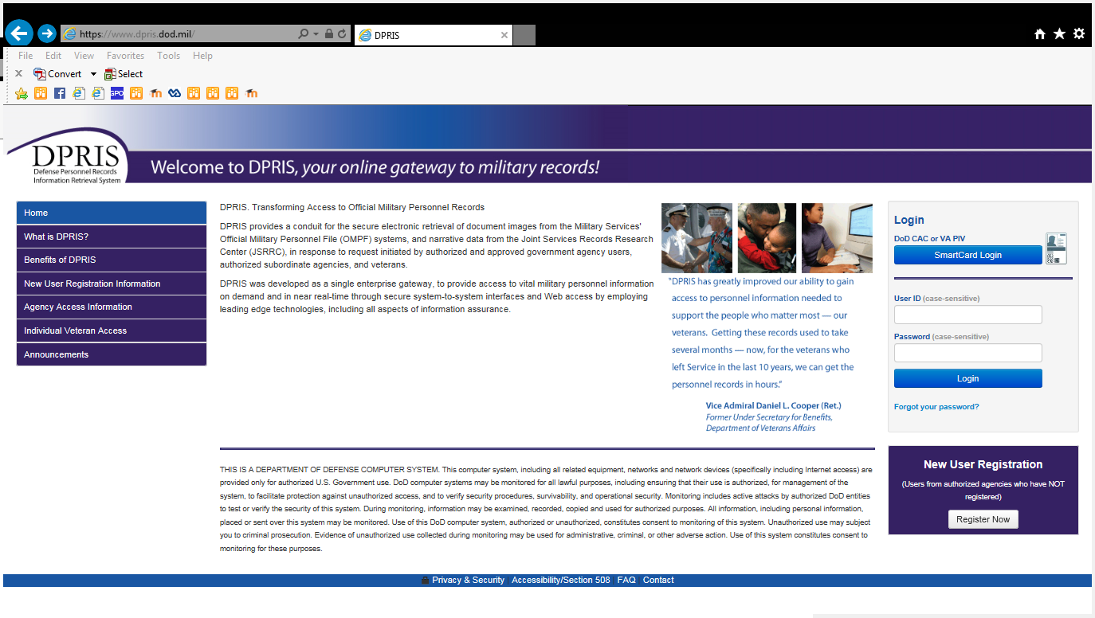
DPRIS Website
Notes:
D P R I S Website

Slide 11
Home Screen
Notes:
Home Screen

Slide 12
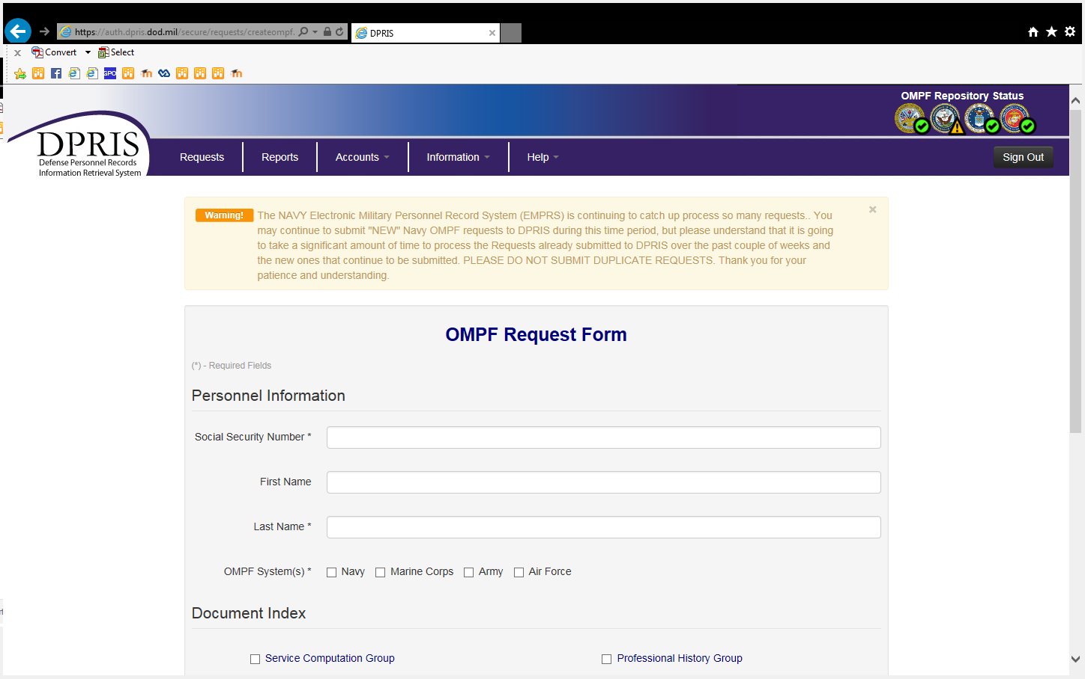
OMPF Request Form
Notes:
O M P F Request Form

Slide 13
Document Index
Notes:
Document Index

Slide 14
Requests Screen
Notes:
Requests Screen

Slide 15
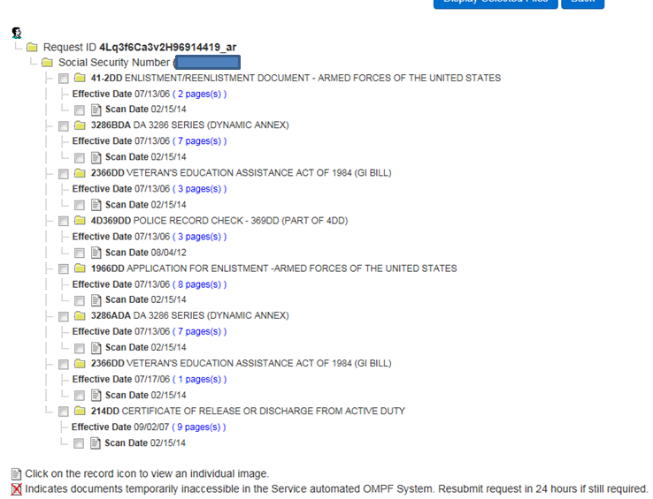
Response
Notes:
Response

Slide 16
DPRIS Help
Notes:
D P R I S Help

Slide 17
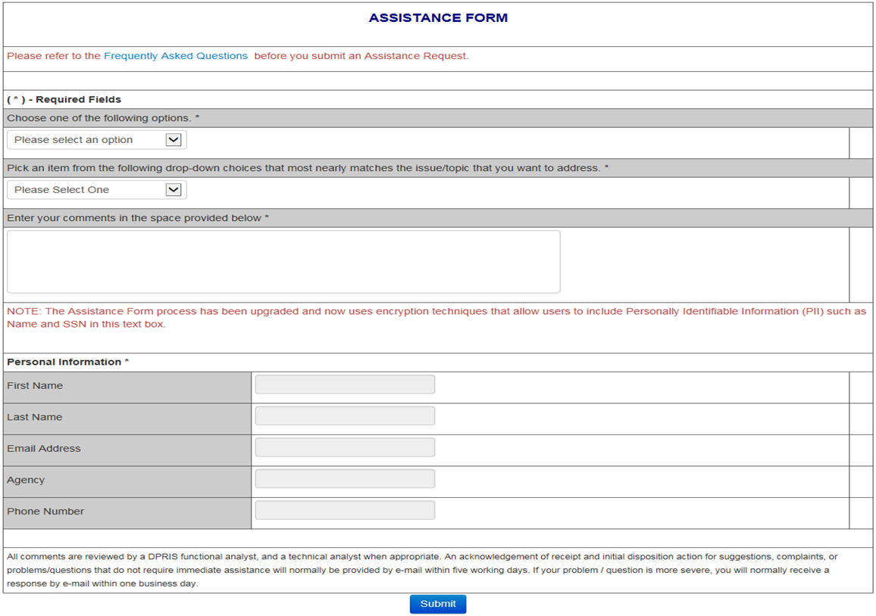
Assistance Form
Notes:
Assistance Form

Slide 18
Personnel Information Exchange Systems (PIES)
An automated system used to request Service Treatment Records (STRs) and Personnel Records that are maintained in the National Personnel Records Center (NPRC).
Notes:
Personnel Information Exchange Systems (P I E S)
An automated system used to request Service Treatment Records (STRs) and Personnel Records that are maintained in the National Personnel Records Center (NPRC).

Slide 19
NPRC STRs
If the veteran last served in the… | and service ended prior to…
Army | October 16, 1992
Navy | January 31, 1994
Air Force | May 1, 1994, if separated from active duty June 1, 1994 if separated from National Guard or Reserves
Marine Corps | May 1, 1994
Coast Guard | May 1, 1998
Notes:
NPRC STRs
If the veteran last served in the
Army
and service ended prior to October 16, 1992
If the veteran last served in the
Navy
and service ended prior to January 31, 1994
If the veteran last served in the
Air Force
and service ended prior to May 1, 1994, if separated from active duty
June 1, 1994, if separated from National Guard or Reserves
If the veteran last served in the
Marine Corps
and service ended prior to May 1, 1994
If the veteran last served in the
Coast Guard
and service ended prior to May 1, 1998

Slide 20
PIES Home Screen
Notes:
P I E S Home Screen

Slide 21
SHARE: BIRLS – VID
BIRLS Inquiry: Vet’s
Identification Data (VID)
Screen Information is transferred to PIES
Notes:
SHARE: B I R L S V I D
B I R L S Inquiry: Vet’s
Identification Data (V I D)
Screen Information is transferred to P I E S

Slide 22
Using PIES
Notes:
Using P I E S

Slide 23
Using PIES (cont.)
Notes:
Using P I E S (continued)

Slide 24
DPRIS to PIES Cross Reference Guide
DPRIS to PIES Cross Reference Guide is available on the Compensation Service Intranet under:
Procedures (212)
PIES/DPRIS
Notes:
D P R I S to P I E S Cross Reference Guide
D P R I S to P I E S Cross Reference Guide is available on the Compensation Service Intranet under:
Procedures (212)
P I E S D P R I S

Slide 25
Review
Questions
Notes:
Questions?

