Slide 1
IDES MSC Examination Review
Compensation Service
May 2016

Slide 2
Objectives
Identify which computer systems contain examination reports
Identify the components of a complete examination report

Slide 3
References
M21-1, Part III, Subpart i, Chapter 2, Section D - Integrated Disability Evaluation System (IDES)
M21-1, Part III, Subpart iv, Chapter 3, Section D - Examination Reports

Slide 4
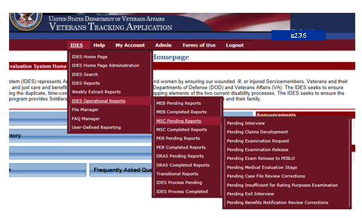
VTA Pending Examination Report
IDES Operational Reports
IDES Pending Reports
Pending Examination Report

Slide 5
VTA Report Filters & Headings

Slide 6
Review VBMS
Examination reports completed by the VA examination facilities are located in CAPRI.
These are automatically uploaded into VBMS. Depending on the template used by the examination provider, a few examination reports still get uploaded into Virtual VA, which is accessible through VBMS.

Slide 7
Locating Contract Exam Reports
Examination reports completed by a VA contract examiner are located in either VBMS or Virtual VA. They are also available in the vendor’s web site as follows:
For Quality, Timeliness, Customer (QTC) service, go to QTC Exam Track.
For Veterans Evaluation Services (VES), go to VES Exams

Slide 8
Requirements for Examination Reports
VA examinations are to be conducted using DBQs which are disease and condition-specific, organized as a documentation tool to provide the precise medical evidence needed to rate specific disabilities. The examiner is
asked to complete the form step by step
answer the questions posed, and
provide additional information as required by examination findings.

Slide 9
Requirements for Examination Reports
Common features of DBQs include
a diagnosis section
medical history
objective findings
results of diagnostic testing performed, and
a remarks section for any necessary explanation.

Slide 10
Insufficient Exams
Any missing required information on the report makes the examination insufficient for rating purposes. This can include, but is not limited to, the following instances
The examination report is unsigned.
The examination report did not address all disabilities for which an examination was requested.
The required question(s) on the DBQ were left blank.
The required review of the claims folder was not accomplished.

Slide 11
Insufficient Exams, cont.
Any missing required information on the report makes the examination insufficient for rating purposes. This can include, but is not limited to, the following instances
Missing information on the report pertinent to the disability under review, such as failure to discuss the impact of musculoskeletal pain on the functional loss of an affected joint.
A medical opinion is not properly supported by a valid rationale and/or by the evidence of record.
A requested medical opinion was not furnished.

Slide 12
Missing Examination Reports
Verifying all the referred and claimed conditions were examined.
Compare the conditions listed on the VA Form 21-0819 to the completed examination reports to find any missing exams.
Compare the exam request to the completed exam reports.
Exceptions: The evidence of record is sufficient for rating purposes.

Slide 13
Procedure for Missing Exam reports
In cases where the MSC identifies missing DBQs (or missing elements required by the DBQ), or the MSC failed to request examination of all conditions listed on the 21-0819, the MSC must obtain the missing exam information before providing the exam results to the PEBLO.

Slide 14
Examining Facility Error
Enter an insufficient exam request for any missed exams. Ensure the exam was on the initial request.

Slide 15
Requestor Error
If the initial exam request did not include the referred or claimed condition, then enter a new exam request for the missed conditions.

Slide 16
Reviewing Examination Reports for Rating Criteria
The following points are found in M21-1, Part III, Subpart iv, Chapter 3, Section D.4
Bruxism Examination Report Review
Eye Examination Report Review
Headache Examination Report Review
Hearing Loss and Tinnitus Examination Report Review
Mental Health Examination Report Review
METS for Heart Conditions Examination Report Review

Slide 17
Reviewing Examination Reports for Rating Criteria
Musculoskeletal Report Review for Functional Loss, ROM, and X-rays
Nerves Examination Report Review
PFT Examination Report Review
PTSD Examination Review
Skin and Scars Examination Report Review
Sleep Disorders Examination Review
TMJ Examination Report Review

Slide 18
Reviewing Examination Reports for Rating Criteria
TBI Examination Report Review
Facets
Residuals
Other physical conditions
Other required exams
Medical Opinions for co-existing TBI and mental conditions

Slide 19
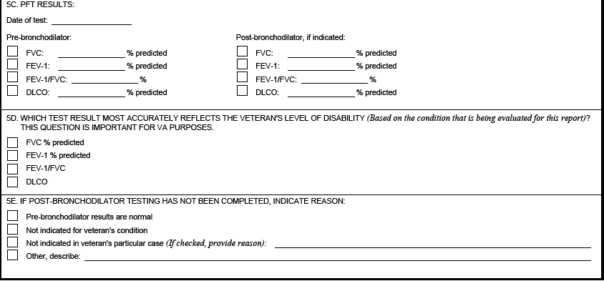
PFT

Slide 20
Questions

