Slide 1
Automobile & Adaptive Equipment Allowance
Compensation Service
July 2020

Slide 2
Purpose of this Lesson
A Veterans Service Representative (VSR) is responsible for proper notification of eligibility for, and claims processing of, Automobile and Adaptive Equipment Allowance benefits.

Slide 3
Objectives
Relate what the benefits are
List the eligibility criteria for automobile and/or adaptive equipment allowances
Identify the proper claim forms and controlling End Products (EPs)
Determine what actions to take based on submission of a claim for automobile and/or adaptive equipment
Describe award notification requirements

Slide 4
References
M21-1 Part IX, Subpart i.2, Automobile and Adaptive Equipment Allowance Under 38 U.S.C. Chapter 39
M21-1, Part III, Subpart ii, 2.B.1.b, Requirements for a Complete Claim Received on or After March 24, 2015
38 CFR §3.808 Automobiles or other conveyances and adaptive equipment; certification.

Slide 5
What is an Automobile Allowance?
Service members and Veterans may be eligible for a one-time payment of not more than $21,488.29 (FY 2020) toward the purchase of an automobile, or other conveyance deemed necessary, if they have certain service-connected disabilities.
An exception to the one-time payment rule can be made when:
The first vehicle purchased with VA financial assistance is destroyed as a result of any natural catastrophe
Destruction was not the Veteran’s fault, and
Veteran does not receive compensation for the loss from a property insurer
The law prohibits VA from making payments for automobile/conveyance grants directly to Veterans. VA is required to pay the benefits to the seller.
Notes:
IX.i.2.1.b

Slide 6
Eligibility for Automobile Allowance
The following disabilities may qualify a Veteran or service member for an automobile allowance and/or adaptive equipment:
loss, or permanent loss of use (LOU), of one or both feet, or
loss, or permanent LOU, of one or both hands, or
permanent impairment of vision in both eyes with defects specified in 38 CFR 3.808, or
a severe burn injury, or
amyotrophic lateral sclerosis (ALS)
Final determination of eligibility is made by the rating activity and can be inferred without a claim.
Notes:
IX.i.2.1.a

Slide 7
What is an Adaptive Equipment Allowance?
Adaptive equipment includes, but is not limited to, power steering, power brakes, power windows, power seats, and special equipment necessary to assist the eligible person into and out of the vehicle.
The adaptive equipment benefit may be paid more than once, and it may be paid to either the seller or the Veteran.
Notes:
IX.i.2.1.d

Slide 8
Eligibility for Adaptive Equipment Allowance
A Veteran or service member who qualifies for the automobile allowance also qualifies for adaptive equipment. To be eligible to receive only adaptive equipment, the Veteran or service member must be entitled to disability compensation for ankylosis of one or both knees or hips based on:
the establishment of service connection (SC), or
entitlement under 38 U.S.C. 1151 as the result of
VA treatment or examination
compensated work therapy, or
vocational training under 38 U.S.C. Chapter 31.
Final determination of eligibility is made by the rating activity and can be inferred without a claim.
Notes:
IX.i.2.1.c

Slide 9
Vocational Readiness and Employment (Chapter 31)
Automobile adaptive equipment may be furnished to a beneficiary under 38 U.S.C. Chapter 31 if Vocational Readiness and Employment (VR&E) determines that the equipment is necessary to:
overcome an employment handicap to which a SC disability materially contributes, and
achieve the goals of the program of rehabilitation.
Notes:
IX.i.2.1.f

Slide 10
Disqualifying Eye Condition
Even though compensation for disability of paired service-connected (SC) and non-service-connected (NSC) organs is payable under 38 CFR 3.383, Veterans do not qualify for the automobile and/or adaptive equipment allowance based on bilateral visual impairment if the impairment of vision in one eye is due to an NSC disease or injury.
Note: Entitlement to the automobile and adaptive equipment allowance may be based on disability of paired extremities under 38 CFR 3.383 because eligibility under 38 U.S.C. Chapter 39 requires the SC loss, or LOU, of only one hand or one foot.
Notes:
IX.i.2.1.e

Slide 11
Claim for Automobile Allowance
There is no time limit for filing a claim.
Claim may be received on VA Form 21-526EZ, but VA Form 21-4502, Application for Automobile or Other Conveyance and Adaptive Equipment, is required for the award of benefits.
Claim is controlled with EP 290 - Automobile Allowance (unless included in an Original claim).
Ensure Section 5103 notification requirements have been met prior to forwarding to the rating activity
  526ez is sufficient
  Otherwise, send a Standard 5103 letter
Notes:
IX.i.2.2.a; M21-4, Appendix B

Slide 12
Claim for Adaptive Equipment Allowance Only
There is no time limit for filing a claim.
Claim may be received on VA Form 21-526EZ, but VA Form 10-1394, Application for Adaptive Equip - Motor Vehicle, is required for the award of benefits.
Claim is controlled with EP 290 - Vehicular Adaptive Equipment (unless included in an Original claim).
Ensure Section 5103 notification requirements have been met prior to forwarding to the rating activity
  526ez is sufficient
  Otherwise, send a Standard 5103 letter
Notes:
IX.i.2.2.b; M21-4, Appendix B

Slide 13
Finance Responsible for all Eligible and Complete Adaptive Equipment Allowance Claims
After 5103 notice period has expired, refer all substantially complete claims for adaptive equipment to the finance activity. It will determine if the adaptive equipment is preapproved for reimbursement based upon the effective date of entitlement, the Veteran’s SC disability, or if it is specifically authorized by the local VA outpatient clinic.
Notes:
IX.i.2.6.f

Slide 14
Handling Incomplete Applications
If an application from a person on active duty is incomplete in any essential part or the medical evidence or service status is insufficiently documented:
return the application to the VA prosthetics department, if it is responsible for the deficiency; otherwise
advise the service member of the deficiency, and
ask him/her to obtain the necessary evidence.
Notes:
IX.i.2.2.c

Slide 15
If Eligibility Has Not Been Determined
If prior rating decisions do not establish the existence of a qualifying SC disability, refer the claim to the rating activity following completion of any necessary development.
Rating decisions finding eligibility to adaptive equipment only will be clear that it does not include the automobile allowance.
Notes:
IX.i.2.3.a

Slide 16
Reviewing VA Form 21-4502 and Determining Prior Payment Status
Please review M21-1 Part IX, Subpart i, 2.5.a for detailed instructions on how to process claims for Automobile Allowance.
Notes:
IX.i.2.5.a

Slide 17
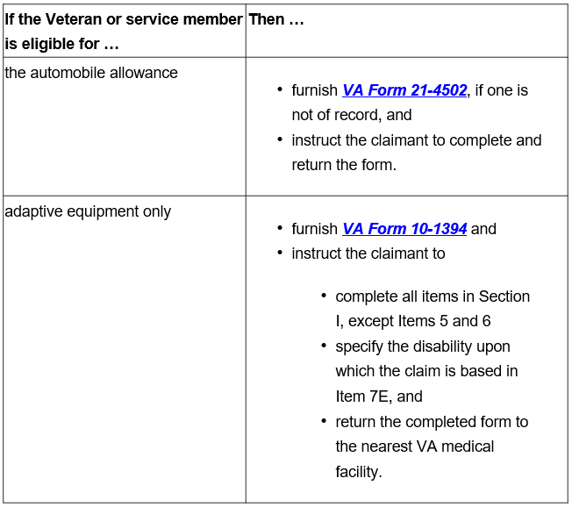
Post Rating Notification - lacking prescribed form
Notes:
IX.i.2.4.a. Notifying Claimants of Potential Automobile Allowance Eligibility

Slide 18
Post Rating Notification - lacking prescribed form (cont.)
The redesigned automated decision letter (RADL) created in VBMS-A will add lines for the auto allowance or adaptive equipment grant, but the VSR should double-check the letter to ensure the language informing the Veteran of eligibility is clear, and that the appropriate attachments are included.

Slide 19
Summary
What is the benefit?
What are the eligibility requirements for automobile and adaptive equipment allowances?
What are the proper claim forms and controlling Eps?
What actions do we take based on submission of a claim for automobile and/or adaptive equipment?
What are the eligibility notification procedures?

Slide 20
Questions?

