Slide 1
Payment Tracers

Slide 2
Overview of Today’s Training
Payment Tracers
The purpose of this lesson is to provide the Veterans Claims Examiners Non-Technical Agents with the knowledge needed to properly perform a payment tracer for an issued Check or electronic funds transfer (EFT) payment.

Slide 3
Lesson Objectives
Upon completion of the Payment Tracers lesson, you should be able to:
Identify what factors should be evaluated prior to performing a payment tracer
Identify the procedures for requesting a 1st, 2nd, and 3rd payment tracer
Identify finance issues that require escalation
Identify what happens after a payment tracer is performed

Slide 4
Payment Tracer - Defined
A Payment Tracer is a transaction performed by finance that will determine if a payment has been deposited, cashed, or is still unaccounted for.

Slide 5
Steps to Initiate a Payment Tracer
Payment tracers can be requested for payments made by:
Direct Deposit (EFT)
Check
STEPS
Students and/or School Officials may contact the VA to report non-receipt of payment and request a payment tracer.
The VA employee submits the request to the VA finance department.
Finance performs the tracer and notifies the claimant of results.

Slide 6
Requesting a Payment Tracer - Considerations
Check the following BEFORE requesting a payment tracer:
Has the payment been issued?
Was the payment sent to the correct location?
Was the payment included with other payments?
Was the payment applied to a debt?
Was the payment returned?

Slide 7
1. Has the Payment Been Issued?
Once a payment is sent by the VA, it will show in one of two places:
BDN M22 Screen
SHARE

Slide 8
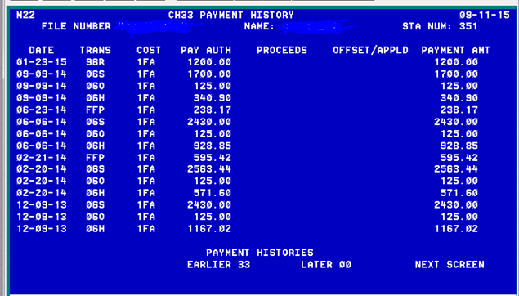
1. Has the Payment Been Issued? – BDN and SHARE
The payment amount and date authorized will show on the BDN M22 screen. (except in the case of Ch35)
To see the date the payment was actually sent, you must check in SHARE.

Slide 9
2. Was the Payment Sent to the Correct Location?
Verify the student’s:
Address
EFT Account
Correct if necessary using the established procedures.

Slide 10
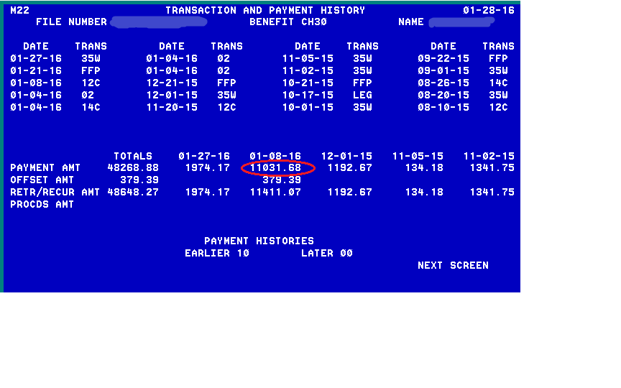
3. Was the Payment Included With Other Payments?
Compare expected payment amount with actual payment:
The actual payment amount will show on the BDN M22 screen.

Slide 11
4. Was the Payment Applied to a Debt?
Check to see if the payment was applied to a debt (Check BDN M22 and M01):
The BDN M22 screen will show:
The authorized payment amount
Any amount applied to a debt
The actual payment amount

Slide 12
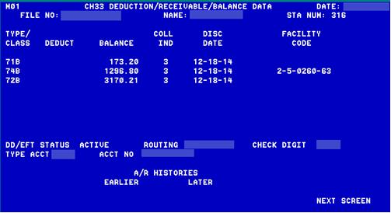
4. Was the Payment Applied to a Debt? (Continued)
Check to see if the payment was applied to a debt (Check BDN M22 and M01):

Slide 13
5. Was the Payment Returned?
Check BDN and SHARE to see if the payment was returned.
BDN M23 Screen (Code 21R or 21S)
BDN M21 Screen (proceeds)
SHARE (bottom of screen)
Returned Payment will show on the bottom of SHARE:

Slide 14
Requesting a Payment Tracer
Wait at least 10 business days from the date a check was issued in SHARE before requesting a tracer
If the claimant reports that their check was lost or stolen, you may complete a payment tracer the same day
Wait at least 5 business days from the date of the EFT transaction in SHARE before requesting a tracer

Slide 15
Payments Over a Year Old
Treasury typically does not trace payments over one year old.
Do not perform payment tracer requests for payments over a year old
Advise the claimant to report non-receipt of payment to their postal service, local law enforcement or DA’s office if needed
Only in the instance of theft/fraud may a payment be traced after one year
The claimant should send a written request to their RPO and include a copy of the report from their local law enforcement

Slide 16
Comprehension Check
What 5 things should you check prior to requesting a Payment Tracer?
Who actually performs the Payment Tracer?

Slide 17
Group Activity
Practical Application
Claimant Inquiries: Payment Scenarios based on information in BDN, SHARE, TIMS and LTS.

Slide 18
Payment Tracer 1st, 2nd, 3rd Requests
The procedures for requesting a payment tracer differ depending on whether it is a 1st, 2nd or 3rd request.
1st
2nd
3rd

Slide 19
Payment Tracer – 1st Request Procedures
1st Request:
Use the Check Tracer Button on the ECC Index
Complete the email template
Email to finance
Capture a copy of the sent email into TIMS
Label captured email in TIMS as “Tracer Request”
Notes:
Do they need instructions for capturing email into TIMS?

Slide 20
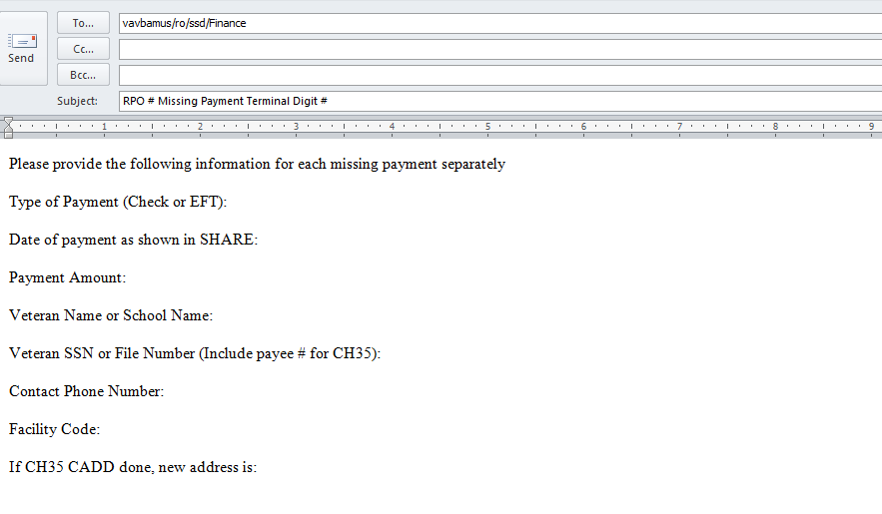
Payment Tracer Email Template
**In the subject line, put the RPO #, Missing Payment, Last two of claim number.
Ex: RPO 351 Missing Payment 12

Slide 21
Payment Tracer – 2nd Request Procedures
2nd Request:
Wait at least 10 business days from 1st Request
Follow procedures from 1st Request
Include “2nd Tracer Request” in subject line of email
Label captured email in TIMS as “2nd Tracer Request”

Slide 22
Payment Tracer Procedures
3rd Request:
Wait at least 10 business days from 2nd Request
Escalate the call to the ECC Escalation Line
If escalation line is closed:
Complete the Finance Escalation Request Form (located in “Job Aids” on the ECC Index)
Give the Form to your coach
Place a note in TIMS that “3rd Request for payment tracer sent to coach on mm-dd-yy”

Slide 23
Additional Finance Issues Requiring Escalation
Escalate these calls (or complete a Finance Escalation Request Form if the Escalation Line is closed):
3rd Payment Tracer Request
Requests to release/reissue payments showing at the bottom of SHARE or in proceeds (after CADD failed to release)
Requests to release/reissue a returned payment for Chapter 35
Direct communication with finance is needed
Note: DO NOT complete a Form 119 for these issues.

Slide 24
Finance Escalation Request Form Template

Slide 25
Individual Activity
Completing a Payment Tracer and a Finance Escalation Request Form:
Locate the Tracer Button on the ECC Index.
Complete a payment tracer using the information provided.
Locate the Finance Escalation Request Form on the ECC Index.
Complete a Finance Escalation Request Form using the information provided.

Slide 26
What Happens After the Payment is Traced?
After a payment tracer has been requested, claimants should allow at least 2-4 weeks for the U.S. Treasury to contact them.

Slide 27
What Happens After the Check is Traced?
Checks:
If the check has not been cashed, Treasury will send the claimant a courtesy replacement check.
If the claimant later finds the original check, they should mail one of the checks back to the VA
If both checks are cashed, the claimant will receive a debt

Slide 28
What Happens After the Check is Traced? (Continued)
Checks:
If the check has been cashed, Treasury will send the claimant a fraud package (FMS 3858)
The package will contain:
Photo copy of the front and back of the cashed check
Signature sample form
Fraud claim form (FMS 1133)
The claimant must complete the claim and return the package to the U.S. Treasury
Treasury will notify the claimant regarding the outcome and send a replacement check if applicable

Slide 29
What Happens After the EFT is Traced?
EFT Payments:
Finance and Treasury will work together to determine:
If the payment was deposited
What account the payment was deposited to
If the payment was NOT deposited
Depending upon information received from the claimant’s bank, Treasury will:
Determine if payment needs to be made
Notify the claimant of their findings

Slide 30
Comprehension Check
How long should a claimant allow for the U.S. Treasury to contact them after a payment tracer has been requested?
What happens if the payment tracer reveals that the claimant’s check has been cashed?

Slide 31
Lesson References
VBA Financial Procedures Guide
Veterans Benefits Administration, MP-4, Part IV
Non-Receipt of Payment Participant Guide Quality Client Services (27)
FMS Form 3858
FMS Form 1133
ECC Index Documents:
Finance Escalation Request Form
Check Tracer Procedures
Check Tracer Script

Slide 32
Summary
You have completed the Payment Tracers lesson. You should be able to:
Identify what factors should be evaluated prior to performing a payment tracer
Identify the procedures for requesting a 1st, 2nd, and 3rd payment tracer
Identify finance issues that require escalation
Identify what happens after a payment tracer is performed

Slide 33
What questions do you have?
Questions

Slide 34
TMS Assessment and Survey
The assessment and survey have been assigned to you in TMS
The assessment is comprised of multiple choice questions
The questions are based on the information presented in this lesson
The assessment should take you approximately 90 minutes
Be sure to complete both the assessment and the survey in TMS to receive credit for this training

