Slide 1
Cardiovascular System
Compensation Service
March 2016

Slide 2
Objectives
Explore the primary components and functions of the cardiovascular system
Review the principles in evaluating cardiovascular related disabilities evaluation criteria

Slide 3
References
38 CFR 3.307, Presumptive service connection for chronic, tropical or prisoner-of-war related disease, or disease associated with exposure to certain herbicide agents; wartime and service on or after January 1, 1947
38 CFR 3.309, Disease subject to presumptive service connection
38 CFR 4.100, Application of the evaluation criteria for diagnostic codes 7000-7007, 7011, and 7015-7020
M21-1, Part IV, Subpart ii, 2, C - Service Connection (SC) for Disabilities Resulting From Exposure to Environmental Hazards or Service in the Republic of Vietnam (RVN)
38 CFR 4.104, Schedule of ratings—Cardiovascular system
M21-1, Part III, Subpart iv, 4, E - Cardiovascular System Conditions
Drosky v. Brown, No 96-573, May 14, 1997
Otero-Castro v. Principi, No. 01-1360, October 4, 2002

Slide 4
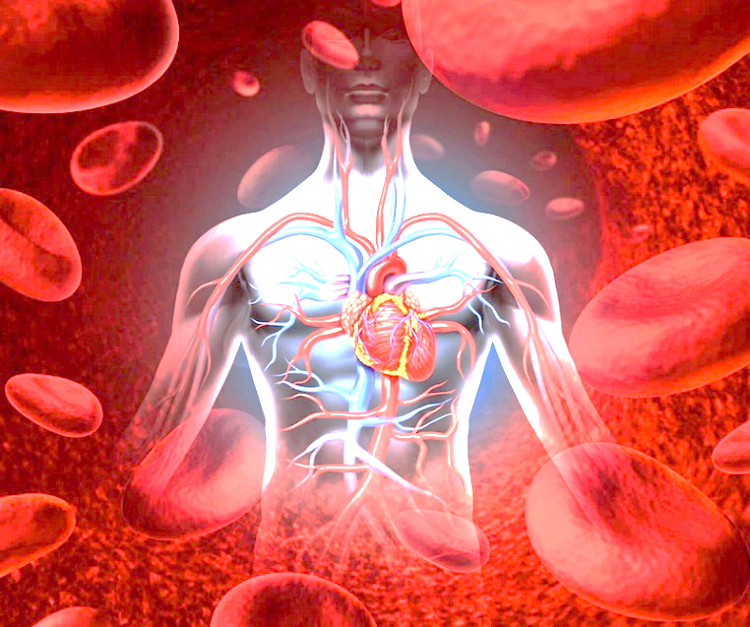
Functions of the Cardiovascular System
Primary Components
Heart
Arterial & venous systems
Blood

Slide 5
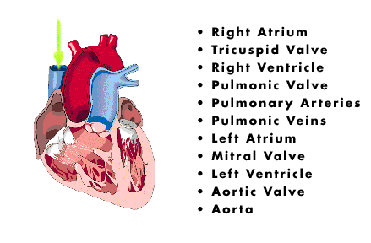
Anatomy of the Heart
Anatomy of the heart:
A hollow muscular organ lying in the center of the chest
Divided into left and right sides, each have upper chamber (atrium) that collects blood and a lower chamber (ventricle) that ejects blood
Inlet and outlet valves in each ventricle ensure one-way blood flow

Slide 6
Heart Anterior/Posterior views

Slide 7
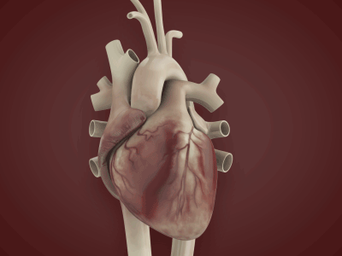
Primary functions of the heart include:
Oxygen mover for the body
Collects O²-enriched blood coming from lungs
Pumps it to entire body
Helps rid body of waste product (CO²)
Collects oxygen-depleted blood from the body
Pumps it to the lungs for re-oxygenation
During each heartbeat, each heart chamber:
Relaxes as it fills (diastole)
And then contracts as it pumps blood (systole)

Slide 8
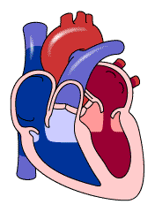
Pulmonary circulation
Blood flow:
CO²-laden blood from body flows through largest veins (vena cavae) into right atrium
Right atrium fills
Heart muscle propels
blood into right ventricle

Slide 9
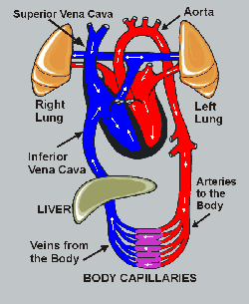
Pulmonary circulation
Right ventricle fills;
Heart muscle pumps blood through pulmonary valve into pulmonary arteries to the lungs;
Blood in lungs absorbs O² and gives up CO^{2;}
CO² is exhaled (Respiratory System);
O²-enriched blood returns to the heart through pulmonary veins into the left atrium.
Left atrium fills;
Blood is pumped into left ventricle;
When left ventricle fills, heart muscle pumps blood through aortic valve into aorta (largest artery in the body);
O²-enriched blood supplies all of body except lungs.

Slide 10
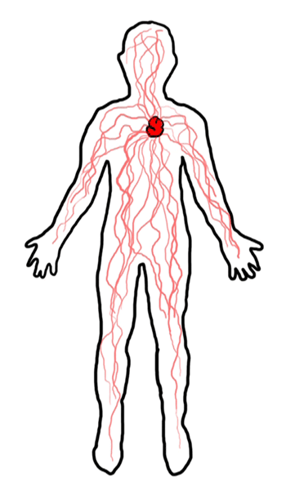
Circulatory System
The Circulatory System:
Arteries
Arterioles
Capillaries
Venules
Veins

Slide 11
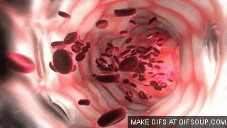
Circulatory System
Arteries
Strong and flexible
Carry blood away from the heart
Bear the highest blood pressures
Help maintain blood pressure between beats
Smaller arteries and arterioles:
Have muscular walls
Adjust their diameter to increase or decrease blood flow to a particular area

Slide 12
Circulatory System
Capillaries:
Tiny, extremely thin-walled
Act as bridges between arteries and veins
Allow nutrients to pass from blood to tissues
Allow waste to pass from tissues into blood
Drain into venules, which drain into veins, which lead back to the heart
Veins:
Thin-walled but generally larger in diameter than arteries,
Carry same volume of blood, but at a lower speed, and
Under much less pressure

Slide 13
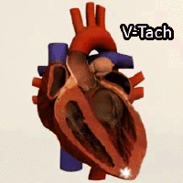
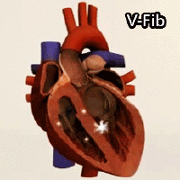
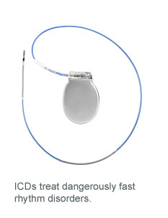
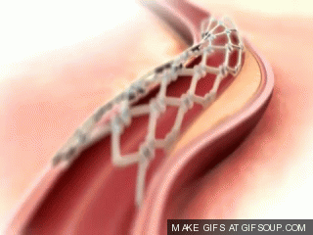
Cardiovascular related disabilities
Arrhythmias(DC 7010 and 7011)
Ventricular and Superventricular
Implantable device
cardiac pacemakers vs implantable cardioverter-defibrillators
Ischemic Heart Disease (IHD)

Slide 14
Ischemic Heart Disease (IHD)
Ischemia is caused by inadequate blood supply to a local area of the heart muscle (myocardium) due to a blockage in the blood vessels to the area. IHD is a condition in which there is or there has been an episode of ischemia
Infarct is an area of necrosis (death of body tissue) in the heart muscle (myocardium) due to ischemia
3.309 Presumptive Service Connections may have had an ischemic event in the past but not presently and still have IHD for VA purposes

Slide 15
Rating the Cardiovascular System
For rating purposes, the cardiovascular system is subdivided into:
Diseases of the Heart;
DC 7000 – 7008,
DC 7010 & 7011
DC 7015 - 7020
Diseases of the Arteries & Veins;
DC *7101 (hypertensive vascular disease)
DC 7110 – 7123
Cold Injury Residuals DC 7122
*Separate evaluations for hypertension and heart disease are allowed!

Slide 16
Rating based on METS and LVEF
METs
What are METs?
How are METs used in evaluation of the cardiovascular system
Even if the requirement for a 10% or 30% evaluation is met, METs testing is required in all cases, with what four exceptions?
38 CFR 4.100(b)
Left ventricular ejection fraction
Congestive heart failure
Cardiac hypertrophy or dilatation on electrocardiogram, echocardiogram, or X-ray
Continuous medication

Slide 17
Rating based on METS and LVEF
Left ventricular ejection fraction (LVEF)
Otero-Castro v. Principi: DCs 7005 and 7007 do not require a separate showing of left-ventricular dysfunction in addition to an ejection fraction of 30 through 50% for a 60% rating.
If LVEF testing is not of record, evaluation should be based on the other criteria unless the examiner states that the LVEF test is needed in a particular case.
In all cases, the following must be ascertained:
Whether or not cardiac hypertrophy or dilatation (documented by electrocardiogram, echocardiogram or X-ray) is present, and
Whether or not there is a need for continuous medication.

Slide 18
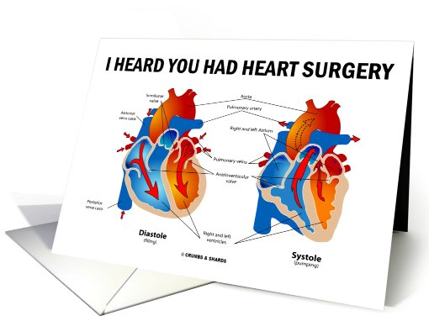
Total impairment criteria & convalescence
Total impairment criteria
When is a 100 percent evaluation required?
Convalescence Periods
2 months
3 months
Indefinite period with mandatory exam at 6 months
Indefinite period with mandatory exam at 1 year
Application of 38 CFR 105(e)?

Slide 19
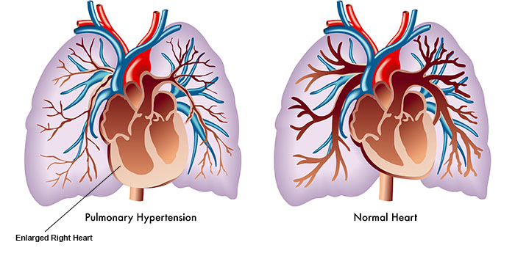
Cor Pulmonale
A combination of hypertrophy and dilatation of the right ventricle secondary to pulmonary hypertension, due to disease of the lung parenchyma or pulmonary vascular system.
Always secondary to a lung condition.
Evaluate cor pulmonale as part of the pulmonary condition that causes it
(Note 1 under §4.104).

Slide 20
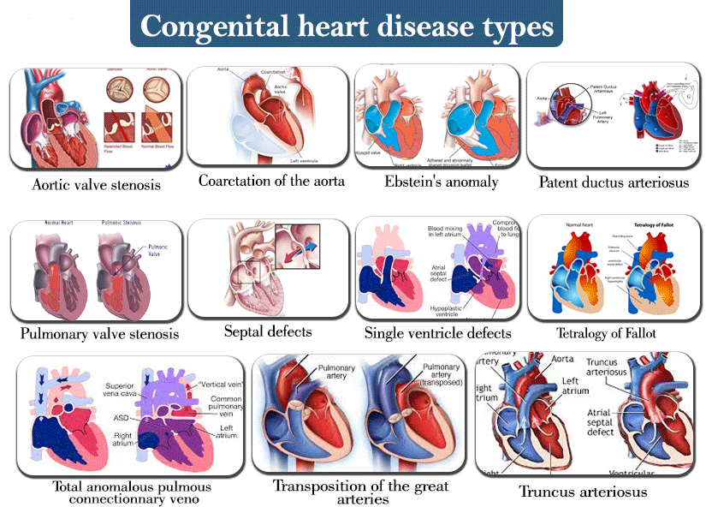
Congenital Heart Defects
Common heart conditions due to prenatal influences, such as:
patent foramen ovale
patent ductus arteriosus
coarctation of the aorta, and
intraventricular septal defect.

Slide 21
Coexisting Heart Diseases
No etiological relationship between “Rheumatic heart disease and either Hypertensive or Arteriosclerotic heart disease.
A medical opinion is necessary to determine whether current signs and symptoms can be attributed to one of the coexisting conditions.

Slide 22
Secondary considerations;
Due to relationship with Hypertension, grant secondary SC for:
Cerebral arteriosclerosis or thrombosis with hemiplegia
Nephrosclerosis of the kidneys with impairment of renal function
myocardial damage or coronary occlusion of the heart
(Note: Existence of arteriosclerosis does not imply or indicate previous hypertension.)
Subsequent to Amputations, grant secondary SC for ischemic heart disease or other cardiovascular disease developing in a veteran who has:
SC amputation of one lower extremity at or above the knee, or
SC amputations of both lower extremities at or above the ankles

Slide 23
Review Exercise & Practical Scenarios

Slide 24
Questions

