Slide 1
Applying DeLuca
Compensation Service
February 2016

Slide 2
Objectives
Identify manual references for joints, functional loss and painful motion
Define functional loss
Know how to apply the requirements of 38 CFR 4.40, 4.45 and 4.59
Identify court decisions concerning 38 CFR 4.40, 4.45 and 4.59

Slide 3
References
38 CFR 4.21, Application of rating schedule
38 CFR 4.40, Functional loss
38 CFR 4.45, The joints
38 CFR 4.59, Painful motion
38 CFR 4.71, Measurement of ankylosis and joint motion
M21-1, Part III, Subpart iv, Chapter 4, Section A, Musculoskeletal conditions
Schafrath v. Derwinski, 1 Vet App 589, 592
Hicks v. Brown, 8 Vet App 417, 421
DeLuca v. Brown, 8 Vet App 202
VBN Broadcast, “Considering DeLuca”, March 29, 2005
FAQ on DeLuca, April 7, 2005
FAQ on Painful Motion, September 17, 2008
Medical EPSS

Slide 4
Functional Loss
38 CFR 4.40, Functional Loss – deals primarily with the musculoskeletal system
Defined as: the inability, due to damage or infection in parts of the system, to perform normal working movements of the body with normal excursion, strength, speed, coordination, and endurance

Slide 5
Functional Loss
Functional loss may be due to:
Absence of part or all of the necessary bones, joints and muscles, or associated structures in a body part; or deformity, adhesions, defective innervation, or other pathology.
Evidence by visible behavior of the claimant undertaking the motion.
Remember: Weakness is as important as limitation of motion

Slide 6
The Joints
38 CFR 4.45. With regard for the joints, the factors of disability reside in the reduction of their normal excursion of movement in different planes. Inquiry will be directed to these considerations:
Less movement than normal
More movement than normal
Weakened movement
Excess fatigability.
Incoordination
Pain on movement, swelling, deformity or atrophy of disuse.

Slide 7
Painful Motion
38 CFR 4.59 – considerations of painful motion of the joints
Painful motion is an important factor when dealing with any form of arthritis
Facial expression, wincing, etc. on pressure or with manipulation, should be carefully noted
Intent of schedule is to recognize painful motion with joint or periarticular pathology as productive of a disability.
Recognize actual painful, unstable, or mal-aligned joints, due to healed injury with entitlement to minimum compensation rating for the joint.
Painful joint motion ALWAYS equals a 10 percent disability evaluation.

Slide 8
Considering Pain
Remember – pain, in and of itself, is NOT a disability for compensation purposes.
Under 38 CFR 4.59, pain must be considered when evaluating a joint.

Slide 9
Hicks v. Brown
Under 38 CFR 4.59, painful motion is considered limited motion even though range of motion is possible beyond the point when pain sets in.

Slide 10
DeLuca v. Brown
The Court required that any evidence demonstrating weakened movement, excess fatigability, in-coordination, and pain in evaluating disabilities must be considered.
The Rating Schedule does not prohibit consideration of a higher evaluation based on limitation of motion due to pain, to include during flare-ups.

Slide 11
DeLuca v. Brown
The examiner must provide an opinion as to whether the pain could significantly limit functional ability during flare-ups or used repeatedly over time.
This limitation must be expressed in degrees of additional range of motion lost due to pain on use of flare-ups.

Slide 12
DeLuca v. Brown
Rating Schedule requires a complete examination when evaluating the joints.
Required for understanding the nature and extent of the disability
Provided on both history and objective findings
Factors of 38 CFR 4.45 must be noted either by presence or absence, by both history and objective findings
Disability Benefits Questionnaires Switchboard
http://vbacodmoint1.vba.va.gov/bl/21/DBQ/default.asp

Slide 13
Schafrath v. Derwinski
Court noted that the functional loss due to pain is to be rated at the same levels as the functional loss where motion is impeded.
“To impede” is defined as to interfere with or slow the progress of; to retard or obstruct the progress of. (Hinder.)

Slide 14
New Requirements
Per the new disability examination worksheets, VSRs and RVSRs should request that examiners base all DeLuca findings on at least three repetitions of range of motion.
Note: Medical contraindications would override any requirement
for repetitive testing.

Slide 15
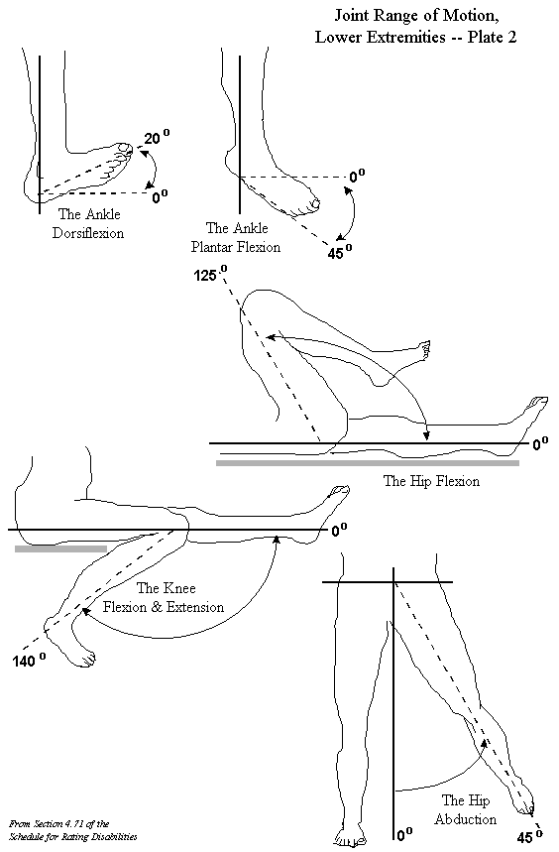
Rating Schedule

Slide 16
Scenario 1
A Veteran is seen at an examination for his left knee condition. During the examination, he shows no pain on motion and the active range of motion is 110 – 0 degrees.
After the third range of motion test, the Veteran’s flexion is now reduced to 45 degrees.
What evaluation does this warrant?

Slide 17
Answer
10 percent, per the DeLuca standards.

Slide 18
Scenario 2
A Veteran is seen at an examination for his right shoulder condition. During the examination, there is no evidence of arthritis and the range of motion through all three repetitions is 180 – 0.
However, there is evidence of pain and weakness at 145 degrees of flexion, on each of the three tests.
What evaluation does this warrant?

Slide 19
Answer
10 percent, per 38 CFR 4.59a

Slide 20
Questions

