Slide 1
Service Records
Compensation Service
March 2016
Notes:
Welcome to Service Records course. To advance each slide, click anywhere on the screen.

Slide 2
Objective
Given all available references, trainees will be able to effectively review, understand, and translate service treatment records (STRs) with 98% accuracy.
Notes:
Objective
Upon completion of this lesson, you will be able to:
Given all available references, trainees will be able to effectively review, understand, and translate service treatment records (STRs) with 98% accuracy.

Slide 3
References
M21-1 Part I, 1.C – Requesting Records
M21-1 Part III, Subpart iii, 2.A – General Information on Service Records
M21-1 Part III, Subpart iii, 2.B – Migration of Service Records and the Procedures for Obtaining Them
M21-1 Part III, Subpart iii, 2.I – Control and Follow-Up of Requests for Service Records
M21-1 Part IV, Subpart ii, 1.D – Claims for Service Connection (SC) for Post-Traumatic Stress Disorder (PTSD)
M21-1 Part IV, Subpart ii, 2.A – Deciding Claims for Disability Compensation
Notes:
References
The references for this course are listed on the screen. You may click any hyperlinked references for further details.

Slide 4
Definition of Service Treatment Records
(STRs)
Service treatment records (STRs) are military health records.
Note: If a Service member obtains treatment "off-base" at a civilian facility, any medical or mental health records created during the course of treatment are not automatically associated with the Service member's STRs. Furthermore, these records are never forwarded for long-term storage to the National Personnel Records Center (NPRC). Rather, they are destroyed after a period of inactivity (five years for mental health records).
Notes:
Definition of Service Treatment Records (STRs)
Service treatment records (STRs) are military health records.
Note:
If a Service member obtains treatment "off-base" at a civilian facility, any medical or mental health records created during the course of treatment are not automatically associated with the Service member's STRs. Furthermore, these records are never forwarded for long-term storage to the National Personnel Records Center (NPRC). Rather, they are destroyed after a period of inactivity (five years for mental health records).

Slide 5
Requesting STRs
National Personnel Records Center (NPRC) (Use PIES application):
  O50 request code → acquire all available STRs and OMPF records and upload to VBMS eFolder
  When the PIES request is completed, the records and/or completed 3101 request are being directly sent for scanning
Records Management Center (RMC):
  Claims folder is located at RMC - RMC will ship to scanning and upload into VBMS eFolder
  STRs are located at RMC
    If STRs are In Transit → no further action is required
    If STRS are not In Transit → request by sending email to RMC and RMC will ship to scanning and upload to VBMS
Notes:
Requesting STRs
National Personnel Records Center (NPRC) (Use PIES application):
- O50 request code → acquire all available STRs and OMPF records and upload to VBMS eFolder
- When the PIES request is completed, the records and/or completed 3101 request are being directly sent for scanning
Records Management Center (RMC):
- Claims folder is located at RMC - RMC will ship to scanning and upload into VBMS eFolder
- STRs are located at RMC
- If STRs are In Transit → no further action is required
- If STRS are not In Transit → request by sending email to RMC and RMC will ship to scanning and upload to VBMS

Slide 6
Requesting STRs: HAIMS
Health Artifacts and Imaging Management Solution (HAIMS):
Beginning on January 1, 2014, military service departments stop sending paper claims for separating or retiring Servicemembers
  Reserve and National Guard components included
  Certifies the upload the electronic STRs
  Within 45 days after separation or retires
  Does not apply to pre-separation claims
    Except when the predischarge is established in VBMS
      If separated/retired prior to 01-01-2014, follow established procedures outlined in M21-1.III.iii.2
    Army, Air Force, Navy and Marine Corps, Coast Guard
Notes:
Health Artifacts and Imaging Management Solution (HAIMS):
Beginning on January 1, 2014, military service departments stop sending paper claims for separating or retiring Servicemembers
- Reserve and National Guard components included
- Certifies the upload the electronic STRs
- Within 45 days after separation or retires
- Does not apply to pre-separation claims
- Except when the predischarge is established in VBMS
- If separated/retired prior to 01-01-2014, follow established procedures outlined in M21-1.III.iii.2
- Army, Air Force, Navy and Marine Corps, Coast Guard

Slide 7
STR Contents
STRs include … | STRs do not include …
physical examination reports, including reports from entrance and discharge physical examinations, if performed
the service member’s medical history
all dental examination reports and records
clinical record cover sheets and summaries
outpatient medical and dental treatment records
physical profiles
medical board proceedings, and
prescriptions for eyeglasses and orthopedic footwear
inpatient treatment records (clinical records)
finance records
mental health records, or
the Military Personnel Record Jacket (MPRJ), which may contain physical profiles and medical board proceedings
Notes:
STRs include …
physical examination reports, including reports from entrance and discharge physical examinations, if performed
the service member’s medical history
all dental examination reports and records
clinical record cover sheets and summaries
outpatient medical and dental treatment records
physical profiles
medical board proceedings, and
prescriptions for eyeglasses and orthopedic footwear
STRs do not include …
inpatient treatment records (clinical records)
finance records
mental health records, or
the Military Personnel Record Jacket (MPRJ), which may contain physical profiles and medical board proceedings

Slide 8
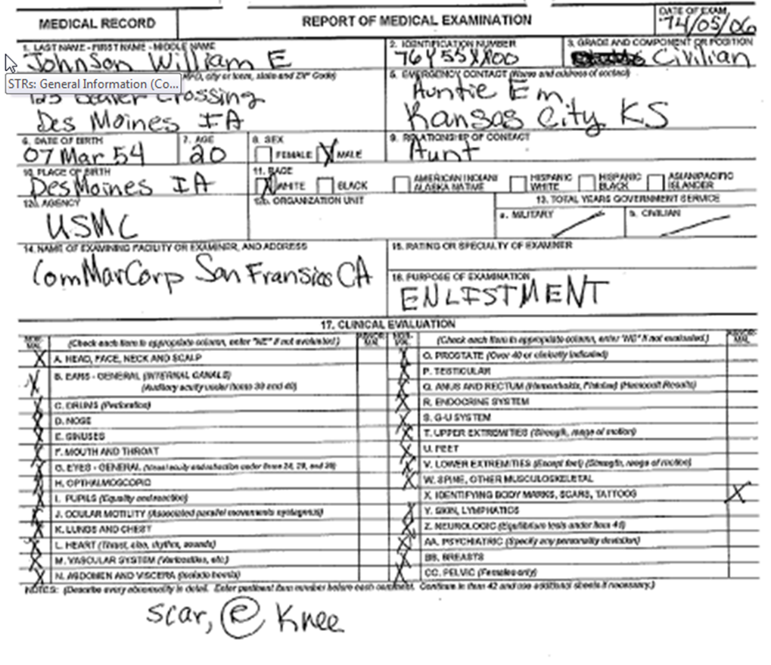
Example: Enlistment Examination
DD Form 2808
Notes:
Example: Enlistment Examination
DD Form 2808

Slide 9
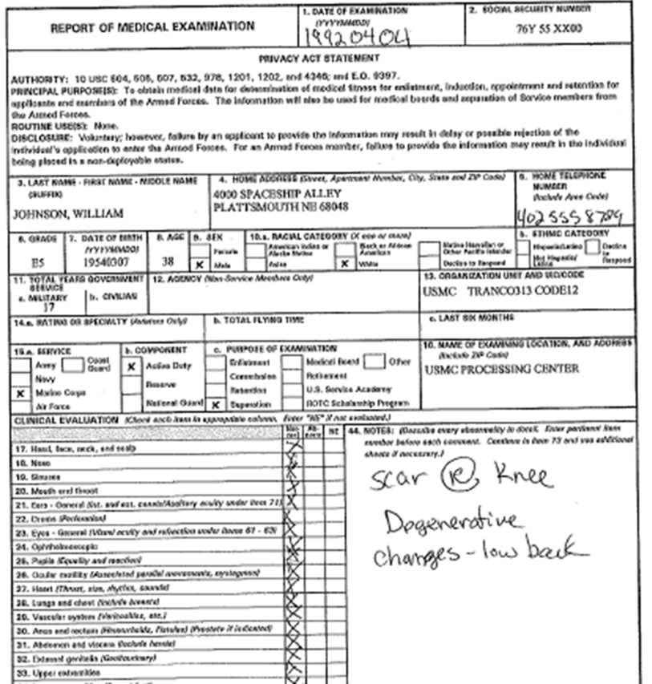
Example: Separation Examination
DD Form 2808
Notes:
Example: Separation Examination
DD Form 2808

Slide 10
STR Review
Locate and tab entrance and separation exams.
Review all available records for claimed condition(s) and chronic conditions and tab if/where they are found. (Example: shell fragment wound (SFW))
Take notes on development checklist.
Solicit a claim for chronic, unclaimed disabilities noted in the STRs.
Notes:
STR Review
Locate and tab entrance and separation exams.
Review all available records for claimed condition(s) and chronic conditions and tab if/where they are found. (Example: shell fragment wound (SFW))
Take notes on development checklist.
Solicit a claim for chronic, unclaimed disabilities noted in the STRs.

Slide 11
STR Review
Paper Claim Reminder:
Avoid:
marking on, date stamping, or punching holes in any records received from the service department,
or removing service treatment records (STRs) from the STR folder unless necessary for photocopying.
Notes:
STR Review
Paper Claim Reminder:
Avoid:
marking on, date stamping, or punching holes in any records received from the service department,
or removing service treatment records (STRs) from the STR folder unless necessary for photocopying.

Slide 12
STR Data Format
S: Subjective
O: Objective
A: Assessment
P: Plan
Notes:
STR Data Format
S: Subjective
O: Objective
A: Assessment
P: Plan

Slide 13
SOAP Format
Many treatment records will use different abbreviations, or possibly none at all, to signify each section.
This format is not unique to military records and treatment records/reports from private doctors/clinics/hospitals may also utilize SOAP.
Notes:
SOAP Format
Many treatment records will use different abbreviations, or possibly none at all, to signify each section.
This format is not unique to military records and treatment records/reports from private doctors/clinics/hospitals may also utilize SOAP.

Slide 14
STR Format Example
Gorgas Army Hospital
Past hx R knee injury in 1995. Arthroscopic surgery showed torn medical meniscus. Pt underwent medial meniscectomy, physical therapy, then limited duty. Sx continued. MEB completed 9/95. That exam showed marked lateral laxity, some tenderness at medial aspect, no edema, no locking. Pt discharged from service w/disability severance pay. Today, C/O R knee buckling, pain w/standing, sitting, stair climbing.
Flexion to 110, extension to 5. + tenderness to patellar compression. + varus/valgus stress test. Marked lateral laxity. Negative drawer sign. No edema.
X-ray: slight joint space narrowing, early arthritic changes.
s/p R medial meniscectomy w/residual laxity, DJD.
MRI, orthopedics consult.
Notes:
STR Format Example
Gorgas Army Hospital
Past hx R knee injury in 1995. Arthroscopic surgery showed torn medical meniscus. Pt underwent medial meniscectomy, physical therapy, then limited duty. Sx continued. MEB completed 9/95. That exam showed marked lateral laxity, some tenderness at medial aspect, no edema, no locking. Pt discharged from service w/disability severance pay. Today, C/O R knee buckling, pain w/standing, sitting, stair climbing.
Flexion to 110, extension to 5. + tenderness to patellar compression. + varus/valgus stress test. Marked lateral laxity. Negative drawer sign. No edema.
X-ray: slight joint space narrowing, early arthritic changes.
s/p R medial meniscectomy w/residual laxity, DJD.
MRI, orthopedics consult.

Slide 15
Questions

Slide 16
Translating SOAP Exercise
Notes:
Translating SOAP Exercise

