Slide 1
Amyotrophic Lateral Sclerosis (ALS) Rating Criteria
Compensation Service
February 2016

Slide 2
Objectives
Describe Amyotrophic Lateral Sclerosis and its symptoms
Describe the proper way to evaluate and apply diagnostic codes to ALS claims
Identify the appropriate subordinate issues associated with ALS claims

Slide 3
References
38 CFR 3.307 Presumptive service-connection for chronic, tropical or prisoner-of-war related disease, or disease associated with exposure to certain herbicide agents; wartime and service on or after January 1, 1947
38 CFR 3.309 Disease subject to presumptive service connection
38 CFR 3.318 Presumptive service connection for Amyotrophic Lateral Sclerosis
38 CFR 3.350 Special monthly compensation ratings
38 CFR 3.352 Criteria for determining need for aid and attendance and “permanently bedridden”
38 CFR 3.383 Special consideration for paired organs and extremities
38 CFR 3.707 Dependents’ Educational Assistance
38 CFR 3.807 Dependents’ Educational Assistance; certification

Slide 4
References
38 CFR 3.808 Automobile or other conveyance; certification
38 CFR 3.809 Special home adaptation grants under 38 USC 2101 (a)
38 CFR 4.63 Loss of use of hand or foot
38 CFR 4.124a Schedule of ratings – Neurological Conditions and Convulsive Disorders
M21-1, Part III, Subpart iv, Chapter 4, Section G - Neurological Conditions and Convulsive Disorders
M21-1, Part IX, Subpart i, Chapter 3 - Specially Adapted Housing (SAH) or Special Housing Adaptation (SHA) Grants
M21-1, Part IX, Subpart i, Chapter 2 - Automobile and Adaptive Equipment Allowance Under 38 U.S.C. Chapter 39
M21-1, Part IV, Subpart ii, Chapter 2, Section H - Special Monthly Compensation (SMC)
M21-1, Part III, Subpart ii, Chapter 2, Section A - Department of Veterans Affairs (VA) Benefit Programs

Slide 5
Amyotrophic Lateral Sclerosis
Description of the disease:
Also commonly known as Lou Gehrig’s Disease
A rapidly progressive, invariably neuromuscular disease
Attacks the nerve cells in the brain and spinal cord responsible for controlling voluntary muscles
Causes muscle weakness, muscle atrophy, and spontaneous muscle activity
Patients lose their strength and ability to move their arms, legs, and body.
Most people die from respiratory failure, within 3 to 5 years from the onset of symptoms.

Slide 6
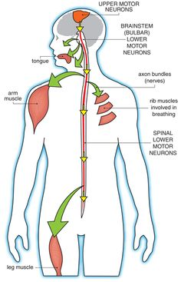
Amyotrophic Lateral Sclerosis
Motor neuron disease
Progressive
Always fatal
50% within 3 years
20% within 5 years
10% within 10 years
> 30 years rare

Slide 7
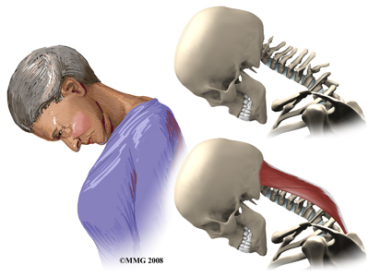
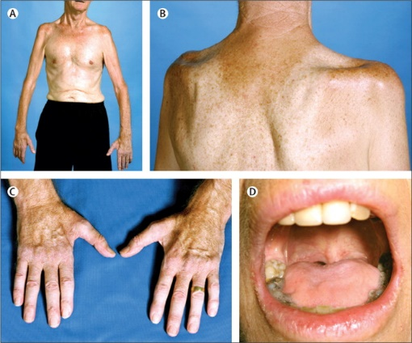
ALS Symptoms
Symptoms include:
Difficulty breathing
Difficulty swallowing
Gagging
Chokes easily
Head drop due to weak spinal and neck muscles
Muscle cramps
Muscle weakness that slowly gets worse
Commonly involves one part of the body first, such as the hand or arm
Eventually leads to difficulty with lifting, climbing stairs, or walking

Slide 8
ALS Symptoms
Paralysis
Speech problems, such as slow or abnormal speech patterns
Voice changes, hoarseness
Other symptoms;
Drooling
Muscle contractions
Muscle spasms
Ankle, feet, and leg swelling
Weight loss
There is no known cure. Riluzole is reported to prolong life, but does not reverse or stop the disease from getting worse.

Slide 9
ALS: Recent Changes
Effective September 23, 2008, 38 CFR 3.318 established a presumption of SC for ALS for any Veteran who
Had active, continuous service of 90 days or more, and
Develops the disease at any time after discharge from active service
Effective January 19, 2012, the diagnostic criteria for ALS was amended in 38 CFR 4.124a to provide a 100-percent evaluation for any Veteran with SC ALS.
Effective December 3, 2013, 38 C.F.R. 3.809d provides that SC ALS is a qualifying condition for the purpose of entitlement to specially adapted housing.
Effective February 25, 2015, 38 CFR 3.808 provides that SC ALS is a qualifying condition for entitlement to a certificate of eligibility for automobile or other conveyance and adaptive equipment.

Slide 10
38 CFR 3.318
Presumptive Service Connection for Amyotrophic Lateral Sclerosis
(a) Except as provided in paragraph (b) of this section, the development of amyotrophic lateral sclerosis manifested at any time after discharge or release from active military, naval, or air service is sufficient to establish service connection for that disease.

Slide 11
38 CFR 3.318
(b) Service connection will not be established under this section:
(1) If there is affirmative evidence that amyotrophic lateral sclerosis was not incurred during or aggravated by active military, naval, or air service;
(2) If there is affirmative evidence that amyotrophic lateral sclerosis is due to the Veteran's own willful misconduct; or
(3) If the Veteran did not have active, continuous service of 90 days or more.

Slide 12
ALS Rating Criteria
ALS is rated under 38 CFR 4.124a, diagnostic code 8017.
With a confirmed diagnosis of ALS, with no individual complication warranting a total evaluation, assign a single 100% evaluation using DC 8017 and include all complications in the diagnosis
IE. ALS with dysphagia and bilateral lower extremity nerve involvement
When a single 100-percent evaluation is warranted for a complication of ALS:
Assign a 100-percent evaluation for that complication with a hyphenated DC (i.e., 8017-5110, loss of use of both feet
Assign separate evaluations for any additional complications
Note: Do not assign a separate evaluation under 38 CFR 4.124a, DC 8017 alone; this would be pyramiding under 38 CFR 4.14.

Slide 13
ALS: Complications
ALS is a neurological disease
Complications arise due to neurological loss of voluntary muscle control
38 CFR 4.20 does not permit analogous coding for organic diseases and conditions of functional origin
Default to 38 CFR 4.124a for complication evaluations due to ALS

Slide 14
Rating Extremities
ALS Muscle Symptoms
Difficulty standing, walking, or running
Frequent tripping or falls
Difficulty with fine hand motions
Atrophy of hand muscles
Weakness and atrophy in specific muscles
Tight stiff muscles
Muscle twitching under skin (fasciculations)

Slide 15
Rating Extremities
Rate on overall disability picture
ALS evaluation will involve coding for unilateral or bilateral loss of use
Evaluate extremities under 38 CFR 4.124a for peripheral nerves when loss of use is not shown
Remember loss of use may be shown under the complete evaluation for neurological
38 CFR 3.383 – keep in mind the paired extremities – review the medical evidence for service-connected and nonservice-connected conditions.

Slide 16
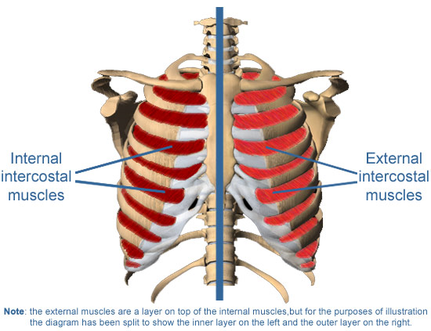
Rating Respiratory
Respiratory diseases under 38 CFR 4.97 are functional in origin where ALS is concerned
Late stage ALS will cause paralysis and atrophy of the diaphragm muscle and voluntary chest wall muscles
Will lead to respiratory arrest

Slide 17
Rating Respiratory
Respiratory arrest may be acute or chronic
Acute onsets are common in ALS and imitate Obstructive Sleep Apnea (a functional process)
The use of a Bi-pap machine indicates the onset of respiratory arrest
Patients generally forego the tracheotomy for placement of the respirator support equipment; however, recommendation of such a procedure is strongly indicative of chronic respiratory arrest

Slide 18
Rating Digestive
ALS eventually paralyzes digestive functioning
Effects seen often and early in the process
The neurons controlling the tongue and the organs of digestion are destroyed
ALS patients are often provided a feeding tube (PEG)
Intubation prevents liquid entering lungs and causing pneumonia and suffocation
Ease of ingesting vital nutrition for quality of life

Slide 19
Rating Digestive
Rate on predominant symptoms
Symptoms often associated with cranial nerves
Symptoms include
Dysphagia (trouble swallowing)
Difficulty chewing food
Oversensitive gag reflex
Atrophy of the tongue

Slide 20
Rating Psychiatric
ALS does not fundamentally impact mental functioning
Depression and anxiety are considered complications of the disease process
Cognitive dysfunction is rare
Frontotemporal dementia occurs in some cases
Incompetency due to mental functioning is rare
(more due to physical functioning)

Slide 21
Dependents Educational Assistance (DEA)
Education/training allowance to spouse and children of Veteran who:
has a SC condition that is P&T (i.e. – rated at the 100% disability evaluation or entitled to Individual Unemployability benefits), or
died of a SC condition or while the condition was evaluated as P&T
Will be established once rated with ALS

Slide 22
Specially Adapted Housing Grant
Effective December 3, 2013, 38 C.F.R. 3.809d provides that SC ALS is a qualifying condition for the purpose of entitlement to specially adapted housing.
When granting service connection for ALS, SAH becomes a subordinate issue and will be addressed per M21-1, IX.1.3.3.f.

Slide 23
Special Housing Adaptation Grant
Eligibility established with the following SC conditions:
Blindness in both eyes (20/200 corrected acuity or less in better eye (effective 10/1/2012))
Deep partial thickness burns that have resulted in contractures with limitation of motion of two or more extremities or of at least one extremity and the trunk, or
Full thickness or sub-dermal burns that have resulted in contracture(s) with limitation of motion of one or more extremities of the trunk, or
Residuals of an inhalation injury (including, but not limited to, pulmonary fibrosis, asthma, and chronic obstructive pulmonary disease), or
Loss, or loss of use of, both hands

Slide 24
Specially Adapted Housing/ Special Housing Adaptation
VA Form 26-4555 “Veteran’s Application in Acquiring Specially Adapted Housing or Special Housing Adaptation Grant”
Form used to request either benefit or both benefits.

Slide 25
Automobile and Adaptive Equipment Allowance
Effective February 25, 2015, 38 CFR 3.808 provides that SC ALS is a qualifying condition for entitlement to a certificate of eligibility for automobile or other conveyance and adaptive equipment. The amendment applies to all applications pending before VA on, or received after, February 25, 2015
When granting service connection for ALS, Automobile and Adaptive Equipment Allowance becomes a subordinate issue and will be addressed per M21-1, IX.i.2.3.b

Slide 26
Questions

