Slide 1
VACOLS
Compensation Service
February 2016

Slide 2
Objectives
Obtain information on an appeal.
Run reports regarding appeal statistics.
Identify and understand the separate screens, tabs, and menus available in VACOLS.
Certify cases using Caseflow.

Slide 3
References
VACOLS Versions 8.4.0 Release Notes
VACOLS User Guide – Introduction
VACOLS User Guide – Part 1
VACOLS User Guide – Part 2
VACOLS User Guide – Part 3
VACOLS User Guide – Part 4
VACOLS User Guide – Part 5
VACOLS User Guide – Part 6
VACOLS User Guide – Part 7

Slide 4
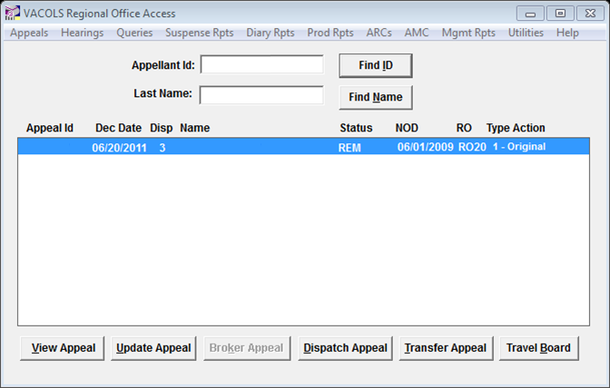
Veterans Appeals Control and Locator System
Appeals tracking system – from notice of disagreement to final disposition
NOTE: After 60 minutes of inactivity, the user will automatically be logged off.

Slide 5
Home Screen
View Appeal Button – Displays information about the appeal. Various screens are labeled in a tabbed folder format and several menus are available to process individual records.
Update Appeal Button – Updates records.
Dispatch Appeal Button – Disposes of the appeal by certification to BVA (in paper claims), allowing the benefit in the field, withdrawal of the appeal due to death of the appellant, or withdrawal of the appeal by the appellant.
Transfer Appeal Button – Permanently transfers an appeal to another RO.
Travel Board Button – Enters a Travel Board or video hearing request.

Slide 6
View Appeal Button
To view the appeal information for the selected claimant.

Slide 7
Update Appeal Button
To update any records still in your custody.
You can enter the information concerning the type of BVA hearing requested and also indicate Travel Board readiness.
If the appellant has opted for a Video hearing, and has signed a waiver for a Video hearing in lieu of a Travel Board hearing, click on the Video button.
You can also make changes to the appellant information, address, or representative, and key in evidentiary dates such as the SOC, SSOC, or Form 9.
When the Form 9 date has been entered in the database, the appeal is assigned a docket.

Slide 8
Broker Appeal Button
To broker appeals to another field station.

Slide 9
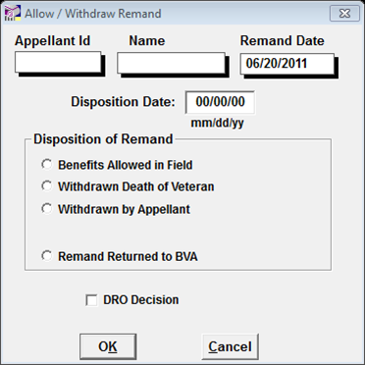
Dispatch Appeal Button
To dispose of the appeal in its entirety.
The appeal can be dispatched through four different methods.
Note: When the DRO Decision checkbox is selected, two option qualifiers are displayed
Informal Conference
Formal Hearing
Note: When Advance Allowed in Field is selected, the Grant Reasons dropdown box will appear. Select the basis of the grant of benefits.
Note: If there are any open diary actions, they will automatically be closed when dispatched.

Slide 10
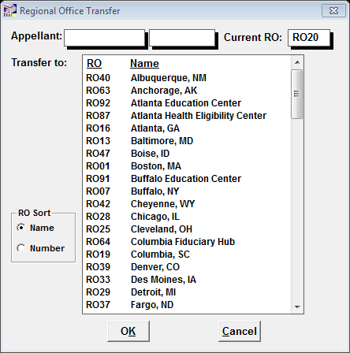
Transfer Appeal Button
To notify BVA and the receiving RO of a permanently transferred file.
Note: If an appeal is transferred while in a report screen, it appears as if all appeals in that report have been transferred.
Note: BVA’s system of numbering RO stations differs slightly from VBA’s system.

Slide 11
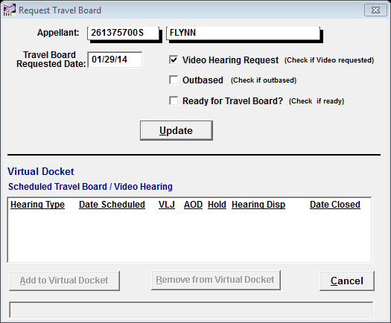
Travel Board Button
To indicate that a travel board hearing has been requested and if it’s ready.
This button is also used to indicate if a video hearing will be conducted in lieu of a travel board hearing.

Slide 12
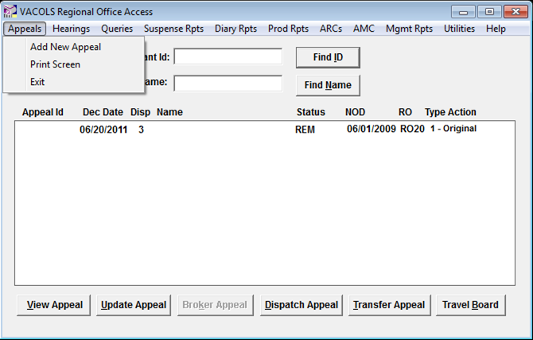
Appeals Menu
Add New Appeal: To add a new appeal to the database on receipt of a properly executed NOD.
Print Screen: Print the screen.
Exit: Exit VACOLS.

Slide 13
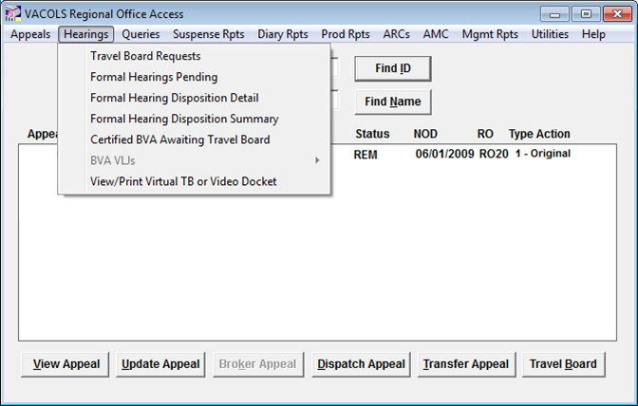
Hearings Menu
Travel Board Requests: Used to display, manage, and control outstanding Travel Board requests which have been added under Add New Appeal, or if BVA had previously entered the information. The request can be removed from the list when the hearing has been held.
Formal Hearings Pending: Used to query, display, and manage outstanding Formal DRO hearing requests, those scheduled and the number of days pending before the hearing date.
Formal Hearing Disposition Hearing Detail: Used to query, display, and manage closed Formal DRO hearing activity by disposition (Held, Canceled, Postponed, or No Show).

Slide 14
Hearings Menu
Formal Hearing Disposition Summary: Used to query, display, and summarize all formal DRO hearings activity.
Certified BVA Awaiting Travel Board: Used to query, display, and manage all certified appeals that are awaiting a Travel Board hearing.
BVA VLJs: Used to query by BVA Veterans Law Judge.
View/Print Virtual TB or Video Docket: Used to view and print Virtual TB or Video Docket.

Slide 15
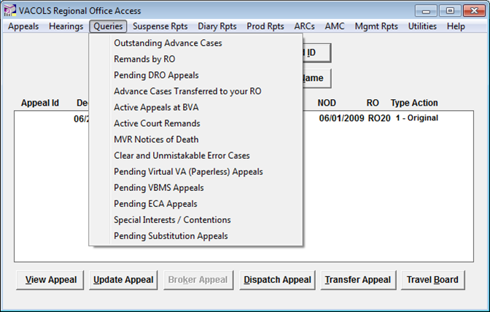
Queries Menu
Outstanding Advance Cases: Used to display all outstanding advance appeals. This will display multiple appeals if more than one NOD has been filed. This will display advance records prior to and after the docketing of the Form 9.
An incorrect entry cannot be corrected at the RO, so please be careful when entering entry update information. You must notify the Board of the error by contacting the appropriate Administrative Team.

Slide 16
Queries Menu
Remands by RO: Used to display all appeals that have been remanded to a specific RO and are still listed as unresolved on the BVA docket. This does not include cases remanded to the AMC. This will also display remands transferred to your RO from other ROs.
If a station closes a remanded record in error you can correct the error by accessing the “Utilities” menu, by the selection option “Undo BVA Certification or Remand Returned to BVA”. If a station closes a remanded issue in error, the correction must be done through the “Issues” tab by changing the disposition back to “Remand.

Slide 17
Queries Menu
Pending DRO Appeals: Used to display all appeals where a DRO hearing is elected. The list is updateable for individual or multiple appeals.
Advance Cases Transferred to your RO: Used to display cases transferred to your RO from other ROs. Transferred cases will also be displayed on the receiving station’s All Outstanding Advance Cases.
Active Appeals at BVA: Used to display active appeals received at the Board.
Active Court Remands: used to display cases remanded by the U.S. Court of Appeals for Veterans Claims (Court) to BVA and in an active status as well as those appeals remanded by the Court and, in turn, remanded to your RO for further development.

Slide 18
Queries Menu
MVR Notices of Death: used to display appeals where BVA has been notified by VA facilities of the death of veterans.
This information should be verified via a death certificate prior to closing the VACOLS record. The notification of death is not always for the appellant of record.
Clear and Unmistakable Error Cases: used to display the cases that need to be sent to BVA for the processing of a CUE claim of a prior Board Decision.
Pending Virtual VA (Paperless) Appeals: used to display the number of paperless appeals which are pending.

Slide 19
Queries Menu
Pending VBMS Appeals: used to display the number of VBMS appeals pending.
Pending ECA Appeals: used to display the number of ECA appeals pending.
Special Interests / Contentions: Used to see all advance appeals where a special interest / contention has been checked.
Pending Substitutions Appeals: used to display the number of Substitution appeals pending.

Slide 20
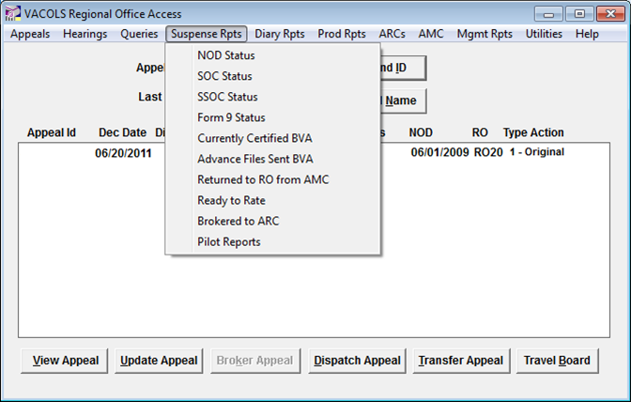
Suspense Reports Menu
NOD Status: Used to display all advance appeals in which a NOD has been received and added to the database.
SOC Status: Used to display all advance appeals for which an SOC has been dispatched.
SSOC Status: Used to display all advance appeals for which up to eight SSOCs has been dispatched.
Form 9 Status: Used to display all appeals for which a Substantive Appeal has been received, added, and docketed. For those appeals with Substantive Appeals that may have subsequent SSOCs, the report offers the option to include those appeals.
Currently Certified BVA: A query option of all appeals that have been certified for transfer to BVA, but not yet sent.

Slide 21
Suspense Reports Menu
Advance Files Sent To BVA: Used to display all original appeals that have been certified to BVA.
Returned to RO From AMC: Used to display all BVA remands to the AMC and subsequently returned to the RO or VAMC for processing of the remand.
Ready to Rate: Used to display all appeals that are ready to rate.
Brokered to the Appeal Resource Centers (ARC): Used to display all appeals brokered to the appeals resource centers.
Pilot Reports: Used to display all appeals identified under Special Interests as a Pilot Program.

Slide 22
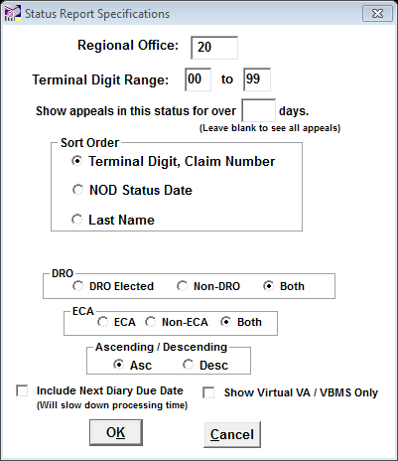
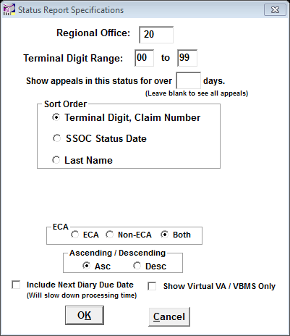
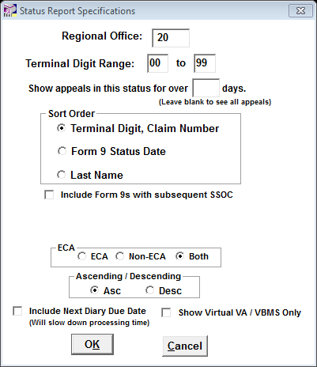
Status Report Query Details
NOD Status
SOC Status
SSOC Status
Form 9 Status

Slide 23
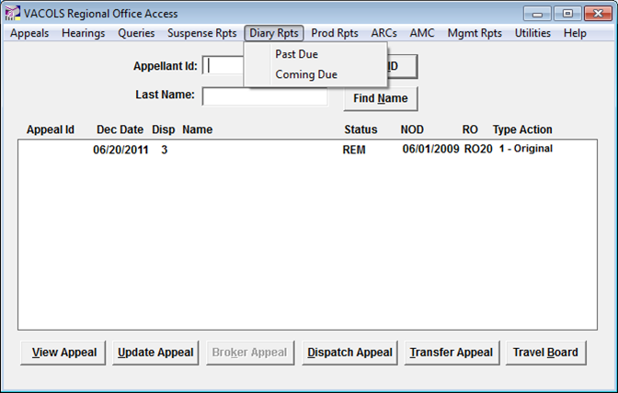
Diary Reports Menu
Past Due: Used to display all diaries in advance or remand status that are past due.
Coming Due: Used to display all diaries in advance or remand status that are coming due within a user-specified period.
Note: Diary controls entered by the AMC are excluded from all other VA field station Past Due and Coming Due reports.

Slide 24
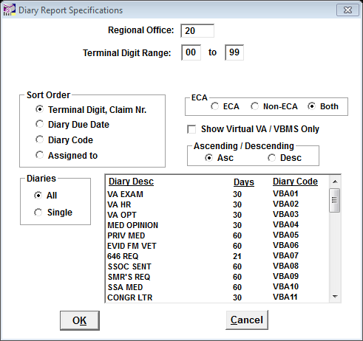
Diary Reports Menu Details
Diary Report Specifications

Slide 25
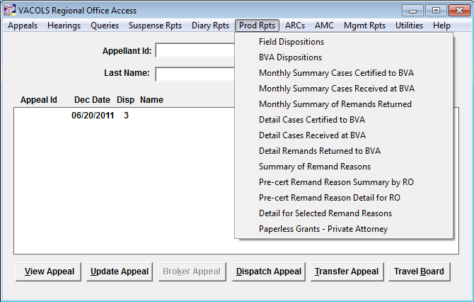
Production Reports Menu
Field Dispositions: Used to generate a report of appeals dispatched in the field during a user-specified date range.
BVA Dispositions: Used to generate a report of appeals dispatched by BVA during a user-specified date range.
Monthly Summary Cases Certified to BVA: Used to generate a report of appeals certified to BVA during a user-specified month range.
Monthly Summary Cases Received at BVA: Used to generate a report of original and post-remand appeals received at BVA during a user-specified month range.

Slide 26
Production Reports Menu
Monthly Summary of Remands Returned: Used to generate a report of remands returned to BVA during a user-specified month range. This includes appeals remanded to BVA by CAVC which BVA subsequently remands to the field.
Detail Cases Certified to BVA: Used to generate a report of type action appeals certified to BVA during a user-specified date range with appellate identifiers.
Detail Cases Received at BVA: Used to generate a report of type action appeals received at BVA during a user-specified date range with appellate identifiers.

Slide 27
Production Reports Menu
Detail Remands Returned to BVA: Used to generate a report of remands returned to BVA during a user-specified date range with appellate identifiers. This differentiates between Board remands returned to BVA by the regional office or AMC.
Summary of Remand Reasons: Used to generate a report demonstrating why issues were remanded by BVA. This further breaks down the remand reasons into those which occurred before certification to BVA and those caused by events after certification to BVA.

Slide 28
Production Reports Menu
Pre-Cert Remand Reasons Summary By RO: Used to generate a report to provide specific RO and AMC totals for pre-certified appeals. It provides overall percentages of issues and appeals that were remanded for pre-certification reasons.
Pre-Cert Remand Reasons Detailed Report: Used to generate a report of remands returned to BVA for during a user-specified date range with appellate identifiers. This includes details (claim number, name, decision date etc.) with pre-cert remand reasons. This differentiates between Board remands returned to BVA by the regional office or AMC.

Slide 29
Production Reports Menu
Detail For Selected Remand Reasons: Used to select specific Remand Reasons for a user-specified decision date range (pre- or post-certification) and receive a detailed report of appeals remanded for said reasons.
Paperless Grants – Private Attorney: Used to generate a report of BVA grants with Private Attorney representation.

Slide 30
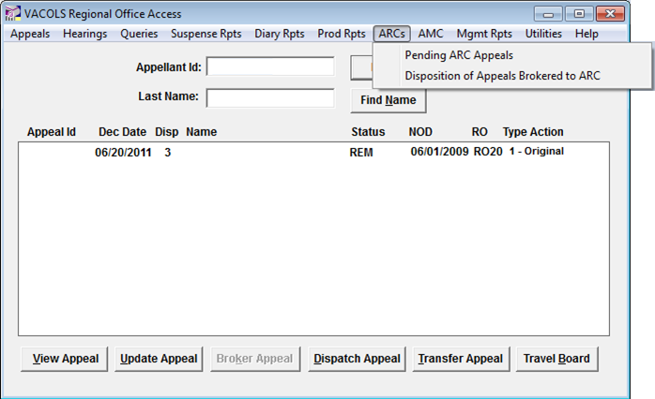
Appeals Resource Centers Menu
This menu is antiquated.

Slide 31
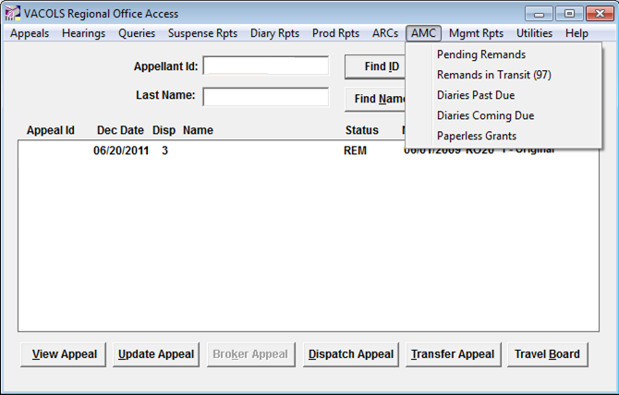
Appeals Management Center Menu
Pending Remands: Used to generate a list of BVA remands originally remanded to the Appeals Management Center, but may have been sent to another VA station.
Remands in Transit: Used to generate a list of appeals in transit, i.e., appeals remanded from BVA to the AMC but not yet received.
Diaries Past Due: Used to generate a list of VA field station (RO and AMC) as well as BVA-initiated overdue diaries.
Diaries Coming Due: Used to generate a list of VA field station-initiated diaries pending as of a user-specified date.
Paperless Grants: Used to generate a list of granted paperless appeals.

Slide 32
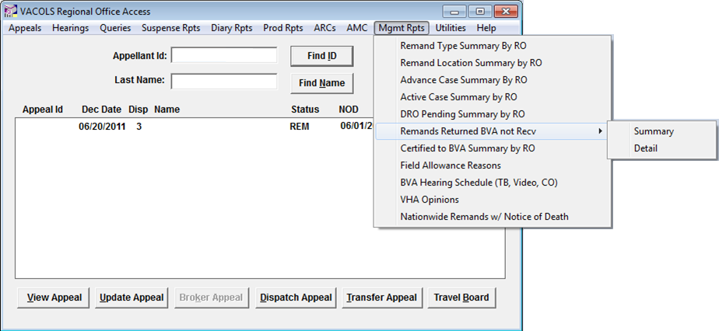
Management Reports Menu
All reports compile nationwide totals for all ROs, as well as the AMC, and will take several minutes to generate. The voluminous data being compiled can affect database performance, so please use discretion when generating these reports.

Slide 33
Management Reports Menu
Remanded Type Summary By RO: Used to generate a nationwide report total of Board remands returned resulting from a CAVC remand or inadequate development by a regional office (Regular).
Remanded Location Summary By RO: Used to generate a report total (nationwide or by field station) of the remand location. Locations are defined as the RO or AMC.
Advance Case Summary By RO: Used to generate a report total (nationwide or by field station) of advance cases on BVA’s docket in field custody.
Active Appeals at BVA: Used to generate a report total (nationwide or by field station) of active appeals transferred and in BVA custody.
DRO Pending Summary By RO: Used to generate a report total (nationwide or by field station) of pending DRO decisions and ready to rate appeals.

Slide 34
Management Reports Menu
Remands Returned BVA Not Received: Used to generate a report total (by RO and AMC) of routine BVA remands and appeals remanded to BVA by CAVC that BVA subsequently remands to the field. This report can further extrapolate remands in ROs not received by BVA by identifying summary totals and by individual file number identifiers.
The Nationwide summary report provides summary totals of Board remands by RO and those in the custody of the RO or AMC.
The RO Totals summary report provides summary totals of Board remands adjudicated by your station and those in the custody of your station or AMC.
Certified to BVA Summary By RO: Used to show appeals that an RO has certified to BVA.
The Nationwide summary report provides summary totals of Board remands by RO and those in the custody of the RO or AMC.
The RO Totals summary report provides summary totals of Board remands adjudicated by your station and those in the custody of your station or AMC.

Slide 35
Management Reports Menu
Field Allowances Reasons: Used to generate a report total (nationwide or by field station) of allowances granted in the field characterized by total issues granted, claims granted on a CUE basis, de novo basis, and based on new evidence.
The Nationwide summary report provides summary totals of Board remands by RO and those in the custody of the RO or AMC.
The RO Totals summary report provides summary totals of Board remands adjudicated by your station and those in the custody of your station or AMC.
BVA Hearing Schedule (TB, Video, CO): Used to generate a report to view BVA hearings scheduled from or at your station. Users can select Travel Board (TB) , Video, or Central Office (CO) hearings, or generate a comprehensive schedule for all hearing types for any user-specified date range.
VHA Opinions: Used to ascertain a report total for active appeals in which BVA has requested a medical opinion to VHA, regardless of agency of original jurisdiction.
Nationwide Remands with Notice of Death: Used to show appeals in Remand status where a Notice of Death has been received.

Slide 36
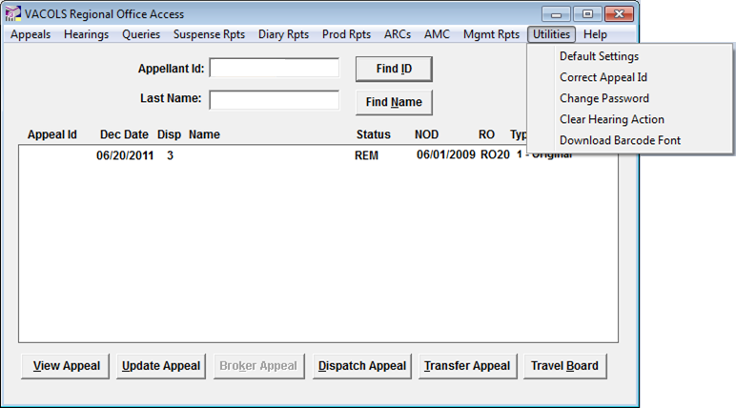
Utilities Menu
Default Settings: Used to change the default setting to a specific tab when viewing an appellate record (i.e., Docket tab, Issues tab, Diary tab, etc.) and receiving attachments.
Correct Appeal ID: Used to change or correct a file number in advance records only. When this action is completed, all appellate records for this appellant will be changed to the corrected number.
If an appeal ID for an Active, Remand, or History appeal needs corrected, the request must go to BVA.

Slide 37
Utilities Menu
Change Password: Used to change the RO’s logon password.
Clear Hearing Action: Used to clear the Type of Hearing Held on advance records only when it is incorrectly reported that a Hearing was held.
Download Barcode Font: Used to download barcode font to be used on Virtual Docket sheets.

Slide 38
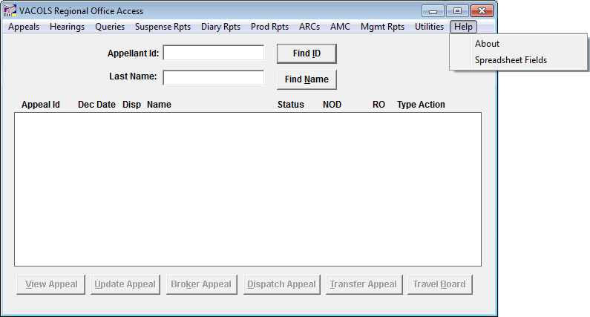
Help Menu
About: Used to view general information about VACOLS and the latest enhancements.
Spreadsheet Fields: Used to view a field description for database fields of query or report results saved as Excel spreadsheets.

Slide 39
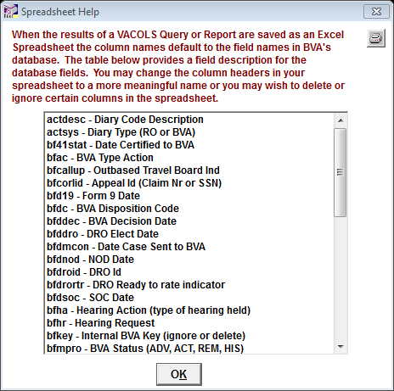
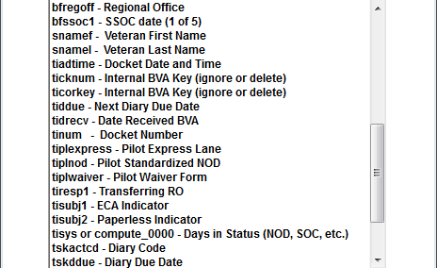
Help Menu

Slide 40
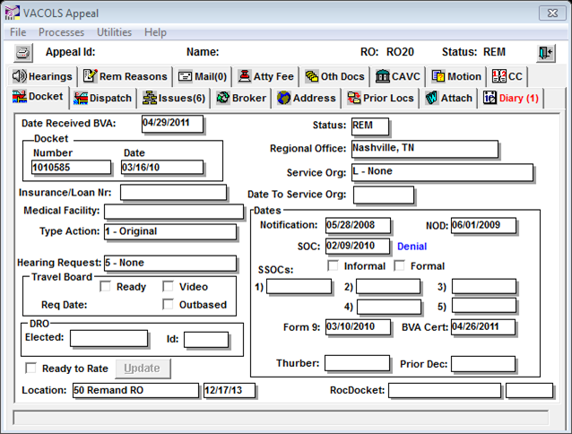
Docket Tab
Displays statistical information about the appeal.
Note: This is a read-only tab.
Note: The blue text next to the SOC field indicates the outcome of the DRO decision, if the DRO Program was selected.

Slide 41
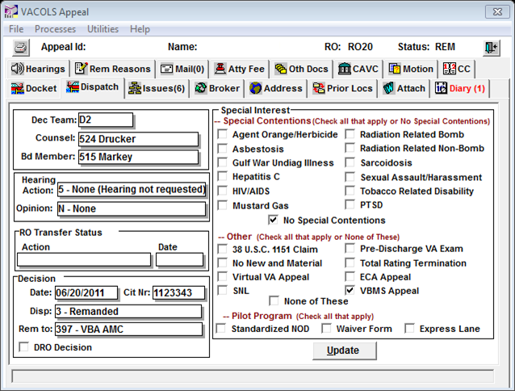
Dispatch Tab
Displays information concerning a final disposition of the appeal.
Used to input special interest issues and track special interest cases.
Note: When a record is active and in Board custody, this is a read-only tab.

Slide 42
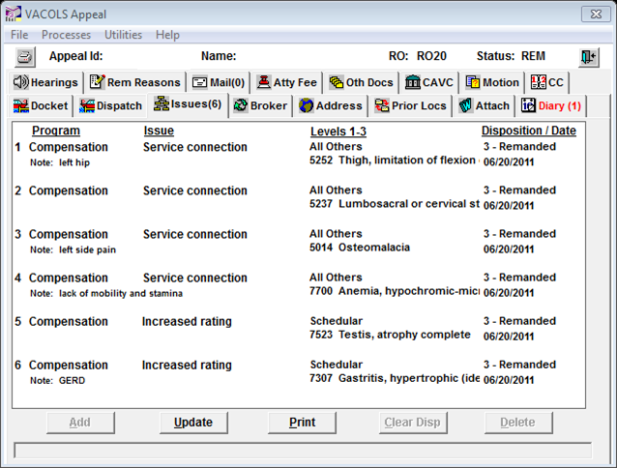
Issues Tab
Displays all issues on appeal.
Click on the Add button to add new issues for the same appeal.
Highlight an issue and click on the Clear Disp button to clear or delete the disposition of a particular issue.
Highlight an issue and click on the Update button to dispose of individual issues.
Highlight an issue and click on the Delete button to delete a particular issue.

Slide 43
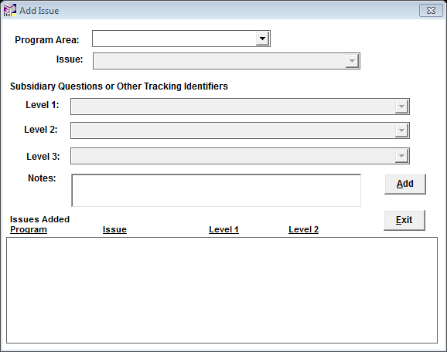
Add Issue Menu
Used to add issues to an appeal

Slide 44
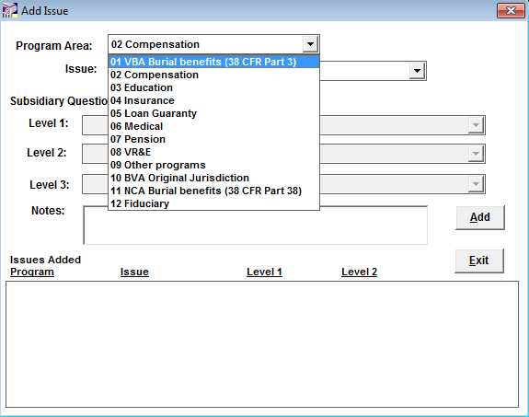
Add Issue Menu
Program Area Dropdown Menu
Compensation will be the most commonly used at the RO level.

Slide 45
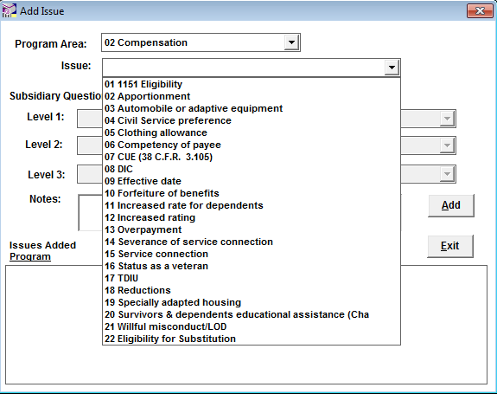
Add Issue Menu
Issue Dropdown Menu
Effective date, Increased rating, Service connection, and TDIU will be the most commonly used at the RO level.

Slide 46
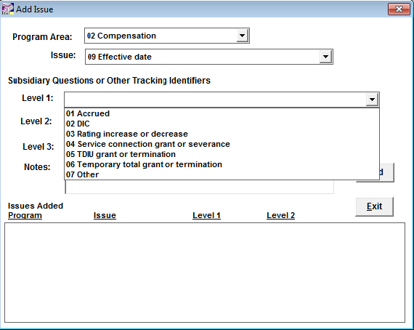
Add Issue Menu
Effective Date Level 1 Dropdown Menu

Slide 47
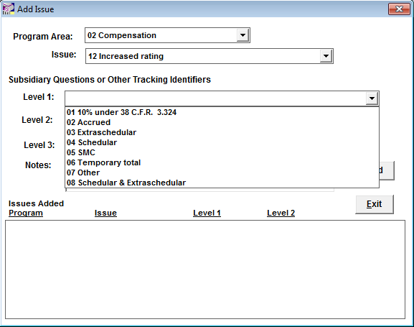
Add Issue Menu
Increased Rating Level 1 Dropdown Menu

Slide 48
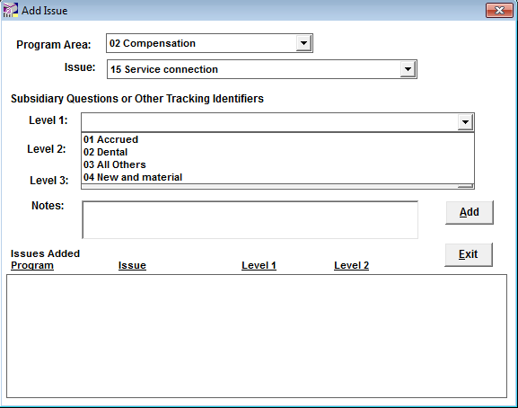
Add Issue Menu
Service Connection Level 1 Dropdown Menu

Slide 49
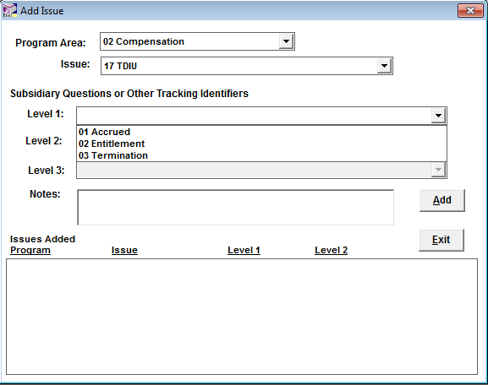
Add Issue Menu
TDIU Level 1 Dropdown Menu

Slide 50
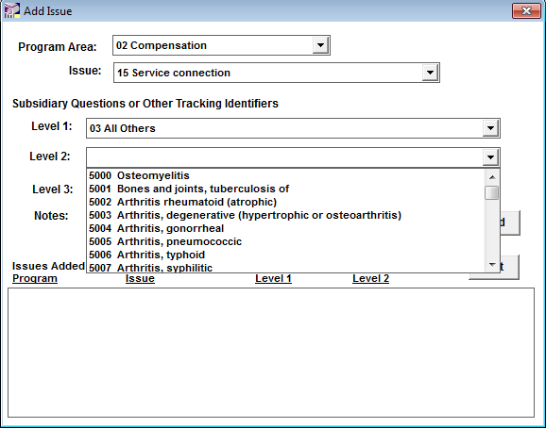
Add Issue Menu
Level 2 Dropdown Menu

Slide 51
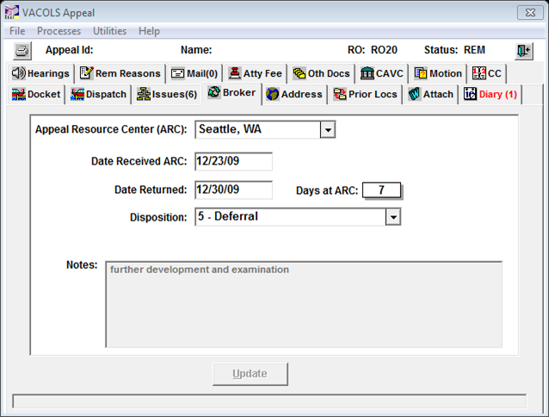
Broker Tab
Displays information on brokered appeals.

Slide 52
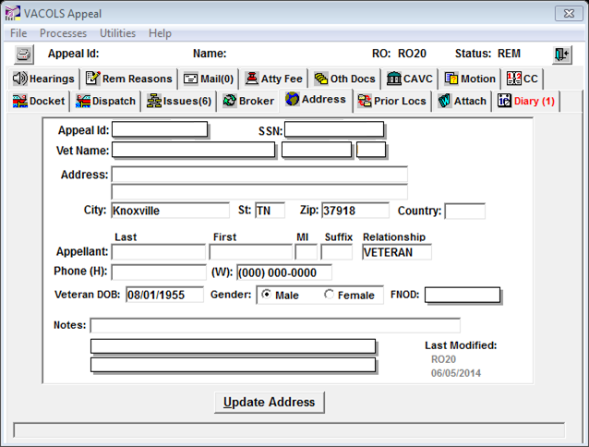
Address Tab
Displays the appellant’s address as well as other personal identifiers.
To add or modify an address, enter the appropriate information in all identifiable fields and click the Update Address button to store the information to VACOLS.
Note: The Notes field identifies previous addresses for the appellant.

Slide 53
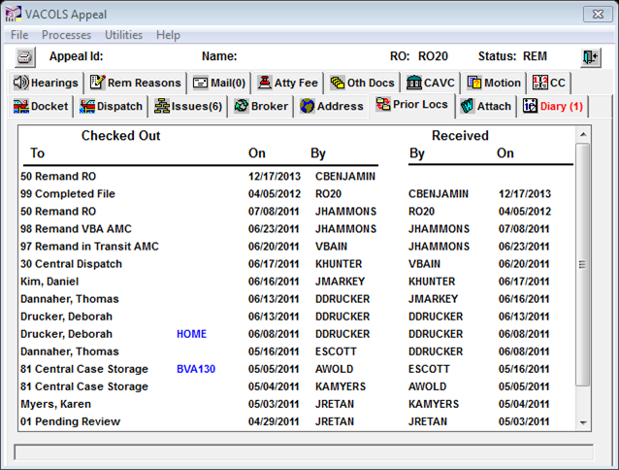
Prior Locs Tab
Displays the date the appeal was added to VACOLS.
Once the appeal is received at the Board, a chronological location history of the appeal is displayed.

Slide 54
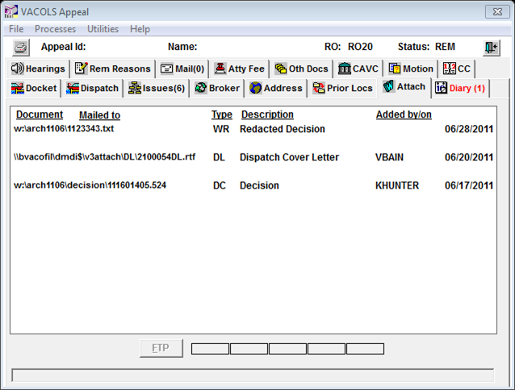
Attachments Tab
Displays all BVA document attachments to the VACOLS record.
The Board attaches a variety of documents.
The one of interest is the Decision. The Decision attachment is identical to the one in the claims folder.
To view an attachment, highlight the document and click on the FTP button.
The time bar will notify you “Please Wait, FTP in Process…”
It will take a few minutes to transfer.
Note: You must have a c:\user directory for the file transfer to take place.

Slide 55
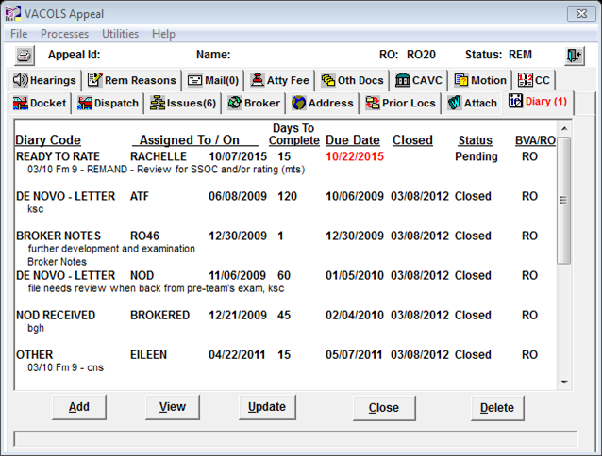
Diary Tab
Display any BVA or field-based diarized actions entered on an appeal.

Slide 56
Diary Tab
Add – Create a new diary. Enter your RO’s standard assignee practice in the Assigned to field and click on the Diary Code dropdown box to display the nature of the diary you wish to create.
Note: There are pre-determined suspense dates for all diary codes. VACOLS will automatically default to the pre-determined suspense date. This field can be over-written to another date. The Assigned by, Status, Date Assigned, and Due Date fields are system generated.
Note: The Requested Activity and Response Notes windows are optional.
Note: Field stations have the ability to create field diary actions on cases temporarily transferred to their stations to process separate appeals. Do not adjudicate appeals in ACT status charged to 92-Outside BVA, as those cases are under active appellate consideration.

Slide 57
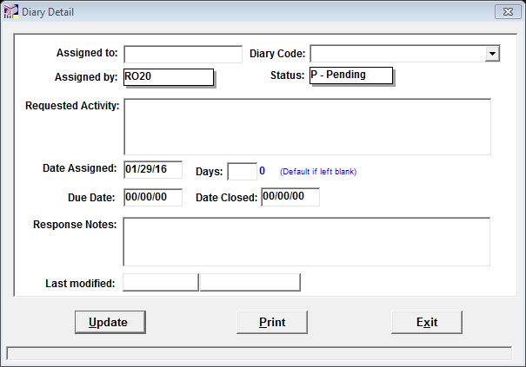
Adding a Diary

Slide 58
Diary Tab
View – View the detail window for a selected diary, regardless of who established the diary.
Update – Modify an existing diary.
To update an existing diary, highlight the diary and click the Update button; adjust as appropriate and click the Update button.
Close – Close an existing diary.
Note: When a case is certified to BVA, all open diary actions are automatically closed.
Delete – Delete a diary inadvertently entered.

Slide 59
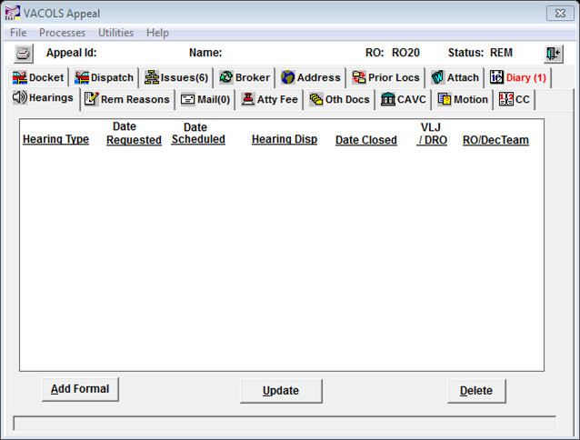
Hearings Tab
Displays information concerning field hearings and BVA hearing activity.
This is entered by the level of jurisdiction.

Slide 60
Hearings Tab
Click Add
Hearing Type is an automatic entry.
Enter the date the appellant or representative requested the hearing in Date Requested.
Enter the DRO/Hearing Officer identification in the appropriate box.
Enter the date the appellant has been scheduled for the hearing in the appropriate box.
Select the disposition of the hearing from the drop-down box.
When a disposition has been selected, the Date Closed field will appear to enter the date of the hearing to close the activity.
The Notes field is for specific information regarding the characterization of field hearing activity.

Slide 61
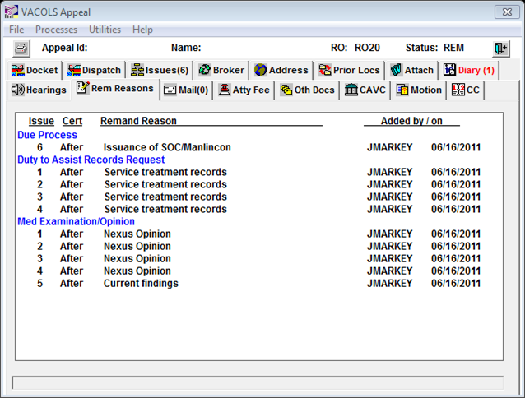
Remand Reason Tab
Displays all reasons for BVA remand

Slide 62
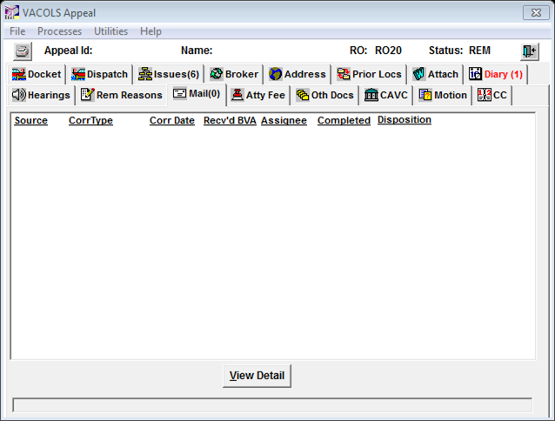
Mail Tab
Displays incoming and Congressional correspondence requiring additional BVA action.
Congressional correspondence includes Congressional telephonic inquiries received at BVA and Board-generated Congressional correspondence replies or field-based Congressional correspondence replies.
Note: Entries are read-only regardless of the status of the appeal.

Slide 63
Mail Tab
The screen will display five originating sources:
correspondence received at BVA via U.S. Postal Service,
correspondence received at BVA via fax,
Congressional telephonic inquiries,
correspondence received at BVA via interoffice referral by the RO or documentation in the claims folder requiring BVA action, and
correspondence received from the White House.
Note: This tab displays correspondence and telephonic Congressional inquiries received at BVA only. It is read-only.

Slide 64
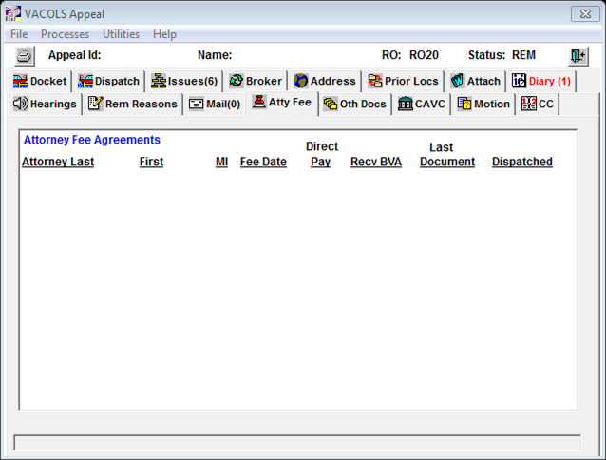
Attorney Fee Tab
Displays attorney fee agreement data entered by the Board’s Attorney Fee Office.
The Board's Attorney Fee Office received over 1,500 such queries from ROs in 2002. This approach dramatically reduces the number of e-mail queries.
Attorney Fee Coordinators can access fee agreement information via VACOLS and determine whether a fee agreement in a claims folder is the same one that BVA has, thereby eliminating the necessity of e-mail requests to the Board.
Note: Attorney fee agreement identifiers are on this tab and a scanned copy of the agreement can be viewed from the Attachments tab.

Slide 65
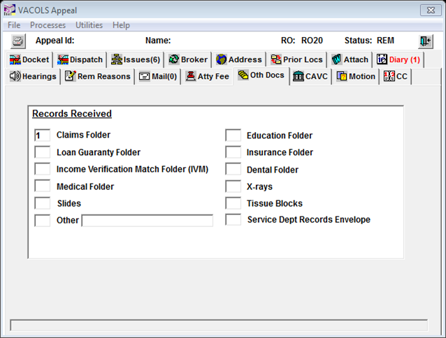
Other Docs Tab
Displays a read-only screen reflecting a records inventory of other records accompanying a claims folder while under BVA custody.

Slide 66
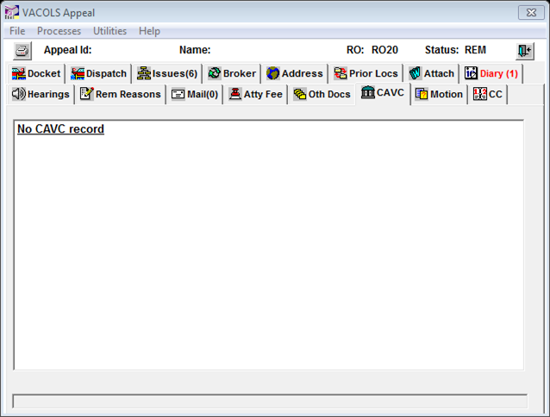
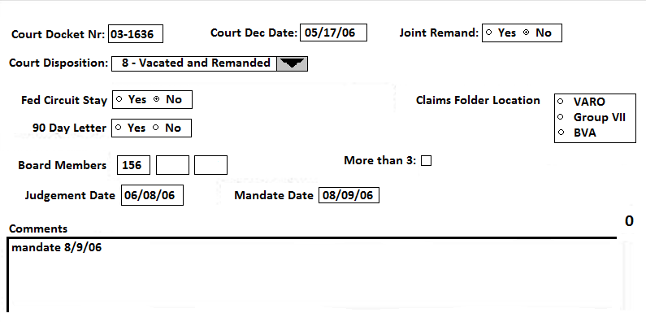
CAVC Tab
Displays information entered by BVA staff when a BVA decision has been appealed to CAVC and a decision rendered.
The CAVC decision is identified on the CAVC tab by:
Entry of dates on the CAVC tab is of record on two occasions:
remanded to BVA,
vacated due to the appellant's death, or
reversed by CAVC.
When BVA receives notice, via OGC, BVA staff will create a new record reflecting a status of CAV and a type action 7 (Court Remand).
When a case returns to BVA’s docket and custody as a type action 7, the CAV status record is converted to an Active record.

Slide 67
CAVC Tab
Court Disposition field reflects the Court’s decision.
90 day letter radio buttons reflect if a Litigation Support-initiated solicitation letter has been dispatched. If Yes, the Active Court Remand record will have the letter attached.
Federal Circuit Stay radio buttons indicate whether the Court's decision has been appealed to the Federal Circuit. If Yes, BVA cannot proceed until the appeal to the Federal Circuit terminates.
Claims Folder Location radio buttons reflect the location of the records. The records may be located at the RO, Group VII (OGC), or at BVA.
Board Members field reflects the identification number of the Board Judge who denied the appeal now appealed to the Court.
More Than 3 box reflects whether there were more than three signatory Board Judges to a Board decision.

Slide 68
CAVC Tab
Judgment Date field reflects the date the Court entered its judgment.
Judgments are issues 21 days after the Court's decision unless post-decision motions are filed.
During that 21-day period, motions for reconsideration and for hearing can be filed.
The Litigation Support staff in the Appellate Group does not dispatch a solicitation letter (the 90-day letter) until after judgment has issued.
Mandate Date field reflects the date the Court transfers jurisdiction.
The mandate date is entered 60 days after the judgment.
During that period, a discontented party can appeal to the Federal Circuit Court.
If an appeal is not taken, the mandate is entered in the field and jurisdiction is transferred to BVA.
Comments window is an open text space for the Litigation Support staff to enter such things as the type of letters dispatched.

Slide 69
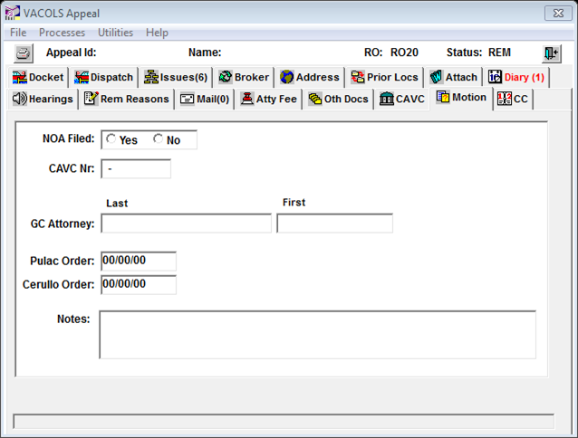
Motion Tab
A temporary status record.
For the Board to retain a fair share productivity indication.
An electronic identifier for a motion for reconsideration pursuant to 38 CFR 20.1000.

Slide 70
38 CFR 20.1000
Rule 1000. When reconsideration is accorded.
Reconsideration of an appellate decision may be accorded at any time by the Board of Veterans' Appeals on motion by the appellant or his or her representative or on the Board's own motion:
Upon allegation of obvious error of fact or law;
Upon discovery of new and material evidence in the form of relevant records or reports of the service department concerned; or
Upon allegation that an allowance of benefits by the Board has been materially influenced by false or fraudulent evidence submitted by or on behalf of the appellant.

Slide 71
Motion Tab
Upon receipt and processing of a motion for reconsideration, the Motion status record and the Motion tab are created.
If a Notice of Appeal (NOA) has not been received, the NOA radio button will indicate No.
If a NOA has been received at the OGC, the NOA radio button will indicate Yes.
CAVC Nr: This becomes of record upon receipt of the motion for reconsideration by the Litigation Support staff and is the CAVC docket number identifier for the case.

Slide 72
Motion Tab
GC Attorney: This becomes of record upon receipt of the motion and is entered by the Litigation Support staff. It identifies the name of the attorney from the OGC assigned to defend the Board’s denial.
Pulac Order: This becomes of record within several weeks of receipt of the motion and is entered by the Litigation Support staff.
Cerullo Order: Same as the Pulac Order.
Notes: This is an open text area and available to the Litigation Support staff to enter information regarding the NOA, Pulac, or Cerullo data.

Slide 73
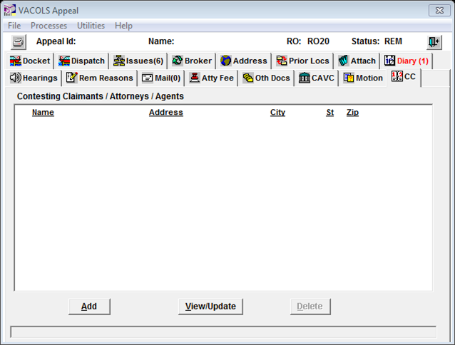
CC Tab
Displays information pertaining to Contesting Claimants and their representatives.

Slide 74
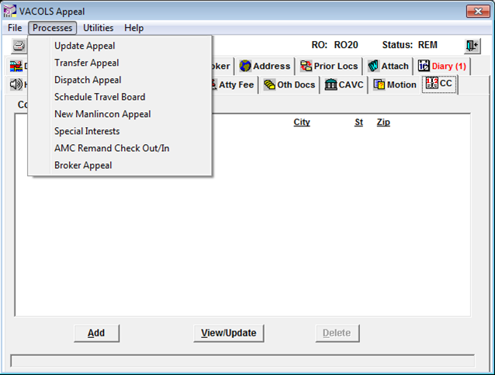
Processes Menu
Update Appeal: used to update appellate records with additional actions, addresses, telephone numbers, hearing requests, DRO elections (partial/denial of issues and informal/formal hearings), etc.
Fields on this screen can be updated with new information.
When the DRO Elect field is entered, the DRO election date cannot be greater than the SOC date; otherwise an edit prompt is displayed.
When the SOC is dispatched and the DRO program is elected, users must click on the appropriate radio button regarding a partial grant or denial with respect to the issue(s).
Once the SOC is dispatched and appropriate entries are made regarding the DRO program election, the Special Interest screen appears to capture issues of interest to VBA and BVA.
When all special interest tracking has been captured, click on Update to store the information to VACOLS.
When a Travel Board is requested users can indicate if the Travel Board hearing is to be out-based.
VBA tracks the period between certification and when it is actually sent to the Board. Users can input the date an appeal is sent to BVA. (This may or may not be the same as the date certified to BVA.) The date Sent to BVA must be equal to or greater than the BVA certification date. If the certification date is not entered, VACOLS will automatically enter the certification date as the Sent to BVA date.

Slide 75
Processes Menu
Transfer Appeal: used to electronically transfer an advance appeal from one RO to another.
Highlight the RO that the file is permanently being transferred to and click the OK button for the record to be electronically transferred to the new station.
Physical transfer of the claims folder must be initiated immediately.
Note: The custodial station must be recognized in VACOLS as the agency of jurisdiction before electronic transfer can be made.

Slide 76
Processes Menu
Dispatch Appeal: used to dispose of an advance record in its entirety regardless of the number of issues and to enter issues subject to special interest by VBA and BVA in the Special Interests field.
Click Dispatch Appeal to certify an appeal to the Board (in paper appeals), dispose of an appeal where benefits have been granted in full, or to indicate withdrawal of an appeal.
Enter the date of the action: the date of certification to BVA; the date of the Rating Action allowing the full grant; the date of death of the appellant; or, the date of notification the appellant wished to withdraw the appeal.
If a certification, withdrawal, or a full allowance of benefits, all open diaries will be closed. The user will receive the Special Interests screen to enter special interest case tracking data.
Note: When dispatching a remand record as returned to BVA, the date returned cannot be prior to the date of the remand.
VACOLS will automatically close the record, changing the status to history.

Slide 77
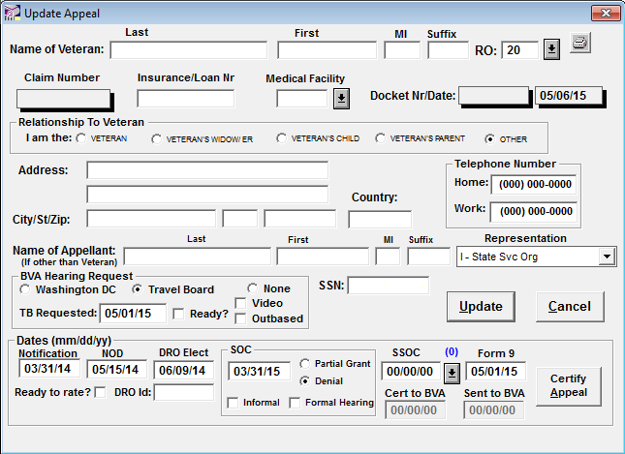
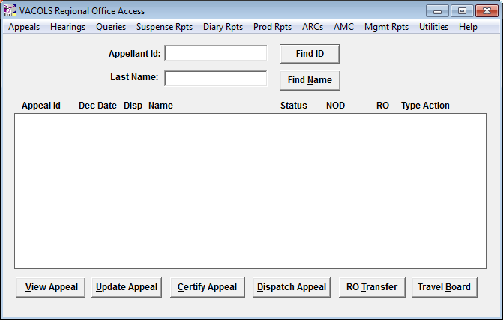
Caseflow
Caseflow is a new BVA process for certifying appeals through VBMS/VACOLS unification.
Once dates for the NOD, Form 9, SOC, and (optionally) SSOC have been entered into VACOLS, click the Certify Appeal button on the Home screen or the Update Appeal tab.
Note: Right now Caseflow only works with a new and unreleased version of VACOLS.

Slide 78
Caseflow
Select VBMS paperless e-folder from the popup window.
Click Certify.
Note: The first time you use it you'll have to log in with your VACOLS regional office Username and Password.

Slide 79
Caseflow
Once Caseflow is open, it will check to see if documents in the VBMS eFolder (such as the NOD, SOC, and Form 9) match the dates entered in VACOLS. If they do not, you will see a page similar to this, where you will be asked to fix the dates in either VACOLS or VBMS.
Once you fix the dates click the Refresh button. If you can't find the document in the eFolder, the appeal cannot be certified and you'll need to click Cancel Certification.
This case cannot be certified.

Slide 80
Caseflow
Once all the documents are detected, you'll see a page similar to this.
Fill out details for the electronic Form 8.
Once all of the forms have been completed, click Preview Completed Form 8.

Slide 81
Caseflow
On the next page, you'll be able to preview the completed Form 8. If anything looks incorrect, go back and fix it on the previous page. Otherwise, click Upload and Certify link. The Form 8 will automatically be uploaded to the eFolder and the appeal will be certified to the Board of Veterans Appeals.
You'll receive a confirmation page indicating what you've done. You can now close the browser window and open up another appeal using VACOLS.

Slide 82
Caseflow
Caseflow is a web-based tool that makes it easy to autofill electronic Form 8s and certify paperless appeals to BVA. It automatically checks to ensure documents such as the Form 9, NOD, SOC, and SSOC have been added to an appeal.
You must currently log in with both VA credentials and VACOLS credentials to ensure that the PII handled in Caseflow is secure. A fix is under development that will allow use of VA credentials only.
Caseflow only works with paperless appeals. To certify a hardcopy or Virtual VA appeal, follow the steps that have always been taken but select Hardcopy claims folder or Virtual VA then click the Certify Appeal button to manually enter a Certification Date.
Caseflow was developed by BVA and the Digital Service in collaboration with VBA.
At the top of every page in Caseflow there is a Send feedback link allowing correspondence, such as questions, feature ideas, or issues you may encounter.

Slide 83
Processes Menu
Schedule Travel Board: used to schedule a Travel Board (or video in lieu of) hearing.
Enter the date the Travel Board hearing request was received and check the appropriate boxes if the appeal is ready for a Travel Board hearing and/or if the appellate has waived the right to a Travel Board hearing in lieu of a video hearing or if the Travel Board hearing is to be held at a satellite station.

Slide 84
Processes Menu
New Manlincon Appeal: used to automatically create an original appellate record where a remanded appeal cites any issue(s) subject to Manlincon v. West.
Enter the date of the NOD for which the Manlincon issue was received.
VACOLS will revert to the Home screen indicating a new appellate record was created (carrying over the Manlincon issue) to reflect the new appeal with the intact NOD date.

Slide 85
Processes Menu
Special Interests: used to capture and track appeals that are of special interest to VA management.
Special Contentions: The focus is on contentions; the nature of the appealed issue(s), such as service-connection or increased rating, is immaterial. No Special Contentions would be checked where applicable.
Other: The purpose of two categories of boxes is that selections for this category are based on facts rather than contentions.

Slide 86
Processes Menu
AMC Remand Check Out/In: used to provide AMC users the ability to check in/out a remand record to any of the following VA field stations.
NOTE: The record will be electronically launched to another station (to now appear on another station’s reports). Transfer to the corresponding electronic location.

Slide 87
Utilities Menu
Only used on advance records with the exception of
Undo Advance or Remand Returned to BVA.
Clear Hearing Action: To clear a hearing action entered on advance appeals by field user when it was incorrectly reported that a hearing was held.
Correct Appeal ID: To correct invalid Appeal IDs for advance cases. Only BVA can correct Appeal IDs for Active, Remand, or History appeals.
Delete Appeal: To correct invalid Appeal IDs for advance cases. Only BVA can correct Appeal IDs for Active, Remand, or History appeals.
Undo BVA Certification or Remand Returned to BVA: To cancel an erroneous entry for BVA certification on an advance or post remand appeal.

Slide 88
Utilities Menu
Reactivate Appeal: To reactivate a history record for appeals closed out in the pre-Form 9 stage of development. When the appeal is reactivated, a Reactivated Appeal diary action is automatically generated.
Add Substitution: To designate an approved substitute (Widow, Child, Parent etc.) to continue the appeal in the case of the death of the original appellate. The substitution appeal will include a designation in red below the Type Action field on the Dispatch tab indicating that the appeal is proceeding with a substitute.
Clear Broker Data: To clear erroneously entered broker data.

Slide 89
Help Menu
Provides general information about VACOLS and the latest enhancements.

Slide 90
Questions

