Slide 1
Respiratory System (Post Challenge)
Compensation Service
February 2016

Slide 2
Lesson Objectives
Objectives: The RVSR will be able to:
Properly evaluate respiratory conditions
Apply PFT results to the rating schedule
Identify other considerations

Slide 3
References
38 CFR 3.300 Claims based on the effects of tobacco products
38 CFR 3.309 Disease subject to presumptive service connection
38 CFR 4.96 Special provisions regarding evaluation of respiratory conditions
38 CFR 4.97 Schedule of ratings – respiratory system
M21-1, Part III, Subpart iv, Chapter 4, Section D - Respiratory Conditions
M21-1, Part IV, Subpart ii, Chapter 2, Section K - Other Compensation Considerations

Slide 4
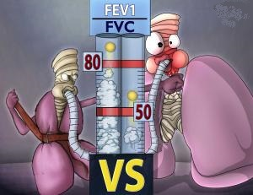
Respiratory System Basics
Restrictive
Obstructive
The two can co-exist

Slide 5
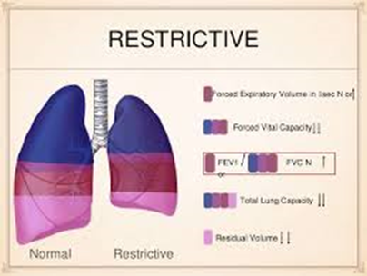
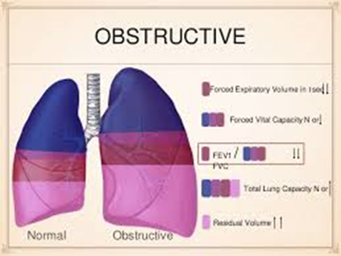
Respiratory System Basics
Restrictive disease:
Reduced expansion of lung parenchyma – decreased vital capacity
Obstructive disease:
Resistance to airflow due to obstruction

Slide 6
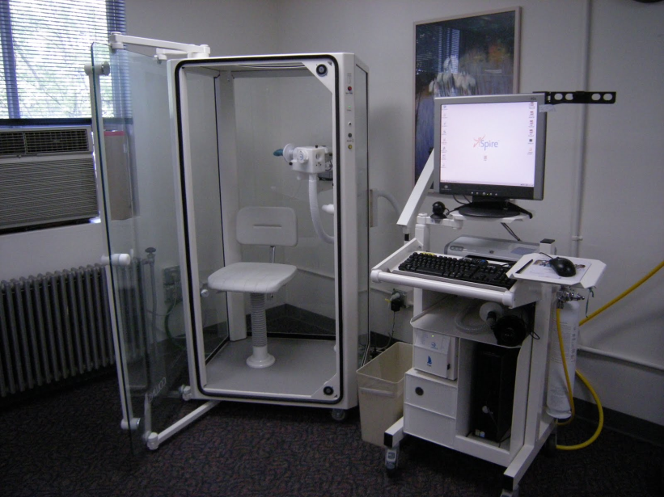
Evaluating Respiratory Conditions -- PFTs
Pulmonary Function Tests (PFTs) are required for evaluating interstitial lung diseases and all diseases of trachea and bronchi, except for Bronchiectasis.

Slide 7
Evaluating Respiratory Conditions -- PFTs
When the rating schedule criteria includes pulmonary function test (PFT) results, PFTs must be obtained except when:
the results of a maximum exercise capacity test are of record and are 20 milliliters/per kilogram of body weight per minute (ml/kg/min) or less
pulmonary hypertension has been diagnosed
cor pulmonale has been diagnosed
right ventricular hypertrophy has been diagnosed
there have been one or more episodes of acute respiratory failure, or
outpatient oxygen therapy is required.

Slide 8
Evaluating Respiratory Conditions -- PFTs
PFT values:
the basis for rating
objective measured values

Slide 9
Evaluating Respiratory Conditions -- PFTs
Common measures – PFTs
FEV-1
FVC
FEV-1/FVC
Most respiratory evaluations based on FEV-1 and/or FEV-1/FVC
Ratings based on post-bronchodilator findings

Slide 10
Evaluating Respiratory Conditions -- PFTs
PFT'S are commonly applied in evaluating respiratory conditions
Percentages may vary among the DC’s

Slide 11
Evaluating Respiratory Conditions -- PFTs
PFT'S from Non-VA facilities:
May vary from VA test results
Reconcile differences based on all the evidence of record
Request a medical opinion or additional testing where necessary
Remember 38 CFR §4.31 in assigning evaluations

Slide 12
38 CFR 4.96
38 CFR 4.96 - Special provisions regarding evaluation of respiratory conditions
Broken into 4 paragraphs
Rating coexisting respiratory conditions
Rating “protected” tuberculosis cases
Special monthly compensation
Special provisions for the application of evaluation criteria for diagnostic codes 6600, 6603, 6604, 6825-6833, and 6840-6845

Slide 13
38 CFR 4.96 (a)
Rating coexisting respiratory conditions
Separate evaluations for conditions under DC’s 6600 through 6817 and 6822 through 6847 is not allowed
Assign a single evaluation under the diagnostic code which reflects the predominant disability

Slide 14
38 CFR 4.96 (b)
Rating “protected” tuberculosis cases
Refer to this section when addressing claims in which a Veteran was receiving compensation for tuberculosis on or around August 19, 1968

Slide 15
38 CFR 4.96 (c)
Special monthly compensation
Refer to 38 CFR 3.350 for claims involving complete organic aphonia
The footnotes describe other conditions which under certain circumstances also establish entitlement to special monthly compensation

Slide 16
38 CFR 4.96 (d)
Special provisions for the application of evaluation criteria for diagnostic codes 6600, 6603, 6604, 6825-6833, and 6840-6845

Slide 17
38 CFR 4.96 (d)(1)
PFT’s are required to evaluate the above conditions, except:
When max exercise capacity is 20 ml/kg/min or less. If not of record, evaluate on alternative criteria
When pulmonary HTN, cor pulmonale, or RVH has been diagnosed
When there has been one or more episodes of acute respiratory failure
When outpatient oxygen therapy is required

Slide 18
38 CFR 4.96 (d)(2)
If DLCO (SB) is not of record, and examiner says why test would not be useful or valid, evaluate on alternative criteria.
“DLCO testing was not performed because of the asymptomatic PFT assessment, indicative of no diagnosis found on examination”.

Slide 19
38 CFR 4.96 (d)(3)
Even if PFTs are not consistent with clinical findings, use them to evaluate unless the examiner states why they would not be valid

Slide 20
38 CFR 4.96 (d)(4&5)
Normal testing procedures:
Where pre-bronchodilator values are normal…
Post-bronchodilator values are not done
Post-bronchodilator values are required in all other cases

Slide 21
38 CFR 4.96 (d)(6)
Bronchodilator may be medically contraindicated. If so, The examiner should explain why.
Use post-bronchodilator values in evaluating unless:
The post-bronchodilator values are poorer than pre-bronchodilator values (paradoxical response)
Use pre-bronchodilator values in those few cases

Slide 22
38 CFR 4.96 (d)(7)
When test results have disparity between the different tests:
The examiner should explain which test more accurately reflects the level of disability
Where FEV-1 is greater than 100%, an FEV-1/FVC that is below normal should be considered a physiologic variant rather than an abnormal value

Slide 23
Tobacco Related Claims
Effective June 9, 1998, the awarding of service connection for a disability or death that results from the Veteran’s use of tobacco products in service is prohibited.
38 CFR 3.300

Slide 24
Tobacco Related Claims
SC not prohibited under certain circumstances
Secondary SC may be established for a tobacco-related disability or death that is a result of or aggravated by a SC disability unrelated to tobacco use.

Slide 25
Alternative Rating Criteria
Many of the conditions under the respiratory system are evaluated using PFTs
However, it is not to be overlooked that many of these conditions also contain alternative rating criteria
For example, Asthma, bronchial DC 6602
Each compensable evaluation may be based on PFT results, or
the frequency and type of medication prescribed to treat bronchial asthma

Slide 26
Sleep Apnea
For rating purposes, a diagnosis of sleep apnea must be confirmed by a sleep study
Home sleep studies are only accepted if:
it has been clinically determined that the Veteran can be appropriately evaluated by a home sleep study, and
a competent medical provider has evaluated the results
Receipt of medical evidence suggesting a diagnosis of sleep apnea is sufficient to trigger an exam, but without a confirmed sleep study diagnosis, it is not sufficient to award SC

Slide 27
Sleep Apnea
Before performing additional development for an increased evaluation, first consider:
Has service connection been in effect for 10 years or more
If not, request an exam with sleep study to confirm diagnosis
If sleep study confirms diagnosis, proceed with claim for increase
If no diagnosis is found, prepare a proposal to sever SC in accordance with 38 CFR 3.105(d)

Slide 28
Review
Questions

