Slide 1
Mental Disorders (RVSR IWT)
Compensation Service
July 2016
Notes:
Welcome to Mental Disorders (RVSR IWT) course. To advance each slide, click anywhere on the screen.

Slide 2
Lesson Objectives
Upon the completion of this less and given all available references, RVSR trainees will be able to accomplish the following:
grant, deny, and/or evaluate PTSD and other mental disorders
address 38 U.S.C 1702
address competency and incompetency
Notes:
Lesson Objectives
Upon the completion of this less and given all available references, RVSR trainees will be able to accomplish the following:
grant, deny, and/or evaluate PTSD and other mental disorders
address 38 U.S.C 1702
address competency and incompetency

Slide 3
References
M21-1, Part III, Subpart iv, 4, H, Mental Disorders
M21-1, Part IV, Subpart ii, 1, D, Claims for Service Connection for Posttraumatic Stress Disorder
M21-1, Part III, Subpart iv, 3, D, Examination Reports
M21-1, Part III, Subpart iv, 8, A, Evaluating Competency
M21-1, Part III, Subpart iv, 6, C, Completing the Rating Decision Narrative
M21-1, Part IX, Subpart ii, 2, 5, Rating for Service Connection for Psychosis Under 38 U.S.C. 1702
Notes:
References
The references for this course are listed on the screen. You may click any hyperlinked references for further details.

Slide 4
Posttraumatic Stress Disorder (PTSD) Defined
A disorder in which an overwhelming traumatic event is re-experienced, causing intense fear, helplessness, horror, and avoidance of stimuli associated with the trauma.
The development of symptoms usually occurs after a psychologically traumatic event (stressor) that the person experienced, witnessed, or was confronted with that involved actual or threatened death or serious injury, or a threat to the physical integrity of themselves or others. Such as:
Combat exposure
Child sexual or physical abuse
Terrorist attack
Sexual/physical assault
Serious accident
Natural disaster
Notes:
Posttraumatic Stress Disorder (PTSD) Defined
A disorder in which an overwhelming traumatic event is re-experienced, causing intense fear, helplessness, horror, and avoidance of stimuli associated with the trauma.
The development of symptoms usually occurs after a psychologically traumatic event (stressor)
that the person experienced, witnessed, or was confronted with that involved actual or threatened death or serious injury,
or a threat to the physical integrity of themselves or others. Such as:
Combat exposure, Child sexual or physical abuse
Terrorist attack, Sexual/physical assault
Serious accident, Natural disaster

Slide 5
PTSD Eligibility Criteria
Service connection for PTSD associated with an in-service stressor requires:
Credible supporting evidence that the claimed in-service stressor actually occurred
Medical evidence diagnosing the condition
A link, established by medical evidence, between current symptomatology and the claimed in-service stressor.
Notes:
PTSD Eligibility Criteria
Service connection for PTSD associated with an in-service stressor requires:
Credible supporting evidence that the claimed in-service stressor actually occurred
Medical evidence diagnosing the condition
A link, established by medical evidence, between current symptomatology and the claimed in-service stressor.

Slide 6
Categories and Types of PTSD Claims
There are five regulatory categories with special liberalizing considerations for establishing occurrence of the claimed stressor:
Section 3.304(f)(1) In-service diagnosis of PTSD
Section 3.304(f)(2) Combat related
Section 3.304(f)(3) Fear of hostile military or terrorist activity related
Section 3.304(f)(4) Former prisoner-of-war related
Section 3.304(f)(5) Personal assault/MST related
Notes:
Categories and Types of PTSD Claims
There are five regulatory categories with special liberalizing considerations for establishing occurrence of the claimed stressor:
Section 3.3 04(f)(1) In-service diagnosis of PTSD
Section 3.3 04(f)(2) Combat related
Section 3.3 04(f)(3) Fear of hostile military or terrorist activity related
Section 3.3 04(f)(4) Former prisoner-of-war related
Section 3.3 04(f)(5) Personal assault/MST related

Slide 7
In-service diagnosis of PTSD
When PTSD is properly diagnosed in service, the Veteran’s testimony alone may establish that the claimed in-service stressor occurred, as long as the claimed stressor is
related to the Veteran’s service, and
consistent with the circumstances, conditions, or hardships of that service.
Notes:
In-service diagnosis of PTSD
When PTSD is properly diagnosed in service, the Veteran’s testimony alone may establish that the claimed in-service stressor occurred,
as long as the claimed stressor is
related to the Veteran’s service, and
consistent with the circumstances, conditions, or hardships of that service.

Slide 8
Combat Related
Engaging in combat with the enemy means personal participation in events constituting an actual fight or encounter with a military foe or hostile unit or instrumentality.
When the Veteran engaged in combat, the Veteran’s testimony alone may establish that the claimed in-service stressor occurred, as long as the claimed stressor is
related to that combat, and
consistent with the circumstances, conditions, or hardships of that service.
Notes:
Combat Related
Engaging in combat with the enemy means personal participation in events constituting an actual fight or encounter with a military foe or hostile unit or instrumentality.
When the Veteran engaged in combat, the Veteran’s testimony alone may establish that the claimed in-service stressor occurred, as long as the claimed stressor is
related to that combat, and
consistent with the circumstances, conditions, or hardships of that service.

Slide 9
Individual Decorations as Evidence of Combat Participation
Air Force Achievement Medal with “V” Device
Air Force Combat Action Medal
Air Force Commendation Medal with “V” Device
Air Force Cross
Air Medal with “V” Device
Army Commendation Medal with “V” Device
Bronze Star Medal with “V” Device
Combat Action Badge (CAB)
Combat Action Ribbon (CAR) (Note: Prior to February 1969, the Navy Achievement Medal with “V” Device was awarded.)
Combat Aircrew Insignia
Combat Infantry/Infantryman Badge (CIB)
Combat Medical Badge
Distinguished Flying Cross
Distinguished Service Cross
Fleet Marine Force (FMF) Combat Operations Insignia
Joint Service Commendation Medal with “V” Device
Medal of Honor
Navy Commendation Medal with “V” Device
Navy Cross
Purple Heart, and/or
Silver Star.
Notes:
Individual Decorations as Evidence of Combat Participation
Air Force Achievement Medal with “V” Device, Air Force Combat Action Medal
Air Force Commendation Medal with “V” Device, Air Force Cross
Air Medal with “V” Device, Army Commendation Medal with “V” Device
Bronze Star Medal with “V” Device, Combat Action Badge (CAB)
Combat Action Ribbon (CAR) (Note: Prior to February 1969, the Navy Achievement Medal with “V” Device was awarded.)
Combat Aircrew Insignia, Combat Infantry/Infantryman Badge (CIB)
Combat Medical Badge, Distinguished Flying Cross
Distinguished Service Cross, Fleet Marine Force (FMF) Combat Operations Insignia
Joint Service Commendation Medal with “V” Device
Medal of Honor, Navy Commendation Medal with “V” Device
Navy Cross, Purple Heart, and or Silver Star.

Slide 10
Fear of Hostile Military or Terrorist Activity
Fear of hostile military or terrorist activity means
the Veteran experienced, witnessed, or was confronted with an event or circumstance that involved
actual or threatened death or serious injury, or
a threat to the physical integrity of the Veteran or others, and
the Veteran’s response to the event or circumstances involved a psychological or psycho-physiological state of fear, helplessness, or horror.
Examples of exposure to hostile military or terrorist activity include presence at events involving
actual or potential improvised explosive device (IED)
vehicle-embedded explosive devices
incoming artillery, rocket, or mortar fire
small arms fire, including suspected sniper fire, or
attack upon friendly aircraft.
Notes:
Fear of Hostile Military of Terrorist Activity
Fear of hostile military or terrorist activity means
the Veteran experienced, witnessed, or was confronted with an event or circumstance that involved
actual or threatened death or serious injury, or
a threat to the physical integrity of the Veteran or others, and
the Veteran’s response to the event or circumstances involved a psychological or psycho-physiological state of fear, helplessness, or horror.

Slide 11
Establishing a Stressor Related to the Fear of Hostile Military or Terrorist Activity
The Veteran’s DD Form 214, Certificate of Release or Discharge From Active Duty, or other service records, shows service in an area of potential hostile military or terrorist activity.
The receipt of military awards such as, but not limited to,
the Vietnam Service or Campaign Medal,
Kuwait Liberation Medal,
Iraq Campaign Medal, and
Afghanistan Campaign Medal;
is generally considered evidence of service in an area of potential hostile military or terrorist activity.
Notes:
Establishing a Stressor Related to the Fear of Hostile Military or Terrorist Activity
The Veteran’s DD Form 2 14, Certificate of Release or Discharge From Active Duty, or other service records,
shows service in an area of potential hostile military or terrorist activity.
The receipt of military awards such as, but not limited to,
the Vietnam Service or Campaign Medal, Kuwait Liberation Medal,
Iraq Campaign Medal, and Afghanistan Campaign Medal
is generally considered evidence of service in an area of potential hostile military or terrorist activity.

Slide 12
Former POW
When the Veteran is a Former Prisoner of War (FPOW), the Veteran’s testimony alone may establish that the claimed in-service stressor occurred, as long as the claimed stressor is
related to that prisoner-of-war experience, and
consistent with the circumstances, conditions, or hardships of that service.
Notes:
Former POW
When the Veteran is a Former Prisoner of War (FPOW),
the Veteran’s testimony alone may establish that the claimed in-service stressor occurred, as long as the claimed stressor is
related to that prisoner-of-war experience, and
consistent with the circumstances, conditions, or hardships of that service.

Slide 13
Personal Assault/Trauma
Personal trauma, for the purpose of VA disability compensation claims based on PTSD, refers broadly to stressor events involving harm perpetrated by a person who is not considered part of an enemy force.
Examples: Assault, battery, robbery, mugging, stalking, harassment.
Military sexual trauma is a subset of personal trauma and refers to sexual harassment, sexual assault, or rape that occurs in a military setting.
Notes:
Personal Assault Trauma
Personal trauma, for the purpose of VA disability compensation claims based on PTSD,
refers broadly to stressor events involving harm perpetrated by a person who is not considered part of an enemy force.
Examples: Assault, battery, robbery, mugging, stalking, harassment.
Military sexual trauma is a subset of personal trauma and refers to sexual harassment, sexual assault, or rape that occurs in a military setting.

Slide 14
Alternative Evidence of In-Service Personal Trauma
Sources of such evidence may include
A rape crisis center or center for domestic abuse
A counseling facility or health clinic
Family members or roommates
A faculty member
Civilian police reports
Medical reports from civilian physicians or caregivers who treated the Veteran immediately following the incident or sometime later
A chaplain or clergy
Fellow service members
Personal diaries or journals
Notes:
Alternative Evidence of In-Service Personal Trauma
Sources of such evidence may include:
A rape crisis center or center for domestic abuse
A counseling facility or health clinic
Family members or roommates
A faculty member
Civilian police reports
Medical reports from civilian physicians or caregivers who treated the Veteran immediately following the incident or sometime later
A chaplain or clergy
Fellow service members , and
Personal diaries or journals

Slide 15
Secondary and Behavioral Changes (Markers)
Secondary and behavioral change evidence of trauma may include
Increased use or abuse of leave without an apparent reason
Episodes of depression, panic attacks, or anxiety without identifiable reasons
Visits to a medical or counseling clinic or dispensary without a specific diagnosis or specific ailment
Use of, or increased interest in, pregnancy tests or tests for sexually-transmitted diseases around the time of the incident
Sudden requests that the Veteran’s military occupational series or duty assignment be changed without other justification
Notes:
Secondary and Behavioral Changes (Markers)
Secondary and behavioral change evidence of trauma may include:
Increased use or abuse of leave without an apparent reason
Episodes of depression, panic attacks, or anxiety without identifiable reasons
Visits to a medical or counseling clinic or dispensary without a specific diagnosis or specific ailment
Use of, or increased interest in, pregnancy tests or tests for sexually-transmitted diseases around the time of the incident
Sudden requests that the Veteran’s military occupational series or duty assignment be changed without other justification

Slide 16
Interpretation of Secondary Evidence of Personal Trauma
Secondary or behavior change evidence needs interpretation by a clinician
Submit evidence received for a medical opinion
If the examiner offers a credible assessment that the evidence of record is consistent with the occurrence of the claimed assault, that opinion can constitute credible supporting evidence
Notes:
Interpretation of Secondary Evidence of Personal Trauma
Secondary or behavior change evidence needs interpretation by a clinician
Submit evidence received for a medical opinion
If the examiner offers a credible assessment that the evidence of record is consistent with the occurrence of the claimed assault,
that opinion can constitute credible supporting evidence

Slide 17
When In-Service Stressor Corroboration is Needed
Examples of claimed stressors that must be corroborated are
A plane crash caused by severe weather
A severe motor vehicle accident
A personal assault
Witnessing the death, injury, or threat to the physical being of another person caused by something other than hostile military or terrorist activity, and
Actual or threatened death or serious injury, or other threat to one’s physical being, caused by something other than hostile military or terrorist activity.
Notes:
When In-Service Stressor Corroboration is Needed
Examples of claimed stressors that must be corroborated are
A plane crash caused by severe weather
A severe motor vehicle accident
A personal assault
Witnessing the death, injury, or threat to the physical being of another person caused by something other than hostile military or terrorist activity, and
Actual or threatened death or serious injury, or other threat to one’s physical being, caused by something other than hostile military or terrorist activity.

Slide 18
General Information on Mental Disorders
A claim for a particular mental disorder should be read as a claim for any mental disability that may be reasonably defined by
the description of the claim
the symptoms that the claimant describes
the information and evidence that the claimant submits, and
any other information and evidence obtained.
Example: Veteran claims anxiety, and upon examination is diagnosed with posttraumatic stress disorder (PTSD).
Notes:
General Information on Mental Disorders
A claim for a particular mental disorder should be read as a claim for any mental disability that may be reasonably defined by
the description of the claim
the symptoms that the claimant describes
the information and evidence that the claimant submits, and
any other information and evidence obtained.
Example: Veteran claims anxiety, and upon examination is diagnosed with posttraumatic stress disorder (PTSD).

Slide 19
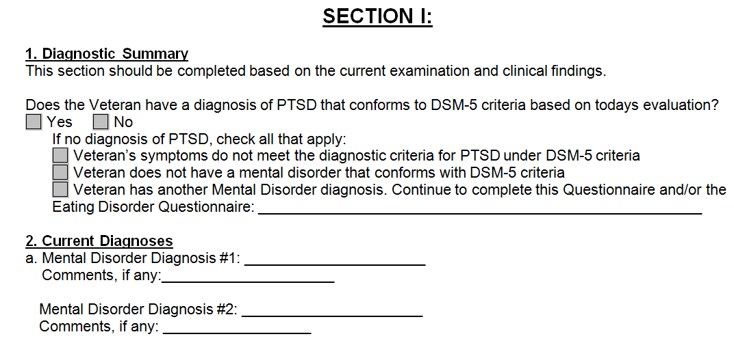
Diagnosis of Mental Disorders
Under the DSM-5, PTSD is included in the chapter Trauma- and Stressor-Related Disorders
A change in diagnosis of a psychiatric condition
A progression
A correction of an error in the prior diagnosis, or
A development of a new and separate condition
Notes:
Diagnosis of Mental Disorders
Under the DSM-5, PTSD is included in the chapter Trauma- and Stressor-Related Disorders
A change in diagnosis of a psychiatric condition
A progression
A correction of an error in the prior diagnosis, or
A development of a new and separate condition

Slide 20
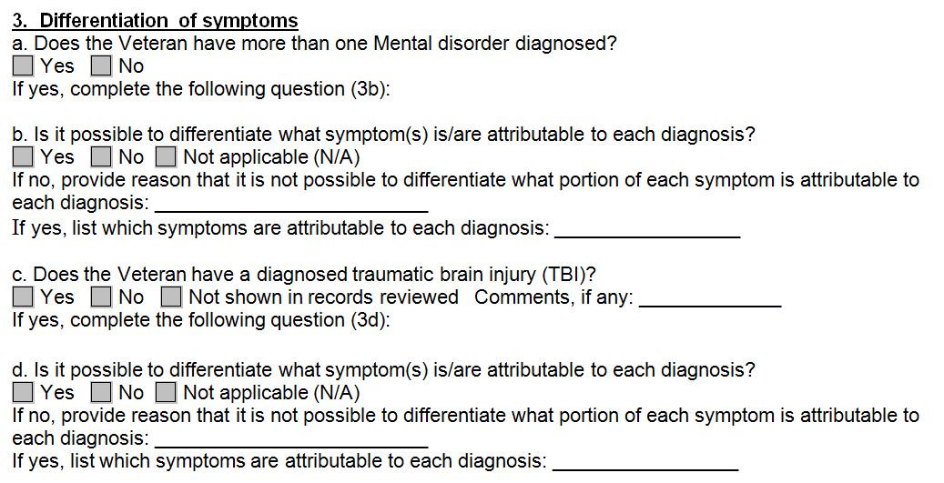
Evaluating a Disability Diagnosed as Both a Physical and Mental Disorder
Avoid assigning separate evaluations for SC disabilities based on the same manifestations as this constitutes pyramiding. To warrant separate evaluations, symptoms considered must be distinct and not overlap.
Example: PTSD and TBI may not be assigned separate evaluations based on shared symptoms such as social interaction, judgement, or orientation as this represents rating the same manifestations twice.
Notes:
Evaluating a Disability Diagnosed as Both a Physical and Mental Disorder
Avoid assigning separate evaluations for SC disabilities based on the same manifestations as this constitutes pyramiding.
To warrant separate evaluations, symptoms considered must be distinct and not overlap
Example: PTSD and TBI may not be assigned separate evaluations based on shared symptoms such as social interaction, judgement, or orientation
as this represents rating the same manifestations twice.

Slide 21
Intellectual disability (intellectual developmental disorder) and Personality Disorders
Intellectual disability (intellectual developmental disorder) and personality disorders are not diseases or injuries for compensation purposes.
Exceptions:
aggravation, or
secondary to a service-connected psychomotor epilepsy.
Notes:
Intellectual disability (intellectual developmental disorder) and Personality Disorders
Intellectual disability (intellectual developmental disorder) and personality disorders are not diseases or injuries for compensation purposes.
Exceptions:
aggravation, or
secondary to a service-connected psychomotor epilepsy.

Slide 22
Mental Disorders Due to Traumatic Stress
When a mental disorder that develops in service as a result of a highly stressful event is severe enough to bring about the Veteran's release from active military service, the evaluation cannot be less than 50 percent.
Schedule an examination within the six month period following the Veteran's discharge to determine whether a change in evaluation is warranted.
Notes:
Mental Disorders Due to Traumatic Stress
When a mental disorder that develops in service as a result of a highly stressful event is severe enough to bring about the Veteran's release from active military service, the evaluation cannot be less than 50 percent.
Schedule an examination within the six month period following the Veteran's discharge to determine whether a change in evaluation is warranted.

Slide 23
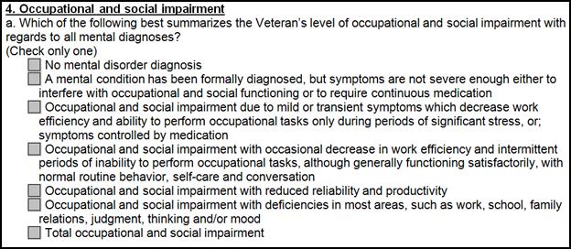
100%- Total Occupational and Social Impairment
Due to such symptoms as:
DBQ
gross impairment in thought processes or communication;
persistent delusions or hallucinations;
grossly inappropriate behavior;
persistent danger of hurting self or others;
intermittent inability to perform activities of daily living (including maintenance of minimal personal hygiene);
disorientation to time or place;
memory loss for names of close relatives, own occupation, or own name.
Evaluation Builder
Notes:
100% - Total Occupational and Social Impairment
Due to such symptoms as:
gross impairment in thought processes or communication;
persistent delusions or hallucinations;
grossly inappropriate behavior;
persistent danger of hurting self or others;
intermittent inability to perform activities of daily living (including maintenance of minimal personal hygiene);
disorientation to time or place;
memory loss for names of close relatives, own occupation, or own name.

Slide 24
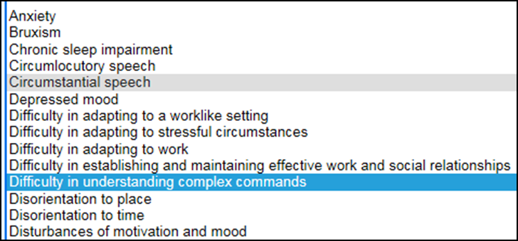
70%- Deficiencies in Most Areas, Such as Work, School, Family Relations, Judgment, Thinking, or Mood
Due to such symptoms as:
DBQ
suicidal ideation;
obsessional rituals which interfere with routine activities;
speech intermittently illogical, obscure, or irrelevant;
near-continuous panic or depression affecting the ability to function independently, appropriately and effectively;
impaired impulse control (such as unprovoked irritability with periods of violence);
spatial disorientation;
neglect of personal appearance and hygiene;
difficulty in adapting to stressful circumstances (including work or a worklike setting);
inability to establish and maintain effective relationships.
Evaluation Builder
Notes:
70% - Deficiencies in Most Areas, Such as Work, School, Family Relations, Judgement, Thinking, or Mood
Due to such symptoms as:
suicidal ideation;
obsessional rituals which interfere with routine activities;
speech intermittently illogical, obscure, or irrelevant;
near-continuous panic or depression affecting the ability to function independently, appropriately and effectively;
impaired impulse control (such as unprovoked irritability with periods of violence);
spatial disorientation;
neglect of personal appearance and hygiene;
difficulty in adapting to stressful circumstances (including work or a worklike setting);
inability to establish and maintain effective relationships.

Slide 25
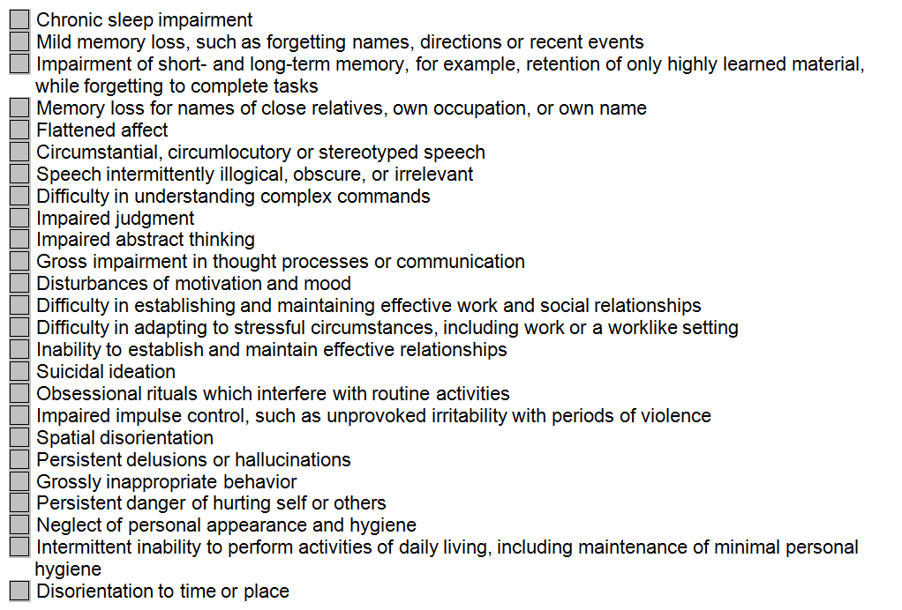
50%- Reduced Reliability and Productivity
Due to such symptoms as:
flattened affect;
circumstantial, circumlocutory, or stereotyped speech;
panic attacks more than once a week;
difficulty in understanding complex commands;
impairment of short- and long-term memory (e.g., retention of only highly learned material, forgetting to complete tasks);
impaired judgment;
impaired abstract thinking;
disturbances of motivation and mood;
difficulty in establishing and maintaining effective work and social relationships.
DBQ
Notes:
50% - Reduced Reliability and Productivity
Due to such symptoms as:
flattened affect;
circumstantial, circumlocutory, or stereotyped speech;
panic attacks more than once a week;
difficulty in understanding complex commands;
impairment of short- and long-term memory (e.g., retention of only highly learned material, forgetting to complete tasks);
impaired judgment;
impaired abstract thinking;
disturbances of motivation and mood;
difficulty in establishing and maintaining effective work and social relationships.

Slide 26
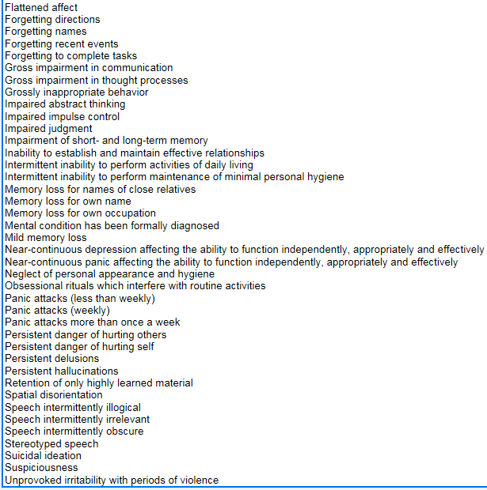
30%- Occasional Decrease in Work Efficiency and Intermittent Periods of Inability to Perform Occupational Tasks
Evaluation Builder
(although generally functioning satisfactorily, with routine behavior, self-care, and conversation normal)
Due to such symptoms as:
depressed mood,
anxiety,
suspiciousness,
panic attacks (weekly or less often),
chronic sleep impairment,
mild memory loss (such as forgetting names, directions, recent events).
Notes:
30% - Occasional Decrease in Work Efficiency and Intermittent Periods of Inability to Preform Occupational Tasks
(although generally functioning satisfactorily, with routine behavior, self-care, and conversation normal)
Due to such symptoms as:
depressed mood,
anxiety,
suspiciousness,
panic attacks (weekly or less often),
chronic sleep impairment,
mild memory loss (such as forgetting names, directions, recent events).

Slide 27
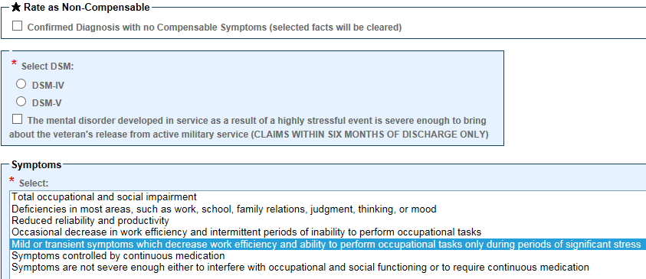
10% and 0%
Occupational and social impairment due to mild or transient symptoms which decrease work efficiency and ability to perform occupational tasks only during periods of significant stress, or symptoms controlled by continuous medication. | 10
A mental condition has been formally diagnosed, but symptoms are not severe enough either to interfere with occupational and social functioning or to require continuous medication. | 0
Evaluation Builder
Notes:
10% and 0%
Occupational and social impairment due to mild or transient symptoms which decrease work efficiency
and ability to perform occupational tasks only during periods of significant stress,
or symptoms controlled by continuous medication.
10
A mental condition has been formally diagnosed, but symptoms are not severe enough
either to interfere with occupational and social functioning or to require continuous medication.
0

Slide 28
Anorexia & Bulimia
Rating Formula for Eating Disorders
Self-induced weight loss to less than 80 percent of expected minimum weight, with incapacitating episodes of at least six weeks total duration per year, and requiring hospitalization more than twice a year for parenteral nutrition or tube feeding. | 100
Self-induced weight loss to less than 85 percent of expected minimum weight with incapacitating episodes of six or more weeks total duration per year. | 60
Self-induced weight loss to less than 85 percent of expected minimum weight with incapacitating episodes of more than two but less than six weeks total duration per year. | 30
Binge eating followed by self-induced vomiting or other measures to prevent weight gain, or resistance to weight gain even when below expected minimum weight, with diagnosis of an eating disorder and incapacitating episodes of up to two weeks total duration per year. | 10
Binge eating followed by self-induced vomiting or other measures to prevent weight gain, or resistance to weight gain even when below expected minimum weight, with diagnosis of an eating disorder but without incapacitating episodes. | 0
Notes:
Anorexia and Bulimia
Rating Formula for Eating Disorders
Self-induced weight loss to less than 80 percent of expected minimum weight, with incapacitating episodes of at least six weeks total duration per year,
and requiring hospitalization more than twice a year for parenteral nutrition or tube feeding.
Self-induced weight loss to less than 85 percent of expected minimum weight with incapacitating episodes of six or more weeks total duration per year.
Self-induced weight loss to less than 85 percent of expected minimum weight with incapacitating episodes of more than two but less than six weeks total duration per year.
Binge eating followed by self-induced vomiting or other measures to prevent weight gain,
or resistance to weight gain even when below expected minimum weight,
with diagnosis of an eating disorder and incapacitating episodes of up to two weeks total duration per year.
Binge eating followed by self-induced vomiting or other measures to prevent weight gain,
or resistance to weight gain even when below expected minimum weight,
with diagnosis of an eating disorder but without incapacitating episodes.

Slide 29
Convalescence Ratings Following Extended Hospitalization
If a mental disorder has been assigned a total evaluation due to a continuous period of hospitalization lasting six months or more, continue the total evaluation and schedule a mandatory examination six months after the Veteran is discharged or released to nonbed care.
A change in evaluation based on that or any subsequent examination shall be subject to the provisions of §3.105(e) of this chapter.
Notes:
Convalescence Ratings Following Extended Hospitalization
If a mental disorder has been assigned a total evaluation due to a continuous period of hospitalization lasting six months or more,
continue the total evaluation and schedule a mandatory examination six months after the Veteran is discharged or released to nonbed care.
A change in evaluation based on that or any subsequent examination shall be subject to the provisions of §3.105(e) of this chapter.

Slide 30
Evidence of Improvement
Do not make drastic reductions in evaluations in ratings for psychiatric disorders if a reduction to an intermediate rate is more in agreement with the degree of disability
Observe the general policy of gradually reducing the evaluation to afford the Veteran all possible opportunities for adjustment.
Notes:
Evidence of Improvement
Do not make drastic reductions in evaluations in ratings for psychiatric disorders
if a reduction to an intermediate rate is more in agreement with the degree of disability
Observe the general policy of gradually reducing the evaluation to afford the Veteran all possible opportunities for adjustment.

Slide 31
Psychosis
For the purpose of presumptive service connection, a psychosis is any of the following disorders:
Brief Psychotic Disorder,
Delusional Disorder,
Psychotic Disorder Due to Another Medical Condition,
Other Specified Schizophrenia Spectrum and Other Psychotic Disorder,
Schizoaffective Disorder,
Schizophrenia,
Schizophreniform Disorder, and
Substance/Medication-Induced Psychotic Disorder.
Notes:
Psychosis
For the purpose of presumptive service connection, a psychosis is any of the following disorders:
Brief Psychotic Disorder,
Delusional Disorder,
Psychotic Disorder Due to Another Medical Condition,
Other Specified Schizophrenia Spectrum and Other Psychotic Disorder,
Schizoaffective Disorder,
Schizophrenia,
Schizophreniform Disorder, and
Substance/Medication-Induced Psychotic Disorder.

Slide 32
38 U.S.C. 1702
38 U.S.C. 1702 provides that SC is presumed for VA treatment purposes for
Psychoses based on wartime service, or
Any mental condition based on Gulf War service
developed within
two years after the date of separation (under other than dishonorable conditions) from such service, and
two years after the end of the war period
Notes:
38 U.S.C. 17 02
38 U.S.C. 17 02 provides that SC is presumed for VA treatment purposes for
Psychoses based on wartime service, or
Any mental condition based on Gulf War service
developed within
two years after the date of separation (under other than dishonorable conditions) from such service, and
two years after the end of the war period

Slide 33
Competency
A mentally incompetent person is one who, because of injury or disease, lacks the mental capacity to manage his or her own affairs, including disbursement of funds without limitation.
In the absence of clear and convincing evidence to the contrary, presume that a person is competent.
The evidence must leave no doubt as to the beneficiary’s incompetency.
Notes:
Competency
A mentally incompetent person is one who, because of injury or disease,
lacks the mental capacity to manage his or her own affairs, including disbursement of funds without limitation.
In the absence of clear and convincing evidence to the contrary, presume that a person is competent.
The evidence must leave no doubt as to the beneficiary’s incompetency.

Slide 34
Mental Condition is Evaluated as Totally Disabling
Competency must be addressed in cases where a mental condition is evaluated as totally disabling. This includes
a schedular 100 percent evaluation,
when individual employability (IU) is awarded on the basis of a single mental health disability, and
when assigning a temporary total evaluation for a mental disorder under 38 CFR 4.29.
ADL Glossary: VA_COMPETENT
Notes:
Mental Condition is Evaluated as Totally Disabling
Competency must be addressed in cases where a mental condition is evaluated as totally disabling. This includes
a schedular 100 percent evaluation,
when individual employability (IU) is awarded on the basis of a single mental health disability, and
when assigning a temporary total evaluation for a mental disorder under 38 CFR 4.29.
ADL Glossary: VA_COMPETENT

Slide 35
Rating Actions
Rating agencies have sole authority to make official determinations of competency and incompetency for purposes of disbursement of benefits.
If ... | Then ...
an initial competency determination is needed, and no court decree of incompetency or court appointment of a fiduciary by reason of incompetency has been received | the rating activity at the original station of origination (SOO) has sole authority to make the original competency determination.
an initial competency determination is needed, and either a court decree of incompetency or court appointment of a fiduciary by reason of incompetency has been received | a proposal of incompetency/due process is not required per 38 CFR 3.353(e). The SOO completes a final competency determination for a Veteran. The case is then referred directly to the fiduciary hub for appointment of a fiduciary.
Notes:
Rating Actions
Rating agencies have sole authority to make official determinations of competency and incompetency for purposes of disbursement of benefits.
If an initial competency determination is needed, and
no court appointment of a fiduciary by reason of incompetency has been received
Then the rating activity at the original station of origination (S O O) has sole authority to make the original competency determination.
If an initial competency determination is needed, and
either a court decree of incompetency or court appointment of a fiduciary by reason of incompetency has been received
Then a proposal of incompetency due process is not required per 38 CFR 3.3 53 (e).
The S O O completes a final competency determination for a Veteran. The case is then referred directly to the fiduciary hub for appointment of a fiduciary.

Slide 36
Additional Considerations
Substance abuse as a primary disability is not a basis for granting entitlement to or increasing compensation or Veterans Pension under the laws administered by the Department of Veterans Affairs (VA).
Establish service connection on a secondary basis for any diseases or disabilities resulting from alcohol abuse, if alcoholism is determined to be secondary to a service connected disability.
Always consider entitlement to SMCs and CH35.
Notes:
Additional Considerations
Substance abuse as a primary disability is not a basis for granting entitlement to or increasing compensation or Veterans Pension
under the laws administered by the Department of Veterans Affairs (VA).
Establish service connection on a secondary basis for any diseases or disabilities resulting from alcohol abuse,
if alcoholism is determined to be secondary to a service connected disability.
Always consider entitlement to SMCs and CH35.

Slide 37
Questions

