Slide 1
The Genitourinary System
(RVSR IWT)
Compensation Service
February 2016
Notes:
Welcome to The Genitourinary System (RVSR IWT) course. To advance each slide, click anywhere on the screen.

Slide 2
Lesson Objective
Given the available references, evaluate conditions of the genitourinary system with 98% accuracy.
Notes:
Lesson Objective
Given the available references, evaluate conditions of the genitourinary system with 98% accuracy.

Slide 3
References
38 CFR 3.309, Disease subject to presumptive service connection
38 CFR 3.383, Special consideration for paired organs and extremities
38 CFR 4.115, Nephritis
38 CFR 4.115(a), Ratings of the genitourinary system-dysfunctions
Notes:
References
The references for this course are listed on the screen. You may click any hyperlinked references for further details.

Slide 4
References
38 CFR 4.115(b), Ratings of the genitourinary system-diagnoses
M21-1, Part III, Subpart iv, 4.I, Genitourinary Conditions
M21-1, Part III, Subpart iv, 4.F, Consideration of Hypertension as Secondary to Diabetes Mellitus
M21-1, Part IV, Subpart ii, 2.J, Cancer Evaluations and Staged Ratings

Slide 5
Genitourinary Described
The genitourinary system is divided into the urinary and reproductive (genito) functions.
The urinary system's primary function is to help keep the internal environment of the body relatively the same by controlling the composition and volume of blood and body fluids.
The male reproductive system consists of organs that are part of the male reproductive process.
Notes:
Genitourinary Described
The genitourinary system is divided into the urinary and reproductive (genito) functions.
The urinary system's primary function is to help keep the internal environment of the body relatively the same by controlling the composition and volume of blood and body fluids.
The male reproductive system consists of organs that are part of the male reproductive process.

Slide 6
Nephritis
Nephritis (38 CFR 4.115)
Separate ratings are not to be assigned for disability from disease of the heart and any form of nephritis
Except when absence of kidney is the sole disability, or where regular dialysis is required
Nephritis provisions in the rating schedule do not apply to nephropathy.
Heart disease may be separately evaluated from nephropathy.
Notes:
Nephritis
Nephritis (38 CFR 4.115)
Separate s are not to be assigned for disability from disease of the heart and any form of nephritis
Except when absence of kidney is the sole disability, or where regular dialysis is required
Nephritis provisions in the schedule do not apply to nephropathy.
Heart disease may be separately evaluated from nephropathy.

Slide 7
Ratings of the Genitourinary System
Diseases of the genitourinary system generally result in disabilities related to renal or voiding dysfunctions, infections, or a combination of these.
        Renal dysfunction
        Voiding dysfunction
        Urinary frequency
        Obstructed voiding
        Urinary tract infection
Notes:
s of the Genitourinary System
Diseases of the genitourinary system generally result in disabilities related to renal or voiding dysfunctions, infections, or a combination of these.
Renal dysfunction
Voiding dysfunction
Urinary frequency
Obstructed voiding
Urinary tract infection

Slide 8
Renal Dysfunction
Notes:
Renal Dysfunction
Requiring regular dialysis, or precluding more than sedentary activity from one of the following: persistent edema and albuminuria; or, BUN more than 80mg%; or, creatinine more than 8mg%; or, markedly decreased function of kidney or other organ systems, especially cardiovascular, 100
Persistent edema and albuminuria with BUN 40 to 80mg%; or, creatinine 4 to 8mg%; or, generalized poor health characterized by lethargy, weakness, anorexia, weight loss, or limitation of exertion, 80
Constant albuminuria with some edema; or, definite decrease in kidney function; or, hypertension at least 40 percent disabling under diagnostic code 7101, 60
Albumin constant or recurring with hyaline and granular casts or red blood cells; or, transient or slight edema or hypertension at least 10 percent disabling under diagnostic code 7101, 30
Albumin and casts with history of acute nephritis; or, hypertension non-compensable under diagnostic code 7101, 0

Slide 9
Voiding Dysfunction
Notes:
Voiding Dysfunction
Rate particular condition as urine leakage, frequency, or obstructed voiding.
Continual Urine Leakage, Post Surgical Urinary Diversion, Urinary Incontinence, or Stress Incontinence:
Requiring the use of an appliance or the wearing of absorbent materials which must be changed more than 4 times per day
60
Requiring the wearing of absorbent materials which must be changed 2 to 4 times per day
40
Requiring the wearing of absorbent materials which must be changed less than 2 times per day
20

Slide 10
Urinary Frequency
Notes:
Urinary Frequency
Daytime voiding interval less than one hour, or; awakening to void five or more times per night, 40
Daytime voiding interval between one and two hours, or; awakening to void three to four times per night, 20
Daytime voiding interval between two and three hours, or; awakening to void two times per night, 10

Slide 11
Obstructed Voiding
Notes:
Obstructed Voiding
Urinary retention requiring intermittent or continuous catheterization, 30
Marked obstructive symptomatology (hesitancy, slow or weak stream, decreased force of stream) with any one or combination of the following:
Post void residuals greater than 150cc
Uroflowmetry; markedly diminished peak flow rate (less than 10 cc/sec)
Recurrent urinary tract infections secondary to obstruction
Stricture disease requiring periodic dilatation every 2 to 3 months, 10
Obstructive symptomatology with or without structure disease requiring dilatation 1 to 2 times per year, 0

Slide 12
Urinary Tract Infection
Notes:
Urinary Tract Infection
Poor renal function: Rate as renal dysfunction
Recurrent symptomatic infection requiring drainage/frequent hospitalization (greater than two times/year), and /or requiring continuous intensive management, 30
Long-term drug therapy, 1-2 hospitalizations per year and/or requiring intermittent intensive management, 10

Slide 13
Rating Schedule
Review the following disabilities in the Rating Schedule:
Kidney Stones
Erectile Dysfunction and Impotency
Prostate Cancer
Renal Involvement in Diabetes
Neurogenic Bladder
Notes:
Schedule
Review the following disabilities in the Schedule:
Kidney Stones
Erectile Dysfunction and Impotency
Prostate Cancer
Renal Involvement in Diabetes
Neurogenic Bladder

Slide 14
Nephrolithiasis (kidney stones) DC 7508
Notes:
Nephrolithiasis (kidney stones) DC 7508
7508 Nephrolithiasis:
Rate as hydronephrosis, except for recurrent stone formation requiring one or more of the following:
diet therapy
drug therapy
invasive or non-invasive procedures more than two times/year, 30
7509 Hydronephrosis:
Severe; Rate as renal dysfunction.
Frequent attacks of colic with infection (pyonephrosis), kidney function impaired, 30
Frequent attacks of colic, requiring catheter drainage, 20
Only an occasional attack of colic, not infected and not requiring catheter drainage, 10

Slide 15
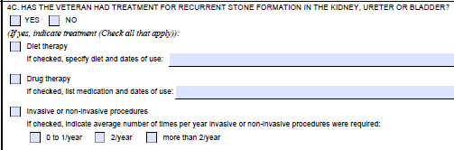
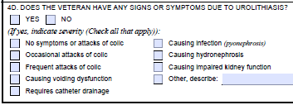
Nephrolithiasis (kidney stones) DC 7508
Notes:
Nephrolithiasis (kidney stones) DC 7508

Slide 16
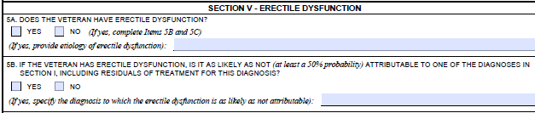
Erectile Dysfunction and Impotency DC 7522
CFR 4.31 In every instance where the schedule does not provide a zero percent evaluation for a diagnostic code, a zero percent evaluation shall be assigned when the requirements for a compensable evaluation are not met.
Notes:
Erectile Dysfunction and Impotency DC 7522
7522 Penis, deformity, with loss of erectile power 20
Review for entitlement to special monthly compensation under 3.350 of this chapter.
CFR 4.31 In every instance where the schedule does not provide a zero percent evaluation for a diagnostic code, a zero percent evaluation shall be assigned when the requirements for a compensable evaluation are not met.

Slide 17
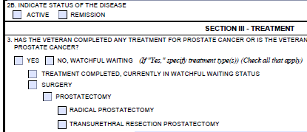
Prostate Cancer DC 7528
Notes:
Prostate Cancer DC 7528
7528 Malignant neoplasms of the genitourinary system, 100
Note: Following the cessation of surgical, X-ray, antineoplastic chemotherapy or other therapeutic procedure, the of 100 percent shall continue with a mandatory VA examination at the expiration of six months. Any change in evaluation based upon that or any subsequent examination shall be subject to the provision s of 3.105(e) of this chapter. If there has been no local recurrence or metastasis, rate on residuals as voiding dysfunction or renal dysfunction, whichever is predominant

Slide 18
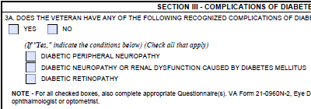

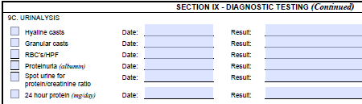
Renal Involvement in Diabetes Mellitus DC 7541
Notes:
Renal Involvement in Diabetes Mellitus DC 7541
Renal involvement in diabetes mellitus, sickle cell anemia, systemic lupus erythematosus, vasculitis, or other systemic disease processes:

Slide 19
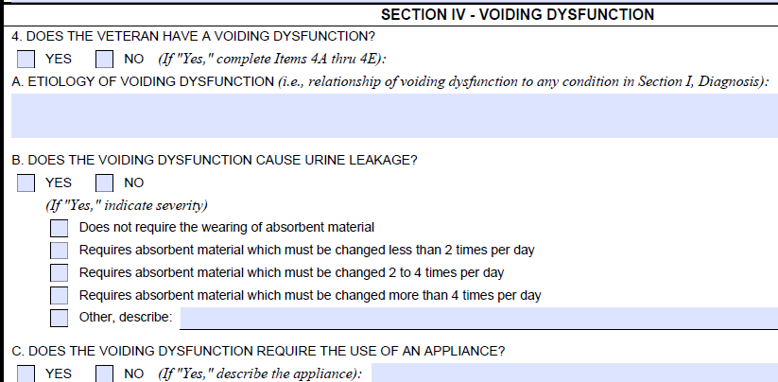
Neurogenic Bladder DC 7542
TIP: Most often secondary to a back condition, or a neurological condition like ALS, MS, or Parkinson's
Notes:
Neurogenic Bladder DC 7542
TIP: Most often secondary to a back condition, or a neurological condition like ALS, MLS, or Parkinson’s

Slide 20
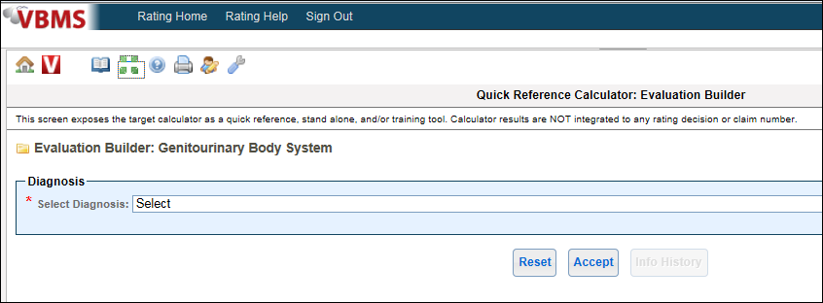
VBMS-R Evaluation Builder Demo
Notes:
VBMS-R Evaluation Builder Demo

Slide 21
Special Considerations
Presumptive Disabilities
Special Monthly Compensation
Ancillary Considerations
Special Development
Rating Schedule Changes
Notes:
Special Considerations
Presumptive Disabilities
Special Monthly Compensation
Ancillary Considerations
Special Development
Schedule Changes

Slide 22
Questions

