Slide 1
Claims Based on Exposure to Environmental Hazards in Iraq, Afghanistan, and Djibouti
Compensation Service
October
2020

Slide 2
Purpose
This lesson is designed to provide the VSR, RVSR, DRO, or QRS with a comprehensive understanding of developing claims for disabilities resulting from exposure to specific environmental hazards in the Gulf War.

Slide 3
Lesson Objectives
Recognize the four Environmental Hazard exposure scenarios related to service in Iraq, Afghanistan, and Djibouti
Identify long term health effects of exposure scenario
Identify eligibility criteria for each exposure scenario
Develop claims for any necessary evidence for compensation related to Environment Hazard exposure
Recognize when to order an exam and medical opinion for conditions related to Environmental Hazard exposure

Slide 4
References
M21-1, Part IV, Subpart ii.1.I.5, Developing Claims Based on Exposure to Other Specific Environmental Hazards
M21-1, Part IV, Subpart ii.2.C.5, SC for Disabilities Resulting From Exposure to Other Specific Environmental Hazards
Fact Sheet: Burn Pits in Iraq, Afghanistan, and the Horn of Africa
Fact Sheet: Particulate Matter throughout Iraq and Afghanistan, and Djibouti
Fact Sheet: Qarmat Ali Water Treatment Plant in Basrah, Iraq
Fact Sheet: Sulfur Fire at the Mishraq State Sulfur Mine Near Mosul, Iraq
Notes:
Facts sheets found in ERB

Slide 5
Locations of Specific Environmental Hazards
Exposure

Slide 6
Environmental Hazards Exposure Scenarios
DoD has identified a number of specific environmental hazards:
Burn pits throughout Iraq, Afghanistan, and Djibouti
Particulate matter in Iraq, Afghanistan, and Djibouti
A sulfur fire at Mishraq State Sulphur Mine near Mosul, Iraq
Hexavalent chromium exposure at the Qarmat Ali Water Treatment Plant near Basrah, Iraq
Notes:
Reference: IV.ii.2.C.5.a. Locations of Specific Environmental Hazards Identified by DoD

Slide 7
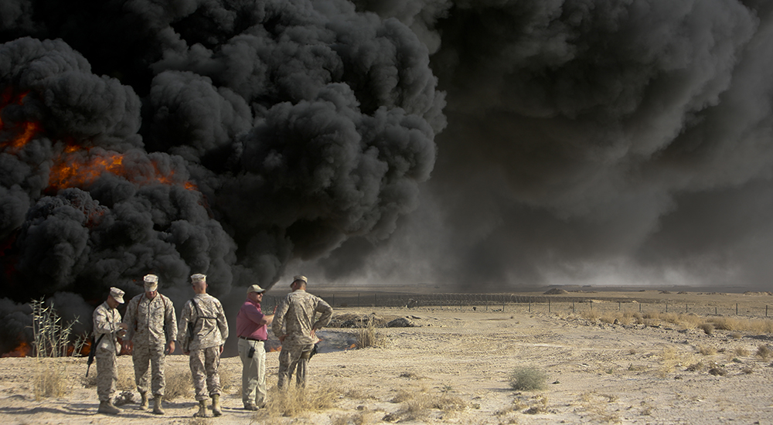
Burn Pits
In Iraq, Afghanistan, and Djibouti (on the Horn of Africa), the U.S. military utilized large burn pits to dispose of waste at many forward operating bases (FOBs) used to dispose
Some of the waste burned in these pits include:
human and medical waste
chemicals
jet fuel
plastic
petroleum and lubricants products
Notes:
Reference: IV.ii.2.C.5.d. Burn Pits. Important: When deciding a claim based on exposure to burn pits, affix the Burn Pit Exposure special issue in VBMS - Ratings (VBMS-R).

Slide 8
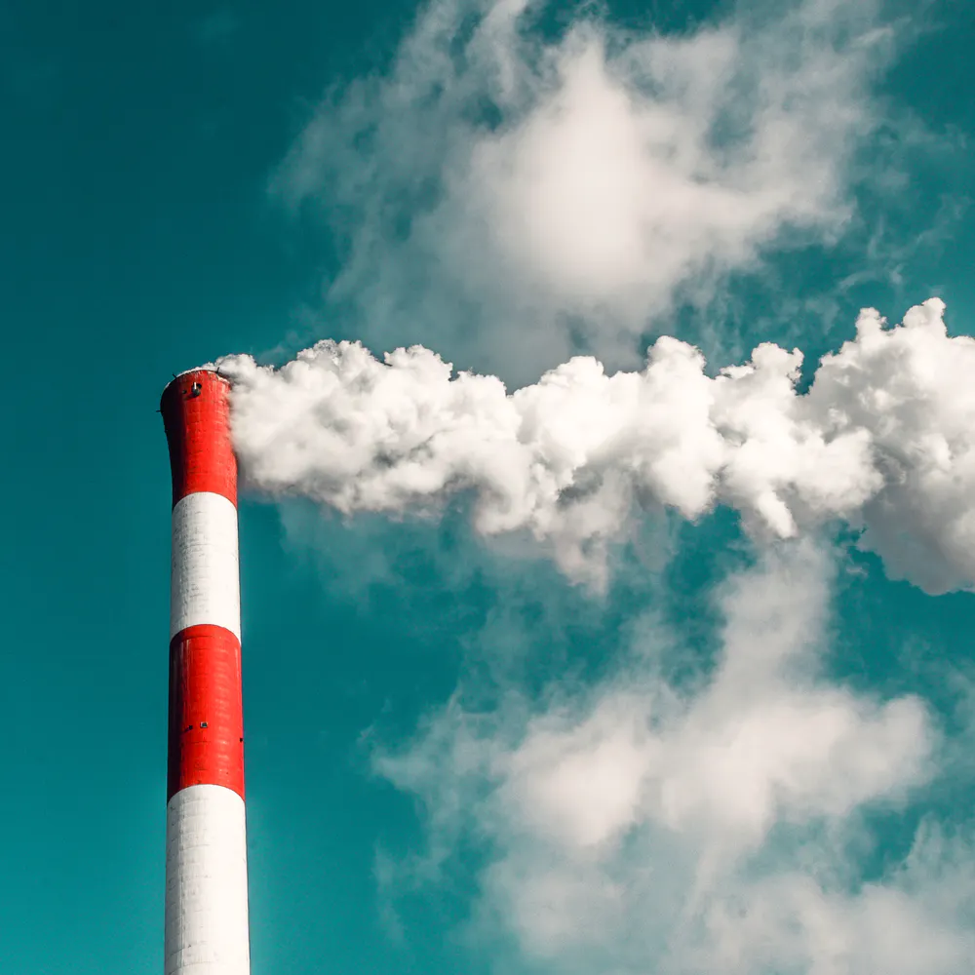
Particulate Matter
Particulate matter is a combination of extremely small particles and liquid droplets. Particulate matter can be made up of a number of components:
acids (such as nitrates and sulfates)
organic chemicals
metals, and
soil or dust particles
The particulate matter levels in Southwest Asia and Djibouti are naturally higher.
Notes:
References: IV.ii.2.C.5.e. Definition: Particulate Matter IV.ii.1.I.5.d. Guidelines for Developing Environmental Hazard Claims

Slide 9
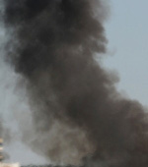
Mishraq State Sulfur Mine Fire
On June 24, 2003, a fire ignited at the Mishraq State Sulfur Mine Plant near Mosul, Iraq. The fire burned for approximately 3 weeks.
Other areas found to be affected included:
Qayyarah Airfield West (Camp Q West), which is 25 km to the south of the mine
the area approximately 50 km to the north up to the Mosul Airfield
The fire released 42 million pounds of sulfur dioxide (SO₂) a day.
Notes:
Reference: IV.ii.2.C.5.f. Description of the Sulfur Fire at Mishraq State Sulfur Mine Near Mosul, Iraq
Note: Qayyarah Airfield West (Camp Q West), which is 25 km to the south and is a major military supply airstrip and the primary area of deployment for the 101st Airborne Division

Slide 10
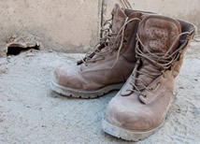
Qarmat Ali Water Treatment Plant
From April through September 2003, National Guard units from Indiana, West Virginia, South Carolina, or Oregon were assigned to guard contract workers restoring the Qarmat Ali Water Treatment Plant near Basrah, Iraq.
Some time later, Hexavalent Chromium or Chromium VI, a carcinogen, was found in the soil and air of the surrounding area.
If a Veteran served in one of these units during the time period, exposure can be conceded.
Notes:
Reference: IV.ii.2.C.5.j. NG Exposure to Chromium VI at Qarmat Ali Water Treatment Plant in Basrah, Iraq
Note: This facility was contaminated with sodium dichromate dust, which is a source of hexavalent chromium, a chemical that is known to cause cancer.

Slide 11
Knowledge Check
What is a burn pit?
A waste disposal process used by the US military to dispose various waste during the Gulf War.
M21-1 IV.ii.2.C.5.d. - Burn Pits

Slide 12
Knowledge Check (cont.)
Particulate matter is a combination of?
extremely small particles and liquid droplets.
M21-1 IV.ii.2.C.5.e. - Definition: Particulate Matter

Slide 13
Knowledge Check (cont.)
Other areas found to be affected by the Mishraq State Sulfur Mine Fire include?
Qayyarah Airfield West, arear north of the Mosul Airfield
M21-1 IV.ii.2.C.5.f. - Description of the Sulfur Fire at Mishraq State Sulfur Mine Near Mosul, Iraq

Slide 14
Knowledge Check (cont.)
What National Guard units were assigned to guard workers at the Qarmat Ali Water Treatment Plant?
Indiana, West Virginia, South Carolina or Oregon
M21-1 IV.ii.2.C.5.j. - NG Exposure to Chromium VI at Qarmat Ali Water Treatment Plant in Basrah, Iraq

Slide 15
Developing Environmental Hazard Claims

Slide 16
Long Term Effects of Exposure
Environmental Hazard | Potential Health Effects
Burn Pits | conditions involving the respiratory system, skin, eyes, liver, kidneys, central nervous system, cardiovascular system, reproductive system, peripheral nervous system, and GI tract (FACT Sheet: Burn Pits in Iraq, Afghanistan, and the Horn of Africa)
Particulate Matter | respiratory (lungs) and cardiopulmonary (heart) conditions (FACT Sheet: Particulate Matter throughout Iraq, Afghanistan, and Djibouti)
Mishraq State Sulfur Mine Fire | constrictive bronchiolitis; unexplained shortness of breath; irritation and reddening of the nose and throat; eye irritation and/or pain; coughing; burns of the skin; airway obstruction; hypoxemia; pulmonary edema and even death (FACT Sheet: Sulfur Fire at the Mishraq State Sulfur Mine Near Mosul, Iraq)
Qarmat Ali Water Treatment Plant | irritation of eyes, lungs, nose, sinuses, skin, and/or throat; abnormal pulmonary function, kidney, or liver tests. (FACT Sheet: Qarmat Ali Water Treatment Plant in Basrah, Iraq)
Notes:
Ensure you add FACT sheet from ERB to each Potential Health Effects category when developing.
The fact sheets are found under the heading Fact Sheets on the Disability Benefits Questionnaires Switchboard
• FACT sheet - Burn Pits in Iraq, Afghanistan, and the Horn of Africa
• FACT sheet - Particulate Matter throughout Iraq, Afghanistan, and Djibouti
• FACT sheet - Sulfur Fire at the Mishraq State Sulfur Mine Near Mosul, Iraq
• FACT sheet - Qarmat Ali Water Treatment Plant in Basrah, Iraq

Slide 17
Eligibility Requirements
Environmental Hazard | Requirement
Burn Pits | Service in Iraq, Afghanistan, or Djibouti Statement of exposure to Burn Pits
Particulate Matter | Service in Iraq, Afghanistan, or Djibouti
Mishraq State Sulfur Mine Fire | Service with 101st Airborne Division 52nd Engineering Battalion, 326th Engineering Battalion, or 887th Engineering Battalion in Iraq within three weeks of June 24, 2003 OR Service at the Qayyarah Airfield West (Camp Q West) or the area north of the Mishraq State Sulfur, up to the Mosul Airfield
Qarmat Ali Water Treatment Plant | Service with the Indiana, West Virginia, South Carolina, or Oregon National Guard in Iraq from April through September 2003
Notes:
References: Burn Pits –
IV.ii.2.C.5.m. Considering Lay Statements in Verifying Exposure to Environmental Hazards
IV.ii.2.C.5.d. Burn Pits and IV.ii.2.C.5.l. Using Alternate Evidence to Establish Exposure to Environmental Hazards; Particulate Matter –
IV.ii.2.C.5.e. Definition: Particulate Matter: Mishraq State Sulfur Mine Fire – IV.ii.2.C.5.f. Description of the Sulfur Fire at Mishraq State Sulfur Mine Near Mosul, Iraq Qarmat Ali Water Treatment Plant –
IV.ii.2.C.5.j. NG Exposure to Chromium VI at Qarmat Ali Water Treatment Plant in Basrah, Iraq

Slide 18
Claims Based Solely on Exposure to Environmental Hazards
A claim is not substantially complete if a Veteran alleges exposure to environmental hazards during service but does not identify the medical condition or symptom for which service connection (SC) is claimed.
In cases such as these:
inform the Veteran that exposure in and of itself is not a disability, and
ask the Veteran to identify the disability(ies) that resulted from exposure to environmental hazards during service.
If exposure is the only claimed condition:
Change the EP to a 400 – Incomplete Application
Clear the EP 400 after the letter is sent
Notes:
References: IV.ii.1.I.5.c. Action to Take When the Veteran Claims Environmental Hazards Exposure but Does Not Claim a Disability
I.1.B.1.h. Notification Requirements for an Incomplete Application Based on Exposure Allegation
I.1.B.1.g. Notification Requirements for an Incomplete Application

Slide 19
Developing Environmental Hazard Claims
Do not routinely develop to the Veteran without first reviewing the claims folder.
If evidence of exposure cannot be established, develop to the Veteran using a Supplemental Development Letter.
If you are sending a development letter to the Veteran, provide the Veteran with information about the GW Information Center and the GW Registry Exam.
Notes:
References: IV.ii.1.I.5.e. Establishing Exposure to Environmental Hazards
IV.ii.1.I.5.d. Guidelines for Developing Environmental Hazard Claims
III.ii.3.D.2.d. Description of Claim Information Fields in VBMS
Important: Check the box in the GULF WAR REGISTRY PERMIT field (in VBMS) when claimants indicate they were included in the Veterans Heath Administration (VHA) Persian Gulf Health Registry.

Slide 20
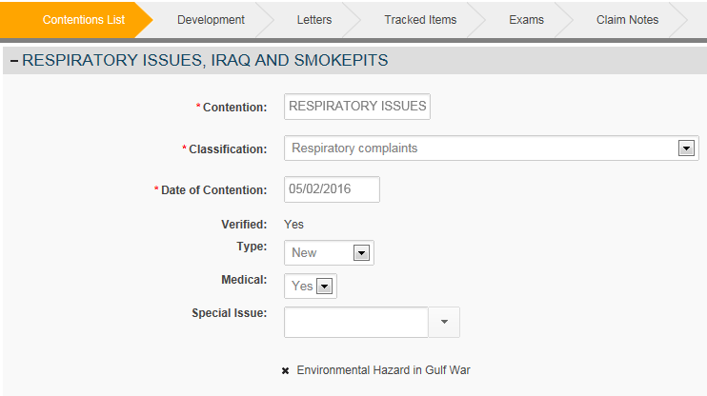
Special Issue Indicators
Any claimed condition related to Environmental Hazards must have the special issue “Environmental Hazard in Gulf War” on a contention in VBMS.
Notes:
References: IV.ii.1.I.5.b. Environmental Hazard EP Control and Tracking
III.iii.1.F.2.e. Entering a Claim-Specific Special Issue→

Slide 21
Knowledge Check
Is an Environmental Hazard claim substantially complete if the Veteran does not identify a medical condition or symptom?
No. The Veteran must specify the medical condition or symptom for which service connection is claimed.
M21-1 IV.ii.1.I.5.c. - Action to Take When the Veteran Claims Environmental Hazards Exposure but Does Not Claim a Disability

Slide 22
Knowledge Check (cont.)
What special issue is required for claimed conditions related to Environmental Hazards?
Environmental Hazard in Gulf War
M21-1 IV.ii.1.I.5.b. - Environmental Hazard EP Control and Tracking

Slide 23
Developing Environmental Hazard Claims: Veteran
VBMS Paragraph | Use
GW – Earliest manifestations/evidence of illness | Not used any longer. This information is solicited in the VA Form 21-526EZ.
GW – evidence of SW Asia service needed | Used if the Veteran has not provided information about his/her exposure.*
GW – notice – information center (toll-free helpline) | Include this paragraph if sending the Veteran a development letter.
GW – registry exam? | Include this paragraph if sending the Veteran a development letter.
GW – tell us specific disability from GW | Used if the Veteran does not specify an actual condition.
If specific information is required (i.e., Burn Pit statement or service in Mosul), draft a custom paragraph asking for specifics about the Veteran’s exposure.
** Phone development is acceptable.
Notes:
References: IV.ii.1.I.5.b. Environmental Hazard EP Control and Tracking
Subsequent Development letter: VBMS Paragraphs - (Show trainees’ selections in the VBMS letter)
GW – Earliest manifestations/evid of illness: (This is no longer required. This information is solicited in the VA Form 21-526EZ located on page 4 in the Evidence Tables under Disability Service Connection.)

Slide 24
Developing Environmental Hazard Claims: Federal and Non-Federal Records
Develop for Federal Records as normal:
STRs
Personnel Records
VAMC Records
Develop for Non-Federal Records
Private Medical Records
If you do not have evidence of exposure in the claims folder, develop for the Veteran’s personnel folder, if not already completed.
Notes:
References: I.1.C.1.a. VA’s Duty to Obtain Federal Records
III.iii.2.B.1.a. Basic Elements in Securing Veterans’ Service Records
III.iii.2.B.2.c. Determining Whether Additional Development to Obtain STRs Is Necessary
III.iii.1.C.2.b. Requirement to Obtain VA Medical Records (CAPRI)
I.1.C.2.a. VA’s Duty to Obtain Relevant Non-Federal or Private Records
IV.ii.1.I.5.e. Establishing Exposure to Environmental Hazards

Slide 25
Developing Environmental Hazard Claims: Qarmat Ali Water Treatment Plant
DoD has provided VA with a list of those who served at the Qarmat Ali Water Treatment Plant in Basrah, Iraq.
If the Veteran is claiming exposure at Qarmat Ali Water Treatment Plant and service can’t verified via the DoD list, assign the Compensation Service Review – Environmental Hazards Verification special issue, create the Compensation Service Case Review tracked item and add a note to the efolder stating the claim is referred to Compensation Service for verification.
See M21-1 IV.ii.1.I.5.f. - Verifying Service at the Qarmat Ali Water Treatment Plant, for additional detail.
Notes:
Reference: IV.ii.1.I.5.f. Verifying Service at the Qarmat Ali Water Treatment Plant

Slide 26
VHA Persian Gulf Health Registry Examinations
In all cases when the Veteran has been examined as part of the Veterans Heath Administration (VHA) Persian Gulf Health Registry, ensure those results have been obtained utilizing CAPRI/JLV.

Slide 27
Knowledge Check
When developing to a Veteran who has not provided information about his/her exposure, what VBMS paragraph must be added to the letter?
GW – Evidence of SW Asia service needed
VBMS development

Slide 28
Knowledge Check (cont.)
A list of those who served at Qarmat Ali Water Treatment Plant is available. How would you verify service for a Veteran whose unit is not on the DoD list?
Assign the Compensation Service Review – Environmental Hazards Verification special issue to a contention, create Compensation Service Review tracked item and add note to eFolder stating claim referred to Compensation Service for verification.
M21-1 IV.ii.1.I.5.f. - Verifying Service at the Qarmat Ali Water Treatment Plant

Slide 29
Review of Evidence
Thoroughly review STRs (to include the Post-Deployment Health Assessment (PDHA) and Discharge Examination) and military personnel records for evidence that corroborates the Veteran’s statement of exposure.
STRs and personnel records will not verify all incidents of exposure. It is important to consider alternate evidence in establishing whether the Veteran participated in or was affected by an in-service environmental hazard exposure incident, such as:
personal statements
buddy statements
unit histories
news articles, and
other lay evidence.
Notes:
References: IV.ii.1.I.5.e. Establishing Exposure to Environmental Hazards (review the Post-Deployment Health Assessment (PDHA) and Discharge Examination, generally located in the STRs)
IV.ii.1.I.5.g. Using Alternate Evidence or Lay Statements to Establish Exposure to Environmental Hazards

Slide 30
Conceding Exposure
Concede exposure to the claimed environmental hazard if the evidence of records shows the Veteran meets the eligibility requirements for each exposure scenario.
The Veteran does not need to explicitly claim an environmental hazard.
Example: The Veteran is claiming asthma. The Veteran provides a lay statement of burn pit exposure and the Veteran’s DD Form 214 shows that she served in Iraq.
The Veteran may be eligible for more than one exposure scenario.
Notes:
References: IV.ii.1.I.5.e. Establishing Exposure to Environmental Hazards
IV.ii.2.C.5.l. Using Alternate Evidence to Establish Exposure to Environmental Hazards
IV.ii.1.I.5.g. Using Alternate Evidence or Lay Statements to Establish Exposure to
Environmental Hazards M21-1, III.iv.5.A.2.b. Definition: Credibility

Slide 31
Knowledge Check
Reviewing evidence is an important part of claims development. What alternate evidence may be used to confirm an in-service environmental hazard exposure event?
Personal statements, buddy statements, unit histories, news articles and other lay evidence.
M21-1 IV.ii.2.C.5.l. - Reviewing Evidence to Establish Exposure to Environmental Hazards

Slide 32
Knowledge Check (cont.)
Can the DD 214 be used to concede exposure to an Environmental Hazard?
Yes. The DD 214 may show the Veteran served in an area where Environmental Hazards were at issue.
M21-1 IV.ii.1.I.5.e. - Establishing Exposure to Environmental Hazards

Slide 33
Developing Environmental Hazard Claims: Exams/Opinions
An examination and medical opinion is necessary in environmental hazard claims when there is:
competent lay or medical evidence of a disease/signs/symptoms related to one of the exposure scenarios
and
Veteran eligibility.
Important: The threshold for requesting an examination is low.
Notes:
References: 38 CFR 3.317 Compensation for certain disabilities occurring in Persian Gulf veterans
IV.ii.1.E.2.a. When an Examination Is Necessary in Southwest Asia Claims
(Gulf War General Medical Examination (Including Burn Pits) Disability Benefits Questionnaire (DBQ)),
IV.ii.1.E.2.b. When to Request a Gulf War General Medical Examination in a
Southwest Asia Claim,
III.iv.3.A.1.h. Definition: Specialist Examination - Any required specialist DBQs as defined in M21-1, III, iv, 3.A.1.h.,
IV.ii.1.I.5.g. Using Alternate Evidence or Lay Statements to Establish Exposure to Environmental Hazards, III.iv.5.A.3.c. Medical Assessments – History and Policy Applications
Note: The threshold for requiring an examination is low. It is lower than the standard to prove entitlement to SC under 38 CFR 3.317, because the purpose is only to determine whether VA has a duty to assist in substantiating the claim.

Slide 34
Developing Environmental Hazard Claims: Exams/Opinions (cont.)
When an examination/opinion is necessary:
Request appropriate DBQ based on applicable body system(s).
Advise the examiner of the nature of the claimed environmental hazard and the location/timeframe of exposure.
Ask the examiner to:
review all evidence in the claims folder, including the Fact Sheets, and
provide an opinion with rationale, as to the likelihood that the Veteran’s claimed disability is related to the hazardous environmental exposure.
You may need to combine this exam with a Gulf War General Medical Examination. In this scenario, you should still select the appropriate DBQs and upload the Fact Sheets.
Notes:
References: IV.ii.1.E.2.b. When to Request a Gulf War General Medical Examination in a
Southwest Asia Claim
IV.ii.1.E.2.c. Required Language in Examination Requests for Southwest Asia Claims
IV.ii.1.E.2.d. Impact of Known Clinical Diagnoses on Whether an Examination Is Necessary for a Southwest Asia Claim
Note: TMS 4307809 (VSR Challenge) Southwest Asia Development - This lesson explains and demonstrates to the VSR how to develop claims for disabilities based on the provisions of 38 CFR §3.317, to include undiagnosed illness, medically unexplained chronic multi-symptom illness (MUCMI), and presumptive infectious diseases.

Slide 35
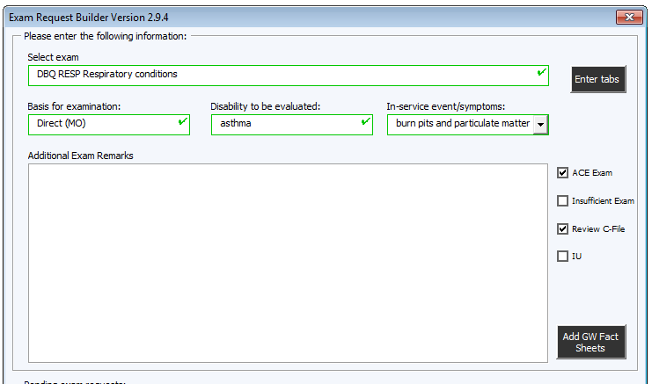
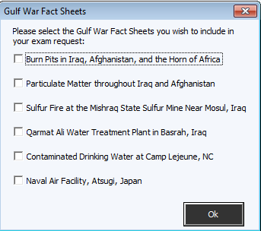
Developing Environmental Hazard Claims: ERB Exams/Opinions
ERB Exams/Opinions require fact sheets be included as part of the exam. Selecting the ‘Add GW Fact Sheets’ button and then the appropriate Fact Sheet(s) ensures the examiner has the information required to properly assess the condition.
*
*
*
*
*
*
Notes:
Compensation Service Intranet Home Page: Job Aids - VA References & Links; Exam Request Builder and Exam Request Builder (ERB) Info

Slide 36
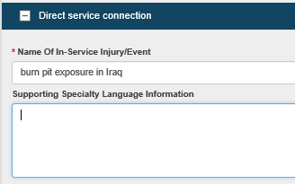
EMS Exam Requests
If you are not ordering a Gulf War or regular General Medical Examination, you can utilize the ACE process.
You must upload and annotate the applicable Environment Hazard Fact Sheet(s) to VBMS.
Notes:
Note: Facts sheets are located within the ERB Exam

Slide 37
Knowledge Check
When requesting an exam for conditions related to exposure to Environmental Hazards, what additional information must be provided to the examiner?
The Environmental Hazard Fact Sheet(s)
M21-1 IV.ii.1.I.5.h. - What to Include in VA Examination and/or Medical Opinion Requests in Environmental Hazard Claims

Slide 38
Questions

