Slide 1
Systematic Analysis of Operations (SAO)
Compensation Service
January 2016

Slide 2
Objectives
Know the purpose of an SAO
Know the SAO schedule
Know the format of an SAO
Know the elements of an SAO
Handling recommendations and completion

Slide 3
References
M21-4, Chapter 5 for most current list*
February 2014 Compensation Service Bulletin
VBA Letter 20-09-17
*SAOs are subject to change

Slide 4
Purpose of SAOs - Analysis
SAOs are a self-audit technique, and are to be used as a positive guide for operational improvement
Monitor progress toward established goals and objectives
Identify problems or out-of-line situations and recommend corrective actions
Assess areas of vulnerability, Determine effectiveness, Identify opportunities for improvement
Verify that records and reports accurately and properly reflect actual operations and results
Evaluate compliance with manuals, regulations, and other directive material
Document a history of operational performance

Slide 5
Depth of the Analysis
The analyst’s job is to determine why problems exist
The depth of analysis must be sufficient so that problems or potential problem areas are clearly explained
Determine the root cause of a problem

Slide 6
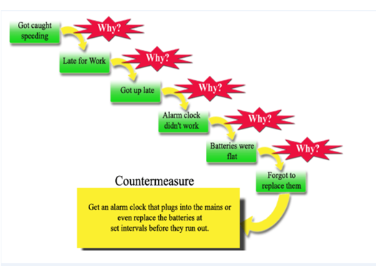
Depth of the Analysis

Slide 7
Depth of the Analysis
Sample size
Use random and/or judgment sampling, that relates to the specific needs of a targeted analysis and that is appropriate for the type of data being collected
State the size of the sample used, as well as population size when applicable
Describe the results
Example: A sample size of 40 locally generated supplemental development letters to the Veteran, with a date range of January 2014 to March 2014, were reviewed. Fifteen out of the 40 letters reviewed were missing required technical information, for a total error rate of 37.5 percent.
Reports and Sample Pulls
VOR, Director’s Dashboards, Correspondence, PA&I Reports, etc.
Additional Techniques
Interviews, Questionnaires, etc.

Slide 8
Depth of the Analysis
SAOs should ensure effective and efficient benefit delivery, by addressing, at a minimum:
(1) identification of any problem and/or potential problem areas
(2) recommendations/suggestions for corrective action
Policy, procedure, and requirements contained in all VBA directives may be utilized as evaluation criteria

Slide 9
SAO Elements
Scope of Review
Facts and Findings
Analysis
Conclusion
Previous Reviews/Actions
Recommend Improvement Actions

Slide 10
Reviews & Recommendations
Provide status of prior action items and/or recommendations from the last report.
Approved SAO recommendations must be completed, documented as complete or explained why not completed.
When you identify opportunities for improvement, include your recommended actions to address the issue
Ensure methods and procedures to complete recommended actions are included

Slide 11
SAO Recommendations
All SAO recommendations will be tracked in the same way general SAOs are tracked and maintained
Recommendations will be summarized on a separate sheet
SAO Tracker
Example:
The summarized recommendations will be flash filed in the corresponding SAO until complete

Slide 12
SAO Recommendations
Avoid phrasing a recommendation in this way:
“Continue doing process X.”
Instead, phrase in this way:
“Process X should be continued until reevaluation is completed on specific date to determine if criteria Y is met.”
Avoid phrasing a recommendation in this way:
“Follow up analysis should be conducted in a timely manner.”
Instead, phrase in this way:
“Follow up analysis, in the form of a random sample of X number of Ys, should be completed by specific date to see if criteria X is sufficient to meet the requirements of Document Y. Otherwise, an action plan should be implemented addressing criteria X no later than specific date.”
Avoid phrasing a recommendation in this way:
“Conduct additional training on topic X.”
Instead, phrase in this way:
“Conduct X number of training sessions on topic Y to be completed no later than specific date.”

Slide 13
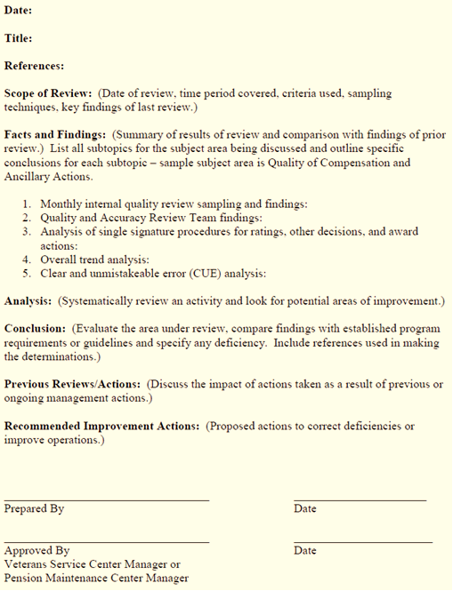
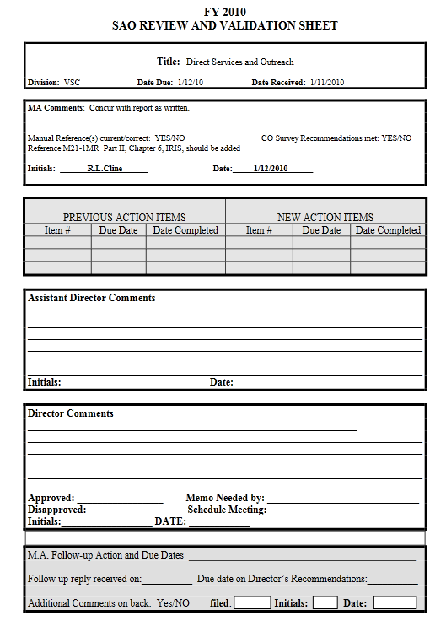
SAO Format
SAO Formatting
M21-4, Chapter 5, Appendix A
SAO Review and Validation Sheet

Slide 14
Required SAOs
The areas covered and required elements for each SAO are subject to change. See M21-4, Chapter 5.04 for the most current list.
Claims Processing Timeliness
Quality of Compensation and Ancillary Actions
Quality of Development Activity
Quality of Centralized Mail Activities (updated 9/25/14 – formally: Control Actions)
Examinations, Hospital Summaries, and Hospital Adjustments
Appeals
Division management
Internal Controls
Quality Review Teams (Added 9/25/14)
Fiduciary
Public Contact and Outreach (updated 9/25/14 – formally: Direct Services)

Slide 15
SAO Schedule
Schedule should be approved before October 1 for the FY
Must show the position title of the person responsible for the report and the month due
Schedule should include a tracker of the dates the completed SAOs were submitted

Slide 16
Questions

