Slide 1
Diseases of the Ear and Other Sense Organs
Compensation Service
January 2016

Slide 2
Objectives
demonstrate a general understanding of how to rate diseases of the ear, and other sense organs

Slide 3
References
38 CFR 4.87, Schedule of Ratings - Ear
38 cfr 4.87a Schedule of Ratings - Other Sense Organs
38 CFR 3.350, Special monthly compensation ratings
3.383 - Special consideration for paired organs and extremities
M21-1, Part III, Subpart iv, 4, B - Conditions of the Organs of Special Sense

Slide 4
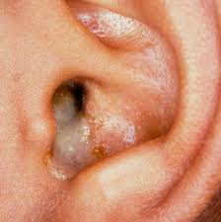
Diseases of the ear, and other sense organs
Chronic suppurative otitis media, mastoiditis, or cholesteatoma (or any combination):
Note: Evaluate hearing impairment,
and complications such as labyrinthitis, tinnitus, facial nerve paralysis, or bone loss of skull, separately.

Slide 5
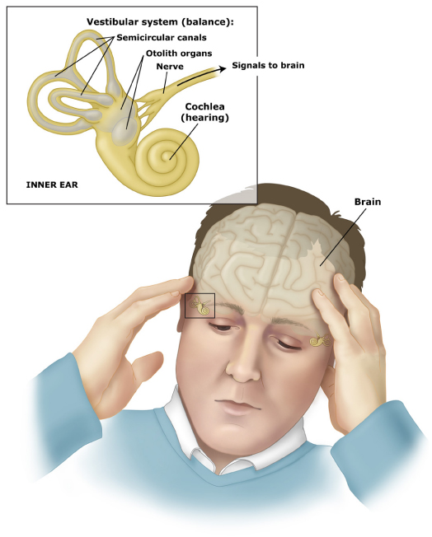
Diseases of the ear
Peripheral vestibular disorders:
Note: Objective findings supporting the
diagnosis of vestibular disequilibrium are
required before a compensable evaluation
can be assigned under this code. Hearing
impairment or suppuration shall be
separately rated and combined.

Slide 6
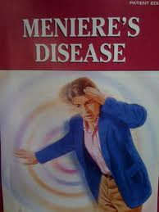
Diseases of the ear
Meniere’s syndrome (endolymphatic hydrops):
Note: Evaluate Meniere’s syndrome either under 6205 criteria or by separately evaluating vertigo (as a peripheral vestibular disorder), hearing impairment, and tinnitus, whichever method results in a higher overall evaluation. But do not combine an evaluation for hearing impairment, tinnitus, or vertigo with an evaluation under diagnostic code 6205.

Slide 7
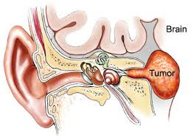
Diseases of the ear
Malignant neoplasm of the ear (other than skin only)
Note: A rating of 100 percent shall continue
beyond the cessation of any surgical radiation
treatment, antineoplastic chemotherapy or other
therapeutic procedure.
Six months after discontinuance of such treatment, the appropriate disability rating shall be determined by mandatory VA examination.
Any change in evaluation based on that or any subsequent examination shall be subject to the provisions of §3.105(e) of this chapter. If there has been no local recurrence or metastasis, rate on residuals.

Slide 8
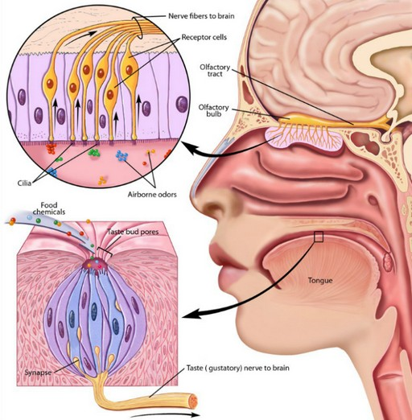
Other sense organs
Sense of smell, complete loss
Sense of taste, complete loss
Note: Evaluation will be assigned under diagnostic codes 6275 or 6276 only if there is an anatomical or pathological basis for the condition.

Slide 9
Additional considerations
M21-1 Part III.iv.4.B.3.m.
If the disease of one ear, such as chronic catarrhal otitis media or otosclerosis, is held as the result of service, the subsequent development of similar pathology in the other ear must be held due to the same cause if;
the time element is not manifestly excessive, a few years at most, and
there has been no intercurrent infection to cause the additional disability.
Note: If there is continuous SC infection of the upper respiratory tract, the time cited for the purpose of service connecting infection of the second ear should be extended indefinitely.

Slide 10
Practical Exercise
Please complete the Practical Exercise located in Handout page

Slide 11
Review

Slide 12
Questions

