Slide 1
Neurological and Convulsive Disorders
Compensation Service
January 2016

Slide 2
Objectives
understand the various etiologies and the prevalence of neurological and convulsive disorders
recognize those conditions most frequently claimed under the neurological system
understand how to rate neurological issues

Slide 3
References
38 CFR 3.350 - Special monthly compensation ratings
38 CFR 4.120 - Evaluations by Comparison
38 CFR 4.121 - Identification of epilepsy
38 CFR 4.122 - Psychomotor epilepsy
38 CFR 4.123 - Neuritis, Cranial or Peripheral
38 CFR 4.124 (a) - Schedule of Ratings - Neurological Conditions
38 CFR 4.31 - A no-percent rating
M21-1, Part III, Subpart iv, 4, G - Neurological Conditions and Convulsive Disorders

Slide 4
General Considerations
VA has seen an increase in the prevalence of Service Connected claims for disease such as:
Diabetic complications,
Parkinson’s Disease, Multiple Sclerosis (MS)
Amyotrophic Lateral Sclerosis (ALS)
Traumatic Brain Injury (TBI)
Cerebral Vascular accidents (CVA), or
Organic diseases of the Central Nervous System
As such, a thorough knowledge and understanding of the neurological rating schedule is important

Slide 5
Diseases of the central nervous system
Organic Diseases
Miscellaneous Diseases
Diseases of the Cranial Nerves
Diseases of the Peripheral Nerves

Slide 6
Organic Diseases
Rated under Diagnostic Codes (DC) 8000 – 8046
Amyotrophic Lateral Sclerosis (ALS)
Remember to rate manifestation of different body systems SEPERATELY if they result in the Higher overall award (i.e. Higher Level SMC)
Multiple sclerosis (MS)
evaluate each affected system or body part separately, show the DC for MS only once by listing it with the most severely affected function
There must be ascertainable residuals for a compensable evaluation. If there are no residuals, a 0% evaluation is to be assigned.

Slide 7
Multiple system involvement example
Example: A single 100% evaluation under DC 8018 for multiple sclerosis with loss of use of both lower extremities may overlook involvement of other body systems that may meet requirements for an intermediate rate under 38 CFR 3.350(f)(3) or next higher rate under 38CFR 3.350(f)(4).
In such a case a 100% evaluation for loss of use of both lower extremities should be assigned under DC 8018-5110; and any involvement of other extremities, or other disabilities due to multiple sclerosis, rated separately and combined.
(SMC will be covered in more depth in a separate lesson.)

Slide 8
Miscellaneous Diseases
Miscellaneous diseases DC 8100 – 8108
Migraines
Require Prostrating attacks averaging one in 2 months over last several months for a compensable rating (10%)
Prostrating, as used in 38 CFR 4.124a, DC 8100, means “causing extreme exhaustion, powerlessness, debilitation or incapacitation with substantial inability to engage in ordinary activities.”
Completely prostrating as used in 38 CFR 4.124a, DC 8100, means extreme exhaustion or powerlessness with essentially total inability to engage in ordinary activities.

Slide 9
Diseases of the Cranial Nerves
38 CFR 4.123 - Neuritis of a nerve is inflammation attended by pain and tenderness of the nerve, anesthesia, disturbances of sensation; and may result in paralysis, wasting and disappearance of the reflexes associated with the nerve involved.
38 CFR 4.124 - Neuralgia is a paroxysmal pain extending along the course of the nerve.

Slide 10
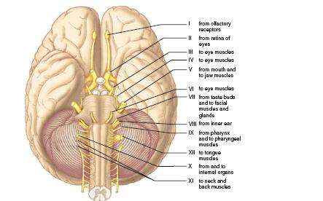
Cranial Nerves
Cranial Nerves | How to Evaluate | Nerve Function | Associated Symptoms
Cranial Nerve I | Rate Under Organs of Sense | Smell | Reduced or Complete Loss of Smell
Cranial Nerve II | Rate Under Organs of Sense | Vision | Loss of Vision, Blurry Vision, Double Vision
Cranial Nerve III | Rate Under Organs of Sense | Eyelid & Eyeball Movement | Inability to open or close eyes or eyelid
Cranial Nerve IV | Rate Under Organs of Sense | Downward Eye Movement | Fixed Eye Position
Cranial Nerve V | Always Bilateral So Provide an Eval for Each Affected Side | Chewing & Mouth Movement | Pain, Reduced Senses, or Loss of Mouth Motion
Cranial Nerve VI | Rate Under Organs of Sense | Lateral Eye Movement | Fixed Eye Position
Cranial Nerve VII | Always Bilateral So Provide an Eval for Each Affected Side | Facial Expressions | Pain/Sensory Loss of Face, Loss of Auto Movements, Drooling
Cranial Nerve VIII | Rate Under Organs of Sense | Hearing & Equilibrium | Reduced Hearing, Vertigo, Deafness
Cranial Nerve IX | Always Bilateral So Provide an Eval for Each Affected Side | Taste & Carotid Blood Pressure | Reduced Senses in Pharynx & Tonsils
Cranial Nerve X | Always Bilateral So Provide an Eval for Each Affected Side | Controls Voice, Slows Heart Rate & Stimulates Digestion | Voice Reduced in Volume, Low Blood Pressure, Constipation
Cranial Nerve XI | Always Bilateral So Provide an Eval for Each Affected Side | Controls Sternomastoid & Trapezius Muscle | Stooped Posture, Difficulty Swallowing
Cranial Nerve XII | Always Bilateral So Provide an Eval for Each Affected Side | Controls Tongue Movements | Slurred Speech

Slide 11
Diseases of the peripheral nerves
DC 8510 – DC 8730
Incomplete paralysis
indicates a degree of lost or impaired function substantially less than the type pictured for complete paralysis given with each nerve
neuritis
rated at maximum equal to severe, incomplete paralysis
maximum rating for neuritis not characterized by organic changes (loss of reflexes, muscle atrophy, sensory disturbances, or constant pain) will be that for moderate
with sciatic nerve involvement, maximum rating is moderately severe, incomplete paralysis.
neuralgia
rated as maximum equal to moderate incomplete paralysis

Slide 12
Peripheral Nerves

Slide 13
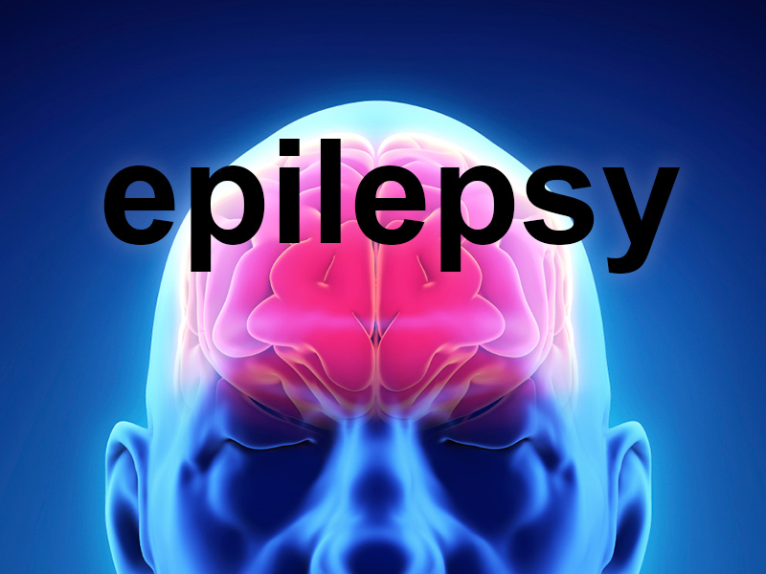
Epilepsies
Psychomotor epilepsy
grand mal
major seizures
petit mal
minor seizures

Slide 14
Epilepsies
Psychomotor epilepsy
Major seizure
generalized tonic-clonic convulsion with unconsciousness
Minor seizure
brief interruption in consciousness or conscious control
staring or rhythmic blinking or nodding
sudden jerking movements
sudden loss of postural control

Slide 15
Epilepsies
Psychomotor epilepsy (38 CFR 4.122)
psychomotor seizures
episodic alterations in conscious control
automatic states
generalized convulsions
random motor movements
hallucinatory phenomena
perceptual illusions
alterations in thinking/memory/mood/affect

Slide 16
Epilepsies
Rating DC 8910 – 8914
Epileptic seizures evaluated based on frequency
competent consistent lay testimony
emphasizing convulsive and immediate post-convulsive characteristics
ascertained under ordinary conditions of life
seizures must be witnessed or verified at some time by a physician
factors other than observing an actual seizure may be sufficient
neurological observation may be necessary

Slide 17
Practical Exercise
Complete the Practical Exercise found in Handout Page 30.

Slide 18
Review

Slide 19
Questions

