Slide 1
Legacy Content Manager
Pension and Fiduciary Service
February 2021
Notes:
Course Description:
This lesson teaches learners about the Legacy Content Manager (LCM).

Slide 2
Objectives
Define Legacy Content Manager (LCM)
Know what types of records are in LCM
Know how & when to log into LCM
Search for a Veteran’s electronic folder (eFolder)
Access a record within a Veteran’s eFolder
Navigate to LCM’s learning tools
Notes:
At the end of this lesson, given the training and references, the learner will be able to do the following:
Understand what is Legacy Content Manager (LCM)
Know what types of records are in LCM
Know how & when to log into LCM
Search for a Veteran’s electronic folder (eFolder)
Access a record within a Veteran’s eFolder
Navigate to LCM’s learning tools

Slide 3
References
Legacy Content Manager website
Legacy Content Manager User Guide
VBMS User Guide (LCM Documents Tab)
M21-1, Part III, Subpart ii, Chapter 3, Section B, Claim Folder Formats
M21-1, Part V, Subpart IV, Chapter 2, Section 1, Mandatory Use of eFolders
Notes:
The following are the relevant references:
Legacy Content Manager website
Legacy Content Manager User Guide
VBMS User Guide (LCM Documents Tab)
M21-1, Part III, Subpart ii, Chapter 3, Section B, Claim Folder Formats
M21-1, Part V, Subpart IV, Chapter 2, Section 1, Mandatory Use of eFolders

Slide 4
What is Legacy Content Manager?
Legacy Content Manager (LCM) is an intranet web-based application that centers on the concept of a Veteran’s electronic claims folder, or eFolder.
In most instances, you can access the LCM eFolder through the existing VBMS folder tab. Through this link, you can view documents received by LCM Paperless Claim Processing.
Notes:
Learning Objective: Understand what is Legacy Content Manager (LCM)?
Legacy Content Manager (LCM) is an intranet web-based application that centers on the concept of a Veteran’s electronic claims folder, or eFolder.
In most instances, you can access the LCM eFolder through the existing VBMS folder tab. Through this link, you can view documents received by LCM Paperless Claim Processing.

Slide 5
What is Legacy Content Manager? (continued)
LCM provides:
Electronic storage for outgoing & incoming Veteran’s claims correspondence and evidence
Ability to categorize, search & sort the contents of the eFolder
Notes:
Learning Objective: Understand what is Legacy Content Manager (LCM)?
LCM provides:
Electronic storage for outgoing & incoming Veteran’s claims correspondence and evidence
Ability to categorize, search & sort the contents of the eFolder

Slide 6
What Types of Documents are in LCM?
Pension documents
Restricted documents
Debt Management Center letters
Rating Decisions
PCGL Award letters
BDN letters
CRSC/CRDP letters
COLA End of Year letters
Write-outs
Marine Corps Records (Korea/Vietnam Wartime)
Federal Tax Income (FTI)
Notes:
Learning Objective: Know what types of Records are available in LCM
Pension documents
Restricted documents
Debt Management Center letters
Rating Decisions
PCGL Award letters
BDN letters
CRSC/CRDP letters
COLA End of Year letters
Write-outs
Marine Corps Records (Korea/Vietnam Wartime)
Federal Tax Income (FTI)

Slide 7
How to Log into LCM
LCM is often viewed through a tab in the VBMS eFolder. Checking for documents in LCM when working a case is very important.
To log directly into LCM:
Go to LCM website
Login using VA Single Sign-On.
Notes:
Learning Objective: Know how and when to log into LCM

Slide 8
When to Log Directly into LCM
If the link to LCM documents within the VBMS eFolder fails to open the LCM documents
To review restricted documents
They can only be accessed through the LCM system.
As directed by local management
Notes:
Learning Objective: Know how and when to log into LCM

Slide 9
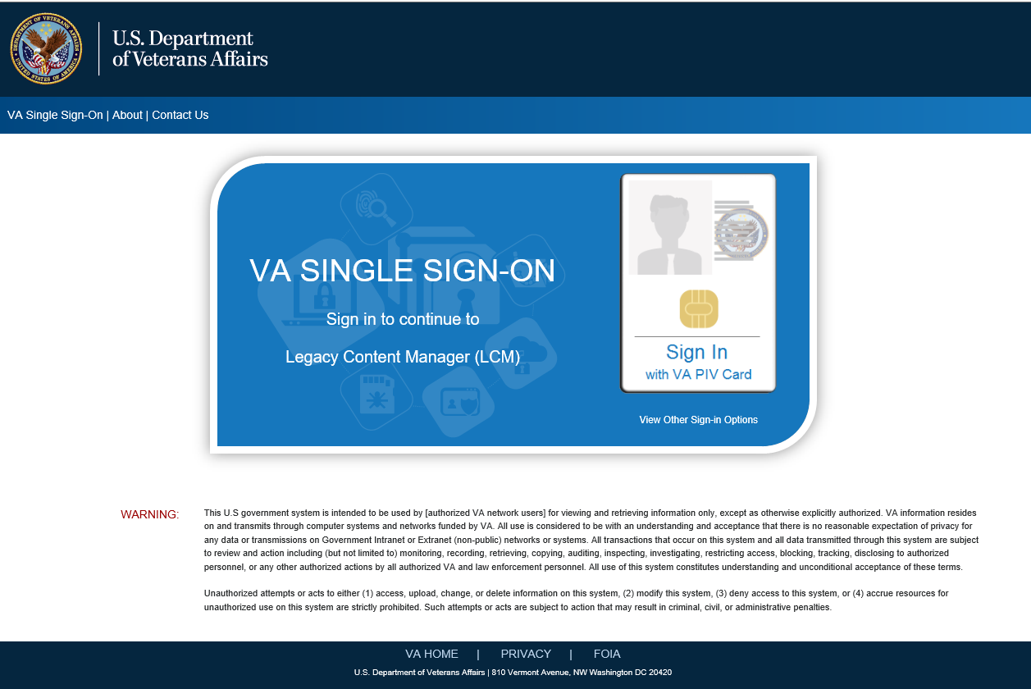
LCM Login Page
Notes:
Learning Objective: Know how and when to log into LCM

Slide 10
View Veteran’s Profile
To locate a Veteran’s eFolder, enter the VA file number into the search field in the upper left.
Notes:
Learning Objective: Search for a Veteran’s electronic folder (eFolder)

Slide 11
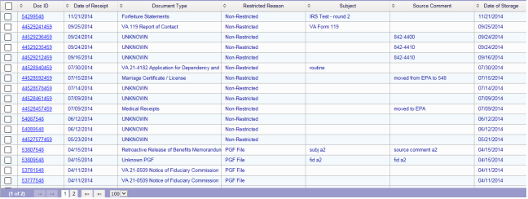
Document Grid View
Notes:
Learning Objective: Access a record within a Veteran’s eFolder

Slide 12
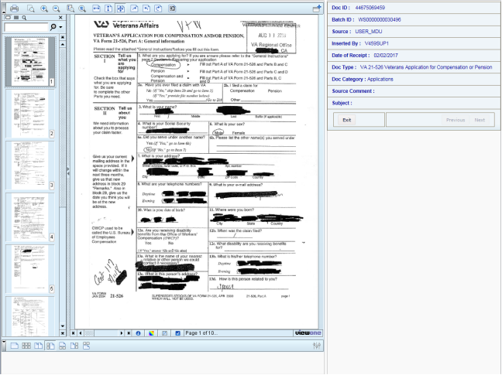
Viewing Documents
Notes:
Learning Objective: Access a record within a Veteran’s eFolder

Slide 13
Access to LCM Resources
Compensation Service Intranet Legacy Content Manager (LCM)
Click on the LCM User Guide at the top of the page.
Notes:
Learning Objective: Navigate to LCM’s learning tools

Slide 14
31. Questions?
What is Legacy Content Manager?
What Types of Documents are in LCM?
How to Login to LCM
When to Log Directly Into LCM
LCM Login Page
View Veteran’s Profile
Document Grid View
Viewing Documents
Access to LCM Resources
Notes:
Instructor Notes:
(Recall) These are our learning objectives as stated from the beginning of the training:
Define Legacy Content Manager (LCM)
Know what types of records are in LCM
Know how & when to log into LCM
Search for a Veteran’s electronic folder (eFolder)
Access a record within a Veteran’s eFolder
Navigate to LCM’s learning tools
(Recap) We discussed each of these learning objectives through the following topics in each slide today:
What is Legacy Content Manager?
What Types of Documents are in LCM?
How to Login to LCM
When to Log Directly Into LCM
LCM Login Page
View Veteran’s Profile
Document Grid View
Viewing Documents
Access to LCM Resources
What questions do you have for me today?

Slide 15
TMS Survey
A satisfaction survey has been assigned to you in TMS.
You should be able to complete the survey and within ten minutes.
Be sure to complete the survey in TMS to receive credit for this training.
Notes:
Instructor Notes:
A satisfaction survey has been assigned to you in TMS. You should be able to complete the survey within ten minutes. Completing the survey will allow you to receive credit for this training.

