Slide 1
Introduction to COVERS
Compensation Service Training Staff
January 2016

Slide 2
Lesson Objectives
Identify the purpose and general features of COVERS
Differentiate between the functions of COVERS
2

Slide 3
References
COVERS User Guide
3

Slide 4
Purpose of COVERS
COVERS is the primary tool used in tracking internal movement of paper claims folders.
COVERS tracks two types of folders:
  Claims folders
  Notice of death (NOD) folders
With the implementation of VBMS, COVERS is also used to verify if the file has been scanned into VBMS.
COVERS should not be used to transfer paperless files
4

Slide 5
General Features of COVERS
COVERS:
  Provides a history of folder movement
  Uses barcode technology to support regional office and record management center (RMC) folder activities
  Provides an electronic means by which to establish an online alert for folder requests, pending mail, or messages directed to the user
  Interfaces with BIRLS through SHARE
  Can be operated with a keyboard and mouse, or with a scanner (for the barcode label) serving in lieu of the keyboard for entering claims folder data
5

Slide 6
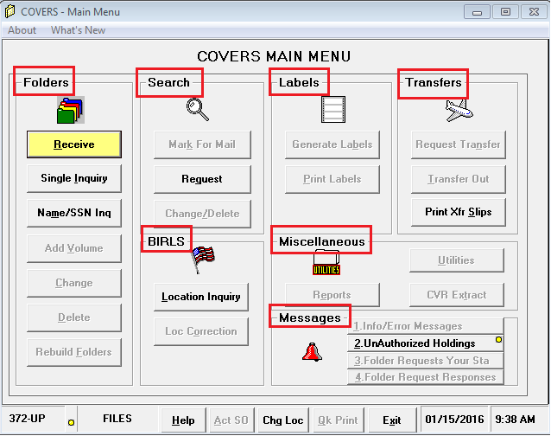
General Functions of Covers
COVERS contains the following general functions:
  Folders
  Search
  BIRLS
  Labels
  Transfers
  Messages
  Miscellaneous
6

Slide 7
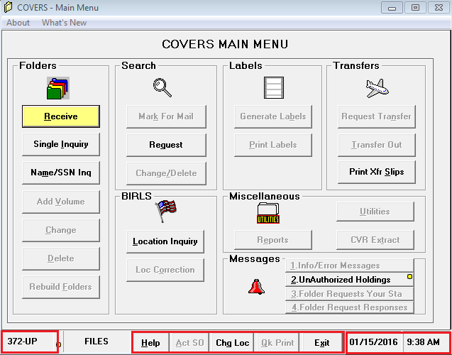
Permission Protected Functions
Function buttons on the main screen are protected by permissions.
The lower task functions are:
  (station number) UP
  Help
  Act as SO
  Chg Loc
  Qk Print
  Exit
  Date/Time
7

Slide 8
Review

